Slide 1
Support Vector Machines
Based on Burges (1998), Scholkopf (1998), Cristianini and Shawe-Taylor (2000), and Hastie et al. (2001)
David Madigan

Slide 2
Introduction
Widely used method for learning classifiers and regression models
Has some theoretical support from Statistical Learning Theory
Empirically works very well, at least for some classes of problems

Slide 3
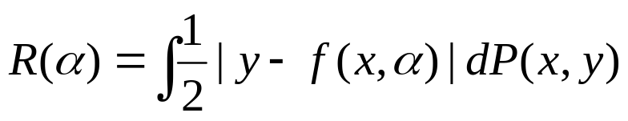
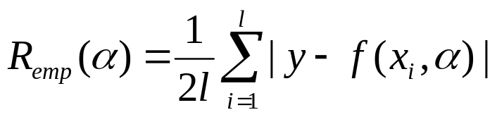
VC Dimension
l observations consisting of a pair: x_{i} ∈ R^{n}, i=1,…,l and the associated “label” y_{i} ∈ {-1,1}
Assume the observations are iid from P(x,y)
Have a “machine” whose task is to learn the mapping x_{i} → y_{i}
Machine is defined by a set of mappings x → f(x,α)
Expected test error of the machine (risk):
Empirical risk:

Slide 4
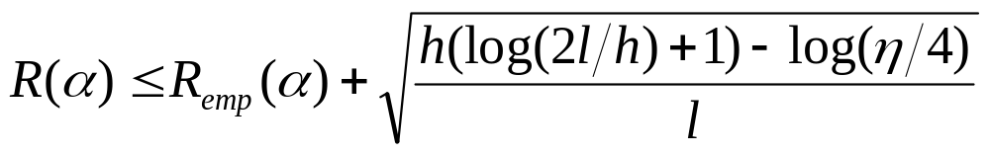
VC Dimension (cont.)
Choose some η between 0 and 1. Vapnik (1995) showed that with probability 1- η :
h is the Vapnik Chervonenkis (VC) dimension and is a measure of the capacity or complexity of the machine.
Note the bound is independent of P(x,y)!!!
If we know h, can readily compute the RHS. This provides a principled way to choose a learning machine.

Slide 5
VC Dimension (cont.)
Consider a set of function f(x,α) ∈ {-1,1}. A given set of l points can be labeled in 2^{l} ways. If a member of the set {f(α)} can be found which correctly assigns the labels for all labelings, then the set of points is shattered by that set of functions
The VC dimension of {f(α)} is the maximum number of training points that can be shattered by {f(α)}
For example, the VC dimension of a set of oriented lines in R² is three.
In general, the VC dimension of a set of oriented hyperplanes in R^{n} is n+1.
Note: need to find just one set of points.

Slide 6
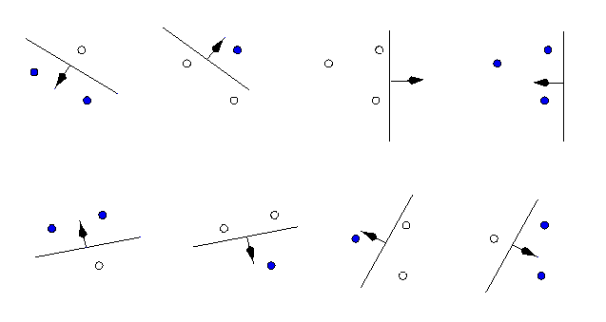

Slide 7
VC Dimension (cont.)
Note: VC dimension is not directly related to number of parameters. Vapnik (1995) has an example with 1 parameter and infinite VC dimension.
VC Confidence

Slide 8
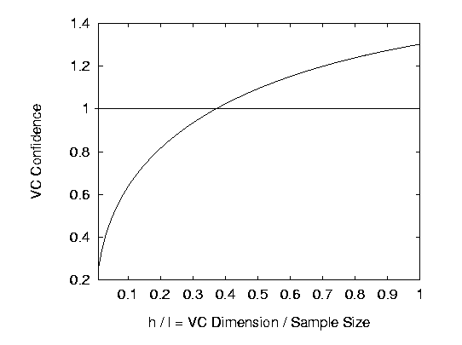
η =0.05 and l=10,000
Amongst machines with zero empirical risk, choose the one with smallest VC dimension

Slide 9
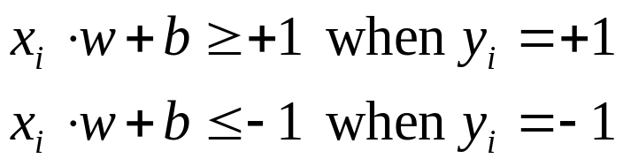
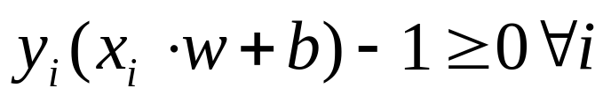
Linear SVM - Separable Case
l observations consisting of a pair: x_{i} ∈ R^{d}, i=1,…,l and the associated “label” y_{i} ∈ {-1,1}
Suppose ∃ a (separating) hyperplane w.x+b=0 that separates the positive from the negative examples. That is, all the training examples satisfy:
equivalently:
Let d₊ (d₋) be the shortest distance from the sep. hyperplane to the closest positive (negative) example. The margin of the sep. hyperplane is defined to be d₊ + d₋

Slide 10
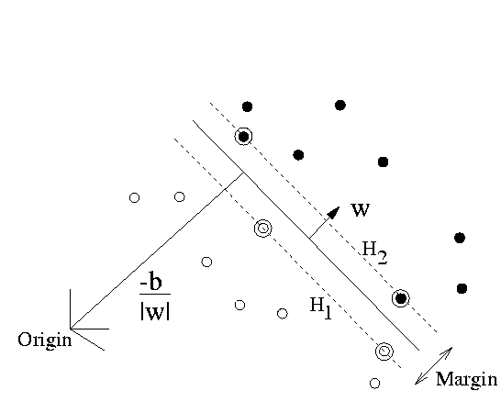
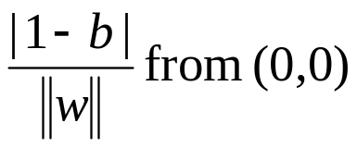
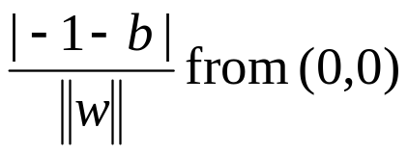

w.x+b=0

Slide 11
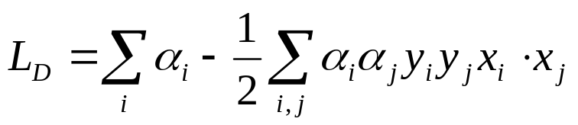

SVM (cont.)
SVM finds the hyperplane that minimizes |w| (equiv |w|²) subject to:
Equivalently maximize:
with respect to the α_{i}’s, subject to α_{i}≥0 and
This is a convex quadratic programming problem
Note: only depends on dot-products of feature vectors
(Support vectors are points for which equality holds)

Slide 12
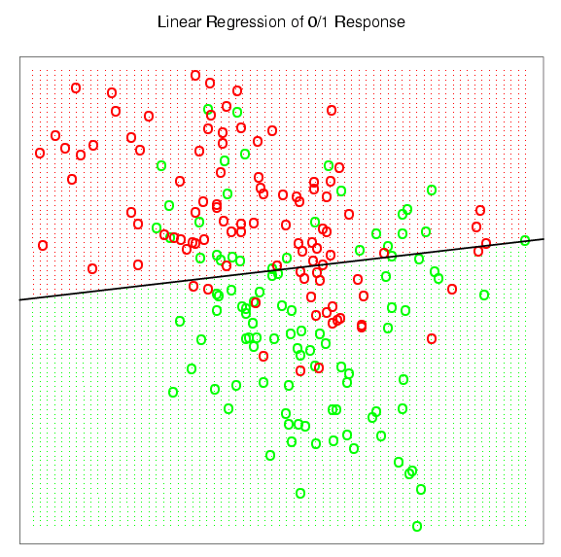

Slide 13
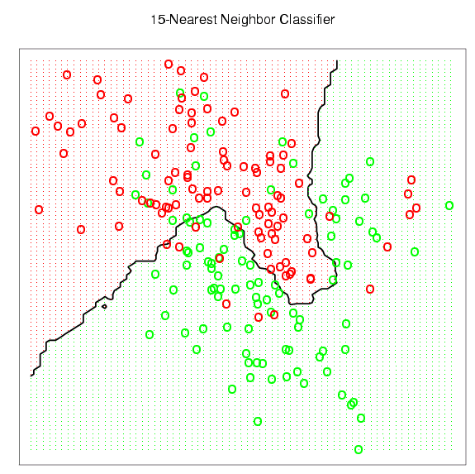

Slide 14
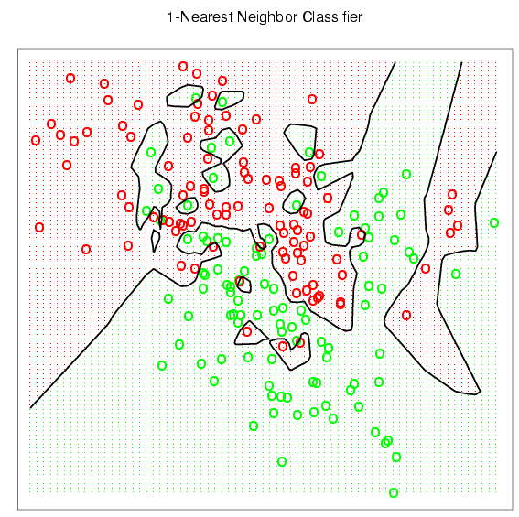

Slide 15
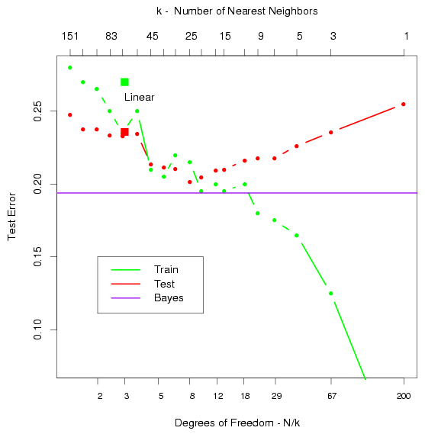

Slide 16
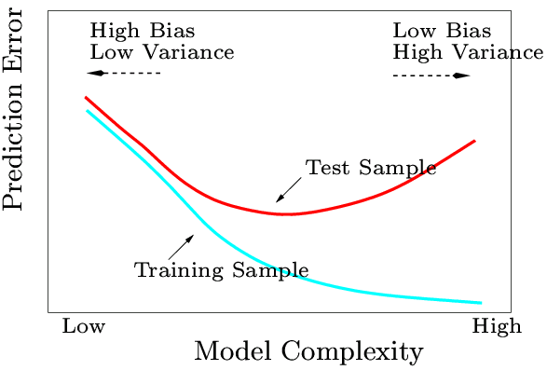

Slide 17
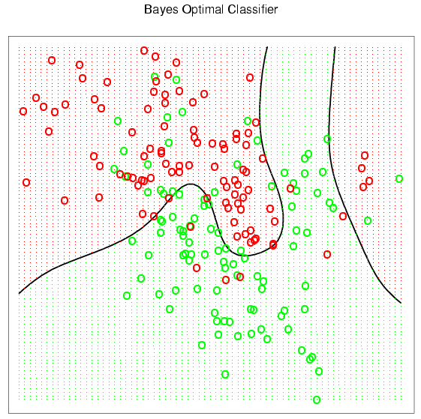

Slide 18
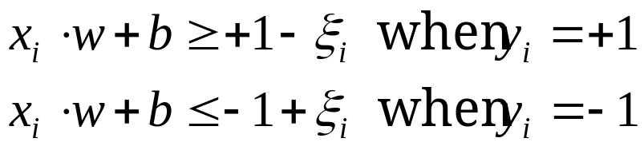
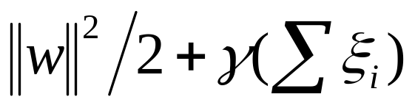

Linear SVM - Non-Separable Case
l observations consisting of a pair: x_{i} ∈ R^{d}, i=1,…,l and the associated “label” y_{i} ∈ {-1,1}
Introduce positive slack variables ξ_{i}:
and modify the objective function to be:
corresponds to the separable case

Slide 19
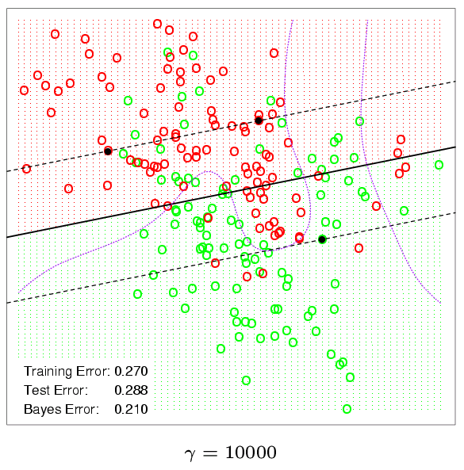

Slide 20
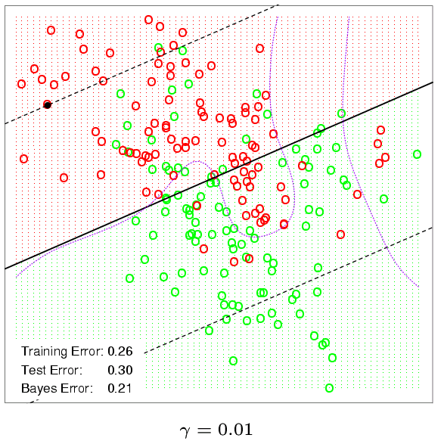

Slide 21
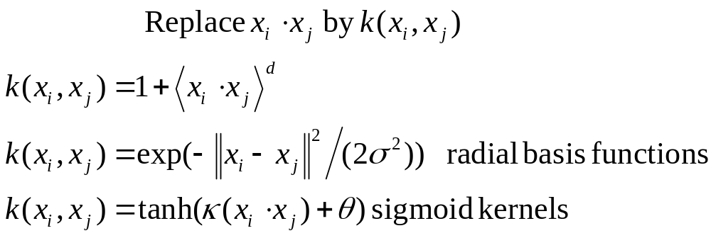
Non-Linear SVM

Slide 22
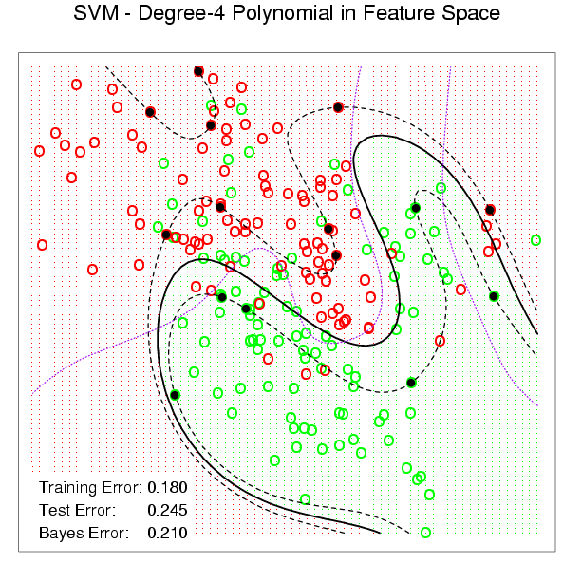

Slide 23
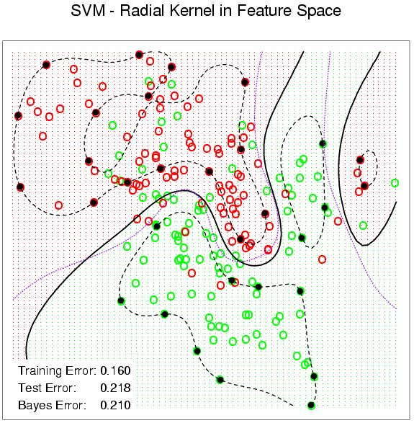

Slide 24
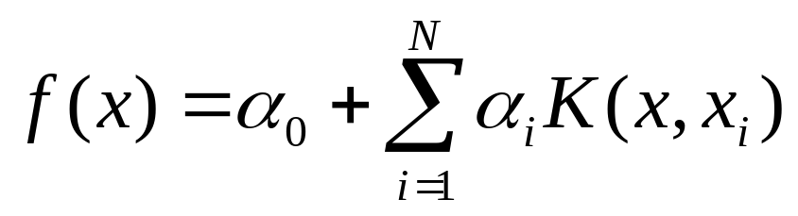
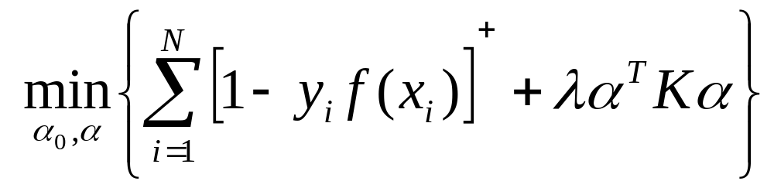
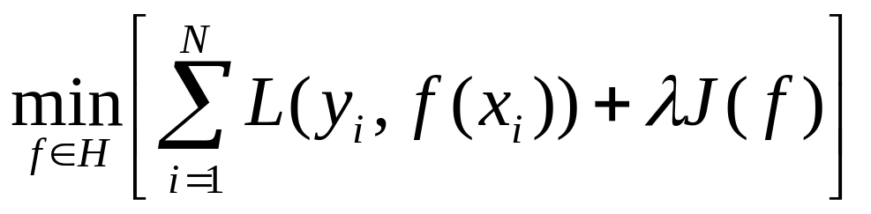
Reproducing Kernels
We saw previously that if K is a mercer kernel, the SVM is of the form:
and the optimization criterion is:
which is a special case of:

Slide 25
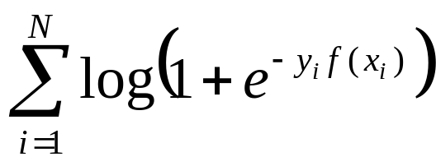
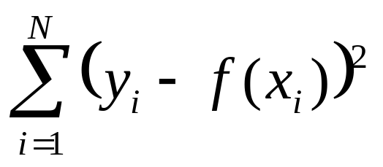
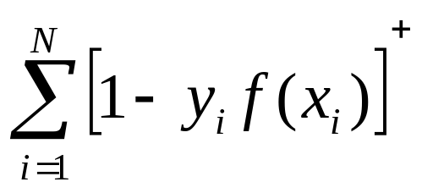
Other J’s and Loss Functions
There are many reasonable loss functions one could use:
Loss Function | L(Y,F(X))
- Binomial Log-Likelihood |  | Logistic regression
Squared Error |  | LDA
SVM

Slide 26
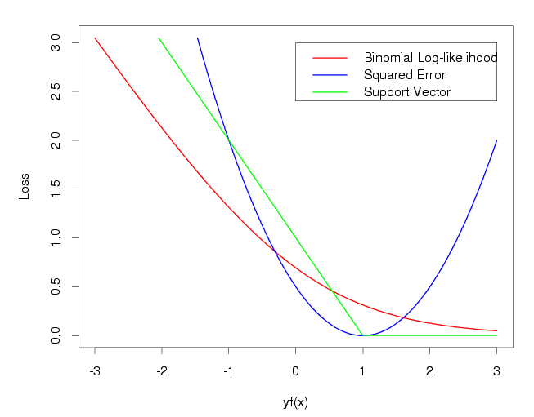

Slide 27
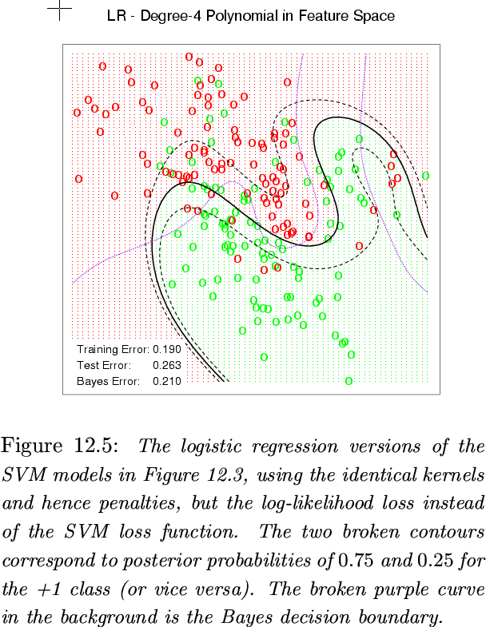

Slide 28
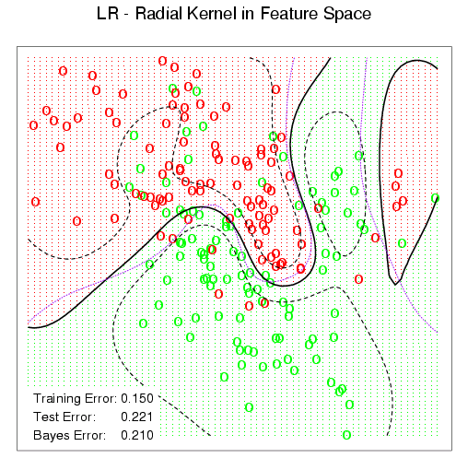

Slide 29
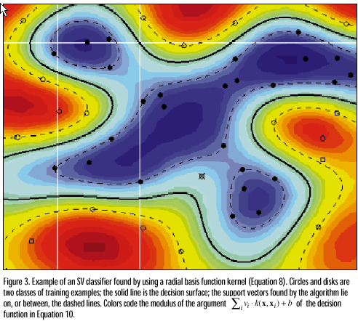

Slide 30
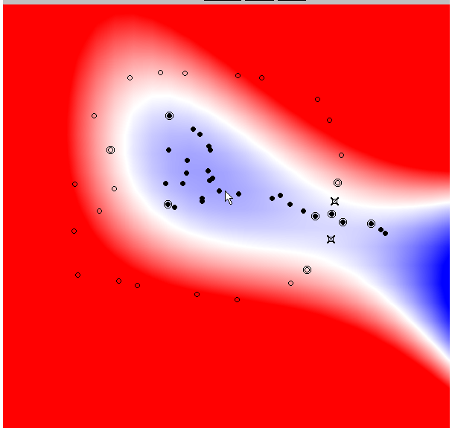
http://svm.research.bell-labs.com/SVT/SVMsvt.html

Slide 31
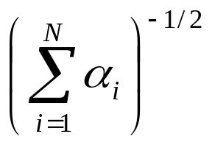

Generalization bounds?
Finding VC dimension of machines with different kernels is non-trivial.
Some (e.g. RBF) have infinite VC dimension but still work well in practice.
Can derive a bound based on the margin
and the “radius” but the bound tends to be unrealistic.

Slide 32
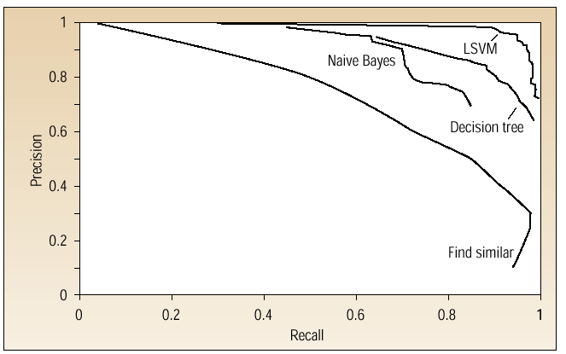
Text Categorization Results
Dumais et al. (1998)

Slide 33
SVM Issues
Lots of work on speeding up the quadratic program
Choice of kernel: doesn’t seem to matter much in practice
Many open theoretical problems

