Slide 1

Interactive Visualization Platform
for Informatics Education Statistics
Across European Universities
Bc. Břetislav Milota · Bc. Martin Schön
Dept. of Computer Science & Engineering
Faculty of Applied Sciences, University of West Bohemia, Pilsen
KIV/VI — May 2026
University of West Bohemia · Information Visualization · May 2026
Notes:
Good afternoon — my name is Břetislav Milota, and together with my colleague Martin Schön we built an interactive web platform for exploring informatics education statistics across European universities. This was our semester project for Information Visualization —at the University of West Bohemia in Pilsen.

Slide 2
THE PROBLEM & GOAL
The Problem
Our Goal
Informatics Europe (IE) maintains time-series data on student enrollment, graduation rates, and female representation across Europe.
But all of it lives in
Excel workbooks — requiring manual effort to find patterns.
Existing portals offer only tabular views. Geographic and temporal trends are invisible.
A unified, browser-based platform that transforms raw spreadsheets into interactive multi-level visualizations.
Serving:
→ Researchers & policy makers
→ University administrators
→ IE staff
>200
34
14
Institutions
Countries
Years of data
2 / 10
Notes:
The problem we set out to solve is this: Informatics Europe — the association of computer science and informatics institutions across Europe — maintains multi-year data on student enrollment, graduation rates, and female representation. But the data lives in Excel spreadsheets. Finding a geographic pattern, comparing two countries, or spotting a14-year trend requires a significant amount of work. Our goal was to turn those spreadsheets into a unified, interactive, browser-based platform — usable by researchers, administrators, and policy makers — covering over 200 institutions across 34 countries with 14 years of data.

Slide 3
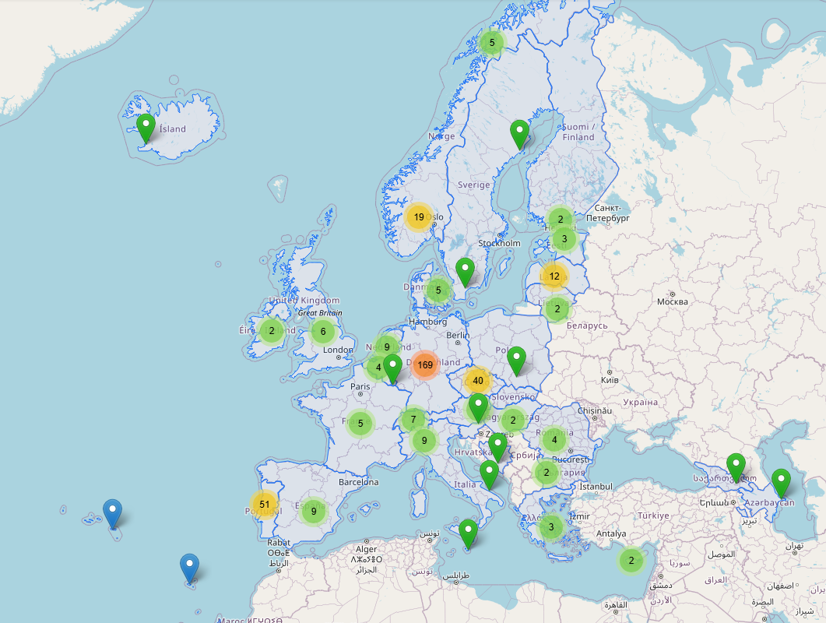
INTERACTIVE MAP
Clustered Markers
Automatically group at low zoom — click or zoom to expand to individual institutions.
Color Coding
Green = IE member institutions. Blue = general institutions. Red = selected.
Department Level
Zooming into a country reveals individual department markers, not just universities.
3 / 10
Notes:
The main entry point is a full-screen interactive map. At a continent-wide zoom, markers cluster automatically to show institutional density. As you zoom in, clusters expand to reveal individual universities — and in countries with detailed data, you can drill down to individual departments. Color coding keeps things readable: green markers are IE member institutions, blue markers are general institutions, and a selected marker turns red.

Slide 4
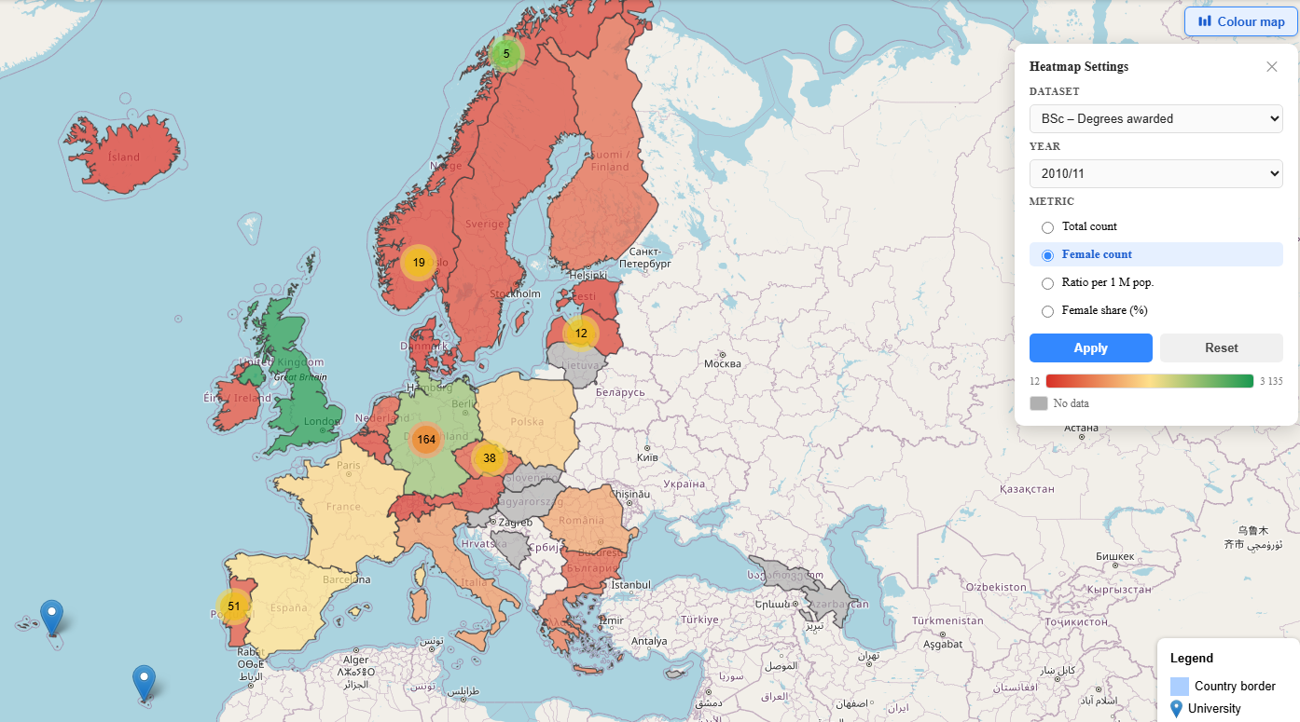
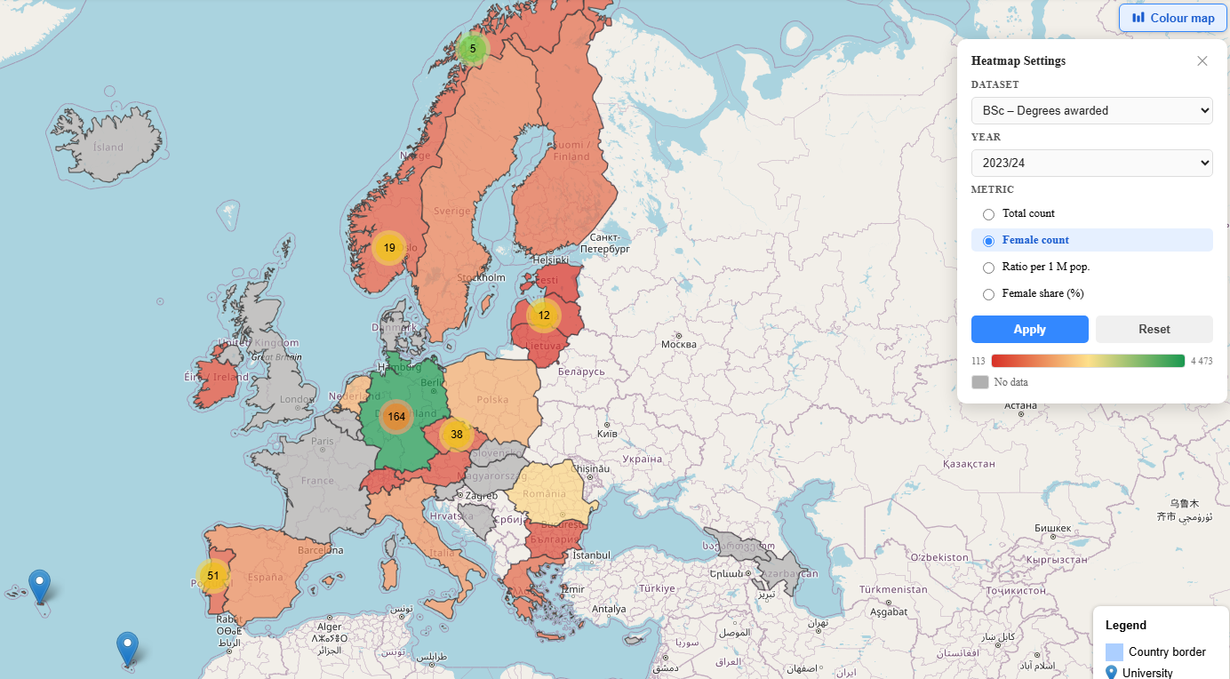
CHOROPLETH LAYER
9 configurable combinations — {BSc, MSc, PhD} × {enrolled, first-year, degrees} — with 4 metrics each
Female BSc count — 2010/11
13 years →
Female BSc count — 2023/24
Key insight: Absolute female counts grew in most countries from 2010 to 2024 — yet the relative share barely changed. This is invisible in tables, immediately obvious in the choropleth.
4 / 10
Notes:
Overlaid on the map is a configurable choropleth layer. You can choose any combination of degree level — Bachelor's, Master‘s, or PhD — with enrollment type, and then pick a metric: total count, female count, female share as a percentage, or count per million inhabitants. These two maps illustrate the point well. On the left: absolute female Bachelor's enrollment in 2010.On the right: the same metric in 2023.The colors have shifted — absolute numbers grew. But when you switch to the female share metric, the picture barely moves. Thirteen years of data, and the gender ratio has remained nearly flat. That discrepancy is invisible in a table, but visible in the choropleth.

Slide 5
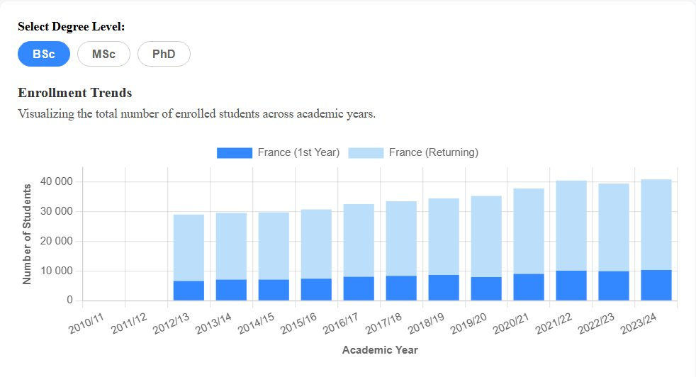
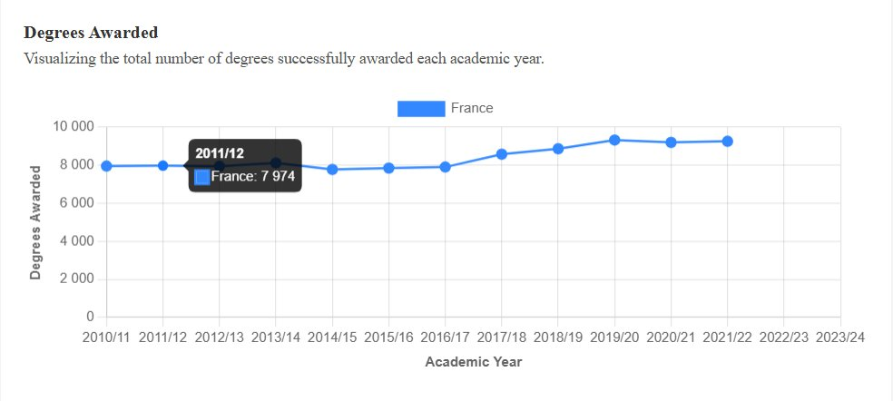
STATISTICAL CHARTS — ENROLLMENT & DEGREES
Enrollment Trends
Degrees Awarded Over Time
Stacked bars split first-year vs. returning cohorts for bachelors.
Line chart tracking total degrees per year — shows academic output trajectory.
Enrollment Over Time
Graduates Over Time
BSc, MSc and PhD per country – from Informatics Europe data.
Line chart of BSc and MSc graduates per institution — from Informatics Europe data.
5 / 10
Notes:
Clicking on any country or institution opens a detail modal with several chart types. The Enrollment Trends chart uses stacked bars to separate first-year bachelor students from returning cohorts — which makes retention patterns visible over time. Next to it, the Degrees Awarded chart tracks total degrees per year as a line chart, showing the academic output trajectory of a country.

Slide 6
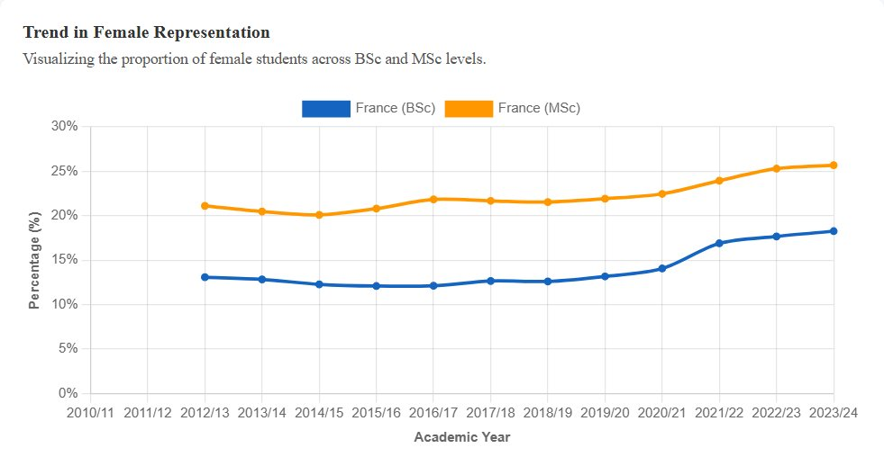
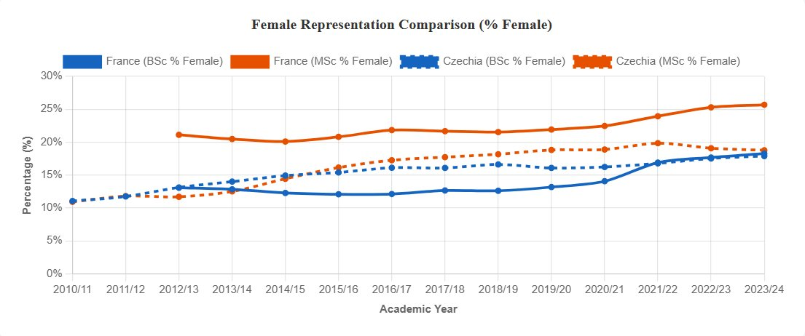
STATISTICAL CHARTS — FEMALE REPRESENTATION
Female Representation Trend
Female Representation — Side-by-Side
BSc vs MSc female share per year — exposes whether the gap differs between programme levels.
Four lines: BSc & MSc for two countries. Colour = degree level, line style = country.
Key insight: MSc female share is consistently higher than BSc in most countries — yet both remain well below 30%. The comparison view makes cross-country divergence immediately visible.
6 / 10
Notes:
The female representation view plots BSc and MSc female share on the same axis, with separate lines — so you can see whether the gap differs between programme levels within the same country. And with the comparison modal, you can overlay two countries at once —four lines total, with colour distinguishing degree level and line style distinguishing the country. The key insight here is that MSc female share is consistently higher than BSc in most countries — yet both remain well below 30%.

Slide 7
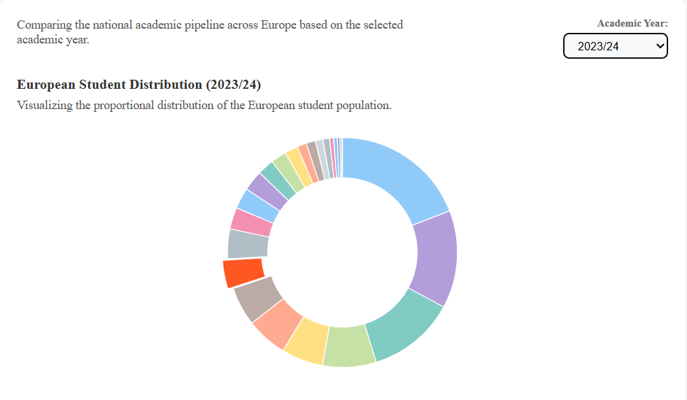
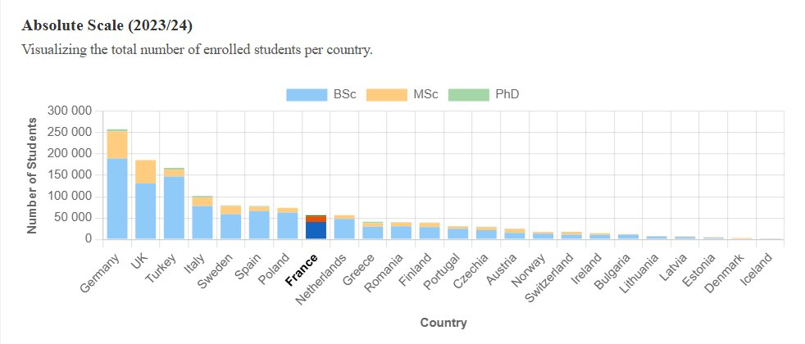
STATISTICAL CHARTS — EUROPEAN CONTEXT 1
European Student Distribution
Absolute Scale
Each country's proportional share of total EU informatics students.
Raw enrollment per country — large nations (Germany, UK, Turkey) dominate.
7 / 10
Notes:
Zooming out to the European level, users can view two comparative charts. The doughnut chart shows each country's proportional share of the total European informatics student population. And the Absolute Scale bar chart shows raw enrollment numbers per country —where large nations like Germany dominate.

Slide 8
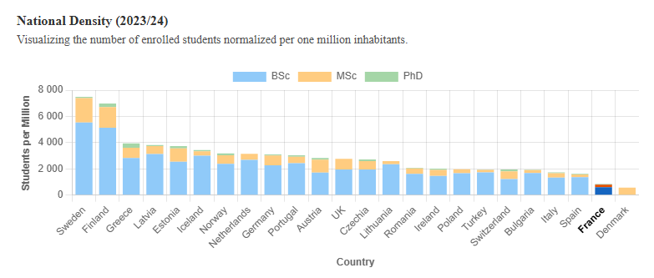
STATISTICAL CHARTS — EUROPEAN CONTEXT 2
National Density
Students per million inhabitants — reverses the ranking; small Nordic nations lead.
8 / 10
Notes:
But when you normalize by population — dividing by million inhabitants —the ranking reverses completely. Sweden, Finland, and Greece rise to the top, while Germany drop.

Slide 9
KEY FINDINGS
01
The gender gap persists
02
Growth masks stagnation
Most European countries show fewer than 25% female students at BSc level — a ratio barely changed over 14 years.
Absolute female enrollment grew in most countries, yet the relative share is nearly unchanged. Choropleth maps make this immediately visible.
03
Population normalization reverses rankings
Sweden, Finland, and Estonia top the density charts — invisible in raw figures dominated by Germany.
9 / 10
Notes:
Now let me highlight three things the platform makes visible. First: the gender gap is persistent. Most European countries have been below 25% female at BSc level for the entire 14-year window— and that has barely changed. Second: growth masks stagnation. Raw female enrollment numbers grew, giving the impression of progress — but the relative share shows almost no movement. Third: population normalization reverses the country rankings completely. Germany dominates the raw charts; Sweden, Finland, and Estonia lead the per-million view.

Slide 10
Conclusion
What we built
A fully static Vue 3 SPA integrating:
· Geographic choropleth layer
· Clustered interactive map
· Statistical charts (enrollment, gender, density)
· Side-by-side comparison modal
· Search & filter across 200+ institutions
10 / 10
University of West Bohemia · KIV/VI · May 2026
Notes:
To summarize: we built a fully static, browser-based platform that brings geographic, temporal, and comparative visualization to a dataset that previously required manual spreadsheet work to navigate. Thank you for watching.

