Slide 1

Hashing
Lecture Slides by:
Dr. Inayat Ur-Rehman

Slide 2
WHY WE NEED HASHING?
We would build a data structure for which both the insertion and find operations are O (1) in the worst case.
If we cannot guarantee O (1) performance in the worst case , then we make it our design objective to achieve O (1) performance in the average case .
In order to meet the performance objective of constant time insert and find operations, we need a way to do them without performing a search . I.e., given an item x , we need to be able to determine directly from x the array position where it is to be stored.

Slide 3
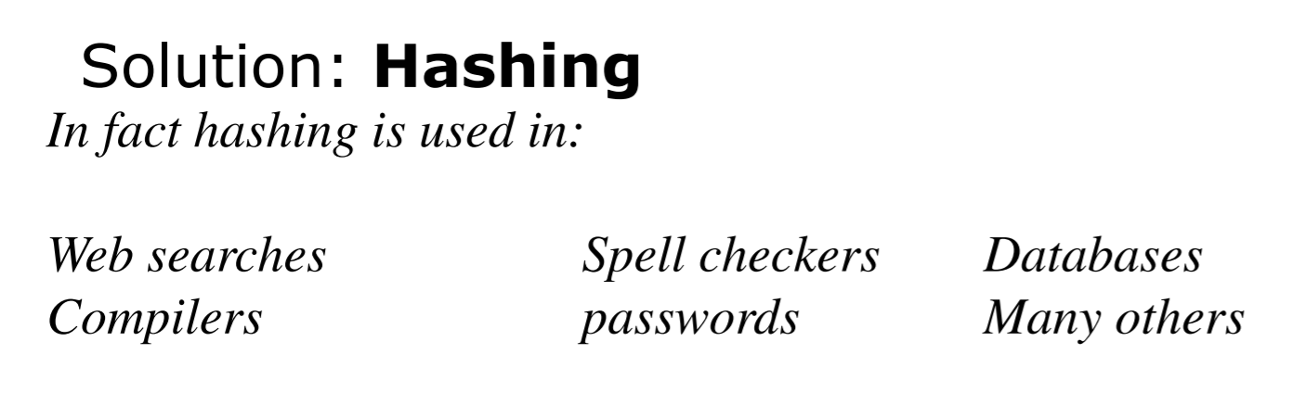
We need something that can do better than a binary search, O(log N).
We want, O(1).
Have 2 parts = key for indexing and one or more data fields

Slide 4
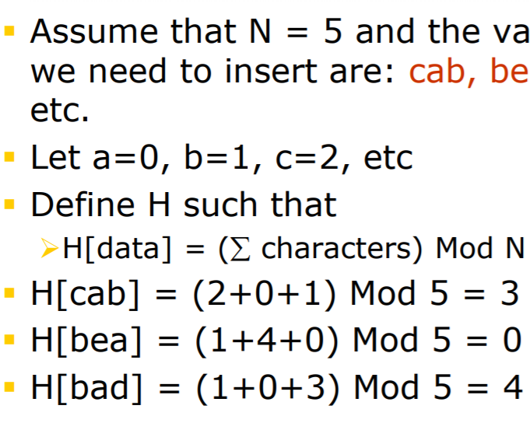
FINDING HASH FUNCTION

Slide 5
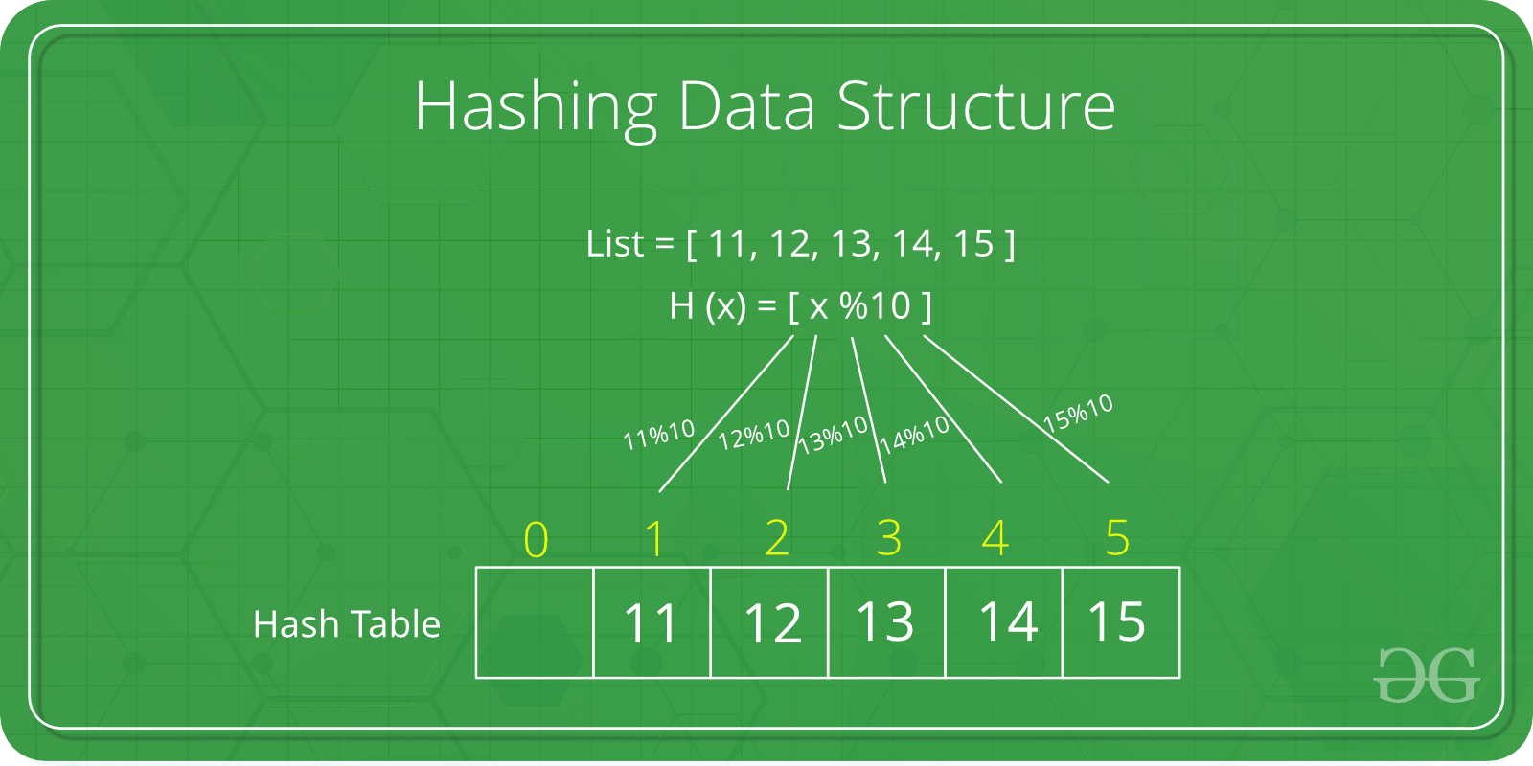


Slide 6

Collision Resolution
Linear Probing
Chaining method

Slide 7
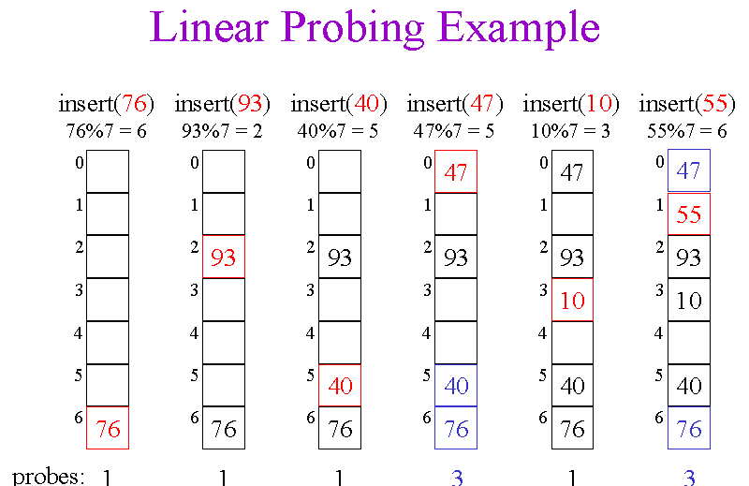

Slide 8
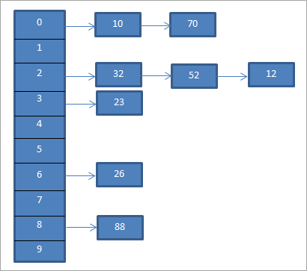
Chaining method:

