Slide 1
Drawing Editor
CmpE 496 HCI
Homework 1
Ufuk Arslan
2017400219
Oğuz Arslan
2017405180
03.22.2022

Slide 2

Tools Used
Python3 as the programming language
Tkinter library for GUI

Slide 3
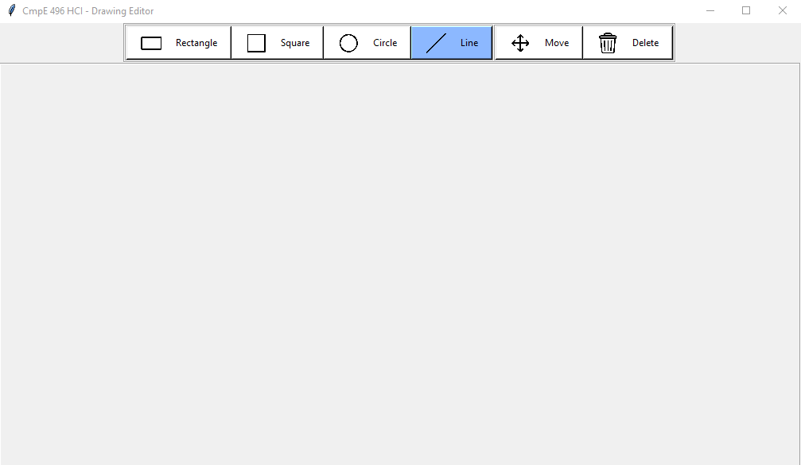
Start Program
We run the program by typing python3 paint.py in the project folder. At the start the line tool is selected.

Slide 4
Select Tools
You can select the tool or operation to use from the top bar. You can see the icons of each tool as well. When you hover over tools the mouse cursor changes. Active tool button is highlighted blue.

Slide 5
Draw Shapes
You can draw rectangles, squares, circles, and lines. Each shape is stored as an object on the canvas that can be moved or deleted later.

Slide 6
Delete Shapes
You can use delete tool to delete shapes. The closest shape to the cursor is colored red so you know which shape to will be deleted.

Slide 7
Move Shapes
You can use move tool to move shapes. The closest shape to the cursor is colored cyan so you know which shape to will be moved.

Slide 8
