Slide 1

Simple Stable Coin: Algorithmic Stable Coin
Presenters: Tomer Afek, Uri Gadot
Course: 048888 - Blockchains and Cryptocurrencies
Date: 29/06/2021

Slide 2
Background
Why Stablecoins?
The common cryptocurrencies (BTC, ETH, etc.) suffer from high volatility in their valuations.
What are Stablecoins?
Cryptocurrencies which try to tackle price fluctuations by tying their value to other more stable assets – usually fiat.

Slide 3
Background
Types of Stablecoins:
Fiat-Collateralized Stablecoins
Crypto-Collateralized Stablecoins
Non-Collateralized (algorithmic) Stablecoins
Algorithmic Stablecoins:
Do not use any reserve, but include a working mechanism, like that of a central bank, to retain a stable price.

Slide 4

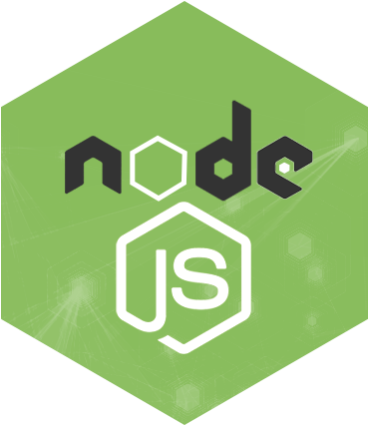

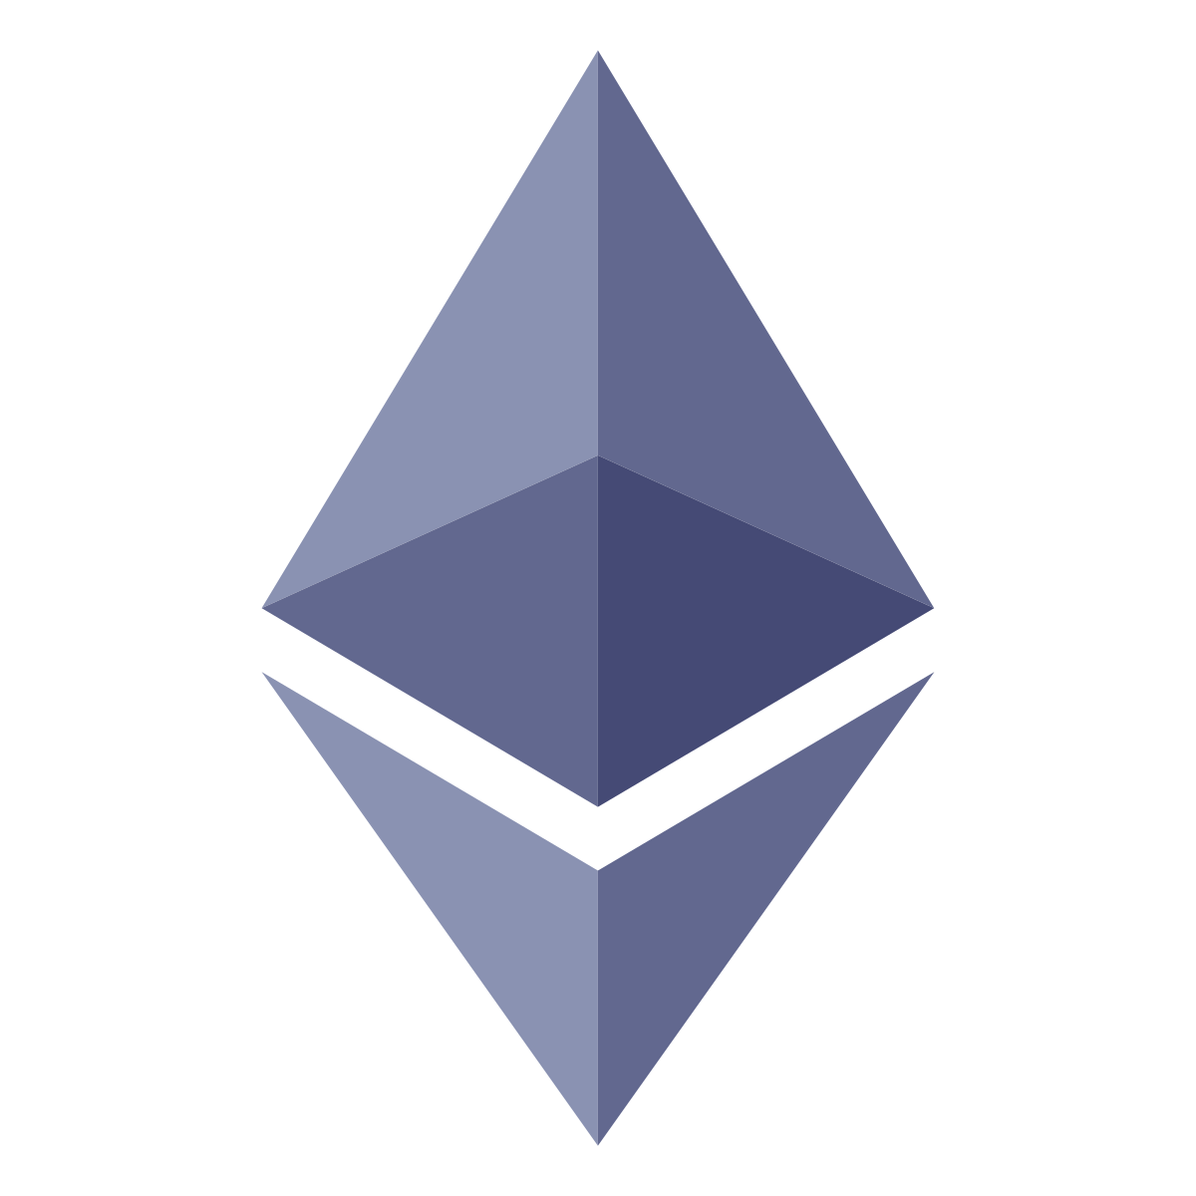
Project’s Environment
Tools:
Ganache – sets-up a local Ethereum test-net
Truffle – A development framework for Ethereum
NodeJS – JavaScript run-time platform
Languages:
Solidity – Ethereum’s smart contracts language
JavaScript – testing and running the smart contracts
Python – for the show-off ☺

Slide 5
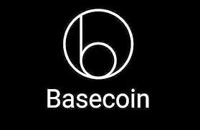
Base Coin – Our Inspiration
Uses a consensus mechanism to increase or decrease the supply of tokens on need basis.
An algorithmic Stablecoin launched in 2018 *
It does so by using three different tokens:
Basecoin (The actual Cryptocurrency)
Base Bonds
Base Shares
* Shut down in December of 2018 After intervention by the U.S. Securities and Exchange Commission (SEC)

Slide 6
Simple Stable Coin – Smart Contracts
Central Bank:
Gets the coin value from the Oracle contract.
Chooses whether to buy bonds / sell bonds / produce coins to share-holders, based on the current coin value.
Coin:
Holds the amount of coins / bonds / shares for each user
Also, the total amount of the above.
Manages the different actions that the central bank chose to do
Oracle:
Periodically checks the coin value.

Slide 7
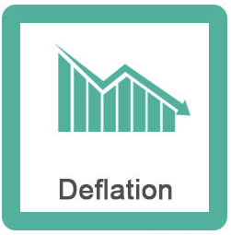
Simple Stable Coin – Flows
Coin Value < 1$
Central bank contract realizes that deflation needs to be done.
Coin contract performs the deflation:
Sell bonds through an auction:
Each user chooses the price for a single bond he is willing to pay (<1 BaseCoin) + the amount of bonds.
We find the clearing-price – in which we can sell all bonds.
(Users are motivated to buy bonds because they could later redeem them for 1 BaseCoin)
This action decreases the total amount of coins → coin value goes up.

Slide 8
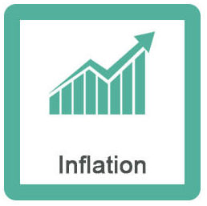
Simple Stable Coin – Flows
Coin Value > 1$
Central bank contract realizes that inflation needs to be done.
Coin contract performs the inflation:
Redeem a limited amount of bonds for each user (if he has any) for 1 BaseCoin each. *
This action increases the total amount of coins → coin value goes down.
If there are no bonds left, produce coins for all users who hold shares.
Relatively to the number of shares of each user. **
This action increases the total amount of coins → coin value goes down.
* There should be FIFO queue of bonds (buy first → redeem first), we didn’t implement it for simplicity reasons.
** Our implementation assumes each user has a constant amount of one share

Slide 9
Simple Stable Coin – Smart Contracts
Central Bank
Coin
Attributes (State)
C2D_Ratio
Methods
updateC2D
Central Bank Balance (=Total)
Attributes (State)
Balances [users]
Bonds [users]
Shares [users]
Auction Data
Methods
Register
transferAmount
InflateBalance
conductAuction
InflateBalance
conductAuction
Oracle
C2D Ratio
Attributes (State)
BaseCoinDollars
Methods
Update
getC2DRatio
* C2D Ratio = Coin To Dollar Ratio

Slide 10

Problems we encountered
Setting-up the Ethereum local test-net (using Truffle + Ganache)
We started this project with no prior technical knowledge
Slow learning curve
Debugging the smart contracts
No option for a debugger or to print stuff
Oracle is very complicated to implement
Tried to use a known Ethereum API to perform HTTP query from our smart contract
This API works only on the main-net → couldn’t use it
Instead, used two alternatives:
Perform HTTP query on JavaScript and then transfer the data to the Oracle contract
Insert our own values through the command line

Slide 11
Future Work
Deploy on Ethereum Main-Net with real Oracle interface
Implement a more complex mechanism
bonds FIFO
Shares trading
Etc.
Implement different stabilizing mechanisms

Slide 12


Time to Demonstrate Thank You For Listening! https://github.com/Ugadot/StableCoin

