Slide 1
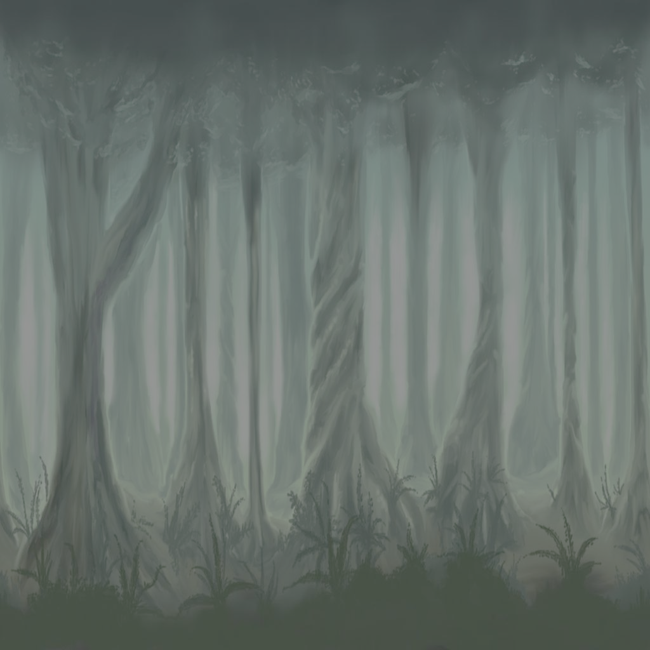
Empyrean
Semester Report
December 8, 2004

Slide 2
Brought to you by …
Corey Annis - 2D Artist
Chad Austin - Team Lead, Lead Programmer
Tom Batkiewicz - Programmer
Tarun Bhatia - Modeler
Robert Brantseg - Modeler
Brian Christianson - Music
Josh Delaney - Lead Artist, Modeler
Mitch Fluegel - Modeler
Andy Friesen - Programmer

Slide 3
More Credits
Mike Holtan - Programmer
Teresa Karr - Modeler
Joe Lee - Modeler
Wen Jin - Programmer
Jared Knutzon - Programmer
Armin Sokocevic - Concept Artist
Bryan Walter - Programmer
Kent Yen - Modeler
Yue Zhao - Modeler

Slide 4
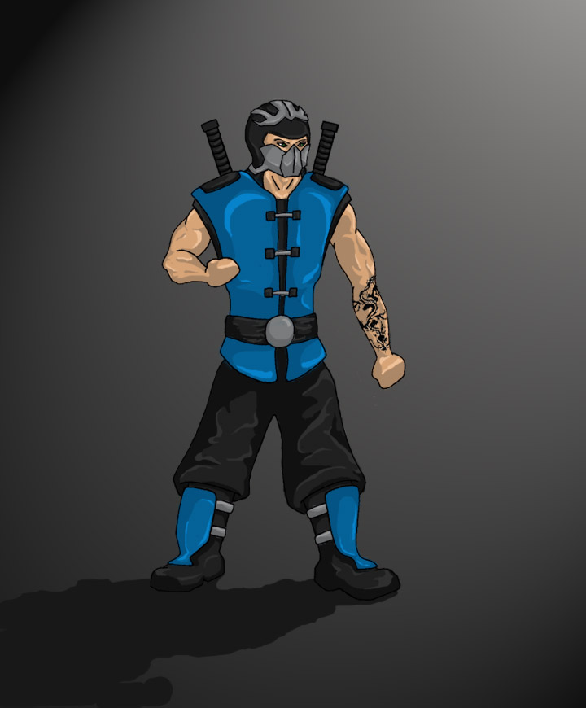
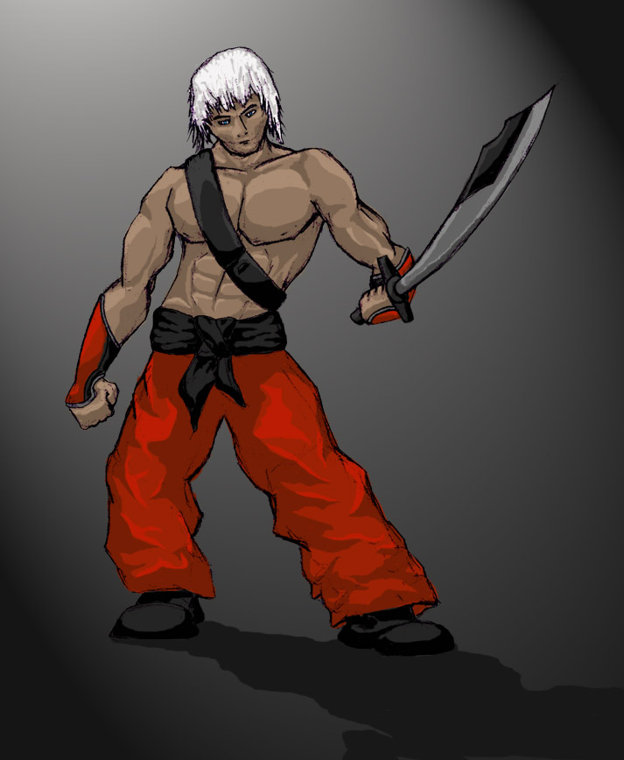
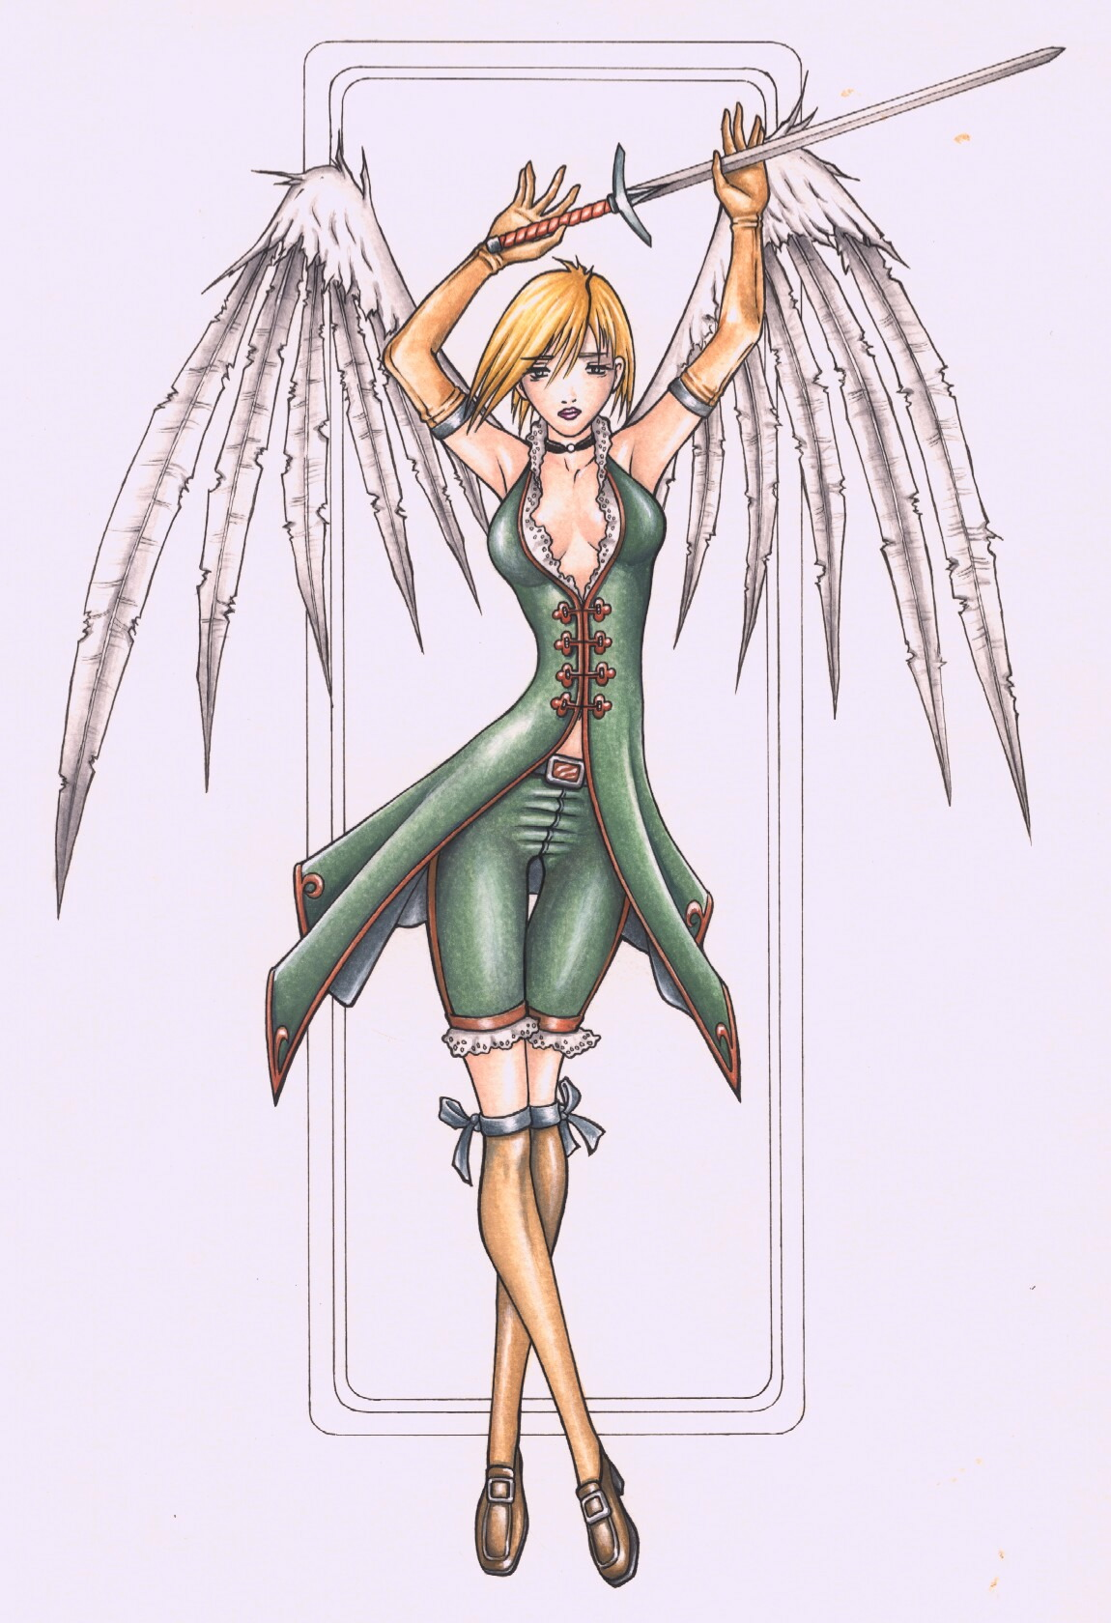
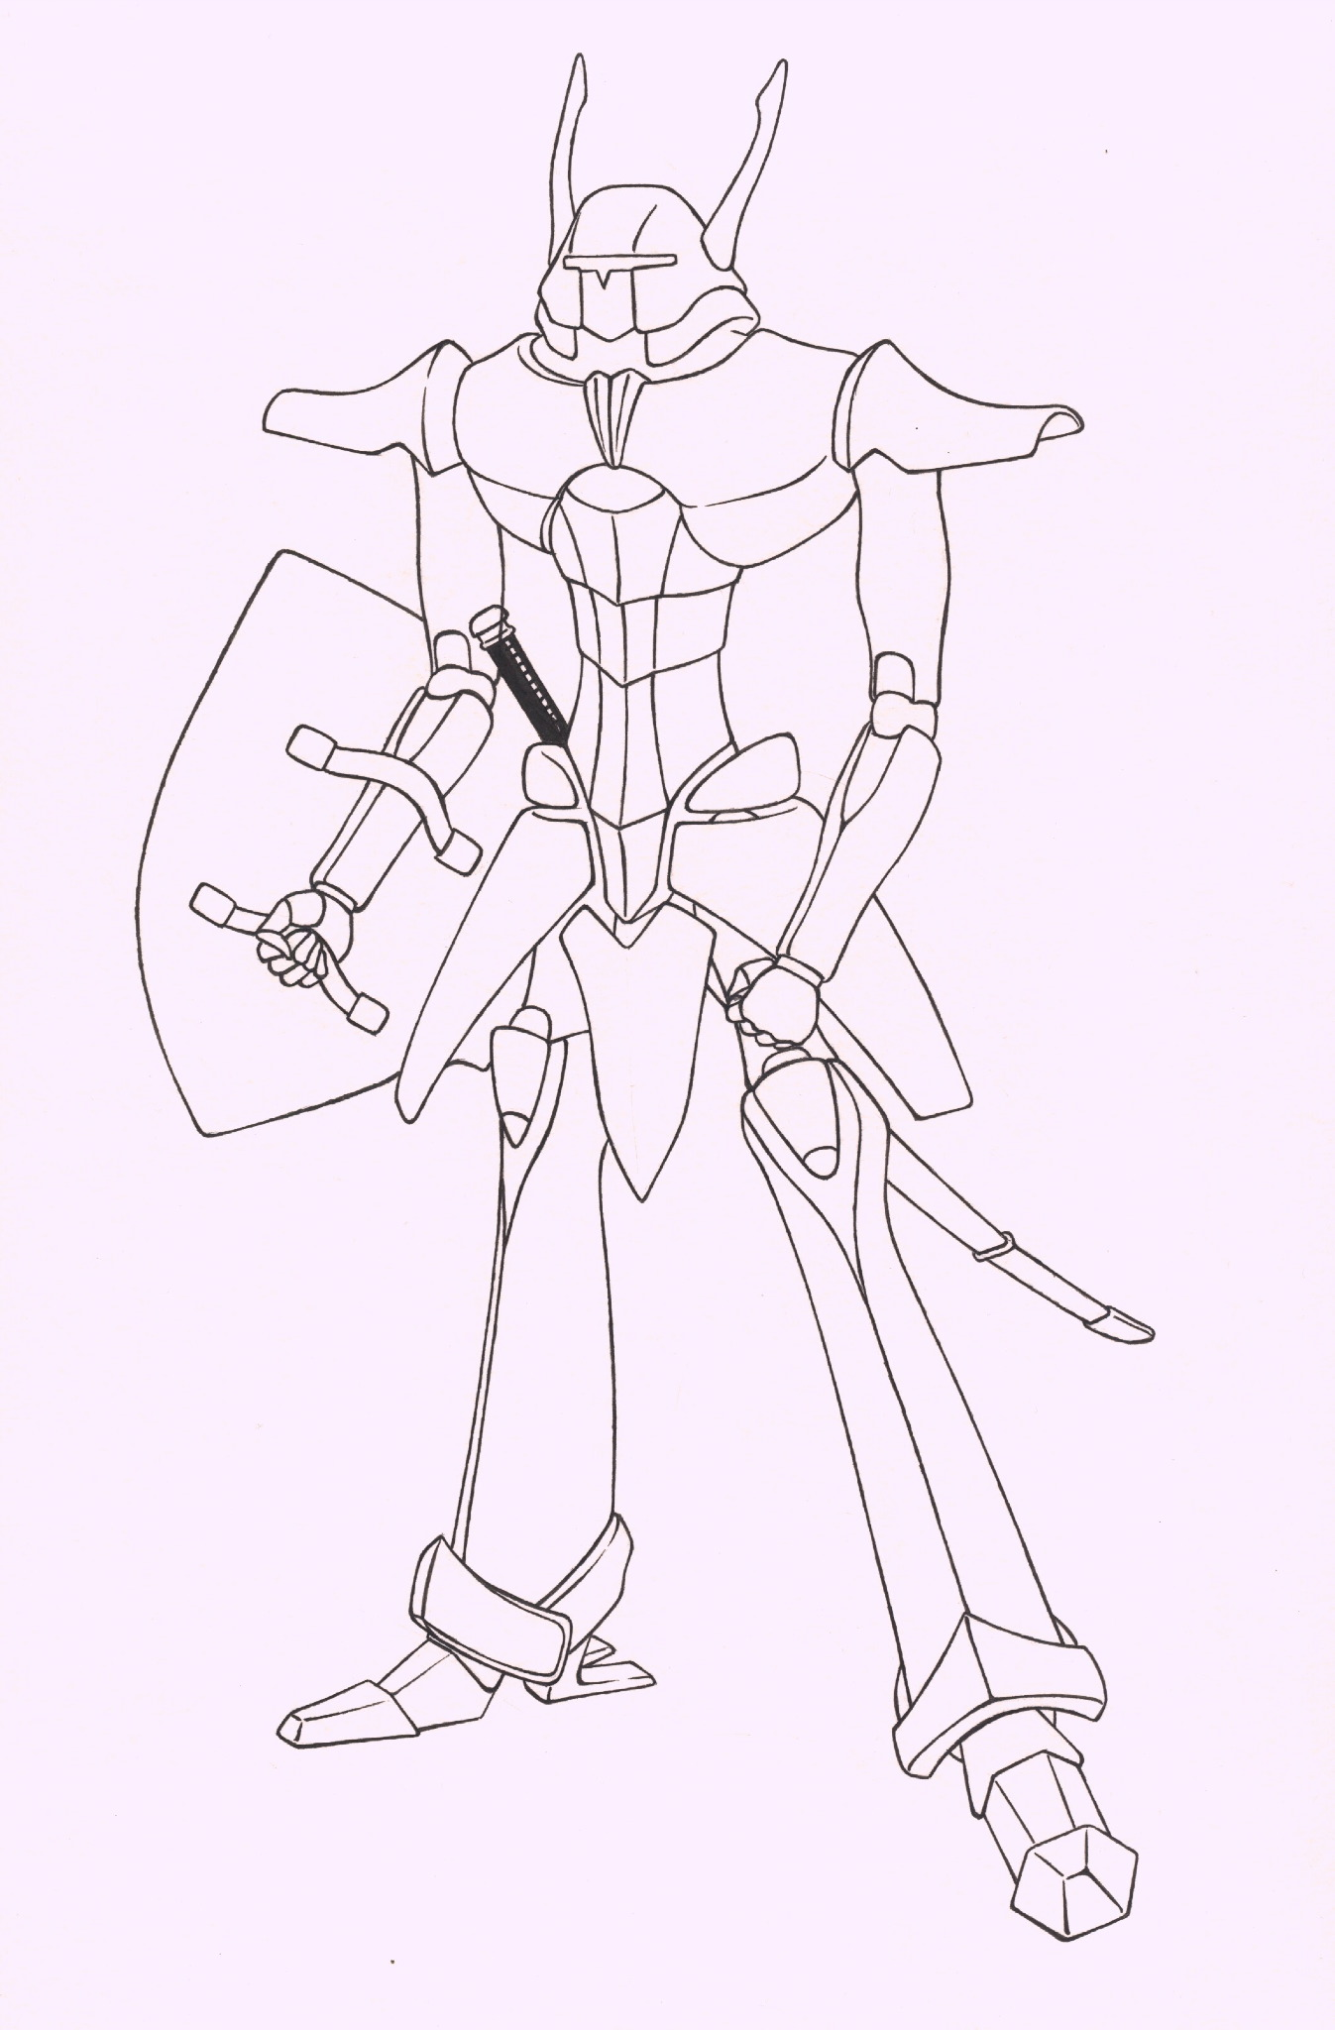
Game Summary

Slide 5
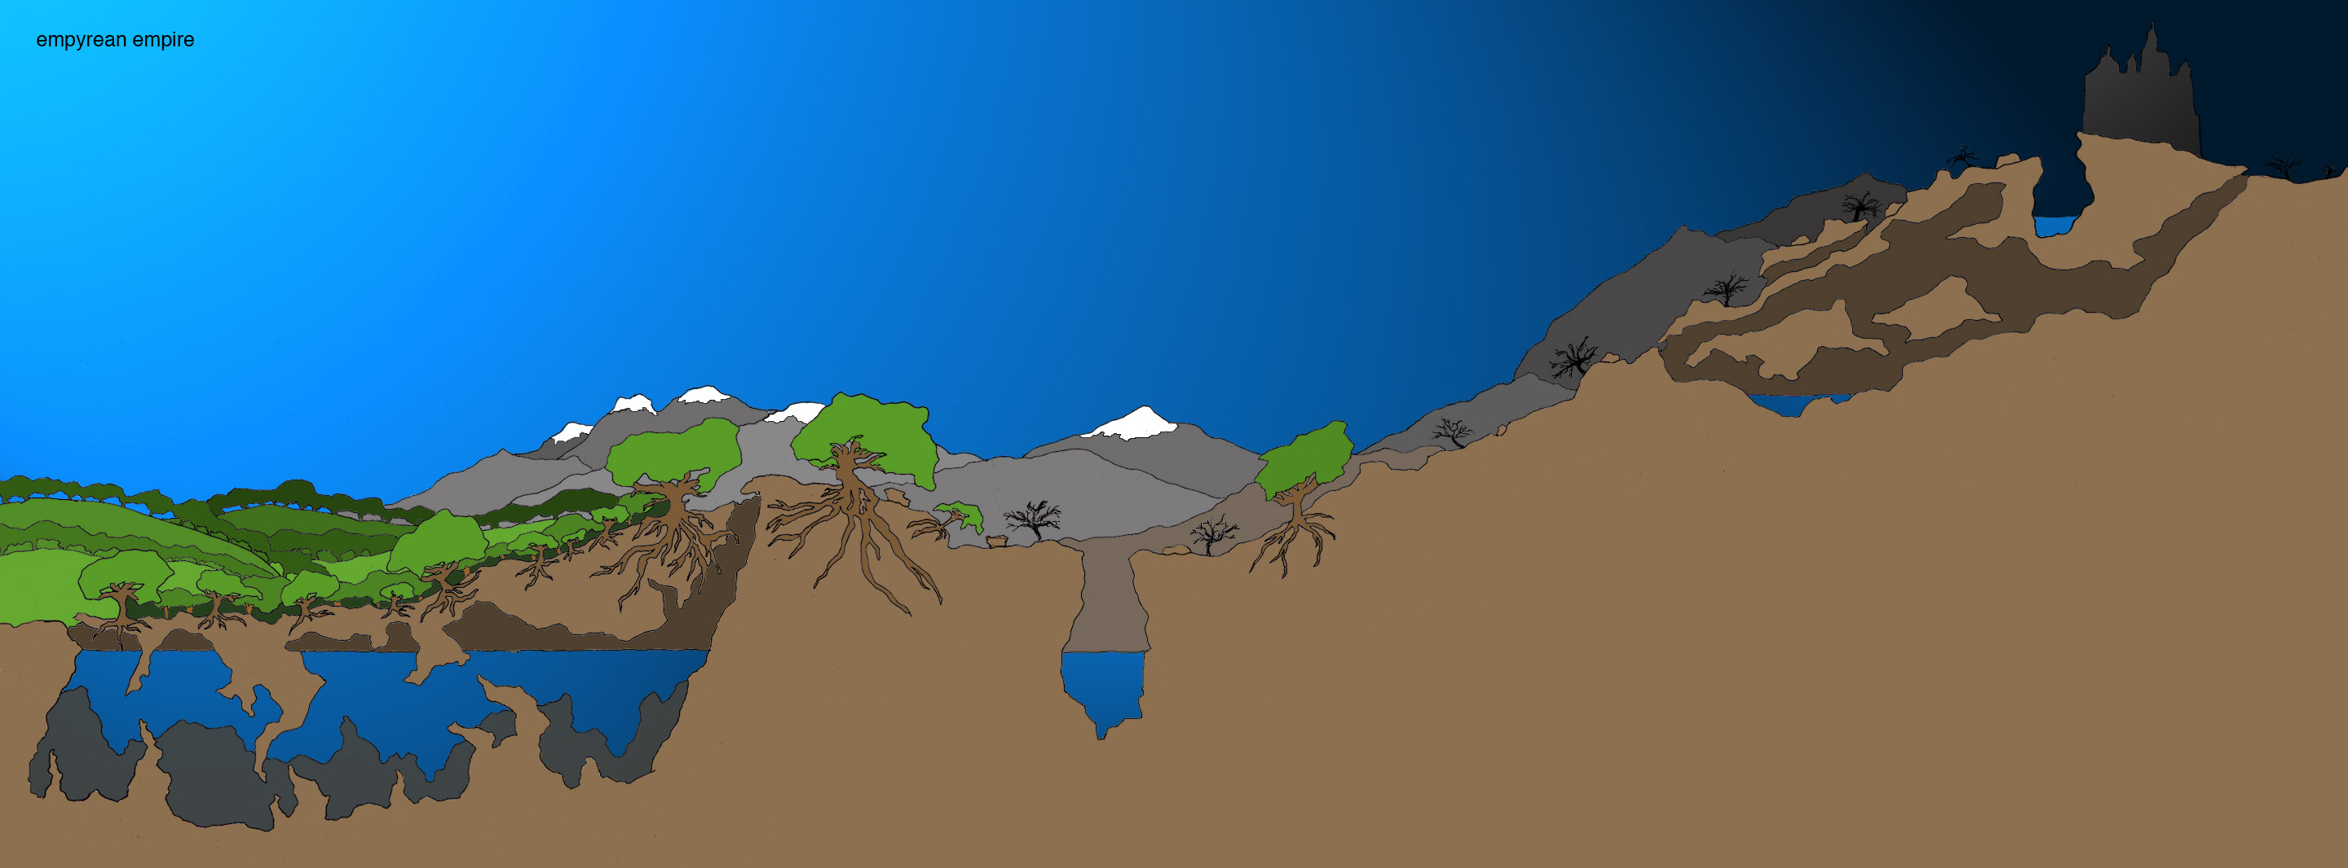
Sketch: Stage 1

Slide 6
Game Progress
Performance Speedups
Physics
Maya Exporter to Cal3D
Monster AI
Rendering
Level Model
Entity Models
Music

Slide 7
Speedups, Physics, Maya Exporter
Added axis aligned boundary box check
Several minor improvements
Maya Exporter to Cal3D
Learned of difficulty with contact forces and collision detection.
Created a force based system that can handle external forces

Slide 8
Monster AI
Scripting in Python
Finding the nearest player
Fish monster
Grunt monster
Attacking

Slide 9
Rendering
3D terrain map allows for lighting and occlusion
Positional light on the player and a global light
Water Effect using a fragment program on the GPU
Glow post process effect
Mist, animation of grass and trees, per pixel lighting, glow effect, and particle systems in development

Slide 10
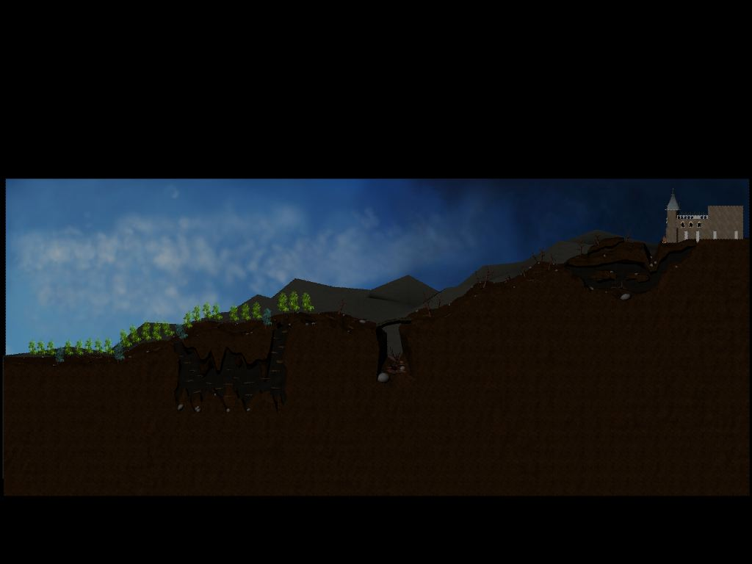
Level Model

Slide 11
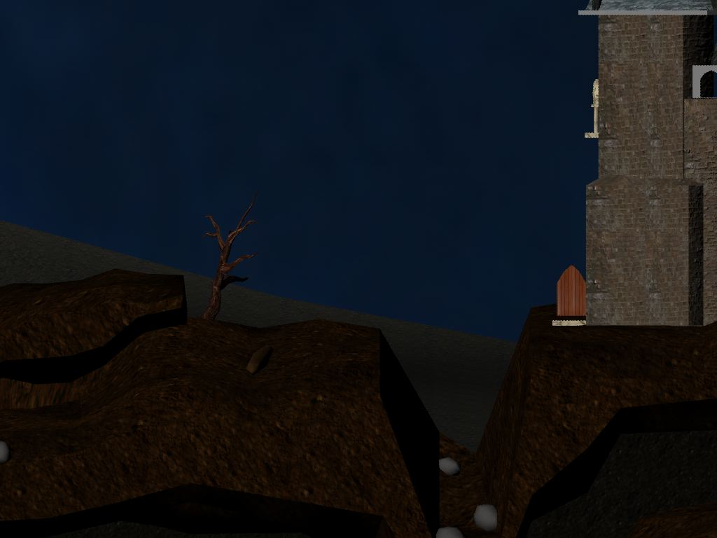
Level Model

Slide 12
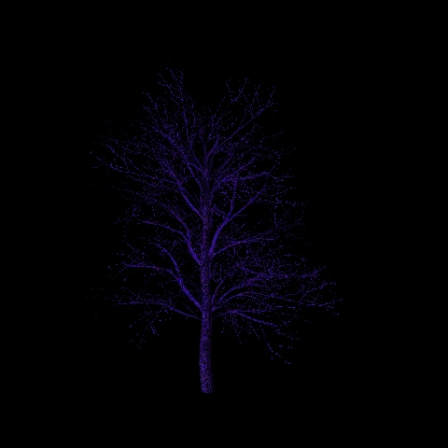
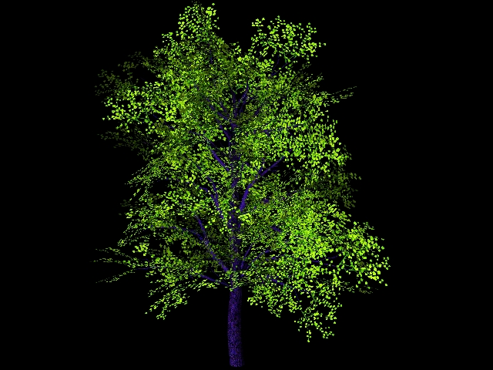
Level Model

Slide 13
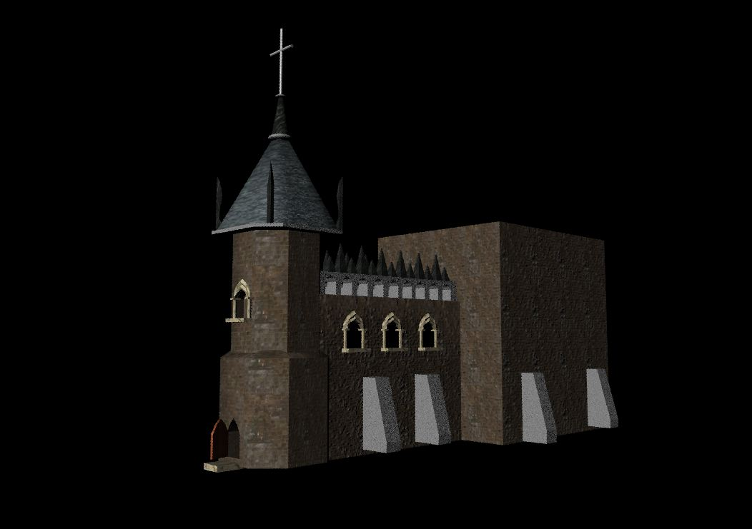
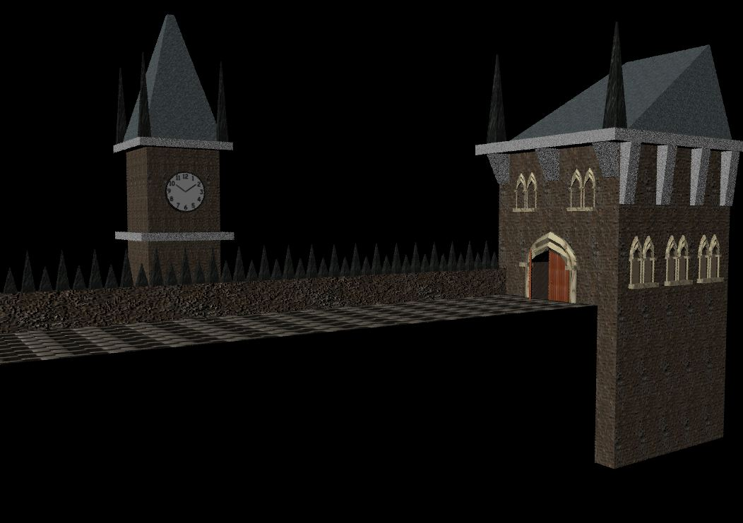
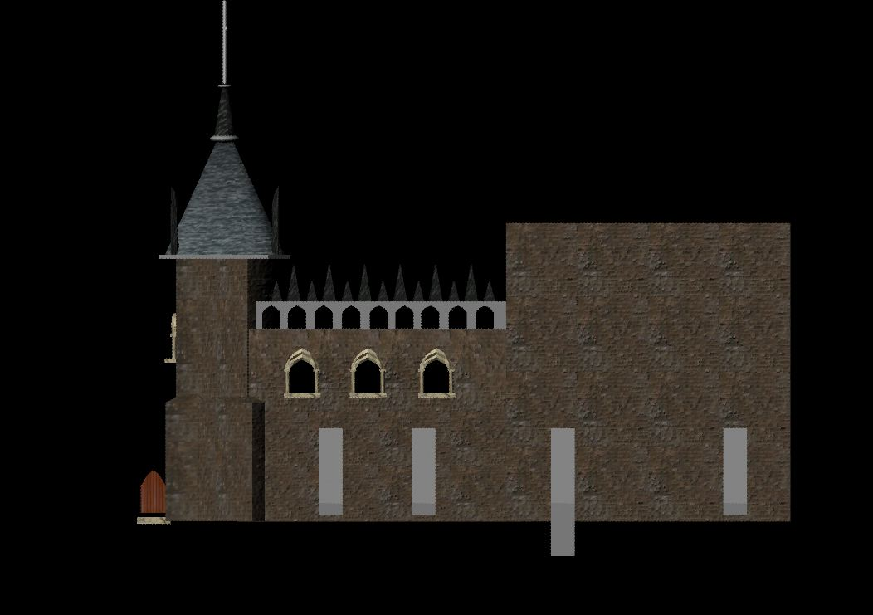
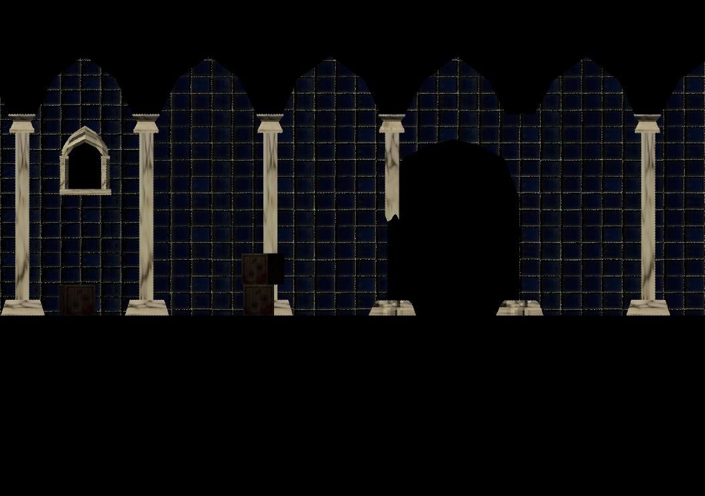
Level Model

Slide 14
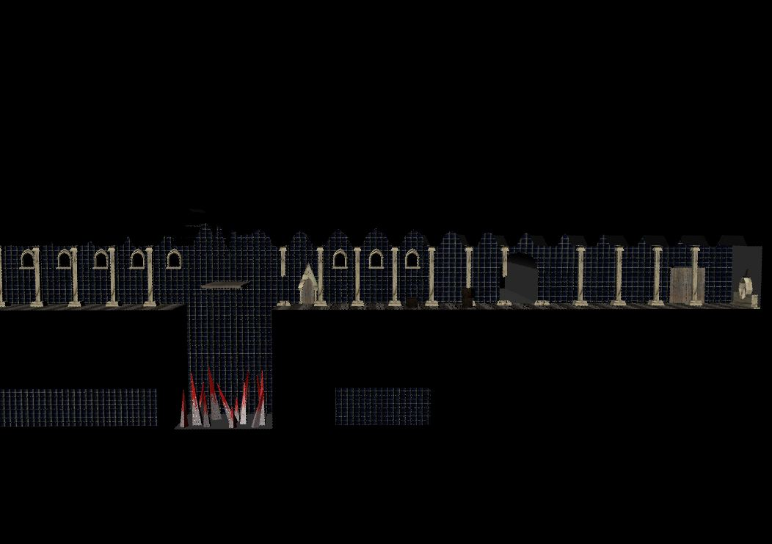
Level Model

Slide 15
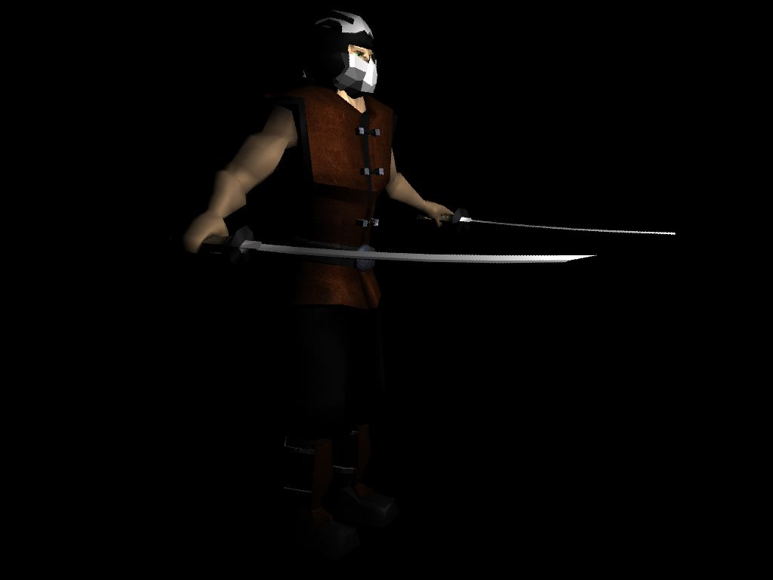
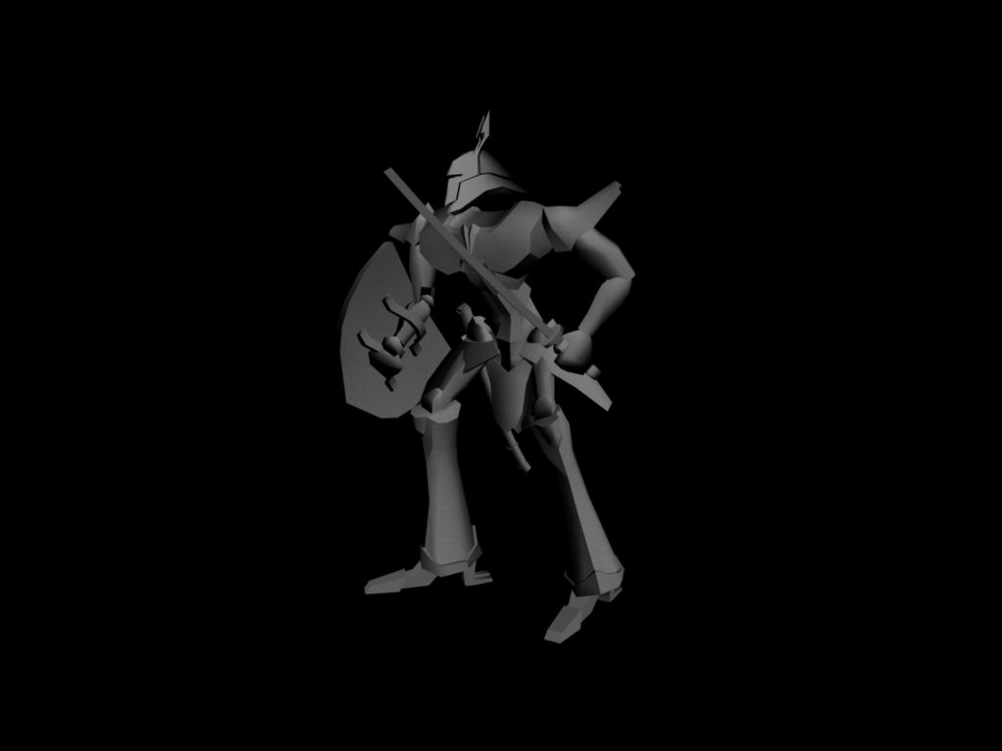
Character Models

Slide 16
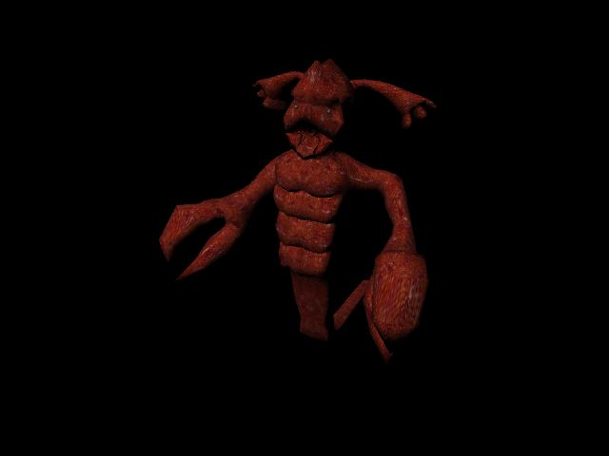
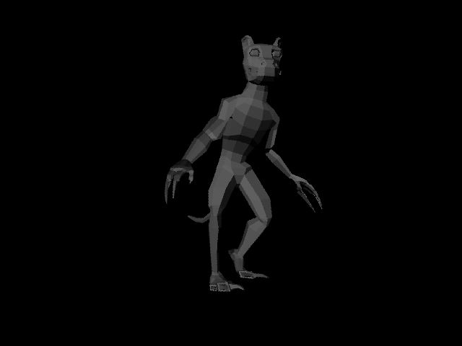
Monster Models

Slide 17
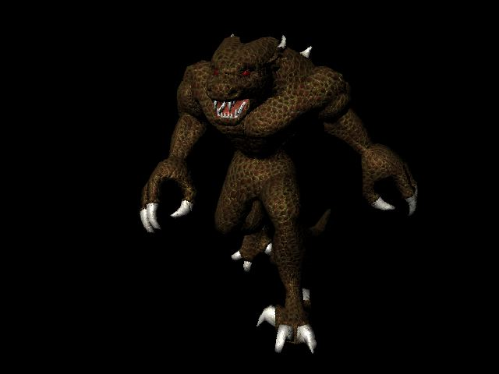
Monster Models

Slide 18
Future Work
Student IGF submission completed, project now open to world at large
Polish the first level terrain
Flesh out overall story
Create the necessary cut scenes
Implement all of the characters’ abilities and maneuvers
Improve monster AI

Slide 19
Future Work
Implement character saving on server
Get all of the art in the game including textures on models

Slide 20
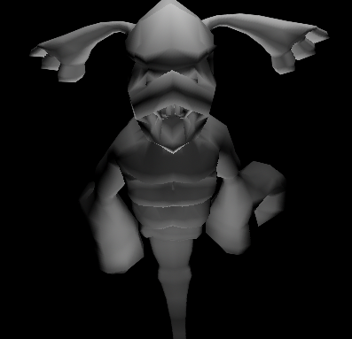
Demo Time

