Slide 1
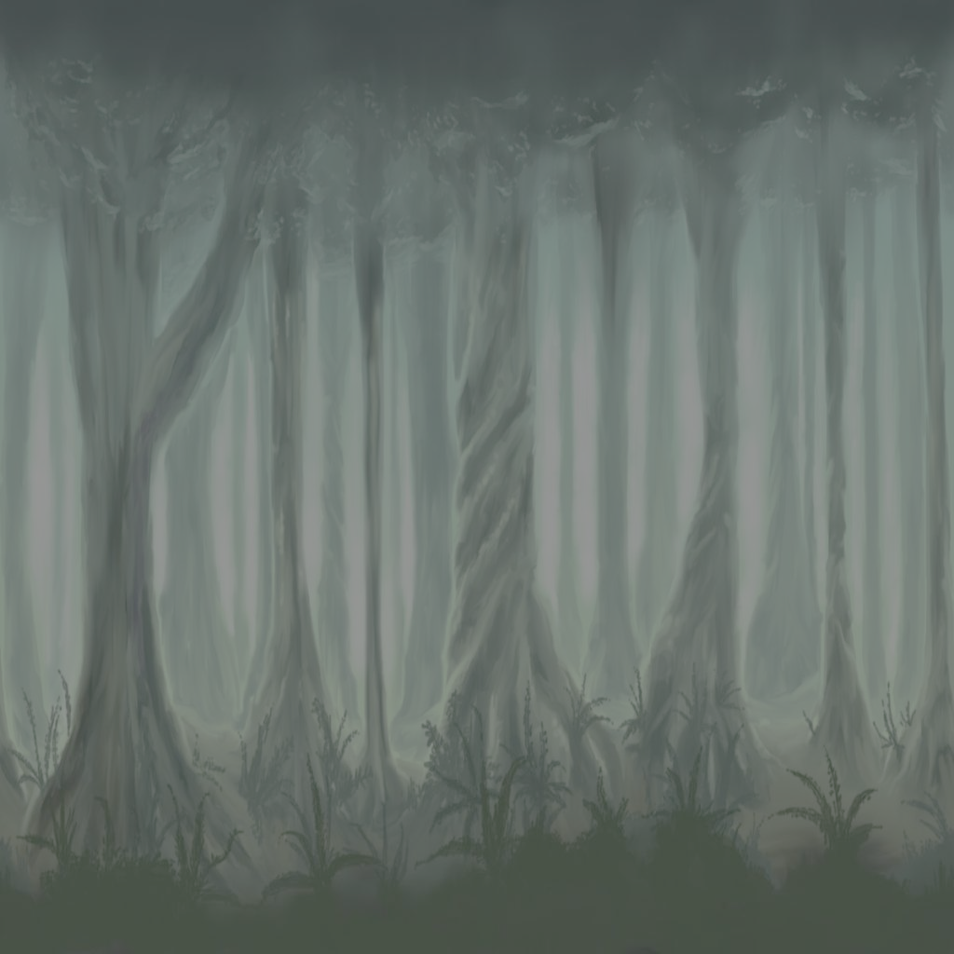
Empyrean
Semester Report
April 28, 2004

Slide 2
Brought to you by …
Chad Austin – team lead, programmer
Josh Delaney – artist, modeler
Teresa Karr – artist, modeler
Jared Knutzon – programmer
Joe Lee - modeler
Armin Sokocevic – artistic lead, modeler
Bryan Walter – rule designer, programmer

Slide 3
Agenda
Introductions
Initiation
Game Design
Game Development
Future Work

Slide 4
Introductions
Four playable characters
  Caphriel
  Kuya
  Ronan
  Akazen
You can play with up to 3 of your friends, but all must play different characters

Slide 5
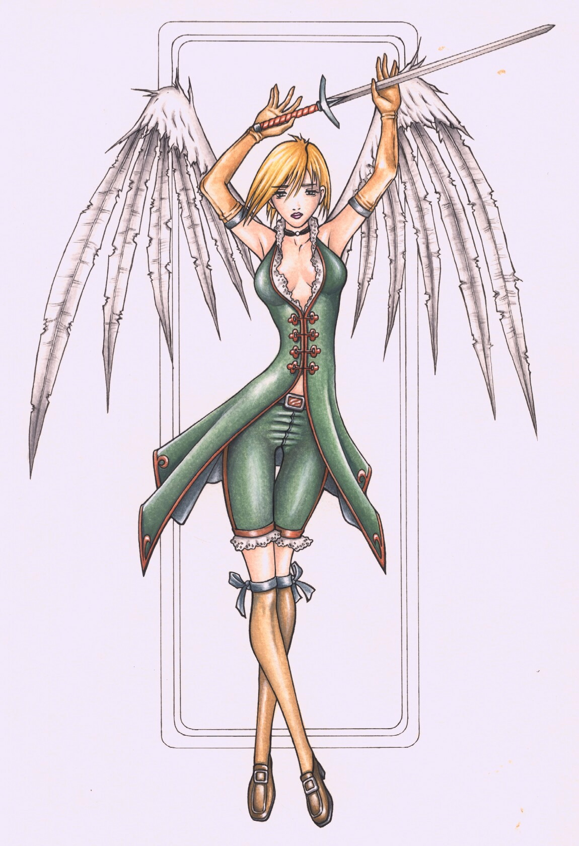
Caphriel
Special Maneuver:
  Flight
Special Ability:
  Runic Elemental Magic

Slide 6
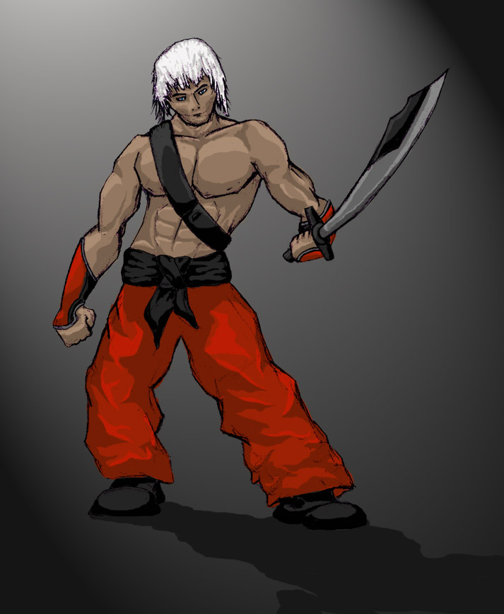
Kuya
Special Maneuver:
  Wall Phase
Special Ability:
  Strong Attack
  Combinations

Slide 7
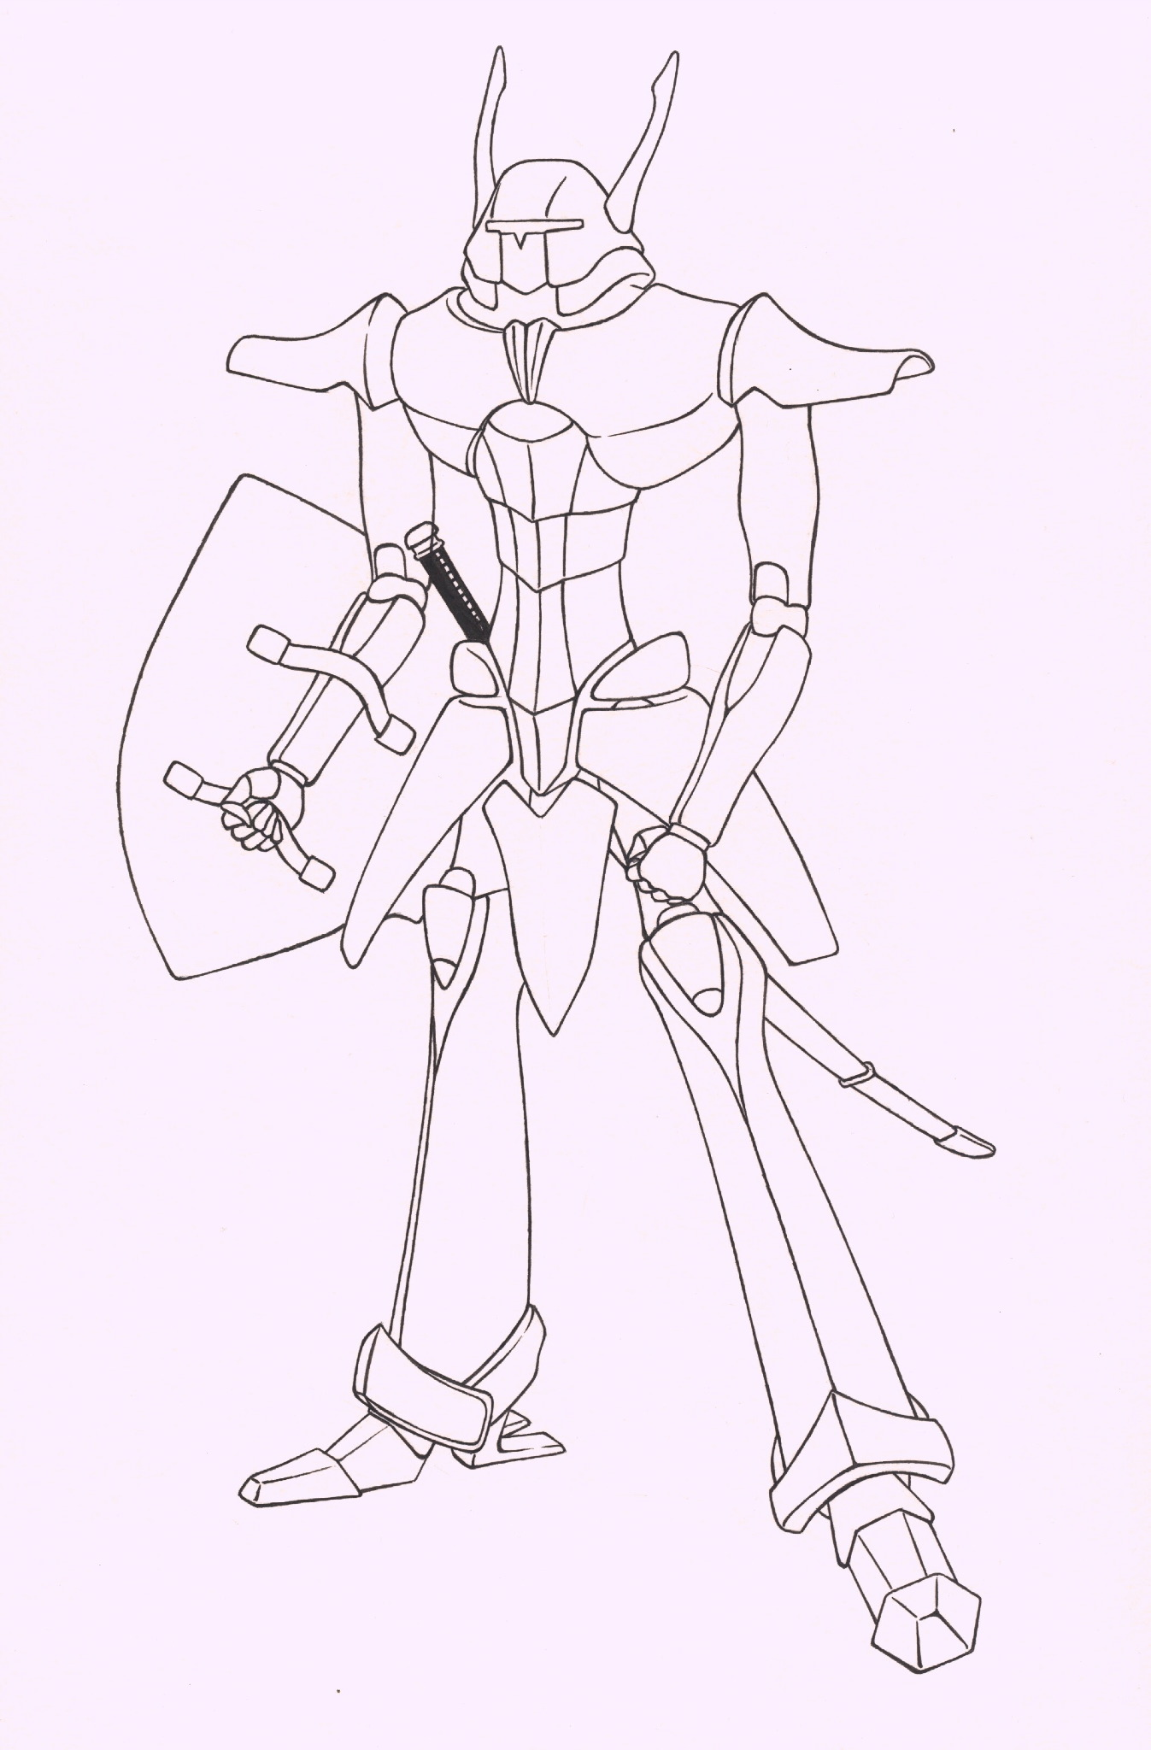
Ronan
Special Maneuver:
  Aquatic Mode
Special Ability:
  Powerful Long
  Range Attacks

Slide 8
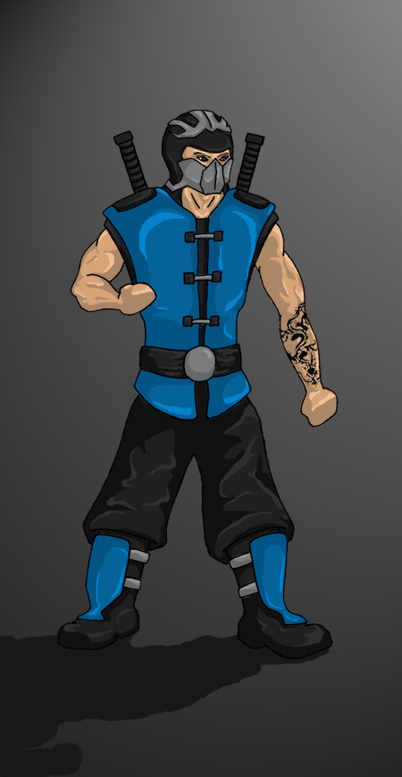
Akazen
Special Maneuver:
  Climbing, Crawling
Special Ability:
  Lightning Fast
  Attacks

Slide 9
Initiation
Marcus, the son of the powerful vapotencer Xavier was abducted
The group of four is hired by Xavier to retrieve his son
The group heads toward the fortress in the mountains where Marcus is rumored to be

Slide 10
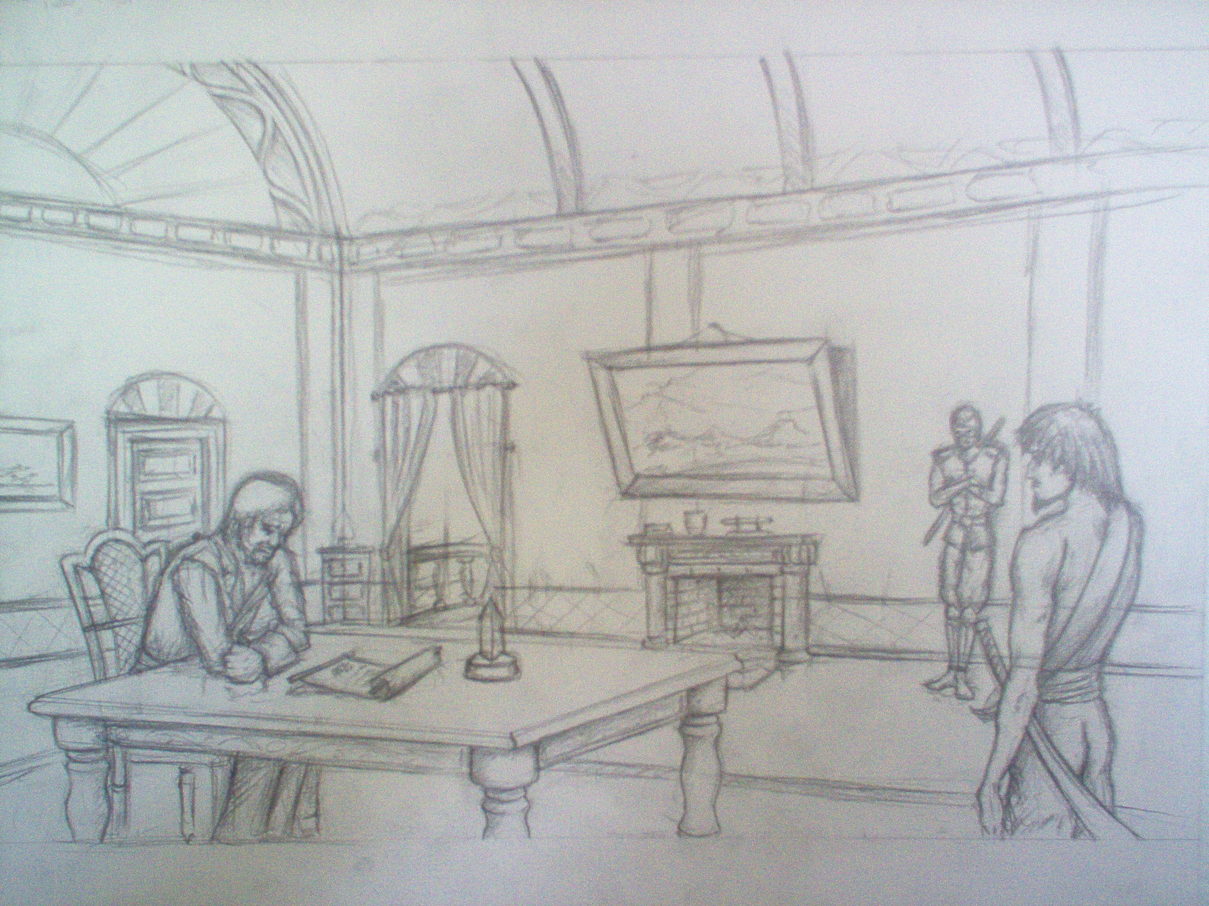
Initiation

Slide 11
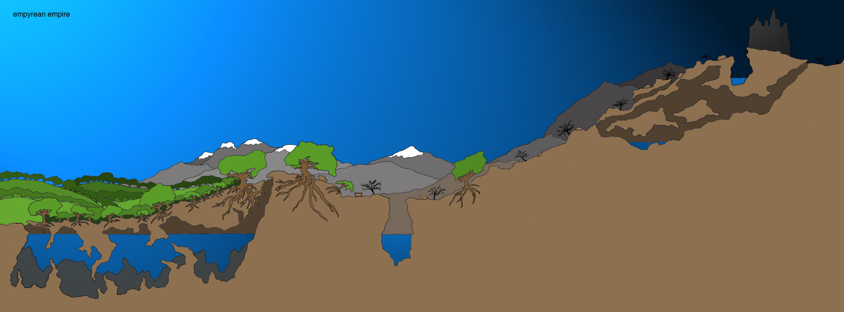
Initiation: stage 1

Slide 12
Initiation: stage 2

Slide 13
Game Design
All characters do not need to be on the same screen due to the network connectivity
Players will need to cooperate to succeed
Characters will unlock a variety of attacks and abilities as the game progresses
Persistent server will allow a player to store multiple characters and find others to play with
Side scrolling action/RPG

Slide 14
Game Engine Development
We have completed:
  Networking
  Collision, basic physics
  Basic attacking and jumping
  Server controlled monster behavior system
  Map loading from 3D geometry
  Joystick (controller) control
  Heads up display with vitality and ether
  Integrated combat system and equipment rules

Slide 15
Game Content Development
We have completed:
  Concept art for all characters
  Concept art for several monsters
  Models for Ronan and Akazen
  Models for Gargoyle and Cat monster
  First level color concept drawing
  Test terrain and map
  Cut scene sketches for story introduction

Slide 16
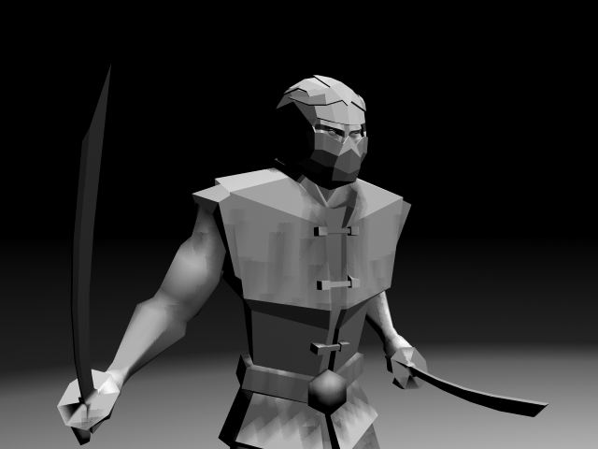
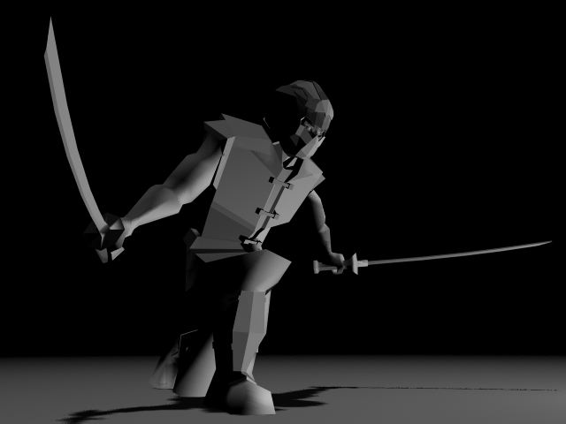
Character Models

Slide 17
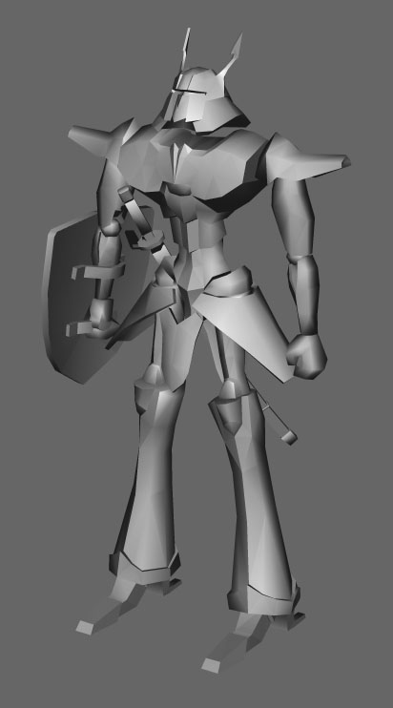
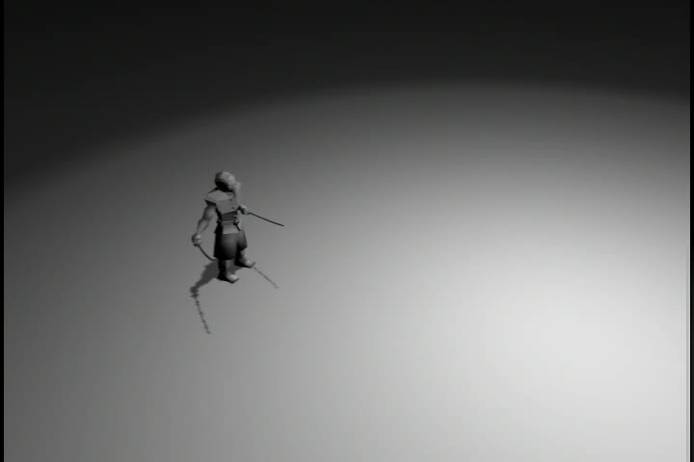
Character Models

Slide 18
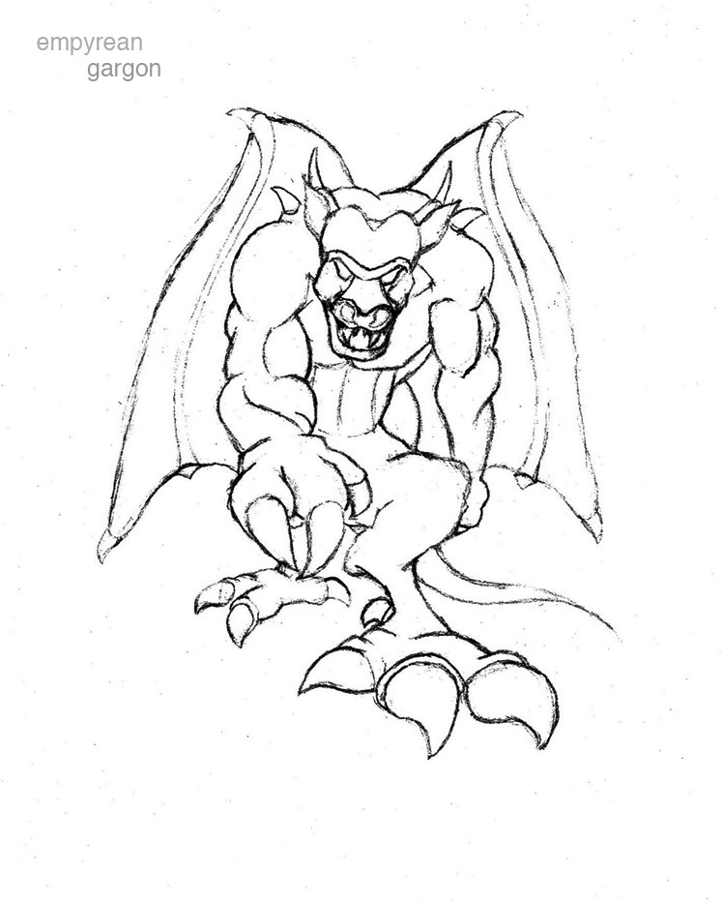
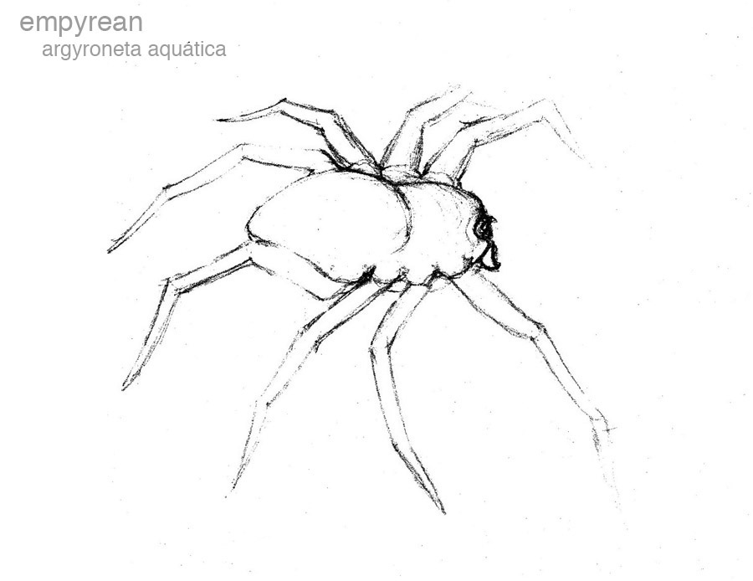
Monster Sketches

Slide 19
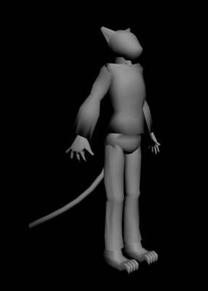
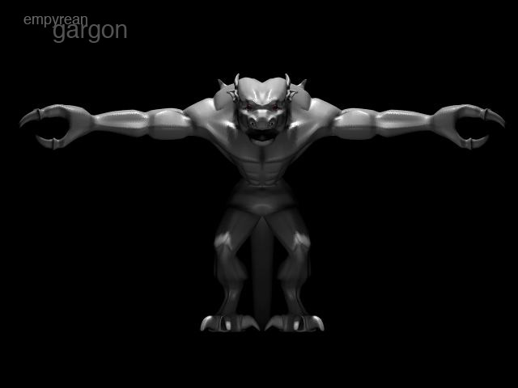
Monster Models

Slide 20
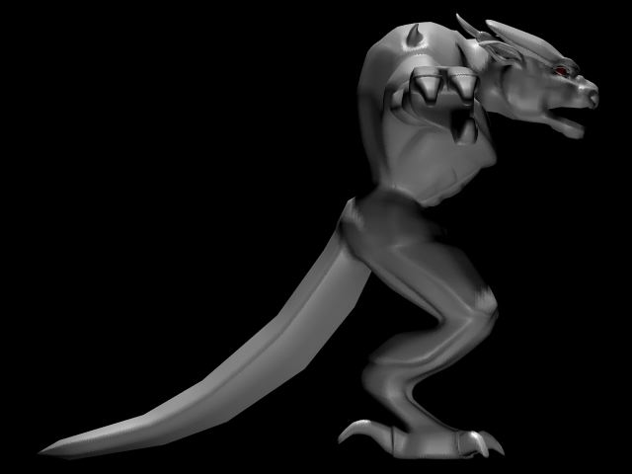
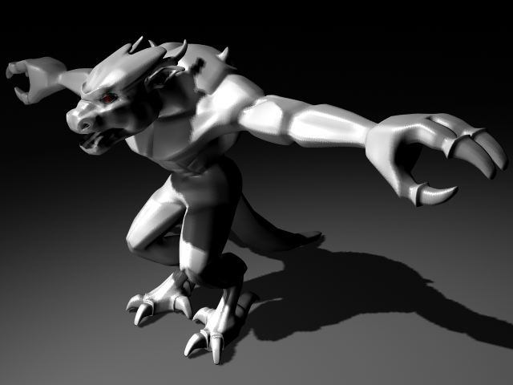
Monster Models

Slide 21
Future Work
Finish character models
Create 3D model of the first level terrain
Flesh out overall story
Create the necessary cut scenes
Implement all of the characters’ abilities and maneuvers
Create monsters that can attack, and then create ones that attack well

Slide 22
Future Work
Implement character saving on server
Connect in python scripting
Revamp the user interface
State sorting renderer
Improved physics
Add advanced lighting and graphics techniques

Slide 23
Needs
3 Modelers
Texture Artist
Sound Track and Sound Effects Lead
2D UI/HUD/etc Artist
Script / AI / Behavior Programmer
Engine Programmer

