Slide 1
Traffilyzer Traffic Incident Analysis Application
A Simple Web Application for Analyzing Traffic Incidents in Lithuania

Slide 2
Plan for the presentation
Introduction and technology stack
Architecture
Data analysis and data cleanup
Key features and known issues
Future improvements
Demo

Slide 3
Introduction
The purpose of this project is to create a simple, interactive application that analyses traffic incident data in Lithuania for the year 2023
It should give a good perspective on road safety for drivers
It should outline issues intoxicated drivers

Slide 4
Technology Stack
Backend:
Python + FastAPI Fast and efficient RESTful APIs to handle data aggregation and serve endpoints.
Frontend:
React + TypeScript + Vite React for dynamic, user-interactive UI with TypeScript for better developer experience, and Vite for fast builds and hot-reloading.

Slide 5
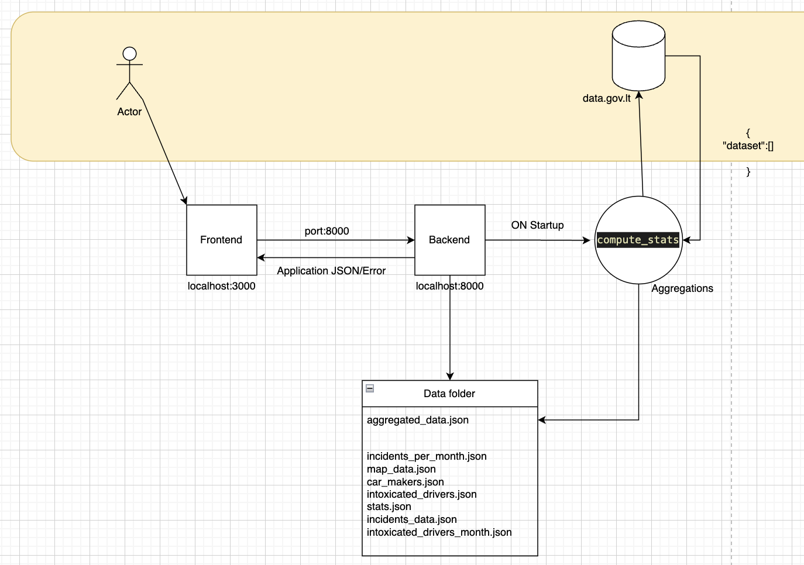
How it works: Architecture

Slide 6
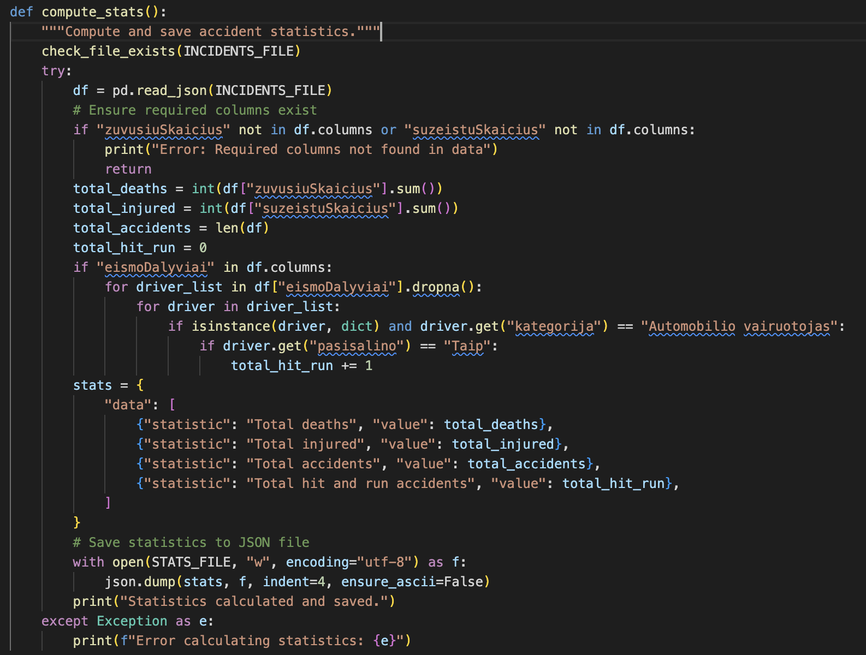
How it works details:

Slide 7
How it works: Data information
Application analyses data from Lithuanian Open Data source (https://data.gov.lt/datasets/509/#info )
Data is about car incidents where people had injuries or fatalities
Data is in Lithaunian and well structured,
Data contains a lot of capital cases, Lithuanian characters,spaces and abbreviations or acronyms which not always are clear

Slide 8
How it works: Data cleanup
Data is provided with coordinates in EPSG:3346
However, EPSG:4326 format is needed to display it on the map
Contained incidents from other years – removed from set
Dataset is huge and not all data is needed
Some coordinates for accidents are inaccurate but records were left to keep other statistics in place
Data is aggregate into EN language

Slide 9
Key Features
Interactive Data Visualizations Users can explore accident data with easy-to-read graphs and charts.
Accident Map The application provides a map interface with pins showing accident locations.
Real-Time Data Fetching The app fetches fresh data from the API each time it’s started.
Environment agnostic :
Application is set up to work with Docker and containers

Slide 10
Issues with the project
Slow Start-Up Data aggregation at the start is resource-intensive and takes a long time, especially when processing large datasets on a local machine.
No Persistence The app doesn't store the data in a database, which makes it slow on every start-up and leads to inefficient use of resources.

Slide 11
Future Improvements
Database Integration
Move Data to Database (PostgreSQL) Storing data in a database will reduce the need for frequent data downloading and aggregation.
Caching Mechanism
Implement Redis Caching results using Redis will significantly speed up the app by reducing the need to reaggregate data on every start.
User Interactivity
Allow User Input for Filtering Allow users to filter data by car types, accident severity, or time period.
Login System Add authentication to save user preferences and give personalized access to features.

Slide 12
Interactive Demo

