Slide 1
Is AI taking jobs —
643
job-cut announcements
or just taking the blame?
What 2026 layoff announcements and job postings actually show
146
rows checked by hand
3
independent data sources
Uğur Avşar · Softito Data Analytics capstone project · November 2026
Notes:
Hi, I'm Uğur. Every week we read headlines like 'Company X cuts thousands of jobs because of AI'. In this project I checked what is really behind those headlines: how often companies actually name AI as the reason, how that changed during 2026, and what happened on the hiring side at the same time. I used 643 announcements, checked 146 of them by hand, and compared three data sources.

Slide 2
Headlines say AI is cutting jobs. What does the data say?
What companies say
What the data shows
Layoff announcements that name AI as the reason — the story we read in the news.
How many cuts really cite AI, how that changed over the year, and what happened in hiring.
Five questions
Q1
Q2
Q3
Q4
Q5
Which industries cut the most?
Where is AI cited most?
How did it change over the year?
Are AI-attributed cuts bigger?
What happened in job postings?
2
Notes:
The project compares two things: what companies say, and what the data shows. I answer five simple questions: which industries cut the most jobs, where AI is named most often, how that changed over the year, whether AI-related cuts are bigger, and what happened in job postings. The first four are about layoffs, the last one is about hiring.

Slide 3
The short answer
1 in 6
40%
295
2×
people in announced job cuts were attributed to AI (16.9%)
of announcements cited AI at the May peak — only 3–6% from August
people in the median AI-attributed announcement — vs. 180 for others
share of US job postings mentioning AI in one year (3.6% → 7.2%)
In 2026, AI faded as a reason for job cuts while it showed up more and more in job postings. The two trends are shown side by side — this is not a cause-and-effect claim.
3
Notes:
Here is the answer up front. About one in six people in announced job cuts were linked to AI. AI as a reason peaked in May, when 40 percent of announcements mentioned it, and dropped to 3 to 6 percent from August. AI-related announcements are bigger: 295 people at the median versus 180. And on the hiring side, the share of US job postings that mention AI doubled in a year. Important: I show these two trends side by side; I do not claim one causes the other.

Slide 4
Three data sources, one question
1
2
3
layoffhedge.com
Indeed Hiring Lab
Challenger reports
643 job-cut announcements in 2026, worldwide
Job postings in 9 countries, 2019–2026
Monthly US job-cut reports, Jan–Oct 2026
Main data: who cut jobs, how many, and the stated reason
Hiring side: share of postings that mention AI
Independent check: does the AI trend look the same?
How: Python (pandas) to clean and check the data → PostgreSQL to model and query it → Power BI to visualise it. No machine learning — just careful counting.
Sources: layoffhedge.com (2026-11-08) · Indeed Hiring Lab AI Tracker (CC BY 4.0) · Challenger, Gray & Christmas monthly reports
4
Notes:
I used three sources. The main one is layoffhedge.com: a list of 2026 job-cut announcements with the company, the number of people and the reason. For the hiring side I used Indeed, which measures how many job postings mention AI. And to check my results independently I used Challenger, a US firm that publishes monthly job-cut reports. The tools were Python, PostgreSQL and Power BI.

Slide 5
Before trusting the data, I checked it
1
Automatic checks on all 653 rows
4
announcements from earlier years removed (e.g. Intel 2024)
blanks, duplicates, impossible values, dates without a year
2
146 rows compared with news articles
2
wrong numbers corrected (e.g. Verizon 3,000 → 500)
every large row, every AI row, and a random sample
3
Robustness test
72%
of all people in the data checked by hand
results recomputed using only the verified rows — they stay the same
No row was deleted: every problem is flagged in a column, so every number can be recomputed.
5
Notes:
The main source is not well known, so I did not trust it blindly. First, automatic checks on all rows. Then I compared 146 rows with news articles: every large announcement, every AI-related one, and a random sample of small ones. I found four announcements from earlier years, for example an Intel plan from 2024, and two wrong numbers, which I corrected. In total 72 percent of all people in the data were checked by hand. Finally I re-ran everything with only the verified rows, and the results did not change.

Slide 6
Not every “AI layoff” is really about AI
The source labels some cuts “AI-driven”. Checking the news showed two problems:
UPS — 30,000
Main reason: less work from Amazon, not AI
Oracle — “up to 30,000”
A maximum, not a final number
Share of people in announced job cuts attributed to AI
Strict definition (headline): AI is cited, the label is not questionable, the number is not “up to …”.
Broad definition (upper bound only): every AI label.
6
Notes:
The source labels some cuts as AI-driven, but that label is not always right. For UPS, the main reason was less business from Amazon. For Oracle, the number is 'up to 30,000', a maximum. So I use two definitions. The strict one, which I use as my headline, gives 16.9 percent. The broad one, with every AI label, gives 38.4 percent, but that number is inflated by a few giant plans, so I only report it as an upper bound.

Slide 7
Q1
Three industries make up two thirds of the cuts
66%
of all people in announced cuts are in these three industries
Automotive is driven by a few giant plans — Volkswagen alone announced 100,000 cuts.
Source: layoffhedge.com, main analysis (643 announcements, 653,456 people). Top 8 of 13 industries shown.
7
Notes:
First question: which industries announced the most cuts? Automotive and transportation, tech, and finance and banking together make up about two thirds of all people in announced cuts. Automotive is high because of a few giant plans: Volkswagen alone announced 100,000 cuts. The ranking stays the same when I use only verified rows.

Slide 8
Q2
Fintech, finance and tech cite AI the most
How to read it
Each bar is the share of that industry's announced cuts (in people) attributed to AI, strict definition.
Industries with fewer than 10 announcements are left out — one announcement would decide their share.
Source: layoffhedge.com, strict AI definition; industries with 10+ announcements.
8
Notes:
Second question: where is AI named most often? Among industries with enough announcements, crypto and fintech, finance and banking, and tech attribute the largest share of their cuts to AI. Health care, consumer goods and education never name AI. Automotive almost never: the big UPS cut had another main reason. I left out industries with fewer than 10 announcements, because there one single announcement decides the number.

Slide 9
Q3
AI was cited often until July — rarely after
Peak in May
40% of announcements cited AI; from August only 3–6%.
Two sources agree
An independent US source moves the same way (correlation 0.72).
Sources: layoffhedge.com (share of announcements citing AI, strict); Challenger, Gray & Christmas. Jan–Oct 2026.
9
Notes:
Third question: how did it change over the year? The blue line is the share of announcements that cite AI. It peaks in May at 40 percent and drops to 3 to 6 percent from August. The grey line is Challenger, an independent US source, and it shows the same pattern, with a correlation of 0.72. Two separate sources telling the same story makes me more confident. With only ten months, I treat it as confirmation of the direction, not as proof.

Slide 10
Why I count announcements, not people
October 2026 shows why:
50.5%
5.3%
of people in October's cuts were linked to AI — almost all from one plan: the Dutch Government's 25,000 jobs, spread until 2035
of October's announcements cited AI — the real picture for that month
One giant plan can flip a whole month. Counting announcements shows how many companies name AI, and it is the measure that matches the independent US data.
10
Notes:
A quick note on method. If I measure by people, one huge plan can flip a whole month. In October, 50 percent of people in announced cuts were linked to AI, but almost all of that is one plan: the Dutch Government's 25,000 jobs, spread until 2035. Counted by announcements, only about 5 percent of October's announcements cited AI. So for the trend I count announcements; that is also the measure that matches the independent US data.

Slide 11
Q4
AI-attributed announcements are bigger
Not a coincidence
The difference (115 people) is very unlikely to be chance: 95% range 50–421, Mann-Whitney test p < 0.001.
But not bigger companies
Companies citing AI are actually smaller (median 4,438 vs 10,000 employees). An earlier claim of mine did not survive testing, so I dropped it.
Median people per announcement
Source: layoffhedge.com, main analysis. Medians are used because a few giant announcements distort averages.
11
Notes:
Fourth question: are AI-related cuts bigger? Yes. The typical AI-related announcement covers 295 people, versus 180 for others, and statistical tests say this difference is very unlikely to be chance. But careful: it does not mean big companies are the ones blaming AI. Companies citing AI are actually smaller. I had claimed the opposite earlier in the project; my robustness test showed it was wrong, so I removed it.

Slide 12
Q5
Job postings mentioning AI doubled in a year
United States
3.6% → 7.2%
Sep 2025 → Sep 2026
United Kingdom
4.9% → 9.8%
All 8 comparable countries rose
Source: Indeed Hiring Lab AI Tracker (CC BY 4.0). “Mentions AI” is not the same as demand for AI skills.
12
Notes:
Fifth question, the hiring side. The share of job postings that mention AI doubled in a year: in the US from 3.6 to 7.2 percent, in the UK from 4.9 to 9.8 percent. It rose in all eight countries I could compare. One caution: a posting 'mentioning AI' is not the same as demand for AI skills; for example, some postings just say 'we use AI in hiring'. I left Canada out, because a new Ontario law forces that sentence into postings.

Slide 13
AI faded in layoffs but grew in job postings
Layoff side: share of job-cut announcements citing AI
Hiring side: share of US job postings mentioning AI
Two trends side by side, January–September 2026 — not cause and effect.
13
Notes:
This slide puts both sides together. On the left, AI as a reason for job cuts fades after the summer. On the right, the share of job postings that mention AI keeps rising every month. I show them side by side on purpose, as two separate charts. I do not say one causes the other; the sources also cover different places, worldwide versus the US.

Slide 14
What this suggests for people looking for a job
AI looks less like a layoff threat and more like a requirement in job postings.
1
2
3
Read headlines critically
Build AI literacy
Treat this as a hint, not proof
“The company says AI” is not the same as “AI caused it”.
More and more postings mention AI — knowing how to work with it helps.
The data has no seniority level, so junior roles were not measured separately.
Interpretation, not a tested finding.
14
Notes:
What does this mean for someone looking for a job, for example a junior candidate like me? My interpretation is that AI currently looks less like a layoff threat and more like a requirement in job postings. So read layoff headlines critically, and build basic AI literacy. But I want to be honest: none of my data shows seniority, so this is an interpretation, not something I tested for junior roles specifically.

Slide 15
What this analysis cannot tell us
Only announced cuts
Stated reasons, not causes
Small companies and unreported cuts are missing.
We see what companies say, not what really happened.
Different scopes
“Mentions AI” ≠ skill demand
Layoffs: worldwide · postings: 9 countries, no Turkey · Challenger: US only.
Postings can mention AI for other reasons.
Short time series
No seniority data
10 months; November 2026 is incomplete.
Junior roles cannot be measured separately.
15
Notes:
Every analysis has limits, and I want to name mine. I only see announced cuts. I see the reasons companies state, not the real causes. My sources cover different places. A posting that mentions AI is not always asking for AI skills. The time series is short. And there is no seniority information. This is why I talk about directions and patterns, not about causes.

Slide 16
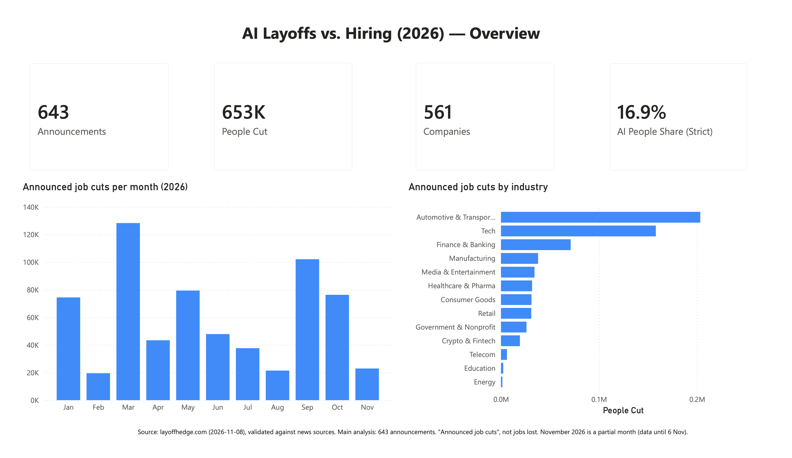
How it was built
Python
PostgreSQL
Power BI
Cleaning, 146 manual checks, statistical tests
→
Star schema; 41 checks — SQL = Python
→
4-page interactive dashboard
Power BI dashboard — page 1 of 4
Thank you — questions?
github.com/Uguravsar75/ai-layoffs-vs-hiring-2026
Notes:
Finally, how I built it. Python for cleaning, the manual checks and the statistics. PostgreSQL for a proper data model, with 41 automatic checks that the SQL results match Python exactly. And Power BI for a four-page dashboard. Everything, including the code and the verification log, is on GitHub. Thank you, I'm happy to take questions.

