Slide 1
---------------------------------------------------------------------------------------------------------------------------
Retail Sales Performance Dashboard
Business Intelligence Portfolio Project
Dennis Chinonso Ugwuonu
SQL • Excel • Power BI • GitHub
July 2026
-------------------------------------------------------------------------------------------------------------------------------

Slide 2
Business Problem
Business Challenge
Sales data is collected across products, customers, states, and payment methods.
The data exists in raw form and is difficult to analyze.
Management lacks a centralized view of business performance.
This limits timely, data-driven decision-making.
Project Objective
Build an interactive Business Intelligence dashboard.
Transform raw sales data into meaningful insights.
Monitor KPIs and sales performance.
Support faster, evidence-based business decisions.
Key Business Questions
Which products and categories generate the highest sales and profit?
Which states contribute the most to total revenue?
How do monthly sales and profits change over time?
Who are the company's top-performing customers?
Which product categories require improvement in profitability?

Slide 3
Dataset & Tools Used Project Resources and Tech Stack
Dataset
Madhav E-Commerce Sales Dataset
Contains orders, customers, products, payment methods, profit, sales, and geographic data.
Data was cleaned and transformed before analysis.
Used for dashboard development and KPI reporting.
Tools Used
SQL (DuckDB) – Data querying and analysis
Microsoft Excel – Data cleaning and KPI analysis
Power BI – Dashboard development and visualization
GitHub – Documentation and portfolio management

Slide 4
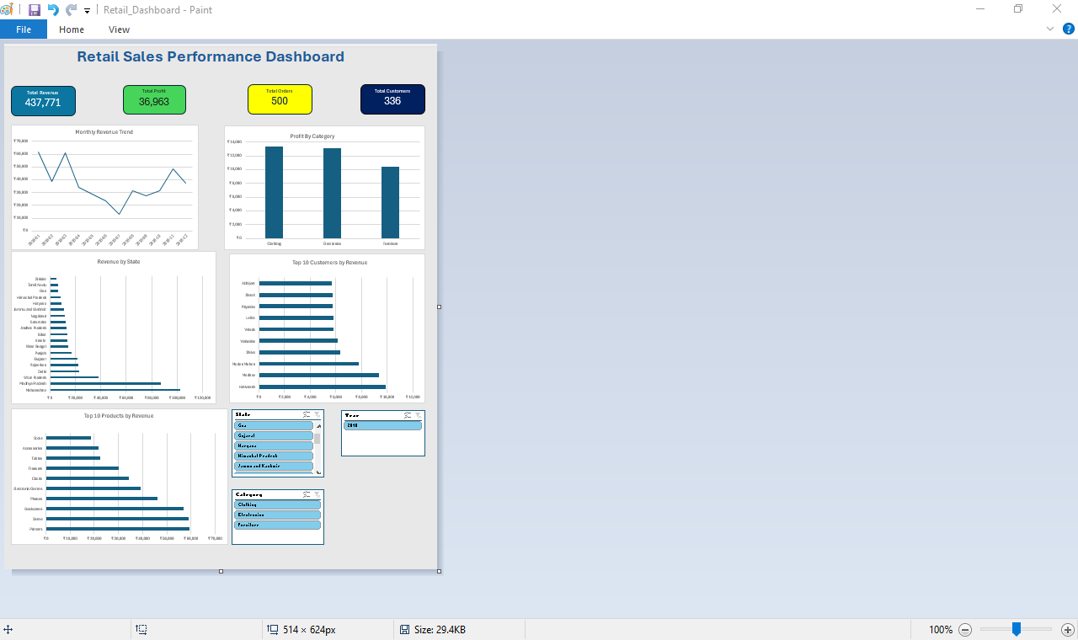
Dashboard Overview Interactive Excel dashboard developed to monitor retail sales performance through key business metrics and visual analytics.
Dashboard Features
✓ KPI Summary Cards
✓ Monthly Revenue Trend
✓ Profit by Category
✓ Sales by State
✓ Top Customers
✓ Top Products
✓ Interactive Slicers (State, Category, Year)

Slide 5
Key Insights
📈 Sales Performance
• Tracks KPIs and monthly sales trends.
• Highlights regional performance.
• Supports growth planning.
👥 Customer Insights
• Identifies top customers.
• Reveals purchasing patterns.
• Improves retention strategies.
📦 Product & Category Insights
• Highlights top-selling products.
• Compares profitability.
• Supports pricing decisions.
🌍 Regional Performance
• Compares state performance.
• Identifies growth opportunities.
• Supports resource allocation.
These insights support data-driven business decisions and strategic planning.

Slide 6
Business Recommendations
📈 Increase Investment
• Focus on top-selling products.
• Optimize inventory.
• Increase marketing.
👥 Customer Retention
• Reward loyal customers.
• Personalize promotions.
• Encourage repeat purchases.
🌍 Regional Performance
• Improve low-performing regions.
• Launch targeted campaigns.
• Optimize distribution.
📊 Data-Driven Decisions
• Monitor KPIs.
• Review dashboard regularly.
• Support strategic planning.
These recommendations help maximize profitability, improve customer loyalty, and support sustainable business growth.

Slide 7
Lessons Learned
Technical Skills Gained
Improved SQL skills for business analysis.
Strengthened Microsoft Excel skills for data cleaning and KPI reporting.
Built Pivot Tables and Pivot Charts.
Developed dashboard design and data visualization skills.
Improved GitHub documentation and presentation skills.
Challenges Overcome
Combined multiple tables into one analysis dataset.
Resolved data formatting and cleaning issues.
Completed the BI dashboard despite Power BI installation challenges.
Strengthened problem-solving through practical project work.
Future Improvements
Develop an interactive Power BI dashboard.
Analyze larger and more diverse datasets.
Add forecasting and advanced KPIs.
Automate dashboard refresh and reporting.

Slide 8
Thank You! Questions & Discussions
Presented by
Dennis Chinonso Ugwuonu
Business Intelligence Portfolio Project
GitHub Portfolio
----------------------------------------------------------------------------------------------------------------------------------------------
Thank you for your time and consideration.

Slide 9
Thank You! Questions & Discussion
Dennis Chinonso Ugwuonu
Retail Sales Performance Dashboard Business Intelligence Portfolio Project
GitHub: GitHub Portfolio
Email: dennis.ugwuonu@gmail.com
Thank you for your time and attention.

