Slide 1

CRM for Education Industry
In today's world, Customer Relationship Management (CRM) is not only for businesses, but also for the education industry. CRM can help institutions effectively manage their student and alumni relationships.
M.BINDU SWARNA SAI
21L65A0424

Slide 2
Overview of CRM
Definition
Importance
Components
CRM is a software that helps organizations manage their interactions with customers, including students, staff, parents, and alumni.
CRM can help improve communication, streamline operations, and increase efficiency in the education industry.
CRM consists of contact management, sales management, marketing automation, and analytics features.

Slide 3
Importance of CRM in Education
Recruitment
CRM can help institutions find prospective students, track leads, and personalize communication to increase enrollment.
1
2
3
Student Retention
Alumni Relations
CRM enables institutions to monitor student engagement and support them throughout their academic journey.
CRM can help institutions keep track of alumni engagement and communication, and encourage giving back to the institution.

Slide 4
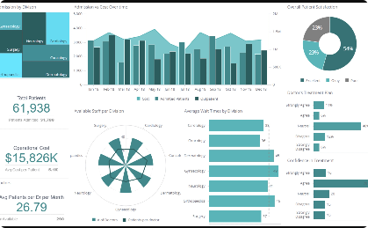



Key Features of a CRM for Education Industry
Dashboard
Email & SMS Marketing
Lead Tracking
Event Management
Real-time data and visualization of student engagement and institutional performance.
Automated and personalized messaging to reach students, staff, and alumni.
Track prospective students and their communication history with the institution.
Coordinate events such as recruiting fairs, open houses, and alumni gatherings.

Slide 5

Benefits of Using CRM in Education
1
Predictive Analytics 📈
2
Personalization 🤝
3
Collaboration 🤝
CRM can analyze institutional data to predict student behavior, such as the likelihood to drop out or succeed academically.
CRM can personalize communication with students, staff, and alumni to increase engagement and improve overall satisfaction.
CRM can help different departments in an institution work together effectively, by sharing data and communication history.

Slide 6
Implementing a CRM in Education
1
Assessment & Planning
Identify goals, stakeholders, and resources needed to implement a CRM in an institution.
Vendor Selection & Integration
2
Select a CRM vendor that fits the institution's needs, and integrate the CRM with existing systems.
3
Training & Adoption
Train staff and faculty on using the CRM, and encourage adoption through incentives and support.

Slide 7
Challenges in Implementing CRM for Education Industry
Data Management
Resistance to Change
Integration with Legacy Systems
Managing large amounts of student data can be complex and time-consuming, and requires clear policies and procedures.
Faculty and staff may be resistant to adopting new technologies, and require strong leadership and training to overcome this challenge.
Integrating a CRM with existing systems, such as registration and financial aid, can be a challenging and costly task.

Slide 8

Conclusion and Future Directions
CRM is an important tool for institutions in the education industry to improve communication, streamline operations, and increase efficiency. However, successful implementation requires careful planning, training, and collaboration. In the future, CRM is likely to become even more important as institutions focus on higher levels of personalization and data-driven decision making for improved student outcomes.

