Slide 1
CRM OF EDUCATION INDUSTRY
Neelapu Uhasri
Mudivinchi Krishnaveni
Mummina Binduswarnasai
Seshapu Anil Kumar

Slide 2
INTRODUCTION
Customer relationship management (CRM) is the combination of practices, strategies and technologies that companies use to manage and analyze customer interactions and data throughout the customer lifecycle. The goal is to improve customer service relationships and assist in customer retention and drive sales growth. CRM systems compile customer data across different channels, or points of contact, between the customer and the company, which could include the company's website, telephone, live chat, direct mail, marketing materials and social networks. CRM systems can also give customer-facing staff members detailed information on customers' personal information, purchase history, buying preferences and concerns.

Slide 3
Components of CRM
Marketing automation:CRM tools with marketing automation capabilities can automate repetitive tasks to enhance marketing efforts at different points in the lifecycle for lead generation. For example, as sales prospects come into the system, it might automatically send email marketing content, with the goal of turning a sales lead into a full-fledged customer.
Sales force automation: sales force automation tools track customer interactions and automate certain business functions of the sales cycle that are necessary to follow leads, obtain new customers and build customer loyalty.

Slide 4
COMPONENTS
Contact center automation: Designed to reduce tedious aspects of a contact center agent's job, contact center automation might include prerecorded audio that assists in customer problem-solving and information dissemination. Various software tools that integrate with the agent's desktop tools can handle customer requests in order to cut down on the length of calls and to simplify customer service processes. Automated contact center tools, such as chatbots, can improve customer user experiences.
Geolocation technology, or location-based services: Some CRM systems include technology that can create geographic marketing campaigns based on customers' physical locations, sometimes integrating with popular location-based GPS (global positioning system) apps. Geolocation technology can also be used as a networking or contact management tool in order to find sales prospects based on a location.

Slide 5
COMPONENTS
Workflow automation: CRM systems help businesses optimize processes by streamlining mundane workloads, enabling employees to focus on creative and more high-level tasks.
Lead management: Sales leads can be tracked through CRM, enabling sales teams to input, track and analyze data for leads in one place.
Human resource management: CRM systems help track employee information, such as contact information, performance reviews and benefits within a company. This enables the HR department to more effectively manage the internal workforce.

Slide 6
COMPONENTS
Analytics: Analytics in CRM help create better customer satisfaction rates by analyzing user data and helping create targeted marketing campaigns.
Artificial intelligence: AI technologies, such as salesforce Einstein , have been built into CRM platforms to automate repetitive tasks, identify customer-buying patterns to predict future customer behaviors and more.
Project management. Some CRM systems include features to help users keep track of client project details such as objectives, strategic alignment, processes, risk management and progress.
Integration with other software. Many CRM systems can integrate with other software, such as call center and enterprise resource planning (ERP) systems.

Slide 7
Types of CRM technology
Cloud-based CRM: With CRM that uses cloud computing, also known as SaaS (software as a service) or on-demand CRM, data is stored on an external, remote network that employees can access anytime, anywhere there is an internet connection, sometimes with a third-party service provider overseeing installation and maintenance. The cloud's quick, relatively easy deployment capabilities appeal to companies with limited technological expertise or resources.

Slide 8
TYPES
On-premises CRM: This system puts the onus of administration, control, security and maintenance of the database and information on the company using the CRM software. With this approach, the company purchases licenses upfront, instead of buying yearly subscriptions from a cloud CRM provider. The software resides on the company's own servers and the user assumes the cost of any upgrades. It also usually requires a prolonged installation process to fully integrate a company's data. Companies with complex CRM needs might benefit from an on-premises deployment.

Slide 9
TYPES
Open source CRM: An open source CRM system makes source code available to the public, enabling companies to make alterations at no cost to the company employing the system. Open source CRM systems also enable the addition and customization of data links on social media channels, assisting companies looking to improve social CRM practices.
Open Source CRM platforms such as OroCRM, Bitrix24, SuiteCRM and SugarCRM offer alternatives to the proprietary platforms from Salesforce, Microsoft and other vendors.
Adoption of any of these CRM deployment methods depends on a company's business needs, resources and goals, as each has different costs associated with it.

Slide 10
CRM examples in practice
Contact center: Traditionally, data intake practices for CRM systems have been the responsibility of sales and marketing departments, as well as contact center agents. Sales and marketing teams procure leads and update the system with information throughout the customer lifecycle, and contact centers gather data and revise customer history records through service calls and technical support interactions.

Slide 11
EXAMPLES
Social CRM: Social media in CRM involves businesses engaging with customers directly through social media platforms, such as Facebook, Twitter and LinkedIn. Social media presents an open forum for customers to share experiences with a brand, whether they are airing grievances or promoting products.

Slide 12
EXAMPLES
Mobile CRM:CRM applications built for smartphones and tablets have become a must-have for sales representatives and marketing professionals who want to access customer information and perform tasks when they are not physically in their offices. Mobile CRM apps take advantage of features that are unique to mobile devices, such as GPS and voice recognition capabilities, to give sales and marketing employees access to customer information from anywhere.

Slide 13
EXAMPLES
Business-to-business (B2B) practices: A CRM system in a B2B environment helps monitor sales as they move through the sales funnel, enabling a business to address any issues that might come up during the process. CRM systems in the B2B market help create more visibility into leads and, therefore, increase efficiency throughout the sales process.

Slide 14
CRM for education industry
customer relationship management. CRM higher education technology enables institutions to manage relationships with all of their customers (including students, alumni, faculty, staff, and corporate partners) and connect insights from those interactions in a unified view.

Slide 15
CRM FOR HIGHER EDUCATION IMPORTANCE
CRM higher education technology enables institutions to manage relationships with all of their customers (including students, alumni, faculty, staff, and corporate partners) and connect insights from those interactions in a unified view.

Slide 16
CRM Important
Quickly support new business models and personalized experiences without the pain of updating legacy systems: with CRM, faculty and staff can collaborate from anywhere and track critical metrics such as retention, enrollment, and engagement rates across a variety of channels.
Connect insights across recruitment & admissions, student experience, advancement, and marketing for a 360-degree view of every constituent: Unlike individual point solutions, which only address a single-use case or challenge, an integrated CRM platform eliminates the pain of having disparate data spread across a variety of systems.

Slide 17
More time for faculty and staff to do what they do best – ensuring students have the support and resources they need to thrive: With CRM for higher education, institutions can provide more tailored outreach to prospective students, automate self-service, and increase alumni engagement and fundraising efforts and spend less time spent searching for data across multiple point solutions means.
With an integrated platform for the entire education journey, institutions of all sizes can use CRM to create engaged learner relationships for life.

Slide 18
Benefits of CRM for Higher Education
Institutions can benefit from CRM higher education technology in a variety of ways:
A unified view of constituent information
$2.4 million in total legacy cost savings
An improved student experience
Empowered faculty and staff
The flexibility needed to pivot quickly
Let’s take a look at each one in detail

Slide 19
CRM Lowers Total Cost of Ownership
Using an integrated platform instead of multiple point solutions not only simplifies data complexity for higher education institutions; it also saves money.
In fact, CRM higher education technology averages $2.4 million in total legacy cost savings, according to a Forrester Total Impact Study. The study found that higher education institutions using Salesforceare driving 195% in ROI over three years, with a 7-month payback period. They’re also seeing significant increases in revenue and cost savings.
This is because institutions eliminate the expenses associated with more training, the adoption of outdated processes, and the time spent updating legacy systems when using multiple point solutions to manage the student journey.
CRM evolves as an institution does: It’s a flexible, integrated platform.

Slide 20
CRM Improves the Student Experience.
CRM enables higher education institutions to stay ahead of student needs with tools such as proactive alerts and conversational chat bots. According to Forrester, students are more likely to enroll in a college, and stay there, when a single platform is used to provide more effective communications, remove barriers to information, and streamline support services.
Central New Mexico Community College was looking for a single, consolidated view of all of the customers they serve —from students, alumni, parents and donors to employers that hire students. CRM for higher education provided the ideal solution to create a 360-degree view of every engagement, in one place.
“In our old system, when I needed data about our department, I had to go to our institutional research office and ask them to run a report, and it might take a couple of weeks to get the data back,” said Ann Lyn Hall, Executive Director of CNM Connect Services. “Now, I have access to data and reports myself – I don’t need someone else to help me run those numbers, which is a big time saver.”

Slide 21
BENEFITS OF USING A CRM FOR EDUCATION
Personalized outreach:Tracking student interactions with your website, social media, or other online platforms enables you to deliver the right information to them at the right time. For example, suppose current or potential students express interest in specific courses or majors. A CRM like monday sales CRM simplifies direct communication with departments, creating personalized content for outreach and providing the course-relevant information they seek.

Slide 22
Fast responses:When a prospective student sends a message via the college website contact page or on social media, the CRM platform makes it easy for staff members to respond immediately. For example, monday sales CRM enables 72+ integrations with email software, live chatbots and other essential tools making it easy to automate messages, and set up reminders, all of which help recruiters stay in touch with interested applicants.
Streamlined admissions process:Your CRM platform will improve the admission process, reducing the need for paperwork, spreadsheets, and extra staff to sort through traditional applications. Individuals complete their applications on the platform and upload the required documents, resulting in a positive user experience. At the back end of your CRM, store all documents in a central location for staff to access and update applicants.

Slide 23
Improved donor engagement:A CRM manages your relationships with donors, alumni, and other stakeholders. By tracking donations and pledges, you can ensure you’ll always acknowledge and promptly thank your donors. Managing donor information also allows you to track fundraising goals and progress so you can produce reports that will help you secure more funding. With monday sales CRM, you can easily store contact details for each donor, integrate with your preferred email and meeting software, and set up templates to streamline communication with your audience.
Enhanced student lifecycle experience:CRM software provides benefits throughout the entire student journey — from the first class through graduation, career planning, and placement. Monitor data such as contact information, demographics, and academic progress to identify at-risk students and intervene before they drop out.Engaging with former students also builds the donor base so you can invite those with undergraduate degrees back to graduate school or university-sponsored events. Maintaining contact with former students may also boost recruitment by encouraging them to reach out to prospective college applicants in their areas.

Slide 24
Greater understanding of pain points:
An integrated CRM platform delivers a complete overview of the educational organization by combining data from admissions, student experience, advancement, and marketing.
Rather than focusing on individual pain points, your CRM will import data from multiple integrated systems to improve your understanding of your entire operations.

Slide 25
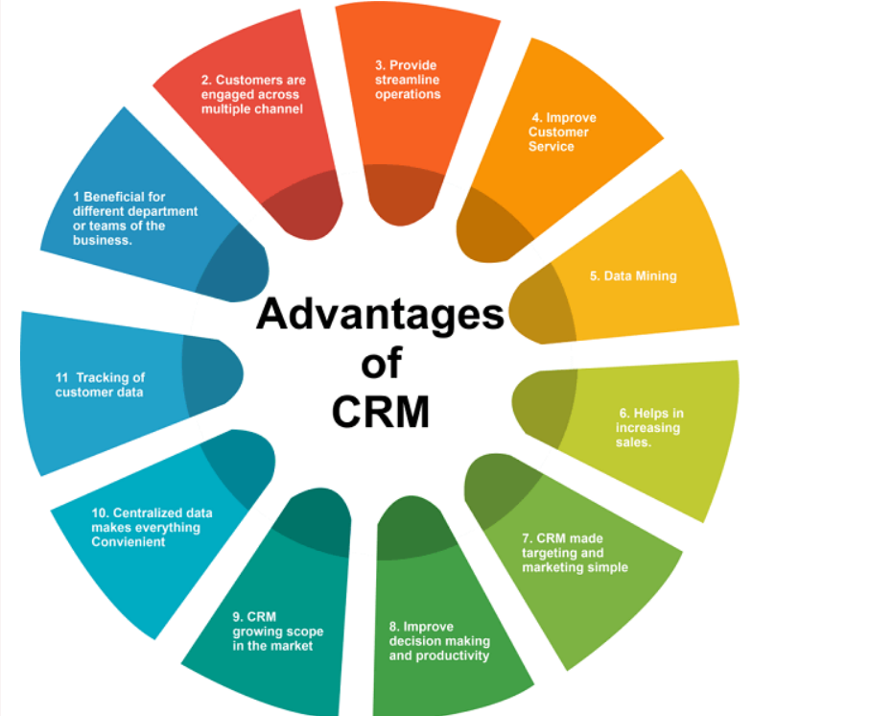
Advantages of crm

Slide 26
1. Beneficial for the different departments or teams of the business:
Customer relationship management automation systems can benefit small and large businesses and their teams, such as marketing, sales, customer service, field service, and project service automation teams in different aspects. Together they raise the business's growth chart by increasing the product's productivity. With this, CRM is capable of improving and simplifying complex customer engagement.

Slide 27
2. Customers are engaged across multiple channel:
There are various advantages of using a CRM system for a business as it provides the best possible customer service by improving customer service, customer retention, tracking customer data, streamlining operations, reducing costs, and taking the business to the next level. The CRM can engage the user with its customer across multiple channels like email, social media, live chat, and phone. You can connect with your customer on any platform and track customer interaction in one place, which helps get a complete picture of each customer.

Slide 28
3. Provide streamline operations:
A properly implemented CRM in business provides streamlined operations by automating tasks such as order fulfillment, customer contact management, and lead tracking. Streamlining the functioning of CRM operations helps focus on more strategic activities for the business and saves money and time.
4. Improve customer service:
Customer relationship service is designed to interact with customers and store their data in one place. It helps in maintaining good customer relationships and gives customer satisfaction. With the help of CRM, the customer service team can listen to customers' problems and resolve them quickly and efficiently. With this, teams can contact every customer to offer assistance before problems arise.

Slide 29
5. Data mining:
CRM (customer relationship management) software stores customer data in one place and allows people to discover progress areas, creating a real-time business environment where the user can make instant changes. With this, we can analyze the CRM or business performance.
6. Helps in increasing sales:
As with CRM, the customer service team can reach every customer that increases the sale of every business and track the progress of each sale opportunity. This information will be used to tweak the sales process and apply ways to increase the chances of sales. It is a lead management tool with which we can keep an eye on what works well or is not.

Slide 30
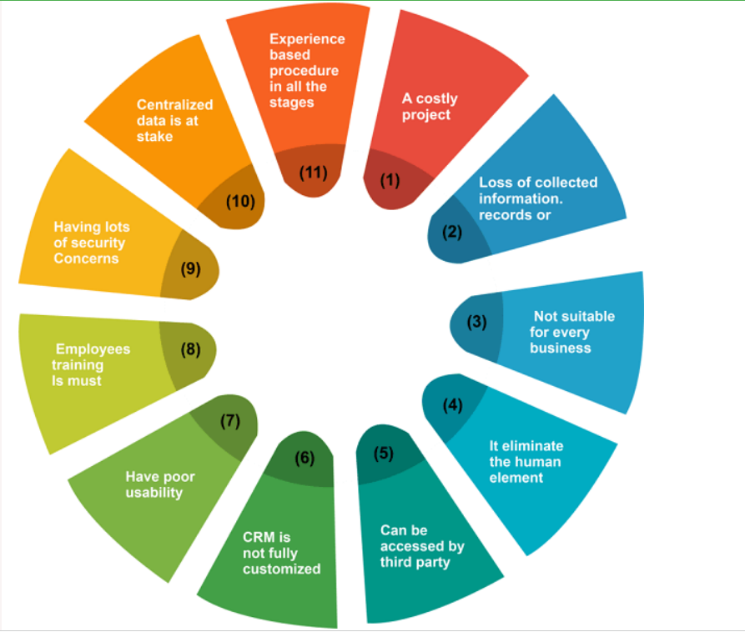
Disadvantage of crm

Slide 31
1. A costly project:
CRM software tool is an expensive investment that some businesses can only afford, and if they do invest, it doesn't guarantee the return on investment is worth it. It is a huge investment that factors like data mitigation, integration cost, training, and support also affect.
2. Loss of collected information or records:
CRM (customer relationship management) tools can be responsible for losing the customer's information as some CRM software keeps track of customers' information using remote internet connections. Due to this, sometimes organization needs to have control over the customer's information (detailed), especially when a system failure event happens. An unstable CRM can result in the loss of money in revenue for the company in the future.

Slide 32
3. Not suitable for every business:
Every business can't afford CRM for data collection and connecting with customers. Some businesses can't correct to the customers directly therefore, they don't need a CRM tool. Forming CRM to make it function properly company or business has to spend a lot of money, including various phases.
4. It eliminates the human element:
CRM is a fully automated tool that has prevented human intervention. It automatically collects all the data and processes it. CRM efficiently manages the relationship between the company and customers as it directly interacts between people and its staff. Customers can shift anywhere due to the loss of human touch, reducing sales and revenue.

Slide 33
5. Can be accessed by the third party:
As we know, CRM collects customers' sensitive information and stores it, which other parties can misuse. For example, web hosting companies take and sell collected data to a third party that misuses the data and causes loss to people.
6. CRM is not fully customized:
A business can only customize a CRM system and make CRM fit their specific needs and requirements. It can create problems for CRM users; they get frustrated and need help to make the system work according to their requirements.

Slide 34
CONCLUSION
CRM for higher education plays an important role in the automation of the institute's communication and processes. It helps them to connect with the interested and talented students who are seeking courses and programs based on their interests, affordability, and other parameters
Business is an ongoing process that has to update itself with time (adopt new technologies) to remain in the competition. Before technology, customer data or CRM was based on papers, but slowly, companies started tracking customer-related data with spreadsheets, emails, address books, and other ways.

Slide 35
CRM is a powerful tool that automatically collects information about existing and prospective customers (their personal or professional information, including social media posts, phone numbers, email addresses, phone numbers, service, purchase history, and support tickets). Further, the whole information is integrated by the system and generates consolidated profiles that can be shared with appropriate teams. One of the best features of CRM is that it can connect with other business tools, such as document-sharing apps and online chat.

Slide 36
THANK YOU

