Slide 1
Java. Automation Build.
Maven for ATQC
IT Academy
08/14/2014

Slide 2
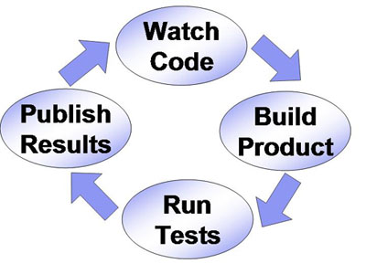
Agenda
Practices of Continuous Integration
Departure Point. Maven's Objectives
Quick Start. Example
Maven Lifecycle
Dependency Management
Selenium Tests
Plug-ins
IDE Integration
Maven Profiles
Properties Settings

Slide 3

Agenda
Communication with Java Сode
SureFire Plug-in
Reports of Tests
Failsafe Plug-in
Reports of Integration Tests
Running Tests in Parallel
JUnit4. Test Management
Memory Management
Pre- and Post-Integration Phase

Slide 4
Continuous Integration

Slide 5
Continuous Integration
Continuous Integration is a QC practice where members of a team integrate their work frequently, usually each person integrates at least daily – leading to multiple integrations per day.
Each integration is verified by an automated build (including test) to detect integration errors as quickly as possible.
Many teams find that this approach leads to significantly reduced integration problems and allows a team to develop cohesive software more rapidly.

Slide 6
Continuous Integration
Testing is an integral part of software development life cycle.
Desirable to conduct testing in an environment as close as possible to the real (OS, Software, Hardware, Load), which would be able to detect errors that do not appear on a development server, but can occur during operation.
Adding two afore-mentioned thesis, together we have a concept called Continuous Integration.

Slide 7

Continuous Integration
The essence of the CI is a constant (for example, after each commit) assembly and testing of software developed in as close to the working environment in order to as much as possible the early detection of errors and informing of developers.
To automate the process of continuous build, there are ready-made solutions Hudson, Jenkins, CruiseControl, TeamCity, TFS, etc.

Slide 8
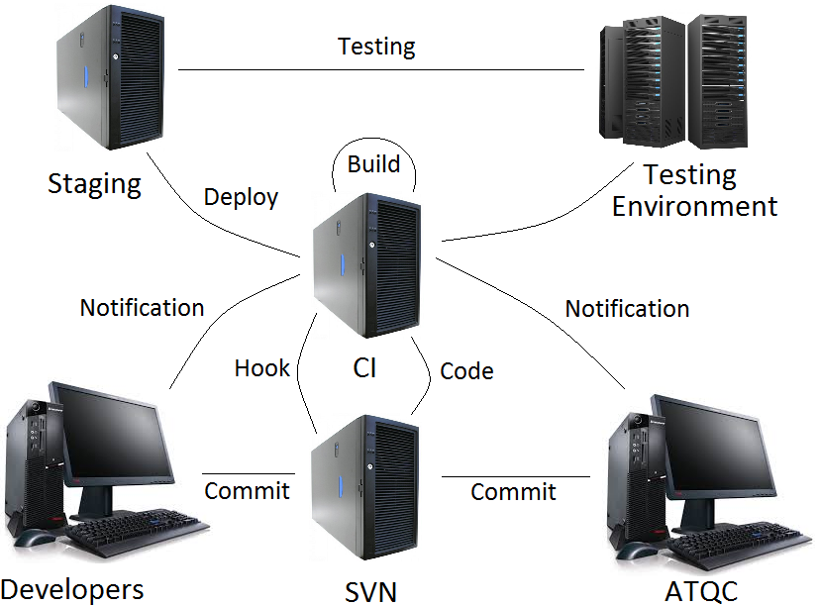
Workflow Build Deploy Test

Slide 9
Departure Point

Slide 10
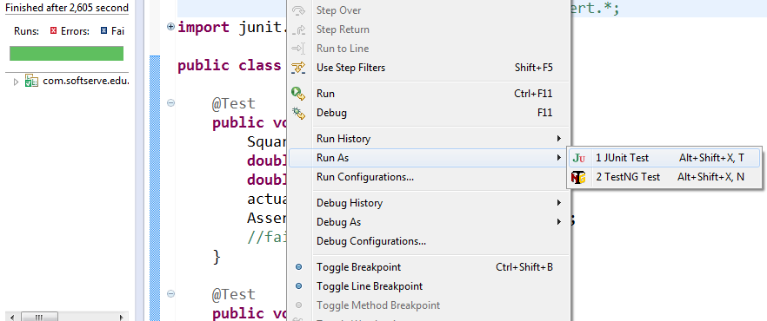
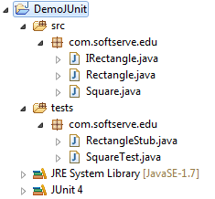
Don't Applicable to CI Projects

Slide 11
Automation Tool Selection
Compatibility with the application environment;
Cost of test automation tool;
Easy to write;
Easy to execute;
Easy to maintain;
Extensibility with additional components;
Easy to learn;
Strong community to resolve tool-related issues;
Reliability;
etc.

Slide 12

Popular Tools
Projects can be built;
Make Util;
Shell-execute scripts;
Commands Windows;
Apache Ant;
Apache Maven;
Gradle;
etc.

Slide 13
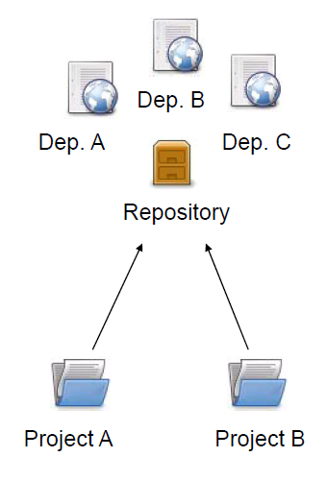
Dependency Management

Slide 14
Maven's Objectives
Tool for building Java project.
Making the build process easy.
Providing a uniform build system.
Declarative description of the project.
Independence from the OS. To build a project on any operating system.
Dependency Management.
Resolve version conflicts.
Can build from the command line. This is often necessary to automatically build the project on the server (Continuous Integration).
Good integration with IDEs.

Slide 15
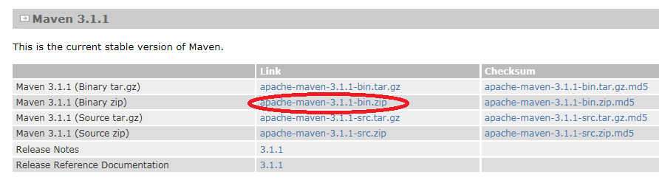
Maven Download
http://maven.apache.org/download.cgi
Maven is a Java tool, so you must have Java installed;
Unzip the distribution archive;
Add the M2_HOME environment variable with the value
C:\...\Apache\apache-maven-3.1.1
Add the M2 environment variable with the value
%M2_HOME%\bin

Slide 16
Quick Start

Slide 17
Creating Project, Generate POM
mvn archetype:generate
-DgroupId=com.softserve.edu
-DartifactId=work
-Dversion=1.0-SNAPSHOT
-DarchetypeArtifactId=maven-archetype-quickstart
-DarchetypeVersion=1.0
-DinteractiveMode=false
The quickstart archetype is a simple project with JAR packaging and a single dependency on JUnit. After generating a project with the quickstart archetype, you will have a single class.

Slide 18
Single Class
package com.softserve.edu;
/**
* Hello world!
*
*/
public class App
{
public static void main( String[ ] args )
{
System.out.println( "Hello World!" );
}
}

Slide 19
JUnit Test Class
package com.softserve.edu;
import junit.framework.Test;
import junit.framework.TestCase;
import junit.framework.TestSuite;
public class AppTest extends TestCase
{ public AppTest( String testName )
{ super( testName ); }
public static Test suite( )
{ return new TestSuite( AppTest.class ); }
public void testApp( )
{ assertTrue( true ); }
}

Slide 20
pom.xml
<project xmlns="http://maven.apache.org/POM/4.0.0" … >
<modelVersion>4.0.0</modelVersion>
<groupId>com.softserve.edu</groupId>
<artifactId>work</artifactId>
<packaging>jar</packaging>
<version>1.0-SNAPSHOT</version>
<name>work</name>
<url>http://maven.apache.org</url>
<dependencies> <dependency>
<groupId>junit</groupId>
<artifactId>junit</artifactId>
<version>3.8.1</version>
<scope>test</scope>
</dependency> </dependencies>
</project>

Slide 21
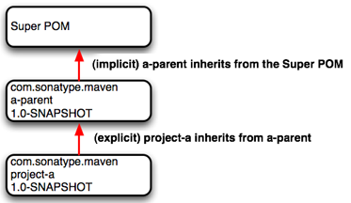
Maven pom.xml
The POM extends the Super POM;
  Only 4 lines are required.
<project>
<modelVersion>4.0.0</modelVersion>
<groupId>com.softserve.edu</groupId>
<artifactId>assignment</artifactId>
<version>1.0</version>
</project>

Slide 22
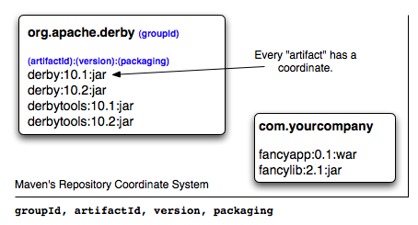
Maven Coordinates
A Maven coordinate is a tuple of values that uniquely identifies any artifact.
Maven coordinates are used throughout Maven configuration and POM files.
A coordinate comprises three pieces of information:
  The group ID;
  The artifact ID;
  The version.

Slide 23
Maven Coordinates
The group ID:
  The entity or organization responsible for producing the artifact. For example, com.softserve.edu can be a group ID.
The artifact ID:
  The name of the actual artifact. For example, a project with a main class called OpsImp may use OpsImp as its artifact ID.
The version:
  A version number of the artifact. The supported format is in the form of mmm.nnn.bbb-qqqqqqq-dd, where mmm is the major version number, nnn is the minor version number, and bbb is the bugfix level. Optionally, either qqqqq (qualifier) or dd (build number) can also be added to the version number.

Slide 24
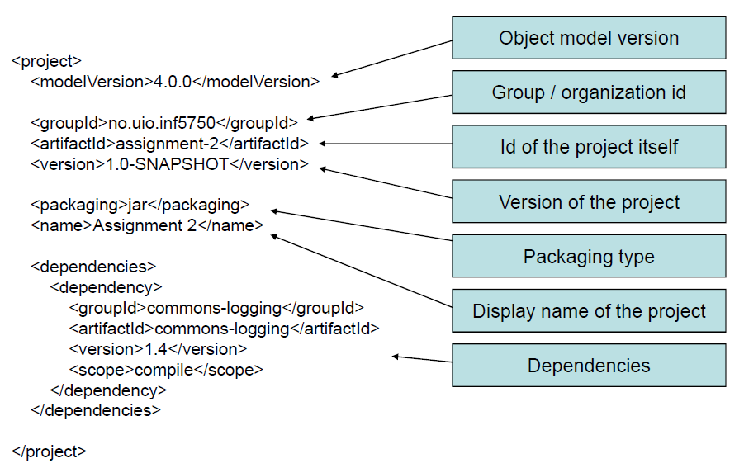
Maven pom.xml

Slide 25
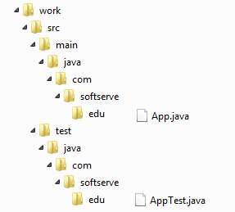
Maven Directories Structure

Slide 26
Maven Directories Structure
src/main/java Java source files goes here;
src/main/resources Other resources your application needs;
src/main/filters Resource filters (properties files);
src/main/config Configuration files;
src/main/webapp Web application directory for a WAR project;
src/test/java Test sources like unit tests (not deployed);
src/test/resources Test resources (not deployed);
src/test/filters Test resource filter files (not deployed);
src/site Files used to generate the Maven project website;
target/ The target directory is used to house all output of the build.

Slide 27
Maven Packaging
Maven compile project and output to a “jar” file
mvn package
It compiles, run unit test and generate the project “jar” file in project/target folder. Run the generated jar file
java -cp target/work-1.0-SNAPSHOT.jar
com.softserve.edu.App
Hello World!
Run the main method in a maven
mvn exec:java
-Dexec.mainClass="com.softserve.edu.App"

Slide 28
Maven Lifecycle

Slide 29
Maven Lifecycle and Phases
The build lifecycle is the process of building and distributing an artifact.
A phase is a step in the build lifecycle.
Most important default phases:
  Validate
  Compile
  Test
  Package
  Install
  Deploy
Some common phases not default:
  Clean
  Site

Slide 30
Maven Lifecycle and Phases
Package – Take the compiled code and package it in its distributable format (JAR, WAR, etc.);
pre-integration-test – Perform actions required before integration tests are executed;
integration-test – Process and deploy the package if necessary into an environment where integration tests can be run;
post-integration-test – Perform actions required after integration tests have been executed;
verify – Run any checks to verify the package is valid and meets quality criteria;
install – Install the package into the local repository;
deploy – Copies the final package to the remote repository.

Slide 31
Maven Commands
Validate the project is correct and all necessary information is available
mvn validate
Compile the source code of the project
mvn compile
Run unit tests from Command line
mvn test
Take the compiled code and package it in its distributable format, such as a JAR
mvn package
Run integration tests from Command line
mvn verify

Slide 32
Dependency Management

Slide 33
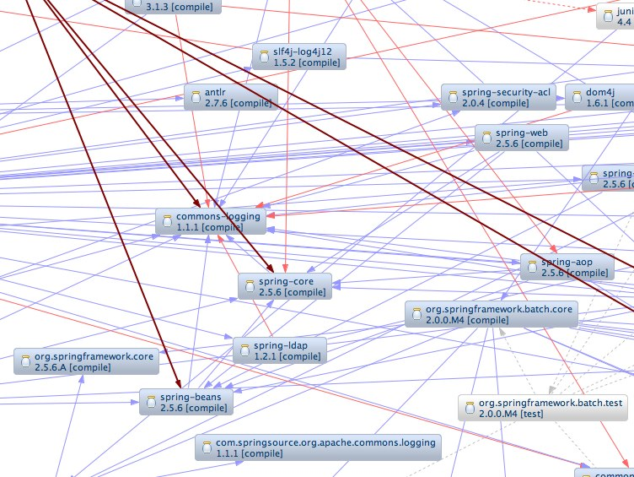
Dependency Hell

Slide 34
Dependency Management
JUnit is the de facto standard unit testing library for the Java language.
Dependencies are defined in the POM.
<dependencies>
<dependency>
<groupId>junit</groupId>
<artifactId>junit</groupId>
<version>4.11</version>
<scope>test</scope>
</dependency>
</dependencies>

Slide 35
Dependency Management
Repository: A shared location for dependencies which all projects can access
  Only one exists;
  Stored outside the project.
<dependencies>
<dependency>
<groupId>org.testng</groupId>
<artifactId>testng</groupId>
<version>6.8.8</version>
<scope>test</scope>
</dependency>
</dependencies>

Slide 36
Dependency Scope. Examples
<dependency>
<groupId>org.slf4j</groupId>
<artifactId>slf4j-api</artifactId>
<version>1.7.5</version>
</dependency>
Code dependent on the API. Implementation can be changed.
<dependency>
<groupId>org.slf4j</groupId>
<artifactId>slf4j-log4j12</artifactId>
<version>1.7.5</version>
<scope>runtime</scope>
</dependency>

Slide 37
Dependency Scope
Affects the classpath used for various build tasks.
Can be defined for all dependencies, compile default.
5 dependency scopes available:
  Compile: Available in all classpaths (default);
  Provided: The JDK or the container provides it;
  Runtime: Only required for execution, not for compilation;
  Test: Only required for testing, not for normal use (not deployed);
  System: You provide it locally, not looked up in a repo.
<scope>system</scope> <systemPath>${java.home}/tools.jar
</systemPath>

Slide 38
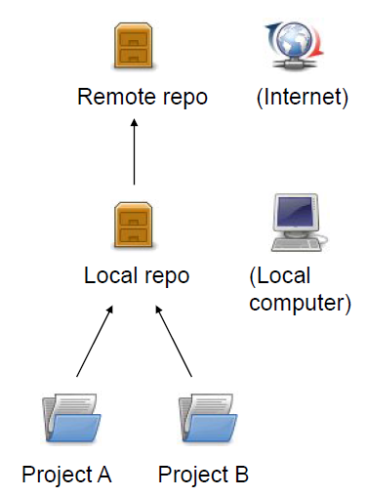
Repositories
Local repository:
  Copy on local computer which is a cache of the remote downloads;
  May contain project-local build artifacts as well;
  Located in (by default) USER_HOME/.m2/repository

Slide 39
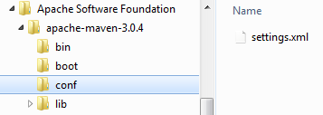
Configure Local Repository
<!-- localRepository
The path to the local repository maven will use to store artifacts.
Default: ~/.m2/repository
<localRepository>/path/to/local/repo</localRepository>
-->
Adding a Local Reference from Comman Line
mvn -Dmaven.repo.local=/path/to/local/repo

Slide 40
Add Repository
Downloading from a remote repository
  Central repo is default;
  Can be overridden.
Adding a Reference to Repository in a POM
<repositories>
<repository>
<id>my-repo</id>
<name>customRepo</name>
<url>http://my-server/repo</url>
</repository>
</repositories>

Slide 41
Specify Repositories. Examples
<repositories>
<repository>
<id>oss.sonatype.org</id>
<name>OSS Sonatype Staging</name>
<url>https://oss.sonatype.org/content
/groups/staging</url>
</repository>
<repository>
<id>java.net.Maven2</id>
<name>Java Net Maven 2</name>
<url>http://download.java.net/maven/2/</url>
</repository>
</repositories>

Slide 42
Proxy Settings
File ~/.m2/settings.xml
<settings>
<proxies>
<proxy>
<active>true</active>
<protocol>http</protocol>
<host>proxy.softserveinc.com</host>
<port>8080</port>
<username>softserve\test</username>
<password>password</password>
</proxy>
</proxies>
</settings>

Slide 43
Selenium Tests

Slide 44
Update Example pom.xml
Update the jUnit from 3.8.1 to latest 4.11.
<dependencies>
<dependency>
<groupId>junit</groupId>
<artifactId>junit</artifactId>
<version>4.11</version>
<scope>test</scope>
</dependency>
</dependencies>

Slide 45
Update Test Class
Add new class SearchTest to src/test/java
package com.softserve.edu;
import org.junit.Assert;
import org.junit.Test;
import org.openqa.selenium.By;
import org.openqa.selenium.WebDriver;
import org.openqa.selenium.WebElement;
import org.openqa.selenium.firefox.FirefoxDriver;
import org.openqa.selenium.support.ui.ExpectedCondition;
import org.openqa.selenium.support.ui.WebDriverWait;
public class SearchTest {
public WebDriver driver;

Slide 46
Selenium WebDriver
@Test
public void testWiki() {
driver = new FirefoxDriver();
driver.get("http://en.wikipedia.org/");
WebElement element = driver.findElement(By.id("searchInput"));
element.clear();
element.sendKeys("Selenium IDE");
driver.findElement(By.id("searchButton")).click();
String s = driver.findElement(By.
xpath("//div[@id='mw-content-text']/p[2]")).getText();
Assert.assertEquals("Selenium was originally developed by
Jason Huggins in 2004", s.substring(0, 58));
driver.quit(); }

Slide 47
Selenium WebDriver
@Test
public void testCheese() {
driver = new FirefoxDriver();
driver.get("http://www.google.com");
WebElement element = driver.findElement(By.name("q"));
element.sendKeys("Cheese!"); element.submit();
// Wait for the page to load, timeout after 10 seconds
(new WebDriverWait(driver, 10)).until(new
ExpectedCondition<Boolean>() {
public Boolean apply(WebDriver d) {
return d.getTitle().toLowerCase().startsWith("cheese!"); } } );
String s = driver.getTitle();
Assert.assertEquals("Cheese", s.substring(0, 6)); driver.quit(); } }

Slide 48
Update pom.xml
<dependencies>
<dependency>
<groupId>org.seleniumhq.selenium</groupId>
<artifactId>selenium-server</artifactId>
<version>2.42.2</version>
</dependency>
<dependency>
<groupId>org.seleniumhq.selenium</groupId>
<artifactId>selenium-java</artifactId>
<version>2.42.2</version>
</dependency>
</dependencies>

Slide 49

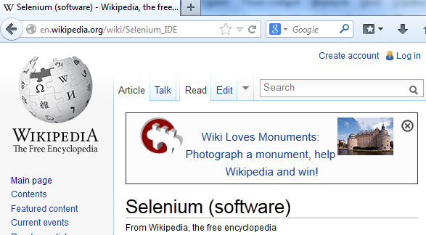
Run Tests
mvn test

Slide 50
Plug-ins

Slide 51
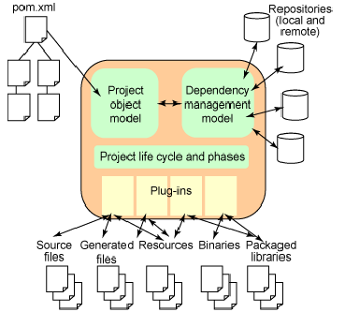
Maven Operation Model
Maven is based on the Plugin-architecture, which allows the use of plug-ins for various tasks: compile, test, build, deploy, checkstyle, etc.

Slide 52
Maven Plugins
clean Clean up target after the build. Deletes the target directory.
compiler Compiles Java source files.
surefile Run the JUnit unit tests. Creates test reports.
failsafe Run integration tests while the Surefire Plugins is designed to run unit tests.
jar Builds a JAR file from the current project.
war Builds a WAR file from the current project.
javadoc Generates Javadoc for the project.
antrun Runs a set of ant tasks from any phase mentioned of the build.

Slide 53
Plugin Execution Examples
Java project can be compiled with the maven-compiler-plugin's compile – goal by running following command
mvn compiler:compile
mvn surefire:test
mvn jar:jar
Build the Project
mvn package
Running integration tests
mvn verify
Phases and goals may be executed in sequence
mvn clean dependency:copy-dependencies package

Slide 54
Plug-ins Execution
mvn [plugin-name]:[goal-name]
The following lifecycle bindings
Phase Plugin execution goal
test surefire:test
integration-test failsafe:integration-test
verify failsafe:verify

Slide 55
Help Plugin
help – one of the most useful plug-ins
mvn help:help
description of plug-ins
mvn help:describe -Dplugin=dependency
mvn help:describe -Dplugin=compiler
Description of the system
mvn help:system
Effective pom - file formed from the super pom file and the project file. It can be seen as
mvn help:effective-pom

Slide 56
Maven Plugins
Maven is – at its heart – a plugin execution framework.
  All work is done by plugins. Looking for a specific goal to execute.
There are the build and the reporting plugins:
  Build plugins will be executed during the build and they should be configured in the <build/> element from the POM.
  Reporting plugins will be executed during the site generation and they should be configured in the <reporting/> element from the POM.

Slide 57
Maven Compiler Plugin
Compiler – the main plugin. It is used in almost all projects. Available by default, but in almost every project it has to re-declare. The default settings are not very suitable.
<plugin>
<groupId>org.apache.maven.plugins</groupId>
<artifactId>maven-compiler-plugin</artifactId>
<version>2.0.2</version>
<configuration>
<source>1.6</source>
<target>1.6</target>
<encoding>UTF-8</encoding>
</configuration>
</plugin>

Slide 58
Maven Compiler Plugin
The default version of Java – 1.3.
Encoding – the default operating system.
Configure maven-compiler-plugin
  Using a version of java 1.6
<source>1.6</source>
  Version of the Java machine that will run this code
<target>1.6</target>
  Encoding source code UTF-8
<encoding>UTF-8</encoding>
The plugin has two goals
compiler:compile and compiler:testCompile

Slide 59
IDE Integration

Slide 60


Convert to IDE
Convert maven java project to IntelliJ Idea project
mvn idea:idea
Convert to Eclipse project
mvn eclipse:eclipse

Slide 61
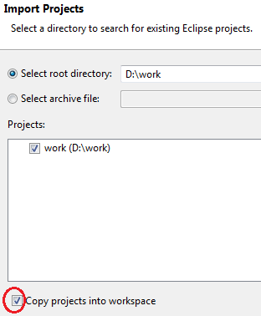
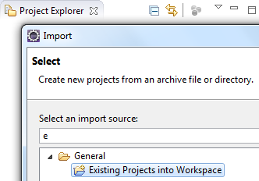
Convert Eclipse IDE

Slide 62
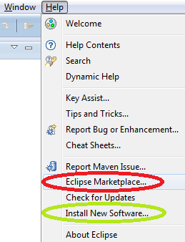
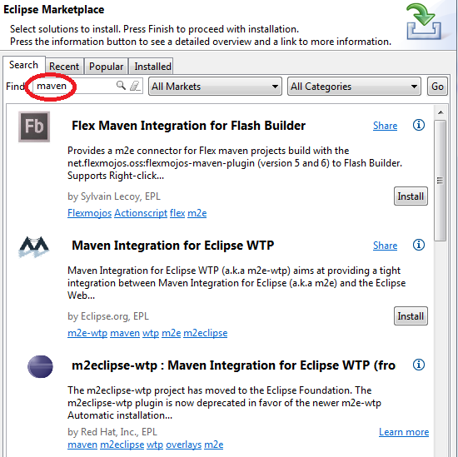
Install Maven for Eclipse IDE

Slide 63
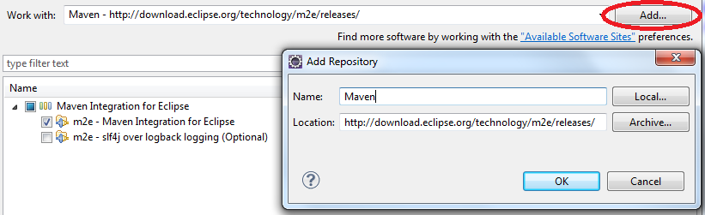
Install Maven for Eclipse IDE
Maven
http://download.eclipse.org/technology/m2e/releases/

Slide 64
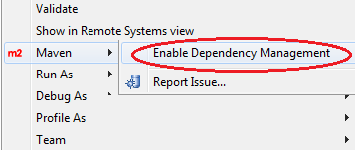
Update Example Test
AppTest.java
package com.softserve.edu;
import org.junit.Assert;
import org.junit.Test;
public class AppTest {
@Test
public void test() {
Assert.assertTrue(true);
//fail("Not yet implemented");
}
}

Slide 65
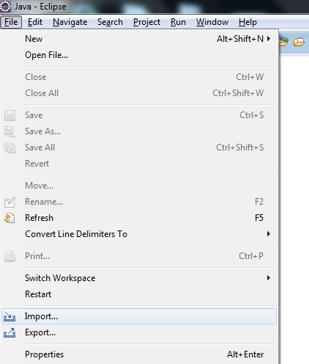
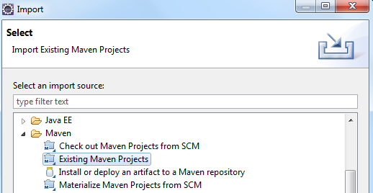
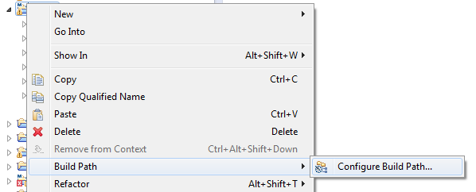
Eclipse Kepler. Import Project

Slide 66
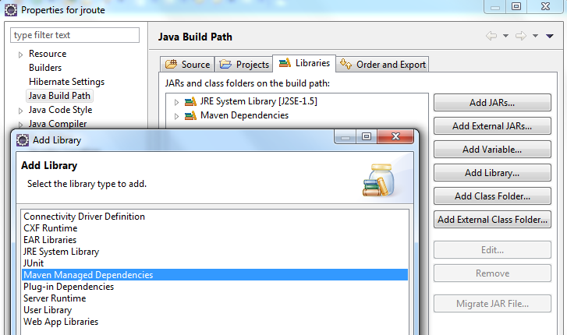
Configure Build Path

Slide 67
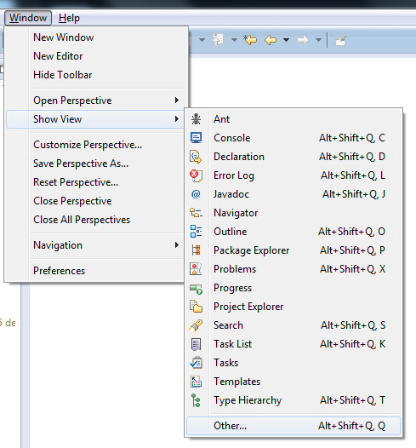
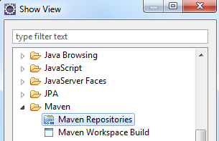
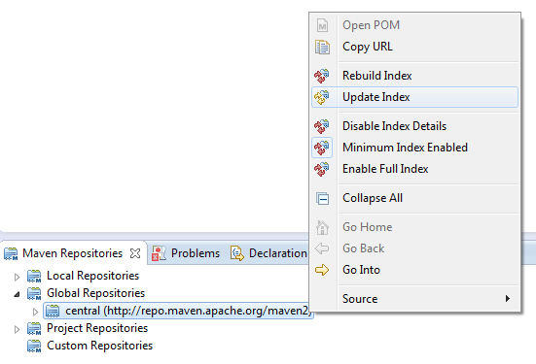
Repositories. Update Index

Slide 68
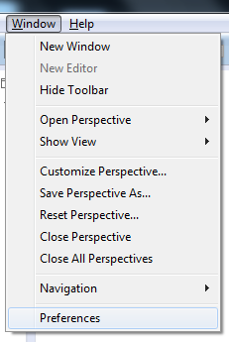
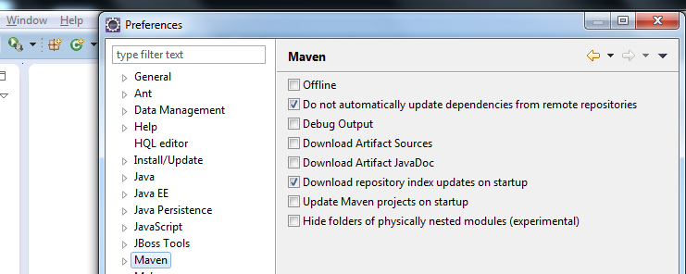
Eclipse Kepler. Configure Maven

Slide 69
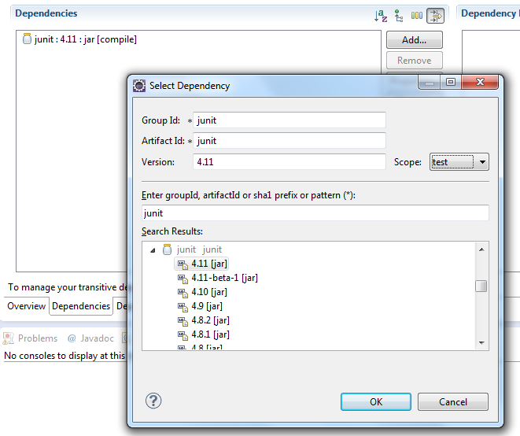
Eclipse Kepler. Add Dependencies

Slide 70
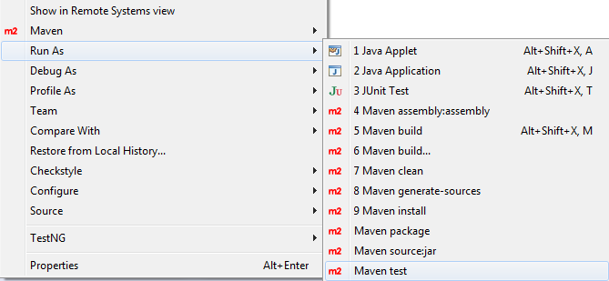
Selenium WebDriver
Run tests from Eclipse

Slide 71
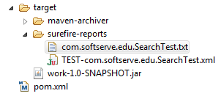
Selenium WebDriver
Results: Tests run: 3, Failures: 0, Errors: 0, Skipped: 0

Slide 72
Maven Profiles

Slide 73
Maven Profiles
The build environment may consist of profiles
<profiles>
<profile>
<id>unit-tests</id>
… … …
</profile>
<profile>
Profiles can be explicitly specified using the -P CLI option
mvn groupId:artifactId:goal
-P unit-tests,integration-tests,profile-3
This option is a comma-delimited list of profile-ids to use.

Slide 74
Profiles. Exclude Sources
Exclude the java sources from compiling (ignore some build errors)
<profile>
<id>exclude-sources</id>
<activation>
<activeByDefault>true</activeByDefault>
</activation>
<build>
<plugins>
<plugin>
<groupId>org.apache.maven.plugins</groupId>
<artifactId>maven-compiler-plugin</artifactId>
<version>3.1</version>

Slide 75
Profiles. Exclude Sources
<executions>
<execution>
<id>exclude-compile</id>
<configuration>
<excludes>
<exclude>**/*NoComp*.java</exclude>
</excludes>
</configuration>
</execution>
</executions>
</plugin>
</plugins>
</build> </profile>

Slide 76
Profiles. Include Sources
Include java sources
<profile>
<id>include-sources</id>
<build>
<plugins>
<plugin>
<groupId>org.apache.maven.plugins</groupId>
<artifactId>maven-compiler-plugin</artifactId>
<version>3.1</version>
<executions>
<execution>
<id>include-compile</id>

Slide 77
Profiles. Include Sources
<configuration>
<includes>
<include>**/*Compile.java</include>
<include>**/New*.java</include>
</includes>
</configuration>
</execution>
</executions>
</plugin>
</plugins>
</build>
</profile>

Slide 78
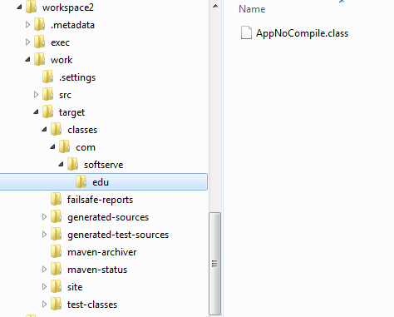
Profiles. Include Sources

Slide 79
Properties Settings

Slide 80
Maven Properties
Maven properties are value placeholder, like properties in Ant.
<modelVersion>4.0.0</modelVersion>
<groupId>com.softserve.edu</groupId>
<artifactId>work</artifactId>
<packaging>jar</packaging>
<version>1.0</version>
<name>work</name>
<url>http://maven.apache.org</url>
<properties>
<org.seleniumhq.selenium-version>2.42.2
</org.seleniumhq.selenium-version>
</properties>

Slide 81
Maven Properties
Values are accessible anywhere within a POM by using the notation ${X}, where X is the property.
<properties>
<org.seleniumhq.selenium-version>2.42.2
</org.seleniumhq.selenium-version>
</properties>
The value may be used as
${org.seleniumhq.selenium-version}

Slide 82
Selenium WebDriver
Do not need to write dependencies to pom.xml
<dependency>
<groupId>org.seleniumhq.selenium</groupId>
<artifactId>selenium-server</artifactId>
<version>${org.seleniumhq.selenium-version}
</version> </dependency>
<dependency>
<groupId>org.seleniumhq.selenium</groupId>
<artifactId>selenium-java</artifactId>
<version>${org.seleniumhq.selenium-version}
</version> </dependency>
<dependency>
<groupId>org.seleniumhq.selenium</groupId>
<artifactId>selenium-firefox-driver</artifactId>
<version>${org.seleniumhq.selenium-version}
</version> </dependency>

Slide 83
Selenium WebDriver
Add dependency to pom.xml
<dependencies>
<dependency>
<groupId>org.seleniumhq.selenium</groupId>
<artifactId>selenium-server</artifactId>
<version>${org.seleniumhq.selenium-version}
</version> </dependency> </dependencies>
.m2\repository\org\seleniumhq\selenium\selenium-server\2.42.2\selenium-server-2.42.2.pom
<groupId>org.seleniumhq.selenium</groupId>
<artifactId>selenium-java</artifactId>
<version>${project.version}</version>

Slide 84
Dependency Tree
Displays the dependency tree for project
mvn dependency:tree
\- org.seleniumhq.selenium:
selenium-server:jar:2.35.0:compile
+- org.seleniumhq.selenium:
selenium-java:jar:2.35.0:compile
| +- org.seleniumhq.selenium:
selenium-chrome-driver:
jar:2.35.0:compie
| +- org.seleniumhq.selenium:
selenium-firefox-driver:
jar:2.35.0:comp

Slide 85
Communication with Java Сode

Slide 86
Get All Properties
All properties accessible via java.lang.System.getProperties()
are available as POM properties
System.out.println("\nALL Property: "
+java.lang.System.getProperties());

Slide 87
Maven Properties
ALL Property: {java.runtime.name=Java(TM) . . .
surefire.test.class.path=
C:\Users\User\workspace2\work\target\test-classes;
C:\Users\User\workspace2\work\target\classes;
C:\Users\User\.m2\repository\junit\junit\4.11\junit-4.11.jar;
C:\Users\User\.m2\repository\org\seleniumhq\selenium\ selenium-server\2.42.2\selenium-server-2.42.2.jar; . . .

Slide 88
Get Properties in Test
You can set system properties in the Maven Surefire Plugin configuration
<build> <plugins> <plugin>
<groupId>org.apache.maven.plugins</groupId>
<artifactId>maven-surefire-plugin</artifactId>
<version>2.16</version>
<configuration>
<systemPropertyVariables>
<selenium-version>
${org.seleniumhq.selenium-version}
</selenium-version> </systemPropertyVariables>
</configuration> </plugin> </plugins> </build>

Slide 89
Get Properties in Test
Property
<selenium-version>
accessible from Java code via
java.lang.System.getProperty("name");
For Example
@Test
public void test() {
System.out.println("\nProperty: "
+System.getProperty("selenium-version"));}
Output:
Property: 2.42.2

Slide 90
Properties. Command Line
You may specify property name/value pairs that will be set as System properties for the execution of the plugin
mvn test -Dselenium-version=2.42.2
or
mvn test
-Dorg.seleniumhq.selenium-version=2.42.2
If a System property is found that is already set (eg from the command line or by the JVM itself), then these configured properties DO NOT override them.

Slide 91
Set Browser Type
<configuration>
<systemPropertyVariables>
<browser>firefox</browser>
</systemPropertyVariables>
</configuration>
Specify the name of <browser>
mvn test –Dbrowser=firefox
Code
WebDriver driver; // . . .
if (System.getProperty("browser")
.equals("firefox")) {
driver = new FirefoxDriver(); }

Slide 92
SureFire Plug-in

Slide 93
Surefire Plugin
Surefire Plugin will automatically include all test classes:
  "**/Test*.java" includes all of its subdirectories and all java filenames that start with "Test“;
  "**/*Test.java" includes all of its subdirectories and all java filenames that end with "Test“;
  "**/*TestCase.java" includes all of its subdirectories and all java filenames that end with "TestCase".

Slide 94
Inclusions and Exclusions
Inclusions Tests
<configuration>
<includes>
<include>Sample.java</include>
</includes>
</configuration>
Exclusions Tests
<configuration>
<excludes>
<exclude>**/TestCircle.java</exclude>
</excludes>
</configuration>

Slide 95
Surefire Plugin. Include Test
<build>
<plugins>
<plugin>
<groupId>org.apache.maven.plugins</groupId>
<artifactId>maven-surefire-plugin</artifactId>
<version>2.16</version>
<configuration>
<includes>
<include>**/SearchTest.java</include>
</includes>
</configuration>
</plugin>
</plugins>
</build>

Slide 96
Surefire Plugin
Skip the tests can be
<build> <plugins> <plugin>
<groupId>org.apache.maven.plugins</groupId>
<artifactId>maven-surefire-plugin</artifactId>
<version>2.16</version>
<configuration>
<skipTests>true</skipTests>
</configuration>
</plugin> </plugins> </build>
or
mvn install –DskipTests
skip the compilation of tests
mvn install -Dmaven.test.skip=true

Slide 97
Surefire Plugin
If you want to skip tests by default but want the ability to re-enable tests from the command line, you need to go via a properties section in the pom
<project xmlns="http://maven.apache.org/POM/4.0.0" . . .>
<modelVersion>4.0.0</modelVersion>
<groupId>com.softserve.edu</groupId>
<artifactId>work</artifactId>
<version>1.0</version>
<properties>
<skipTests>true</skipTests>
</properties>

Slide 98
Surefire Plugin
<build>
<plugins> <plugin>
<groupId>org.apache.maven.plugins</groupId>
<artifactId>maven-surefire-plugin</artifactId>
<version>2.16</version>
<configuration>
<skipTests>${skipTests}</skipTests>
</configuration>
</plugin> </plugins>
</build>

Slide 99
Using TestNG
Using TestNG suite XML files allows flexible configuration of the tests to be run. These files are created in the normal way, and then added to the Surefire Plugin configuration
<build> <plugins> <plugin>
<groupId>org.apache.maven.plugins</groupId>
<artifactId>maven-surefire-plugin</artifactId>
<version>2.17</version>
<configuration>
<suiteXmlFiles>
<suiteXmlFile>testng.xml</suiteXmlFile>
</suiteXmlFiles>
</configuration>
</plugin> </plugins> </build>

Slide 100
TestNG Suite (testng.xml)
<?xml version="1.0" encoding="UTF-8" ?>
<!DOCTYPE suite (View Source for full doctype...)>
<suite name="Suite" parallel="none" junit="false"
configfailurepolicy="skip" thread-count="5"
skipfailedinvocationcounts="false"
data-provider-thread-count="10"
group-by-instances="false" preserve-order="true"
allow-return-values="false">
<test name="Test" junit="false"
skipfailedinvocationcounts="false" preserve-order="true"
group-by-instances="false" allow-return-values="false">
<classes> <class name="com.softserve.edu.AppTest" />
</classes> </test> </suite>

Slide 101
Surefire Plugin
Build jar file only, skip unit tests (skipTests is true)
mvn install
This will allow you to run with tests disabled by default and to run them with this command
mvn install -DskipTests=false
The same can be done with the "skip" parameter and other booleans on the plugin.

Slide 102
Using Surefire Plugin in Profile
The build environment may consist of profiles
<profiles>
<profile>
<id>unit-tests</id>
<build>
<plugins>
<plugin>
<groupId>org.apache.maven.plugins</groupId>
<artifactId>maven-surefire-plugin</artifactId>
<version>2.16</version>

Slide 103
Using Surefire Plugin in Profile
<configuration>
<includes>
<include>**/SearchTest.java</include>
</includes>
</configuration>
</plugin>
</plugins>
</build>
</profile>
</profiles>

Slide 104
Surefire Plugin. Profiles
To call the above profile, run the following command
mvn test –Punit-tests
mvn verify –Punit-tests
mvn clean install –Punit-tests

Slide 105
Reports of Tests

Slide 106
Surefire Report Plugin
Surefire Report Plugin can be used to automatically generate a report of the results
<reporting>
<plugins>
<plugin>
<groupId>org.apache.maven.plugins
</groupId>
<artifactId>maven-surefire-report-plugin
</artifactId>
</plugin>
</plugins>
</reporting>

Slide 107
Including jxr Plugin
maven-jxr-plugin in the reporting section generates a xref representation of source code and test source code
<reporting>
<plugins>
<plugin>
<groupId>org.apache.maven.plugins
</groupId>
<artifactId>maven-jxr-plugin</artifactId>
</plugin>
</plugins>
</reporting>

Slide 108
Inserting Plugins in Profile
<profiles> <profile>
<id>unit-tests</id>
. . .
<reporting> <plugins> <plugin>
<groupId>org.apache.maven.plugins</groupId>
<artifactId>maven-surefire-
report-plugin</artifactId>
</plugin> <plugin>
<groupId>org.apache.maven.plugins</groupId>
<artifactId>maven-jxr-plugin</artifactId>
</plugin> </plugins>
</reporting>
</profile> <profile>

Slide 109
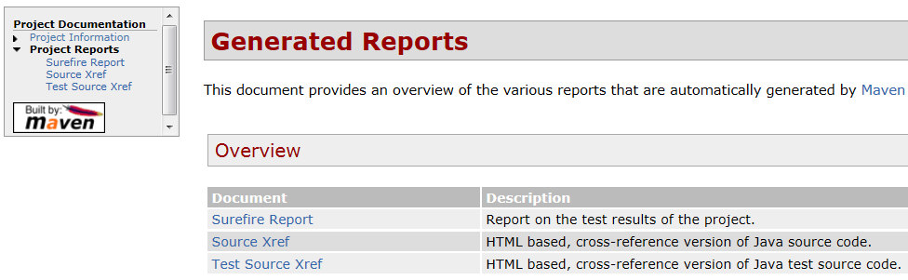
Surefire Report Plugins
To build the site documentation but not deploy it
mvn site –Punit-tests -DskipTests=true
mvn clean site –Punit-tests
\target\site\index.html

Slide 110
Failsafe Plug-in

Slide 111
Surefire vs. Failsafe
maven-surefire-plugin is designed for running unit tests and if any of the tests fail then it will fail the build immediately.
  Phase Build test
  Default output directory:
${basedir}/target/surefire-reports
maven-failsafe-plugin is designed for running integration tests, and decouples failing the build if there are test failures from actually running the tests.
  Phase Build verify
  Default output directory:
${basedir}/target/failsafe-reports

Slide 112
Integration Test
Unit test is an automatic test to test the internal workings of a class. It should be a stand-alone test which is not related to other resources.
Integration test is an automatic test that is done on an environment, so similar to unit tests but with external resources.
Integration tests are dependent on external resources. Maven should be able to package your solution.
Rename all Java integration tests using the same naming convention
NameTest.java > NameIntegrationTest.java

Slide 113
Name of Tests
By default the Failsafe Maven Plugin looks for integration tests matching the patterns
  **/IT*.java,
  **/*IT.java and
  **/*ITCase.java
The advantage to using the Maven Failsafe Plugin is that it will not stop the build during the integration-test phase if there are test failures.
You are now able to run tests using continuous integration systems like Hudson or Continuum without having integration tests failing due to missing external resources.

Slide 114
Failsafe Plugin
The Maven lifecycle has four phases for running integration tests:
  pre-integration-test for setting up the integration test environment;
  integration-test for running the integration tests;
  post-integration-test for tearing down the integration test environment;
  verify for checking the results of the integration tests.
The Failsafe Plugin has only 2 goals:
  failsafe:integration-test runs the integration tests of an application;
  failsafe:verify verifies that the integration tests of an application passed.

Slide 115
Failsafe Plugin
<build>
<plugins>
<plugin>
<groupId>org.apache.maven.plugins</groupId>
<artifactId>maven-failsafe-plugin</artifactId>
<version>2.16</version>
<executions>
<execution>
<id>integration-test-firefox</id>
<phase>integration-test</phase>
<goals>
<goal>integration-test</goal>
</goals>

Slide 116
Specify Test Classes
<configuration>
<includes>
<include>**/SearchTest.java</include>
</includes>
</configuration>
</execution>
</executions>
</plugin>
</plugins>
</build>
Clean target folder and run integration tests
mvn clean verify

Slide 117
Using Failsafe Plugin in Profile
The build environment may consist of profiles.
The activeByDefault means "active if no other profile has been explicitely activated".
<profiles>
<profile>
<id>integration-tests</id>
<activation>
<activeByDefault>true</activeByDefault>
</activation>
<build>
<plugins>

Slide 118
Using Failsafe Plugin in Profile
<plugin>
<groupId>org.apache.maven.plugins</groupId>
<artifactId>maven-surefire-plugin</artifactId>
<version>2.16</version>
<configuration>
<skipTests>true</skipTests>
</configuration>
</plugin>
<plugin>
<groupId>org.apache.maven.plugins</groupId>
<artifactId>maven-failsafe-plugin</artifactId>
<version>2.16</version>

Slide 119
Using Failsafe Plugin in Profile
<configuration>
<systemPropertyVariables>
<browser>firefox</browser>
</systemPropertyVariables>
<configuration>
</plugin>
</plugins>
</build>
</profile>
</profiles>
To call the above profile, run the following command
mvn verify –Pintegration-tests

Slide 120
Reports of
Integration Tests

Slide 121
Failsafe Report
Creates a nicely formatted Failsafe Test Report in html format.
mvn surefire-report:failsafe-report-only
This goal does not run the tests, it only builds the reports.
<reporting>
<plugins>
<plugin>
<groupId>org.apache.maven.plugins</groupId>
<artifactId>maven-surefire-report-plugin
</artifactId>
<version>2.16</version>

Slide 122
Failsafe Report
<reportSets>
<reportSet>
<id>integration-tests</id>
<reports>
<report>report-only</report>
<report>failsafe-report-only</report>
</reports>
<configuration>
<reportsDirectories>
<reportsDirectory>
target/failsafe-reports
</reportsDirectory>

Slide 123
Failsafe Report
</reportsDirectories>
</configuration>
</reportSet>
</reportSets>
<configuration>
<aggregate>true</aggregate>
</configuration>
</plugin>
</plugins>
</reporting>

Slide 124
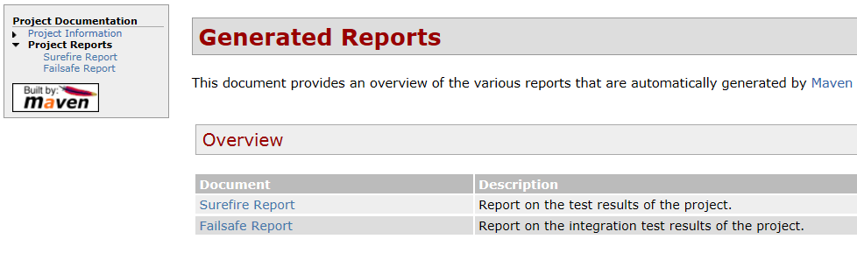
Failsafe Report
Build site
mvn site

Slide 125
Running Tests in Parallel

Slide 126
JUnit support
Surefire (Failsafe) supports three different generations of JUnit:
  JUnit 3.8.x,
  JUnit 4.x (serial provider) and
  JUnit 4.7 (junit-core provider with parallel support).
The provider is selected based on the JUnit version in project and the configuration parameters (for parallel).
Algorithm for choosing which tests to run has changed:
  If the JUnit version in the project >= 4.7 and the parallel attribute has ANY value use junit47 provider;
  If JUnit >= 4.0 is present use junit4 provider;
  else use junit3.8.1.

Slide 127
JUnit support
Manually specifying a provider
<plugin>
<groupId>org.apache.maven.plugins</groupId>
<artifactId>maven-failsafe-plugin</artifactId>
<version>2.16</version>
<dependencies>
<dependency>
<groupId>org.apache.maven.surefire</groupId>
<artifactId>surefire-junit47</artifactId>
<version>2.16</version>
</dependency>
</dependencies>
</plugin>

Slide 128
Running Tests in Parallel
From JUnit 4.7 and onwards you can run your tests in parallel.
You must set the parallel parameter
  Change the threadCount or
  useUnlimitedThreads attribute
<configuration>
<parallel>methods</parallel>
<threadCount>10</threadCount>
</configuration>
<configuration>
<parallel>classes</parallel>
<useUnlimitedThreads>true</useUnlimitedThreads>
</configuration>

Slide 129
Running Methods in Parallel
<build>
<plugins>
<plugin>
<groupId>org.apache.maven.plugins</groupId>
<artifactId>maven-surefire-plugin</artifactId>
<version>2.16</version>
<configuration>
<skipTests>true</skipTests>
</configuration>
</plugin>

Slide 130
Running Methods in Parallel
<plugin>
<groupId>org.apache.maven.plugins</groupId>
<artifactId>maven-failsafe-plugin</artifactId>
<version>2.16</version>
<dependencies>
<dependency>
<groupId>org.apache.maven.surefire</groupId>
<artifactId>surefire-junit47</artifactId>
<version>2.16</version>
</dependency>
</dependencies>

Slide 131
Running Methods in Parallel
<executions>
<execution>
<id>integration-test-firefox</id>
<phase>integration-test</phase>
<goals>
<goal>integration-test</goal>
<goal>verify</goal>
</goals>
<configuration>
<systemPropertyVariables>
<browser>firefox</browser>
</systemPropertyVariables>

Slide 132
Running Methods in Parallel
<parallel>methods</parallel>
<threadCount>10</threadCount>
<!-- includes>
<include>**/AppTest.class</include>
<include>**/SearchTest.class</include>
</includes-->
</configuration>
</execution>
</executions>
</plugin>
</plugins>
</build>

Slide 133
Add Test Methods
Add a new class in src/test/java/com.softserve.edu
public class BigIT {
@Test
public void testIntegration1() {
final Thread thread = Thread.currentThread();
System.out.printf("\n#%d %s: %s", thread.getId(),
thread.getName(), "###BigIT - testIntegration1()");
Assert.assertTrue(true); }
@Test
public void testIntegration2() { . . .
thread.getName(), "###BigIT – testIntegration2()");
Assert.assertTrue(true); } }

Slide 134
Running Integration Test
Run the following command
mvn verify
Running com.softserve.edu.BigIT
#9 pool-1-thread-2: ###BigIT - testIntegration2()
#8 pool-1-thread-1: ###BigIT - testIntegration1()
Tests run: 2, Failures: 0, Errors: 0, Skipped: 0,
Time elapsed: 0 sec - in com.softserve.edu.BigIT
Results:
Tests run: 2, Failures: 0, Errors: 0, Skipped: 0

Slide 135
Addition New Methods
@Test
public void test1() {
final Thread thread = Thread.currentThread();
System.out.printf("\n#%d %s: %s", thread.getId(),
thread.getName(), "***SearchTest - test1()");
Assert.assertTrue(true); }
@Test
public void test2() {
final Thread thread = Thread.currentThread();
System.out.printf("\n#%d %s: %s", thread.getId(),
thread.getName(), "***SearchTest – test2()");
Assert.assertTrue(true); }

Slide 136
AppTest and SearchTest Classes
Running com.softserve.edu.AppTest
Property: 2.42.2
#8 pool-1-thread-1: +++AppTest - test()
Tests run: 1, Failures: 0, Errors: 0, Skipped: 0,
Time elapsed: 0 sec - in com.softserve.edu.AppTest
Running com.softserve.edu.SearchTest
#13 pool-1-thread-6: ***SearchTest - test4()
#12 pool-1-thread-5: ***SearchTest - test3()
#11 pool-1-thread-4: ***SearchTest - test2()
#10 pool-1-thread-3: ***SearchTest - test1()
Tests run: 5, Failures: 0, Errors: 0, Skipped: 0,
Time elapsed: 11.109 sec - in com.softserve.edu.SearchTest
Results: Tests run: 6, Failures: 0, Errors: 0, Skipped: 0

Slide 137
Running Class in Parallel
We can set "both", "methods" and "classes" values
<configuration>
<parallel>classes</parallel>
<threadCount>10</threadCount>
</configuration>

Slide 138
Running Class in Parallel
Add new test method to class AppTest
@Test
public void testA() {
final Thread thread = Thread.currentThread();
System.out.printf("\n#%d %s: %s", thread.getId(),
thread.getName(), "+++AppTest - testA()");
Assert.assertTrue(true); }

Slide 139
Running Class in Parallel
Running com.softserve.edu.SearchTest
#9 pool-1-thread-2: ***SearchTest - test1()
#9 pool-1-thread-2: ***SearchTest - test2()
#9 pool-1-thread-2: ***SearchTest - test3()
#9 pool-1-thread-2: ***SearchTest - test4()
Tests run: 5, Failures: 0, Errors: 0, Skipped: 0,
Time elapsed: 9.705 sec - in com.softserve.edu.SearchTest
Running com.softserve.edu.AppTest
#8 pool-1-thread-1: +++AppTest - testA()
#8 pool-1-thread-1: +++AppTest - test()
Tests run: 2, Failures: 0, Errors: 0, Skipped: 0,
Time elapsed: 0.016 sec - in com.softserve.edu.AppTest
Results: Tests run: 7, Failures: 0, Errors: 0, Skipped: 0

Slide 140
JUnit4.
Test Management

Slide 141
Inserting Category
Create a marker interface to mark all of the tests you want to run or skip from the unit testing process
public interface IntegrationTest {}
Mark integration test class using Junit category annotation at the top of our class
@Category(IntegrationTest.class)

Slide 142
Class Marked
Add new test method to class SmallIT
@Category(IntegrationTest.class)
public class SmallIT {
@Test
public void testIntegration1() {
final Thread thread = Thread.currentThread();
System.out.printf("\n#%d %s: %s", thread.getId(),
Thread.getName(), "###SmallIT - testIntegration1()");
Assert.assertTrue(true);
}
}

Slide 143
Selected Classes
Running tests during the integration-test phase we can use the following Maven snippet
<configuration>
<groups>
com.softserve.edu.IntegrationTest
</groups>
</configuration>
For skip tests
<configuration>
<excludedGroups>
com.softserve.edu.IntegrationTest
</excludedGroups>
</configuration>

Slide 144
Integration Test
<groupId>org.apache.maven.plugins</groupId>
<artifactId>maven-failsafe-plugin</artifactId>
<version>2.16</version>
<configuration>
<groups>com.softserve.edu.IntegrationTest
</groups></configuration>
<executions><execution>
<configuration>
<includes>
<include>**/*.class</include>
</includes>
</configuration>
</execution></executions>

Slide 145
Integration Test
Run the following command
mvn verify
Running com.softserve.edu.SmallIT
#8 pool-1-thread-1: ###SmallIT - testIntegration1()
Tests run: 1, Failures: 0, Errors: 0, Skipped: 0,
Time elapsed: 0.016 sec - in com.softserve.edu.SmallIT
Results:
Tests run: 1, Failures: 0, Errors: 0, Skipped: 0

Slide 146
Memory Management

Slide 147
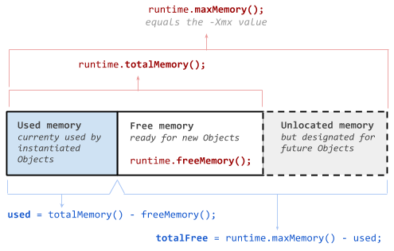
Amount of JVM Memory

Slide 148
OutOfMemoryErrors Problem
According to java documentation the default for the Sun/Oracle Windows and Solaris/Linux JVMs are 64MB.
This could be different for different JVM vendors though.
Unfortunately JVMs change over time and the most appropriate documentation gets more difficult to identify, so to find out the default heap size for specific JVM.
Maven doesn’t use the MAVEN_OPTS variable to set how much memory is available for JUnit tests.
The JUnit tests are run in a separate JVM instance with default memory settings.

Slide 149
OutOfMemoryErrors Solution
To configure the Maven Surefire plugin to give more memory.
<groupId>org.apache.maven.plugins</groupId>
<artifactId>maven-failsafe-plugin</artifactId>
<version>2.13</version>
<configuration>
<argLine>-Xms256m -Xmx512m</argLine>
</configuration>

Slide 150
OutOfMemoryErrors Solution
Construct simple test
@Category(IntegrationTest.class)
public class SmallIT { . . .
@Test
public void testIntegration2() {
long usedMemory =
Runtime.getRuntime().totalMemory()
- Runtime.getRuntime().freeMemory();
System.out.println("\nUsed Memory = “
+ usedMemory / (1024.0 * 1024.0) + "Mb");

Slide 151
OutOfMemoryErrors Solution
System.out.println("\nTotal Amount of Memory = "
+ Runtime.getRuntime().totalMemory()
/ (1024.0 * 1024.0) + "Mb");
System.out.println("\nMaximum Amount of Memory = "
+ Runtime.getRuntime().maxMemory()
/ (1024.0 * 1024.0) + "Mb");
Assert.assertTrue(true);
}
}

Slide 152
OutOfMemoryErrors Solution
Run without <argLine> parameters
mvn verify
Running com.softserve.edu.SmallIT
#9 pool-1-thread-1: ###SmallIT - testIntegration1()
Maximum Amount of Memory = 247.5Mb
Tests run: 2, Failures: 0, Errors: 0, Skipped: 0,
Time elapsed: 0.001 sec - in com.softserve.edu.SmallIT
Results:
Tests run: 2, Failures: 0, Errors: 0, Skipped: 0

Slide 153
OutOfMemoryErrors Solution
Run with arguments -Xms256m -Xmx512m
mvn verify
Running com.softserve.edu.SmallIT
#9 pool-1-thread-1: ###SmallIT - testIntegration1()
Maximum Amount of Memory = 494.9375Mb
Tests run: 2, Failures: 0, Errors: 0, Skipped: 0,
Time elapsed: 0.001 sec - in com.softserve.edu.SmallIT
Results:
Tests run: 2, Failures: 0, Errors: 0, Skipped: 0

Slide 154


Pre- and Post-
Integration Phases

Slide 155
Maven Phases
For example, database should be started during the pre-integration-test phase, and shut down during the post-integration-test.
In the regular built-in maven lifecycles
  pre-integration-test and
  post-integration-test
test phases are not bound to any maven plugin (ie. the default behavior of these phases is "do nothing").
If you want to setup and populate a database for the tests executed in the integration-test phase you need to bind a maven plugin doing that job to these phases.

Slide 156
Exec Plugin
<plugin>
<groupId>org.codehaus.mojo</groupId>
<artifactId>exec-maven-plugin</artifactId>
<version>1.2.1</version>
<executions>
<execution>
<id>pre-integration-test</id>
<goals>
<goal>exec</goal>
</goals>
<phase>pre-integration-test</phase>

Slide 157
Exec Plugin
<configuration>
<executable>pre.bat</executable>
<arguments>
<argument>PreIntegration</argument>
</arguments>
</configuration>
</execution>
<execution>
<id>post-integration-test</id>
<goals>
<goal>exec</goal>
</goals>
<phase>post-integration-test</phase>

Slide 158
Exec Plugin
<configuration>
<executable>java</executable>
<arguments>
<argument>-classpath</argument>
<argument>target/test-classes</argument>
<argument>
com.softserve.edu.PostIntegration
</argument>
<argument>
post-integration-test</argument>
</arguments>
</configuration>
</execution>
</executions>
</plugin>

Slide 159
PostIntegration Class
Add command script pre.bat in root of project
@echo off
echo *** PRE *** %1
Add a new class in src/test/java/com.softserve.edu
package com.softserve.edu;
public class PostIntegration {
public static void main(String[] args) {
System.out.println("\n---testPostIntegration(),
\n\t arguments: " + args[0]);
}
}

Slide 160
Running PostIntegration Class
*** PRE *** PreIntegration
Running com.softserve.edu.SmallIT
testIntegration3()
#8 pool-1-thread-1: ###SmallIT - testIntegration1()
Used Memory = 15.052734375Mb
Total Amount of Memory = 247.5Mb
Maximum Amount of Memory = 494.9375Mb
Tests run: 3, Failures: 0, Errors: 0, Skipped: 0,
Time elapsed: 0.001 sec - in com.softserve.edu.SmallIT
Results:
Tests run: 3, Failures: 0, Errors: 0, Skipped: 0
---testPostIntegration(),
arguments: post-integration-test

Slide 161


