Slide 1


Memory
Management
March 17, 2016
Vitaliy Strykel

Slide 2
Agenda
Architecture of JVM memory
Object Lifecycle
Garbage Collection classification
Garbage Collection types in Java
Code level optimization
System static methods to operate memory
Reference object
Memory optimization for Strings and Numbers

Slide 3
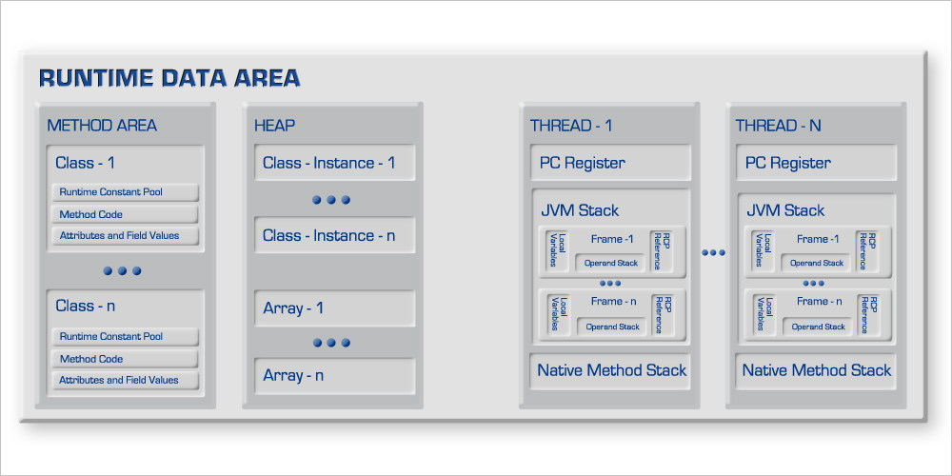
Architecture of JVM memory
Notes:
P37 – divide into 2 slides

Slide 4
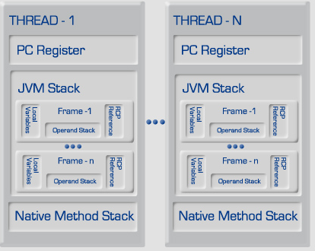
JVM Thread
1. PC Register
2. Stack
3. Native Stack
4. Frames
Notes:
P37 – divide into 2 slides

Slide 5
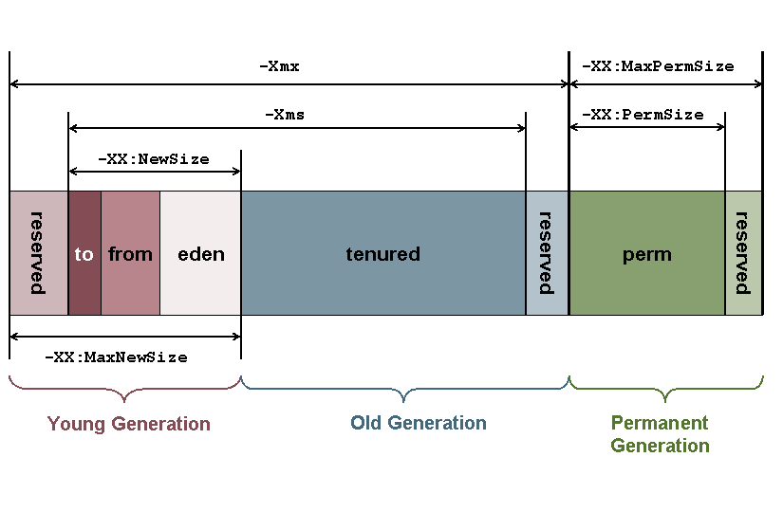
Heap
Notes:
P37 – divide into 2 slides

Slide 6
Stack and Heap
public class Memory {
public static void main(String[] args) { // Line 1
int i=1; // Line 2
Object obj = new Object(); // Line 3
Memory mem = new Memory(); // Line 4
mem.foo(obj); // Line 5
} // Line 9
private void foo(Object param) { // Line 6
String str = param.toString(); // Line 7
System.out.println(str);
} // Line 8
}
Notes:
P37 – divide into 2 slides

Slide 7
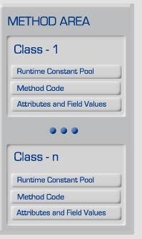
Perm Gen
Runtime Constant Pool
Method Code
Attributes
FieldsValues
Notes:
P37 – divide into 2 slides

Slide 8
Java 8 Memory
Notes:
P37 – divide into 2 slides

Slide 9
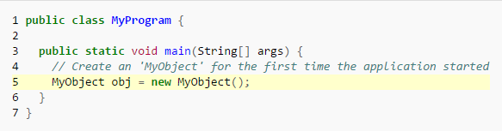
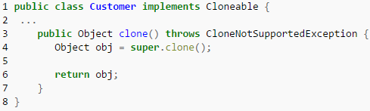
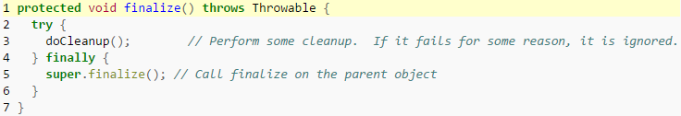
Object Lifecycle
Creating object with new keyword
Creating object by cloning an object
Creating object receiving from a remote source
Destroying objects

Slide 10
Garbage Collection algorithm classification
Serial versus Parallel
Concurrent versus Stop-the-world
Compacting versus Non-compacting versus Copying
Performance Metrics
Throughput
Garbage collection overhead
Pause time
Frequency of collection
Footprint
Promptness

Slide 11
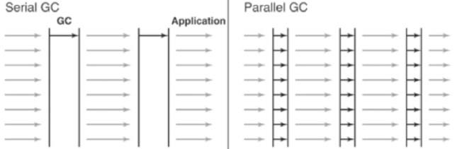
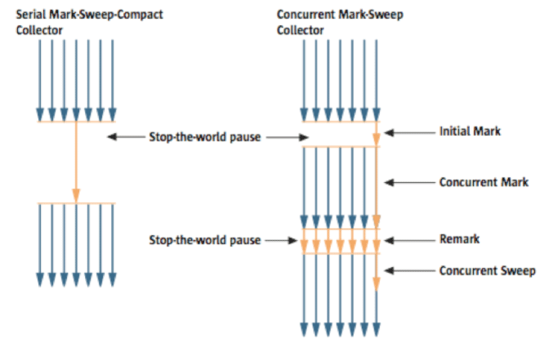

Garbage Collector types in Java
Serial GC (-XX:+UseSerialGC)
Parallel GC (-XX:+UseParallelGC)
Parallel Old GC (Parallel Compacting GC) (-XX:+UseParallelOldGC)
Concurrent Mark & Sweep GC (or "CMS") (-XX:+UseConcMarkSweepGC)
G1 GC (-XX:+UseG1GC)

Slide 12
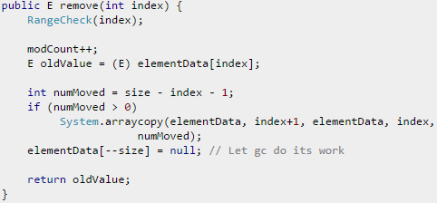
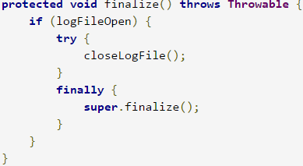
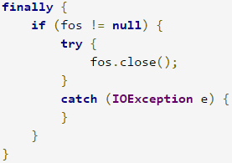
Code level optimization
Nulling
Finalization
Notes:
Pillars slide

Slide 13
System static methods to operate memory
System.gc()
System.runFinalization()
Runtime. freeMemory()
Runtime. totalMemory()
Runtime. maxMemory()

Slide 14
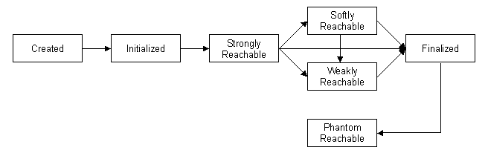
Reference object
Softly reachable
Weakly reachable
Phantom reachable

Slide 15
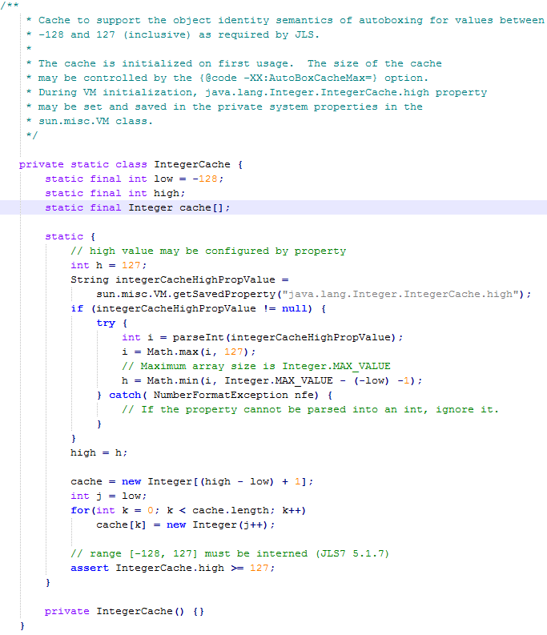
Memory optimization for Strings and Numbers
Number Caching
IntegerCache
ByteCache
ShortCache
LongCache
CharacterCache
String.intern()
a.equals(b) => a.intern() == b.intern()

Slide 16


