Slide 1


Patterns & Principles
Oleksii Barandii
May 12, 2016

Slide 2
Agenda
1
GoF Patterns
2
GRASP
3
SOLID
4
DRY, KISS, YAGNI principles
5
Architecture patterns
5
Architecture in general

Slide 3
GoF (Gang of Four) Patterns
Creational
Singleton
Factory Method
Abstract Factory
Builder
Prototype

Slide 4
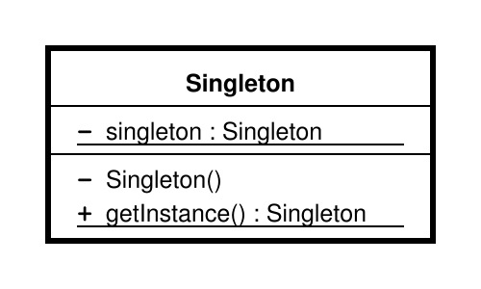
Singleton
Java usage:
java.lang.Runtime#getRuntime()

Slide 5
Factory Method
Java usage:
java.util.Calendar#getInstance()
Product
ConcreteProduct
ConcreteCreator
+factoryMethod()
return new ConcreteProduct

Slide 6
Abstract Factory
Java usage:
javax.xml.parsers.DocumentBuilderFactory#newInstance()
AbstractFactory
ProductA
ConcreteProductA2
ConcreteProductA1
AbstractFactory1
CreateProductA()
CreateProductB()
AbstractFactory2
CreateProductA()
CreateProductB()
ProductB
ConcreteProductB2
ConcreteProductB1

Slide 7
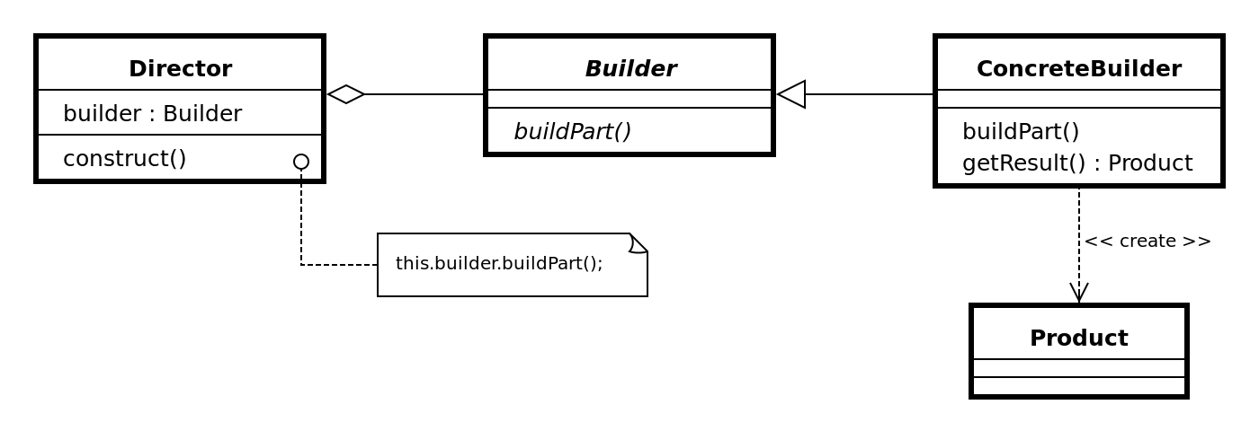
Builder
Java usage:
java.lang.StringBuilder#append()

Slide 8
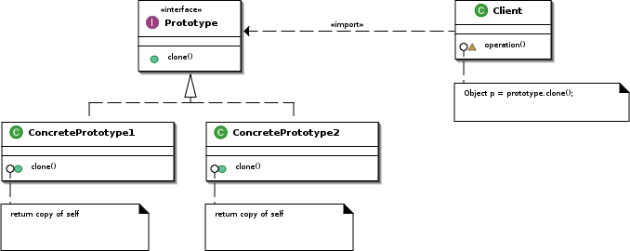
Prototype
Java usage:
java.lang.Object#clone() (the class has to implement java.lang.Cloneable)

Slide 9
GoF (Gang of Four) Patterns
Structural
Adapter
Bridge
Composite
Decorator
Facade
Flyweight
Proxy

Slide 10
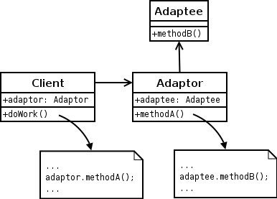
Adapter
Java usage:
java.util.Arrays#asList()
javax.xml.bind.annotation.adapters.XmlAdapter#marshal() and #unmarshal()

Slide 11
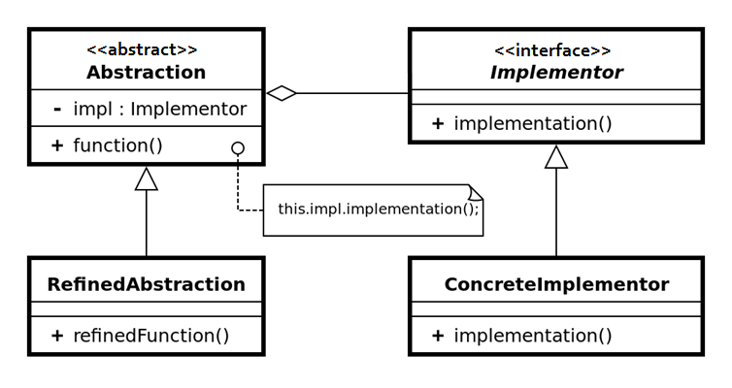
Bridge

Slide 12
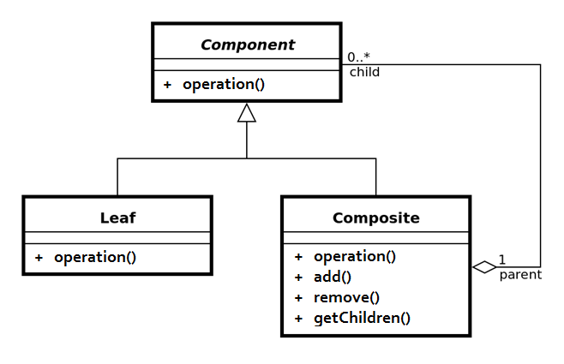
Composite
Java usage:
java.awt.Container#add(Component) (practically all over Swing thus)

Slide 13
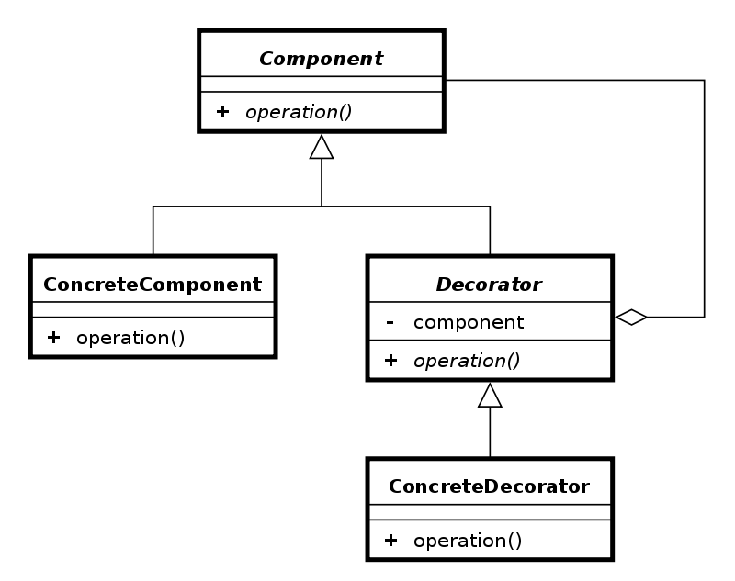
Decorator
Java usage:
All subclasses of java.io.InputStream, OutputStream, Reader and Writer have a constructor taking an instance of same type.

Slide 14
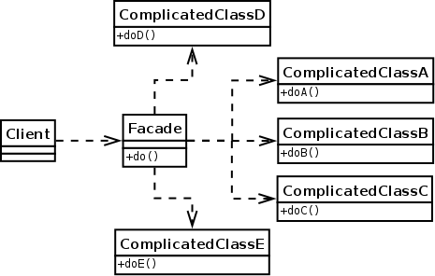
Facade
Java usage:
javax.faces.context.ExternalContext, which internally uses ServletContext, HttpSession, HttpServletRequest, HttpServletResponse, etc.

Slide 15
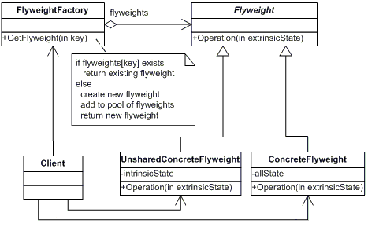
Flyweight
Java usage:
java.lang.Integer#valueOf(int) (also on Boolean, Byte, Character, Short, Long and BigDecimal)

Slide 16
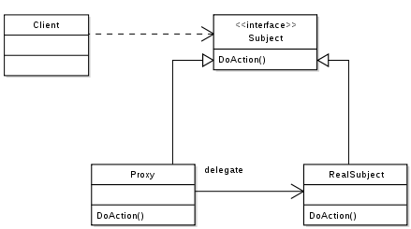
Proxy
Java usage:
java.lang.reflect.Proxy

Slide 17
GoF (Gang of Four) Patterns
Behavioral
Chain of responsibility
Command
Interpreter
Iterator
Mediator
Memento
Observer
State
Strategy
Template method
Visitor

Slide 18
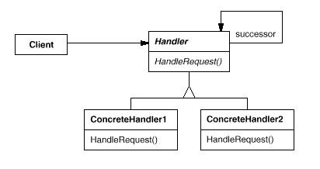
Chain of responsibility
Java usage:
java.util.logging.Logger#log()
javax.servlet.Filter#doFilter()

Slide 19
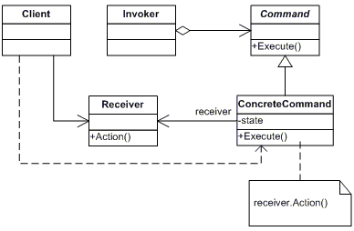
Command
Java usage:
All implementations of java.lang.Runnable
All implementations of javax.swing.Action

Slide 20
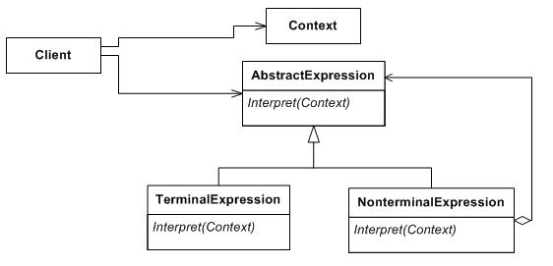
Interpreter
Java usage:
java.util.Pattern
java.text.Normalizer

Slide 21
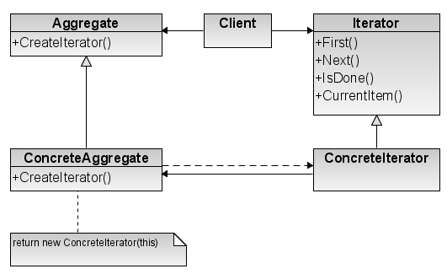
Iterator
Java usage:
All implementations of java.util.Iterator (thus among others also java.util.Scanner!).
All implementations of java.util.Enumeration

Slide 22
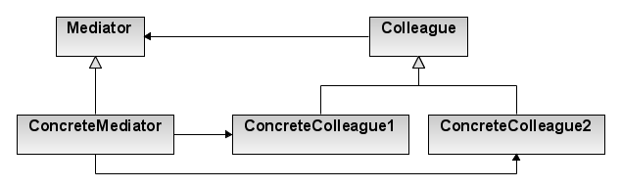
Mediator
Java usage:
java.util.Timer (all scheduleXXX() methods)
java.lang.reflect.Method#invoke()

Slide 23
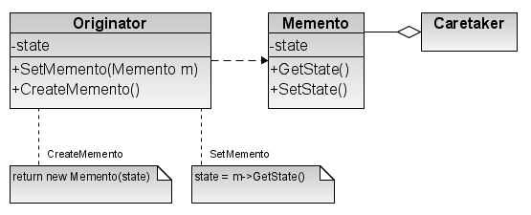
Memento
Java usage:
java.util.Date (the setter methods do that, Date is internally represented by a long value)
All implementations of java.io.Serializable
All implementations of javax.faces.component.StateHolder

Slide 24
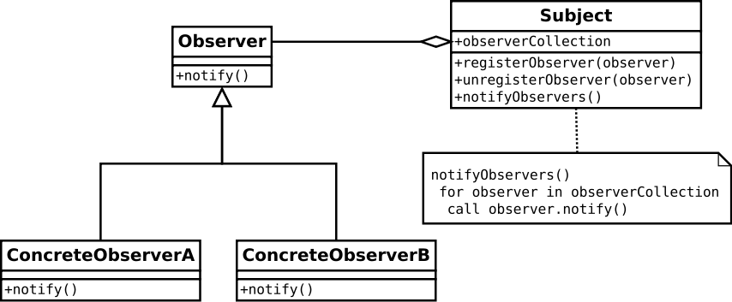
Observer
Java usage:
java.util.Observer/java.util.Observable (rarely used in real world though)
All implementations of java.util.EventListener (practically all over Swing thus)

Slide 25
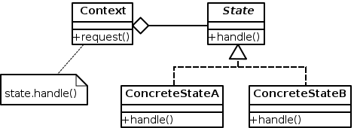
State
Java usage:
javax.faces.lifecycle.LifeCycle#execute() (controlled by FacesServlet, the behaviour is dependent on current phase (state) of JSF lifecycle)

Slide 26
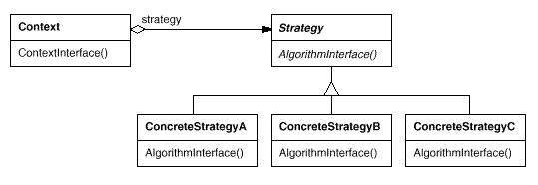
Strategy
Java usage:
java.util.Comparator#compare(), executed by among others Collections#sort().

Slide 27
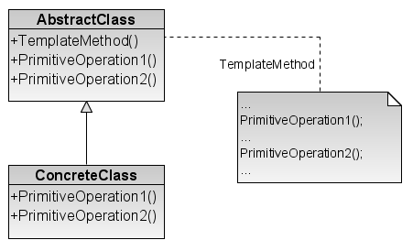
Template method
Java usage:
All non-abstract methods of java.io.InputStream, java.io.OutputStream, java.io.Reader and java.io.Writer.

Slide 28
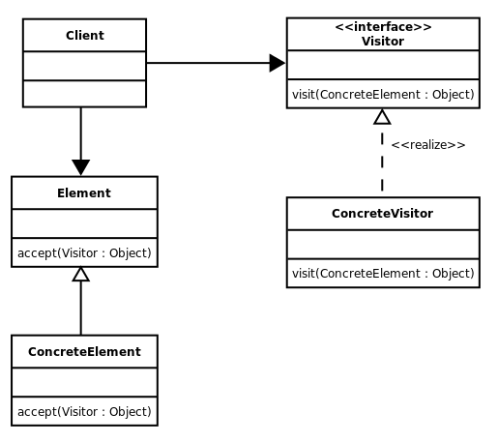
Visitor
Java usage:
javax.lang.model.element.AnnotationValue and AnnotationValueVisitor

Slide 29
GRASP (General Responsibility Assignment Software Patterns)
Information Expert
Creator
Low Coupling
High Cohesion
Controller
Polymorphism
Pure Fabrication
Indirection
Protected Variations

Slide 30
GRASP (General Responsibility Assignment Software Patterns)
Information Expert
Creator
Low Coupling
High Cohesion

Slide 31
Cohesion
Coincidental cohesion (worst)
Coincidental cohesion is when parts of a module are grouped arbitrarily; the only relationship between the parts is that they have been grouped together (e.g. a “Utilities” class).
Logical cohesion
Logical cohesion is when parts of a module are grouped because they are logically categorized to do the same thing even though they are different by nature (e.g. grouping all mouse and keyboard input handling routines).
Temporal cohesion
Temporal cohesion is when parts of a module are grouped by when they are processed - the parts are processed at a particular time in program execution (e.g. a function which is called after catching an exception which closes open files, creates an error log, and notifies the user).
Procedural cohesion
Procedural cohesion is when parts of a module are grouped because they always follow a certain sequence of execution (e.g. a function which checks file permissions and then opens the file).
Communicational/informational cohesion
Communicational cohesion is when parts of a module are grouped because they operate on the same data (e.g. a module which operates on the same record of information).
Sequential cohesion
Sequential cohesion is when parts of a module are grouped because the output from one part is the input to another part like an assembly line (e.g. a function which reads data from a file and processes the data).
Functional cohesion (best)
Functional cohesion is when parts of a module are grouped because they all contribute to a single well-defined task of the module (e.g. Lexical analysis of an XML string).

Slide 32
GRASP (General Responsibility Assignment Software Patterns)
Information Expert
Creator
Low Coupling
High Cohesion
Controller
Polymorphism
Pure Fabrication
Indirection
Protected Variations

Slide 33
SOLID
S
Single responsibility principle
a class should have only a single responsibility (i.e. only one potential change in the software's specification should be able to affect the specification of the class)

Slide 34
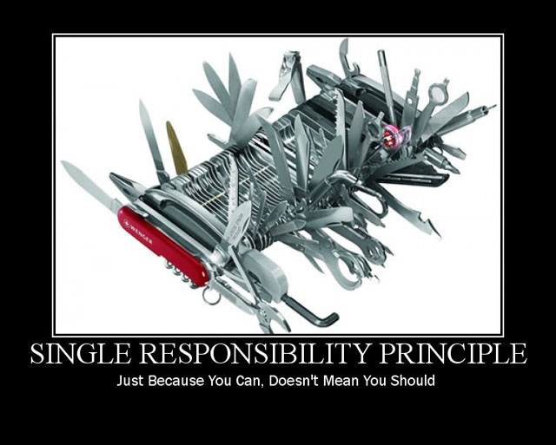
SOLID

Slide 35
SOLID
S
Single responsibility principle
a class should have only a single responsibility (i.e. only one potential change in the software's specification should be able to affect the specification of the class)
O
Open/closed principle
“software entities … should be open for extension, but closed for modification.”

Slide 36
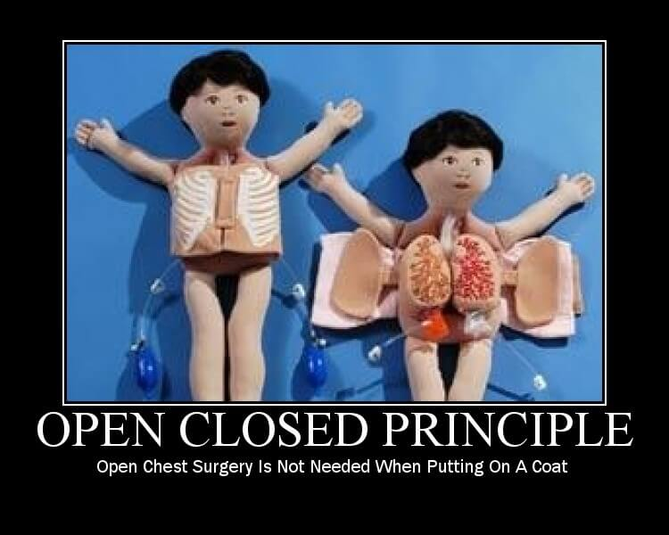
SOLID

Slide 37
SOLID
S
Single responsibility principle
a class should have only a single responsibility (i.e. only one potential change in the software's specification should be able to affect the specification of the class)
O
Open/closed principle
“software entities … should be open for extension, but closed for modification.”
L
Liskov substitution principle
“objects in a program should be replaceable with instances of their subtypes without altering the correctness of that program.” See also design by contract.

Slide 38
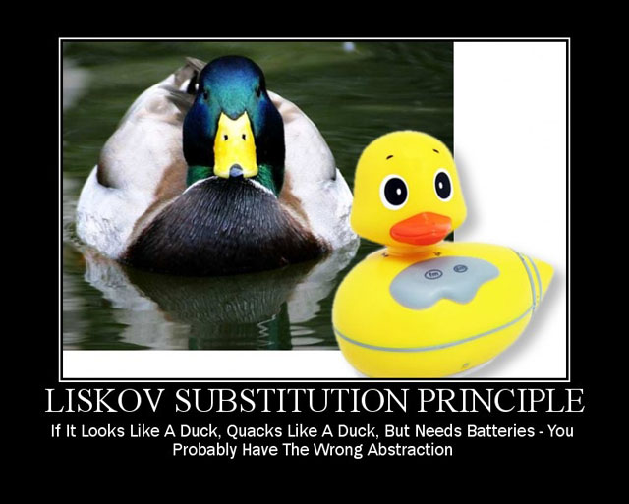
SOLID

Slide 39
SOLID
S
Single responsibility principle
a class should have only a single responsibility (i.e. only one potential change in the software's specification should be able to affect the specification of the class)
O
Open/closed principle
“software entities … should be open for extension, but closed for modification.”
L
Liskov substitution principle
“objects in a program should be replaceable with instances of their subtypes without altering the correctness of that program.” See also design by contract.
I
Interface segregation principle
“many client-specific interfaces are better than one general-purpose interface.”

Slide 40
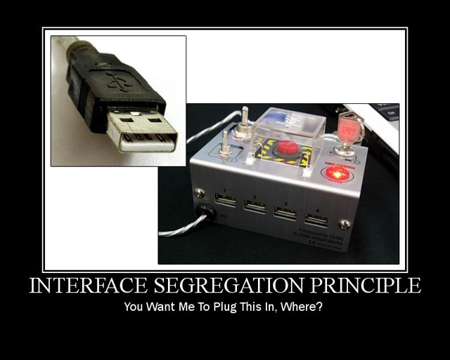
SOLID

Slide 41
SOLID
S
Single responsibility principle
a class should have only a single responsibility (i.e. only one potential change in the software's specification should be able to affect the specification of the class)
O
Open/closed principle
“software entities … should be open for extension, but closed for modification.”
L
Liskov substitution principle
“objects in a program should be replaceable with instances of their subtypes without altering the correctness of that program.” See also design by contract.
I
Interface segregation principle
“many client-specific interfaces are better than one general-purpose interface.”
D
Dependency inversion principle
one should “Depend upon Abstractions. Do not depend upon concretions.”

Slide 42
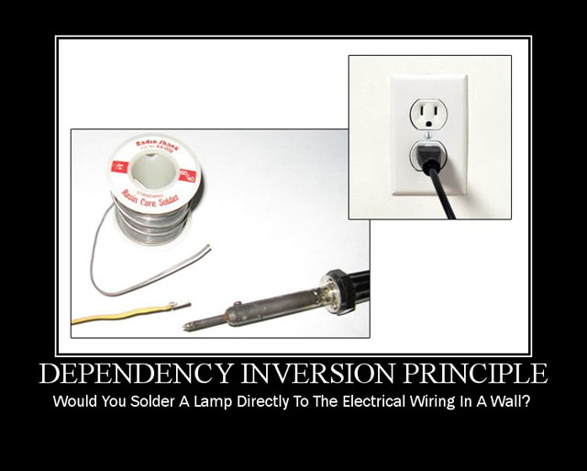
SOLID

Slide 43
DRY, KISS, YAGNI principles
DRY (don't repeat yourself) vs WET (write everything twice)
The DRY principle is stated as "Every piece of knowledge must have a single, unambiguous, authoritative representation within a system.“
WET solutions is commonly taken to stand for either "write everything twice", "we enjoy typing" or "waste everyone's time".
KISS (keep it simple stupid)
"Make everything as simple as possible, but not simpler" – is attributed to Albert Einstein
YAGNI (You Aren't Going to Need It)
"Always implement things when you actually need them, never when you just foresee that you need them.“
The point of YAGNI is that you don't add complexity that isn't needed for the current stories. This is part of the practice of simple design. Refactoring is needed to keep the design as simple as you can, so you should refactor whenever you realize you can make things simpler.

Slide 44
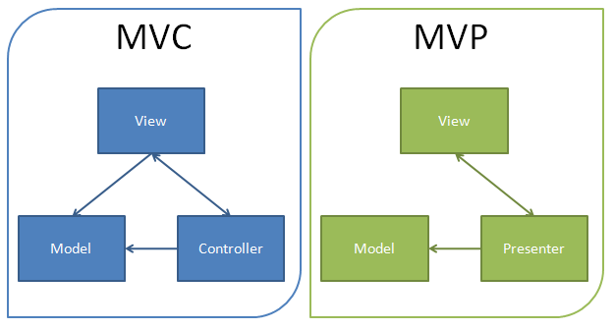
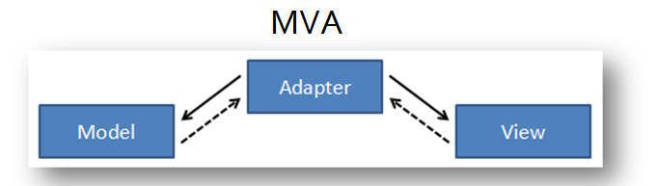
Architecture patterns

Slide 45
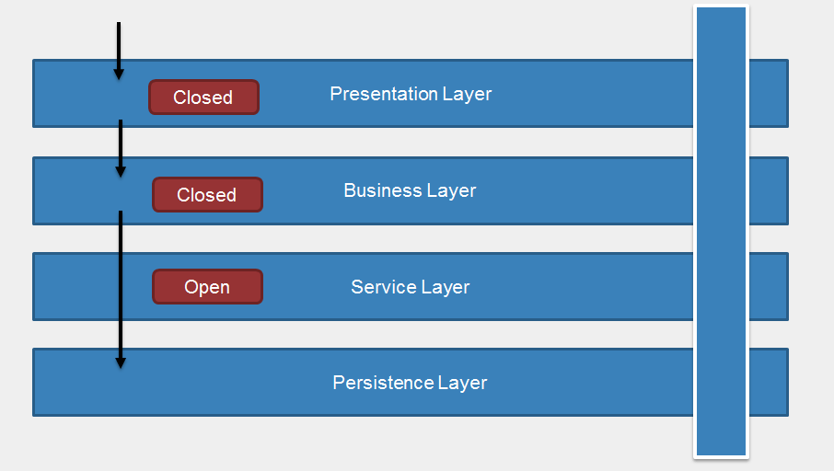
Logical layers & Tiers
Logical layers are merely a way of organizing your code. Typical layers include Presentation, Business and Data – the same as the traditional 3-tier model. But when we’re talking about layers, we’re only talking about logical organization of code. In no way is it implied that these layers might run on different computers or in different processes on a single computer or even in a single process on a single computer. All we are doing is discussing a way of organizing a code into a set of layers defined by specific function.
Physical tiers however, are only about where the code runs. Specifically, tiers are places where layers are deployed and where layers run. In other words, tiers are the physical deployment of layers.

Slide 46
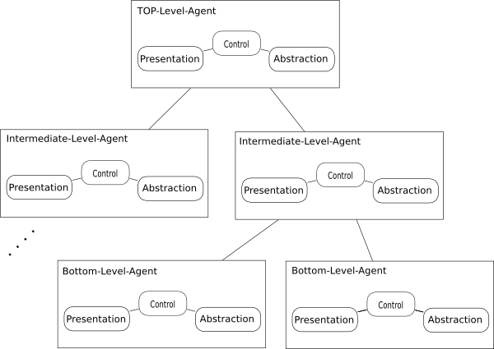
PAC (Presentation Abstraction Control)

Slide 47
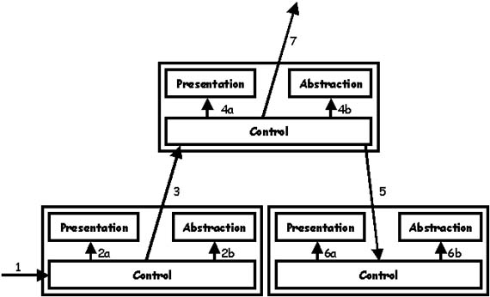
PAC (Presentation Abstraction Control)

Slide 48

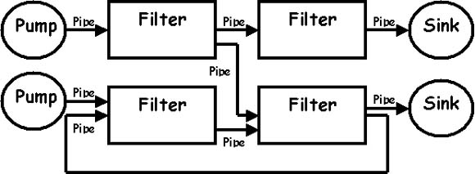
Architecture: pipes and filters

Slide 49
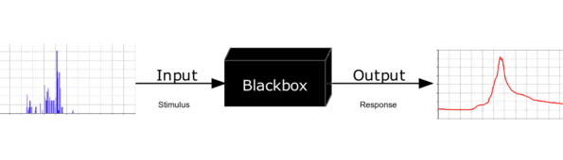
Architecture: blackbox

Slide 50
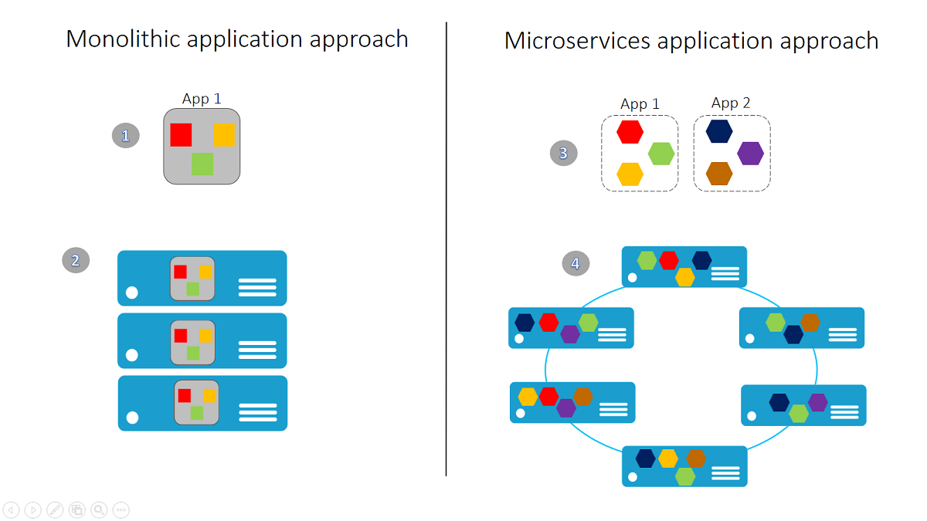
Microservices vs Monolith

Slide 51
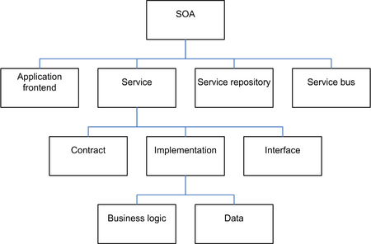
SOA (service-oriented architecture)

Slide 52
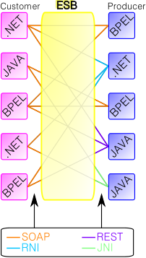
ESB (enterprise service bus)

Slide 53
Links
Wikipedia - https://en.wikipedia.org/wiki/
TutorialsPoint - http://www.tutorialspoint.com/design_pattern/
Garfixia Software Architecture - http://www.dossier-andreas.net/software_architecture/
Analysis of Software Architectures - http://www.firatatagun.com/blog/2016/01/09/analysis-of-software-architectures/
Examples of GoF in Java - http://stackoverflow.com/questions/1673841/examples-of-gof-design-patterns-in-javas-core-libraries
Lviv JaMP - https://kb.epam.com/display/GDOKB/Lviv+JaMP+-+Resources

Slide 54
Thank you!
May 12, 2016

