Slide 1

SOAP WEB SERVICES
SOAP – WSDL – JAXB – JAX-WS
FEBRUARY 20, 2016

Slide 2






Who am I?
Bohdan Lakotiy
Bohdan_Lakotiy@epam.com
Senior Software Engineer
CIS, Ukraine, Lviv
About five years of experience in Web Development and Support.
Working in SAP-SUPP teem since 2012.

Slide 3
AGENDA
What is Web Services
SOAP protocol
How to use SOAP
When and Why use SOAP
Conclusions and Questions

Slide 4



Boring theory…
Web Services - client and server applications that communicate over WWW and provide a standard means of interoperating between software applications running on a variety of platforms and frameworks
Distributed computing - model in which components of a software system are shared among multiple computers to improve efficiency and performance.
A long time ago in a galaxy far, far away...
an application was created, and with it came the first users…
Traditional Application
Distributed Computing
Web Services
XML
EJB(RMI)
JSON
Dude
Single Application
Application
Dude
Separated Applications but same platform
Application

Slide 5
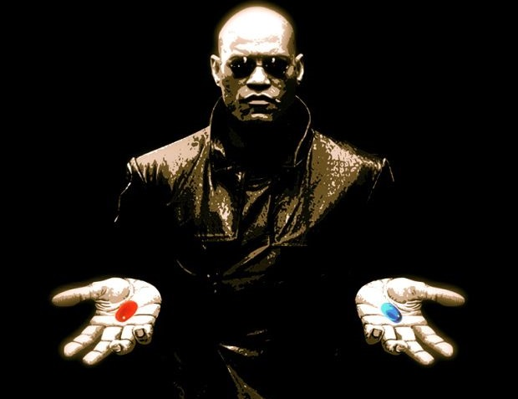
Choose your path Neo!
SOAP
REST

Slide 6
SOAP - Simple Object Access Protocol
Protocol specification for exchanging structured information in the implementation of web services
Extensibility
Neutrality
Independence
Standart XML format
easily extendable and well supported
Protocols support
HTTP, HTTPS, SMTP,
TCP, UDP, JMS
Protocol, Language
Platform and OS independence

Slide 7
Client - The message was incorrectly formed or contained incorrect information
Server - There was a problem with the server so the message could not proceed
VersionMismatch - Found an invalid namespace for the SOAP Envelope element
MustUnderstand - An immediate child element of the Header element, with the
mustUnderstand attribute set to "1", was not understood
<faultcode xsi:type="xsd:string">SOAP-ENV:Client</faultcode>
<faultstring xsi:type="xsd:string">
Failed to locate method (ValidateCreditCard) in class (examplesCreditCard) at...
</faultstring>
SOAP - Request
<?xml version="1.0"?>
<soap:Envelope
xmlns:soap="http://www.w3.org/2003/05/soap-envelope/"
soap:encodingStyle="http://www.w3.org/2003/05/soap-encoding">
  <soap:Header>
    <m:Trans xmlns:m="http://www.w3schools.com/transaction/"
    soap:mustUnderstand="1">234
    </m:Trans>
  </soap:Header>
  <soap:Body>
    <m:GetPrice xmlns:m="http://www.w3schools.com/prices">
    <m:Item>Apples</m:Item>
    </m:GetPrice>
    <soap:Fault>
    ...
    </soap:Fault>
  </soap:Body>
</soap:Envelope>
ENVELOPE
HEADER
BODY
soap:actor="URI“ / soap:role="URI“
soap:mustUnderstand="boolean“
soap:relay="boolean"

Slide 8
WSDL
Web Services Description Language
XML-based protocol for information exchange
in decentralized and distributed environments.
Details a standard way to describe a SOAP-based web service
Describe how to access a web service
and what operations it will perform.
Language for describing how to interface with
XML-based services.
Integral part of Universal Description, Discovery
and Integration (UDDI)

Slide 9
WSDL - Web Services Description Language
  <definitions>
  <types>
  definition of types...
  </types>
  <message>
  definition of a message...
  </message>
  <portType>
  <operation>
  definition of a operation...
  </operation>
  </portType>
  <binding>
  definition of a binding...
  </binding>
  <service>
  definition of a service...
  </service>
  </definitions>
Types
  Used to define custom message types
Messages
  Abstraction of request and response messages that my client and service need to communicate.
PortTypes
  Contains a set of operations.
  Operations organize WSDL messages.
  Operation->method name, portType->java interface
Bindings
  Binds the portType to a specific protocol (typically SOAP over http).
  You can bind one portType to several different protocols by using more than one port.
Services
  Gives you one or more URLs for the service.

Slide 10
XSD - XML Schema
<messageList>
<message>
<phone> 096123666 </phone>
<text> test message</text>
<date> 2013-07-20T12:00:00 </date>
<type> 12 </type>
</message>
...
<message>
<phone> 096123666 </phone>
<text>test message N</text>
<date>2013-07-20T12:00:00</date>
<type>12</type>
</message>
</messageList>
Data contract
that defines
message
format
<complexType name="Message">
<sequence>
<element name="phone" type="string“ minOccurs="1“ maxOccurs="1" />
<element name="text" type="string“ minOccurs="1" maxOccurs="1" />
<element name="date“ type="dateTime" minOccurs="1“ maxOccurs="1" />
<element name="type" type="decimal“ minOccurs="1" maxOccurs="1" />
</sequence>
</complexType>
<element name="messageList“ type="MessageList" />
<complexType name="MessageList">
<sequence>
<element minOccurs="1" maxOccurs="unbounded“ name="message“ type="Message"/>
</sequence>
</complexType>

Slide 11
SOAP/ Development approaches
Contract - first
Contract - last
write WSDL --- generate CODE
write CODE --- generate WSDL
[ Profs ]
Clients are decoupled from
any logic on the server
You can define exact structure for WSDL and request/response messages
[ Cons ]
You need to wright XSD
and apply additional configurations
[ Profs ]
You don't need to learn SOAP
or any XML-related technologies
Potentially faster development
[ Cons ]
No control over WSDL
and XML elements passed in SOAP payload

Slide 12
SOAP/ Generate it!
JAXB generated java classes from schema types
Service Endpoint Interface (SEI)
Exception class - mapped from wsdl:fault
Async Reponse Bean - derived from response wsdl:message
wsimport
D:\>wsimport –d files –s src http://www.example.com/some.service?WSDL
Generates JAX-WS portable artifacts used in JAX-WS web services from your web Service Endpoint Implementation class
wsgen
D:\>wsgen -wsdl –d files –s src -cp com.example.ws.WebService

Slide 13

KITTIES and BOOBIES
YOU ARE NOT PREPARED!

Slide 14

SOAP/ JAX-WS
Java API for XML Web Services
Wright JAX-WS Server
Create Web Service Endpoint Interface
Create Web Service Endpoint Implementation
Publish your WSDL
Wright JAX-WS Client
Use -wsimport to generate necessary client files from WSDL
Make a remote call.

Slide 15
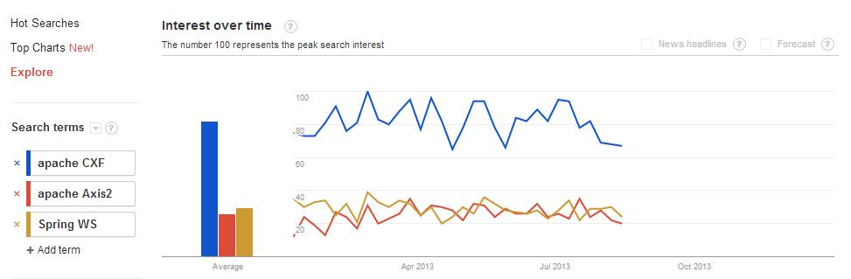
SOAP/ Frameworks
Apache CXF
Apache Axis2
Spring WS
[ Profs ]
Fully compliant with JAX-WS
Contract-First and
Contract-Last support
[ Cons ]
Comparatively more coding
[ Profs ]
Contract-First and
Contract-Last support
[ Cons ]
Not fully compliant for JAX-WS.
Comparatively more coding
[ Profs ]
Supports JAX-WS Annotations
Best for Contract-First
[ Cons ]
No Contract-Last support

Slide 16
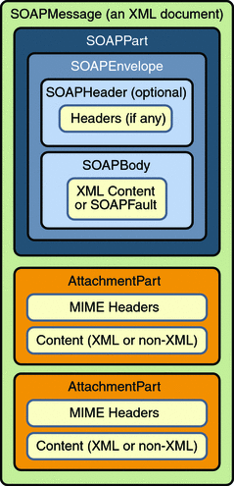
SOAP/ SAAJ
SAAJ
Why SOAP needs attachments?
- All parts of a SOAP message must conform to XML rules.
- Possible memory issues
since entire SOAP message is parsed before further processing.
MIME Headers + Contens

Slide 17
SOAP/ Extended Specifications
WS-Security
Specifies how integrity and confidentiality can be enforced on messages and allows the communication of various security token formats, such as SAML, Kerberos, and X.509
WS-Trust – dealing with the issuing, renewing, and validating of security tokens
XML Encryption – defines how to encrypt the contents of an XML element
XML Signature - defines an XML syntax for digital signatures
WS-Transaction
Defines two coordination types: Atomic Transaction for individual operations
and Business Activity for long running transactions
WS-ReliableMessaging
Describes a protocol that allows SOAP messages to be reliably delivered between distributed applications in the presence of software component, system, or network failures
WS-Discovery
Defines a multicast discovery protocol to locate services on a local network
operates over TCP and UDP port 3702 and uses IP multicast address 239.255.255.250

Slide 18
When to SOAP?
NOT if you just need a simple Web Service
NOT if you are looking for an easy way to build a Web Service
NOT if traffic matters
NOT if all operations are stateless
YES if you require reliable messaging
YES if you need Statefull operations and Transactions
YES if Security matters
YES if you go Enterprise

Slide 19
QUESTIONS?
Don’t you dare!

Slide 20

May the SOAP be with You!

