Slide 1


JAVA Debugging Best Practices
LVIV 2016 (v0.1)
FOR JAVA DEVELOPERS
VOLODYMYR SHYNKLIAR
MARCH, 2016

Slide 2
AGENDA
1
Java Debugging Architecture overview
2
Breakpoints
3
Navigation in debug mode
4
Exploring program’s state
5
Changing program's state
6
Have not sources ?

Slide 3
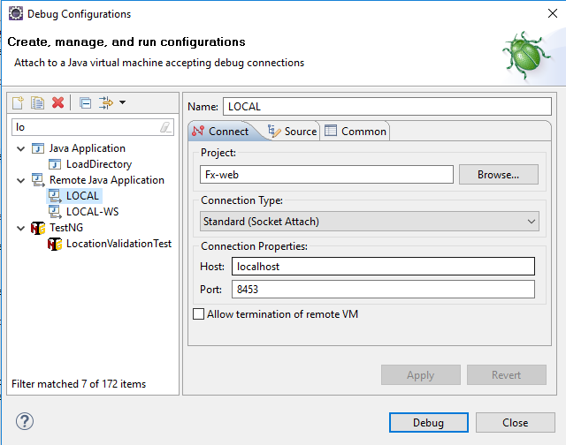
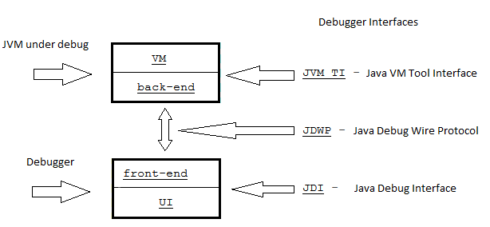
Java Debugging Architecture overview
-Xdebug -Xrunjdwp:transport=dt_socket,address=8453,server=y,suspend=n

Slide 4
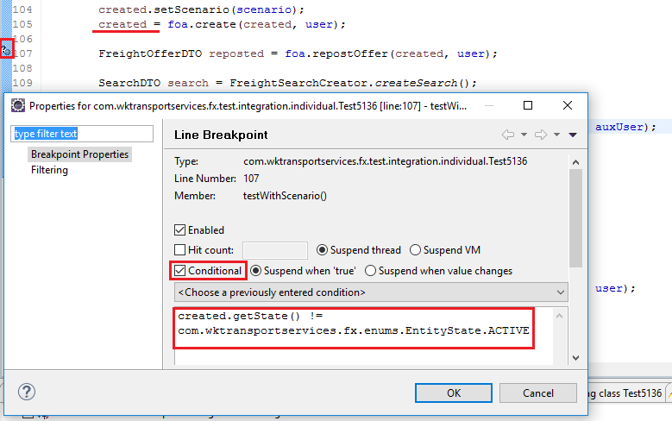
Breakpoints - conditional
Conditional breakpoint

Slide 5
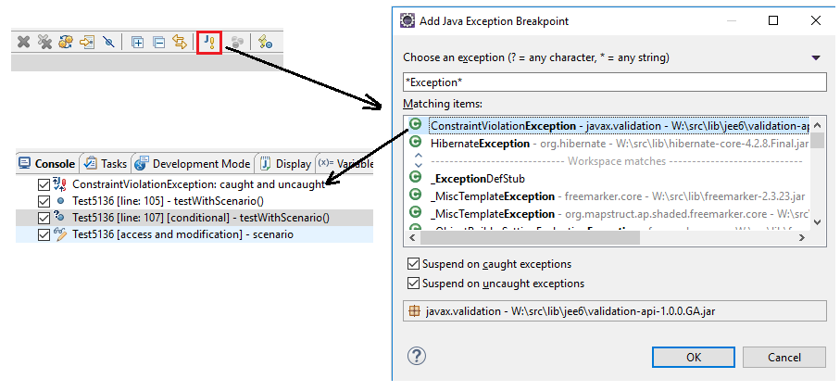
Breakpoints – on exception
Exception breakpoint

Slide 6
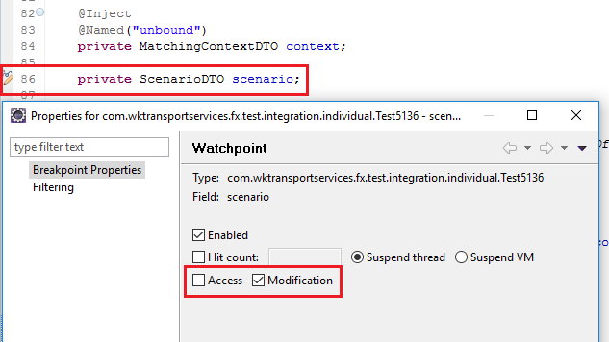
Breakpoints – on field
Field breakpoint

Slide 7
Navigation in debug mode - base
Use your keyboard !
Step Over – F6
Step Into – F5
Step Return – F7
Release – F8
Go to Line – Ctrl+R
Step Into Selection – Ctrl+F5
Toggle Breakpoint – Ctrl+Shift+B

Slide 8
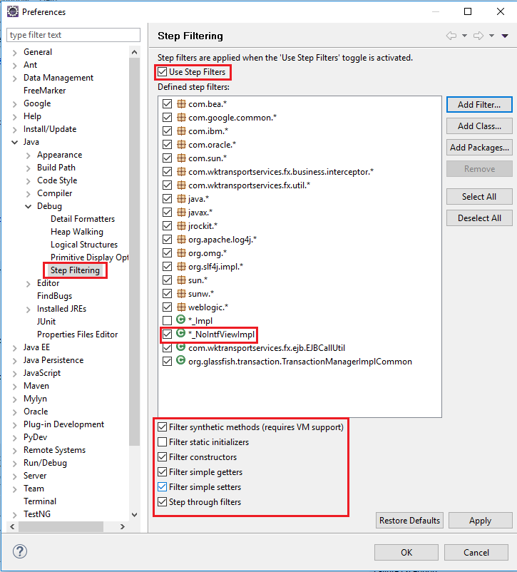
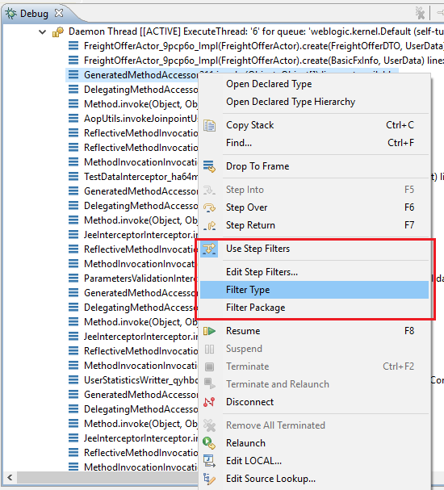
Navigation in debug mode – types filtering

Slide 9
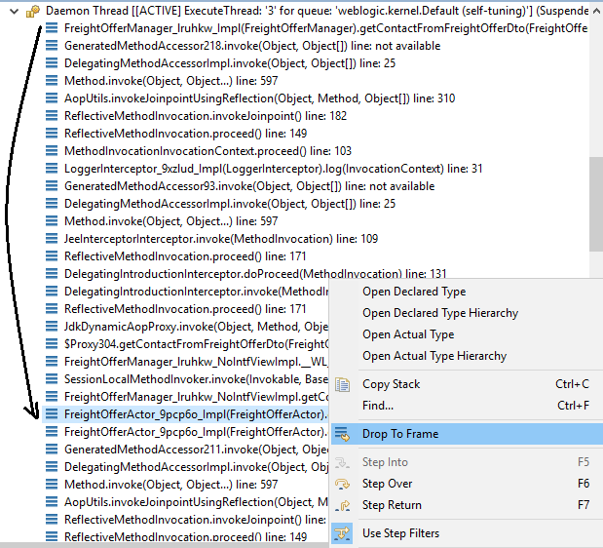
Navigation in debug mode – Drop to Frame

Slide 10
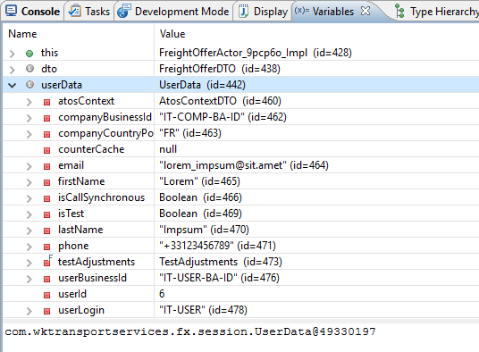
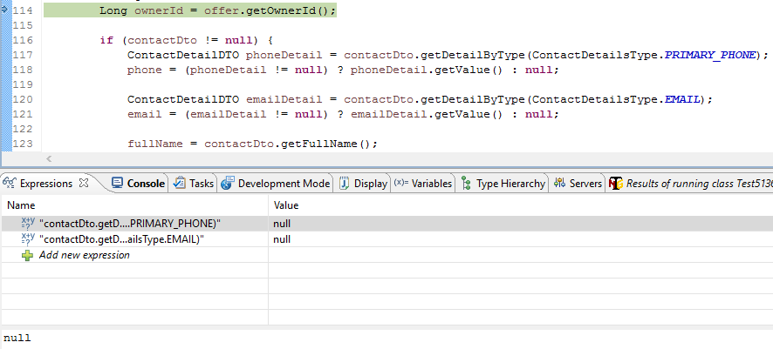
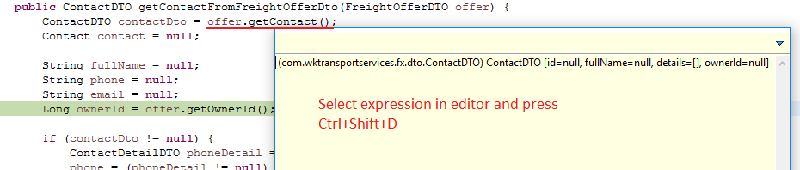
Exploring program’s state - Basic

Slide 11
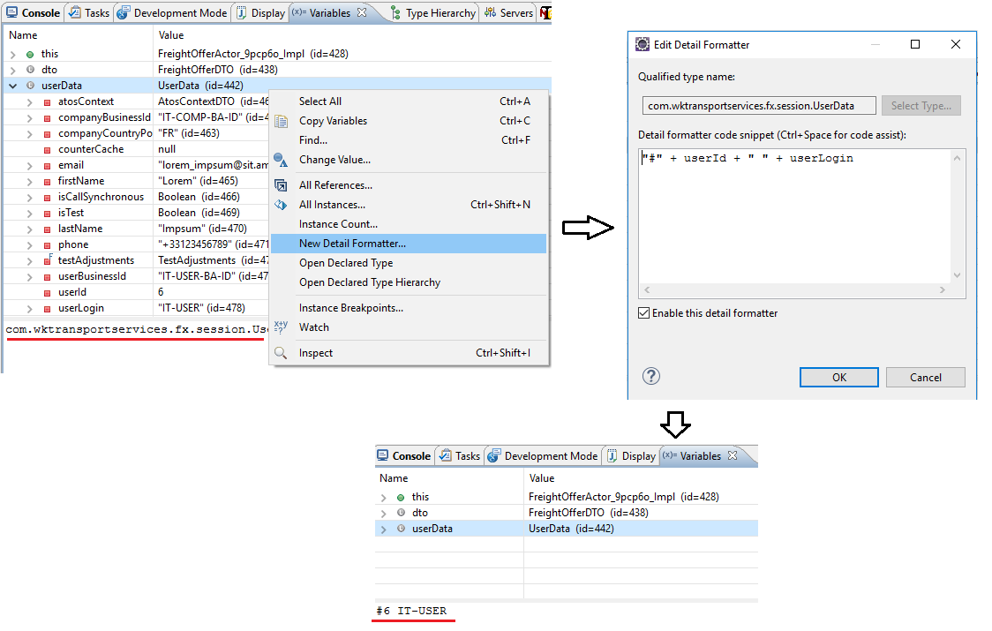
Exploring program’s state – Custom Formatting

Slide 12
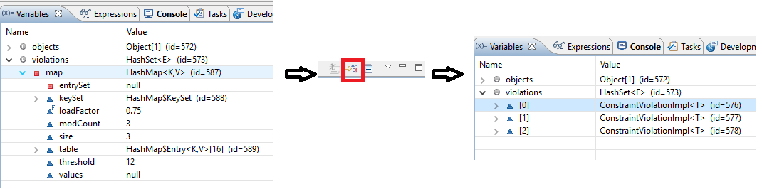
Exploring program’s state – Collections’ Logical View

Slide 13
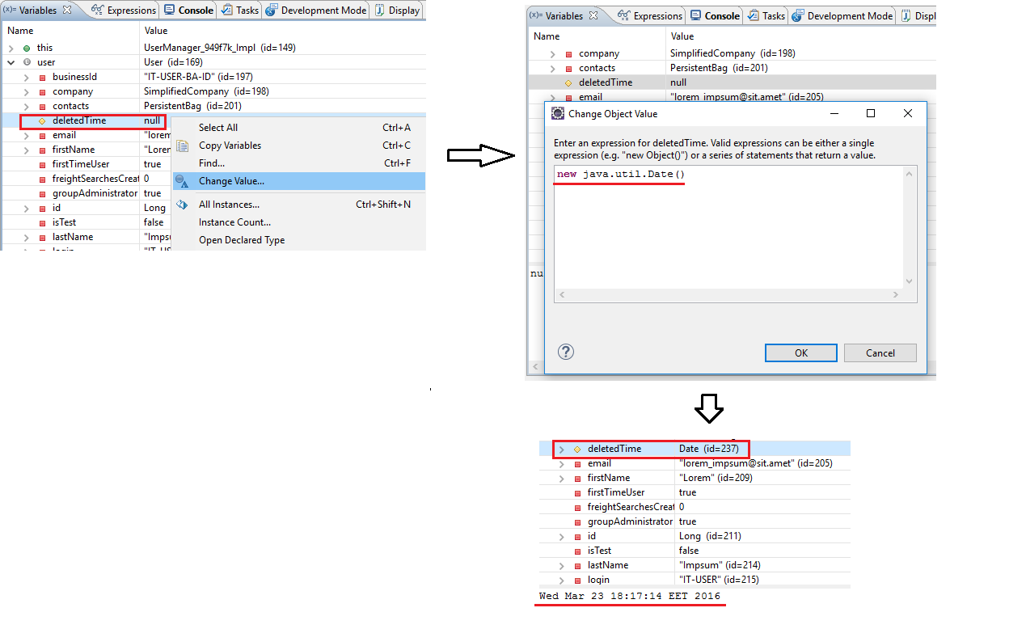
Changing program's state - variables

Slide 14
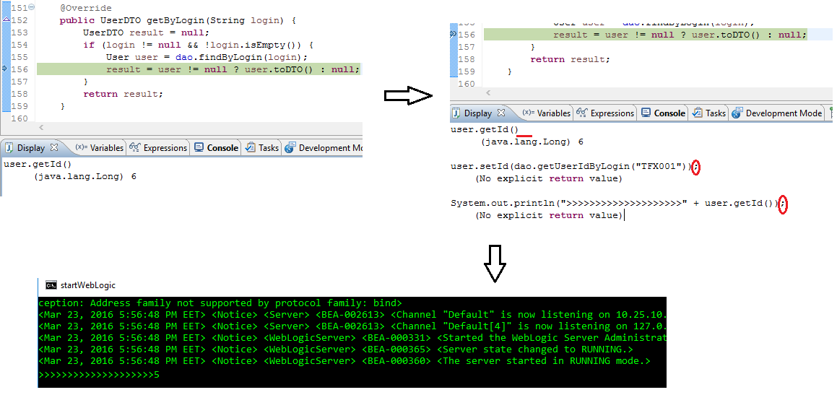
Changing program's state - Display

Slide 15
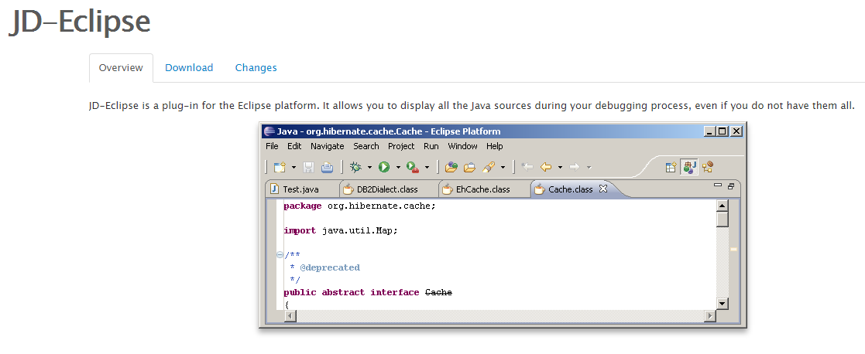
Have not sources ? - Decompiler
http://jd.benow.ca/

Slide 16
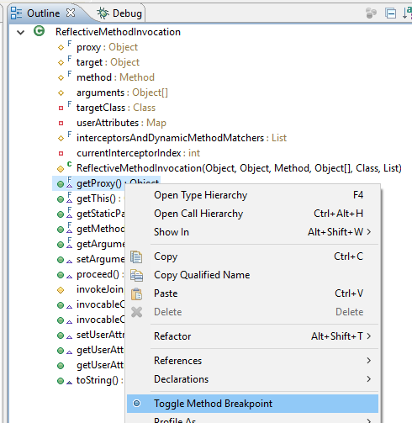
Have not sources ? – Use Outline view

Slide 17

MORE INFORMATION
Lviv JaMP Knowledge Base

