Slide 1
License Plate Detection
Devanshi Pandey (E22CSEU1217)
Shristi Rai (E22CSEU1205)
Pranay Ramtekkar (E22CSEU1214)

Slide 2

Problem Statement
•⁠ ⁠Difficult to detect license plates on fast-moving vehicles
•⁠ ⁠CCTV systems capture low-resolution or blurred footage
•⁠ ⁠Tracking vehicles involved in accidents, violations, or crimes is unreliable

Slide 3

Proposed Solution
•⁠ ⁠License plate detection using template matching
•⁠ ⁠Designed to integrate with existing CCTV infrastructure
•⁠ ⁠Enables better monitoring and traceability of vehicles

Slide 4

Tech Stack
Frontend: Streamlit for interactive web interface.
Backend: Python with OpenCV, TensorFlow/Keras.
Models: Template Matching for plate detection, CNNs like (VGG/ResNet)
Preprocessing: Histogram Equalization, Image Resizing.

Slide 5
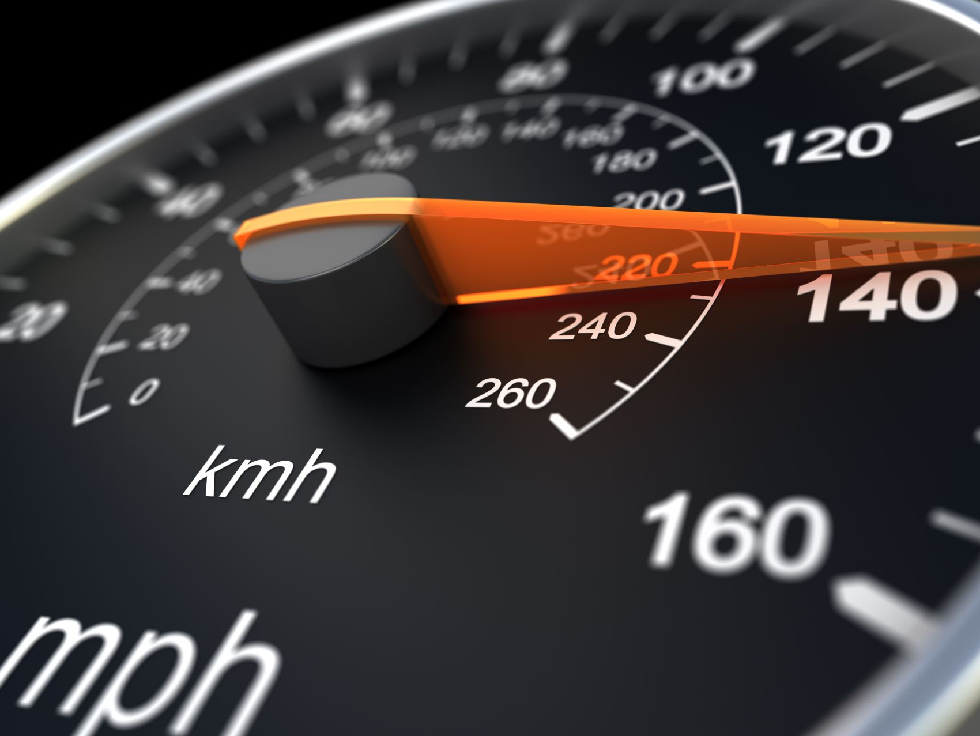
Methodology
•⁠ ⁠Data Collection: Vehicle images under varied conditions
•⁠ ⁠Preprocessing: Resize + contrast enhancement
•⁠ ⁠Detection Pipeline:
1. Sliding window + template matching
2. Non-Maximum Suppression (NMS) to refine results
•⁠ ⁠Output: Detected license plate regions displayed to the user

Slide 6
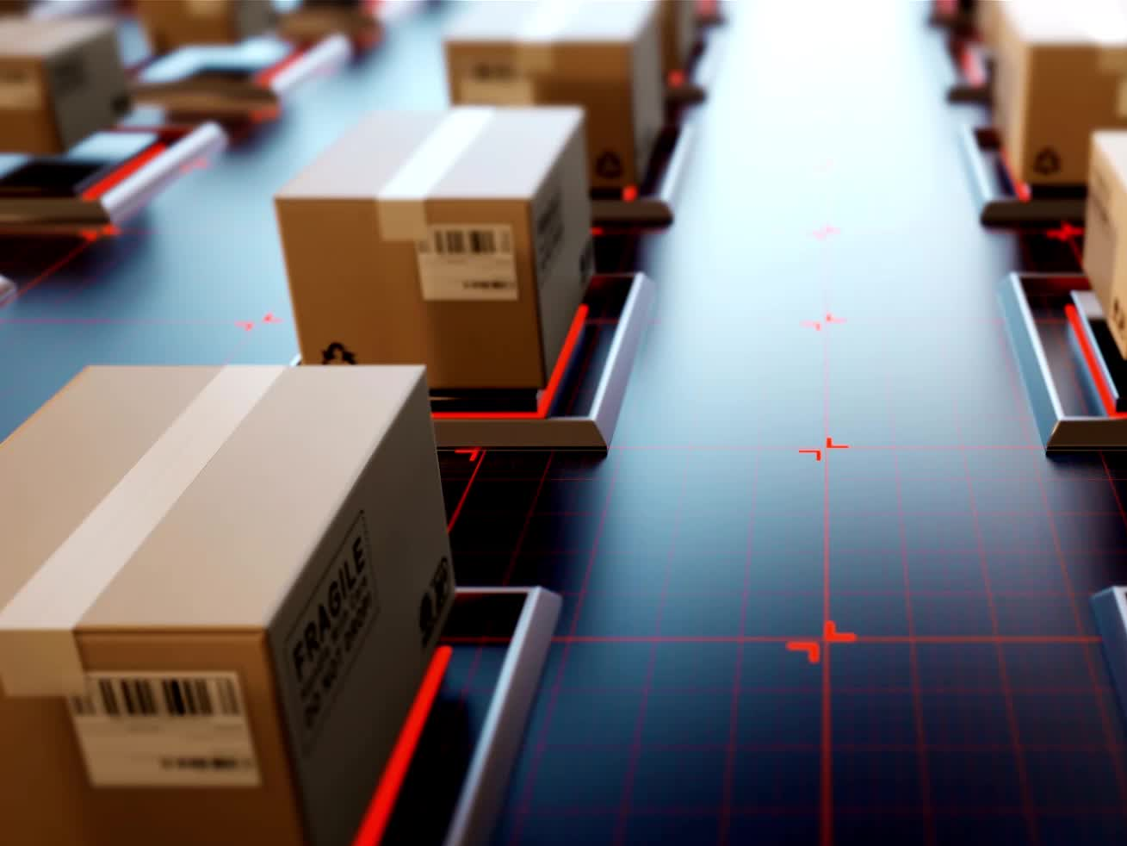
User Interface (Streamlit)
•⁠ ⁠Built using Streamlit
•⁠ ⁠Upload vehicle images
•⁠ ⁠Output: Image with license plate detected and highlighted
•⁠ ⁠Simple, responsive interface for testing and demonstration

Slide 7
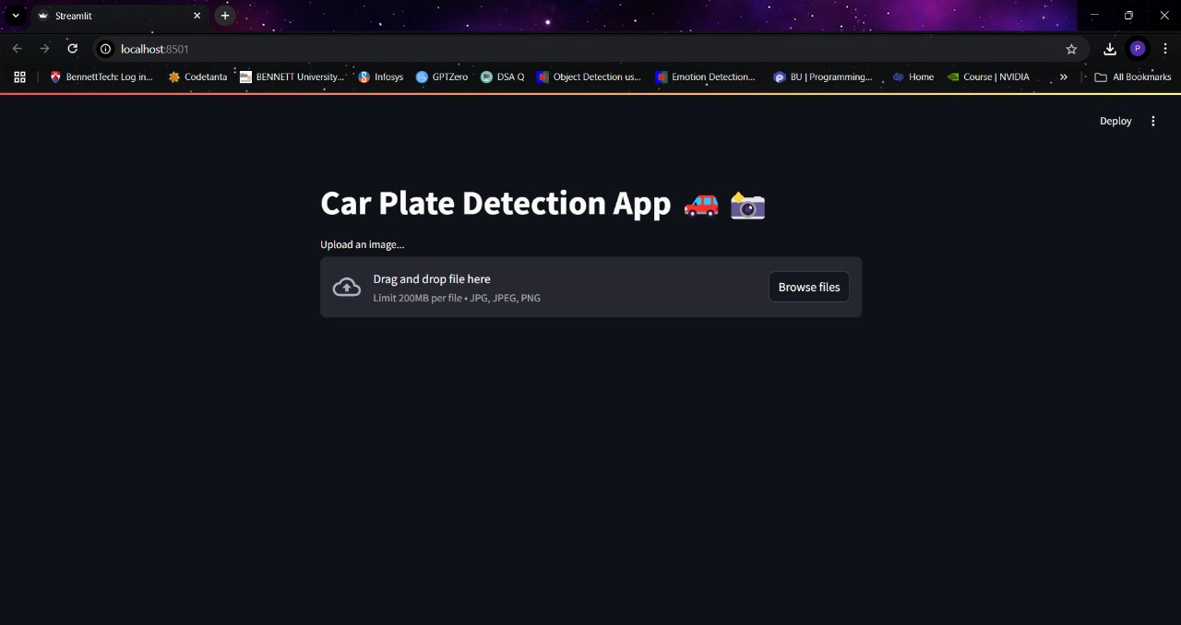
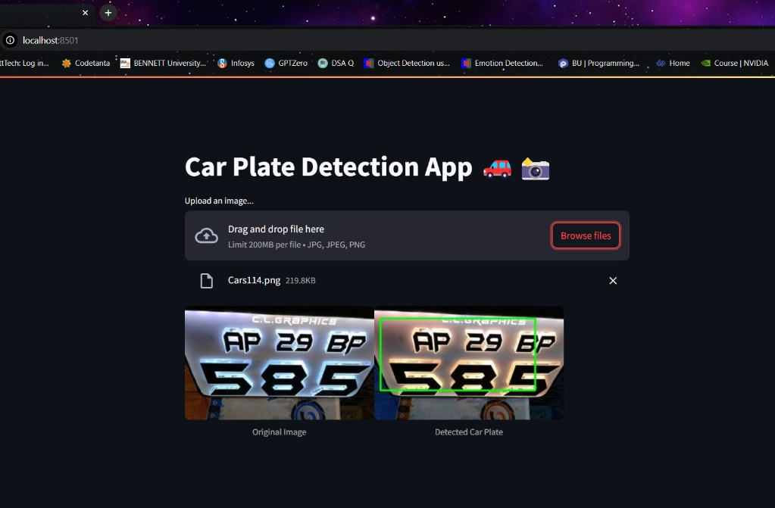
User Interface

Slide 8
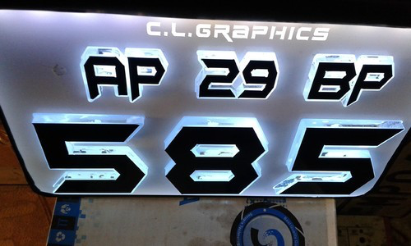
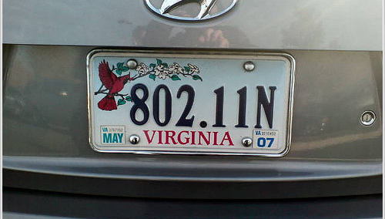
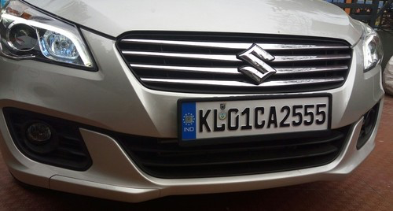
OUTPUTS

Slide 9
Results and Impact
•⁠ ⁠Detects plates even in poor lighting or partial occlusion
•⁠ ⁠More robust than relying on OCR or face data alone
•⁠ ⁠Practical for:
* Accident forensics
* Rule enforcement
* Smart city surveillance

Slide 10
Future Work
•⁠ ⁠Add driver face detection and recognition
•⁠ ⁠Extend to real-time video stream analysis from CCTV
•⁠ ⁠Improve detection accuracy with deep learning models (e.g., YOLO)
•⁠ ⁠Deploy on edge devices for live roadside monitoring
•⁠ ⁠Support multilingual license plates and automatic alerting

