Slide 1



VISION IQ: AN Advanced Visual Question Answering (VQA) System Using CNN, LSTM, and Transformer based Multimodal Fusion
Hasbi Fathima VP, E22CSEU0750

Slide 2
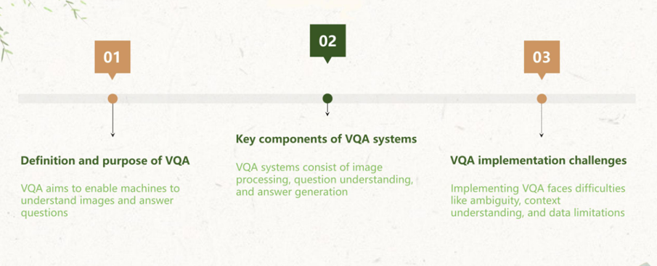
OVERVIEW OF VQA

Slide 3
INTRODUCTION
Visual Question Answering (VQA) is a cutting-edge AI task combining computer vision and natural language processing.
VisionIQ is designed to answer textual questions about images by understanding both visual and linguistic inputs.
VisionIQ uses a deep learning pipeline integrating:
CNNs for extracting image features,
LSTMs for understanding question semantics,
Transformer-based models for multimodal fusion.
Focused on TextVQA tasks, where recognizing and reasoning over text in images is critical.
Bridges the gap between what machines see and what they understand in human language.

Slide 4

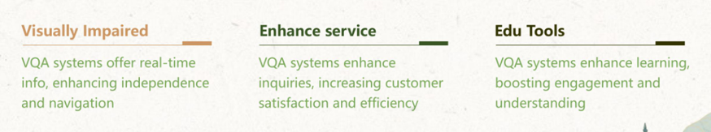
APPLICATIONS OF VQA

Slide 5
DATASET
Link: https: https://huggingface.co/datasets/facebook/textvqa
Dataset Description:
Comprises 45,336 question-answer pairs spanning 28,408 images sourced from the OpenImages dataset.
Each question requires contextual understanding of both visual and textual elements in the image.
Supported Task: Visual Question Answering – answering natural language questions based on image content.
Language: All questions are in English.

Slide 6
LITERATURE SURVEY
Bhardwaj et al. (2023)
Multimodal Learning for Accurate Visual Question Answering: An Attention-Based Approach
Introduced attention-based multimodal alignment that significantly improved interpretability and accuracy.
Nguyen et al. (2024)
Advancing Vietnamese Visual Question Answering with Transformer and Convolutional Integration
Demonstrated improved results by combining CNNs and Transformers, especially in under-resourced languages.
Chatterjee et al. (2023)
Vision-Language Models in VQA: Role of OCR and Multimodal Embeddings
Emphasized the role of Optical Character Recognition (OCR) in TextVQA datasets.
Wu et al. (2022)
Hierarchical Attention Mechanisms for Visual Question Answering
Proposed a multi-level attention system to capture spatial, textual, and semantic nuances.
Chen & Zhao (2023)
Unified Transformer Architectures for Vision-Language Tasks
Developed a unified encoder-decoder architecture for VQA and captioning tasks.
Ramaswamy & Singh (2025)
Multilingual and Multimodal VQA with Cross-Lingual Transformers
Proposed a model handling multilingual questions over diverse image sets, pushing VQA towards global adaptability.

Slide 7
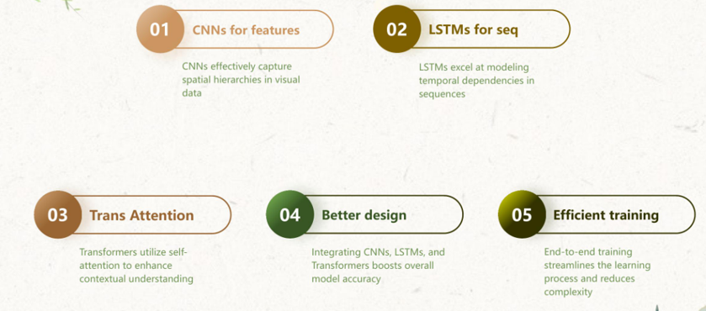
ARCHITECTURE SUMMARY

Slide 8
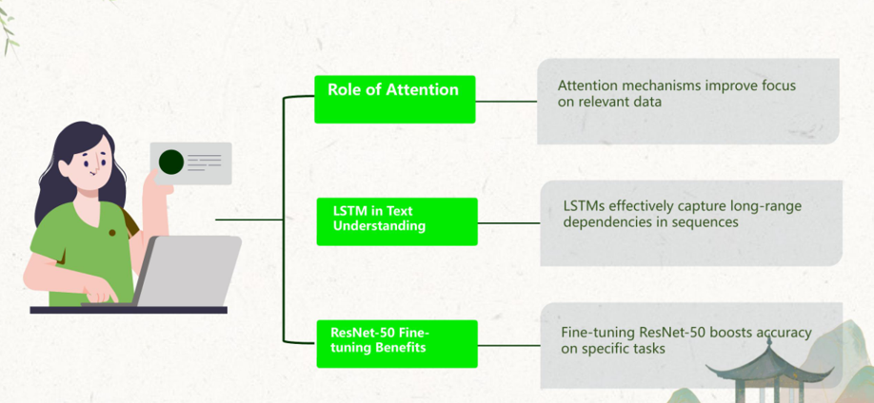

Slide 9

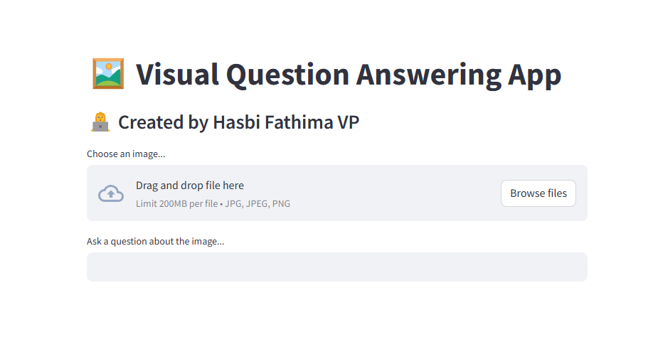
FRONTEND
DEPLOYED USING STREAMLIT

Slide 10
THANK YOU

