Slide 1

Crime and Unemployment: Any Correlation- The Case of Nashville, TN, Louisville, KY and Birmingham AL
Chiedozie M. Uhuegbu
Nashville Software School, DA10

Slide 2
Overview
My capstone will analyze crime data and police call-for-service records in three cities: Nashville, Tennessee; Louisville, Kentucky; and Birmingham, Alabama.
The project will also incorporate unemployment rate data from these cities to explore potential correlations and patterns.
The overarching goal is to understand how economic factors influence crime rates and the demand for police services in these urban areas.
I hope to analyze historical crime data to identify patterns in criminal activities such as theft, burglary, assault, vandalism, and more within the selected cities.
My capstone represents a comprehensive effort to understand the complex interplay between economic conditions, and public safety concerns.
Notes:
I anticipate that the results will provide valuable insights that can inform policy decisions and law enforcement strategies aimed at improving public safety and quality of life in metro cities in the south of America.

Slide 3
Where?
The data from Nashville, TN, is provided by the Metro Nashville Police Department, Information Technology,
For Louisville, KY, the Crime report data is provided for Louisville Metro Police Divisions
Birmingham, AL, is provided by four different police precincts, East, West, North, and South Police Precincts.

Slide 4
Why Unemployment and Crime Data?
37210 Zip code and Graduate School
provide valuable insights into the patterns, trends, and factors influencing criminal activities in various regions.
diverse demographic profiles
distinct geographic locations.
the South of the United States,
Notes:
I have chosen these crime data because I believe that crime data analysis will provide valuable insights into the patterns, trends, and factors influencing criminal activities in various regions. My proposal outlines a data analysis capstone project to analyze crime data and police call-for-service records in three cities: Nashville, Tennessee; Louisville, Kentucky; and Birmingham, Alabama. I selected the cities of Nashville, Louisville, and Birmingham due to their diverse demographic profiles and distinct geographic locations. Again, these cities are in the South of the United States, close to each other, and probably have a similar population.

Slide 5
close to each other, and
probably have a similar population.
have robust data collection and
reporting systems,
ensuring the availability of comprehensive and reliable data for the project.
Notes:
Furthermore, these cities have robust data collection and reporting systems, ensuring the availability of comprehensive and reliable data for the project.

Slide 6
Driving Questions
What are the most common types of crimes reported in each of the three cities, and how do they compare?
How do the rates of violent crimes, such as homicide and aggravated assault, compare across the three cities, does the LMPD beat count influence the crime rate?
Does the location influence the crime rate?

Slide 7
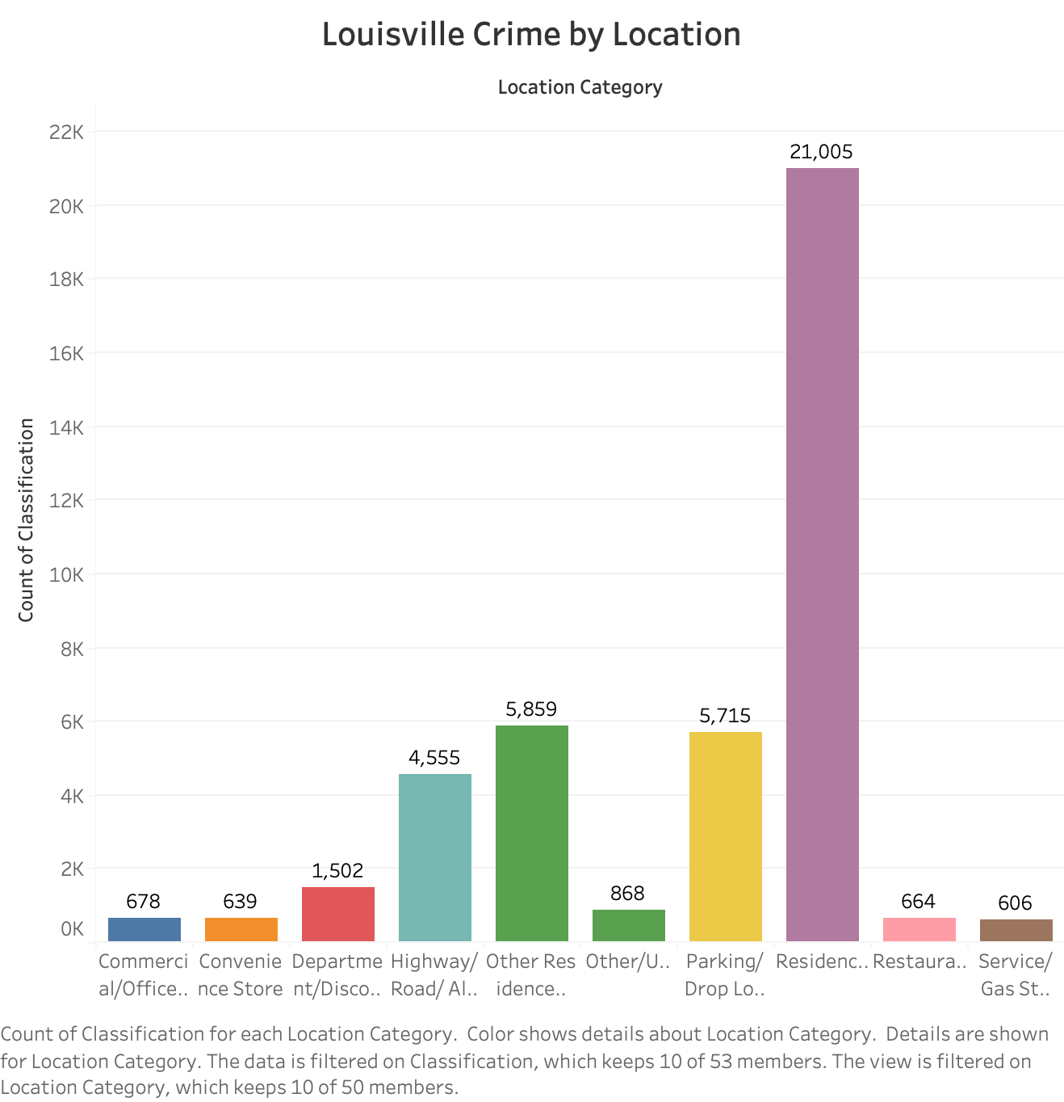

Slide 8
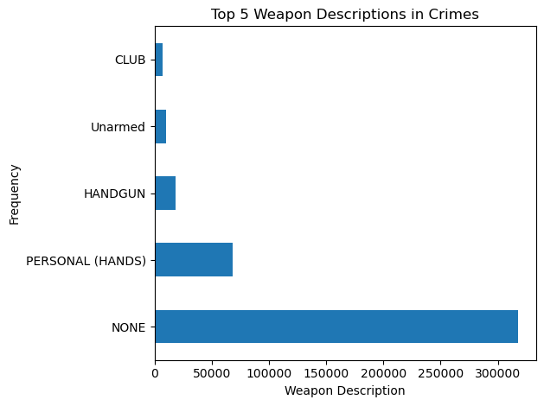

Slide 10
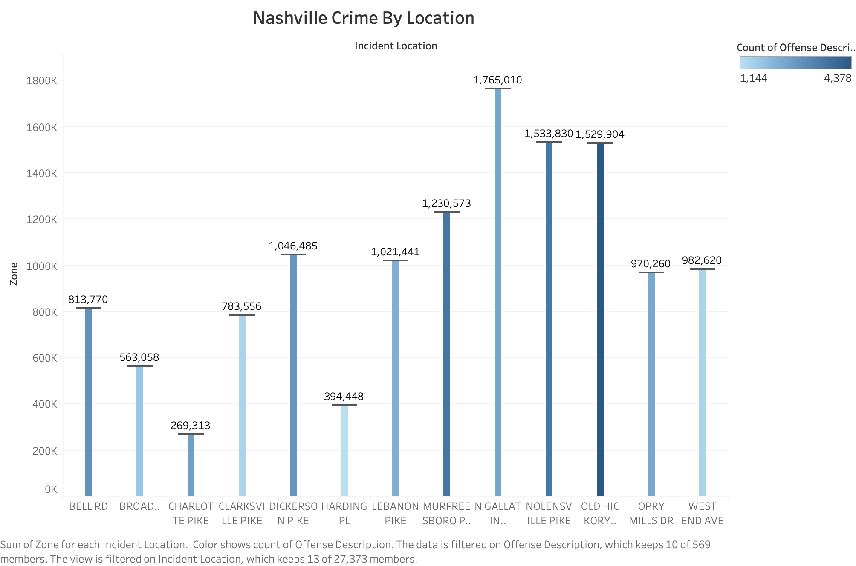

Slide 11
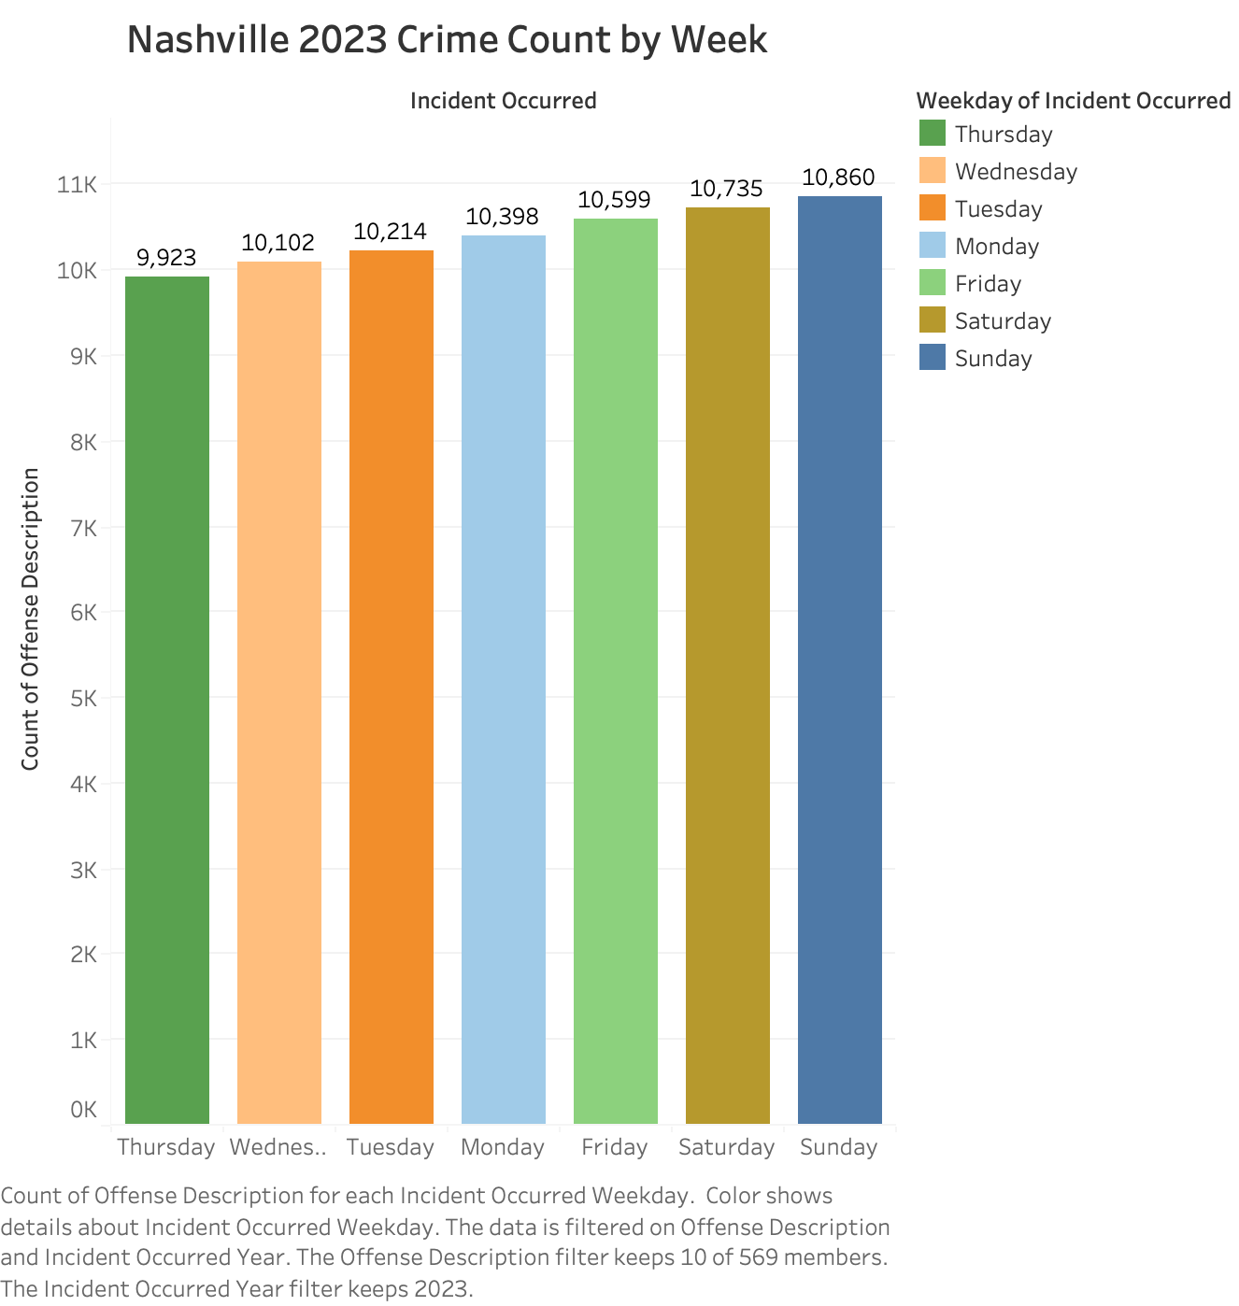

Slide 12
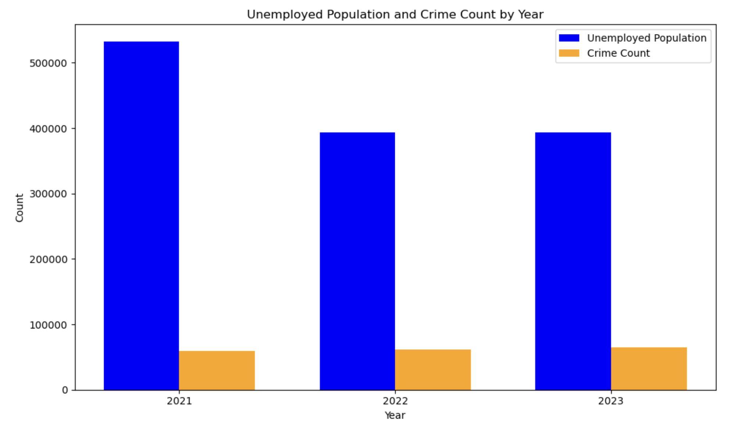
Unemployed Population and Crime Count by Year in Nashville

Slide 13
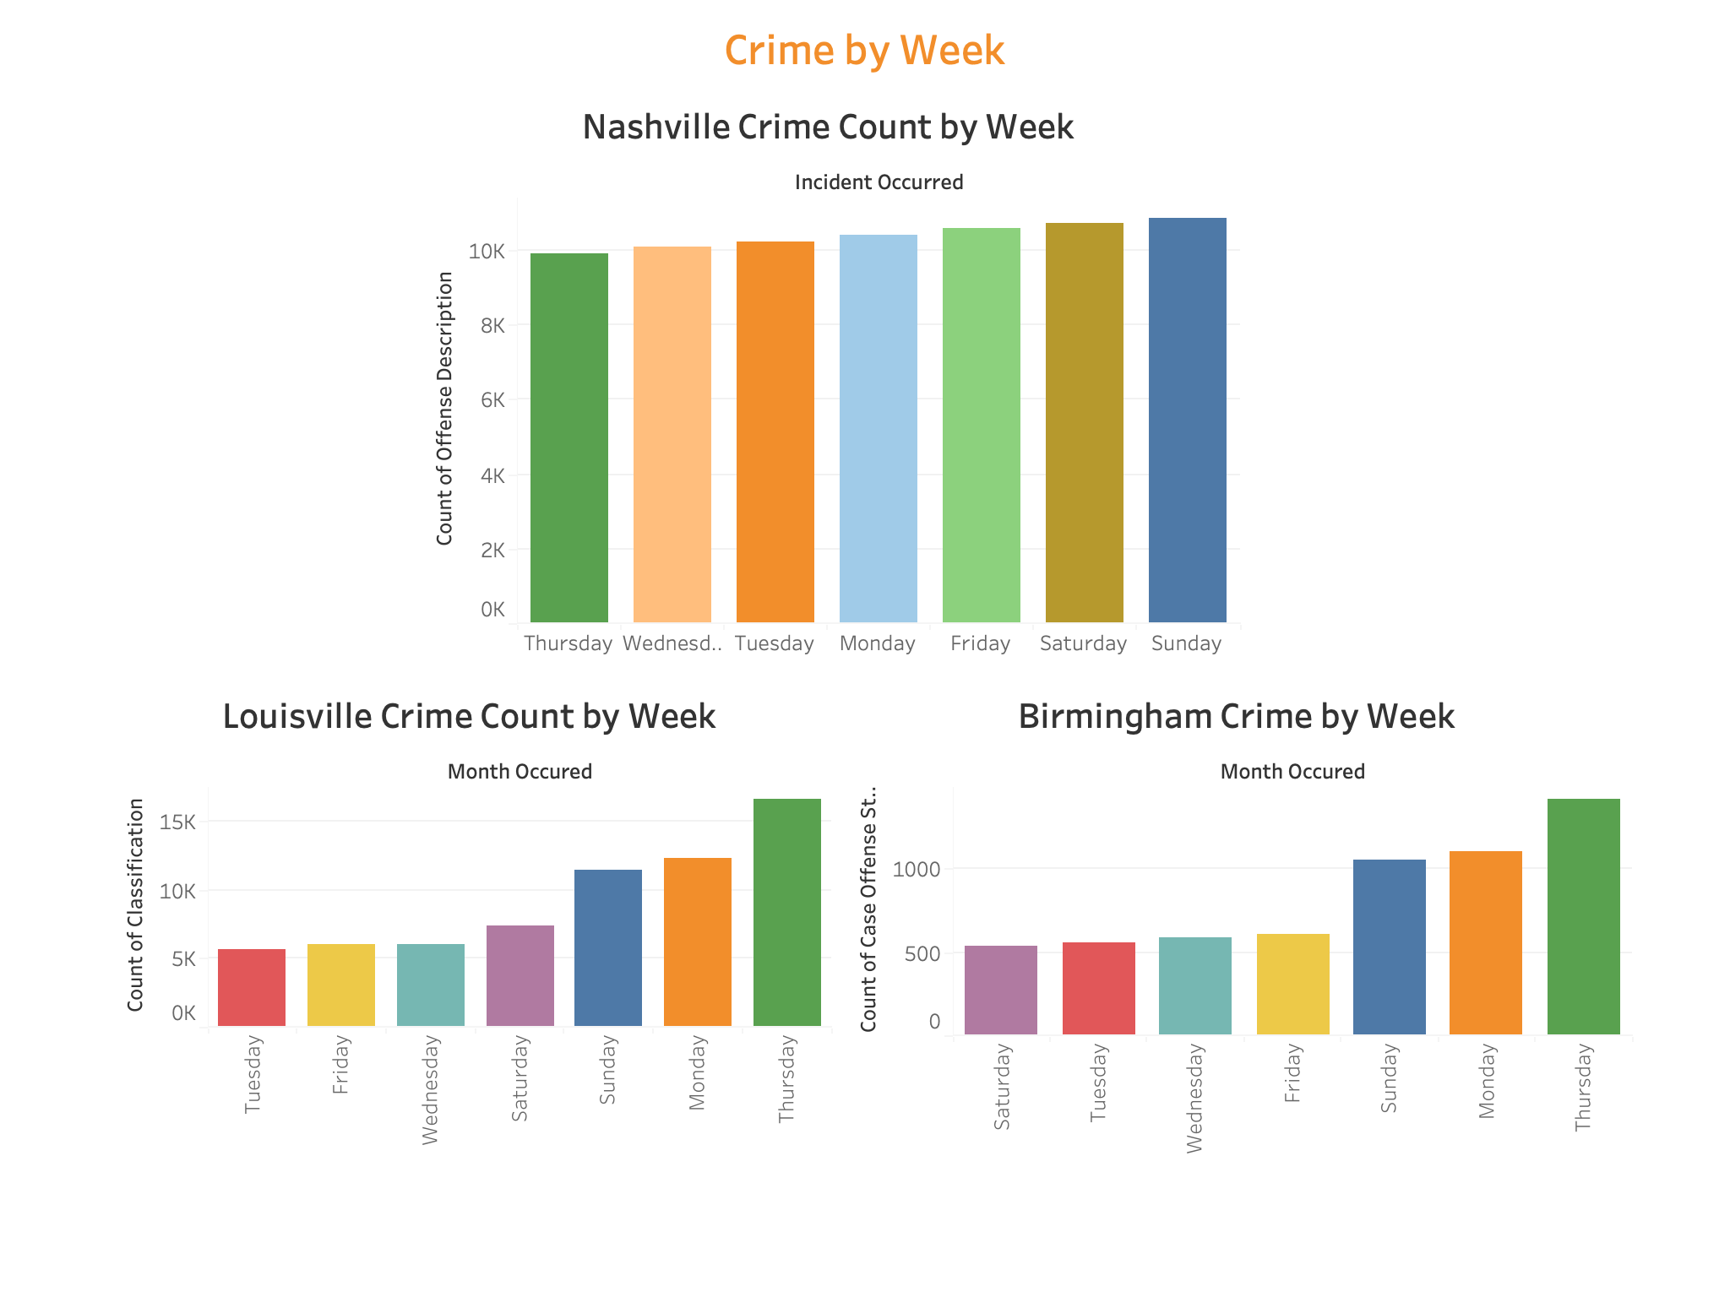

Slide 14
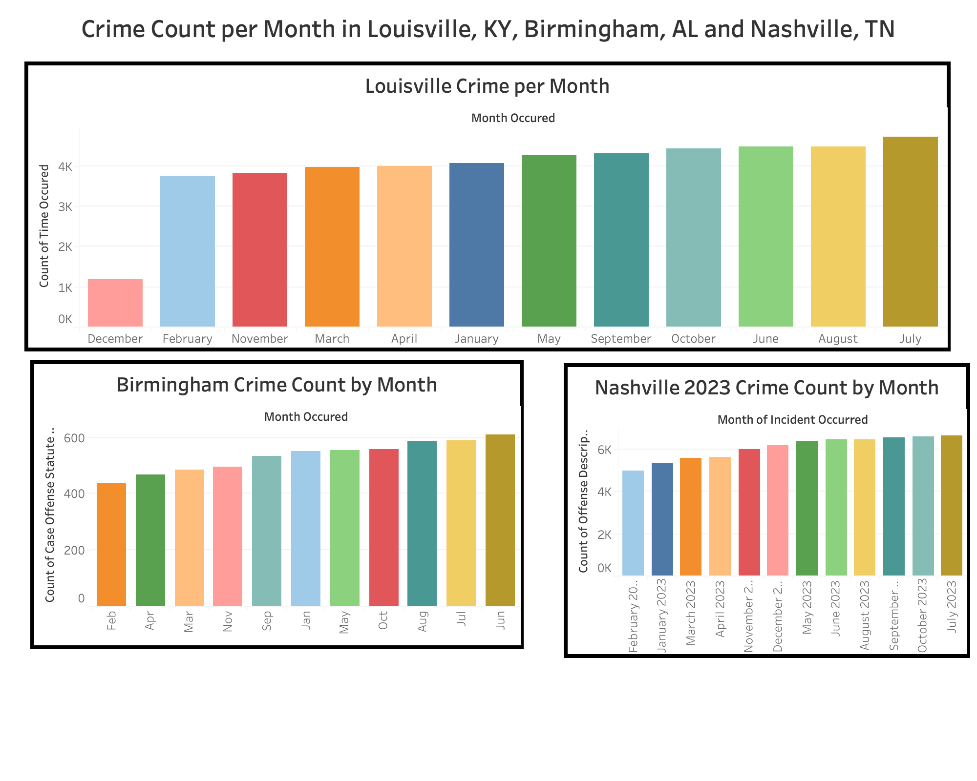

Slide 17
Restaurant=472

Slide 20
Notes:
These values for Victim Race were the top contributors to count of Offense Description for VEHICLE

Slide 21

Conclusion and Recommendation?

