Slide 1
Metabolic Modelling - Introduction

Slide 2
Biology in Space and Time
Space
(mm - m)
Body sizes
(µm)
Cell sizes
(nm)
Molecules

Slide 3
Biology in Space and Time
Space
Time
(mm - m)
Body sizes
Evolution
(years)
Cell regulation:
Circadian rhythms
Gene expression
Metabolism
Signalling
(µm)
Cell sizes
(min - day)
Molecules:
Transcription
Translation
DNA-Protein binding
(nm)
Molecules
(fs – s)

Slide 4
Metabolism & Metabolic Pathways
Metabolism:
A set of life-sustaining chemical reactions in an organism
Metabolic Pathways:
A linked set of chemical reactions taking place within a cell

Slide 5
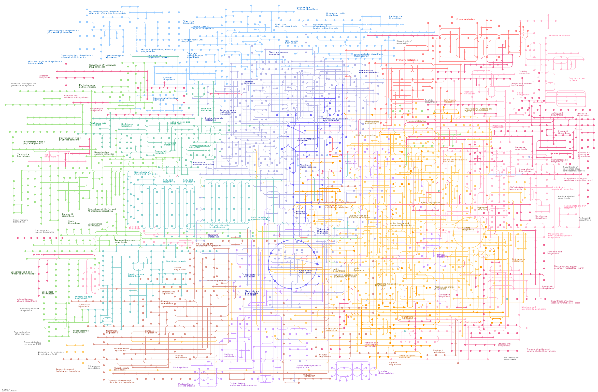

Slide 6
Metabolism is complex
How can we investigate or deal with this complexity?

Slide 7
Metabolism is complex
How can we investigate or deal with this complexity?
Concentrations: Metabolomics
Fluxes: Labelling-experiments

Slide 8
Metabolism is complex
How can we investigate or deal with this complexity?
Concentrations: Metabolomics
Fluxes: Labelling-experiments
Mathematical Modelling

Slide 9
What is a model?

Slide 10
What is a model?
A model is an abstract representation of objects or processes that explains features of these objects or processes

Slide 11
Purpose and Adequateness
One may intend to give a detailed mathematical representation of all the underlying enzymic reactions, which is very important for fitting experimental data in the best way possible.
Notes:
One may intend to give a detailed mathematical representation of all the underlying enzymic reactions, which is very important for fitting experimental data in the best way possible. This type of modelling in biochemistry was stimulated to a considerable extent by the availability of powerful computers. Therefore, rather large kinetic models were developed and solved numerically. The resulting curves are often very impressive but bear the risk of pseudo-exactness because it is often unclear how reliable the theoretical background and the parameters used in the model are. The results of detailed, very complex models are difficult to interpret owing to the high number of variables involved.

Slide 12
Purpose and Adequateness
One may intend to give a detailed mathematical representation of all the underlying enzymic reactions, which is very important for fitting experimental data in the best way possible.
Alternatively, one may be interested in explaining specific phenomena.
Notes:
Alternatively, one may be interested in explaining specific phenomena, such as the dependence of ATP concentration on energetic load in cellular energy metabolism, or in finding the conditions for the emergence of chaos or multistationarity. It is then suitable to develop minimal models by restricting oneself to essential features. This can be done in two ways. One can start from a real pathway and try to describe it by a model simplified as far as possible so that the phenomenon of interest is retained.

Slide 13
Purpose and Adequateness
One may intend to give a detailed mathematical representation of all the underlying enzymic reactions, which is very important for fitting experimental data in the best way possible.
Alternatively, one may be interested in explaining specific phenomena.
The usefulness of a model is determined by the compromise between adequacy and simplicity.
Notes:
The usefulness of a model is determined by the compromise between adequacy (i.e., the correctness of representation) and simplicity (tractability). Every mathematical model is based on
simplifying assumptions to render possible or facilitate the analytical or computational treatment and the interpretation of results.

Slide 14
Basic components of a model:
The basic building blocks are all compounds and all reactions converting these compounds into each other.
Model boundaries (distinguish internal and external components)
Kinetic laws and parameters for all reactions in the model

Slide 15
Later, one can:
Find out whether the model can achieve steady-state or not
Simulate time-course for a given set of parameter values and initial condition
Analyse the effect of perturbations

Slide 16
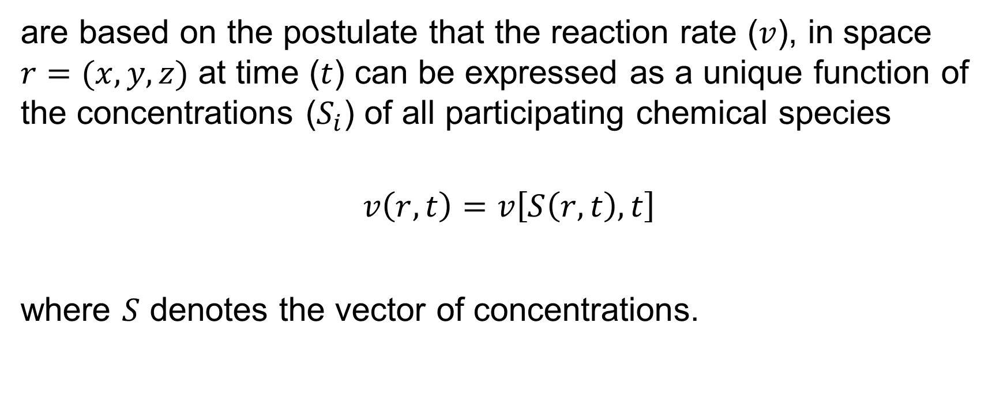
(Bio-) Chemical Kinetics
are based on the postulate that the reaction rate ($v$), in space $r=(x, y, z)$ at time ($t$) can be expressed as a unique function of the concentrations ($S_{i}$) of all participating chemical species
$$\begin{aligned}v\left(r,t\right)=v\left[S\left(r,t\right),t\right]\#\end{aligned}$$
where $S$ denotes the vector of concentrations.
Notes:
This equation allows for the possibility that the rate v is explicitly dependent on time t.
In most cases, however, autonomous systems are considered; that is, systems that do not depend on time directly.
For such systems, Eq. (2.1) implies that the state of a biochemical system at some point in space is uniquely given by all the concentration variables (i.e., by a finite dimensional vector).
The state is also characterized by parameters (e.g., rate constants), which are (in contrast to variables) constant in the time span of interest.

Slide 17
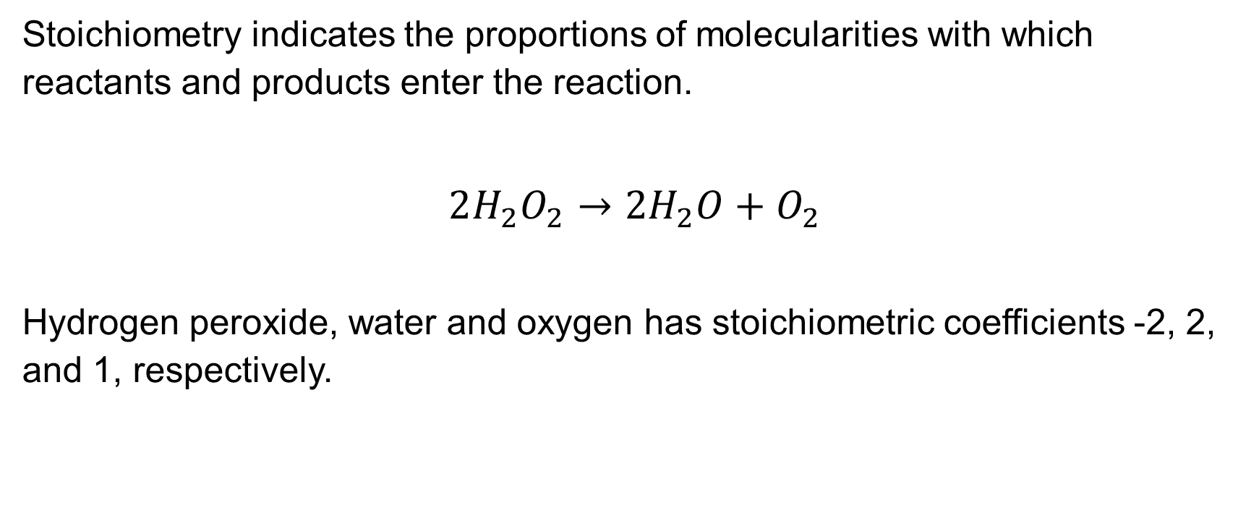
Stoichiometric coefficients
Stoichiometry indicates the proportions of molecularities with which reactants and products enter the reaction.
$$2H_{2}O_{2}→2H_{2}O+O_{2}$$
Hydrogen peroxide, water and oxygen has stoichiometric coefficients -2, 2, and 1, respectively.

Slide 18

Stoichiometric matrix
$$r1:glucose+ATP→glucose6phosphate+ADP$$
$$r2:glucose6phosphate →glucose1phosphate$$
$$\begin{aligned}N=n_{i,j}=\left[\begin{aligned}\begin{matrix}−1 & 0\end{matrix} \\ \begin{matrix}−1 & 0\end{matrix} \\ \begin{matrix}1 & −1\end{matrix} \\ \begin{matrix}1 & 0\end{matrix} \\ \begin{matrix}0 & 1\end{matrix}\end{aligned}\right]\begin{aligned}Glu \\ ATP \\ G6P \\ ADP \\ G1P\end{aligned} \#\end{aligned}$$
r1 r2
Notes:
A set of stoichiometric coefficients of a reaction can be considered as a vector.
When analysing systems of several reactions, it is useful to arrange the set of vectors of stochiometric coefficients in a matrix.

Slide 19
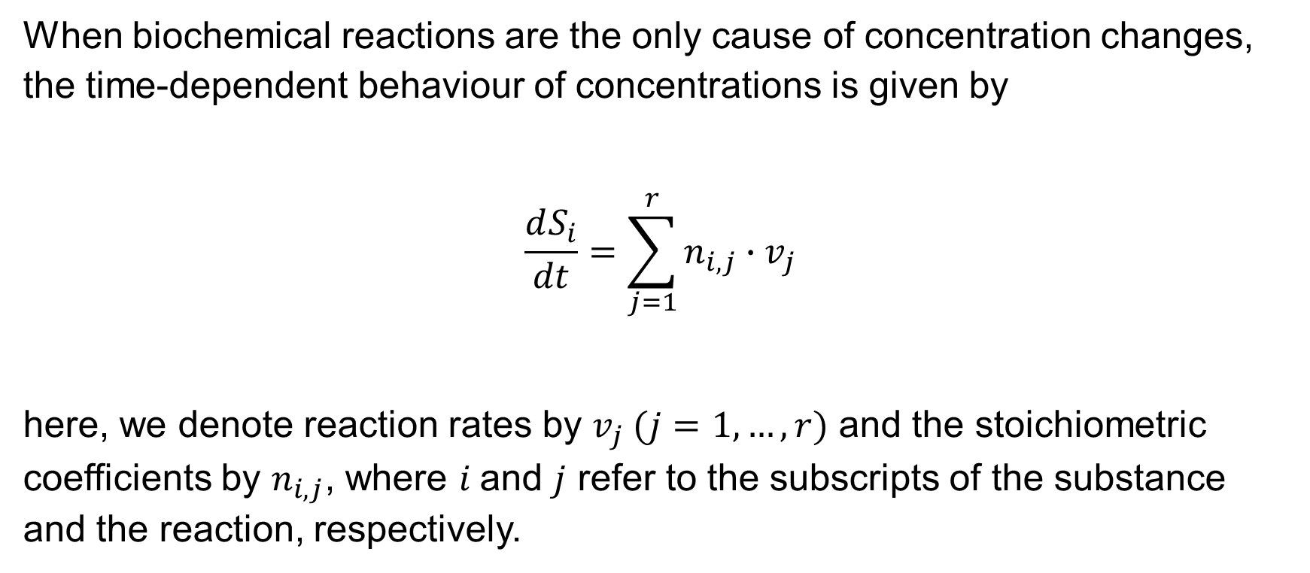
Balance equation
When biochemical reactions are the only cause of concentration changes, the time-dependent behaviour of concentrations is given by
$$\begin{aligned} \frac{dS_{i}}{dt}=\sum_{j=1}^{r}{n_{i,j}∙v_{j}} \#\end{aligned}$$
here, we denote reaction rates by $v_{j} (j=1, …, r)$ and the stoichiometric coefficients by $n_{i,j}$, where $i$and $j$ refer to the subscripts of the substance and the reaction, respectively.

Slide 20
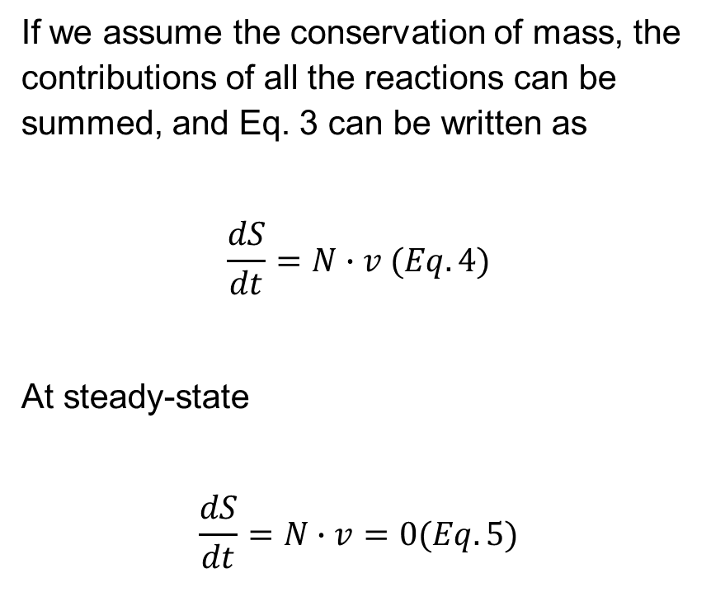
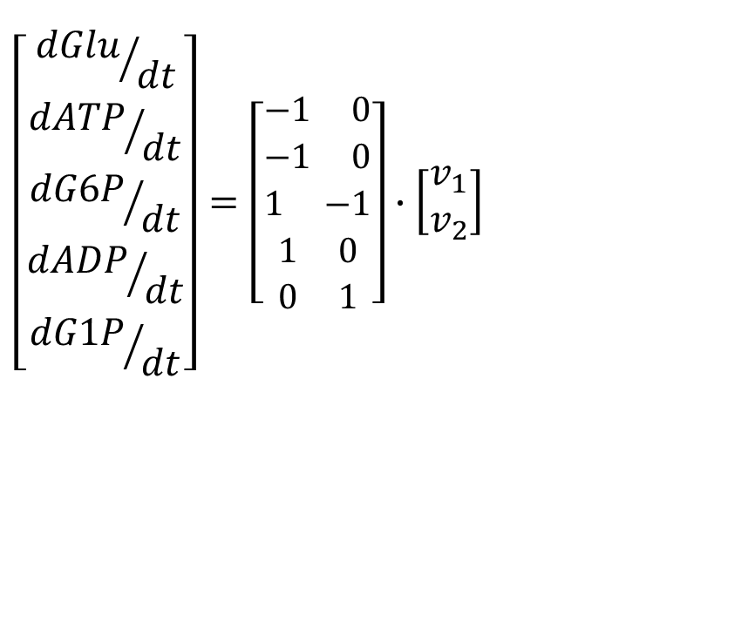
Steady-state
$$\begin{aligned}\left[\begin{aligned}{dGlu}/{dt} \\ {dATP}/{dt} \\ {dG6P}/{dt} \\ {dADP}/{dt} \\ {dG1P}/{dt}\end{aligned}\right]=\left[\begin{aligned}\begin{matrix}−1 & 0\end{matrix} \\ \begin{matrix}−1 & 0\end{matrix} \\ \begin{matrix}1 & −1\end{matrix} \\ \begin{matrix}1 & 0\end{matrix} \\ \begin{matrix}0 & 1\end{matrix}\end{aligned}\right]∙\left[\begin{matrix}v_{1} \\ v_{2}\end{matrix}\right]\#\end{aligned}$$
If we assume the conservation of mass, the contributions of all the reactions can be summed, and Eq. 3 can be written as
$$\begin{aligned}\frac{dS}{dt}=N∙v \#(Eq. 4)\end{aligned}$$
At steady-state
$$\begin{aligned}\frac{dS}{dt}=N∙v=0\#(Eq. 5)\end{aligned}$$

Slide 21




Steady-state
$$v_{1}$$
$$v_{2}$$
X
$$\frac{dX}{dt}=v_{1}−v_{2}=0$$
$$v_{1}=v_{2}$$

Slide 22
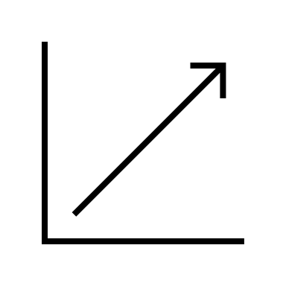
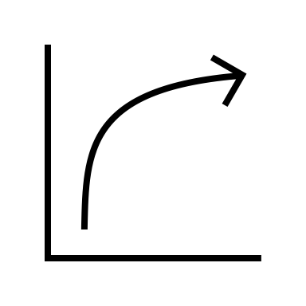




Rate laws
Linear kinetics
Saturation kinetics
$$v_{j}$$
$$v_{j}$$
$$[S_{i}]$$
$$[S_{i}]$$

Slide 23




Linear kinetics: Mass-Action
Guldberg & Waage (1864)
Irreversible Mass-Action Kinetics
$$\begin{aligned}\begin{aligned}v_{j}=k^{+}∙S_{1}^{n_{1,j}}\end{aligned}\end{aligned}$$
$$k^{+}$$
S₁
S₂
$$v_{j}$$
$$[S_{i}]$$

Slide 24

Linear kinetics: Mass-Action
Irreversible Mass-Action Kinetics
$$\begin{aligned}\begin{aligned}v_{j}=k^{+}∙S_{1}^{n_{1,j}}∙S_{3}^{n_{3,j}}\end{aligned}\end{aligned}$$
$$k^{+}$$
S₃ + S₁
S₂

Slide 25






Linear kinetics: Mass-Action
Reversible Mass-Action Kinetics
$$\begin{aligned}\begin{aligned}v_{j}=k^{+}∙S_{1}^{n_{1,j}}−k^{−}∙S_{2}^{n_{2,j}}\end{aligned}\end{aligned}$$
At equilibrium, when $v_{j}=0$ it implies
$$\begin{aligned} q=\frac{k^{+}}{k^{−}} \#\end{aligned}$$
$$k^{+}$$
S₁
$$k^{+}$$
S₂
$$k^{−}$$
$$k^{−}$$
$$v_{j}$$
$$[S_{i}]$$

Slide 26

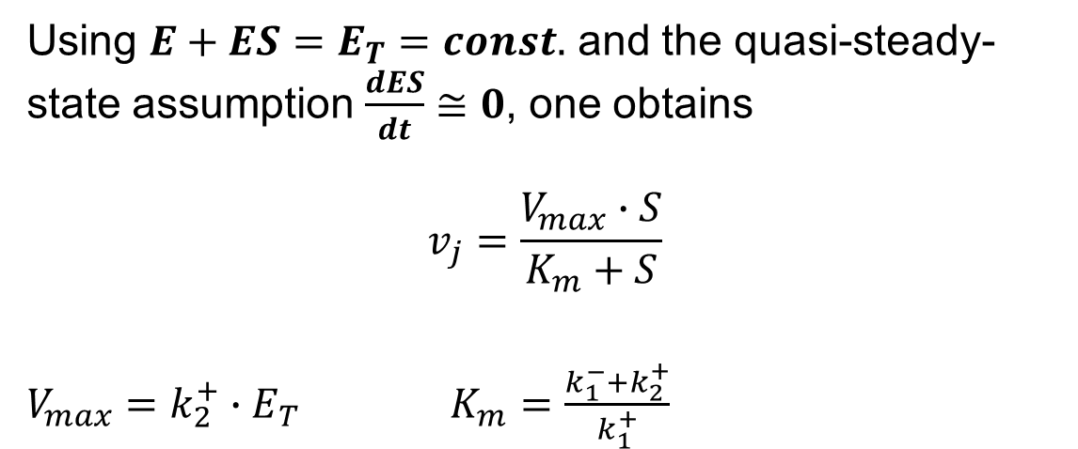




Saturation kinetics: Enzyme Kinetics
$$k_{1}^{+}$$
$$k_{2}^{+}$$
E + S₁
ES
E +S₂
$$k_{1}^{−}$$
Using $E+ES=E_{T}=const.$ and the quasi-steady-state assumption $\frac{dES}{dt}≅0$, one obtains
$$\begin{aligned} v_{j}=\frac{V_{max}∙S}{K_{m}+S} \\ \#\end{aligned}$$
$V_{max}=k_{2}^{+}∙E_{T}$ $K_{m}=\frac{k_{1}^{−}+k_{2}^{+}}{k_{1}^{+}}$
$$v_{j}$$
Michaelis-Menten kinetics (1913)
$$[S_{i}]$$

Slide 27
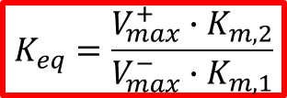

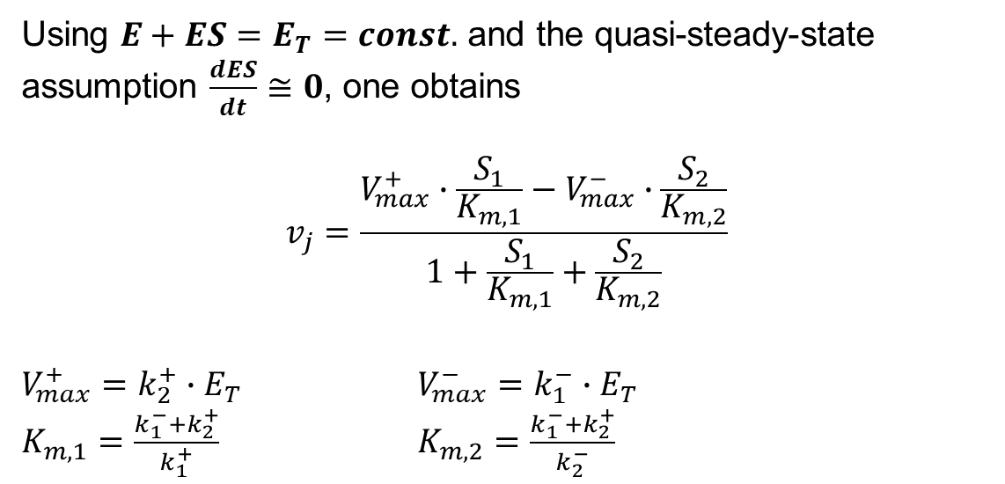
Saturation kinetics: Enzyme kinetics
$$k_{1}^{+}$$
$$k_{2}^{+}$$
E + S₁
ES
E +S₂
$$k_{1}^{−}$$
$$k_{2}^{−}$$
Using $E+ES=E_{T}=const.$ and the quasi-steady-state assumption $\frac{dES}{dt}≅0$, one obtains
$$\begin{aligned} v_{j}=\frac{V_{max}^{+}∙\frac{S_{1}}{K_{m,1}}−V_{max}^{−}∙\frac{S_{2}}{K_{m,2}}}{1+\frac{S_{1}}{K_{m,1}}+\frac{S_{2}}{K_{m,2}}} \#\end{aligned}$$
$V_{max}^{+}=k_{2}^{+}∙E_{T}$ $V_{max}^{−}=k_{1}^{−}∙E_{T}$
$K_{m,1}=\frac{k_{1}^{−}+k_{2}^{+}}{k_{1}^{+}}$ $K_{m,2}=\frac{k_{1}^{−}+k_{2}^{+}}{k_{2}^{−}}$
$$v_{j}$$
Haldane’s relation
(1930)
$$[S_{i}]$$
$$K_{eq}=\frac{V_{max}^{+}∙K_{m,2}}{V_{max}^{−}∙K_{m,1}}$$

Slide 28


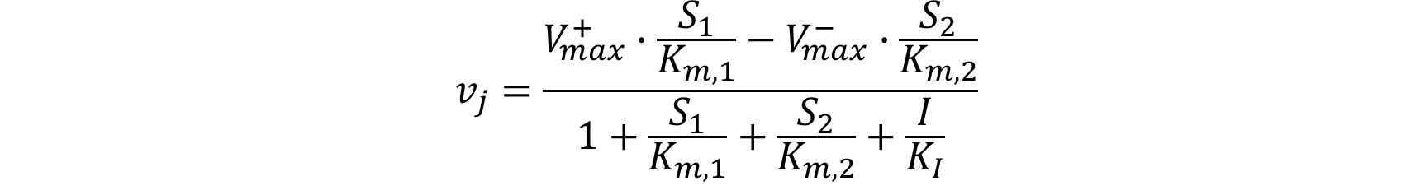




Effect of inhibitors
$$k_{1}^{+}$$
$$k_{2}^{+}$$
E + S₁
ES
E +S₂
_{+ I}
$$k_{1}^{−}$$
$$k_{2}^{−}$$
$$K_{I}$$
$$K_{I}=\frac{E∙I}{EI};and 0<K_{I}<∞$$
EI
$$\begin{aligned} v_{j}=\frac{V_{max}^{+}∙\frac{S_{1}}{K_{m,1}}−V_{max}^{−}∙\frac{S_{2}}{K_{m,2}}}{1+\frac{S_{1}}{K_{m,1}}+\frac{S_{2}}{K_{m,2}}+\frac{I}{K_{I}}} \#\end{aligned}$$

Slide 29




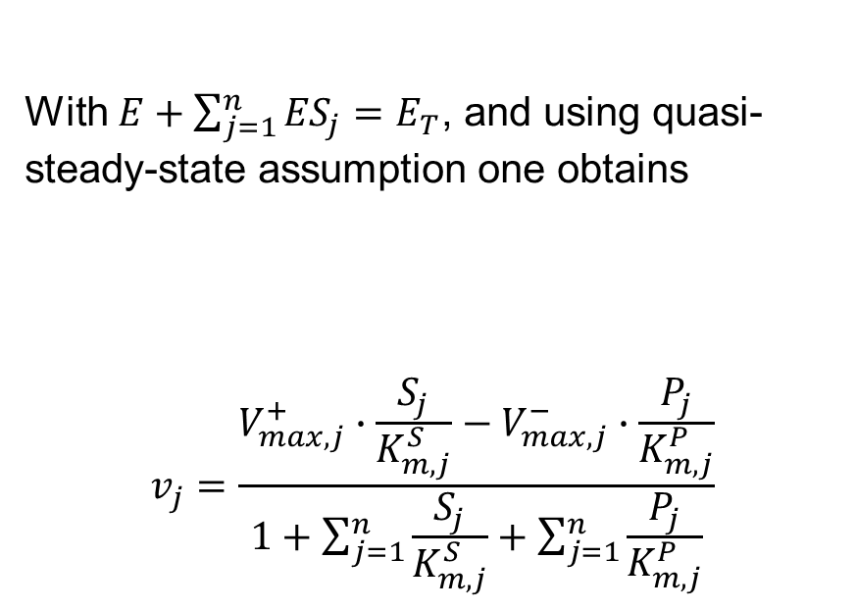








Broad-range Substrate specificity
$$k_{1,1}^{+}$$
$$k_{2,1}^{+}$$
With $E+\sum_{j=1}^{n}{{ES}_{j}=E_{T}}$, and using quasi-steady-state assumption one obtains
$$\begin{aligned} v_{j}=\frac{V_{max,j}^{+}∙\frac{S_{j}}{K_{m,j}^{S}}−V_{max,j}^{−}∙\frac{P_{j}}{K_{m,j}^{P}}}{1+\sum_{j=1}^{n}{\frac{S_{j}}{K_{m,j}^{S}}}+\sum_{j=1}^{n}{\frac{P_{j}}{K_{m,j}^{P}}}} \#\end{aligned}$$
E + S₁
ES₁
E + P₂
$$k_{1,1}^{−}$$
$$k_{2,1}^{−}$$
$$k_{1,2}^{+}$$
$$k_{2,2}^{+}$$
E + S₂
ES₂
E + P₂
.
.
.
$$k_{1,2}^{−}$$
.
.
.
$$k_{2,2}^{−}$$
.
.
.
$$k_{1,n}^{+}$$
$$k_{2,n}^{+}$$
E + S_{n}
ES_{n}
E + P_{n}
$$k_{1,n}^{−}$$
$$k_{2,n}^{−}$$
For more info and theoretical derivations cf.
Chou & Talalay 1977; Schäuble et al. 2013; Sharma 2018

Slide 30
Reconstruction of a mechanistic model
Ingredients:
Set of Ordinary Differential Equations (ODEs) describing the temporal change in biochemical species of a metabolic pathway
Kinetic parameters
A framework to solve ODEs
Analytical
Computational

Slide 31
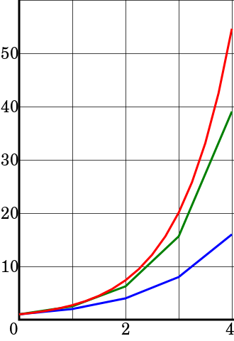
Numerical solution
Euler method is a first-order numerical procedure for solving ODEs with a given initial value.
First-order method means that the local error (error per step) is proportional to the square of the step size, and the global error (error at a given time) is proportional to the step size
Euler’s method:
Calculate rates at a time t
Estimates the concentration at next time point
recalculate rates
Exact solution
Concentration →
Euler method
Time →
Computer power
Notes:
Euler method is a first-order numerical procedure for solving ODEs with a given initial value. First-order method means that the local error (error per step) is proportional to the square of the step size, and the global error (error at a given time) is proportional to the step size
The conclusion of this computation is that {\displaystyle y_{4}=16}. The exact solution of the differential equation is {\displaystyle y(t)=e^{t}}, so {\displaystyle y(4)=e^{4}\approx 54.598}. Although the approximation of the Euler method was not very precise in this specific case, particularly due to a large value step size {\displaystyle h}, its behaviour is qualitatively correct as the figure shows.

Slide 32
ODE solvers
Euler
Runge-Kutta
Adams
Backward Differentiation Formula (BDF)
LSODA:
automatically switches between implicit Adams method (for non-stiff problems) and a method based on backward differentiation formulas (BDF) (for stiff problems).
“non-stiff” problems
“stiff” problems

Slide 33





Computational framework for modelling
DIY using any programming language
Complex Pathway Simulator (COPASI)

Slide 34




Kinetic parameters

Slide 35
Useful resources
Books:
Fundamentals of enzyme kinetics – Athel Cornish-Bowden
Systems Biology – Edda klipp, Wolfram Liebermeister, Christoph Wierling, Axel Kowald
The Regulation of Cellular Systems – Reinhart Heinrich, Stefan Schuster
Model database:
Biomodels (https://www.ebi.ac.uk/biomodels/)
Reaction database:
KEGG (https://www.genome.jp/kegg/)
Kinetic parameters:
BRENDA (https://www.brenda-enzymes.org/)
SABIO-RK (http://sabio.h-its.org/)
Equilibrator (https://equilibrator.weizmann.ac.il/)

