Slide 1
Genetic
Algorithms - I
D600 Algorithm Theory
Lecture-10:
Notes taken from:
Neapolitan (2015) “Foundations of Algorithms”, Chapter 10, Jones & Bartlett
Sivanandam & Deepa (2008) “Introduction of Genetic Algorithms”, Springer
Reggie Davidrajuh
University of Stavanger
Spring 2015

Slide 2
Genetic Algorithm (GA)
At any given time, a number of different organisms co-exist and compete for the same resources in an ecosystem.
  organisms that are most capable (more ‘fit’) of acquiring resources and successfully procreating are the ones whose descendants will tend to be numerous in the future.
  Organisms that are less capable (less ‘fit’), for whatever reason, will tend to have few or no descendants in the future.
Over time, the entire population of the ecosystem is said to evolve to contain organisms that, are more fit than previous generations.
The main reproduction operator used in GA is crossover; in crossover, new individuals are formed from two parents by swapping a sub-sequence between the two chromosomes. Another operator is mutation, in which a single gene in the string is flipped to form a new offspring string.
Crossover does not introduce any new information into the population (deterministic), whereas mutation does (stochastic).

Slide 3
Chromosome, Genome, diploid, Gene, and Allele
An organism is an individual form of life.
Cell is the basic structural & functional unit of an organism.
Chromosomes carry biologically expressed hereditary characters.
A genome is a complete set of chromosomes. Human genome contains 23 chromosomes (22 autosome, 1 sex chromosome).
A diploid cell contains two genomes. Each chromosome in one set is matched with a chromosome in the other set. The chromosomes is a diploid cell is called a homolog.
So a human diploid cell contains 2 x 23 = 46 chromosomes. One homolog comes from each parent.
A gene is a section of a chromosome, consisting of thousands of base pairs (A-T, C-G). Genes are responsible for both the structure and the processes of an organism.
An allele is alternative forms of a gene that arise by mutation and are found at the same place on a chromosome.

Slide 4
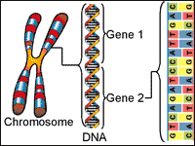
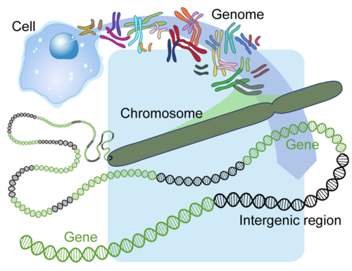
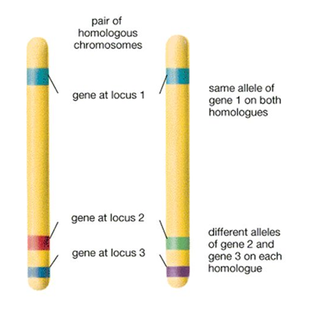
Chromosome, Genome, DNA, Gene, and Allele

Slide 5
Genetic Algorithm (GA)
GA is a stochastic search algorithm: randomness plays essential role in GAs. Both selection and reproduction needs random procedures.
  in traditional search algorithm, the best solution is found out of the number of possible solutions. This exhaustive search becomes impractical as search space grows in size.
  Traditional search algorithms randomly sample (e.g. random walk) or heuristically sample (e.g. gradient descent) the search space one solution at a time in the hope of finding the optimal solution.
  In GA search is population-based. GA performs an efficient directed search through the adaptation of successive generations of a large number of individuals.
  In GA, search is generally better than random search and is not susceptible to the hill-climbing behaviors of gradient-based search.

Slide 6
Genetic Algorithm (GA)
First step in GA:
  Initialization of a population to start the GA iterations
GA is iterative. Each iteration consists of the following steps:
  Evaluation of the fitness of the individuals and
  Selection of the individuals for reproduction; this is done randomly with a probability depending on the relative fitness of the individuals so that best ones are often chosen for reproduction.
  Reproduction of offspring from the selected individuals: new chromosomes are made by recombination (crossover) and mutation.
Last step in GA:
  Termination of the algorithm is stopped when the population converges toward the optimal solution.

Slide 7
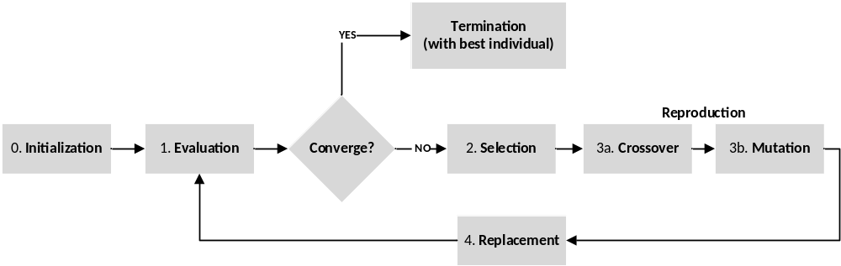
Steps in GA
iteration i=1;
  Step-0: Create initial population Pi ;
  repeat
  { step-1: evaluate fitness of each individual in population Pi;
    step-2: select individuals for reproduction based on fitness;
    step-3: perform crossover & mutation on selected individuals;
    step-4: replace old population with the new generation;
    i++;
  } until terminal condition is met;

Slide 8
randomness plays an essential role in GA
Non-deterministic Selection:
When selecting individuals based on fitness, we do not necessarily simply choose the most fit individuals. Rather, we may employ both exploitation and exploration.
Exploitation means, we exploit the knowledge already obtained by concentrating on regions that look good.
Exploration means, we look for new regions without regard for how good they are.
In the case of choosing individuals, we could explore by choosing a random individual with probability p and exploit by choosing a fit individual with probability (1 – p).

Slide 9
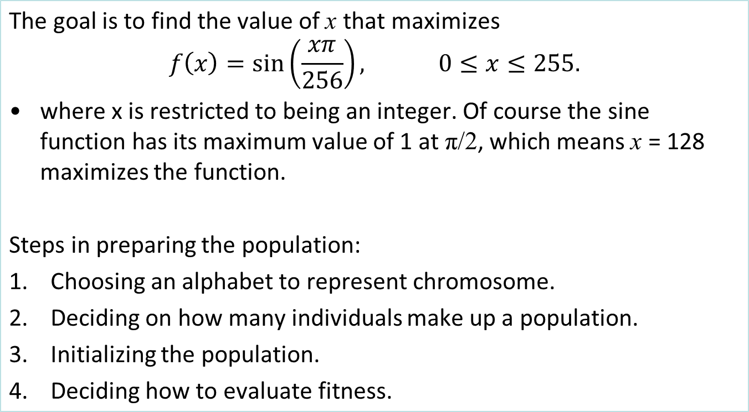
Example-1: Finding maximum

Slide 10
Ex-1: Preparing the initial population
Choosing an alphabet to represent chromosome.
  Candidate solutions are simply integers in the range 0 to 255, we can represent each individual (candidate solution) using 8 bits. For example, the integer 189 is represented as [1 0 1 1 1 1 0 1].
Deciding on how many individuals make up a population.
  In general, there can be thousands of individuals. In this simple example, we will use 8 individuals.
Initializing the population.
  Often this is done at random. We will generate 8 numbers at random from the range 0 to 255.
Deciding on how to evaluate fitness.
  Since the goal is to maximize f(x), the fitness of individual x is simply the value of This function.

Slide 11
Ex-1: The initial population and their fitnesses
Individual | x
[ 1 0 1 1 1 1 0 1 ] | 189
[ 1 1 0 1 1 0 0 0 ] | 216
[ 0 1 1 0 0 0 1 1 ] | 99
[ 1 1 1 0 1 1 0 0 ] | 236
[ 1 0 1 0 1 1 1 0 ] | 174
[ 0 1 0 0 1 0 1 0 ] | 74
[ 0 0 1 0 0 0 1 1 ] | 35
[ 0 0 1 1 0 1 0 1 ] | 53
f(x)
0.733
0.471
0.937
0.243
0.845
0.788
0.416
0.650
sum = 5.083
Normed f(x)
0.144
0.093
0.184
0.048
0.166
0.155
0.082
0.128
sum = 1.000
Cumulative Normed f(x)
0.144
0.237
0.421
0.469
0.635
0.790
0.872
1.000

Slide 12
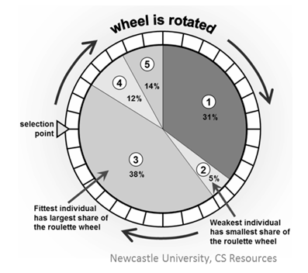
Selection by “Roulette Wheel”
We will combine exploitation with exploration here:
The cumulative fitness values provide a wedge on a roulette wheel for each individual based on its fitness.
E.g.: the 3rd individual (x=99) has a normalized fitness of 0.184 (the highest) and is assigned the wedge corresponding to the interval (0.237, 0.421], which has width 0.184. Thus, this individual has more chances of getting selected when we roll the roulette.
x | Normed f(x) | Cum. Norm. f(x)
189 | 0.144 | 0.144
216 | 0.093 | 0.237
99 | 0.184 | 0.421
236 | 0.048 | 0.469
174 | 0.166 | 0.635
74 | 0.155 | 0.790
35 | 0.082 | 0.872
53 | 0.128 | 1.000

Slide 13
Ex-1: Selecting individuals for reproduction
Individuals for reproduction:
With the help of the roulette wheel, suppose the individuals that are chosen for reproduction are the ones shown on the right.
Note that an individual can appear more than once, and the likelihood of how often it appears depends on its fitness.
  [ 0 1 1 0 0 0 1 1 ]
  [ 0 0 1 1 0 1 0 1 ]
  [ 1 1 0 1 1 0 0 0 ]
  [ 1 0 1 0 1 1 1 0 ]
  [ 0 1 0 0 1 0 1 0 ]
  [ 1 0 1 0 1 1 1 0 ]
  [ 0 1 1 0 0 0 1 1 ]
  [ 1 0 1 1 1 1 0 1 ]

Slide 14
Reproduction by “Crossover”
Pair individuals are randomly selected resulting in 4 pairs.
For each pair, we randomly select two crossover points along the individuals.
Genetic material between the crossover points is exchanged.
Parents
[ 0 1 1 0 0 0 1 1 ] [ 0 0 1 1 0 1 0 1 ]
Children | x | f(x)
[ 0 1 1 1 0 1 1 1 ] [ 0 0 1 0 0 0 0 1 ] | 119 33 | 0.994 0.394
i
j
i
j
[ 1 1 0 1 1 0 0 0 ] [ 1 0 1 0 1 1 1 0 ]
[ 1 0 1 0 1 0 0 0 ] [ 1 1 0 1 1 1 1 0 ] | 168 222 | 0.882 0.405
i
j
i
j
[ 0 1 0 0 1 0 1 0 ] [ 1 0 1 0 1 1 1 0 ]
[ 1 0 0 0 1 0 1 0 ] [ 0 1 1 0 1 1 1 0 ] | 138 110 | 0.992 0.976
j
i
j
i
[ 0 1 1 0 0 0 1 1 ] [ 1 0 1 1 1 1 0 1 ]
[ 0 1 1 0 0 1 0 1 ] [ 1 0 1 1 1 0 1 1 ] | 101 187 | 0.946 0.749
i
j
i
j

Slide 15
Reproducing by crossover
Performing crossovers:
Note that if the second point appears before the first point in the individual, crossover is performed by wrapping around.
The average fitness before crossover is 0.635, while that after crossover is 0.792. Furthermore, after crossover, two individuals have fitnesses above 0.99.
Parents | Children | x | f(x)
[ 0 1 1 0 0 0 1 1 ] [ 0 0 1 1 0 1 0 1 ] | [ 0 1 1 1 0 1 1 1 ] [ 0 0 1 0 0 0 0 1 ] | 119 33 | 0.994 0.394
[ 1 1 0 1 1 0 0 0 ] [ 1 0 1 0 1 1 1 0 ] | [ 1 0 1 0 1 0 0 0 ] [ 1 1 0 1 1 1 1 0 ] | 168 222 | 0.882 0.405
[ 0 1 0 0 1 0 1 0 ] [ 1 0 1 0 1 1 1 0 ] | [ 1 0 0 0 1 0 1 0 ] [ 0 1 1 0 1 1 1 0 ] | 138 110 | 0.992 0.976
[ 0 1 1 0 0 0 1 1 ] [ 1 0 1 1 1 1 0 1 ] | [ 0 1 1 0 0 1 0 1 ] [ 1 0 1 1 1 0 1 1 ] | 101 187 | 0.946 0.749
i
j
i
j
i
j
i
j
wrapping
around
j
i
j
i
i
j
i
j

Slide 16
Mutations and termination
Performing mutations:
For each bit in each individual, we decide at random whether to flip the bit (change 0 to 1 or 1 to 0).
Mutation probabilities are commonly in the range 0.01 to 0.001.
Terminating the iterations:
When one or more of the following conditions are met:
some maximum number of generations is attained,
some allotted amount of time has expired,
when the fitness of the most fit individual reaches a certain level
In this example, iterations terminate when either 10,000 generations are produced or when the fitness exceeds 0.999.

Slide 17
% Neapolitan (2015) “Foundations of Algorithms”, p. 445
global global_info;
global_info.MUTATION_POLICY = 1; % 0=No mutation; 1=Normal mutation
global_info.MUTATION_PROBABILITY = 0.05;
global_info.MAX_FX = 0.999; % max possible value for the optimal function
global_info.current_max_fx = 0; % max value from the current population
global_info.MAX_INTERATIONS = 10000; % maximum number of iterations
global_info.LOG = []; % for recording values from the itertaions
% STEP-0: Initial population of JUST 8 individuals
New_pool = [189 216 99 236 174 74 35 53];
iteration = 1;
while le(iteration, global_info.MAX_INTERATIONS),
evaluation(New_pool, iteration); %STEP-1: evaluation of the candidates
chosen_individuals = selection(New_pool);%STEP-2:selection of candidate
New_pool = crossover(chosen_individuals);%STEP-3a:crossover pairs
New_pool = mutation(New_pool); % STEP-3b: mutate children
% STEP-4 is missing: new generation replaces older COMPLETELY
iteration = iteration + 1; % next iteration
end;
plot(global_info.LOG(:,2)),xlabel('Iterations'),ylabel('Max fx'), grid on;
Population size too small!
Complete replacement of older gen. is not good!

Slide 18
function [fx] = sinfunc01(x)
fx = -1 * sin(x*pi/256);
function [] = evaluation(P, iteration)
global global_info;
max_fx = max(sinfunc01(P));
global_info.current_max_fx = max_fx;
currentLOG = [iteration, max_fx, P];
global_info.LOG = [global_info.LOG; currentLOG];
function [chosen_individuals] = selection(P)
N = size(P, 2); % population size
% prepare for selection from population: convert array into structure
P = create_pool(P);
Individuals_selected = zeros(1, N);
for i = 1:N,
random_value = rand;
j = 1;
while and(lt(j,N), gt(random_value, P(j).Cumulative_Normed_fx)),
j = j+1;
end;
Individuals_selected(i) = j;
end;
chosen_individuals = P(Individuals_selected);

Slide 19
function [New_pool] = mutation(P)
global global_info;
N = size(P, 2);
if not(global_info.MUTATION_POLICY),%global_info.MUTATION_POLICY == 0
New_pool = P;
return;
else % global_info.MUTATION_POLICY == 1 or 2
New_pool = zeros(1, N);
for i = 1:N,
child = P(i);
mutated_child = mutate_one(child);
New_pool(i) = mutated_child;
end; % for i = 1:N,
end; % if not(global_info.MUTATION_POLICY),
function [mutated_child] = mutate_one(child)
global global_info;
child_bin = de2bi(child, 8, 'left-msb');
for j = 1:8,
probability_4_mutation = rand;
if lt(probability_4_mutation, global_info.MUTATION_PROBABILITY),
child_bin(j) = not(child_bin(j));
end;
end;
mutated_child = bin2dec(int2str(child_bin));

Slide 20
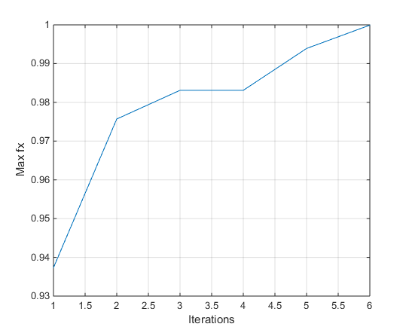
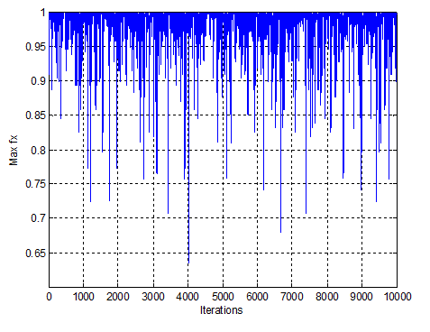
while and(le(iteration, global_info.MAX_INTERATIONS), ...
le(global_info.current_max_fx, global_info.MAX_FX)),
while le(iteration, global_info.MAX_INTERATIONS),

Slide 21
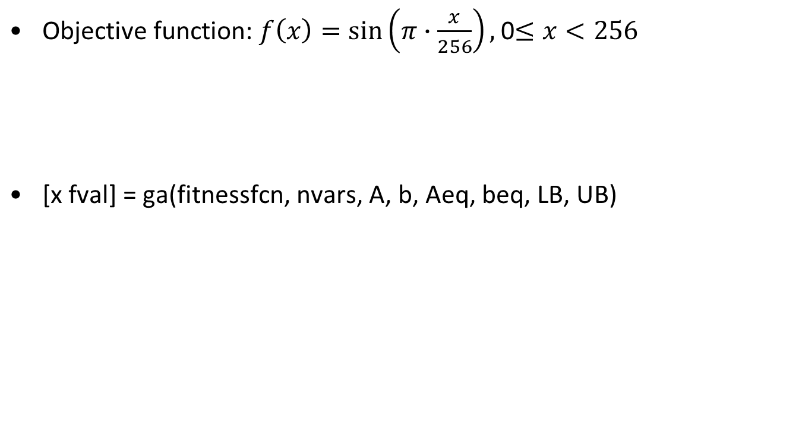
MATLAB
Global Optimization Tool
function [fx] = sinfunc01(x)
fx = -1 * sin(x*pi/256);
>> [x fval] = ga(@sinfunc01, 1, [], [], [], [], 0, 255)
Optimization terminated: average change in the fitness value less than options.TolFun.
x = 128.0000
fval = -1.0000

Slide 22

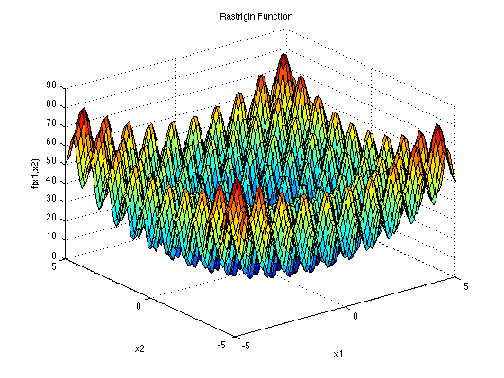
Using Global Optimization Toolbox
Finding minimum and maximum in Rastrigin function.
Input Domain: The function is usually evaluated on the hypercube x_{i} ∈ [-5.12, 5.12], for all i = 1, …, d.
Global Minimum:

Slide 23
Global minimum and maxima in Rastrigin function (2D)
To find minimum, just pass the fitness function (@rastrigin01) to ‘ga’.
To find maximum, pass the fitness function is MATLAB standard format. E.g.: @rastrigin02
function [fx] = rastrigin01(x)
fx = 20 + x(1)^2 + x(2)^2 - 10 *(cos(2*pi*x(1)) + ...
cos(2*pi*x(2)));
function [fx] = rastrigin02(x)
ras = 20 + x(1)^2 + x(2)^2 - 10 * (cos(2*pi*x(1)) + ...
cos(2*pi*x(2)));
fx = -1 * ras;

Slide 24
Global Minimum:
>>[x,fval] = ga(@rastrigin01,2,[],[],[],[], [-5.12,-5.12], [5.12, 5.12])
Optimization terminated: average change in the fitness value less than options.TolFun.
x = 1.0 e-05 * (-0.2662 0.9665)
fval = 1.9938e-08
Global Maxima:
>>[x,fval] = ga(@rastrigin02,2,[],[],[],[], [-5.12,-5.12], [5.12, 5.12])
Optimization terminated: average change in the fitness value less than options.TolFun.
x = -4.5230 -4.5230
fval = -80.7066

Slide 25
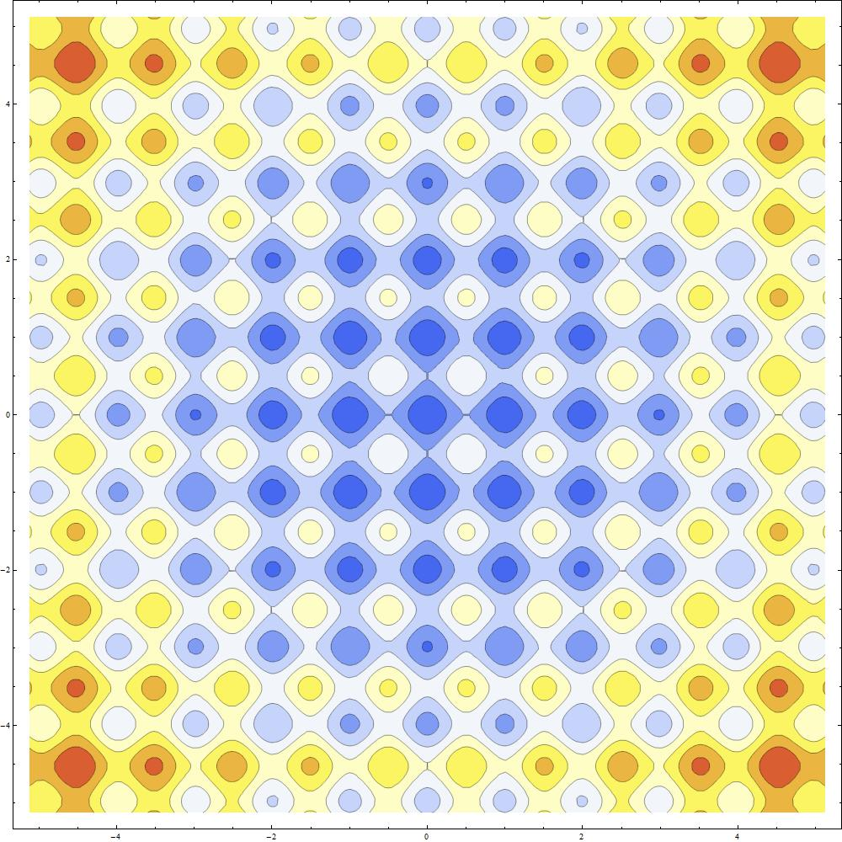
Global minimum: f(x) = 0, at (0, 0)
max: f(x) = 80.7, at (4.52, 4.52)
max: f(x) = 80.7,
at (-4.52, 4.52)
max: f(x) = 80.7,
at (4.52, -4.52)
max: f(x) = 80.7,
at (-4.52, -4.52)
Contour plot

Slide 26
Traveling Salesman Problem
The TSP is a well-known NP-hard problem, for which no one has ever developed a polynomial-time algorithm, and also, no one has ever shown that such an algorithm is not possible.
Variation of TSP: visits each city ONLY once
Note that the starting city is irrelevant to the shortest tour.
The TSP problem is represented by a weighted directed graph where the vertices represent the cities and the arc weights represent road lengths.
The directed graph in an instance of the TSP need not be complete (there wont be edges from a vertex to every other vertex).
The arc weight between v_{i} -> v_{j} need not be the same as v_{j} -> v_{i}.
We shall see a simple GA algorithm with Ordered Crossover.

Slide 27
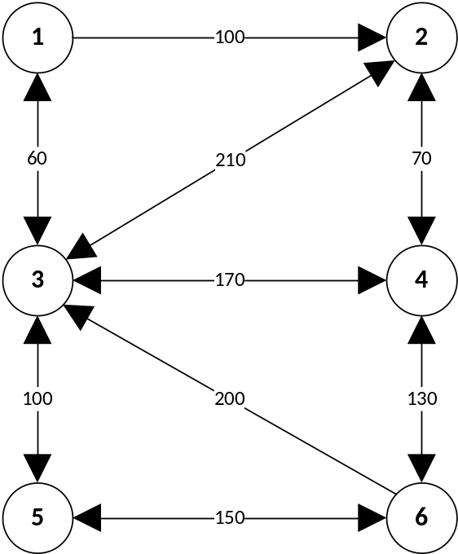
Representation by weighted digraph
Adjacency Matrix A_{(6,6)} =
d_{ij} the distance from v_{i} to v_{j} = a_{ij}
d_{i} : the traversal of p_{i} = [2 1 3 5 4 6]
= v₂→v₁ + v₁→v₃ + v₃→v₅ + + v₅→v₄ + v₄→v₆
= a₂₁ + a₁₃ + a₃₅ + a₅₄ + a₄₆
D: the total distances between any two cities: D = d₁ + d₂ + d₃ + …
|
|
v₁ v₂ v₃ v₄ v₅ v₆
v₁ v₂ v₃ v₄ v₅ v₆
0 100 60 ∞ ∞ ∞
∞ 0 210 70 ∞ ∞
60 210 0 170 100 ∞
∞ 70 170 0 ∞ 130
∞ ∞ 100 ∞ 0 150
∞ ∞ 200 130 150 0

Slide 28
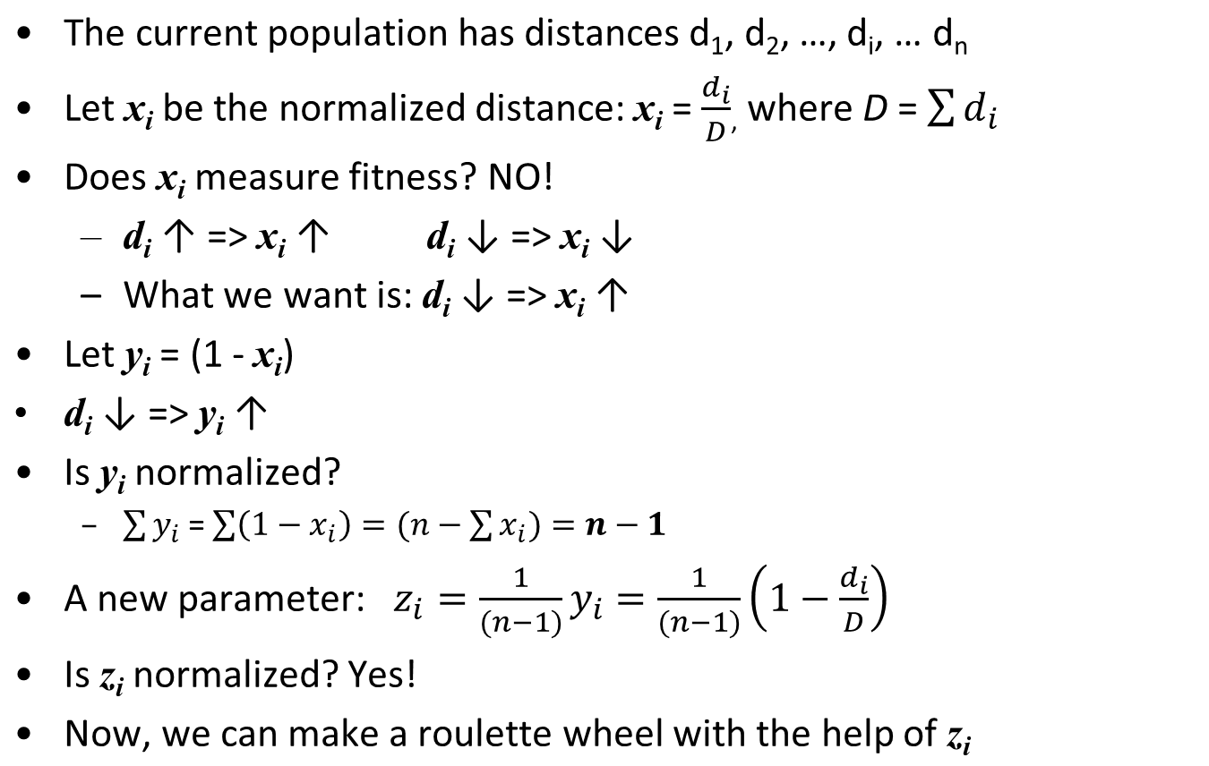
Evaluating Fitness

Slide 29
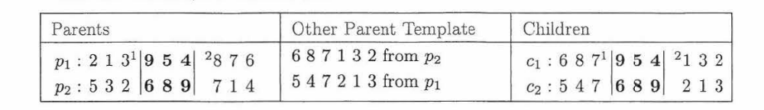
Chromosome, fitness function, and
Ordered Crossover
Chromosome: a straightforward representation for alphabet is to label the vertices 1 through n and list the vertices in the order visited.
p1 is a vector of 9 vertices, [2 1 3 9 5 4 8 7 6], representing the order of city visit v₂ -> v₁ -> v₃, ... , and v₇ -> v₆
The fitness measure: the fitness is the length (distance) of the tour, from the first city (v₂), to the final (v₆).
Crossovers: As before, individuals are randomly paired and for each pair, two crossover points are randomly selected; the segment between those crossover called points the pick.
E.g. the pick of p1 is [9 5 4], whereas the pick of p2 is [6 8 9].

Slide 30
Ordered Crossover
During swapping, the results of a crossover has to be legitimate tours: each city must be listed only once.
By normal crossover, c1 becomes: [2 1 3 | 6 8 9 | 8 7 6], which is not acceptable. Therefore, picks can not be simply exchanged.
Order crossover:
  child is made of 2 parts: the pick and the nonpick.
  the pick of the child is the pick of its own parent
  the non-pick area of the child is filled in from values of the other parent (the other parent template); these are the values of the other parent that are not in the pick.
When making the other parent template: start from the pick of the other parent, go to the end, wraparound and finish at the pick.

Slide 31
Mutation
Valid tour: If the graph is not complete, verify whether the new child represents an actual tour; if not, the crossover is discarded.
Mutations:
  As in the previous example, we cannot just mutate a site by changing a given vertex to another vertex because a vertex would then appear twice.
  Mutation is done by interchanging two vertices
  E.g. c1 before: [6 8 7 9 5 4 1 3 2]
  c1 after mutation : [6 8 4 9 5 7 1 3 2]
  Mutation is done also by reversing the order of a subset of vertices (in this case, we have to verify again, that the reversing of vertices result in an actual tour).

Slide 32
The genetic algorithm for TSP
Create initial population pool
Iteration = 1;
While not( (iteration reached max), or (d_{min} is achieved))
{
  Select candidates for reproduction with the help of fitness measure (z_{i}) and the roulette wheel
  Create a new population by crossover (ordered crossover) and mutation (swap cities or reverse segment)
  Iteration = Iteration + 1
}

Slide 33
Example: TSP with 6 cities
The TSP involves six cities ‘1’ – ‘6’. Connection diagram is given below. Also shown in the adjacency matrix A.
Note that the graph connecting the cities is not complete.
Note that only one-way connection exists between some cities (e.g. between ‘1’ and ‘2’).
Adjacency Matrix A_{(6,6)} =
|
|
v₁ v₂ v₃ v₄ v₅ v₆
v₁ v₂ v₃ v₄ v₅ v₆
0 100 60 ∞ ∞ ∞
∞ 0 210 70 ∞ ∞
60 210 0 170 100 ∞
∞ 70 170 0 ∞ 130
∞ ∞ 100 ∞ 0 150
∞ ∞ 200 130 150 0

Slide 34
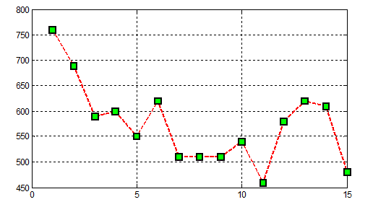
Example: TSP with 6 cities
Six cities: ‘1’ – ‘6’: 720 possible ways to visit (6!)
Only 14 visits (out of 720) are valid, not resulting in ‘infinite’ length
Out of the valid visit:
Shortest visit is of length 460. Shortest path: 5 - 3 - 1 - 2 - 4 - 6
Longest visit is of length 760. Longest path: 1 - 2 - 3 - 4 - 6 – 5

