Slide 1
Genetic Algorithms-II:
Application on Scheduling
D600 Algorithm Theory
Lecture-11:
Notes taken from:
Falkenauer, E. and Bouffouix, S. (1991) “A Genetic Algorithm for Job Shop”, IEEE International Conference on Robotics and Automation.
Wall (1996) “A Genetic Algorithm for Resource-Constrained Scheduling”, PhD Thesis, MIT.
Reggie Davidrajuh
University of Stavanger
Spring 2015

Slide 2
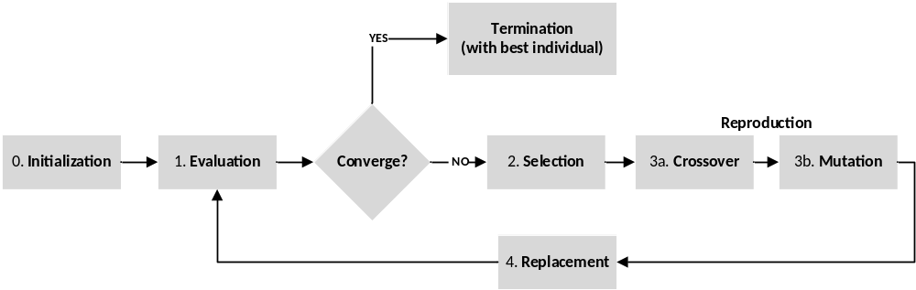
Revision: Steps in GA
iteration i=1;
  Step-0: Create initial population Pi ;
  repeat
  { step-1: evaluate fitness of each individual in population Pi;
    step-2: select individuals for reproduction based on fitness;
    step-3: perform crossover & mutation on selected individuals;
    step-4: replace old population with the new generation;
    i++;
  } until terminal condition is met;

Slide 3
Revision: GA
GA is a search optimization algorithm:
Encoding: The search space of all possible solutions is mapped onto a set of finite strings over a finite (generally small) alphabet.
Chromosome: each point in the search space is represented by exactly one string, called chromosome.
Parallelism: The first generation (initial population ) is selected randomly. Unlike standard optimization techniques, a GA performs a parallel search over a set of points in the search space, thus lessening the probability of being stuck in a local optimum.
Randomized technique: The more fit individuals are selected according to a noisy selection, i.e. individuals are selected randomly, but with probability increasing with fitness.
Noisy selection: the less fit individuals (the weak part of a population) are replaced by the new stronger children obtained by crossover and mutation. In standard optimization techniques, the current best solution is replaced with a new candidate.

Slide 4
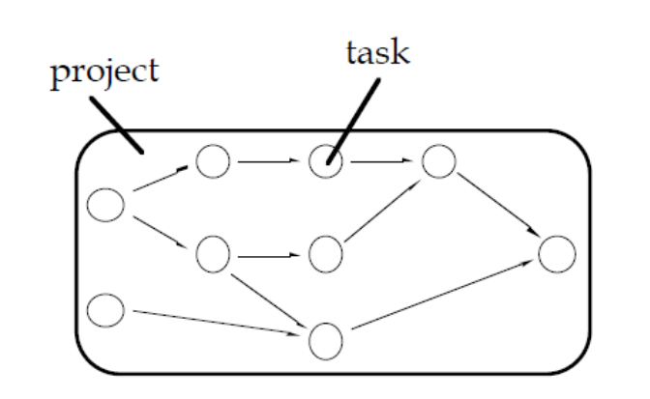
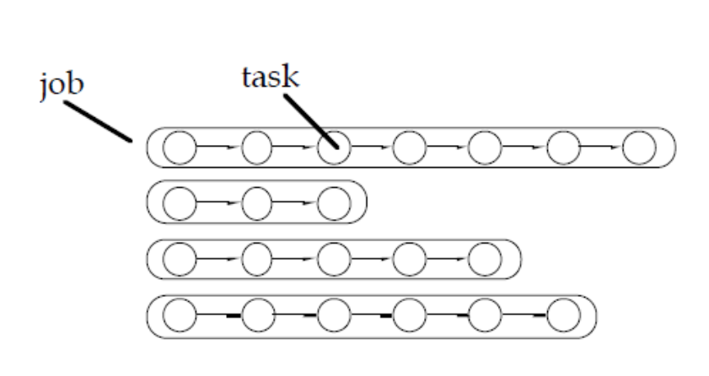
Project Scheduling versus Job-Shop Scheduling
Project scheduling: a single project consists of a set of tasks (or activities). The tasks have precedence relationships, as shown in the figure below. The tasks may have estimated durations. The main aim of scheduling is to minimize the time to complete the entire project. In multi-project scheduling problems, more than one project must be scheduled.
Job-shop scheduling: a work order of n jobs is to be performed, where each job contains m_{i} tasks. Each task has a single predecessor; each task has its own estimated duration. Objective is to minimize the makespan for the work order.

Slide 5
Example-3: The Job Shop Scheduling
The JSP consists of assigning resources of finite capacity to operations, while complying with constraints such as:
Capacity constraints: at any time, not more than a certain number of resources of each type are available.
Precedence constraints: an order (partial or not) is imposed on operations of a job. These are also called as technological constraints.
Temporal constraints: the non-availability of material before a certain date and the necessity to deliver the finished product in a certain day.

Slide 6
Example-3: The JSP
The job shop scheduling problem is about a work order that consists of three Jobs; the jobs have 3, 4, and 5 tasks respectively. The tasks of the jobs and the precedence relations between them are give below:
J_{A}: j_{A1} → j_{A2} → j_{A3}
J_{B}: j_{B1} → j_{B2} → j_{B3} → j_{B4}
J_{C}: j_{C1} → j_{C2} → j_{C3} → j_{C4} → j_{C5}
The tasks can be performed by three machines, which can perform only specific tasks:
M1: j_{A1}, j_{B2}, j_{C1}
M2: j_{A3}, j_{B1}, j_{B4}, j_{C3}, j_{C5}
M3: j_{A2}, j_{B3}, j_{C2}, j_{C4}
Same mathematical problem in different domains.

Slide 7
GA: developing the Fitness fn
In reality: JSP is an optimization is to minimize lateness, lead time, or inventory, total production cost, or maximize throughput.
Though cost is the main issue in industry, we are not going include cost in the fitness function, due to lack of data.
Since late delivery is also a pervasive problem in today’s industry, the fitness function should include and penalize lateness.
Finishing jobs in advance is not good either (inventory issues); however, planning for early finish may counter unexpected event that may hamper production. Hence, fitness function should reward advance.
Fitness function should also take into consideration that a few early deliveries may be compensated by many small advances.
Thus, the fitness function becomes:
f = c∑ advances - ∑ lateness²
where c is a constant between 0 and 1.

Slide 8
Chromosome
Lets design a chromosome with three sub-chromosomes, one for each machine (or resource or station).
Each gene (inside a sub-chromosome) represent the dispatch rule (preference list) for a machine.
The schedule is thus defined implicitly by the chromosome.
With the chromosomes encoding preference lists for the machines, the aim of the genetic search is to find the best permutation of the operations in each list.
The problem is thus very similar to the Traveling Salesman Problem. In TSP, there is only one list, whereas we have three lists in this JSP.
Chromosome-1:
M1: j_{A1} → j_{B2} → j_{C1}
M2: j_{A3} → j_{B1} → j_{B4} → j_{C3} → j_{C5}
M3: j_{A2} → j_{B3} → j_{C2} → j_{C4}
Chromosome-2:
M1: j_{C1} → j_{A1} → j_{B2}
M2: j_{B1} → j_{B4} → j_{C3} → j_{C5} → j_{A3}
M3: j_{B3} → j_{C2} → j_{A2} → j_{C4}

Slide 9
Ordered Cross Over
Chromosome-1:
M1: j_{A1} → j_{B2} → j_{C1}
M2: j_{A3} → j_{B1} → j_{B4} → j_{C3} → j_{C5}
M3: j_{A2} → j_{B3} → j_{C2} → j_{C4}
Chromosome-2:
M1: j_{C1} → j_{A1} → j_{B2}
M2: j_{B1} → j_{B4} → j_{C3} → j_{C5} → j_{A3}
M3: j_{B3} → j_{C2} → j_{A2} → j_{C4}
Tasks performed on each machine must be separated from others.
We will apply the crossover operator independently to each sub-chromosome (e.g. cross the first sub-chromosome of p1 with the first sub-chromosome of p2, the second with the second, and so on).
In addition, we use “ordered crossover” – the technique that we used in solving TSP; ordered crossover only modifies the order of genes on the sub-chromosome.
After the cross over operation, the resulting sub-chromosomes must be validated.
There are other efficient technique for cross over (e.g. Falkenauer and Bouffouix, 1991), that do not demand validation after the operation.

Slide 10
Mutation
The classic mutation operator (i.e. a random modification of an allele) is inapplicable. E.g: M1: j_{A1} → j_{B2} → j_{C1} becomes j_{A1} → j_{C2} → j_{C1} , as it would result in appearance of extraneous task or disappearance of existing ones, ignoring the strong constraint of part routings.
Since the problem is an ordering one, mutation on the basis of a random perturbation of the position of genes on the chromosome (rather than of their value - allele) seems to work; the operator is ‘inversion’ than the usual mutation. E.g: M1: j_{A1} → j_{B2} → j_{C1} becomes j_{B2} → j_{A1} → j_{C1}
After mutation, the new sub-chromosome must be validated, as the new ordering could violate the precedence constraints.
E.g: by inversion of M2: j_{A3} → j_{B1} → j_{B4} → j_{C3} → j_{C5} we could get
j_{A3} → j_{C5} → j_{B4} → j_{C3} → j_{A3} , which is invalid.

Slide 11
Experimenting with the ideas
Encoding of genes: J_{A}, J_{B}, and J_{C} has 3, 4, and 5 tasks respectively.
  Assign numbers to tasks such that tasks in J_{A} get numbered 1:3, J_{B} get 4:7, and J_{C} get 8:12.
  J_{A}: j_{A1} =1, j_{A2} =2, j_{A3} =3,
  J_{B}: j_{B1} =4, j_{B2} =5, j_{B3} = 6, j_{B4} = 7,
  J_{C}: j_{C1} =8, j_{C2} =9, j_{C3} =10, j_{C4} =11, j_{C5} = 12.
Initial population size 30 (validated, out of the possibilities of 3! X 5! X 4!).
Chromosome-1:
M1: j_{A1} → j_{B2} → j_{C1}
M2: j_{A3} → j_{B1} → j_{B4} → j_{C3} → j_{C5}
M3: j_{A2} → j_{B3} → j_{C2} → j_{C4}
Chromosome-2:
M1: j_{C1} → j_{A1} → j_{B2}
M2: j_{B1} → j_{B4} → j_{C3} → j_{C5} → j_{A3}
M3: j_{B3} → j_{C2} → j_{A2} → j_{C4}
Chromosome-1:
M1: [1 5 8]
M2: [3 4 7 10 12]
M3: [2 6 9 11]
Chromosome-2:
M1: [8 1 5]
M2: [4 7 10 12 3]
M3: [6 9 2 11]

Slide 12
Experimenting with the ideas
Reproduction:
  Recombination by “ordered crossover” and then validation.
  inversion (mutation) with probability 0.033, and then validation.
Validation:
  From the sub-chromosome, extract 3 sets of numbers (for the three jobs) S_{A} is 1:3, S_{B} is 4:7, and S_{C} is 8:12.
  If the sets are in ascending order then the sub-chromosome passes that validation test!
  E.g. Suppose M2 is [4 7 3 12 10] after cross over. Then,
    S_{A} = [3], S_{B} = [4 7], and S_{C} = [12 10]
    Though both S_{A} and S_{B} are in ascending order, S_{C} is not; thus the sub-chromosome is not valid!
Chromosome-1:
M1: [1 5 8]
M2: [3 4 7 10 12]
M3: [2 6 9 11]
Chromosome-2:
M1: [8 1 5]
M2: [4 7 10 12 3]
M3: [6 9 2 11]

