Slide 1

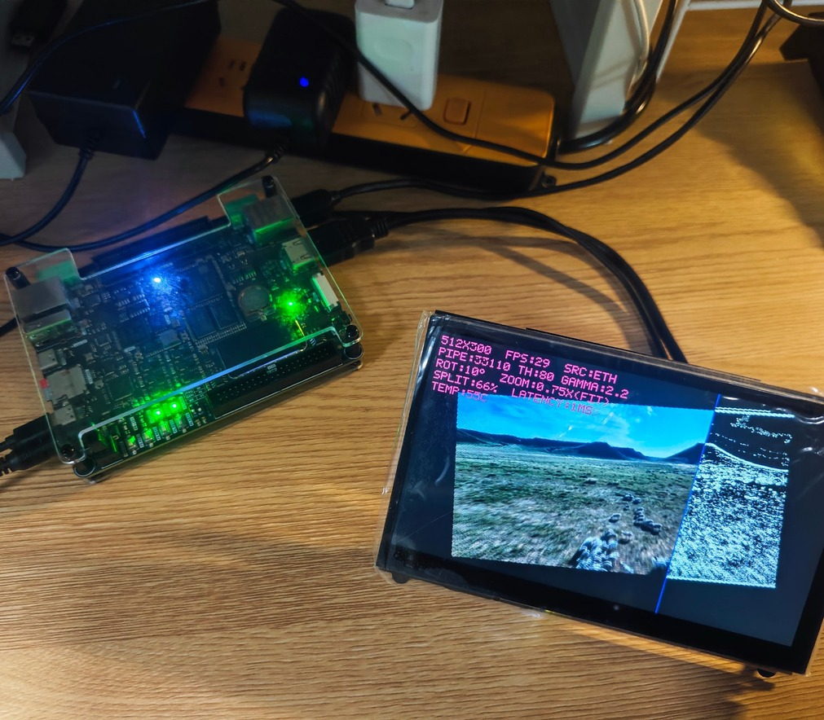

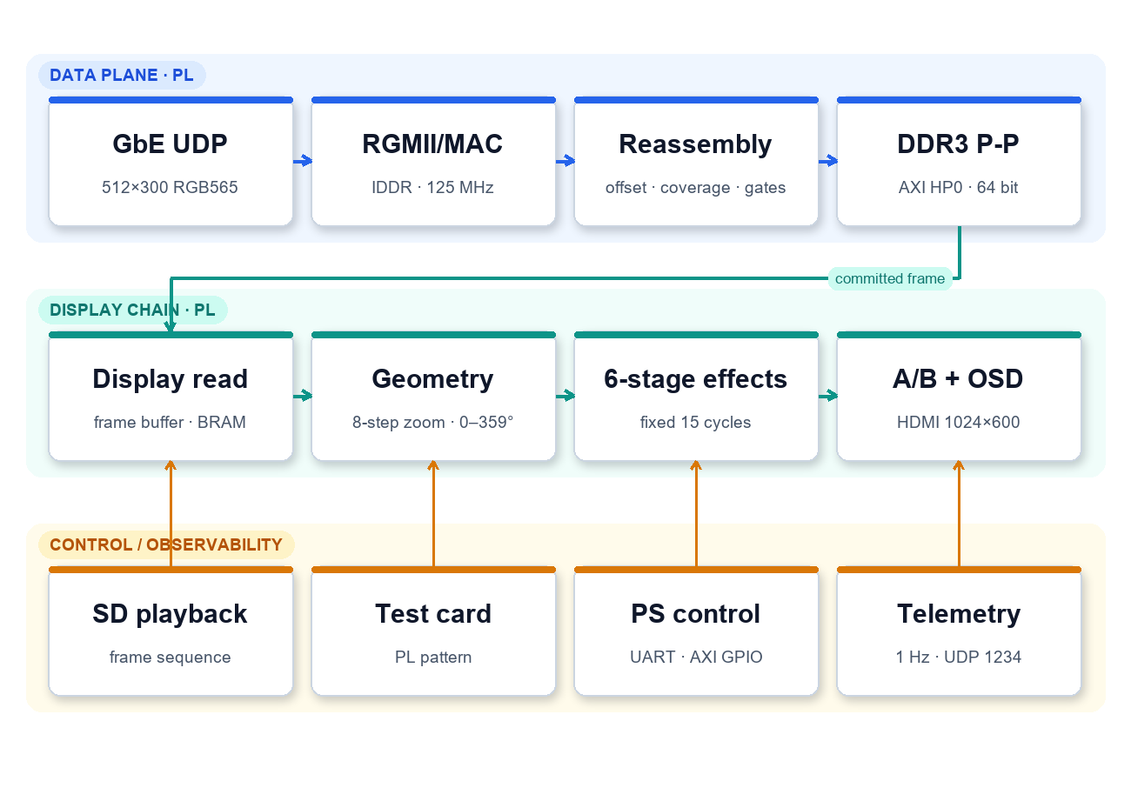
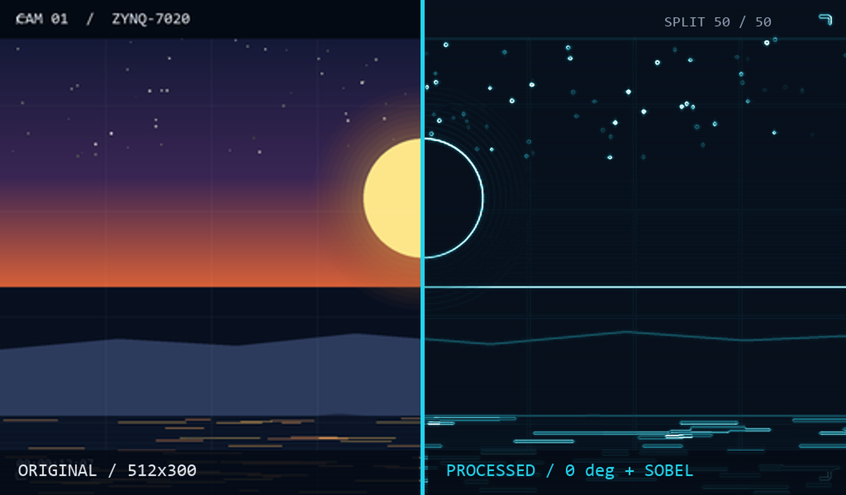


INTRODUCTION
Wang Xu · Uie_Team
One Frame, Two Truths
A Multi-Source Video Node on Zynq-7020
Advisors: Tan Huisheng · Liang Jiaojiao
Hunan University of Technology, Hunan Province
Platform: RK-ZYNQ7020-F / xc7z020clg484-2
System output · on-board test
Remote video nodes usually have one Ethernet cable and no PC. The operator must know whether the frame arrived, whether processing took effect, and how old the picture is. This node answers all three on one Zynq-7020: 512×300 RGB565 enters GbE, whole frames pass a three-condition commit, both panes read back the same frame, and the seam switches original and processed per column.
C
R
R
E
E
S
A
T
U
I
L
V
T
SYSTEM ARCHITECTURE
E
Ingress & storage
1. RGMII + MAC + UDP filter, offset reassembly;
2. Three gates: bytes, row-coverage bitmap, no bad packet;
3. DDR3 ping-pong, AXI HP0 64-bit bursts;
4. Three sources: UDP / SD playback / on-board test card;
5. Switch only after a whole frame; bad packet/missing row abort;
6. Input bandwidth about 74 Mb/s.
D
CREATIVE DESIGN
1. Same-frame A/B: both panes share geometry, row labels and the 15-cycle chain; the seam compares one frame.
2. Three-gate commit: bytes, row coverage and no bad packet commit together; a half frame never reaches the screen.
3. Falsifiable meters: pane_bad, link gaps and 1/100 packet loss turn the instrument red.
4. All-PL + QSPI: receive/display/effects/OSD in PL; cold boot from QSPI.
RESULT
WNS 1.368 / WHS 0.048 ns, zero violations; LUT 28.13%, BRAM 70.00%.
241 frames / 8.03 s = 30.01 fps; selftest 22.0/0/18.9; 105-command UART suite PASS.
1024×600 @ 59.5 Hz, 74 Mb/s; fixed 15-cycle chain; QSPI boot validated.
NEXT
DDR tile cache for higher resolution; compression/link upgrade for 1080p; RGMII eye diagram and remote update.
Typical application case
E
Confidence monitoring for broadcast, security and industrial vision: one cable carries the picture, processing result and link status; same-frame comparison supports algorithm acceptance and fault isolation.
S
I
G
Key technical issues addressed
1. GbE UDP reassembly: offset reassembly; commit only when bytes, row coverage and no-bad-packet gates all pass.
2. Same-frame A/B: both panes share geometry, row labels and the fixed 15-cycle chain; seam selects per column.
3. Observability: aborts, missing rows, pane_bad and link gaps via serial/UDP/GPIO.
4. Storage & sources: DDR3 ping-pong; UDP / SD playback / on-board test card.
5. Boot & test: QSPI cold boot; 105-command UART suite.
N
Display & processing
1. 8-step zoom + 0–359° rotation + bilinear;
2. Six-stage effect chain, fixed 15-cycle latency;
3. Same-frame A/B seam, per-column selection;
4. Five-line OSD + HDMI 1024×600;
5. Serial/UDP/GPIO read the same counters.
Test: 105-command UART suite → link selftest → telemetry listen | Performance: 30.01 fps | Asset: royalty-free scenery

