Slide 1
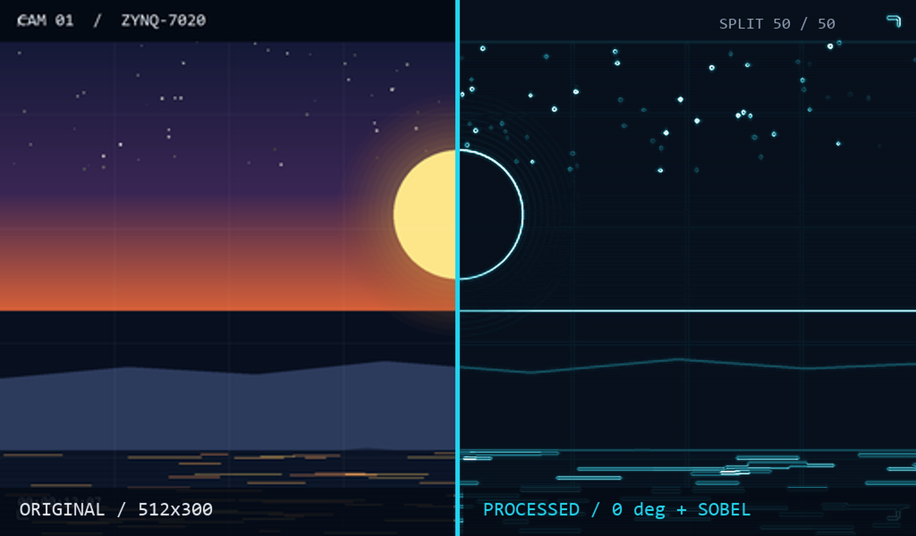
AMD FPGA INNOVATION DESIGN COMPETITION
PRIMARY GROUP · SELF-DEFINED TRACK
AMD
ZYNQ-7020 · A FULLY HARDWARE VIDEO NODE
One frame.
Two truths.
Original and processed pixels leave one frame buffer in the same clock, so the split screen compares content rather than screenshots. The node reports what it did on the wire at 1 Hz.
Rendered from the same 512×300 test frame through the implemented Sobel chain at 0°, no rotation.
01 SAME-FRAME A/B
02 CAUSE-BEARING TELEMETRY
03 CALIBRATED BY FAULT INJECTION
A fixed 15-cycle effect chain sits behind both halves. The seam is a pixel decision, not a compositing trick.
Frames, aborts, missing rows, PL latency, pane integrity and frame gaps arrive as a 1 Hz UDP beacon, not just FPS.
Inject 1-in-100 packet loss: aborts and missed rows must move, FPS must fall, recovery must return to baseline.
THE NUMBERS · ROUTED BUILD
1.341 ns
0.025 ns
70.00%
15 cycles
setup WNS · 0 failing endpoints
hold WHS · tightest path
BRAM · 98 of 140 tiles
fixed effect latency
RGMII → MAC → UDP → DDR → GEOMETRY → 6-STAGE EFFECTS → A/B SEAM → HDMI
512×300 RGB565 at 30 fps → 1024×600 at 59.5 Hz · xc7z020clg484-2 · 1 GbE UDP ingest · SD and test-pattern fallback
AMD, the AMD Arrow logo and combinations thereof are trademarks of Advanced Micro Devices, Inc. Zynq is a trademark of AMD. All other trademarks are the property of their respective owners.
Zynq-7020 · 1024×600 HDMI

