Slide 1

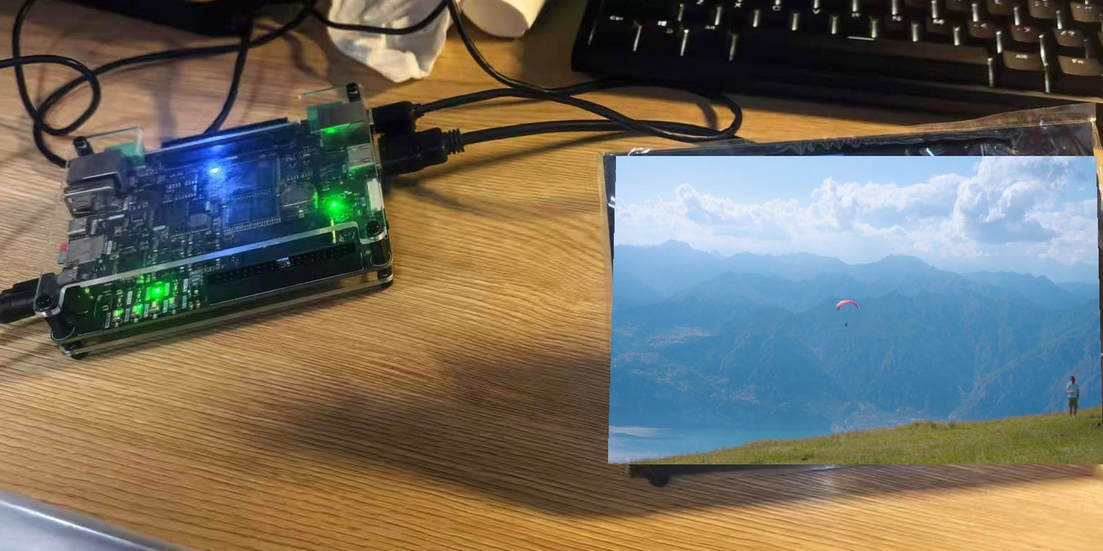
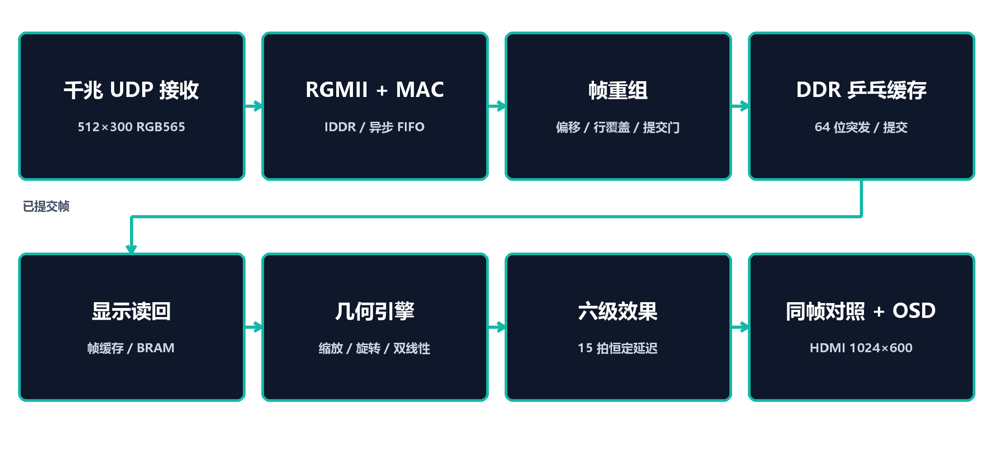

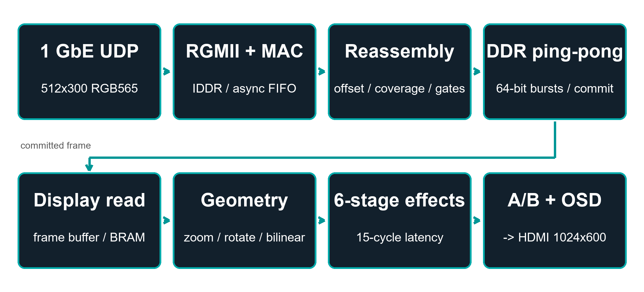
版权所有 2026
团队：Uie_Team
队员：王旭（Wang Xu）
指导老师：Tan Huisheng · Liang Jiaojiao
湖南工业大学 · 湖南省
平台：RK-ZYNQ7020-F · xc7z020clg484-2 · Vivado/Vitis 2025.2.1
多源视频同帧对照处理系统
基于 Zynq-7020 的全硬件视频通路与可观测性设计
作品实物（系统输出画面）
作品介绍
系统架构
创新设计
远程视频节点通常只有一根网线，没有 PC。操作者需要同时知道三件事：画面是否收到、处理是否生效、画面延迟多大。本作品在 Zynq-7020 上完成全硬件处理：512×300 RGB565 视频从千兆网口输入，整帧满足提交条件后写入 DDR 乒乓缓存；显示侧读回同一帧，左侧显示原图，右侧显示处理结果，竖缝逐像素选择。
1. 同帧对照
两侧共用几何运算、行标签和固定 15 拍效果链，比较的是同一帧，而不是两张截图。
典型应用场景
2. 提交条件与状态监测
字节数、行覆盖和坏包计数同时满足才提交；作废帧、缺行数和帧间隔可解释，1/100 丢包即可复现异常。
广播、安防和工业视觉的现场监测：现场没有采集设备时，一根网线可同时传输画面、处理结果和链路状态。
1. 千兆 UDP 接收与重组：RGMII → MAC → UDP 过滤 → 整帧提交；
2. DDR 乒乓缓存：PL 作为 AXI HP0 主设备写入双缓冲；
3. 几何引擎：0.25–2.00 八档缩放 + 0–359° 旋转 + 双线性插值；
4. 15 拍效果链：灰度/反色/模糊/锐化/Sobel/二值化/腐蚀膨胀，延迟恒定；
5. 同帧对照：左侧原图、右侧处理图，竖缝逐像素选择；
6. OSD 与状态回读：串口、遥测和 GPIO 读取同一组计数。
关键技术问题
1. 千兆 UDP 重组：按帧内偏移重组，字节数、行覆盖和坏包计数同时满足才提交。
2. 同帧对照：原图和处理图共用几何运算和 15 拍效果链，竖缝逐像素选择。
3. 状态监测：作废帧、缺行数、帧间隔和时延可通过串口、遥测和 GPIO 读取。
4. 存储：DDR 乒乓帧缓存 + 板载测试图卡。
结果
RGMII → HDMI 全部在 PL 内完成，PS 仅负责控制；1024×600 @ 59.5 Hz。
时序：WNS 1.368 / WHS 0.048 ns，失败端点 0。
8 秒推流 241 帧 = 30.01 fps；自检 22.2/0/18.9 PASS。
串口 105 条 PASS；QSPI 启动通过。
展望：DDR 瓦片缓存 / 1080p 链路 / RGMII 眼图 / 远程升级。
测试工具：串口命令测试(105) · 链路自检 · 遥测监听 | 性能：30.01 fps 满帧率 | 素材：可商用风景视频

Slide 2
Copyright 2026
Team: Uie_Team
Member: Wang Xu
Advisors: Tan Huisheng · Liang Jiaojiao
Hunan University of Technology, Hunan Province
Platform: RK-ZYNQ7020-F · xc7z020clg484-2 · Vivado/Vitis 2025.2.1
One Frame, Two Truths
A Multi-Source Video Node on Zynq-7020
On-board test · system output frame
INTRODUCTION
SYSTEM ARCHITECTURE
CREATIVE DESIGN
Remote video nodes usually have one Ethernet cable and no PC. The operator needs to know whether the frame arrived, whether processing took effect, and how old the picture is. This node performs the complete path on one Zynq-7020: a 512×300 RGB565 stream enters through GbE, whole frames are committed after three conditions, both panes read back the same frame, and the seam selects the original or processed pixel.
1. Same-frame comparison
Both panes share geometry, row labels and the fixed 15-cycle chain — the seam compares one frame, not two screenshots.
Typical application case
2. Commit conditions + status monitoring
Bytes, row coverage and bad-packet count must pass together; aborts, missing rows and frame gaps explain failures at 1/100 drops.
Confidence monitoring for broadcast, security and industrial vision: one cable carries the picture, processing result and link status.
1. GbE UDP reception & reassembly: RGMII → MAC → UDP filter → whole-frame commit;
2. DDR ping-pong buffer: PL as AXI HP0 master, double-buffered;
3. Geometry engine: 0.25–2.00× zoom (8 steps) + 0–359° rotation + bilinear;
4. 15-cycle effect chain: gray/invert/blur/sharpen/Sobel/binary/erode-dilate, constant latency;
5. Same-frame comparison: left original, right processed, per-pixel seam;
6. OSD + status readback: serial, telemetry and GPIO read the same counters.
Key technical issues addressed
1. GbE UDP reassembly: offset-based reassembly; commit only when bytes, row coverage and bad-packet count pass.
2. Same-frame comparison: both panes share geometry and a fixed 15-cycle effect chain; the seam selects per pixel.
3. Status monitoring: aborts, missing rows, frame gaps and latency are readable through serial, telemetry and GPIO.
4. Storage: DDR ping-pong frame buffer + on-board test card.
RESULT
RGMII → HDMI entirely in PL; PS only control. 1024×600 @ 59.5 Hz.
Timing: WNS 1.368 / WHS 0.048 ns, zero failures.
8 s stream: 241 frames @ 30.01 fps; selftest 22.2/0/18.9 PASS.
UART 105 commands PASS; QSPI boot validated.
Next: DDR tile cache / 1080p link / RGMII eye diagram / remote update.
Test tools: UART battery (105) · link selftest · telemetry listen | Performance: 30.01 fps | Asset: royalty-free scenery video

