Slide 1

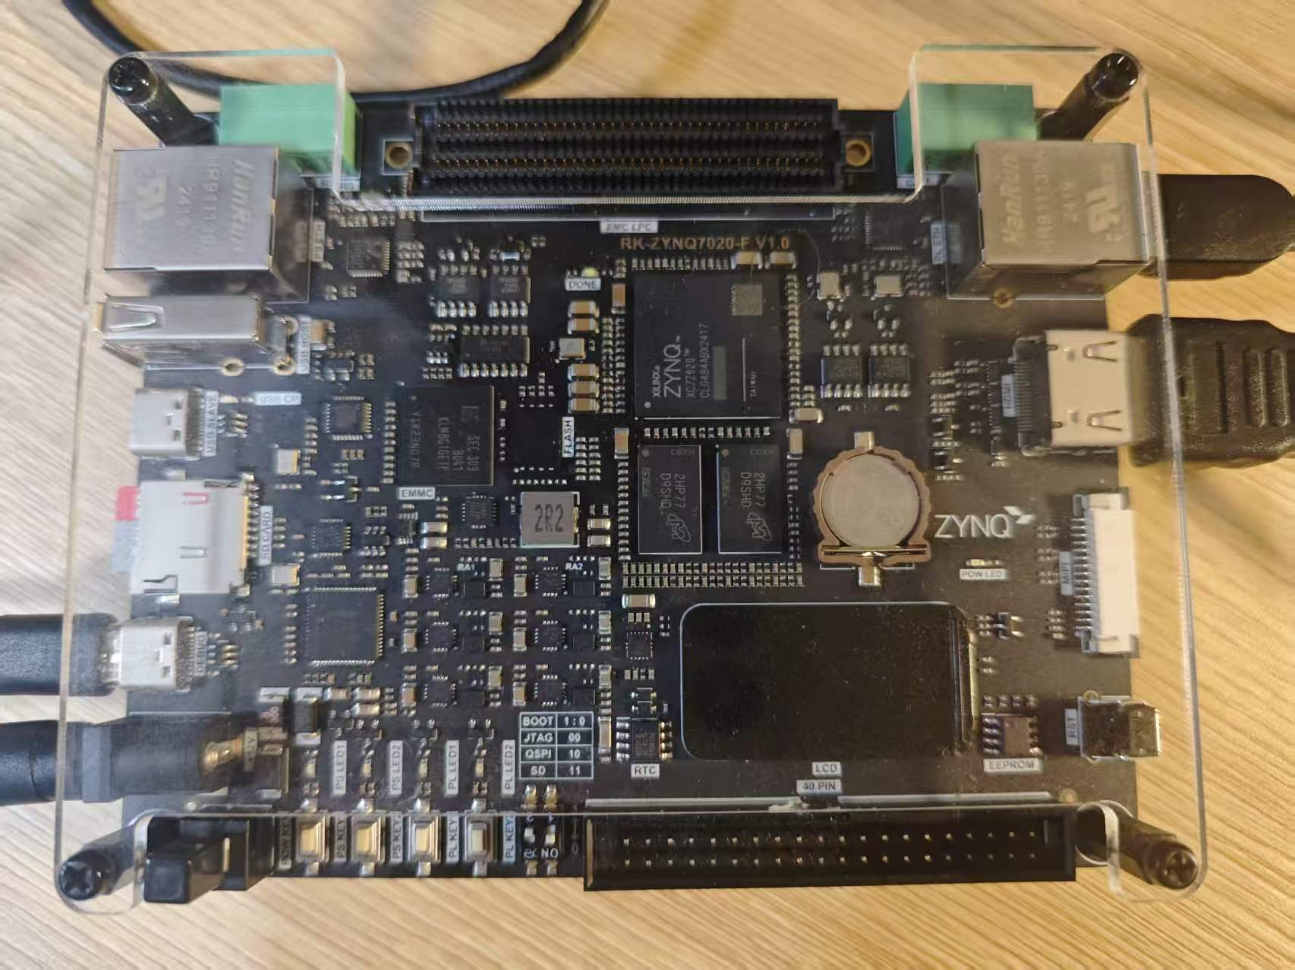

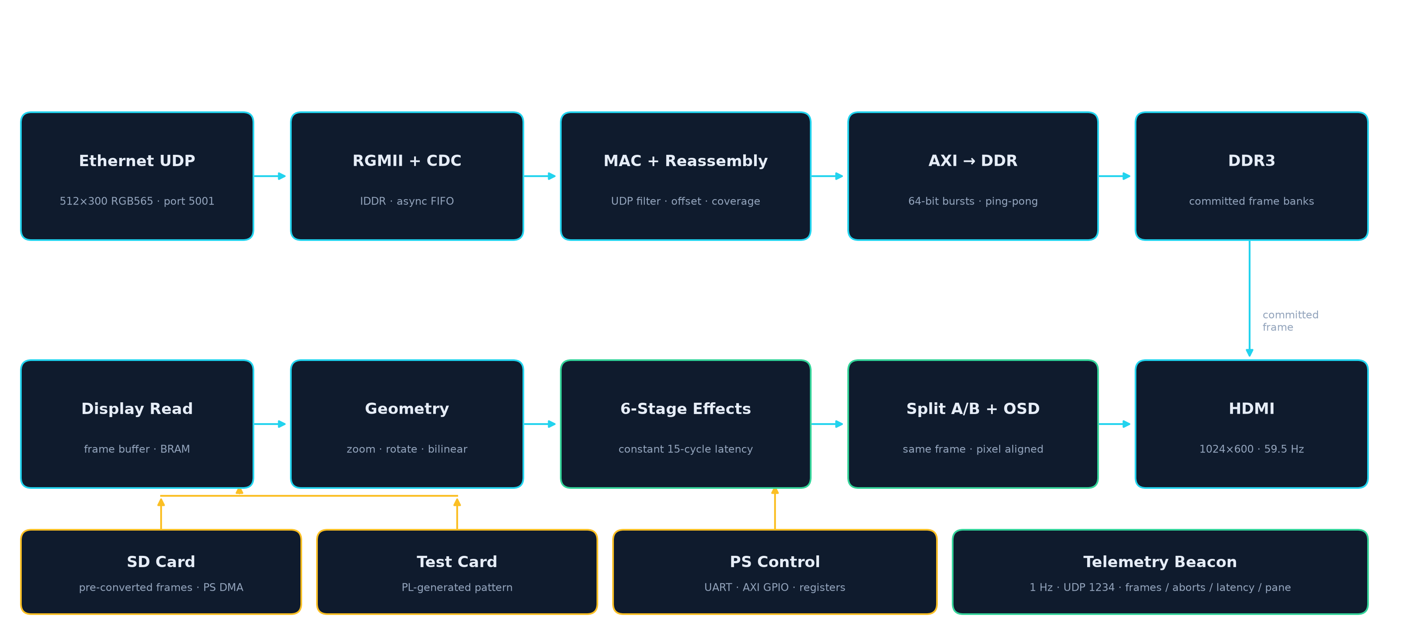
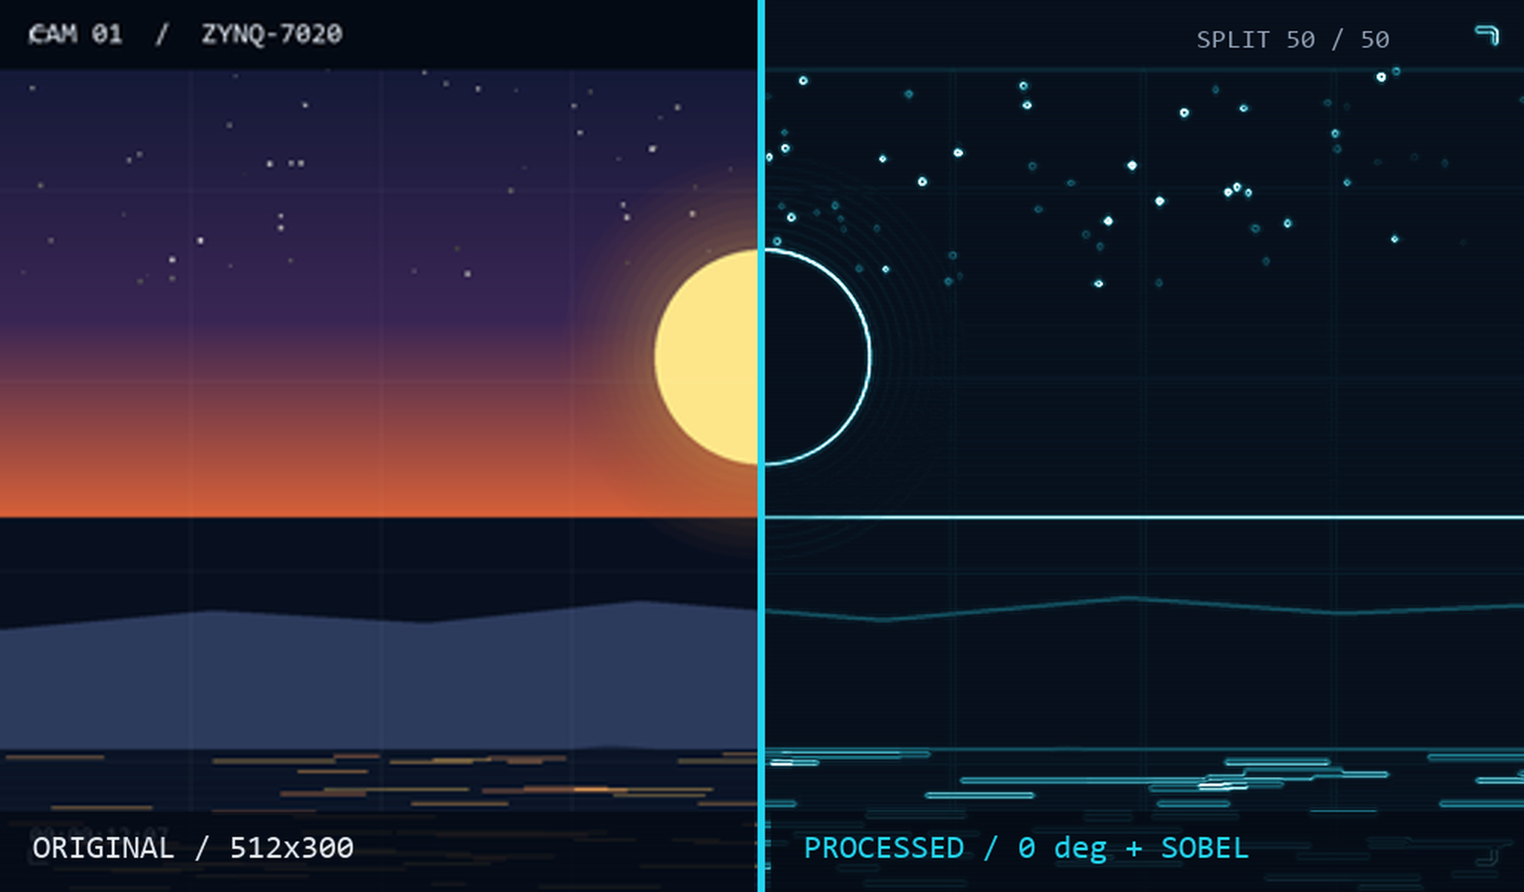
(c) 2026 Uie_Team | AMD FPGA Innovation Design Competition
湖南工业大学
ONE FRAME. TWO TRUTHS.
HUNAN UNIVERSITY
OF TECHNOLOGY
A full-hardware video node on Zynq-7020
多源视频同帧对照处理系统
ZYNQ-7020
Team: Uie_Team · Hunan University of Technology (湖南工业大学), Hunan Province
RK-ZYNQ7020-F V1.0
xc7z020clg484-2 · 1 GbE
INTRODUCTION
SYSTEM ARCHITECTURE
RESULT
Remote video nodes usually have one Ethernet cable and no PC. The operator must know whether the frame arrived, whether processing took effect, and how old the picture is. This node answers all three from one frame: 512x300 RGB565 enters RGMII, is reassembled and committed to DDR only after three gates, then read back once for both panes. The left pane is the original; the right pane is the same frame after geometry and a fixed 15-cycle effect chain. The seam is a per-pixel decision, not two screenshots.
RGMII -> HDMI entirely in PL; PS only control, SD playback and telemetry. 1024x600 at 59.5 Hz, 1 GbE UDP ingest.
Setup WNS
1.341 ns · 0 failing endpoints
Hold WHS
0.025 ns · positive margin
BRAM
70.0% · 98 / 140 tiles
8 s stream
241 frames · 29.95 fps
RGMII -> UDP -> DDR ping-pong -> geometry -> effects -> A/B seam -> HDMI
UART battery
105 commands · PASS
THREE-GATE COMMIT
A frame is committed only when 307200 bytes arrived, all 300 source rows were written, and no packet failed. Otherwise the last good frame stays on screen and aborts + rows_max expose the reason.
QSPI cold boot
DONE / EOS · no CRC error
Fault injection
22.0 / 0 / 18.9 fps · PASS
OBSERVABILITY
link / 1 Hz UDP telemetry: aborts, rows_max, stall, gap_min/max and pane_bad. The same counters are readable over UART, JTAG and the wire.
Same 512x300 frame · seam 50/50 · right pane 0 deg + Sobel
SAME-FRAME A/B
Original and processed panes share one source-coordinate stream, one row map and one 15-cycle effect chain. The seam is a per-pixel select; rotation or stacked effects cannot make the panes disagree.
Key technical issues addressed:
1. 1 GbE UDP: offset reassembly; commit = bytes + 300 rows + no bad packet.
2. Same-frame A/B: one coordinate stream, one row map, 15-cycle chain.
3. Telemetry: aborts, rows_max, gaps, pane_bad; drop 1/100 reddens it.
DROP 1 IN 100 -> ABORTS RISE -> RECOVERY
AMD, the AMD Arrow logo and combinations thereof are trademarks of Advanced Micro Devices, Inc. Zynq is a trademark of AMD. All other trademarks are the property of their respective owners.

