Slide 1
FinanceTracker
Tim Lachenicht & Tobias Kässmann

Slide 2
Task
Develop a microservice application.
Constraints
Framework: Spring (Java), Maven
API: JAX-RS & Spring
Message Queue
Deployment: Docker

Slide 3







Story
has
has
Lars
to make
Income & Expense
Savings Goal
Vacation
owns
part of
transferred via
on
Product
Bank Account
budget & forecast
diet
Analytics

Slide 4


Story
has
has
Lars
to make
Income & Expense
Savings Goal
Vacation
owns
part of
transferred via
on
Product
Bank Account
budget & forecast
diet
Analytics

Slide 5
Bank Account
Information Requirements
Bank Account
ID, Name, Description,
Balance, Disposition Limit,
Labels

Slide 6
Transaction: Income & Expense
Information Requirements
Transaction
ID, Name, Description,
Income or Expense,
Labels, Transfer
OneTime Transaction
Date, Amount, Transfer Status
Recurring Transaction
Start Date, Periodicity,
Fixed Amount (Optional),
Records
Transaction Record
Date, Amount, Transfer Status

Slide 7
Product
Information Requirements
Shopping Cart & Supplies
Collection of Product Entries
Product Entry
Quantity, Desired Quantity, Purchased, Product
Product
Name, Description, Category, Size, Price, Labels, Nutrition
Nutrition
Calories, Carbohydrates,
Protein, Fat, Sugar

Slide 8
Savings Goal
Information Requirements
Savings Goal
ID, Name, Description, Status,
Labels, Periodical or Rule-Based
Periodical Savings Goal
Source & Target Bank Account,
Recurring Rate or Amount,
Duration, Periodicity, Goal
Rule-Based Savings Goal
Match-All or Match-Any,
Collection of Rules
Rule
Bank Account, Target Amount
Equals or Greater or Less

Slide 9
Analytics
Information Requirements
Budget
Monthly Incomes & Expenses
for each:
Fixed or Variable, Label
Budget Plan
Map of Label to Amount,
Start Date
Forecast
Map of Bank Account to Amount,
Date
Diet
Nutrition, Duration

Slide 10
Software Architecture

Slide 11
Software Architecture

Slide 12
Software Architecture

Slide 13
Software Architecture

Slide 14
Mainline Scenario (Sequence Diagram)

Slide 15
Savings Goal

Slide 16
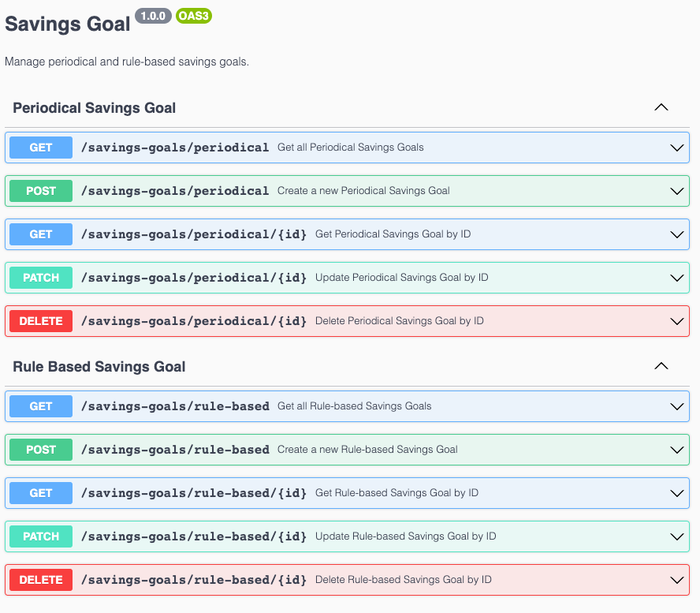
Savings Goal

Slide 17
Savings Goal

Slide 18
Continuous Integration

Slide 19
Testing

Slide 20
Local Deployment

Slide 21
Demo

