Slide 1
FinanceTracker
Tim Lachenicht & Tobias Kässmann

Slide 2
Task
Develop a microservice application.
Constraints
Framework: Spring (Java), Maven
API: JAX-RS & Spring
Message Queue
Deployment: Docker

Slide 3

Story
Lars

Slide 4

Story
Lars
owns
Bank Account

Slide 5

Story
has
Lars
Income & Expense
owns
transferred via
Bank Account

Slide 6

Story
has
Lars
Income & Expense
owns
part of
transferred via
Product
Bank Account

Slide 7


Story
has
has
Lars
to make
Income & Expense
Savings Goal
Vacation
owns
part of
transferred via
on
Product
Bank Account

Slide 8

Story
has
has
Lars
to make
Income & Expense
Savings Goal
Vacation
owns
part of
transferred via
on
Product
Bank Account
budget & forecast
diet
Analytics

Slide 9


Story
has
has
Lars
to make
Income & Expense
Savings Goal
Vacation
owns
part of
transferred via
on
Product
Bank Account
budget & forecast
diet
Analytics

Slide 10

Bank Account
BankAccount
View
Bank Accounts
Create
Bank Account
Delete
Bank Account

Slide 11
Transaction: Income & Expense
Transaction
View Transactions
Create Transaction
BankAccount
Transfer Transaction
Delete Transaction
<<includes>>
Rollback Transaction

Slide 12
Product
Product
Add Product to Shopping Cart
<<includes>>
Create Product
<<extends>>
NutritionAPI
Add Product to Supplies
Add Nutrition
Purchase
Shopping Cart
Transaction

Slide 13
Savings Goal
SavingsGoal
<<includes>>
View Status
View Savings Goal
Transaction
Link Savings Bank Accounts
<<extends>>
Create Savings Goal
BankAccount
Link Rule Bank Accounts
<<extends>>

Slide 14
Analytics
Analytics
SavingsGoal
View Forecast
<<includes>>
Transaction
Generate Report
<<includes>>
View Budget
BankAccount
<<includes>>
View Diet
Create Budget Plan
Product

Slide 15

Software Architecture
UI-FinanceTracker
Product
Transaction
SavingsGoal
BankAccount
Analytics

Slide 16
Software Architecture
[L]
UI-FinanceTracker
[L]
[L]
[K]
Product
Transaction
SavingsGoal
[L]
[K]
BankAccount
Analytics

Slide 17
Software Architecture
[L]
UI-FinanceTracker
[L]
[L]
[K]
Product
Transaction
SavingsGoal
[L]
[K]
BankAccount
Analytics

Slide 18
Software Architecture
[L]
UI-FinanceTracker
[L]
[L]
[K]
Product
Transaction
SavingsGoal
[L]
[K]
BankAccount
Analytics

Slide 19
Software Architecture
[L]
UI-FinanceTracker
[L]
[L]
[K]
Product
Transaction
SavingsGoal
[L]
[K]
BankAccount
Analytics

Slide 20
Software Architecture
[L]
UI-FinanceTracker
[L]
[L]
[K]
Product
Transaction
SavingsGoal
[L]
[K]
BankAccount
Analytics

Slide 21
Savings Goal

Slide 22
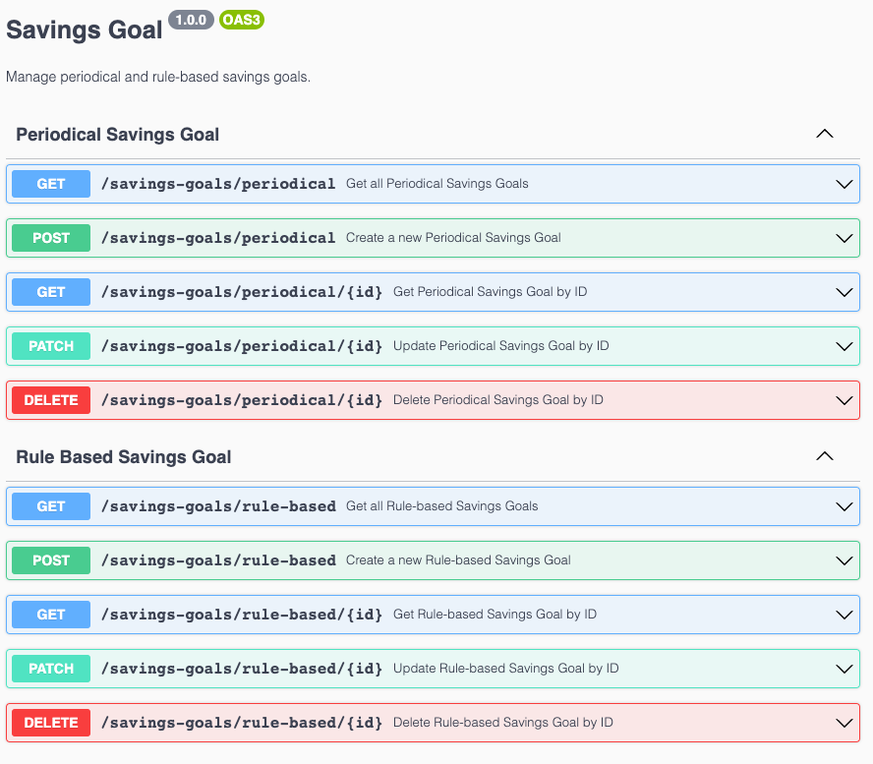
Savings Goal

Slide 23
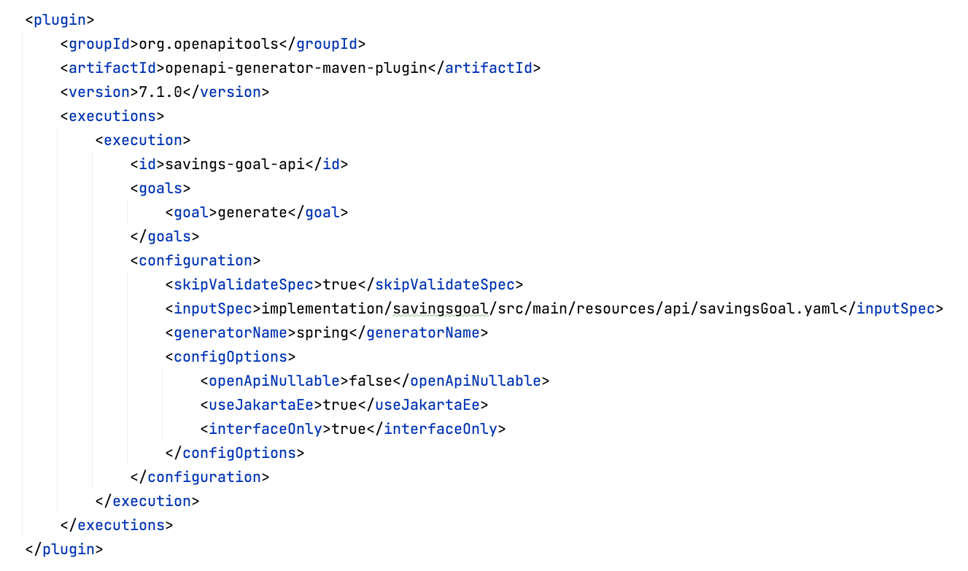
Savings Goal

Slide 24
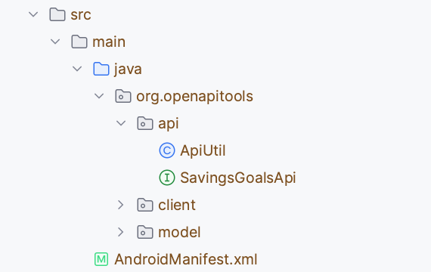
Savings Goal

Slide 25
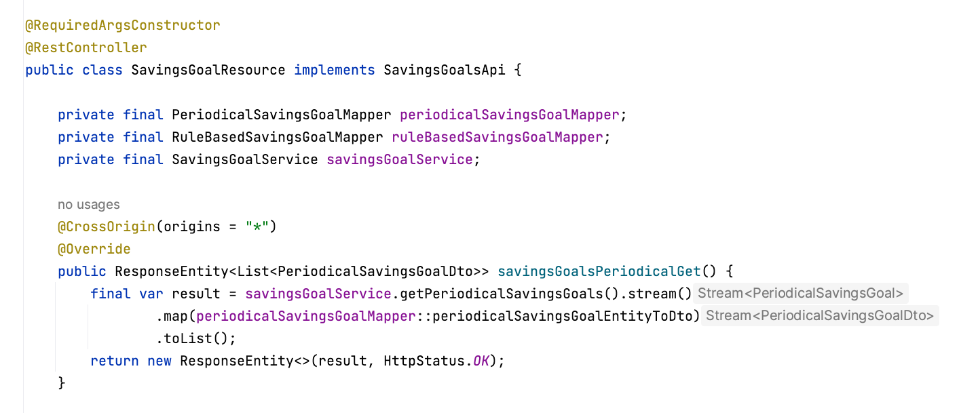
Savings Goal

Slide 26
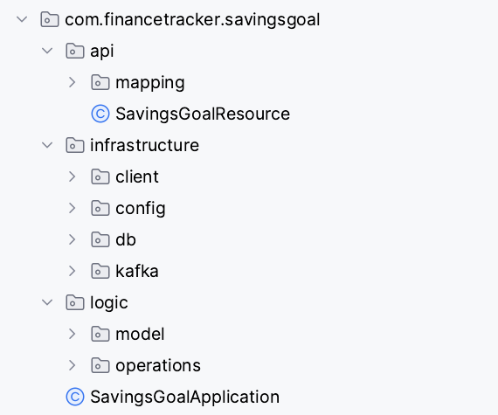
Savings Goal

Slide 27
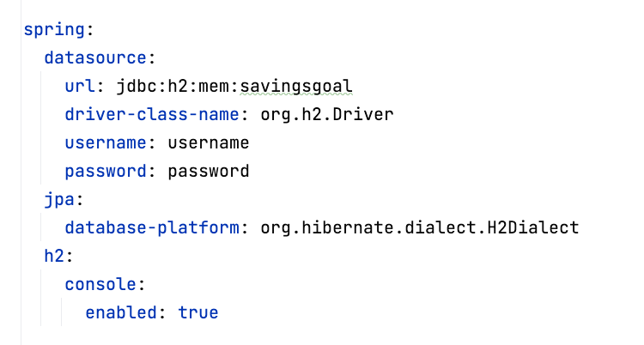
Savings Goal

Slide 28
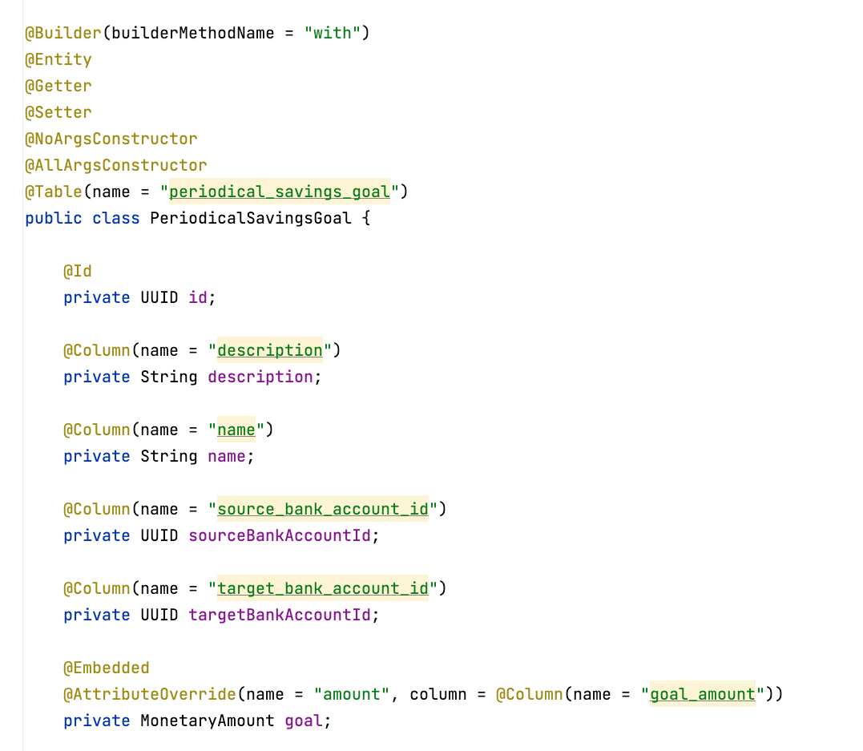
Savings Goal

Slide 29
Savings Goal

Slide 30
Continuous Integration

Slide 31
Testing

Slide 32
Local Deployment

Slide 33
Mainline Scenario (Sequence Diagram)

Slide 34
Demo

