Slide 1
CS801: COMPUTING LAB (M.TECH)
ModelBench
An Interactive Platform for ML Model Comparison and Prediction
Continuous Evaluation 1 (CE-1) Progress Presentation
Team Members:
• Ujjwal Singh (Roll No: 262IS036)
• Aryan (Roll No: 262IS007)
Department of Computer Science & Engineering | National Institute of Technology Karnataka, Surathkal

Slide 2
MODELBENCH | CONTINUOUS EVALUATION 1
Problem & Motivation in Applied Machine Learning
⚠️ The Current Practical Bottlenecks
• Fragmented ML Experimentation: Practitioners repeatedly build, tune, and compare models across separate ad-hoc notebooks, leading to inconsistent pipelines.
• Hidden Data Leakage: Preprocessing transformations (scaling, encoding) often fit on the entire dataset prior to splitting, skewing real-world generalization.
• Predictions Trapped in Code: Trained models remain inside Python scripts; non-technical stakeholders cannot obtain predictions without developer assistance.
• Lack of Standardized Benchmarks: Comparing algorithms fairly requires identical train/test partitions, unified metrics, and diagnostic error analysis.
💡 The ModelBench Approach
• Unified Experimentation Platform: Provides a single interface to load datasets, train candidate model families, and evaluate them on standardized splits.
• Leak-Free Pipeline Architecture: Enforces strict training-only fits with ColumnTransformer, ensuring authentic out-of-sample evaluation.
• Multi-Metric & Diagnostic Inspection: Benchmarks R², MAE, RMSE, and visualizes residual patterns to understand model behavior.
• Dual-Layer Accessibility: Serves both technical ML engineers (benchmarking & diagnostics) and domain users (clean live predictions).

Slide 3
DUAL TARGET PERSONAS & CORE WORKFLOWS
Who is ModelBench For?
👤 End User (Domain Expert / Stakeholder) | 💻 ML Engineer / Researcher
• Does not need machine learning knowledge | • Needs tools for systematic ML experimentation
• Enters familiar, human-readable values | • Selects datasets and candidate model families
• Obtains instant target predictions | • Compares model performance across multiple metrics
• No preprocessing / encoding knowledge required | • Tests regularization penalties & hyperparameters
• Does not need to write Python code or run scripts | • Studies error distributions and diagnostic plots
End User Flow:
Select Dataset → Enter Inputs → ModelBench → Prediction
ML Engineer Flow:
Dataset → Models → Hyperparameters → Evaluation → Diagnostics
⚡ Same platform, two distinct levels of interaction.

Slide 4
FROM PREDICTION TO ML EXPERIMENTATION
How ModelBench Works
MODELBENCH PLATFORM
👤 End User Interaction Flow
1. Select benchmark dataset from catalog
2. Enter familiar inputs (Age, BMI, Smoker...)
3. Select model (or use top benchmarked model)
4. Click Predict → Receive formatted output
💻 ML Engineer Interaction Flow
1. Select dataset & inspect distribution insights
2. Evaluate multiple model architectures
3. Tune regularization hyperparameters (α)
4. Compare metrics (R², MAE, RMSE) on test set
5. Inspect diagnostics (Residuals & Actual vs Pred)
Current CE-1 Demonstration: Medical Insurance Cost Prediction | Future Roadmap: Extensible architecture supporting multiple regression and classification datasets.

Slide 5
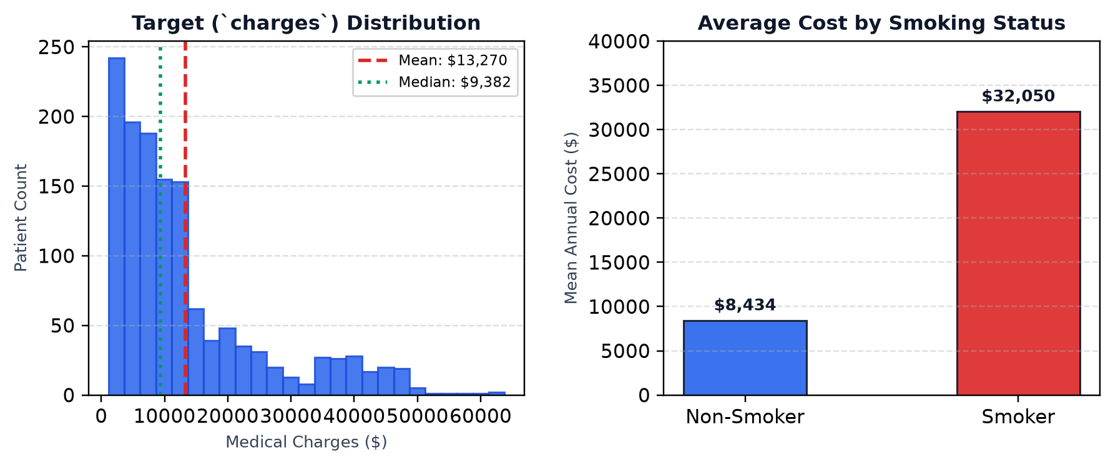
MEDICAL INSURANCE COST PREDICTION
Current CE-1 Demonstration Dataset
📋 Dataset Overview (N = 1,338)
• Task Type: Supervised Continuous Regression.
• Target Variable: `charges` ($) — Annual medical costs (Right-skewed, $1,121 to $63,770).
• Data Quality: Clean, real-world healthcare dataset with zero missing values.
• User-Facing Inputs: Age, Sex, BMI, Number of Children, Smoking Status.
• Internal Baseline: Region handled internally as baseline reference to preserve pipeline structure without cluttering user UI.
User Input Vector → Model Prediction:
[ Age | Sex | BMI | Children | Smoker ]
↓
Estimated Medical Charges ($)
EDA Takeaway: Smoking & BMI show strong non-linear interaction, motivating polynomial feature expansion.

Slide 6
LEAK-FREE SCIKIT-LEARN PIPELINE
Machine Learning Methodology & Preprocessing
⚙️ End-to-End Experimental Workflow
1. Dataset
1,338 rows
2. 80/20 Split
Train: 1,070 | Test: 268
3. ColumnTransformer
Numeric: Scale | Cat: Encode
4. Model Experiments
Linear | Ridge | Poly
5. Evaluation
R² | MAE | RMSE
Linear Regression (OLS Baseline)
• Standard multi-feature linear hypothesis.
• Minimizes Residual Sum of Squares (RSS).
• Assumes independent, additive feature contributions.
• Serves as the empirical benchmark baseline.
Ridge Regression (L2 Regularization)
• Linear model with L2 weight shrinkage.
• Loss: RSS + α Σ βⱼ²
• Tuned α across [0.01, 0.1, 1.0, 10.0, 100.0].
• Controls multicollinearity & stabilizes weights.
Polynomial Ridge (Degree=2, α=10.0)
• Non-linear basis expansion (quadratic & interaction terms).
• Captures feature synergies like (BMI × Smoker).
• Regularized with α=10.0 to prevent overfitting.
• Achieves optimal bias-variance balance.
🔒 Methodological Guarantee: Preprocessing transformers fit strictly on X_train only to prevent data leakage.

Slide 7
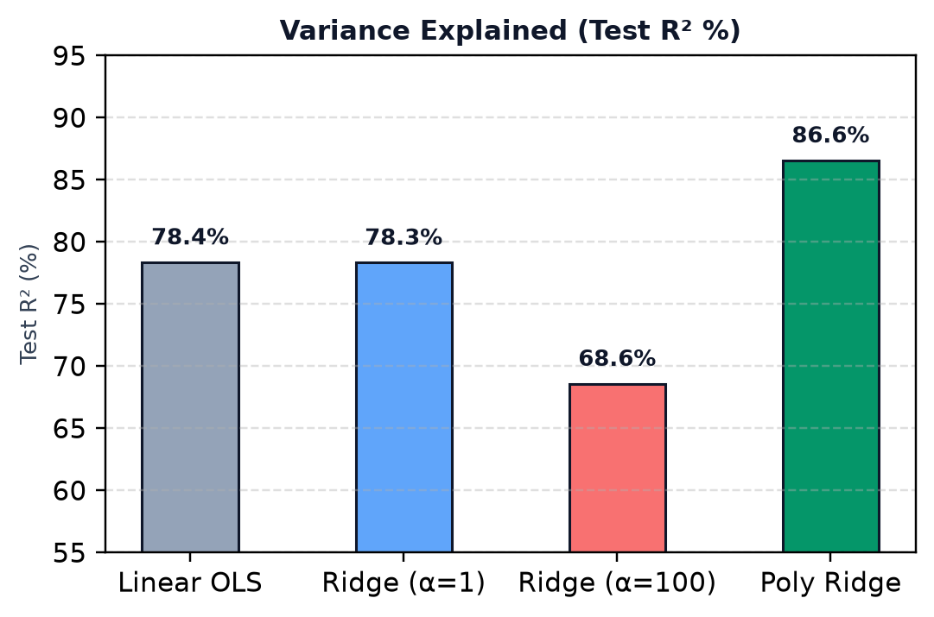
ANSWERING: WHICH CONFIGURATION PERFORMS BEST ON THIS DATASET?
Model Comparison & Hyperparameter Evaluation
Model Configuration | Train R² | Test R² | Test MAE ($) | Test RMSE ($)
Linear Regression (OLS) | 0.7417 | 0.7836 | $4,181.19 | $5,796.28
Ridge (α = 0.01) | 0.7417 | 0.7836 | $4,181.31 | $5,796.28
Ridge (α = 0.1) | 0.7417 | 0.7836 | $4,182.39 | $5,796.34
Ridge (α = 1.0) | 0.7417 | 0.7833 | $4,193.20 | $5,800.46
Ridge (α = 10.0) | 0.7383 | 0.7791 | $4,300.89 | $5,856.32
Ridge (α = 100.0) | 0.6729 | 0.6859 | $5,217.80 | $6,997.74
Polynomial Ridge (d=2, α=10.0) | 0.8407 | 0.8656 | $2,836.88 | $4,568.56
🎯 Empirical Takeaways
• +8.2% Explained Variance: Polynomial Ridge increases R² from 78.36% to 86.56% on unseen test data.
• Substantial Error Reduction: MAE drops by $1,344.31 (32% improvement) by modeling feature interactions.
• Hyperparameter Impact: Excessive shrinkage (α=100) causes underfitting (R²=68.59%). α=10 provides optimal stability.

Slide 8
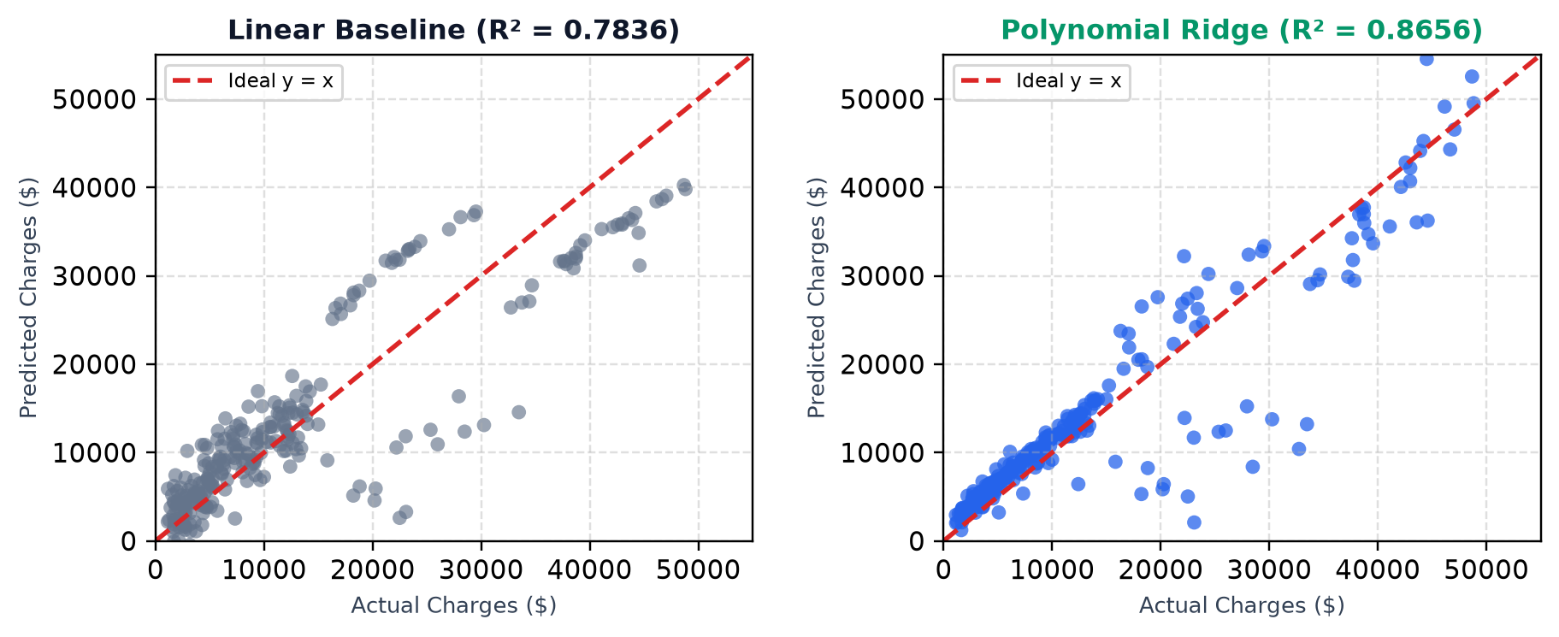
ANALYZING ERROR PATTERNS ACROSS MODEL ARCHITECTURES
Model Diagnostics & Error Inspection
🔍 What the Diagnostic Plots Reveal
• Linear Baseline: Systematically underpredicts high charges ($30k+), creating a dispersed fan pattern (heteroscedasticity) due to unmodeled interactions.
• Polynomial Ridge: Predictions cluster significantly closer to the ideal y=x reference line across both low-cost non-smokers and high-cost obese smokers.
• Residual Uniformity: Variance of residuals is stabilized, demonstrating improved bias-variance tradeoff on 268 test samples.

Slide 9
MODULAR IMPLEMENTATION & COLLABORATIVE DEVELOPMENT
System Architecture & Team Responsibilities
🏗️ ModelBench 3-Tier Architecture
• React Frontend (Vite): Interactive UI for Dataset selection, Model selection, human-readable inputs, and comparison scorecards.
• FastAPI Backend: Lightweight Python service exposing REST endpoints (/api/predict, /api/comparison, /api/diagnostics).
• ML Core Engine: Reusable Scikit-Learn pipelines, ColumnTransformer, and metric evaluation logic.
⚡ Extensible Architecture: Schema-driven design allowing additional datasets and models to be plugged in seamlessly.
👨‍💻 Ujjwal Singh (Roll No: 262IS036)
• Exploratory Data Analysis & statistical distribution plotting.
• Non-linear interaction term discovery (BMI × Smoker).
• Multiple Linear Regression & Polynomial basis expansion (d=2).
• Model diagnostic scatter plotting & residual evaluation.
👨‍💻 Aryan (Roll No: 262IS007)
• Scikit-Learn ColumnTransformer leak-free preprocessing.
• Ridge L2 regularization experiments & α hyperparameter search.
• Benchmarking evaluation module (R², MAE, RMSE metrics).
• FastAPI backend integration & dynamic dataset schema design.

Slide 10
CONTINUOUS EVALUATION 1 MILESTONES & NEXT STEPS
Summary & Project Roadmap
✅ Current Deliverables (CE-1)
• Regression Benchmark Harness: Working end-to-end regression evaluation across Linear, Ridge, and Polynomial architectures.
• Empirical Evaluation Scorecard: Standardized metrics on 268 test samples proving +8.2% explained variance gain.
• Dual-Layer Interface: Interactive UI providing prediction for end users and analytical scorecards for ML practitioners.
• Clean, Leak-Free Codebase: Modular Scikit-Learn pipelines connected to lightweight FastAPI integration layer.
🚀 Next Milestones (CE-2 & Final)
• Multi-Dataset Benchmarking: Integrate additional datasets (Housing Prices, Student Performance, Customer Churn).
• Classification Benchmark Engine: Add Logistic Regression, Decision Trees, Random Forests, and SVM.
• Classification Diagnostics: Incorporate Confusion Matrices, Precision-Recall Curves, and ROC-AUC scores.
• Automated Hyperparameter Search: Implement interactive GridSearch & RandomizedSearchCV visualizer.

