Slide 1
CS801: COMPUTING LAB — MIDSEM EVALUATION
ModelBench
A Web-Based Platform for Empirical Machine Learning Model Evaluation & Comparative Benchmarking
Mid-Semester Project Progress Presentation & Demonstration
Presented By:
• Ujjwal Singh (Roll No: 262IS036)
• Aryan (Roll No: 262IS007)
Course Instructor: Prof. P. Santhi Thilagam | Dept. of CSE, National Institute of Technology Karnataka (NITK), Surathkal

Slide 2
MODELBENCH | MID-SEMESTER EVALUATION
Motivation & Problem Statement in Applied ML
⚠️ The Problem in Applied ML Practice
• Fragmented ML Experimentation: Practitioners train and tune algorithms across ad-hoc Jupyter notebooks with inconsistent preprocessing and train-test splits.
• Hidden Data Leakage: Preprocessing transformations (scaling, encoding) often fit on the entire dataset prior to splitting, distorting out-of-sample generalization.
• Predictions Trapped in Code: Trained models remain inside Python scripts; non-technical stakeholders cannot obtain predictions without developer assistance.
• Superficial Benchmarking: Comparison is often limited to a single scalar metric without residual diagnostics or hyperparameter sensitivity analysis.
💡 The ModelBench Approach
• Unified Benchmarking Platform: Provides a single interface to load datasets, train candidate model families, and evaluate them under standardized conditions.
• Leak-Free Pipeline Architecture: Enforces strict training-only fits with ColumnTransformer, ensuring authentic out-of-sample evaluation.
• Multi-Metric & Diagnostic Inspection: Benchmarks R², MAE, RMSE, and visualizes residual patterns to understand model behavior.
• Dual-Layer Accessibility: Serves both technical ML engineers (benchmarking & diagnostics) and domain users (clean live predictions).

Slide 3
DUAL TARGET PERSONAS & CORE WORKFLOWS
Who is ModelBench For?
👤 End User (Domain Expert / Stakeholder) | 💻 ML Engineer / Researcher
• Does not need machine learning knowledge | • Needs tools for systematic ML experimentation
• Enters familiar, human-readable values | • Selects datasets and candidate model families
• Obtains instant target predictions | • Compares model performance across multiple metrics
• No preprocessing / encoding knowledge required | • Tests regularization penalties & hyperparameters
• Does not need to write Python code or run scripts | • Studies error distributions and diagnostic plots
End User Flow:
Select Dataset → Enter Inputs → ModelBench → Prediction
ML Engineer Flow:
Dataset → Models → Hyperparameters → Evaluation → Diagnostics
⚡ Same platform, two distinct levels of interaction.

Slide 4
OFFICIAL EVALUATION REQUIREMENT: TASKS COMPLETED VS. REMAINING
Mid-Semester Status: Progress Accounting
✅ Tasks Accomplished (Phase 1 & MidSem)
• Regression Benchmark Core: Complete pipeline implemented on Medical Insurance dataset (1,338 records).
• Leak-Free Preprocessing: Scikit-Learn ColumnTransformer (StandardScaler + OneHotEncoder) strictly fit on X_train.
• Algorithms Benchmarked: Linear OLS, Ridge (α = 0.01 to 100), and Polynomial Ridge (d=2, α=10).
• Empirical Performance: Discovered non-linear BMI × Smoker synergy (+8.2% R² gain, $1,344 MAE reduction).
• Error Diagnostics: Residual analysis and Actual vs. Predicted scatter plots generated.
• FastAPI Backend: REST service with pipeline startup caching (<2ms inference).
• React Workbench Dashboard: Interactive 3-tab UI (Prediction, Scorecard, Diagnostics).
🚀 Tasks to be Completed (CE-2 & EndSem)
• Classification Benchmark Engine: Implement Logistic Regression, KNN, Decision Trees, Random Forests, and SVM.
• Classification Dataset: Ingest real-world classification dataset (Telco Customer Churn, ~7,000 records).
• Classification Metrics: Compute Accuracy, Precision, Recall, F1-Score, and ROC-AUC score.
• Diagnostic Visualizers: Interactive Confusion Matrix heatmaps and ROC curve overlays.
• Automated Hyperparameter Tuning: GridSearchCV & RandomizedSearchCV with k-fold cross-validation.
• Multi-Dataset UI Task Switcher: Schema-driven toggle between Regression and Classification.
• Comprehensive Final Project Report: Complete LaTeX documentation and final performance verification.

Slide 5
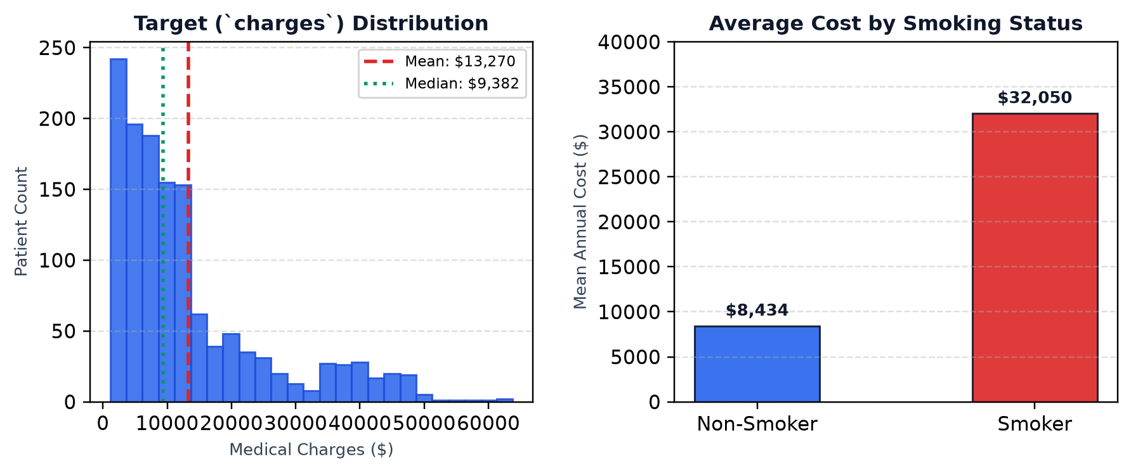
CURRENT DEMONSTRATION DATASET & EXPLORATORY FINDINGS
Current Benchmark: Medical Insurance Dataset
📋 Dataset Overview (N = 1,338)
• Task Type: Supervised Continuous Regression.
• Target Variable: `charges` ($) — Annual medical costs (Right-skewed, $1,121 to $63,770).
• Data Quality: Clean, real-world healthcare dataset with zero missing values.
• User-Facing Inputs: Age, Sex, BMI, Number of Children, Smoking Status.
• Internal Baseline: Region handled internally as baseline reference to preserve pipeline structure without cluttering user UI.
User Input Vector → Model Prediction:
[ Age | Sex | BMI | Children | Smoker ]
↓
Estimated Medical Charges ($)
EDA Takeaway: Smoking & BMI show strong non-linear interaction, motivating polynomial feature expansion.

Slide 6
LEAK-FREE SCIKIT-LEARN PIPELINE ARCHITECTURE
Machine Learning Methodology & Preprocessing
⚙️ End-to-End Experimental Workflow
1. Dataset
1,338 rows
2. 80/20 Split
Train: 1,070 | Test: 268
3. ColumnTransformer
Numeric: Scale | Cat: Encode
4. Model Experiments
Linear | Ridge | Poly
5. Evaluation
R² | MAE | RMSE
Linear Regression (OLS Baseline)
• Standard multi-feature linear hypothesis.
• Minimizes Residual Sum of Squares (RSS).
• Assumes independent, additive feature contributions.
• Serves as the empirical benchmark baseline.
Ridge Regression (L2 Regularization)
• Linear model with L2 weight shrinkage.
• Loss: RSS + α Σ βⱼ²
• Tuned α across [0.01, 0.1, 1.0, 10.0, 100.0].
• Controls multicollinearity & stabilizes weights.
Polynomial Ridge (Degree=2, α=10.0)
• Non-linear basis expansion (quadratic & interaction terms).
• Captures feature synergies like (BMI × Smoker).
• Regularized with α=10.0 to prevent overfitting.
• Achieves optimal bias-variance balance.
🔒 Methodological Guarantee: Preprocessing transformers fit strictly on X_train only to prevent data leakage.

Slide 7
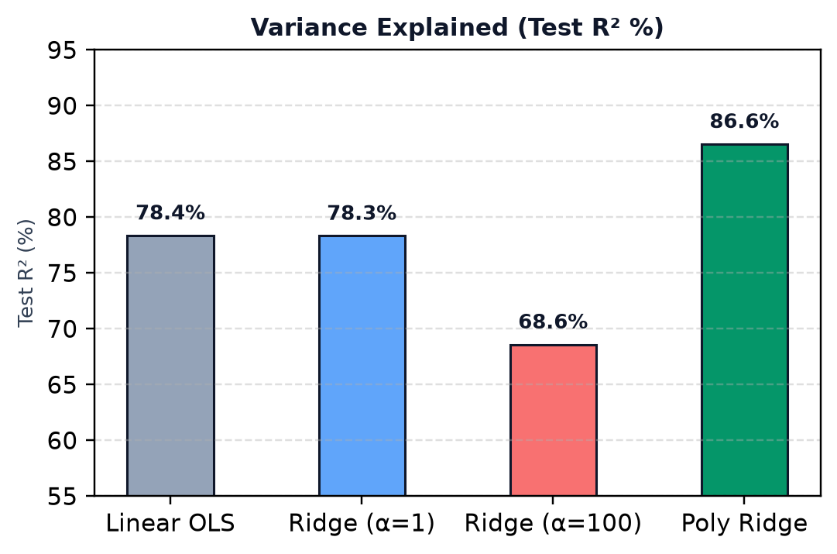
ANSWERING: WHICH CONFIGURATION PERFORMS BEST ON THIS DATASET?
Model Comparison & Hyperparameter Evaluation
Model Configuration | Train R² | Test R² | Test MAE ($) | Test RMSE ($)
Linear Regression (OLS) | 0.7417 | 0.7836 | $4,181.19 | $5,796.28
Ridge (α = 0.01) | 0.7417 | 0.7836 | $4,181.31 | $5,796.28
Ridge (α = 0.1) | 0.7417 | 0.7836 | $4,182.39 | $5,796.34
Ridge (α = 1.0) | 0.7417 | 0.7833 | $4,193.20 | $5,800.46
Ridge (α = 10.0) | 0.7383 | 0.7791 | $4,300.89 | $5,856.32
Ridge (α = 100.0) | 0.6729 | 0.6859 | $5,217.80 | $6,997.74
Polynomial Ridge (d=2, α=10.0) | 0.8407 | 0.8656 | $2,836.88 | $4,568.56
🎯 Empirical Takeaways
• +8.2% Explained Variance: Polynomial Ridge increases R² from 78.36% to 86.56% on unseen test data.
• Substantial Error Reduction: MAE drops by $1,344.31 (32% improvement) by modeling feature interactions.
• Hyperparameter Impact: Excessive shrinkage (α=100) causes underfitting (R²=68.59%). α=10 provides optimal stability.

Slide 8
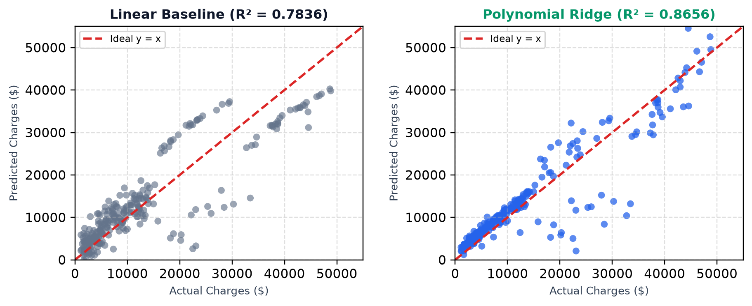
ANALYZING ERROR PATTERNS ACROSS MODEL ARCHITECTURES
Model Diagnostics & Error Inspection
🔍 What the Diagnostic Plots Reveal
• Linear Baseline: Systematically underpredicts high charges ($30k+), creating a dispersed fan pattern (heteroscedasticity) due to unmodeled interactions.
• Polynomial Ridge: Predictions cluster significantly closer to the ideal y=x reference line across both low-cost non-smokers and high-cost obese smokers.
• Residual Uniformity: Variance of residuals is stabilized, demonstrating improved bias-variance tradeoff on 268 test samples.

Slide 9
LIGHTWEIGHT INTEGRATION SUPPORTING 40% EVALUATION COMPONENT
System Architecture & Code Demonstration
1. Frontend Dashboard (React 18 + Vite)
• Single-Page Application (SPA) on Port 5173.
• 3 Clean Workbench Tabs: Prediction, Scorecard, Diagnostics.
• Human-readable inputs (Age, BMI, Smoker).
• Live benchmark scorecard table.
2. Backend API Service (FastAPI)
• Lightweight Python REST server on Port 8000.
• Startup Caching: Pipelines pre-fitted once in memory.
• Sub-millisecond live inference (< 2 ms).
• Handles internal baseline defaults (Region).
3. ML Core Engine (Scikit-Learn)
• Modular pipeline module (ml_core/insurance_regression.py).
• Leak-free ColumnTransformer preprocessing.
• Estimators: Linear, Ridge, and Polynomial Ridge.
• Standardized metric evaluation (R², MAE, RMSE).
💻 CODE DEMONSTRATION PHASE (40% Marks Allocation)
Proceeding to live execution: FastAPI backend terminal → React web dashboard → Jupyter Master Notebook.

Slide 10
EQUAL RESPONSIBILITY ACROSS ML RESEARCH & SOFTWARE INTEGRATION
Team Contributions & Division of Work
👨‍💻 Ujjwal Singh (Roll No: 262IS036)
👨‍💻 Aryan (Roll No: 262IS007)
• Exploratory Data Analysis: Statistical profiling, distribution analysis, and correlation matrices.
• Interaction Discovery: Discovered exponential non-linear synergy between BMI and smoking status.
• Model Implementation: Developed baseline Linear Regression and Polynomial Feature expansion (d=2).
• Diagnostic Visualization: Implemented Actual vs. Predicted scatter curves and residual distributions.
• Master Notebook: Maintained complete reproducible regression notebook in notebooks/regression/.
• Pipeline & Leak Prevention: Built Scikit-Learn ColumnTransformer for automated, leak-free preprocessing.
• Regularization Experiments: Conducted Ridge L2 hyperparameter tuning across α = [0.01, 100].
• Benchmarking Module: Created standardized evaluation module for R², MAE, and RMSE metrics.
• Backend REST Integration: Implemented FastAPI backend layer with memory caching for sub-millisecond execution.
• Schema Coordination: Designed schema-driven API models to support modular multi-dataset extension.

Slide 11
PHASED PROGRESSION TOWARD COMPLETE ML BENCHMARKING SUITE
Roadmap: CE-2 & End-Semester Deliverables
📅 Phase 4: Continuous Evaluation 2 (Nov 01)
• Classification Dataset Ingestion: Add real-world classification dataset (Telco Customer Churn, ~7,000 records).
• Parametric & Tree Classifiers: Implement Logistic Regression, KNN, Decision Tree, and Random Forest.
• Classification Evaluation Metrics: Compute Accuracy, Precision, Recall, F1-Score, and ROC-AUC score.
• Diagnostic Heatmaps: Build interactive Confusion Matrix and ROC curve diagnostic plots.
📅 Phase 5: End-Semester Evaluation (Nov 10–13)
• Automated Hyperparameter Search: Incorporate GridSearchCV & RandomizedSearchCV with k-fold cross-validation.
• Multi-Dataset UI Switching: Schema-driven dynamic interface supporting multiple regression & classification tasks.
• Comprehensive Final Report: Complete LaTeX technical report documenting all algorithms, latency, and findings.
• End-to-End System Verification: Full platform verification and reproducible open-source release.

Slide 12
ModelBench Mid-Semester Evaluation Summary
✅ 80–90% ML Focus: Leak-free ColumnTransformer pipeline with demonstrated +8.2% R² gain
✅ 10–20% Web Integration: Sub-millisecond FastAPI backend and 3-tab React dashboard
✅ Clear Phased Roadmap: Ready for Classification, Trees, Ensembles, and automated tuning for CE-2
Thank You!
Questions & Technical Discussion (15% Evaluation Marks)

