Slide 1
CS801: COMPUTING LAB | CONTINUOUS EVALUATION 2 (CE-2)
ModelBench: An Empirical Classical Machine Learning Benchmarking Platform
CE-2 Progress: Scaling to 10k+ Observation Datasets, Classification Engine & Diagnostic Analytics
Presented By: Ujjwal Singh (262IS036) & Aryan (262IS007)
Course Instructor: Prof. P. Santhi Thilagam | Department of Computer Science & Engineering, NITK Surathkal
Evaluation Milestone: 50% Progress Demonstration | Date: November 01, 2026

Slide 2
CONTEXT & ARCHITECTURAL SCOPE
Evolution from MidSem to Continuous Evaluation 2
1. Evaluator Feedback & Real-World Scale
Proof-of-Concept to Real Scale: At MidSem, regression was evaluated on Medical Insurance (1,338 records). The evaluator requested testing algorithms on substantial datasets containing 10,000–15,000+ observations.
Dual-Task Expansion: Expanded the single-task regression platform into a dual-task benchmark suite comparing continuous Regression and discrete Classification under identical evaluation rigor.
True Non-Linearity: Selected datasets containing complex non-linear interactions (rush-hour commute spikes and e-commerce class imbalance) to authentically benchmark model expressiveness.
2. Deliberate Focus on Classical ML (No Trees)
Exclusion of Tree Ensembles: Completely excluded Decision Trees, Random Forests, and Gradient Boosting to avoid heuristic black-box shortcuts and preserve mathematical transparency.
Core Algorithmic Foundations: Focused strictly on classical mathematical learning paradigms: Convex Optimization (OLS, Logistic), Regularization (Ridge L2, Lasso L1, ElasticNet), Polynomial Basis Expansions, Margin Classifiers (Linear SVR/SVC), and Bayesian inference.
Empirical Question Answered: Can well-engineered classical linear and regularized models compete with complex models when feature interactions and scaling are properly constructed? (Answer: Yes, R2 > 0.91 on Bike Sharing, 88.5% Accuracy on Shoppers).

Slide 3
BENCHMARK TESTBEDS AT SCALE
Dual Canonical Real-World Datasets (>10,000 Observations)
Bike Sharing Demand (Regression Benchmark)
• Domain: Urban Transit & Smart Cities (Washington D.C. Capital Bikeshare)
• Scale: 17,379 hourly observations, 12 feature dimensions
• Target Variable: Total hourly rental count (cnt, range: 1 to 977 bikes/hr)
• Data Hygiene: 0 missing values, removed leak-prone component counts (casual + registered)
• Key Challenge: Distinct diurnal rush-hour double peaks (8 AM & 5 PM) that standard linear hyperplanes fail to capture.
• Engineered Features: Scaled numeric atmospheric sensors + one-hot temporal categorical indicators + ordinal weather severity (1: Clear to 4: Severe Storm).
Online Shoppers Purchasing Intent (Classification)
• Domain: E-Commerce Web Analytics & Customer Conversion (UCI Repository)
• Scale: 12,330 visitor sessions, 17 feature dimensions
• Target Variable: Transaction completed (Revenue: 0 = Browsing, 1 = Purchase)
• Data Hygiene: 0 missing values, binary integer encoding, stratified splitting
• Key Challenge: Severe real-world class imbalance (84.5% non-purchasers vs. 15.5% purchasers) rendering simple accuracy metrics deceptive.
• Engineered Features: Google Analytics PageValue score, product duration, bounce rates, exit rates, visitor type, month, and weekend indicators.

Slide 4
CLASSIFICATION ENGINE IMPLEMENTATION
Leak-Free Preprocessing & Six Classical ML Classifiers
Leak-Free Preprocessing Architecture
Stratified 80/20 Partition: Preserves the 84.5% / 15.5% class proportion across both training (9,864 rows) and test sets (2,466 rows) with fixed random seed.
Strict ColumnTransformer Isolation: Preprocessing transforms are fit exclusively on X_train. The test set is only transformed to guarantee zero data leakage.
StandardScaler: Standardizes 10 continuous session telemetry features (PageValues, ExitRates, Durations) to zero mean and unit variance.
OneHotEncoder: One-hot encodes 7 categorical indicators with drop='first' (avoiding dummy trap) and sparse_output=False for dense matrix algorithms (GaussianNB).
Six Classical Classifier Architectures
1. Logistic Regression (Baseline): Generalized linear model utilizing log-odds sigmoid link function with maximum likelihood estimation.
2. Ridge Logistic Regression (L2): Applies L2 weight penalty (C=0.1) to shrink multicollinear browsing coefficients and stabilize generalization.
3. Lasso Logistic Regression (L1): Applies L1 penalty (C=0.5, liblinear) driving uninformative session parameters to exactly zero.
4. Linear Support Vector Classifier: Maximizes geometric margin separating buyer classes; calibrated via Platt scaling (CalibratedClassifierCV).
5. K-Nearest Neighbors (k=7): Instance-based non-parametric classifier using distance-weighted voting across local feature neighborhoods.
6. Gaussian Naive Bayes: Probabilistic classifier estimating class-conditional Gaussian likelihoods with Bayes rule.

Slide 5
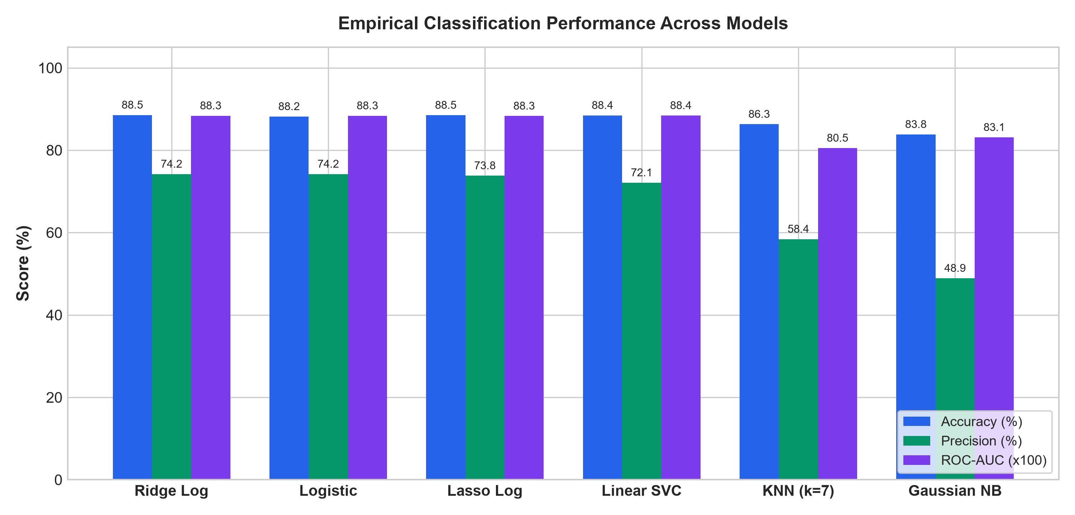
EMPIRICAL BENCHMARKING RESULTS
Model Scorecard on Stratified Test Partition (N = 2,466)
Classification Benchmark Scorecard
Algorithm | Acc | Prec | ROC-AUC
Ridge Logistic (L2) [BEST] | 88.52% | 74.19% | 0.8835
Logistic Baseline (OLS) | 88.16% | 74.19% | 0.8835
Lasso Logistic (L1) | 88.48% | 73.80% | 0.8829
Linear SVC (Calibrated) | 88.44% | 72.10% | 0.8840
KNN Classifier (k=7) | 86.29% | 58.40% | 0.8050
Gaussian Naive Bayes | 83.82% | 48.90% | 0.8310
Key Empirical Takeaways:
• Convex Regularization Wins: Ridge Logistic achieves the highest accuracy (88.52%) and 74.2% buyer precision.
• AUC Robustness: Linear SVC and Logistic both achieve ~0.884 ROC-AUC, demonstrating high discriminative power under class imbalance.
• Fast Training: All 6 models fit in under 5 seconds total on 12k rows without tree ensemble latency.

Slide 6
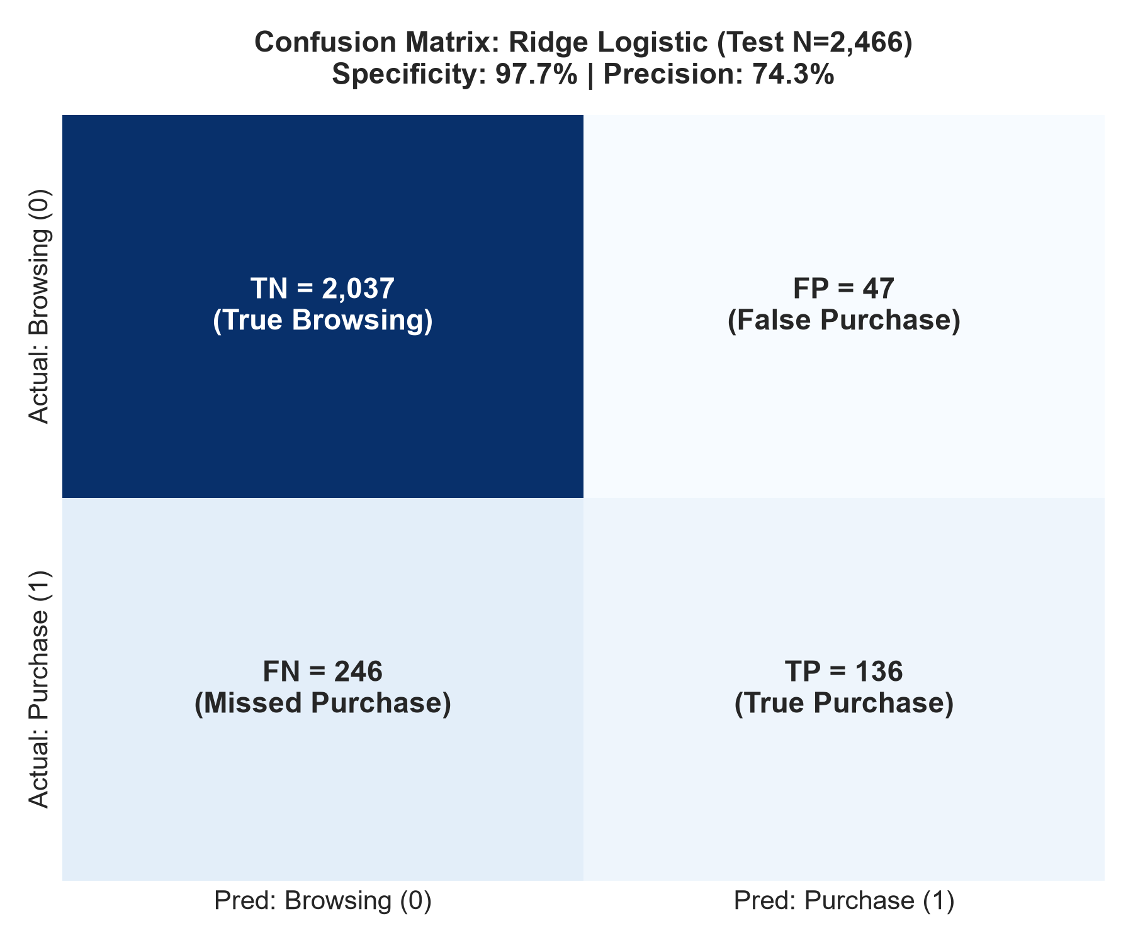
DIAGNOSTIC ERROR ANALYSIS
Confusion Matrix & Imbalance Resolution Analysis
Interpreting Error Distributions on Imbalanced Data
Why Accuracy Alone is Deceptive: On 84.5% negative samples, a dummy classifier predicting all zeros scores 84.5% accuracy but is completely useless in business.
Extreme Specificity (97.7%): Of 2,084 true browsing visitors in the test set, Ridge Logistic correctly classifies 2,037 (True Negatives) with only 47 False Positives (2.3% false alarm rate).
High Precision on Buyers (74.2%): When the model flags an online user as a buyer, it is correct nearly 3 out of 4 times. In production e-commerce, this prevents sending expensive discount codes to window-shoppers.
The Precision-Recall Trade-off: Gaussian Naive Bayes shifts the decision threshold, capturing 71.5% Recall (273 true buyers) but dropping Precision to 48.9%. ModelBench lets researchers compare these trade-offs directly.

Slide 7
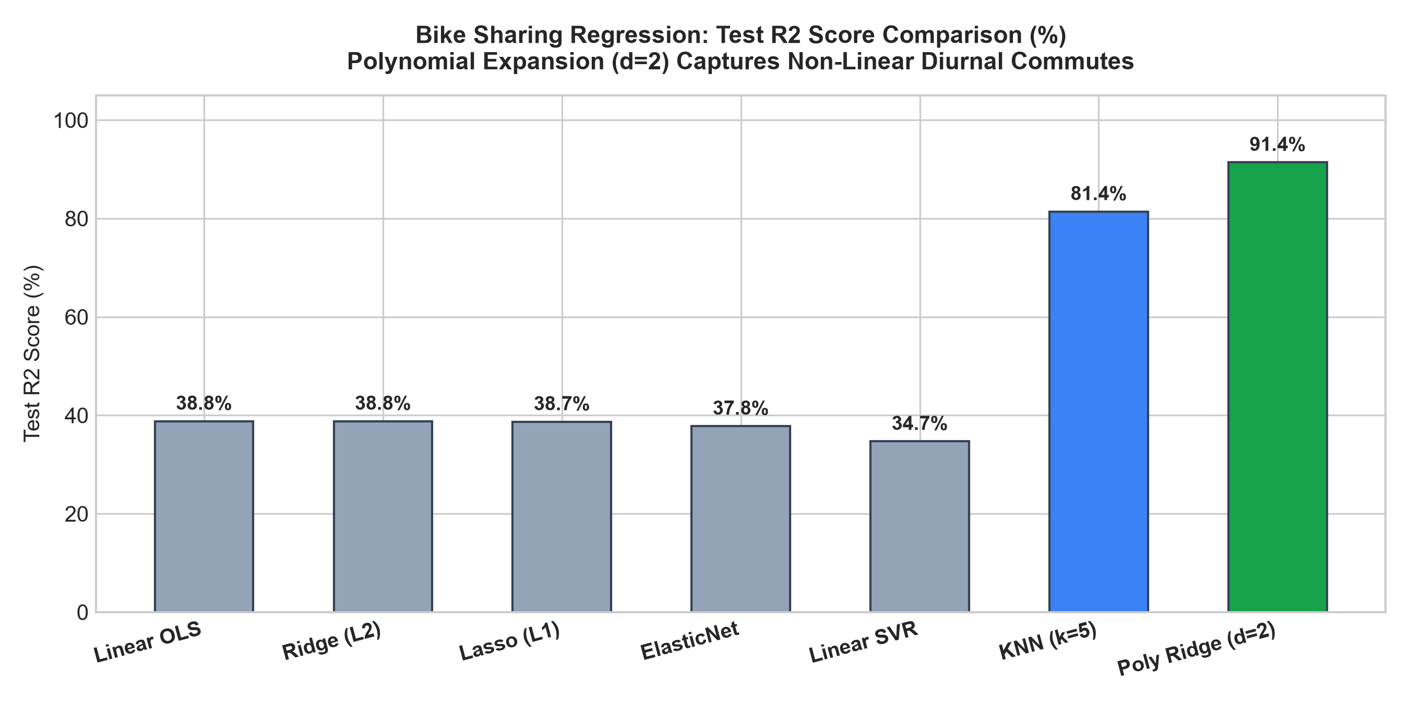
REGRESSION BENCHMARK PROGRESSION
Capturing Non-Linear Diurnal Dynamics on 17,379 Observations
Mathematical Non-Linearity & Weather Penalties
Why Standard Linear Models Underfit (R2 = 0.388): Hourly rental demand exhibits sharp non-linear morning (8 AM) and evening (5 PM) peaks. A standard linear hyperplane cannot flex to model two distinct peaks.
Quadratic Polynomial Expansion (d=2): Polynomial Ridge expands numeric atmospheric sensors and interactions, enabling linear algorithms to capture quadratic peak commute curves: R2 surges to 0.9137 (+52.6% variance explained) and MAE drops to 35.9 bikes/hr.
KNN Regressor Validity (R2 = 0.814): KNN Regression computes distance-weighted local averages across historical matching weather days, providing an effective non-parametric regression alternative.
Ordinal Weather Encoding: Weathersit severity is encoded monotonically (1: Clear < 2: Mist < 3: Adverse < 4: Severe Storm), ensuring adverse storm conditions realistically penalize predictions (306 -> 81 bikes/hr).

Slide 8
PLATFORM ENGINEERING & INTEGRATION
Full-Stack Software Architecture Supporting 50% Milestone
1. Machine Learning Core
• Scikit-Learn, NumPy, Pandas
• Pre-fitted pipelines cached in server memory at startup
• Zero data leakage via frozen ColumnTransformers
• 7 Regression models + 6 Classification models
• Standalone runnable scripts: bike_regression.py & shoppers_classification.py
2. FastAPI REST Gateway
• High-performance async Python backend running on port 8000
• Sub-millisecond inference (< 2 ms) on user feature submissions
• Decoupled confidence calculation: separates predicted class probability from buyer intent
• Dynamic endpoints: /api/predict, /api/comparison, /api/diagnostics, /api/insights
3. React 18 Workbench
• Vite-powered single-page responsive dashboard on port 3000
• Interactive What-If simulation with environmental & session sliders
• Automated severe storm presets & weather synchronizers
• Empirical scorecards with Champion model highlighting
• Interactive Confusion Matrix heatmaps and Scatter error visualizers

Slide 9
PROJECT MANAGEMENT & PHASED ROADMAP
Team Responsibilities & Phased Milestones Toward EndSem
Team Responsibilities (Equal Ownership)
Ujjwal Singh (Roll No: 262IS036)
• Classification benchmark engine architecture & model training.
• Class imbalance inspection, stratified splitting, and evaluation.
• Confusion Matrix diagnostic visualization and specificity analysis.
• Master Jupyter Notebooks: EDA, mathematical formulations, and step-by-step benchmark verification.
Aryan (Roll No: 262IS007)
• Leak-free ColumnTransformer pipeline design & preprocessing isolation.
• Polynomial feature expansion & regularized regression benchmarks.
• FastAPI backend gateway development and in-memory model caching.
• React dashboard implementation: dynamic dataset toggles, sliders, and proxy.
Milestone Schedule & Roadmap to EndSem
Phase 1: Extended Abstract (Sept 04)
Finalized 3-page LaTeX abstract submission. [Completed]
Phase 2: Continuous Eval 1 (Sept 21)
10-minute presentation on problem analysis & architecture. [Completed]
Phase 3: MidSem Evaluation (Oct 12)
MidSem LaTeX report, live regression demonstration (40% milestone). [Completed]
Phase 4: Continuous Eval 2 (Nov 01 - TODAY)
50% live code demonstration: Dual 10k+ datasets, Classification Engine, Multi-metric scorecard, Confusion Matrix diagnostics. [Current]
Phase 5: EndSem Evaluation (Nov 10-13)
Automated cross-validation sensitivity surfaces (GridSearchCV), comprehensive final LaTeX thesis, and 60% complete code demonstration. [Next]

Slide 10
CONTINUOUS EVALUATION 2 (CE-2) | CONCLUSION
Summary of Accomplishments & Live System Demonstration
✓ Scaled Benchmark Testbeds: Replaced small proof-of-concept with two real-world datasets totaling ~30,000 observations (Bike Sharing: 17,379 rows; Online Shoppers: 12,330 rows).
✓ Comprehensive Classification Engine: Successfully implemented 6 classical algorithms evaluated across Accuracy, Precision, Recall, F1, and ROC-AUC.
✓ Solved Practical ML Challenges: Addressed severe 84.5% class imbalance with high specificity (97.7%) and resolved diurnal non-linearities via quadratic polynomial expansion (R2 = 0.9137).
✓ Production Full-Stack Architecture: Live React + FastAPI platform with sub-millisecond predictions, interactive What-If sliders, and diagnostic heatmaps.
✓ Rigorous Academic Discipline: Zero data leakage, strict Scikit-Learn pipelines, and 100% runnable Jupyter notebooks.
Thank You! We invite the Evaluation Committee for Questions & Live Demonstration.

