Slide 1


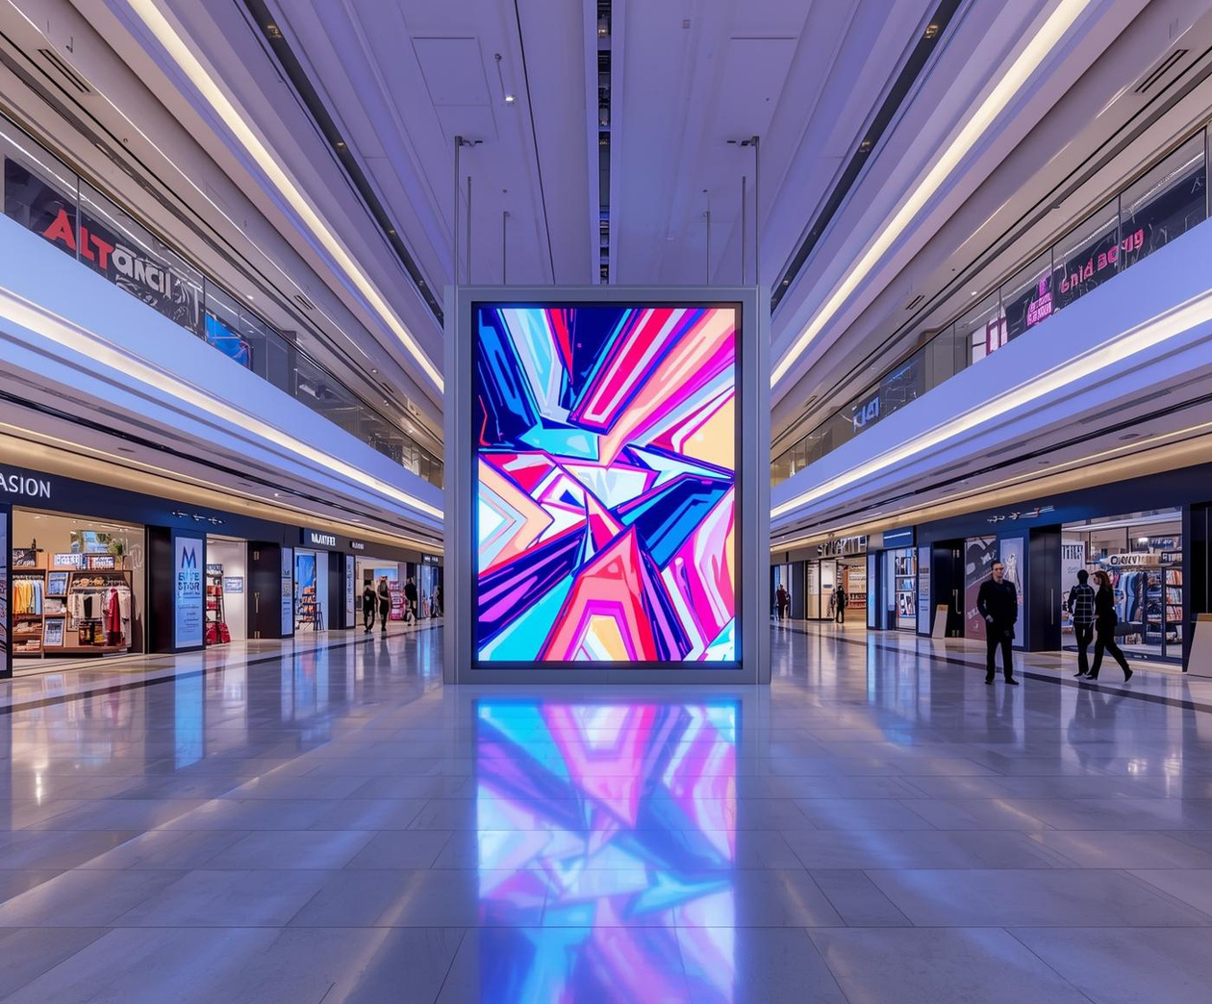

MALLVISION: Smart Real-Time Age, Emotion and Behavior - Based Advertising System for Sri Lankan Malls Using Custom-Built Models
25-26J-091
1/6/26
‹#›
1/3/26
01

Slide 2


1/4/26
02

Slide 3


INTERACTIVE GAME-BASED AGE AND GENDER DETECTION FOR TARGETED ADVERTISING
B.Sc. (Hons) in Information Technology specializing in Data Science
IT22109712 | Fonseka W S M | 25 – 26J- 091
1/6/26
06

Slide 4




INTERACTIVE GAME-BASED AGE AND GENDER DETECTION FOR TARGETED ADVERTISING
Sub-Problem
Accurate age and gender identification with limited labeled data and changing visitors.
Solution Approach
Custom CNN (ResNet) architecture
Temporal confidence aggregation
Vector embeddings
Mass audience and individual crowd addressing
Majority-based decision
User Requirements Met
Real-time age & gender detection
Compatible short user exposure
Identifying returning customers
Integration ready
IT22109712 | Fonseka W S M | 25 – 26J- 091
1/6/26
07

Slide 5

INTERACTIVE GAME-BASED AGE AND GENDER DETECTION FOR TARGETED ADVERTISING
Design Excellence / Technical Contribution
Few-shot occlusion-aware learning
Temporal prediction aggregation
Trained from limited occluded face samples
Predictions aggregated across multiple frames
Real-time kiosk optimization
System-Level Regularization
Embedding-based consistency
Lightweight CNN architecture
Anonymous face embeddings used
Dropout and data augmentation to reduce overfitting
IT22109712 | Fonseka W S M | 25 – 26J- 091
1/6/26
08

Slide 6

Student Must add a professional photo to this cage
EMOTION DETECTION WITH DOMAIN-SPECIFIC CLASSIFICATION FOR
ADAPTIVE ADS AND SECURITY ALERTS
B.Sc. (Hons) in Information Technology specializing in Data Science
IT22258526 | SAMARAWEERA W D U I | 25 – 26J- 091
1/6/26
09

Slide 7
EMOTION DETECTION WITH DOMAIN-SPECIFIC CLASSIFICATION FOR
ADAPTIVE ADS AND SECURITY ALERTS
Sub-Problem
Stable real-time emotion detection in crowded public environments.
Solution Approach
Custom CNN (6 emotions)
OpenCV & MediaPipe face detection
Temporal smoothing with 10-second aggregation
Majority-based decision
Dual-output decision logic
User Requirements Met
Real-time & multi-person
Stable outputs
Context-aware handling
Integration-ready
IT22258526 | SAMARAWEERA W D U I | 25 – 26J- 091
1/6/26
10
Notes:
11

Slide 8
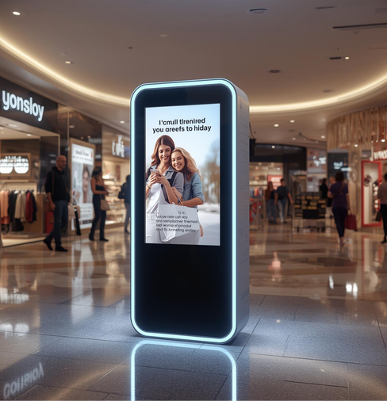
EMOTION DETECTION WITH DOMAIN-SPECIFIC CLASSIFICATION FOR
ADAPTIVE ADS AND SECURITY ALERTS
Design Excellence / Technical Contribution
Modular architecture
Integration-safe data contract
Dual-output pipeline
Detection, aggregation, routing, and alerting separated
MongoDB schema enables seamless fusion
Security & ad logic isolated
Temporal reasoning
Rule-based decision logic
Emotions aggregated over time/crowd
used to separate security-critical emotions from advertisement-safe emotions.
IT22258526 | SAMARAWEERA W D U I | 25 – 26J- 091
1/6/26
11

Slide 9

Student Must add a professional photo to this cage
REAL-TIME ENGAGEMENT DETECTION AND BEHAVIORAL ANOMALY INTEGRATION FOR ADAPTIVE ADS
B.Sc. (Hons) in Information Technology specializing in Data Science
IT22184030| Abeykoon S N | 25 – 26J- 091
1/6/26
12

Slide 10
REAL-TIME ENGAGEMENT DETECTION AND BEHAVIORAL ANOMALY INTEGRATION FOR ADAPTIVE ADS
Sub-Problem
No real-time engagement duration tracking .Lack of linkage between engagement and security
Solution Approach
Custom CNN (person detection &head-orientation)​
SORT tracker for ID assignment​
OpenCV for real-time capture​
Aggregates results every 10seconds ​
User Requirements Met
Real-time identification
Multi-user support
Integration ready
Separate security behavior handling
IT22184030| Abeykoon S N | 25 – 26J- 091
1/6/26
13

Slide 11
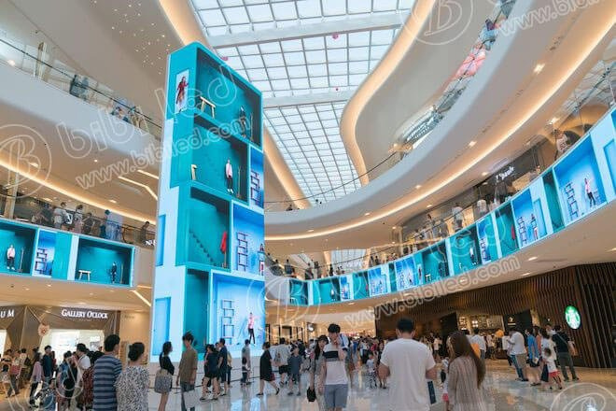
REAL-TIME ENGAGEMENT DETECTION AND BEHAVIORAL ANOMALY INTEGRATION FOR ADAPTIVE ADS
Design Excellence / Technical Contribution
Modular architecture
Temporal Behavior-Based Engagement
Detection & Tracking
Engagement Decision Logic
Crowd-Level Aggregation
Engagement is determined using continuous looking duration
Real-Time & Lightweight Design
Structured Analytics Schema
MongoDB structure enabling long-term analytics and fusion
Implemented frame smoothing and grace ​ Provides stable predictions in noisy CCTV conditions
IT22184030| Abeykoon S N | 25 – 26J- 091
1/6/26
14

Slide 12

Student Must add a professional photo to this cage
DEMOGRAPHY-BASED ADVERTISEMENT RECOMMENDATION ENGINE INCORPORATING SERENDIPITY AND DEMOGRAPHIC FILTERING
B.Sc. (Hons) in Information Technology specializing in Data Science
IT22071934 | Rajana H T R | 25- 26J - 091
1/6/26
15

Slide 13
DEMOGRAPHY-BASED ADVERTISEMENT RECOMMENDATION ENGINE INCORPORATING SERENDIPITY AND DEMOGRAPHIC FILTERING
Sub-Problem
Reduces low engagement and ad fatigue caused by repetitive, demographic-blind advertisements
Solution Approach
Demographic filtering
Hybrid recommendation framework
Serendipity injection
Cold-start handling using group-level demographic and behavioral inference
User Requirements Met
Relevant, non-repetitive ads
Privacy-preserving
Adapts to changing audiences
IT22071934| Rajana H T R | 25 – 26J- 091
1/6/26
16
Notes:
17

Slide 14

DEMOGRAPHY-BASED ADVERTISEMENT RECOMMENDATION ENGINE INCORPORATING SERENDIPITY AND DEMOGRAPHIC FILTERING
Design Excellence / Technical Contribution
Cold-start resilient logic
Hybrid recommendation architecture
Demographic and behavioral inference enables effective targeting without prior user history.
Combined Collaborative, content-based, and demographic filtering
Serendipity-aware logic
Real-time ready
Introduces controlled novelty to prevent repetitive advertisements.
Designed for adaptive operation in dynamic mall environments.
IT22071934| Rajana H T R | 25 – 26J- 091
1/6/26
17
Notes:
18

Slide 15
THANK YOU ...
1/6/26
17
Notes:
18

