Slide 1
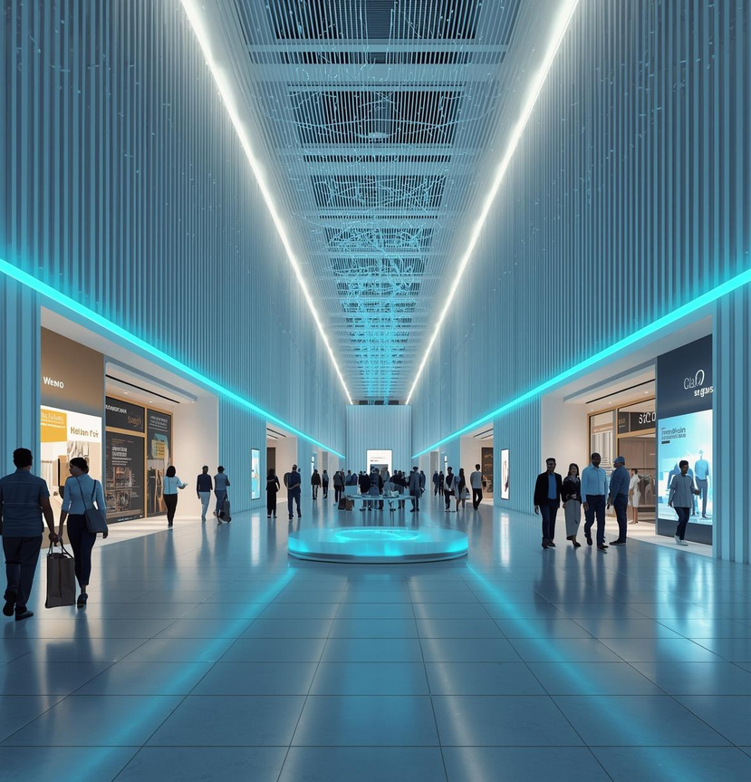
Smart Real-Time Age, Gender , Emotion and Behavior - Based Advertising System for Sri Lankan Malls
Using Custom-Built Models
25-26J-091
1

Slide 3
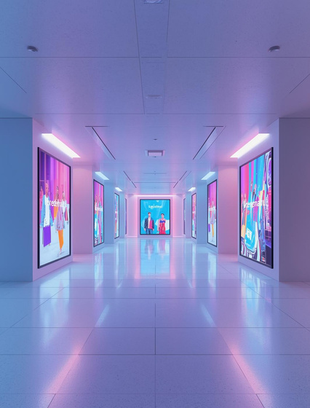
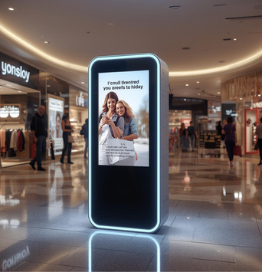
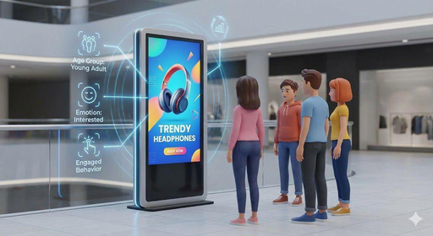
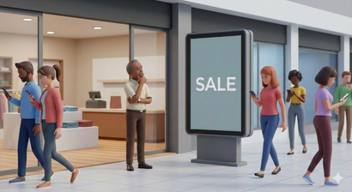
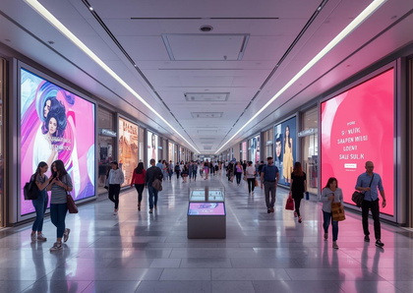
Problem Statement
Context
Stakeholders
Observed Issues
Why It Matters
Large retail malls use static advertising methods.
Visitors and retailers engage with advertising systems.
Current ads lack personalization and audience insights.
Poor experiences reduce ROI and decision-making effectiveness.
2

Slide 4
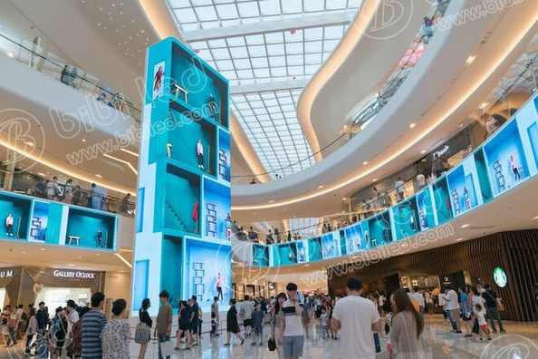
Research Gap
Existing systems lack:
Real-time demographic adaptation
Emotion-aware engagement modeling
Behavior-driven ad switching
Sri Lankan demographic optimization
Main Objective
To develop a real-time adaptive advertising system that detects age, emotion, behavior and object detection with ≥70% validated accuracy and switches ads within 10 seconds.
3

Slide 5

Solution Overview
A real-time system that analyzes audience demographics, emotions, and engagement to dynamically display personalized advertisements while detecting suspicious activities for mall security.
Non-Functional
Key Feature
Ensures reliability, scalability, and privacy compliance.
Personalized content based on user engagement metrics.
4

Slide 6
Evaluation Matrics
Module | Evaluation Metric | Result
Age /Gender Classification | Accuracy | 87%
Emotion Recognition | Accuracy | 71%
Audience Detection | Detection Accuracy | 70%
Engagement Analysis | Attention Detection Accuracy | 87%
Advertisement Recommendation Engine | Recommendation Accuracy | 72%
5

Slide 7
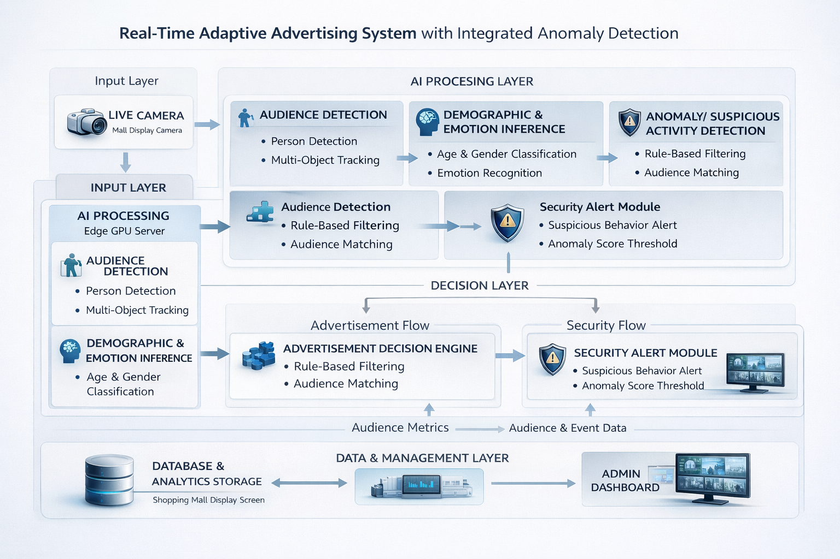
System Architecture
6

Slide 8

Commercialization Impact
Target Market
Key Benefits
Resources
Next Steps
Sri Lankan shopping malls
Retail advertising agencies
Digital signage providers
Real-time demographic personalization
Boost ad ROI
Locally trained models
UGREEN 2K 30FPS Webcam
No extra hardware & Fits existing signage
Affordable -
LKR 45,000
Pilot testing in selected mall
Performance validation study
Cloud deployment scaling
7

Slide 9
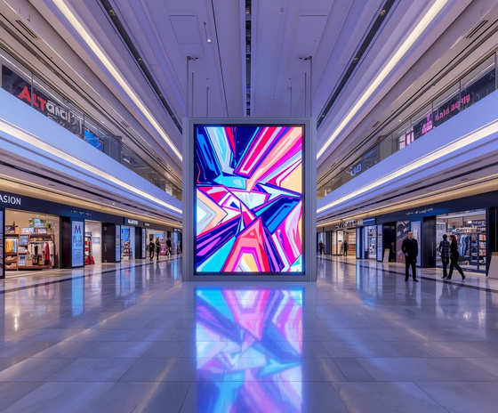
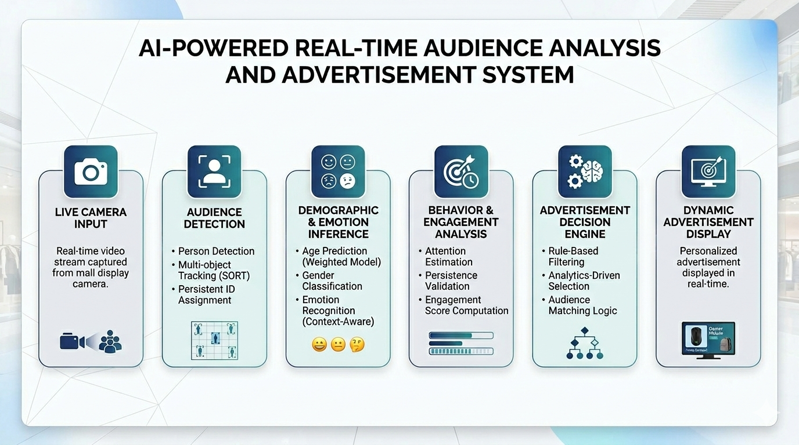
Demo Plan
8

Slide 10
Thank you !
9

