Slide 1

ACKNOWLEDGEMENT
I would like to express my special thanks of gratitude to my professor Prof. Kumarjit Mondal and our Teacher-inCharge Prof. (Mrs.) Sovonita Datta who gave me the golden opportunity to do this wonderful project on the topic “Finance and data”. Sir, Kumarjit Mondal guided me throughout the project by giving me suggestion on software requirements as well as helping me in implementing algorithms. He also helped me in debugging and testing by providing necessary test cases. I was confused while deciding between two different projects but Sovonita Ma’am suggested me to go with the one which will help me more to understand and learn the concepts at its core.

Slide 3
Introduction
The Personal Finance Tracker + Plotter is a software application that helps individuals track and manage their personal finances. The application is built using Python as the programming language, Streamlit as the web framework, and Deta cloud db as the database management system. This document outlines the requirements and specifications for the development of the Personal Finance Tracker + Plotter.

Slide 4
Functional Requirements:-
2.1 User Registration and Authentication
The system shall allow users to register for an account using a valid email address and password.
The system shall provide user authentication to ensure secure access to user-specific data.
2.2 Dashboard
The system shall display a personalized dashboard for each user upon successful login.
The dashboard shall provide an overview of the user's financial status, including total income, expenses, and savings.
2.3 Income Management
The system shall allow users to add and manage multiple sources of income.
Users should be able to enter income details such as income type, amount, and date received.
The system should provide options to categorize income sources for better analysis.
2.4 Expense Tracking
The system shall enable users to record and categorize their expenses.
Users should be able to enter expense details, including expense type, amount, date, and optional description.
The system shall support categorization of expenses to analyze spending patterns.

Slide 5
2.5 Budget Management
The system shall allow users to set monthly or periodic budgets for different expense categories.
Users should be able to define budget limits for each category.
The system should provide notifications or warnings when users exceed their budget limits.
2.6 Savings Tracking
The system shall provide functionality to track savings and financial goals.
Users should be able to set savings targets and monitor progress.
The system may offer visualizations or progress charts to motivate users towards their savings goals.
2.7 Reporting and Visualization
The system shall generate financial reports and visualizations based on income, expenses, and savings data.
Users should be able to view summarized reports, charts, and graphs.
The system should offer filtering and sorting options for custom analysis.
2.8 Data Backup and Restore
The system shall periodically backup user data to ensure data integrity.
Users should be able to restore their data in case of system failures or data loss.
Non-functional Requirements:-
3.1 Performance
The system shall respond to user interactions within an acceptable time frame.
The application should handle a reasonable amount of data without significant performance degradation.

Slide 6
3.2 Security
User authentication and data transmission shall be secured using encryption mechanisms.
The system shall enforce appropriate access controls to protect user data.
3.3 Reliability
The system should be reliable and available for users whenever required.
Backup mechanisms shall be in place to prevent data loss.
3.4 User Interface
The user interface should be intuitive, user-friendly, and responsive.
The design should follow modern UX/UI principles.
3.5 Compatibility
The application shall be compatible with major web browsers.
The system should be responsive and adaptable to different screen sizes.
3.6 Technology Stack
The application shall be developed using Python programming language, Streamlit framework, and Deta cloud db as the database management system.
4. Constraints
The application should be compatible with the hardware and software requirements of the chosen technology stack.
The system should adhere to relevant legal and regulatory requirements regarding data privacy and security.
5. Assumptions
It is assumed that users will have a stable internet connection to access the application.
Users are responsible for maintaining the confidentiality of their login credentials.
6. Glossary
Streamlit: A Python framework for building web applications for data science and machine learning.
Deta cloud db: A NoSQL document-oriented database management system.
SRS: Software Requirements Specification.

Slide 7
Feasibility Study Report - Personal Finance Tracker.

Slide 8
Executive Summary
The feasibility study conducted for the Personal Finance Tracker + Plotter concludes that the development and implementation of this software application are viable and beneficial. The study evaluated the technical, economic, and operational aspects of the project, considering the proposed technology stack and potential market demand. The results indicate that the Personal Finance Tracker + Plotter has strong potential for success and can effectively address the financial management needs of individuals.
Objectives
The main objectives of the feasibility study are as follows:
Evaluate the technical feasibility of developing the Personal Finance Tracker + Plotter using Python, Streamlit, and Deta cloud db.
Assess the economic viability of the project, considering the costs and potential financial benefits.
Determine the operational feasibility, including the target user base and their requirements.
Identify potential risks and challenges associated with the development and deployment of the application.
Technical Feasibility
The technical feasibility of the Personal Finance Tracker + Plotter has been evaluated based on the proposed technology stack. Python as the programming language, Streamlit as the web framework, and Deta cloud db as the database management system offer a robust and scalable foundation for the application. These technologies provide the necessary tools and functionalities to implement the required features effectively. Additionally, the availability of resources, libraries, and community support for these technologies further enhances the technical feasibility of the project.
Economic Feasibility
The economic feasibility analysis focuses on the financial aspects of developing and deploying the Personal Finance Tracker + Plotter. The study includes cost estimation for development, infrastructure, maintenance, and marketing. It also considers the potential revenue generation through user subscriptions, advertisements, or premium features. The analysis indicates that the project has favorable economic prospects, with the potential to generate revenue and achieve profitability in a reasonable timeframe.

Slide 9
Operational Feasibility
The operational feasibility assessment examines the practicality and usability of the Personal Finance Tracker + Plotter. It involves understanding the target user base, their financial management needs, and the compatibility of the application with their requirements. The study finds that there is a significant market demand for personal finance tracking and management tools. The application's features align well with the needs of individuals seeking to improve their financial management, making it operationally feasible.
Risk Assessment
The feasibility study identifies potential risks and challenges associated with the development and deployment of the Personal Finance Tracker + Plotter. These include technical risks, such as software bugs, compatibility issues, and data security concerns. Market risks, such as competition and user adoption, are also considered. Mitigation strategies, such as thorough testing, security measures, continuous updates, and effective marketing strategies, have been identified to mitigate these risks and ensure the successful implementation of the project.
Conclusion
Based on the findings of the feasibility study, it is concluded that the development and deployment of the Personal Finance Tracker + Plotter using Python, Streamlit, and Deta cloud db are feasible and beneficial. The project offers a technically sound solution for personal finance management, with strong economic prospects and operational viability. While some risks and challenges exist, appropriate mitigation strategies can be implemented to ensure project success. The Personal Finance Tracker + Plotter has the potential to meet the financial management needs of individuals effectively and contribute to their financial well-being.

Slide 10
Entity Relationship (ER) - Personal Finance Tracker

Slide 11
The Entity Relationship (ER) represents the entities and their relationships in the Personal Finance Tracker + Plotter application.
User Entity:
Attributes:
UserID (Primary Key), Username, Email, Password
Income Entity:
Attributes: IncomeID (Primary Key), UserID (Foreign Key), IncomeType, Amount, DateReceived, CategoryID (Foreign Key)
Expense Entity:
Attributes: ExpenseID (Primary Key), UserID (Foreign Key), ExpenseType, Amount, DateSpent, Description, CategoryID (Foreign Key)
Category Entity:
Attributes: CategoryID (Primary Key), CategoryName
Budget Entity:
Attributes: BudgetID (Primary Key), UserID (Foreign Key), CategoryID (Foreign Key), BudgetLimit
Savings Entity:
Attributes: SavingsID (Primary Key), UserID (Foreign Key), SavingsTarget, CurrentAmount
Report Entity:
Attributes: ReportID (Primary Key), UserID (Foreign Key), ReportType, GeneratedDate, Content
Relationships:
One-to-Many Relationship:
User to Income: One user can have multiple income sources.
User to Expense: One user can have multiple expenses.
User to Budget: One user can have multiple budget allocations.
User to Savings: One user can have multiple savings targets.
User to Report: One user can have multiple generated reports.

Slide 12
Many-to-One Relationship:
Income to User: Many income sources can belong to a single user.
Expense to User: Many expenses can belong to a single user.
Budget to User: Many budget allocations can belong to a single user.
Savings to User: Many savings targets can belong to a single user.
Report to User: Many generated reports can belong to a single user.
Many-to-One Relationship (Category):
Income to Category: Many income sources can belong to a single category.
Expense to Category: Many expenses can belong to a single category.
Budget to Category: Many budget allocations can belong to a single category.
Note: The ER represents the basic entities and relationships in the Personal Finance Tracker
+ Plotter application. Additional entities and relationships may be included based on the specific requirements and functionality of the application.

Slide 13
Data Flow Diagram (DFD) - Personal Finance Tracker

Slide 14
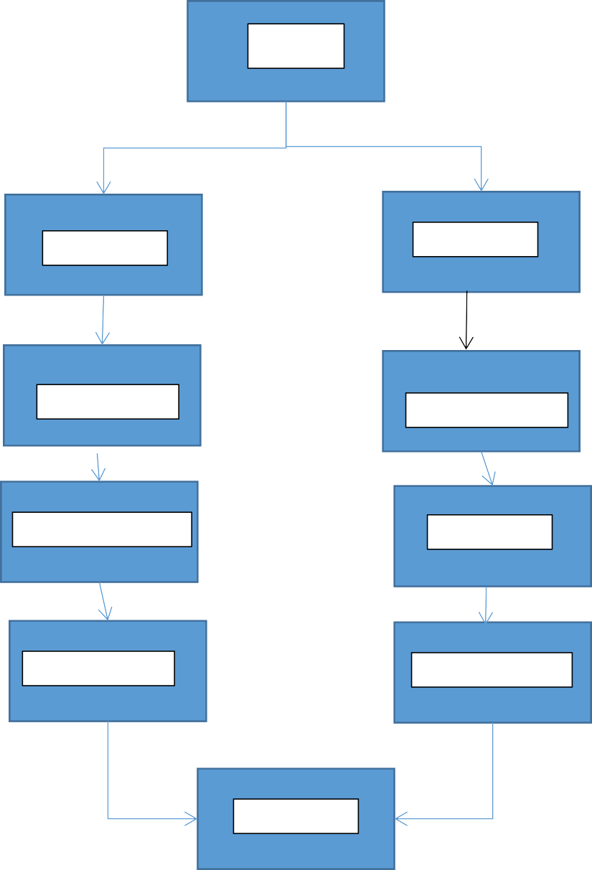
Data Flow Diagram (DFD) - Personal Finance Tracker
User
REGISTER
LOGIN
DASHBOARD
MANGE INCOME
Manage Expense
Set Budget
Track Savings
Generate Report
LOGOUT

Slide 15
Processes:
Register: Allows users to register for a new account by providing necessary details.
Login: Authenticates user credentials and grants access to the application.
Dashboard: Displays a personalized dashboard with an overview of financial status.
Manage Income: Allows users to add, edit, or delete income sources.
Manage Expense: Enables users to add, edit, or delete expenses.
Set Budget: Allows users to set budget limits for various expense categories.
Track Savings: Facilitates the tracking and monitoring of savings and goals.
Generate Report: Generates financial reports based on user data.
Logout: Terminates the user's session and logs them out of the application.
Entities:
User: Represents the user of the application, with relevant information such as username and email.
Income: Contains details of the income sources, including income type, amount, and date received.
Expense: Stores information related to expenses, such as expense type, amount, and
date spent.
Budget: Holds data about the budget allocations and limits for different expense categories.
Savings: Stores information about the user's savings targets and current amounts.
Report: Contains generated financial reports and related details.
Data Flows:
User Registration Data: Data flow containing user registration information.
User Login Data: Data flow containing user login credentials.
Income Data: Data flow containing information about income sources.
Expense Data: Data flow containing information about expenses.
Budget Data: Data flow containing budget allocations and limits.
Savings Data: Data flow containing data related to savings and goals.
Report Data: Data flow containing generated financial reports.
Note: The Level 0 DFD provides an overview of the major processes and entities
involved in the Personal Finance Tracker + Plotter application. Additional levels of DFD can be created to further refine the processes and data flows within each component.

Slide 16
CODE:
import calendar # Core Python Module
from datetime import datetime # Core Python Module
import plotly.graph_objects as go # pip install plotly import streamlit as st # pip install streamlit
from streamlit_option_menu import option_menu # pip install streamlit-option-menu
import database as db # local import import streamlit_authenticator as stauth
####AUTHENTICATION#######
credentials = {
"usernames":{
"user1":{
"name":"john smith",
"password":"abc"
},
"user2":{
"name":"timmy turner", "password":"abc"
}
}
}
authenticator = stauth.Authenticate(credentials, "main", "auth", cookie_expiry_days=30) name, authentication_status, username = authenticator.login("Login", "main")
if authentication_status == False:
st.error("Username/password is incorrect")
if authentication_status == None:
st.warning("Please enter your username and password")
if authentication_status:
# SETTINGS
incomes = ["Salary", "Blog", "Other Income"]
expenses = ["Rent", "Utilities", "Groceries", "Car", "Other Expenses", "Saving"] currency = "INR"
page_title = "Income and Expense Tracker"
page_icon = ":money_with_wings:" # emojis: https://www.webfx.com/tools/emoji-cheat- sheet/
layout = "centered"
#
st.set_page_config(page_title=page_title, page_icon=page_icon, layout=layout) st.title(page_title + " " + page_icon)
# --- DROP DOWN VALUES FOR SELECTING THE PERIOD ---
years = [datetime.today().year, datetime.today().year + 1]

Slide 17
months = list(calendar.month_name[1:])
# --- DATABASE INTERFACE ---
def get_all_periods():
items = db.fetch_all_periods()
periods = [item["key"] for item in items] return periods
# --- HIDE STREAMLIT STYLE ---
hide_st_style = """
<style>
#MainMenu {visibility: hidden;} footer {visibility: hidden;} header {visibility: hidden;}
</style> """
st.markdown(hide_st_style, unsafe_allow_html=True)
# --- NAVIGATION MENU ---
selected = option_menu(
menu_title=None,
options=["Data Entry", "Data Visualization"],
icons=["pencil-fill", "bar-chart-fill"], # https://icons.getbootstrap.com/
orientation="horizontal",
)
# --- INPUT & SAVE PERIODS ---
if selected == "Data Entry": st.header(f"Data Entry in {currency}")
with st.form("entry_form", clear_on_submit=True): col1, col2 = st.columns(2)
col1.selectbox("Select Month:", months, key="month") col2.selectbox("Select Year:", years, key="year")
"---"
with st.expander("Income"): for income in incomes:
st.number_input(f"{income}:", min_value=0, format="%i", step=10,
key=income)
with st.expander("Expenses"): for expense in expenses:
st.number_input(f"{expense}:", min_value=0, format="%i", step=10,
key=expense)
with st.expander("Comment"):
comment = st.text_area("", placeholder="Enter a comment here ...")
"---"
submitted = st.form_submit_button("Save Data") if submitted:
period = str(st.session_state["year"]) + "_" + str(st.session_state["month"])
incomes = {income: st.session_state[income] for income in incomes}
expenses = {expense: st.session_state[expense] for expense in expenses}

Slide 18
db.insert_period(period, incomes, expenses, comment) st.success("Data saved!")
# --- PLOT PERIODS ---
if selected == "Data Visualization": st.header("Data Visualization") with st.form("saved_periods"):
period = st.selectbox("Select Period:", get_all_periods()) submitted = st.form_submit_button("Plot Period")
if submitted:
# Get data from database period_data = db.get_period(period)
comment = period_data.get("comment") expenses = period_data.get("expenses") incomes = period_data.get("incomes")
# Create metrics
total_income = sum(incomes.values()) total_expense = sum(expenses.values()) remaining_budget = total_income - total_expense col1, col2, col3 = st.columns(3)
col1.metric("Total Income", f"{total_income} {currency}") col2.metric("Total Expense", f"{total_expense} {currency}") col3.metric("Remaining Budget", f"{remaining_budget} {currency}") st.text(f"Comment: {comment}")
# Create sankey chart
label = list(incomes.keys()) + ["Total Income"] + list(expenses.keys()) source = list(range(len(incomes))) + [len(incomes)] * len(expenses)
target = [len(incomes)] * len(incomes) + [label.index(expense) for expense in expenses.keys()]
value = list(incomes.values()) + list(expenses.values())
# Data to dict, dict to sankey
link = dict(source=source, target=target, value=value)
node = dict(label=label, pad=20, thickness=30, color="#E694FF") data = go.Sankey(link=link, node=node)
# Plot it!
fig = go.Figure(data) fig.update_layout(margin=dict(l=0, r=0, t=5, b=5)) st.plotly_chart(fig, use_container_width=True)

Slide 19
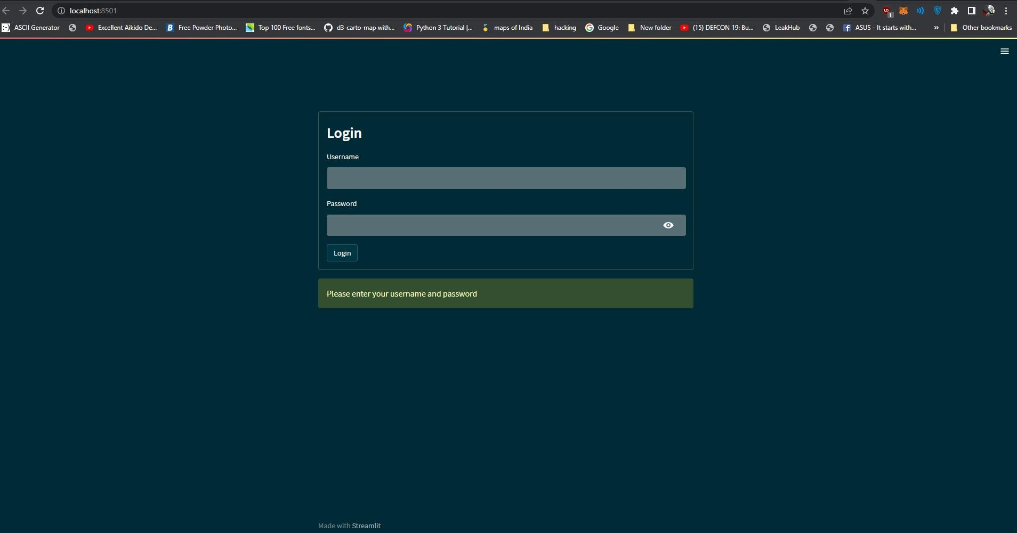
PROJECT SCREENSHOTS:
Here in this figure 1 we can see the login page
Here in figure 2 we can see the main application and data entry functionality of the program.
The code for user authentication:
####AUTHENTICATION#######
credentials = {
"usernames":{
"user1":{
"name":"john smith",
"password":"abc"
},
"user2":{
"name":"timmy turner", "password":"abc"
}
}
}
authenticator = stauth.Authenticate(credentials, "main", "auth", cookie_expiry_days=30) name, authentication_status, username = authenticator.login("Login", "main")
if authentication_status == False:
st.error("Username/password is incorrect")
if authentication_status == None:
st.warning("Please enter your username and password")
if authentication_status:

Slide 20
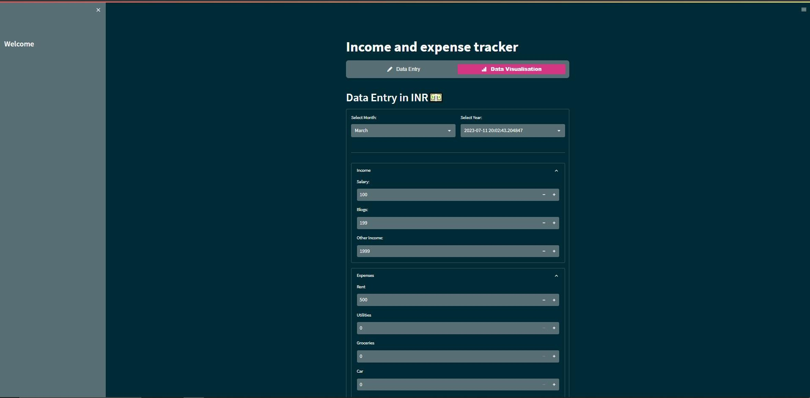
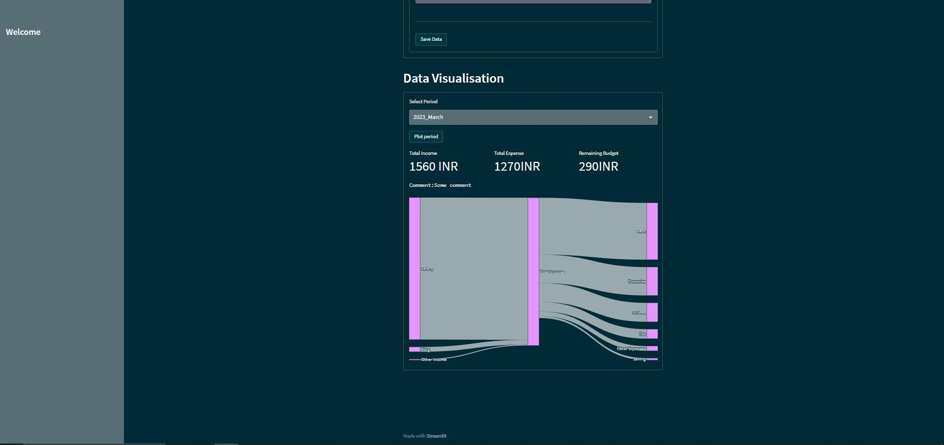
Here in figure 3 & 4 we can see the main data entry and data visualization sections.

Slide 21
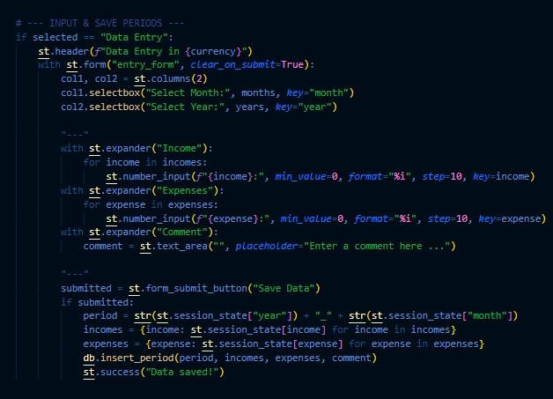
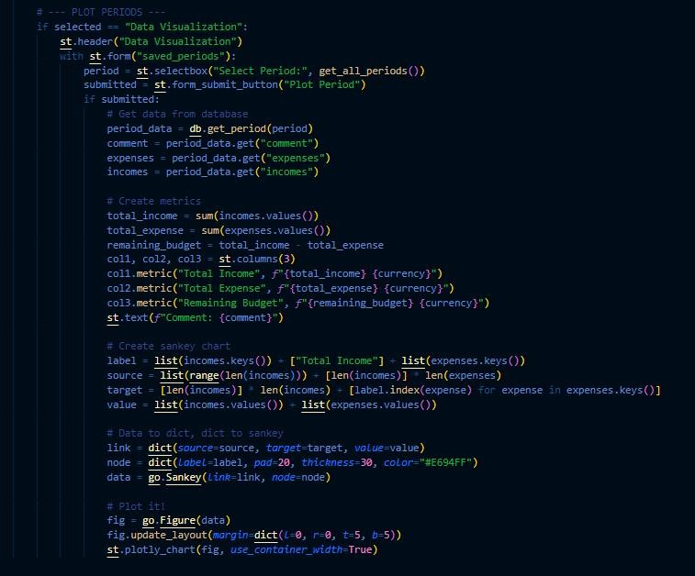
CODE FOR DATA ENTRY AND DATA VISUALISATION:

Slide 22
Summary:
The project thesis titled "Personal Finance Tracker + Plotter" focuses on the development of a software application that helps individuals track and manage their personal finances effectively. The thesis outlines the requirements, specifications, and feasibility of the Personal Finance Tracker + Plotter, along with its technical, economic, and operational aspects.
The application is built using Python as the programming language, Streamlit as the web framework, and Deta cloud db as the database management system. It offers a user-friendly and intuitive interface, allowing users to register for an account and securely access their personal financial data. The dashboard provides an overview of the user's financial status, including income, expenses, and savings.
The functional requirements of the application encompass various aspects such as user registration and authentication, income management, expense tracking, budget management, savings tracking, reporting, visualization, and data backup and restore. These features enable users to record and categorize their income and expenses, set budget limits, track savings and financial goals, generate reports, and visualize their financial data.
The non-functional requirements of the application emphasize performance, security, reliability, user interface, compatibility, and the chosen technology stack. The application aims to respond to user interactions within an acceptable time frame, ensure secure user authentication and data transmission, and be reliable and available whenever required. It also prioritizes a user-friendly and responsive interface, compatibility with major web browsers, and adherence to relevant legal and regulatory requirements.
The feasibility study conducted for the Personal Finance Tracker + Plotter concludes that the development and implementation of the application are viable and beneficial. The technical feasibility is supported by the chosen technology stack's robustness and scalability. The economic feasibility analysis suggests potential revenue generation and profitability. The operational feasibility is confirmed by the alignment of the application's features with the financial management needs of individuals.
The project thesis also includes an entity relationship diagram (ERD) representing the entities and relationships within the application's database, as well as a data flow diagram (DFD) illustrating the processes and data flows involved in the application's functionality.
Overall, the Personal Finance Tracker + Plotter project thesis presents a comprehensive analysis and development plan for an efficient and user-friendly personal finance management application. It offers the potential to address individuals' financial management needs effectively, improve their financial well-being, and contribute to their overall financial stability.

Slide 23
References:
DBMS:https://deta.space/docs/en/
Streamlit:https://docs.streamlit.io/
Plotly:https://plotly.com/python/sankey-diagram/
Importance of personal finance planning : https://fi.money/blogposts/importance-of-personal-financial- planning

