Slide 1


KDAC-2
RESUME SCREENING &
TALENT ANALYTICS PLATFORM
Automating candidate screening with Data Analytics, Machine Learning & GenAI
Team Name : Bit&Byte
Team ID : 44
Notes:
1

Slide 2



THE CHALLENGE
PROBLEM
STATEMENT
Goal: Build an automated, explainable and data-driven platform that parses resumes, ranks candidates against a job description, explains the ranking, and provides talent-pool analytics.
High Volume
Human Bias
No Visibility
Recruiters receive hundreds to thousands of resumes per role — manual review is slow and inconsistent.
Subjective, inconsistent shortlisting criteria across reviewers causes qualified candidates to be overlooked.
Recruiting teams lack analytics on talent pool quality, skill gaps, and pipeline health.
02
Notes:
2

Slide 3
OUR APPROACH
PROPOSED
SOLUTION
1
Resume Synthesis & Augmentation
5
ML Matching Models
GenAI + templated generation of diverse synthetic resumes
Semantic similarity + weighted resume–JD ranking
2
Data Warehouse
6
GenAI Candidate Insights
Star schema — fact table + candidate, job, skill, time dimensions
LLM summaries, gap analysis, explainable fit scoring
3
ETL Pipeline
7
Dockerized Deployment
Extract, parse, and normalize resumes into structured records
Fully containerized, one-command spin-up
4
EDA Dashboards
Skill trends, funnel health, and source quality visualized
03
Notes:
3

Slide 4
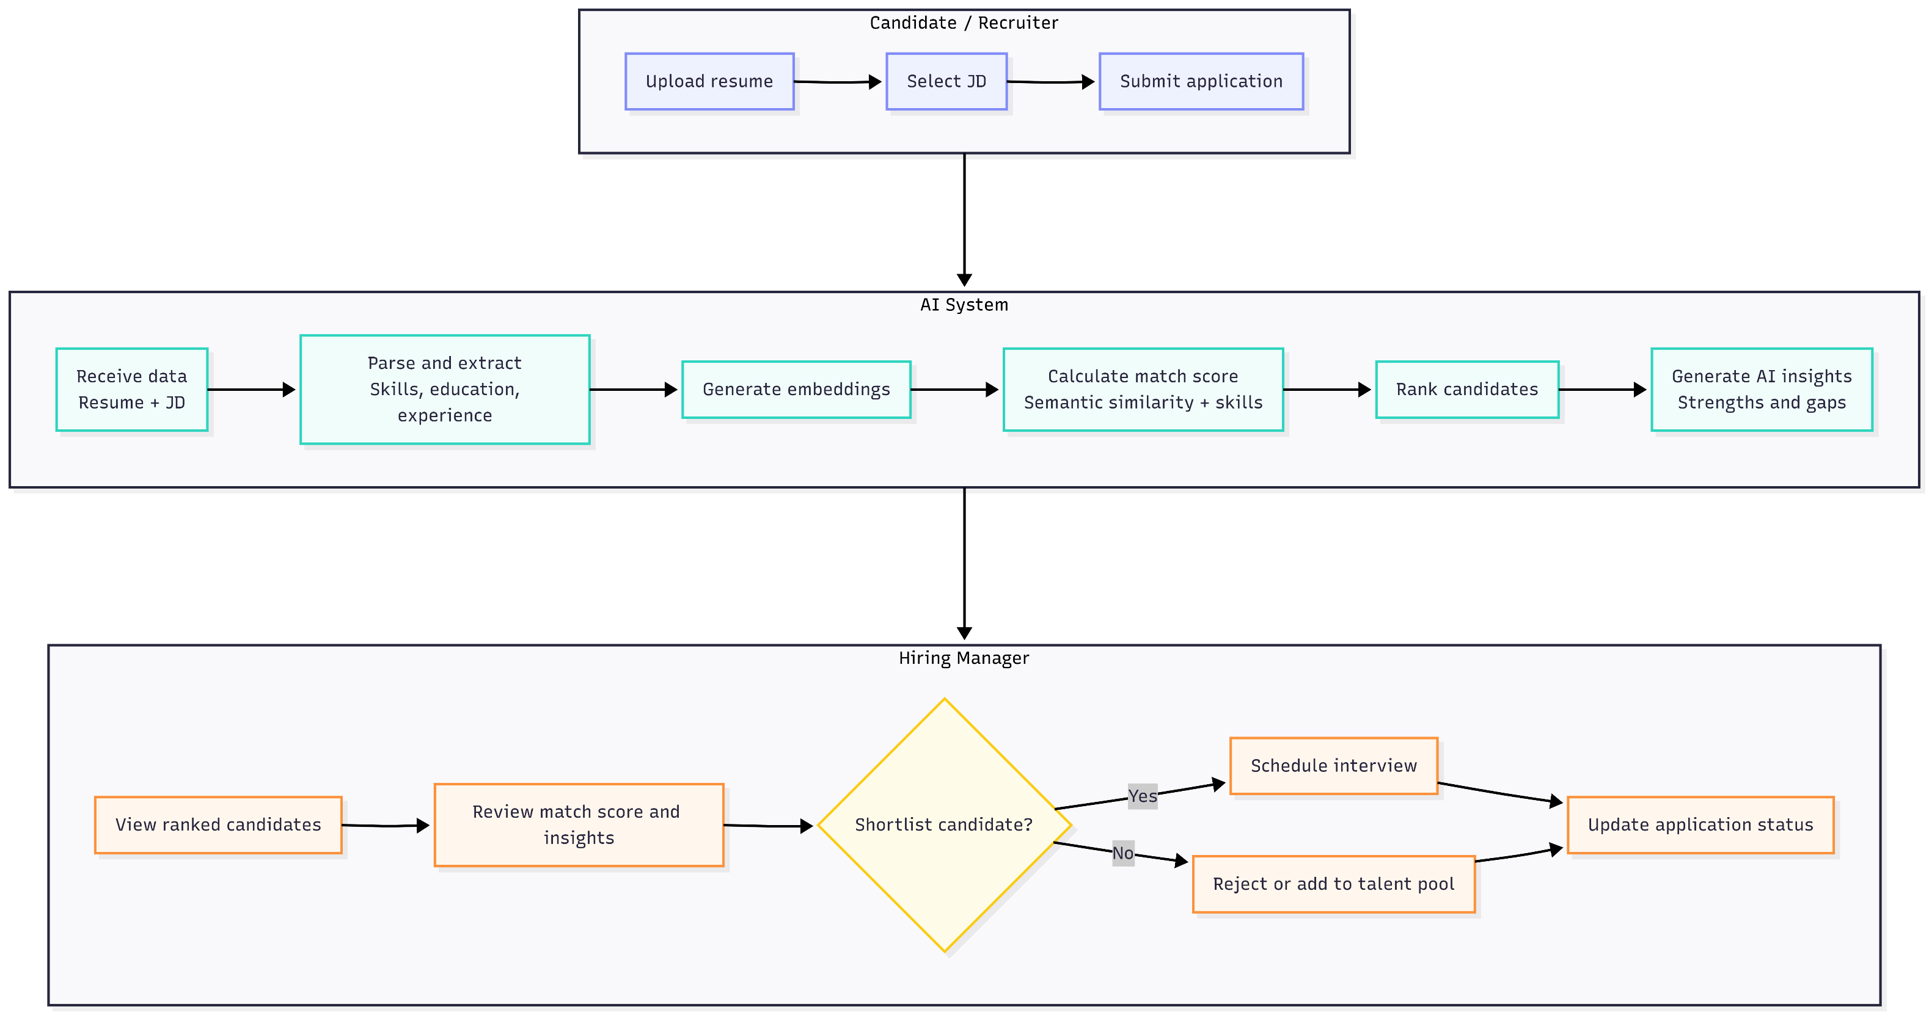
HOW IT WORKS
WORKFLOW DIAGRAM
04
Notes:
4

Slide 5
TOOLS & TECHNOLOGIES
TECHNOLOGY
STACK
Layer | Tool | Why
Orchestration | Apache Airflow | Automates and monitors the resume-processing pipeline
Data Warehouse | PostgreSQL (star schema) | Stores structured candidate, job, skill and application data
Raw File Storage | MinIO | Free, S3-compatible, Docker-native
Parsing | pdfplumber + PyMuPDF + python-docx | Handles text, tables, multi-column resumes
NER / Entities | spaCy | Extracts skills, orgs, dates from resumes
ML / Embeddings | Sentence-Transformers (MiniLM-L6-v2) | Free, local, fast semantic similarity
GenAI | Groq API (Llama 3.x) | Generates candidate summaries, strengths, gaps explanations
Dashboard | Streamlit | Provides recruiter-facing analytics and candidate ranking UI
Deployment | Docker + docker-compose | Provides reproducible, containerized deployment
05
Notes:
5

Slide 6
CORE LOGIC
MATCHING
ALGORITHM
for each resume:
parsed = extract_entities(resume)
resume_vec = embed(parsed.summary)
for each job_description:
jd_vec = embed(jd.text)
jd_skills = extract_skills(jd.text)
for each (resume, jd) pair:
sem_score = cosine_sim(resume_vec, jd_vec)
skill_score = jaccard(resume.skills, jd_skills)
exp_score = match_exp(resume.years, jd.req_years)
final_score = weighted_sum(sem_score, skill_score, exp_score)
insight = generate_explanation(resume, jd, final_score)
rank candidates by final_score
output shortlist + explanations → dashboard
Semantic Score
Cosine similarity between resume & JD embeddings
Skill Overlap
Jaccard similarity of extracted skill sets
Experience Match
Candidate years vs. JD required years
06
Notes:
6

Slide 7



LOOKING AHEAD
ASSUMPTIONS,
CHALLENGES & QUERIES
Assumptions
Challenges
Open Queries
  Synthetic data reasonably approximates real resume diversity
  Job descriptions are reasonably structured
  English-language resumes only for v1
  Resume format variability (tables, multi-column, images)
  Bias potentially embedded in pretrained embeddings
  No labeled ground truth to validate match scores
  LLM hallucination risk in generated insights
  Real anonymized resumes provided, or fully synthetic?
  Any preferred cloud/tooling constraints?
  Expected evaluation dataset size?
08
Notes:
8

Slide 8

THANK YOU
Team Name: Bit&Byte
Team ID : 44
Notes:
9

