Slide 1

Data Visualization
Education Infrastructure
Submitted by: Diyora Ujas Vinodkumar
Roll No.- 224161002
Submitted to: Dr. Ashish Anand

Slide 2
Dataset Information
Percentage of schools with boys toilet
Percentage of schools with girls toilet
Percentage of schools with water facility
Percentage of schools with electricity
Percentage of schools with computers
Gross enrollment
Dropout ratio

Slide 3
Questions: Is there any gender bias with respect to percentage of schools with boys & girls toilet ? Which state has lowest and highest percentage?
Firstly, I have divided states into North, south, west, east and north-east region, along-with union territories
I will compare this data by grouping them into secondary with Higher secondary schools and All schools.
Then, we can get related answers for above questions

Slide 4
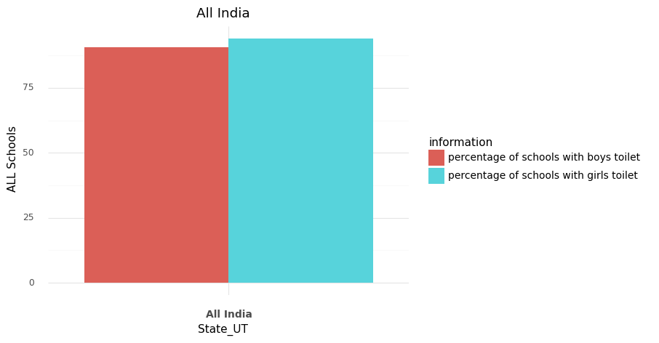
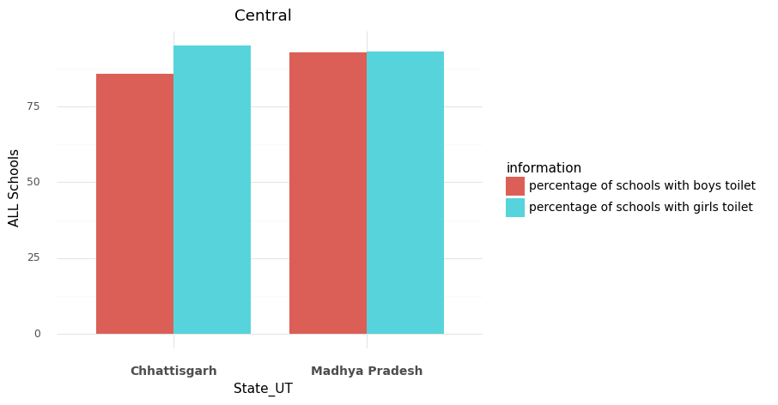
All Schools comparison
There is no gender bias all over india
In central region also, percentage of toilets of both gender is same

Slide 5
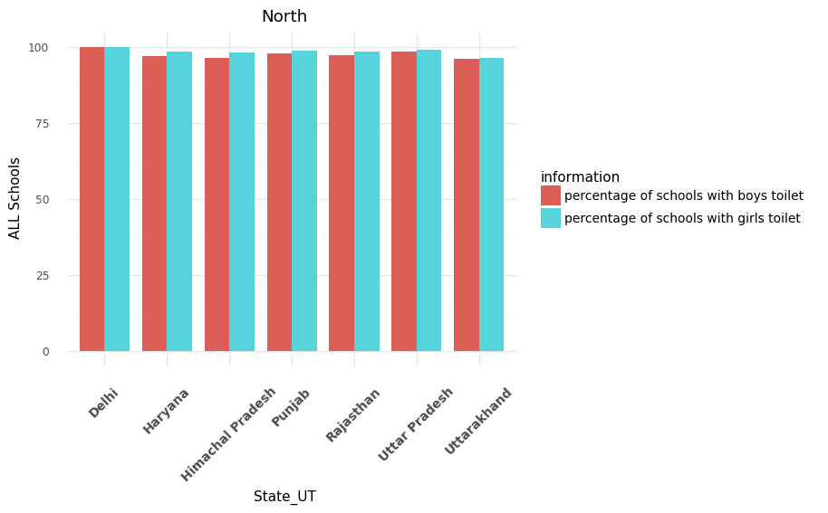
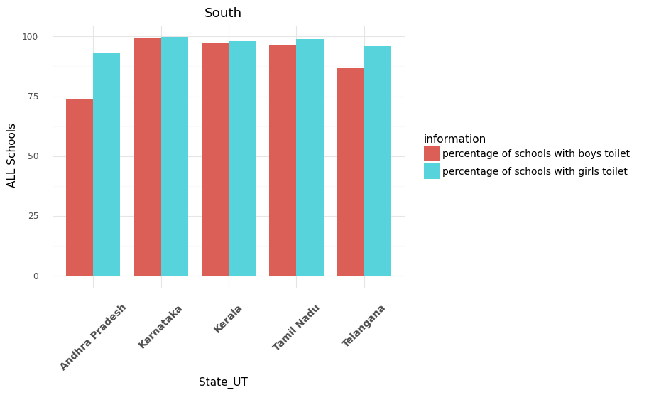
In south, except Andhra Pradesh and Telangana , Percentage is same. Percentage of girls toilet is more than boys toilet in these both states.
In north region, percentage is same in all states

Slide 6
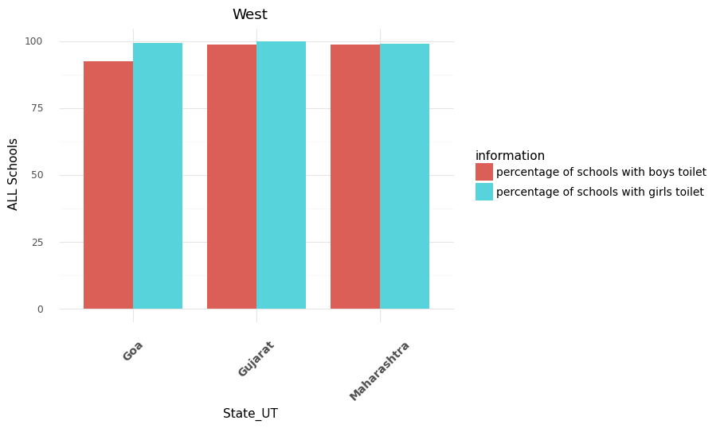
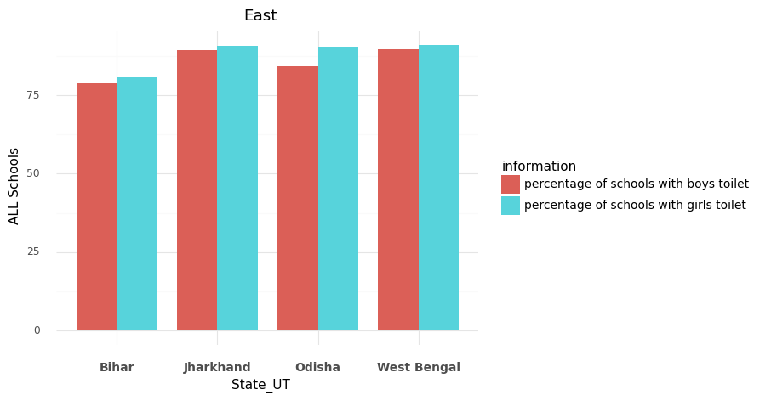
In west, there is no gender bias. All states have almost same percentage variations
In east, there is little gender bias observed in Odisha state
Bihar has least percentage of toilet of boys and girls

Slide 7
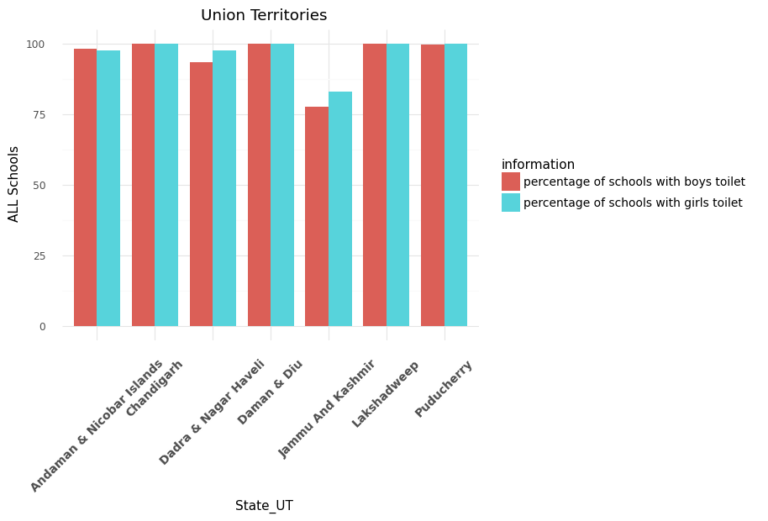
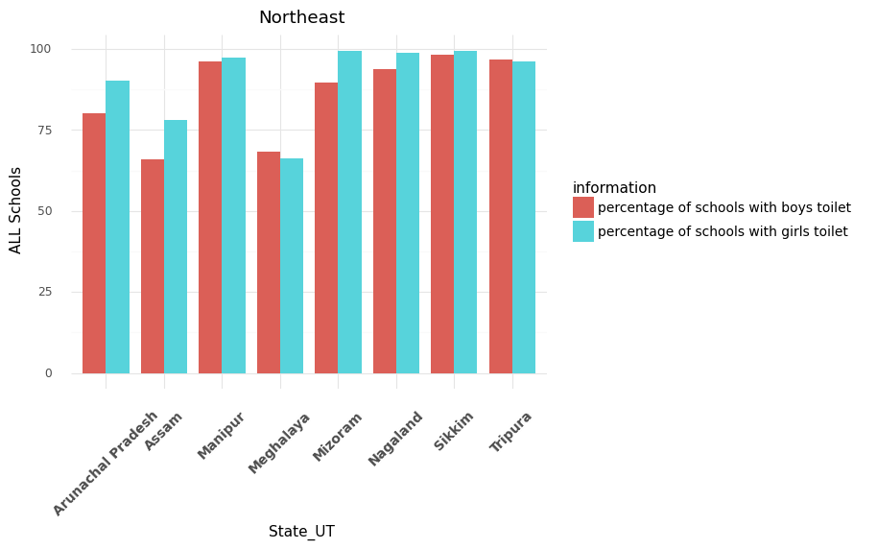
In Northeast region, gender bias is observed in Arunachal Pradesh, Assam & Mizoram
Population of Assam 35.6 million, which is more than all other states, but percentage of boys and girls toilet is less than all other states
Sikkim has lowest population. However, its percentage value is highest among all states
Jammu & Kashmir has least percentage among all union Territories
There is no gender bias observed.

Slide 8
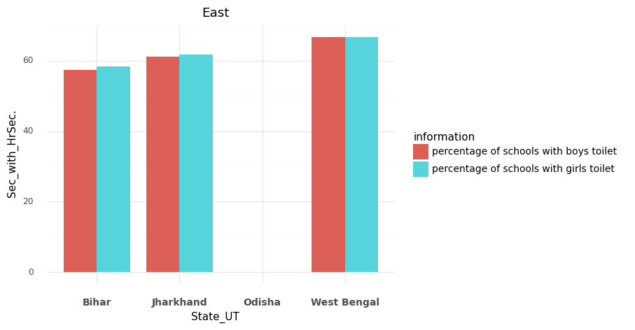
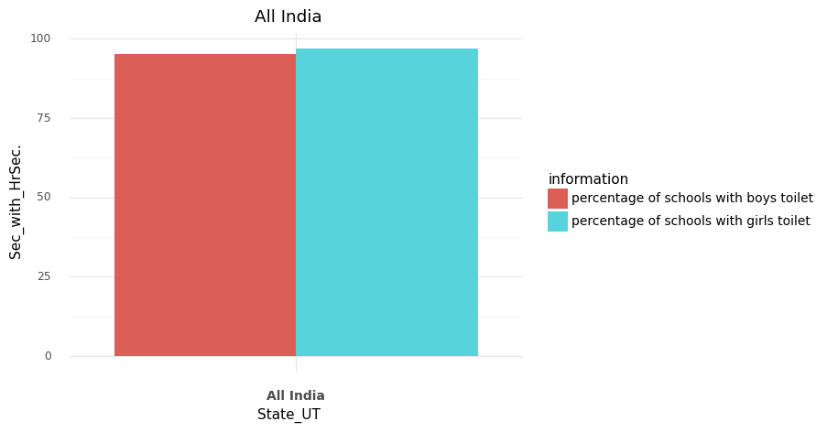
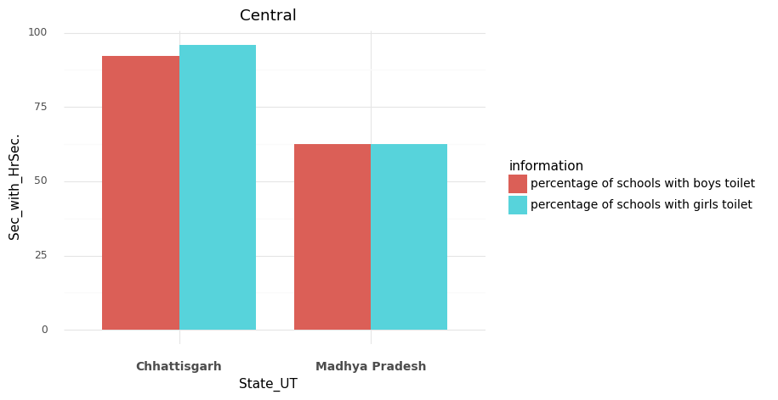
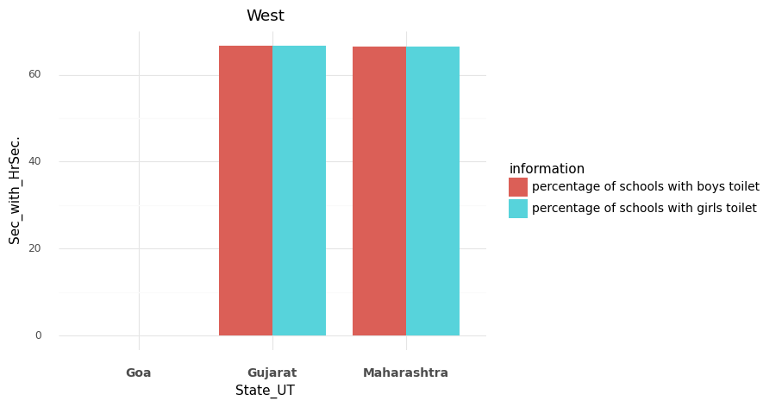
Secondary & Higher Secondary school comparison

Slide 9
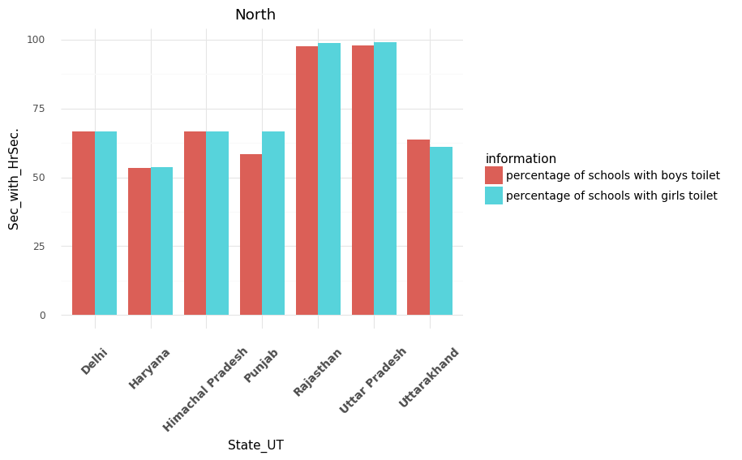
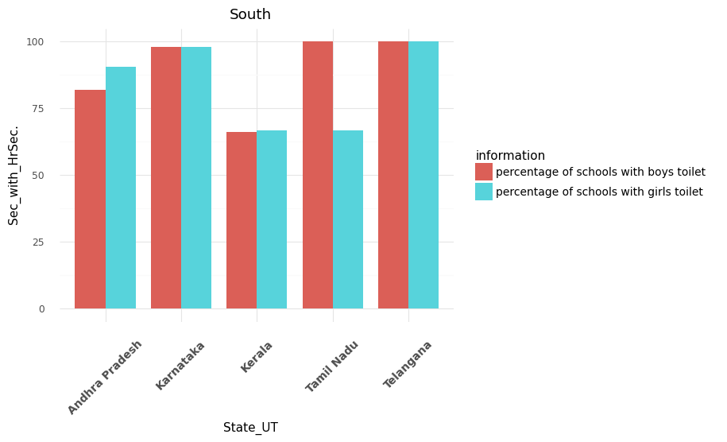
Haryana has less number of toilets among all other states.
Rajsthan and Uttar Pradesh has highest number of toilets.
Tamil Nadu has gender bias.
Kerala has less number of toilets among all other states.

Slide 10
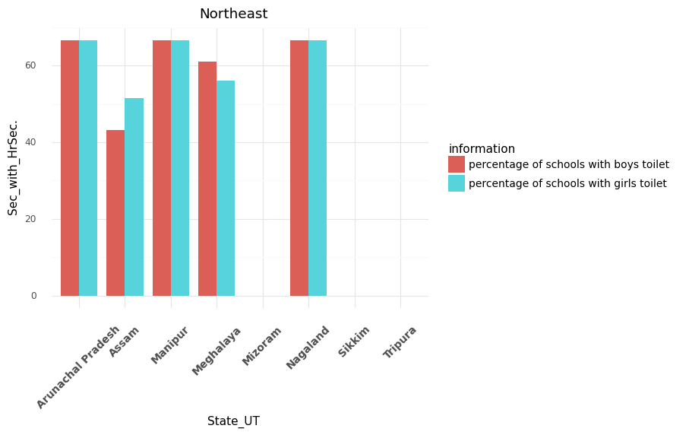
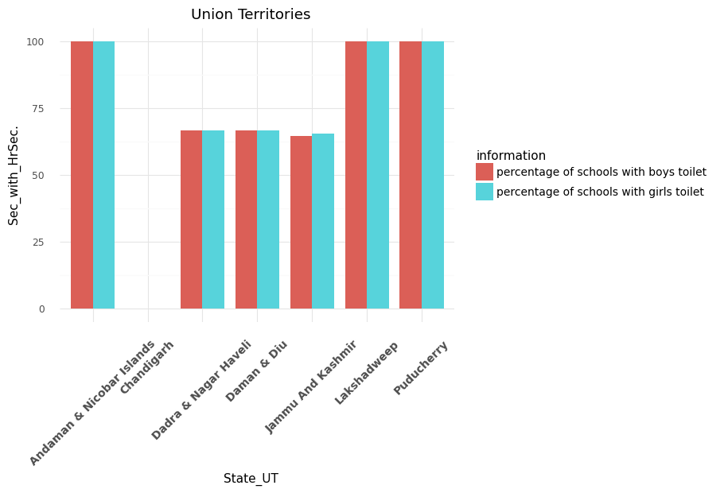
In Mizoram, Sikkim and Tripura , there are no boys & girls toilet.
There is gender bias in Assam.
In Chandigarh, there are no boys and girls toilet .
There is no gender bias.

Slide 11
Percentage of schools with computers , water facility & electricity
Question:
What is year-wise variation of percentage of computers, water facility and electricity in all schools in all states with its respective region ?

Slide 12
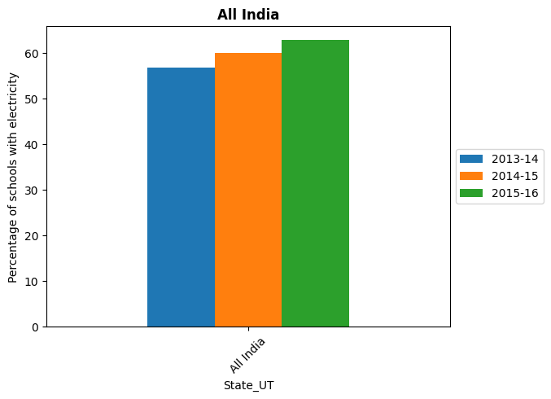
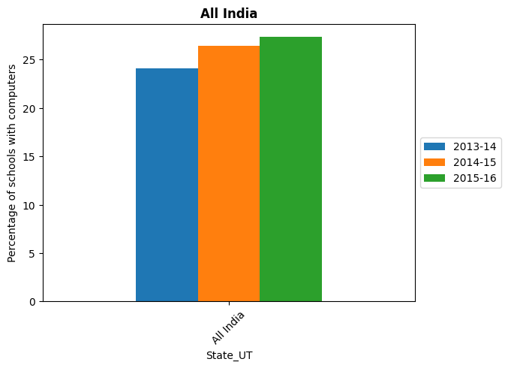
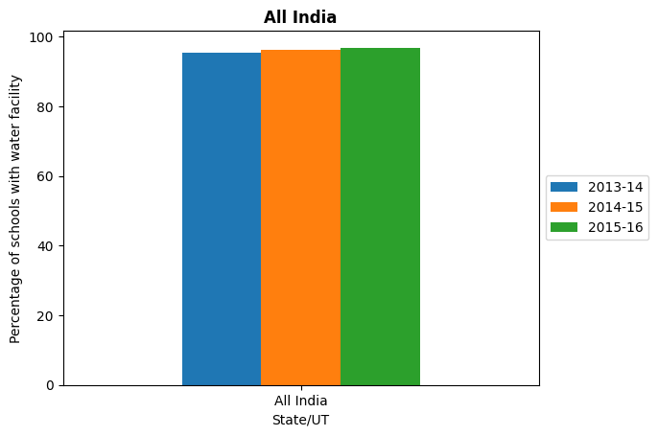
As percentage is increasing , so all schools of India are developing. So, it indicates better future for India but still there is need for computers.

Slide 13
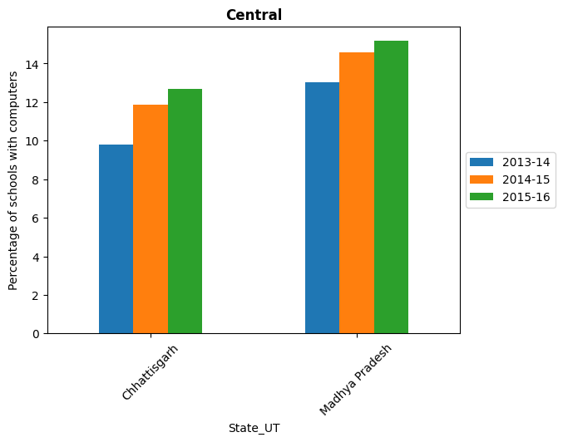
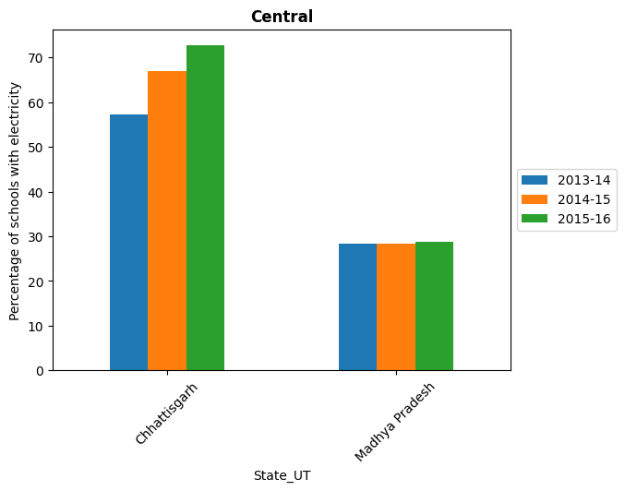
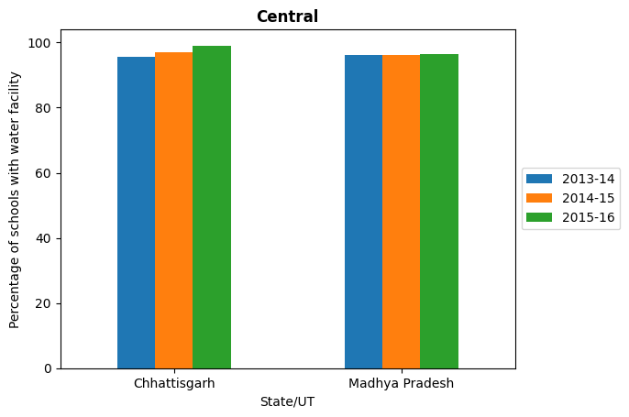

Slide 14
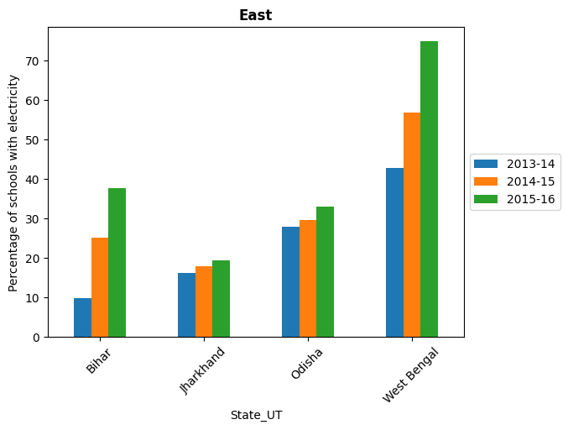
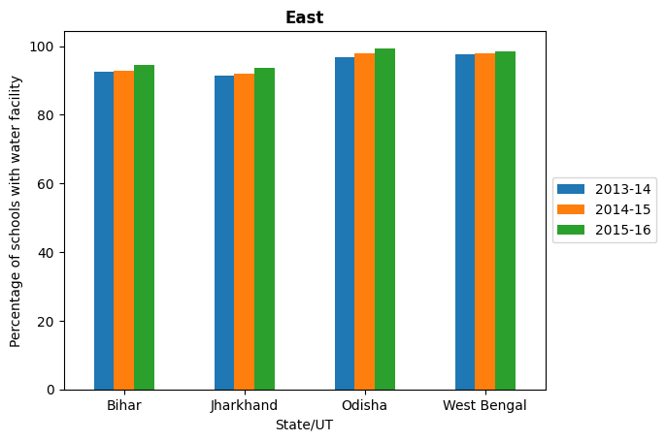

Slide 15
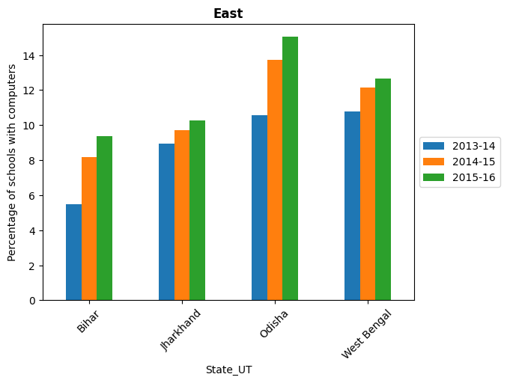

Slide 16
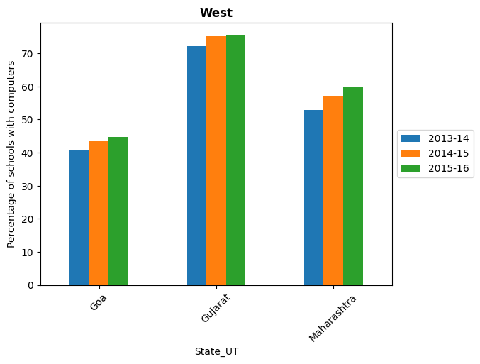
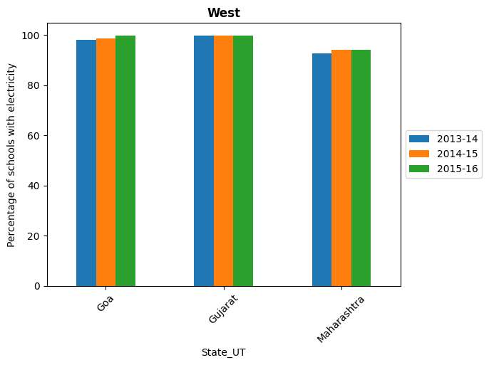
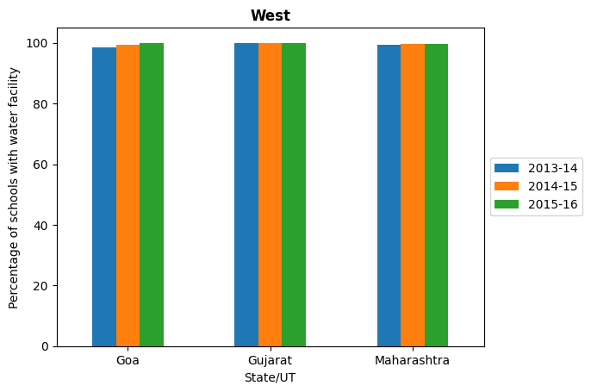

Slide 17
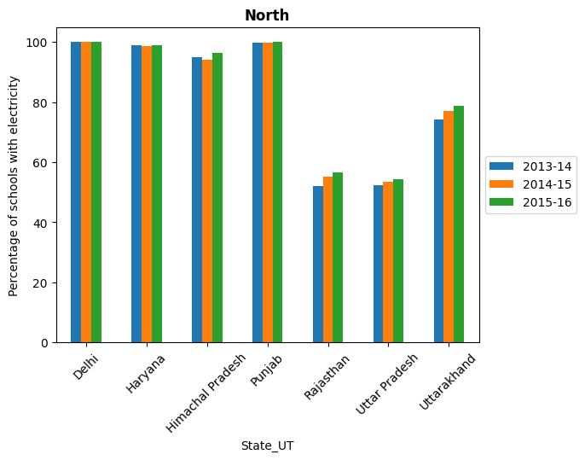
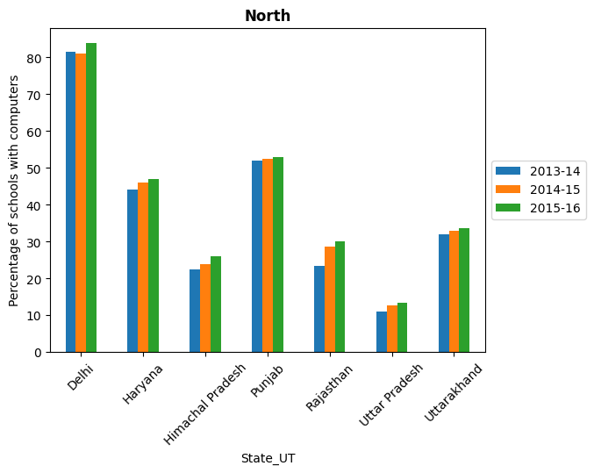

Slide 18
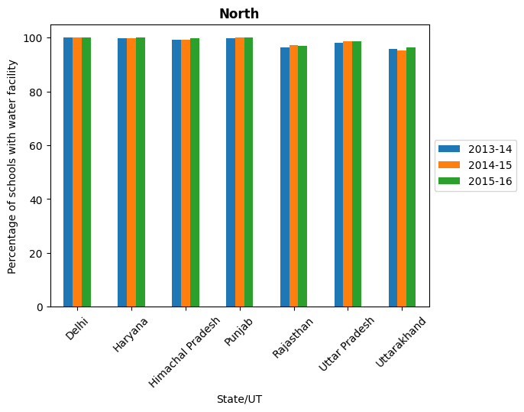

Slide 19
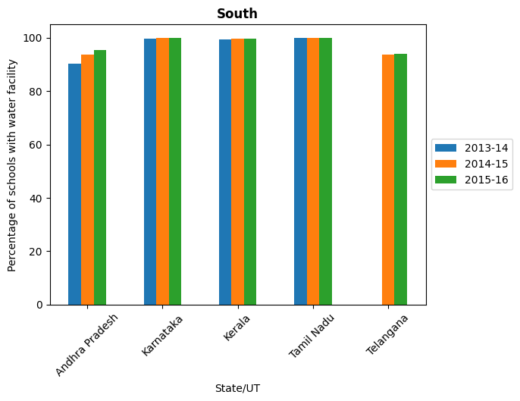
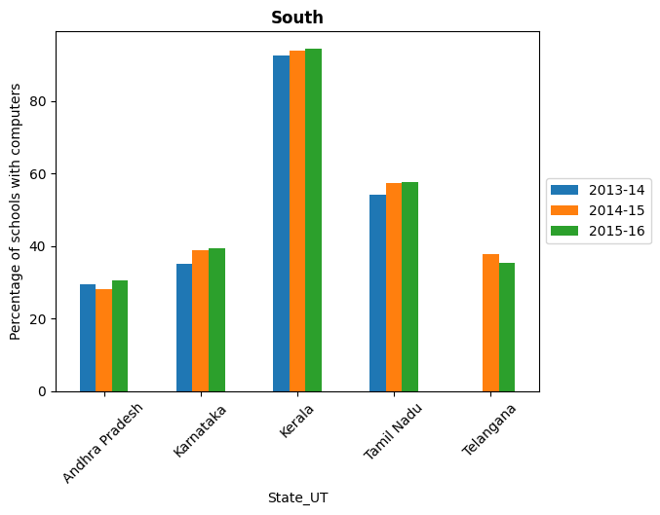

Slide 20
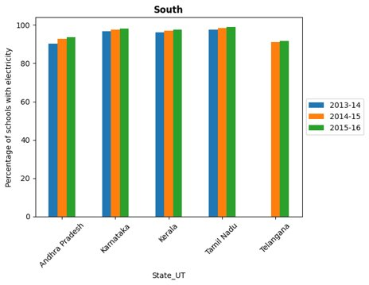

Slide 21
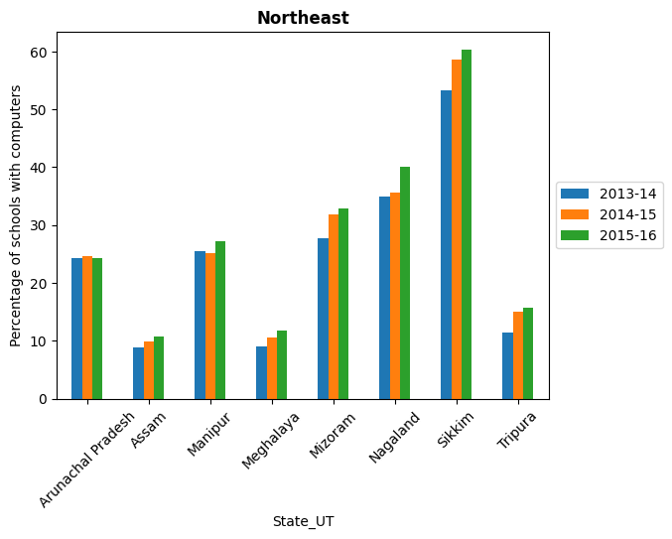
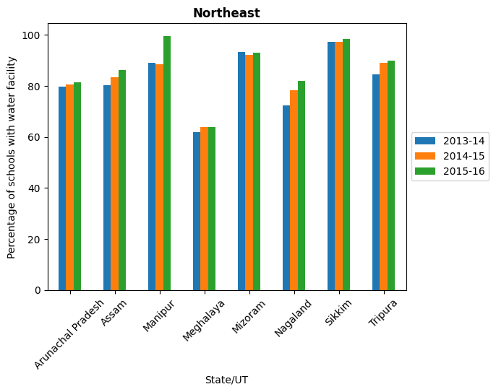

Slide 22
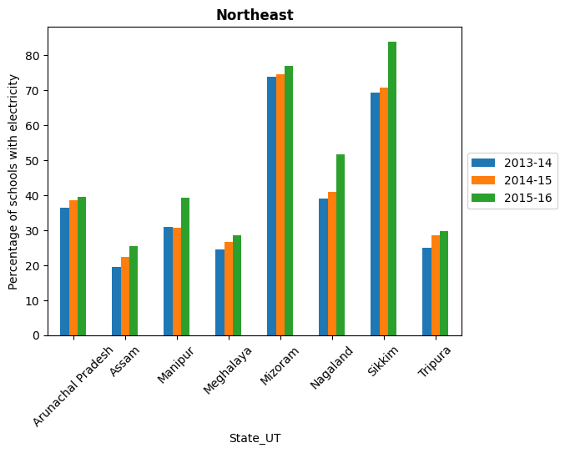

Slide 23
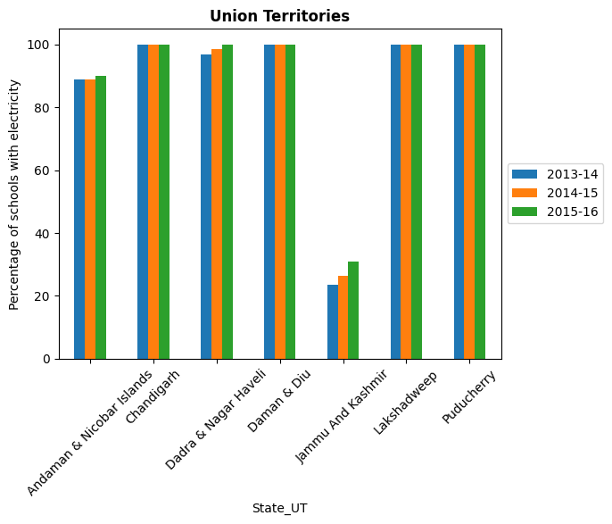
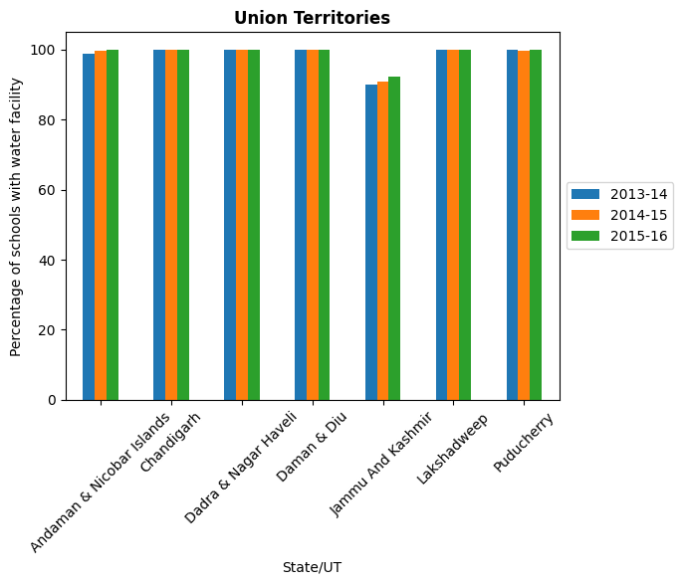

Slide 24
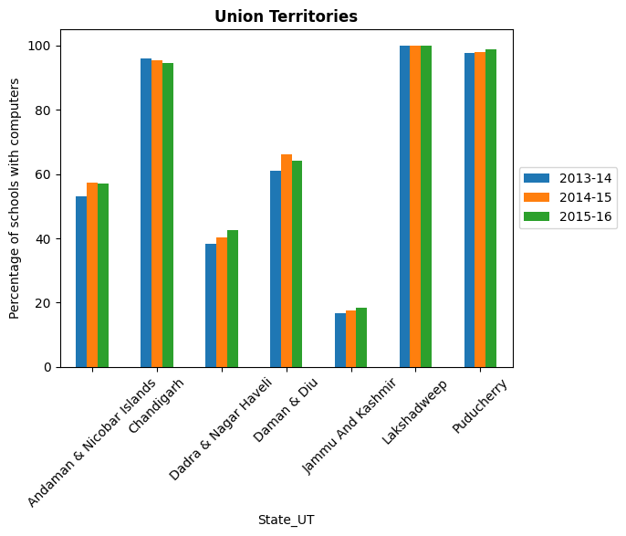

Slide 25
Comparison of GDP with all other variables
I have collected data of state-wise GDP.
Correlation between GDP and all other variables is observed.

Slide 26
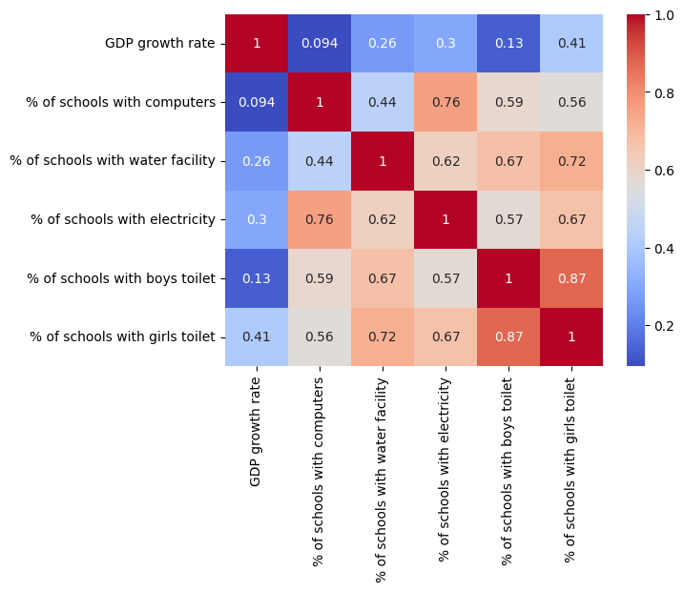
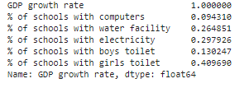
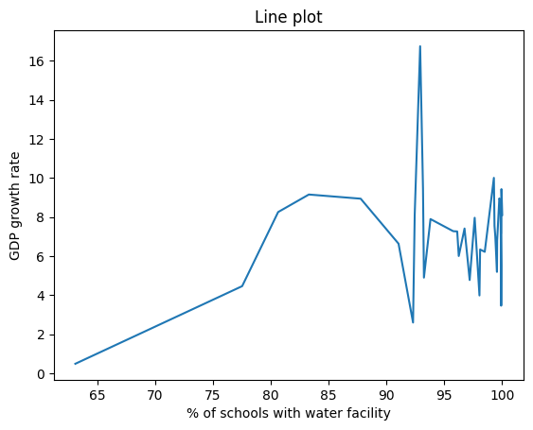

Slide 27
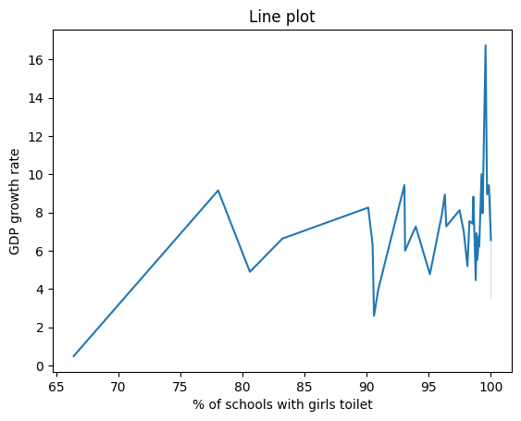
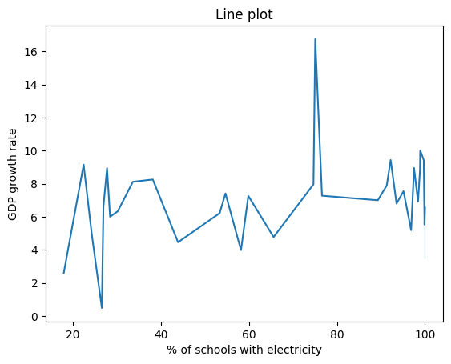

Slide 28
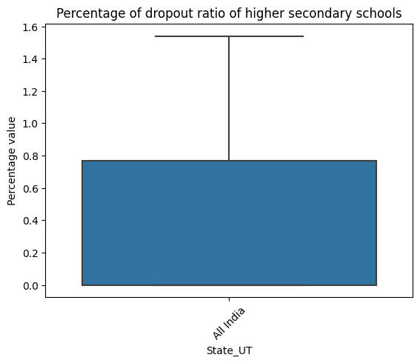
% Gross Enrollment & Dropout ratio variation & comparison for different levels of schools
I have used Box plot for variation
& Bubble plot for comparison.

Slide 29
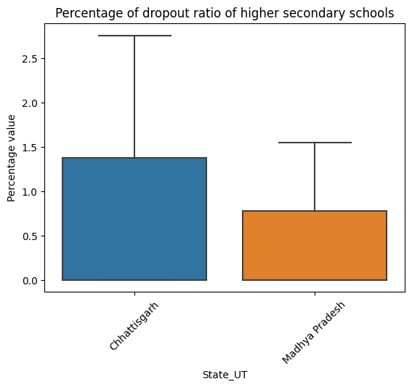
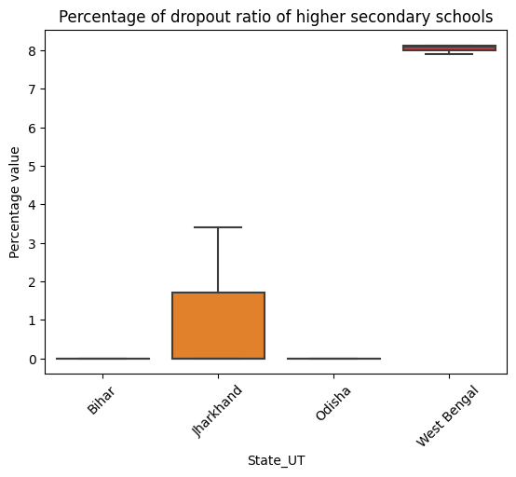

Slide 30
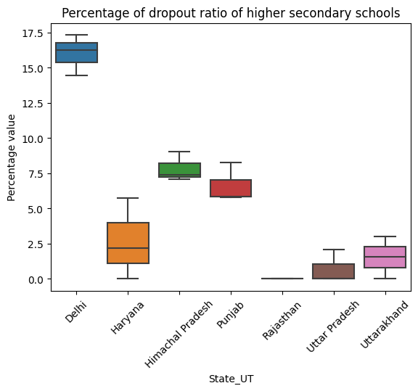
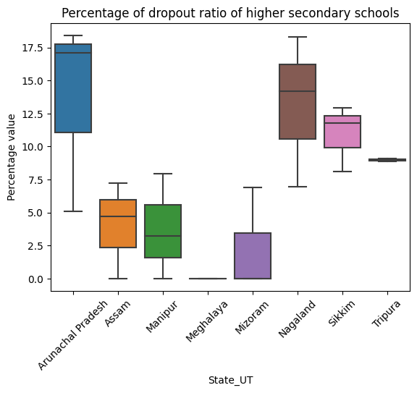

Slide 31



Slide 32



Slide 33



Slide 34



Slide 35



Slide 36



Slide 37



Slide 38



Slide 39


Slide 40
% of Gross Enrollment of Boys vs Girls at various levels of schools
Bar plot are used to show results.

Slide 41


Slide 42



Slide 43


Slide 44


Slide 45



Slide 46


Slide 47


Slide 48


Slide 49


Slide 50


Slide 51

Relation of Gross Enrollment & Dropout Ratio with all other variables
correlation as a measure is used & also scatter plot or line plot is shown

Slide 52



Slide 53



Slide 54
Water facility and Electricity at different levels of schools
For all 4 different levels of schools, water facility and electricity variation is shown using Box plot & Line plot

Slide 55



Slide 56



Slide 57



Slide 58



Slide 59



Slide 60



