Slide 1
Moons & Stars
A game with procedurally generated planets
Author: Ábel Ujfalusi
Supervisor: Lect. Dr. Mircea Ioan Gabriel
Babeş-Bolyai University, Faculty of Mathematics and Computer Science

Slide 2
The 60% asset bottleneck
The high cost of fidelity
Modern game development faces massive challenges in visual asset creation due to the ever increasing consumer demand for more content and more complex visuals

Slide 3



Challenges
Industry success
Existing problems
Titles like Minecraft and No Man’s Sky already demonstrated that procedural content generation (PCG) could be commercially viable in a game. These games shifted the focus from manual asset creation to algorithmic asset generation.
While the technique became successful, it is adapted mostly in the generation of large continuous terrain surfaces raised up from a simple plain. Applying to sphere surfaces and working out suitable level of detail (LoD) algorithms remains a challenge. Rarely tried and implemented in a multiplayer setting

Slide 4
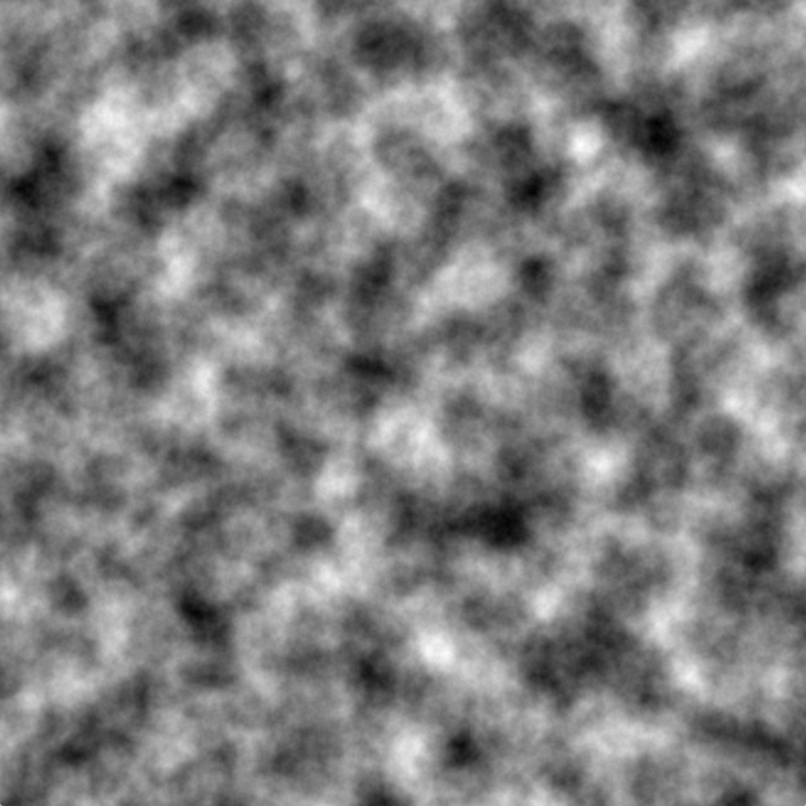

Related work
Applications of Perlin-noise
Perlin-noise is the most often used algorithm in procedural content generation. The coherent noise is very well suited for the creation of terrain features and textures.
Noisemap created with 2D Perlin-noise

Slide 5
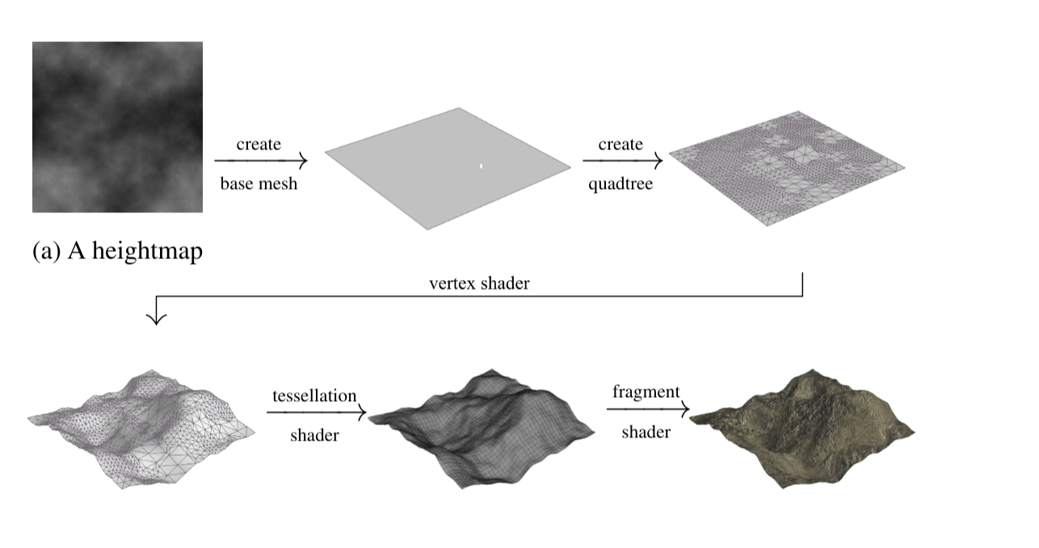
Related work
Level of detail with quadtree
Many different level of detail solutions were invented to balance out performance and visual fidelity of generated visuals
Source: Reprinted from d’Oliveira and Apolinario Jr.

Slide 6
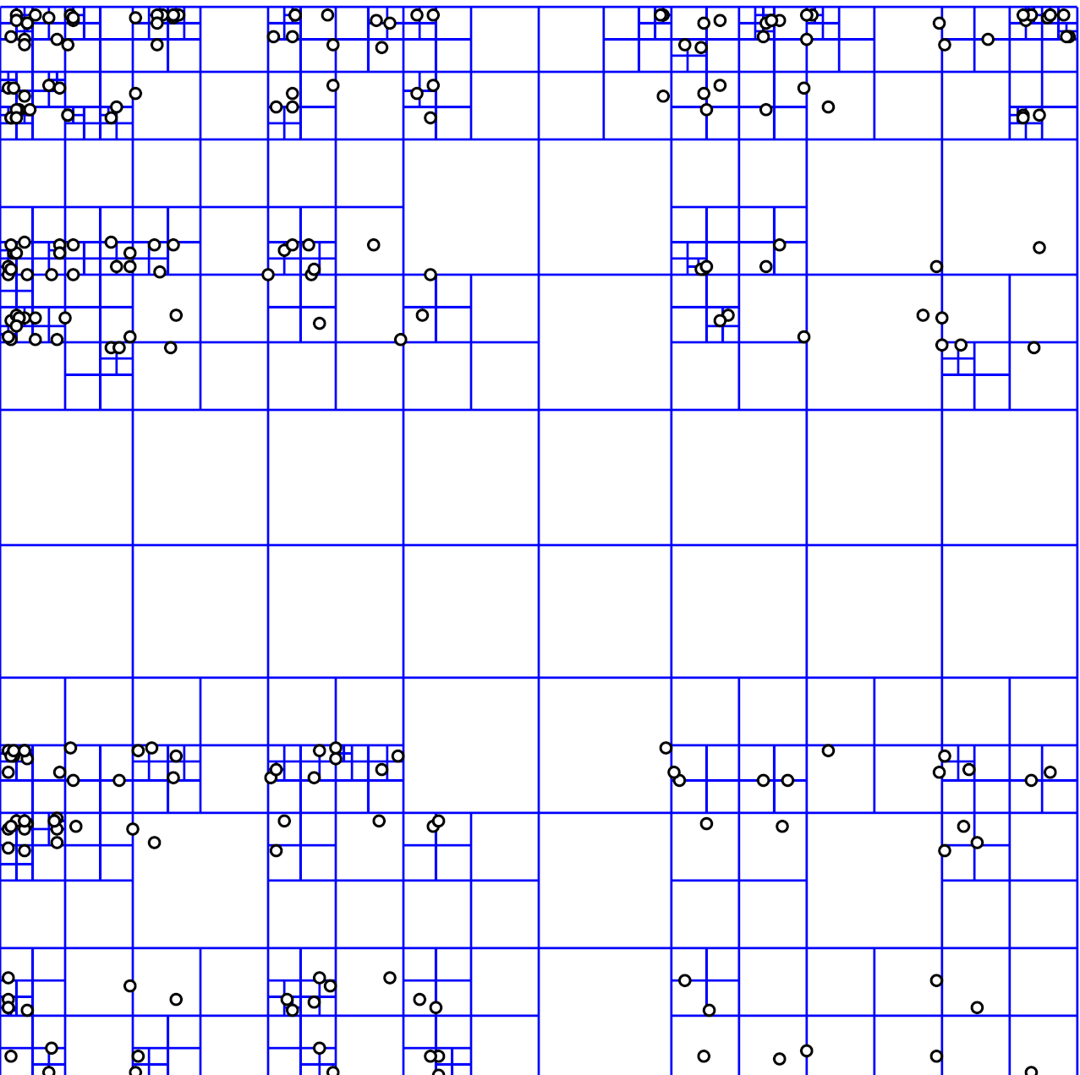
Related work
Quadtree
A data structure used to divide 2 dimensional space, very often used to create level of detail algorithms with subdivision of terrain only in the correct spots.
Source: Wikipedia

Slide 7



Technical system architecture
Tech stack
Planet generation
Multiplayer
Unity Engine with C#
HLSL unlit vertex shader pipeline for
Noise based planet generation with modular noise filtering mechanisms and auto-generated texture
Multiplayer system built with the help of Unity online services

Slide 8
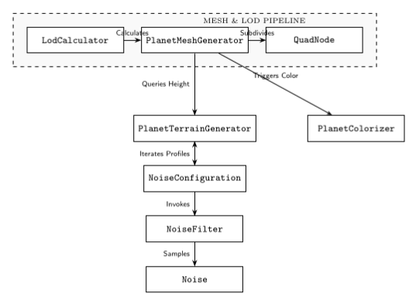
Planet generation
The core feature of the game
Cube sphere based planets, easily subdivideable using quadtrees. Terrain is generated using a modular configuration of noise filters

Slide 9
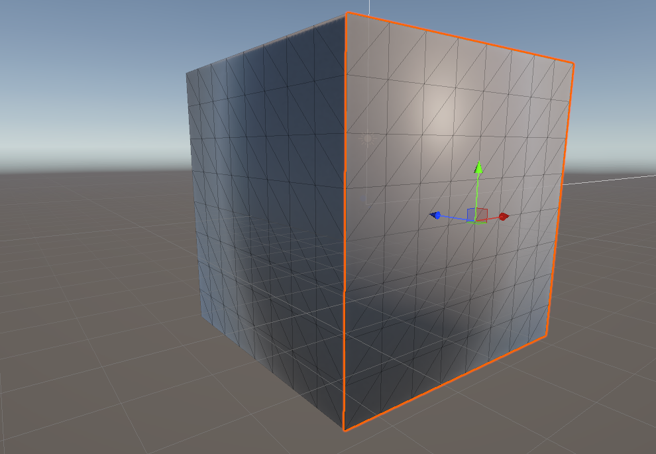
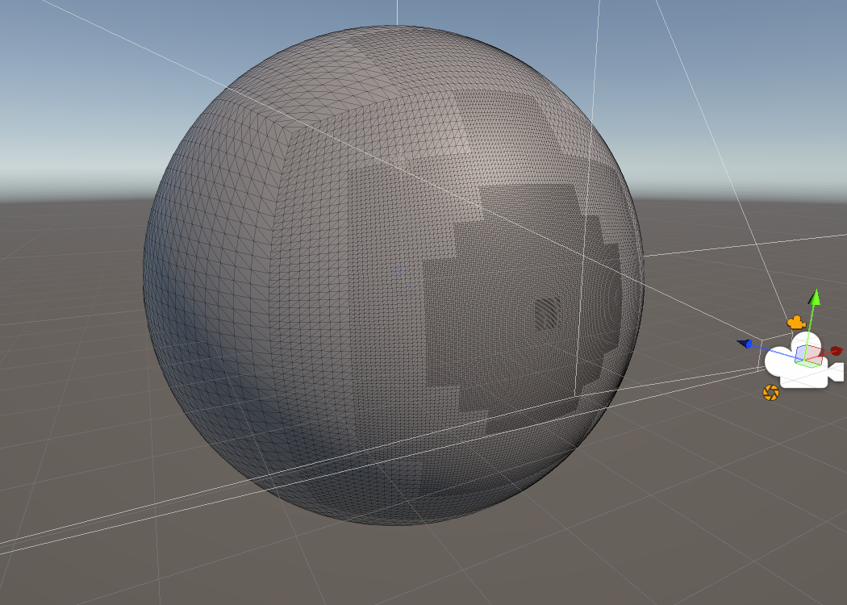
Planet generation
The core feature of the game
Original cube
Sphere subdivided

Slide 10
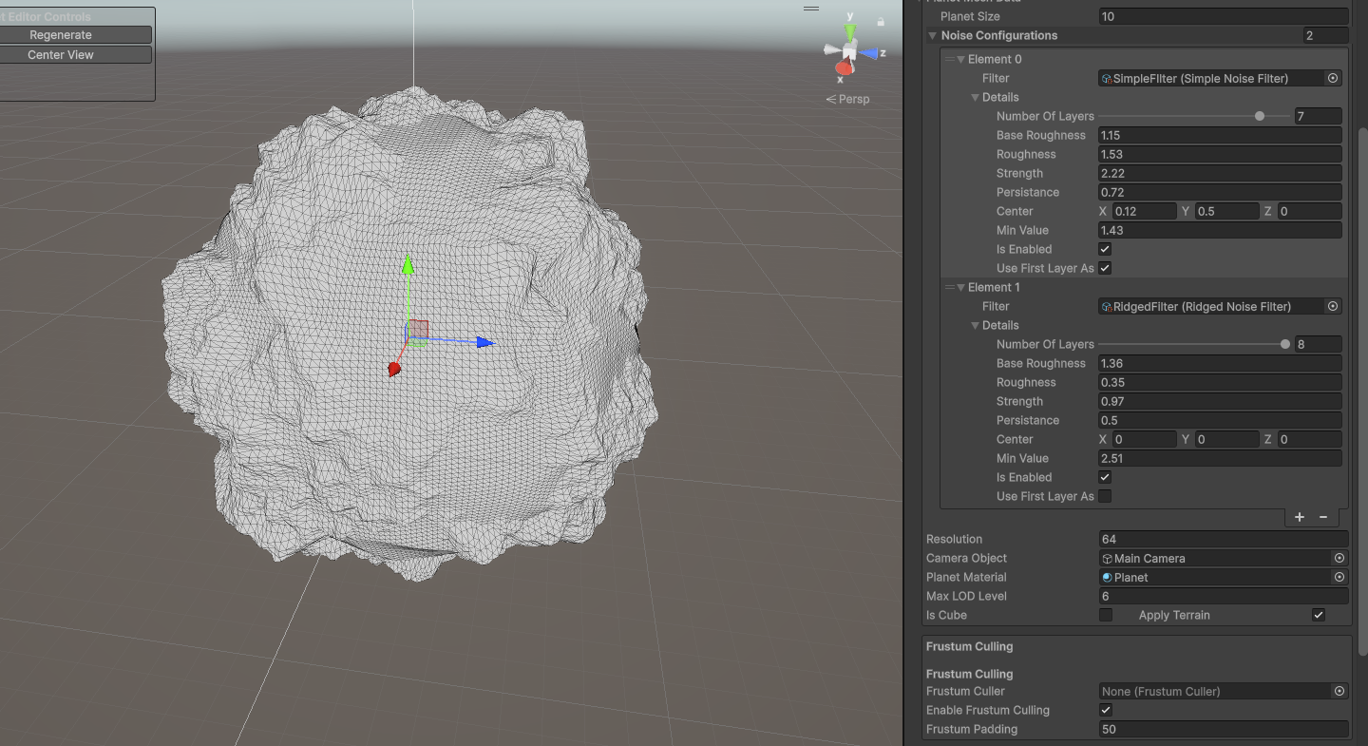
Planet generation
The core feature of the game
Terrain applied over sphere

Slide 11
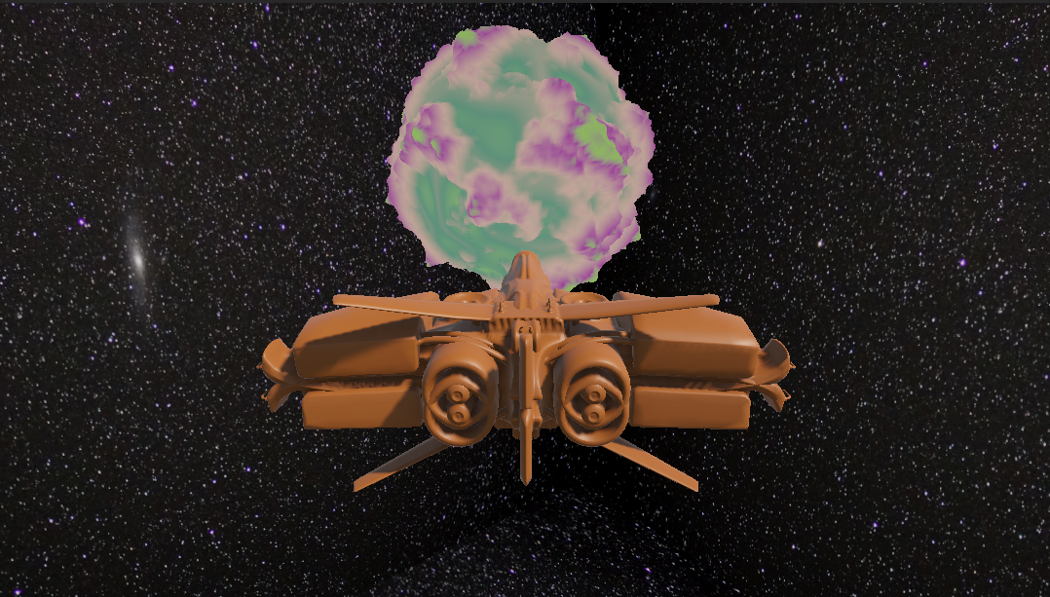
Planet generation
The core feature of the game
Final look in the game

Slide 12
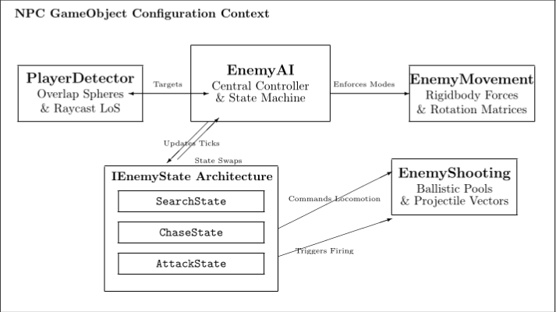
NPC AI state machine
Tactical autonomous entities

Slide 13
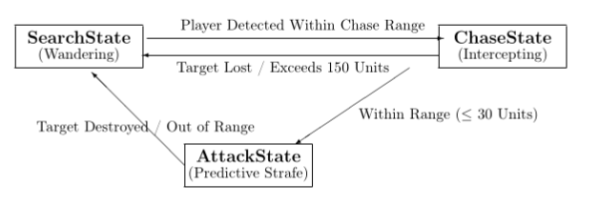
NPC AI state machine
Tactical autonomous entities

Slide 14

Multiplayer & Networking
Parametric replication
Cloud brokered connectivity
Streaming of heavy terrain meshes in a game is unfeasable, so terrain is recreated by taking advantage of a global seed.
Unity Relay and Lobby services handle session initialization and NAT traversal. A host client ensures authoritative world states.

Slide 15
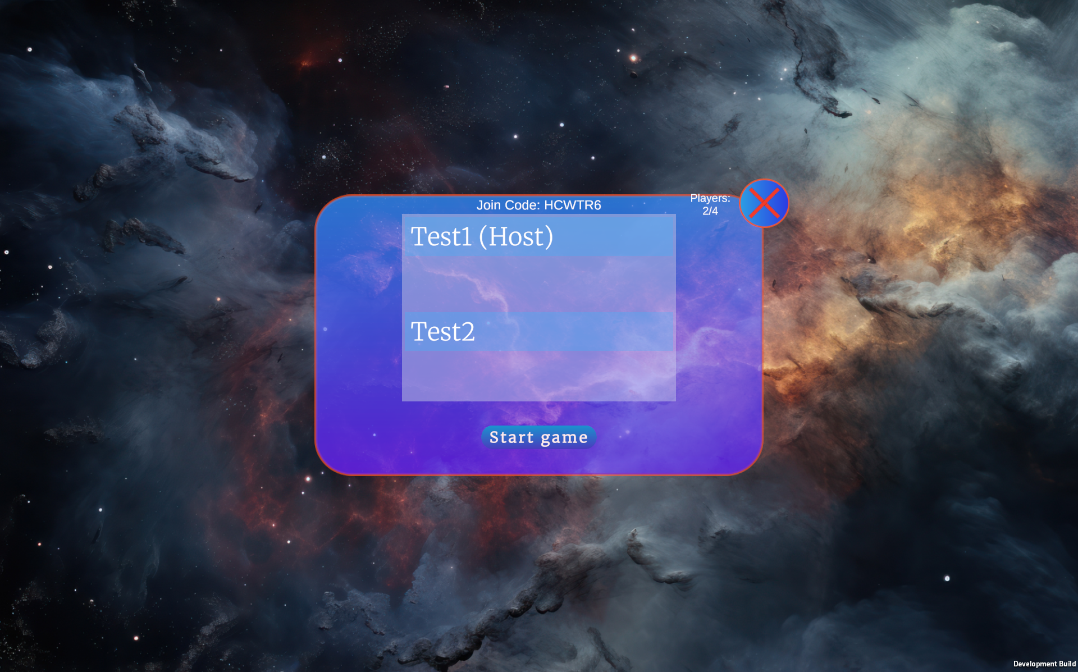
Multiplayer & Networking
Game lobby with 2 players

Slide 16
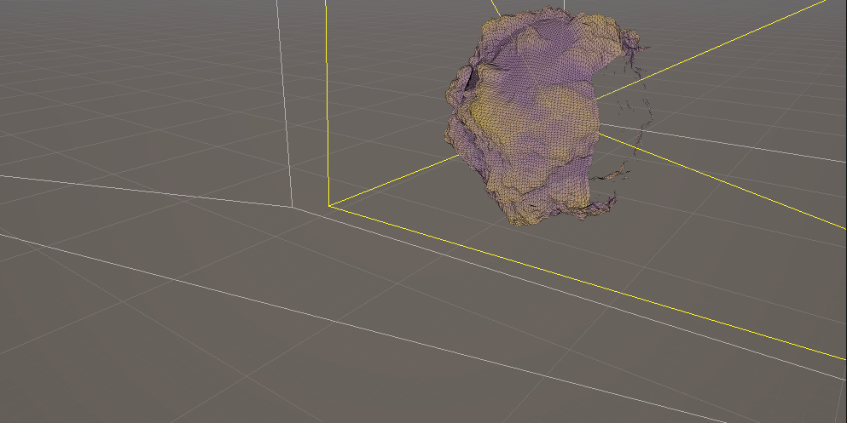
Optimization
Frustum cull
Optimization with frustum cull

Slide 17
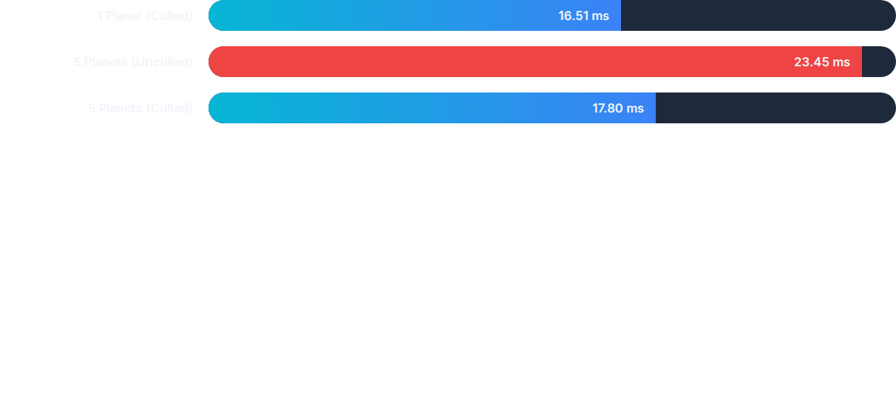
Performance testing
Statistical Variance: Mean frame times satisfy the 60Hz real-time interactive framework boundary (16.67ms) even with multiple active bodies.

Slide 18
Conclusions and possible improvements
Achievements: Successfuly created a multiplayer game with a usable procedural planet generation system and with acceptable performance
Efficiency: Pleasing aesthetics achieved with zero manual assets through deterministic mathematical synthesis.
Future improvements: Optimization by experimenting with GPU compute shaders, running different computation loops on GPU, future addition of different biome regions, more complex NPC behaviour

