Slide 1

Customer Shopping Behavior Analysis
Uncovering insights from 3,900 purchases to guide strategic business decisions

Slide 2

Project Overview
Dataset Size
Purchase Data
3,900 rows × 18 columns
Categories, amounts, seasons, sizes, colors
Customer Info
Behavior Metrics
Age, gender, location, subscription status
Discounts, promo codes, purchase frequency, ratings
Goal: Uncover spending patterns, customer segments, and product preferences to guide strategic decisions.

Slide 3

Data Preparation Process
Python Analysis
Feature Engineering
Data loading with pandas
Initial exploration using info() and describe()
Missing data handling (37 values in Review Rating)
Column standardization to snake_case
Created age_group bins
Calculated purchase_frequency_days
Dropped redundant promo_code_used column
Loaded to PostgreSQL for SQL analysis

Slide 4
Key SQL Findings
$157,890
839
50%
Male Revenue
High-Spend Discount Users
Hat Discount Rate
Generated 2.1× more than female customers ($75,191)
Customers using discounts but spending above average
Highest percentage of discounted purchases among all products

Slide 5




Product Performance
Jewelry
Blouse
Sandals
Jacket
Top-selling accessory with 171 orders
Leading clothing item with 171 orders
Most popular footwear with 160 orders
Leading outerwear with 163 orders

Slide 6

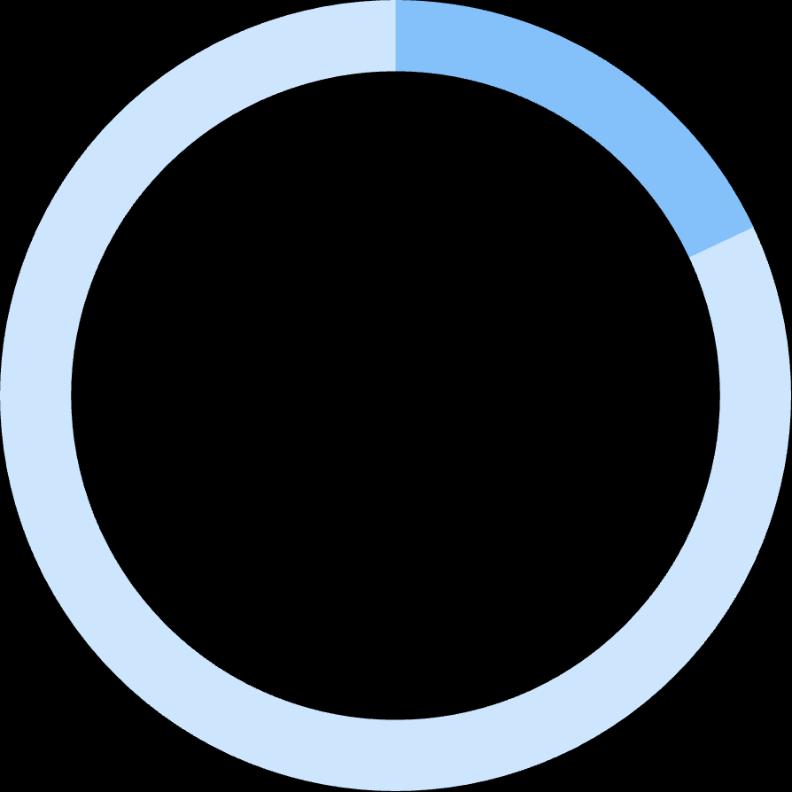

Customer Segmentation
80%
18%
2%
Loyal Customers
Returning Customers
New Customers
3,116 customers with consistent purchase history
701 customers making occasional purchases
83 customers with single transactions

Slide 7

Subscription Insights
Current Status
27% subscribed (1,053 customers) vs. 73% non-subscribed (2,847 customers)
Revenue Comparison
Non-subscribers generate 2.7× more total revenue ($170,436 vs. $62,645)
Repeat Buyers
958 repeat buyers (≥5 purchases) show subscription correlation

Slide 8
Age Group Analysis
26%
23%
Young Adult
Middle-aged
~1,000 sales generating ~$45K revenue
~900 sales generating ~$40K revenue
21%
18%
Adult
Senior
~800 sales generating ~$35K revenue
~700 sales generating ~$30K revenue
Young adults drive highest revenue per transaction at ~$45 average.

Slide 9

Shipping & Ratings
Express Shipping Preference
Average purchase: $60.48 vs. Standard's $58.46
Top-Rated Products
Gloves (3.86), Sandals (3.84), Boots (3.82), Hat (3.80), Skirt (3.78)
Average Rating
3.75/5.0 across all products with 0.72 standard deviation

Slide 10





Strategic Recommendations
Boost Subscriptions
Promote exclusive benefits to increase 27% adoption rate
Loyalty Programs
Reward repeat buyers to grow loyal segment
Discount Policy Review
Balance sales boosts with margin control
Targeted Marketing
Focus on high-revenue age groups and express-shipping users

