Slide 1

Strategic Sales Analysis Report
Bike Purchasing Trends
Identifying the ideal customer profile and key drivers of bike sales through comprehensive data analysis.

Slide 2


EXECUTIVE SUMMARY
The Urban Commuter Professional
The ideal customer is a middle-aged individual (31–54 years old) earning $60,000+ annually, living within 0–5 miles of their workplace.
Convenience and economic necessity are the strongest behavioral predictors of purchase, outweighing demographic factors like gender and marital status.

Slide 3

Age Profile: The Core Buyer
Middle Age (31–54)
Youth (0–30)
Dominant revenue driver accounting for the vast majority of purchases. Combines physical capability with financial stability.
Lower conversion rate despite physical activity. Average income of $30k–$40k limits purchasing power.
Seniors (55+)
Sharp drop in sales volume, suggesting physical barriers to entry for standard bicycles.

Slide 4
Economic Indicators
Economic stability is a clear prerequisite for purchasing. Non-buyers consistently earn ~$4,000 less than buyers.
$60K
$56K
$50K
Male Buyers
Female Buyers
Price Threshold
Average annual income vs. $56,208 for non-buyers
Average annual income vs. $53,440 for non-buyers
Critical income level indicating price sensitivity

Slide 5
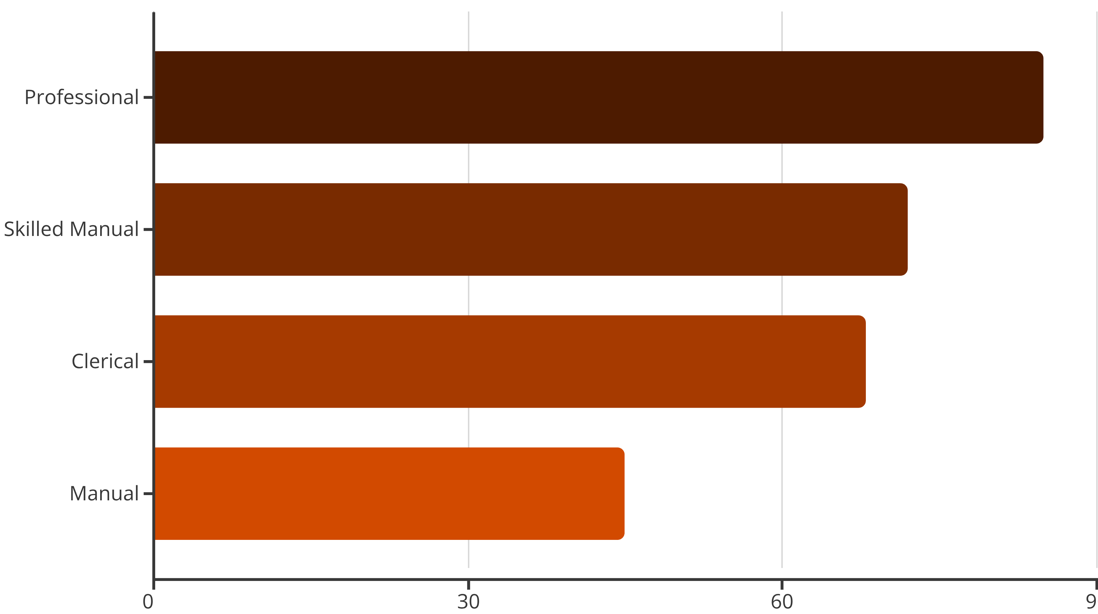
Occupation Impact
"Professional" workers lead consumer segments, while "Manual" laborers show lowest purchase rates, correlating with lower income levels.

Slide 6




KEY PREDICTOR
The Commute Effect
Distance is the critical filter for sales. Purchase volume collapses for commutes longer than 10 miles.
0–1 Miles
Highest purchase volume. Bikes used for utility and short-distance transport.
2–5 Miles
Strong segment for serious bicycle commuters with daily usage.
10+ Miles
Sales collapse as physical effort becomes a significant barrier.

Slide 7

Car Ownership Inverse Correlation
0–2 Cars
Significantly more likely to purchase. Bike viewed as primary or secondary transport necessity.
3+ Cars
Bike purchasing decreases. Viewed as recreational luxury rather than essential tool, reducing urgency.

Slide 8



Geographic Market Insights
North America
Europe
Pacific
Largest market share by total volume, representing primary revenue source.
Strong conversion rates supported by bike-friendly infrastructure and culture.
Smaller but stable market segment with consistent growth potential.

Slide 9

Strategic Recommendations
01
02
Marketing Strategy
Inventory Planning
Launch "Beat the Traffic" campaign targeting urban centers. Focus on utility, time-savings, and green commuting for those within 5 miles of work.
Prioritize Hybrid and Commuter models for 31–54 age demographic. Limit high-end performance models unless offering financing options.
03
Pricing Tiers
Ensure entry-level model accessible to $40,000–$50,000 income bracket to capture Skilled Manual and younger demographics.

Slide 10

Target Audience
The primary "Lookalike Audience" for advertising campaigns:
Single Professionals
Age 30–45
Bachelor's Degree
0–1 Cars

