Slide 1

Acropolis Institute of Technology and Research, Indore
Data Structure(CSIT303)
CI III semester
Session July-Dec 2021
Department : CSIT, Faculty: Nisha Rathi

Slide 2
Acropolis Institute of Technology and Research, Indore
LECTURE 1: (17/8/2021)
Scheme, Syllabus, Course Objectives, Course Outcomes, prerequisite, scope, Data , Information, meaning and need for data structure, difference between feasible and optimal solution
PREREQUISITE:
BT205 Basic Computer Engineering
Programming syntax and implementation knowledge
Department : CSIT, Faculty: Nisha Rathi

Slide 3
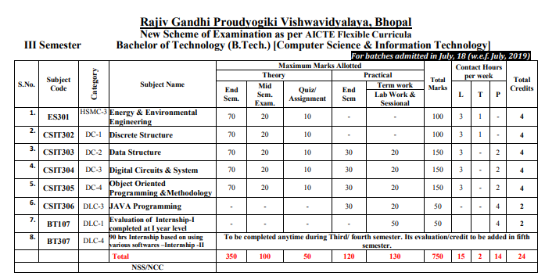
CSIT III semester Scheme
Acropolis Institute of Technology and Research, Indore
Department : CSIT, Faculty: Nisha Rathi

Slide 4
Acropolis Institute of Technology and Research, Indore
DS Syllabus
Unit 1: Introduction Data, data type, data object. Types of data structure – primitive &n nonprimitive , linear & non-linear. Operations on data structures – traversing, searching , inserting , deleting. Complexity analysis – worst case, best case, average case. Time – space trade off , algorithm efficiency, asymptotic notations – big oh , omega , theta.
Unit 2: Arrays & Structure Introduction , declaration of arrays , operations on arrays – inserting , deleting , merging of two arrays , 1 dimensional & 2 dimensional arrays, row & column major representation , address calculation in array , storing values in arrays , evaluation of polynomial – addition & representation. Searching & sorting – Introduction , sequential search, binary search , Fibonacci search , indexed sequential search, hashed search. Types of sorting with general concepts – bubble, heap , insertion , selection, quick , heap , shell , bucket , radix and merge sort.
Unit 3: Stacks & Queues Basic concept of stacks & queues, array representation of stacks, operation on stacks – Push , Pop , Create , getTop , empty , linked representation of stack , multiple stack. Application of stack – Conversion: infix , prefix , postfix and evaluation of arithmetic expression. Linked representation of queue, operations on queue – insertion & deletion. Types of queue with functions – circular , deque , priority queue. Applications of queues – Job scheduling , Josephus problem.
Unit 4: Linked List Introduction – basic terminology, memory allocation & deallocation for linked list. Linked list variants – head pointer , head node , types linked list – linear & circular linked list. Doubly linked list , creation of doubly list, deletion of node from doubly linked list, insertion of a node from doubly linked list, traversal of doubly linked list. Circular linked list – singly circular linked list , circular linked list with header node , doubly circular linked list. Applications of linked list – polynomial representation & garbage collection.
Unit 5: Trees Basic terminology – general tree , representation of general tree, types of trees, binary tree- realization and properties , traversal in binary trees – inorder , preorder , postorder , applications of trees. Graph- Basic Terminologies and representations, Graph search and traversal algorithms.
Department : CSIT, Faculty: Nisha Rathi

Slide 5
Acropolis Institute of Technology and Research, Indore
DS LIST OF EXPERIMENTS
Write a program to search an element in the array using Linear and Binary Search.
Write a program to perform the following operation in Matrix: Addition, Subtraction, Multiplication, Transpose
Write a program to perform the following operation on strings using string functions: Addition ,Copying ,Reverse ,Length of String
Write program for implementing the following sorting methods to arrange a list of integers in ascending order: a) Quick sort b) Selection sort c) Insertion sort d) Merge sort
Write a program that uses stack operations to convert a given infix expression into its postfix equivalent.
Write a program to merge two sorted array into one sorted array.
Write a program to implement stack using array and linked list.
Write a program to implement queue and circular queue using array.
Write a program to insert an element in the beginning and end of singly linked list.
Write a program to insert an element at any position in singly and doubly linked list.
Insert and delete a node at any position in doubly linked list.
Write a program of Tower of Hanoi.
Write a program that uses functions to perform the following: a) Create a binary search tree of integers. b) Traverse the above Binary search tree non recursively in in order.
Department : CSIT, Faculty: Nisha Rathi

Slide 6
Acropolis Institute of Technology and Research, Indore
DS RECOMMENDED BOOKS
1.Varsha H. Patil “Data Structure Using C++” Oxford.
2. Rajesh K. Shukla “Data Structures Using C & C++” Wiley India.
3. Reema Thareja “ Data Structure Using C ” Oxford.
4. Aho, Hopcroft, Ullman, “Data Structures and Algorithms”, Pearson Education.
5. Kushwaha and Mishra “Data Structure: A programming Approach with C”, PHI Learning.
6. A. K Sharma “Data Structure Using C” Pearson.
7. Ellis Horowitz, Sartaj Sahni, “Fundamentals of Data Structures”, Computer Science Press
Department : CSIT, Faculty: Nisha Rathi

Slide 7
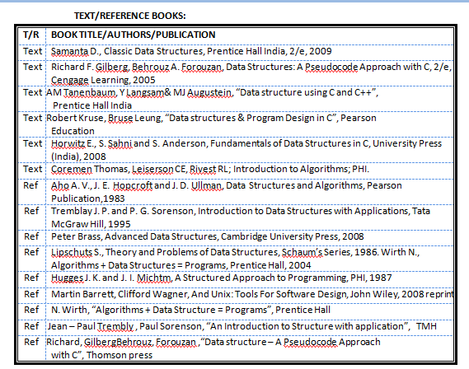
Acropolis Institute of Technology and Research, Indore
DS RECOMMENDED TEXTBOOKS
Department : CSIT, Faculty: Nisha Rathi

Slide 8
Acropolis Institute of Technology & Research, Indore
COURSE OBJECTIVES
1. To introduce the concepts of linear, non-linear data structures , the operations performed on them
and the applications of various data structures.
2. To introduce various algorithms of searching and sorting.
3. To understand the basic concepts of stacks, queues, linked lists, trees and graphs
4. To enable students to write algorithms for solving various problems using data structures
Department : CSIT, Faculty: Nisha Rathi

Slide 9
Acropolis Institute of Technology & Research, Indore
COURSE OUTCOMES
After completion of this course, the students would be able to:
CO1. For a given search problem (linear search and binary search) student will be able to implement it.
CO2. For a given problem of stacks, queues and link lists, students will be able to implement it and analyze the same to determine the time and computation complexity.
CO3. Students will be able to write an algorithm for selection sort, insertion sort, quick sort, merge sort, heap sort, bubble sort and compare their performance.
CO4. Students will be able to implement tree, graph search and traversal algorithms
Department : CSIT, Faculty: Nisha Rathi

Slide 10
Teaching-Learning strategy
This course is oriented towards being:
● active-learning:
– I will not be simply lecturing.
– You will have to do a lot of thinking during class!
● collaborative-learning:
– You will do small group discussion activities.
– You will teach and learn from each other!
● Note:
– You cannot simply sit in class and expect me to “tell” you all the “relevant details”.
– For any topic, I will mostly pose some questions.
– If you do not participate, this course can seem boring and as “not having enough depth”

Slide 11

Motivating Discussion
Structures and algorithms are required for efficient work in all walks of daily life. Examples?
● Hostel-room analogy:
– A “cluttered” room: quick to store but takes time to find items
– An “organized” room: quick to find items but takes time to store
● Points:
– For each “application” a different structure may be required
– Depending on the structure, the process of using it efficiently will be different.

Slide 12
Motivating Discussion
Example: key borrowing log for different rooms
● “Structure” used: A huge journal book
– One page per room – sequentially assigned
– Room→ page index on first page
– Fixed number of entries per page
– When page finishes, watchman writes the new page number at the bottom of this page
Sometimes we have to follow 2-3 links to get to the active page
● More alternatives: File with loose sheets of paper, insert new sheet when page runs out – index using index tabs with room number
– completely gets rid of need for page numbers, following links, etc
– Requires more capabilities, and a different access technique

Slide 13
Acropolis Institute of Technology & Research, Indore
Unit 1: Introduction Data, data type, data object. Types of data structure – primitive &n nonprimitive , linear & non-linear. Operations on data structures – traversing, searching , inserting , deleting. Complexity analysis – worst case, best case, average case. Time – space trade off , algorithm efficiency, asymptotic notations – big oh , omega , theta.
Department : CSIT, Faculty: Nisha Rathi

Slide 14
Acropolis Institute of Technology & Research, Indore
Data
Data is facts and statistics collected for reference or analysis.
Data is the name given to basic facts and entities such as names and numbers. The main examples of data are weights, prices, costs, numbers of items sold, employee names, product names, addresses, tax codes, registration marks etc.
Department : CSIT, Faculty: Nisha Rathi

Slide 15
Acropolis Institute of Technology & Research, Indore
Data v/s Information
Data is an individual unit that contains raw materials which do not carry any specific meaning.
Information is a group of data that collectively carries a logical meaning. When data is processed, organized, structured or presented in a particular context to make it useful, it is called information.
Department : CSIT, Faculty: Nisha Rathi

Slide 16
Acropolis Institute of Technology & Research, Indore
Data v/s Information
Data contains raw figures and facts.
Information unlike data provides insights analyzed through the data collected. Information can't exist without data, but data doesn't rely on the information.
Example. Each student's test score is one piece of data. The average score of a class or of the entire school is information that can be derived from the given data.
Department : CSIT, Faculty: Nisha Rathi

Slide 17
Acropolis Institute of Technology & Research, Indore
Feasible and Optimal solution
A solution (set of values for the decision variables) for which all of the constraints in the Solver model are satisfied is called a feasible solution
An optimal solution is a feasible solution where the objective function reaches its maximum (or minimum) value – for example, the most profit or the least cost.
Department : CSIT, Faculty: Nisha Rathi

Slide 18
Acropolis Institute of Technology and Research, Indore
LECTURE 2: Data types, Data Objects(18/8/2021)
Department : CSIT, Faculty: Nisha Rathi

Slide 19
Acropolis Institute of Technology & Research, Indore
Data type
A data type is a classification of data which tells the compiler or interpreter how the programmer intends to use the data. Most programming languages support various types of data, including integer, real, character or string, and Boolean.
Department : CSIT, Faculty: Nisha Rathi

Slide 20
Acropolis Institute of Technology & Research, Indore
Data type
Data types simply refers to the type and size of data associated with variables and functions.
Data types in C
Types | Data Types
Primary Data Type | integer(int),character(char), floating(float) and void
Derived Data Type | array, pointer, structure, union, Enumeration
Department : CSIT, Faculty: Nisha Rathi

Slide 21
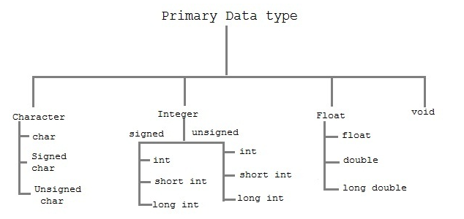
Acropolis Institute of Technology & Research, Indore
Data type
Data types simply refers to the type and size of data associated with variables and functions.
Primary Data types in C
Department : CSIT, Faculty: Nisha Rathi

Slide 22
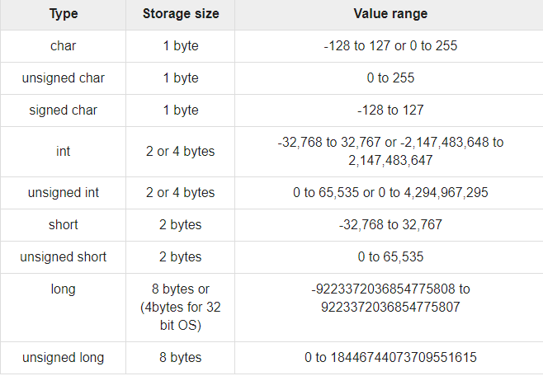
Acropolis Institute of Technology & Research, Indore
Data type
Primary Data types in C
The expressions sizeof(type)
yields the storage size of the object
or type in bytes.
Department : CSIT, Faculty: Nisha Rathi

Slide 23
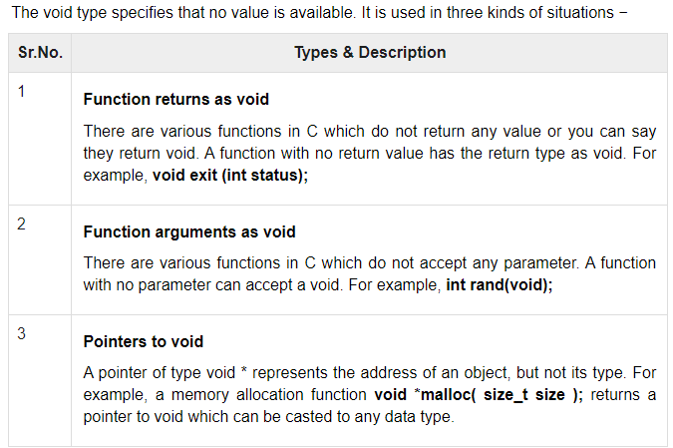
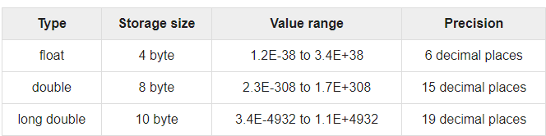
Acropolis Institute of Technology & Research, Indore
Data type
Primary Data types in C
Department : CSIT, Faculty: Nisha Rathi

Slide 24
Acropolis Institute of Technology & Research, Indore
Data types are often grouped into type categories that overlap, such as:
Fundamental types versus derived types
Fundamental data types are also known as "basic", "fundamental" or "built-in" to the language. These include integers, floating-point numbers, and characters. Derived types, also known as "compound" types in Standard C++, are created from the set of basic types, and include arrays, pointers, structures, unions, enumerations. All C++ classes are considered compound types.
Built-in types versus user-defined types
Built-in data types include all of the fundamental types, plus types that refer to the addresses of basic types, such as arrays and pointers. User-defined types are created by the user from the set of basic types, in typedef, structure, union, and enumeration definitions. C++ classes are considered user-defined types.
Scalar types versus aggregate types
Scalar types represent a single data value, while aggregate types represent multiple values, of the same type or of different types. Scalars include the arithmetic types and pointers. Aggregate types include arrays, structures. C++ classes are considered aggregate types.
Data type
Department : CSIT, Faculty: Nisha Rathi

Slide 25
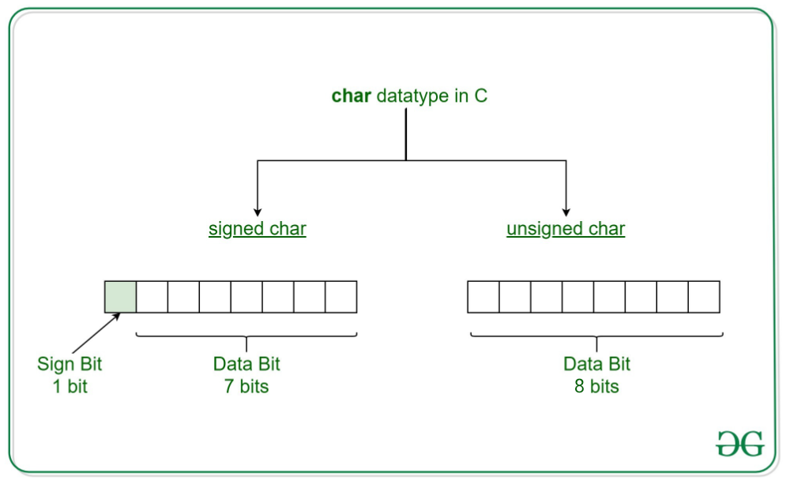
Acropolis Institute of Technology & Research, Indore
Data type
Variants of Char Data types in C
Department : CSIT, Faculty: Nisha Rathi

Slide 26
Acropolis Institute of Technology & Research, Indore
A data object is a region of storage that contains a value or group of values.
Each value can be accessed using its identifier or a more complex expression that refers to the object.
In addition, each object has a unique data type. The data type of an object determines the storage allocation for that object and the interpretation of the values during subsequent access.
It is also used in any type checking operations.
Both the identifier and data type of an object are established in the object declaration.
Data Objects
Department : CSIT, Faculty: Nisha Rathi

Slide 27
Acropolis Institute of Technology and Research, Indore
LECTURE 3: Need for Data Structures, Designing Data Structures , Operations on Data Structures, Data Structure Definition, Classification of Data Structure, Primitive and Non-Primitive , Linear & nonlinear, Overview of arrays, stacks, queues, Linked list, Trees and Graphs (19/8/2021)
Department : CSIT, Faculty: Nisha Rathi

Slide 28

Need for Data Structures
Data structures organize data
Any organization for a collection of records can be searched, processed in any order, or modified
The choice of data structure and algorithm can make the difference between a program running in a few seconds or many days
A solution is said to be efficient if it solves the problem within its constraints (of Time and Space)

Slide 29
Data Structures and Algorithms
A data structure is a systematic way of organizing and accessing data
An algorithm is a step-by-step procedure for solving a problem in a finite amount of time.
Algorithms and Data Structures go hand-in-hand: Certain Algorithms require certain data structures to run efficiently and vice-versa
Aim of a data structure ? To store/organize a given data in the memory of computer so that each subsequent operation (query/update) can be performed quickly

Slide 30
Goals of this Course
Learn
Learn the commonly used data structures “toolkit”.
Measure
Measure the efficiency of a data structure or program.
Design
Design data structures for various applications.
Reinforce
Reinforce the concept that there are costs and benefits for every data structure.

Slide 31
Designing Data Structures
Each data structure has costs and benefits.
Rarely is one data structure better than another in all situations.
A data structure requires:
● space for each data item it stores,
● time to perform each basic operation,
● programming effort.
Each problem has constraints on available time and space.
Only after a careful analysis of problem characteristics and solution requirements can we know the best data structure for the task.

Slide 32
Data Structure Definition
Data Structure is a way of collecting and organizing data in such a way that we can perform operations on these data in an effective way.
In Object Oriented programming, a class also does the same thing, it collects different type of data under one single entity. The only difference being, data structures provides for techniques to access and manipulate data efficiently.
Data Structure should be designed and implemented in such a way that it reduces the complexity and increases the efficiency.

Slide 33
Operations on Data Structures
Design of efficient data structure must take operations to be performed on the data structures into account. The most commonly used operations on data structure are broadly categorized into following types
Insertion
Deletion
Create:- The create operation results in reserving memory for program elements. This can be done by declaration statement. Creation of data structure may take place either during compile-time or run-time. malloc() function of C language is used for creation.
Destroy:- Destroy operation destroys memory space allocated for specified data structure. free() function of C language is used to destroy data structure.
Selection:- Selection operation deals with accessing a particular data within a data structure.

Slide 34
Operations on Data Structures
Updation:- It updates or modifies the data in the data structure.
Searching:- It finds the presence of desired data item in the list of data items; it may also find the locations of all elements that satisfy certain conditions.
Sorting:- Sorting is a process of arranging all data items in a data structure in a particular order, say for example, either in ascending order or in descending order.
Merging:- Merging is a process of combining the data items of two different sorted list into a single sorted list.
Splitting:- Splitting is a process of partitioning single list to multiple list.
Traversal:- Traversal is a process of visiting each and every node of a list in systematic manner.

Slide 35
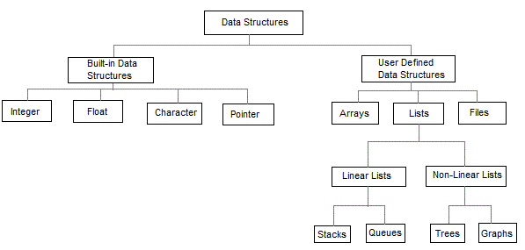
Classification of Data Structure

Slide 36
Classification of Data Structure
Characteristic | Description
Linear | In Linear data structures, the data items are arranged in a linear sequence. Example: Array
Non-Linear | In Non-Linear data structures, the data items are not in sequence. Example: Tree, Graph
Homogeneous | In homogeneous data structures, all the elements are of same type. Example: Array
Non-Homogeneous | In Non-Homogeneous data structure, the elements may or may not be of the same type. Example: Structures
Static | Static data structures are those whose sizes and structures associated memory locations are fixed at compile time. Example: Array
Dynamic | Dynamic structures are those which expands or shrinks depending upon the program need and its execution. Also, their associated memory locations changes. Example: Linked List created using pointers
The data structures can also be classified based on the characteristics

Slide 37
Classification of Data Structure
Built-in Data Structure/ Primitive Data Structure:
Anything that can store data can be called as a data structure, hence Integer, Float, Boolean, Char etc, all are data structures. They are known as Primitive Data Structures.
These are the structures which are supported at the machine level i.e., are directly operated upon by machine instructions, they can be used to make non-primitive data structures. These are integral and are pure in form. They have predefined behavior and specifications. Primitive data structures have different representations on different computers

Slide 38
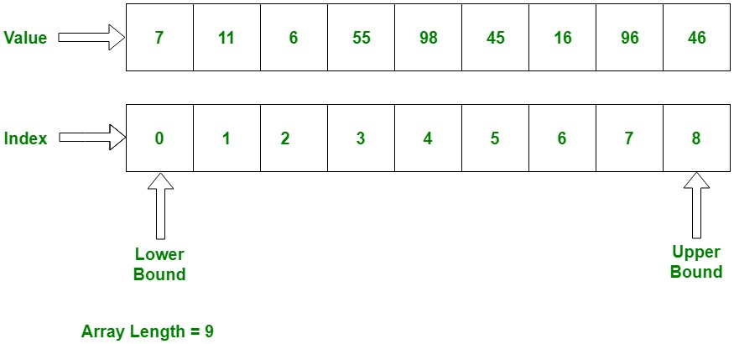
Classification of Data Structure
Arrays: Arrays are a homogeneous and contiguous collection of data of same data types. They have a static memory allocation technique. Insertions and deletions are complex in arrays since elements are stored in consecutive memory allocations.

Slide 39
Classification of Data Structure
Stacks: The stack follows a “LIFO” technique for storing and retrieving elements. The element which is stored at the end will be the first one to be retrieved from the stack. The stack has the following primary functions:
Push(): To insert an element in the stack.
Pop(): To remove an element from the stack.
Queues: The queues follow “FIFO” mechanism for storing and retrieving elements. The elements which are stored first into the queue will only be the first elements to be removed out from the queue. The queue has the following primary functions:
ENQUEUE (): to insert an element into the queue
DEQUEUE(): to remove an element from the queue

Slide 40
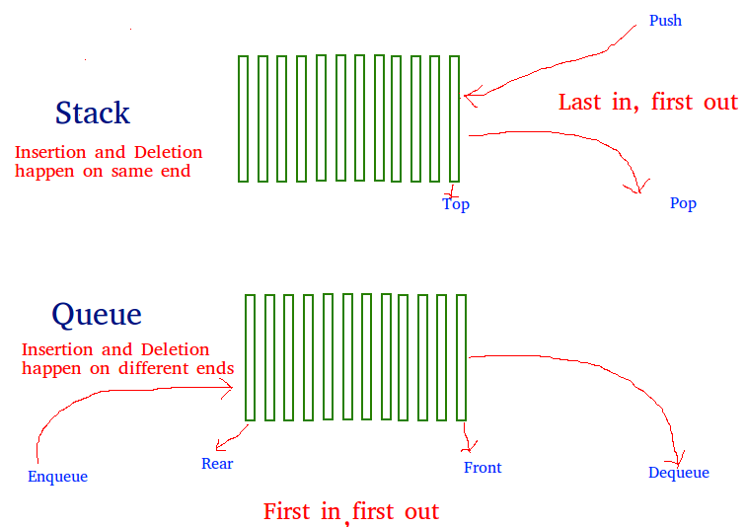
Classification of Data Structures
Department of Computer Sc. & IT. Faculty: Nisha Rathi

Slide 41
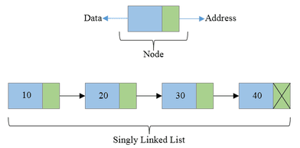
Classification of Data Structure
Linked List: The Linked lists are those which have the elements stored in a sequential order but not compulsorily in contiguous memory locations. Elements are stored on the form of nodes and the pointer to point next element in the list. The insertions and deletions are easier in the list.

Slide 42
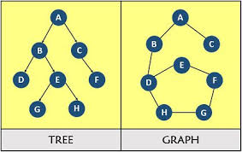
Classification of Data Structure
Non-Linear Data-Structures
Graphs: The Graph data structure is used to represent a network. It comprises of vertices and edges (to connect the vertices). The graphs are very useful when it comes to study a network.
Trees: Tree data structure comprises of nodes connected in a particular arrangement and they (particularly binary trees) make search operations on the data items easy. The tree data structures consists of a root node which is further divided into various child nodes and so on. The number of levels of the tree is also called height of the tree.

Slide 43
Acropolis Institute of Technology and Research, Indore
LECTURE 4: FUCTIONS, DECLARATION, CALLING, DEFINITION, PASSING ARGUMENTS BY VALUE AND BY REFERENCE , pointers (20/8/2021 and 23/8/2021)
Department : CSIT, Faculty: Nisha Rathi

Slide 44
Acropolis Institute of Technology and Research, Indore
LECTURE 6: Memory allocation, Static and Dynamic memory allocation, stack memory and Heap memory, malloc(), calloc(), realloc(), free, new and delete operator (24/8/2021 and 26/8/2021)
Department : CSIT, Faculty: Nisha Rathi

Slide 45
Memory Allocation
Memory allocation is the process of setting aside sections of memory in a program to be used to store variables, and instances of structures and classes.
Why is memory allocation important?
The essential requirement of memory management is to provide ways to dynamically allocate portions of memory to programs at their request, and free it for reuse when no longer needed. This is critical to any advanced computer system where more than a single process might be underway at any time.

Slide 46
Memory allocations:
It is the process of setting aside sections of memory in a program to be used to store variables, and instances of structures and classes.
There are two types of memory allocations possible in C:
Compile-time or Static allocation.
Run-time or Dynamic allocation (using pointers).
Compile-time or Static allocation: Static memory allocation allocated by the compiler. Exact size and type of memory must be known at compile time.
Run-time or Dynamic allocation: Dynamic memory allocation is when an executing program requests that the operating system give it a block of main memory. The program then uses this memory for some purpose.
C provides the following dynamic allocation and de-allocation functions :
malloc( ) calloc( ) free( ) realloc( )
C++ provides new and delete operator for dynamic memory allocation and deallocation

Slide 47
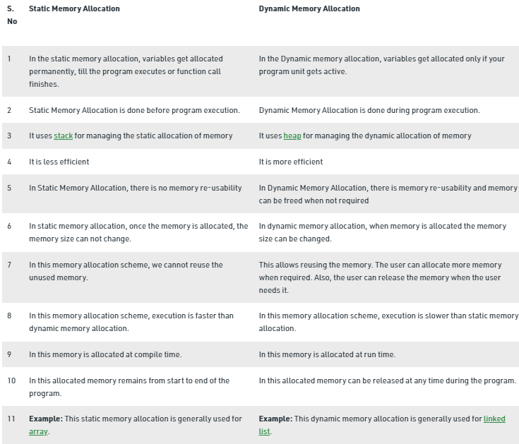
Static and Dynamic Memory allocation

Slide 48
Implementation aspects: Memory representation
The representation of particular data structure in the memory of a computer is called as storage structure. The storage structure representation in auxiliary memory is called as file structure. It is defined as the way of storing and manipulating data in organized form so that it can be used efficiently. Memory in a C/C++ program can either be allocated on stack or heap.
What is a Stack Memory?
A special area of computer's memory which stores temporary variables created by a function. It is a temporary storage memory.
In this , variables are declared, stored and initialized during runtime.
When the computing task is complete, the memory of the variable will be automatically erased. The stack section mostly contains methods, local variable, and reference variables.
What is a Heap Memory?
The heap is a memory used by programming languages to store global variables. By default, all global variable are stored in heap memory space. It supports Dynamic memory allocation.

Slide 49
KEY DIFFERENCE
STACK V/S HEAP MEMORY
Stack is a linear data structure whereas Heap is a hierarchical data structure.
Stack memory will never become fragmented whereas Heap memory can become fragmented as blocks of memory are first allocated and then freed.
Stack accesses local variables only while Heap allows you to access variables globally.
Stack variables can’t be resized whereas Heap variables can be resized.
Stack memory is allocated in a contiguous block whereas Heap memory is allocated in any random order.
Stack doesn’t require to de-allocate variables whereas in Heap de-allocation is needed.
Stack allocation and deallocation are done by compiler instructions whereas Heap allocation and deallocation is done by the programmer.

Slide 50
The Malloc( ) Function The malloc( ) function allocates a block of memory in bytes. The user should explicitly give the block size it requires of the use. The malloc( ) is like a request to the RAM of the system to allocate memory. Syntax:- malloc (number of elements * size of each element) ;
The Calloc( ) Function This function works exactly similar to malloc( ) function except for the fact that it needs two arguments as against one argument required by malloc( ).
Example:-int *ptr ; ptr = (int *) calloc (number of elements, size of each element);
Realloc( ) Function This function is used to resize the size of memory block, which is already allocated. It found use of in two situations :
If the allocated memory block is insufficient for current application.
If the allocated memory is much more than what is required by the current application.
Syntax:-ptr_var = realloc (ptr_var, new_size);
The Free( ) Function is used to de-allocate the previously allocated memory using malloc( ) or calloc( ) functions. Syntax:- free (ptr_var); // Where ptr_var is the pointer in which the address of the allocated memory block is assigned.

Slide 51
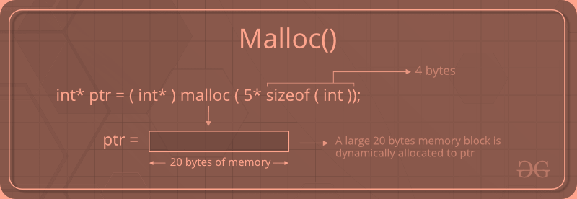
C malloc() method
The “malloc” or “memory allocation” method in C is used to dynamically allocate a single large block of memory with the specified size. It returns a pointer of type void which can be cast into a pointer of any form. It doesn’t Initialize memory at execution time so that it has initializes each block with the default garbage value initially.
Syntax:
ptr = (cast-type*) malloc(byte-size)

Slide 52
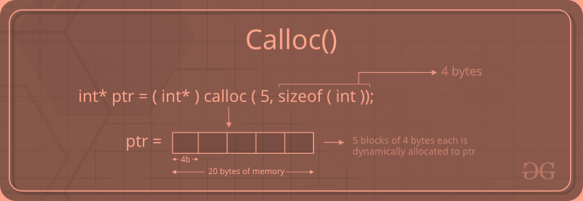
C calloc() method
“calloc” or “contiguous allocation” method in C is used to dynamically allocate the specified number of blocks of memory of the specified type. it is very much similar to malloc() but has two different points and these are:
It initializes each block with a default value ‘0’.
It has two parameters or arguments as compared to malloc().
Syntax:
ptr = (cast-type*)calloc(n, element-size); here, n is the no. of elements and element-size is the size of each element.

Slide 53
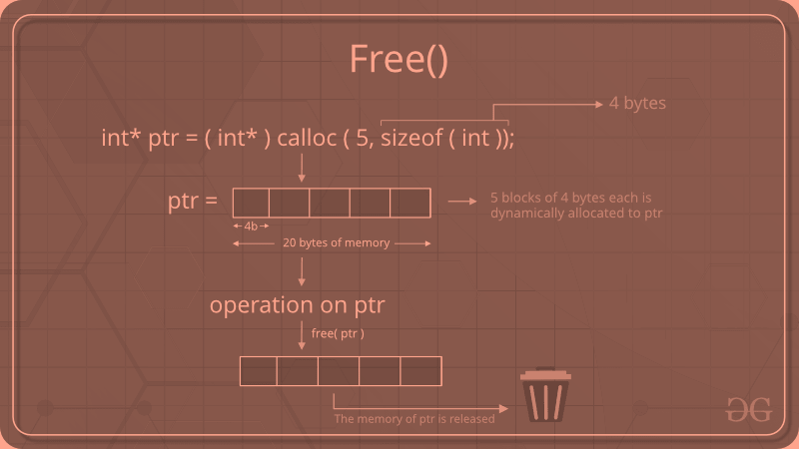
C free() method
“free” method in C is used to dynamically de-allocate the memory. The memory allocated using functions malloc() and calloc() is not de-allocated on their own. Hence the free() method is used, whenever the dynamic memory allocation takes place. It helps to reduce wastage of memory by freeing it.
Syntax:
free(ptr);

Slide 54
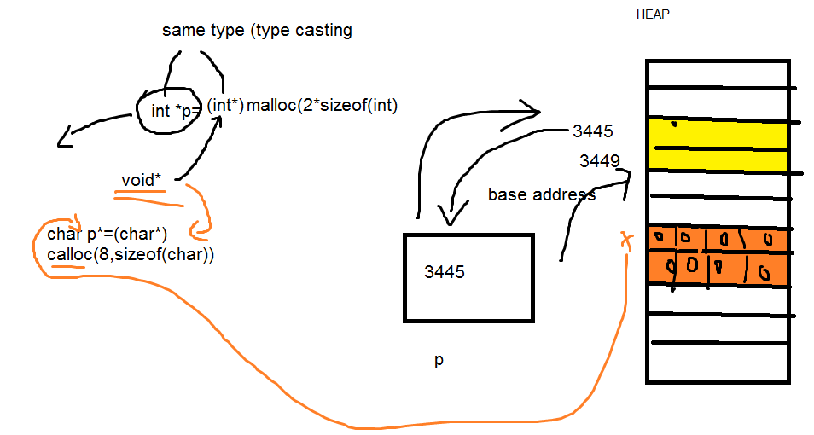
C free() method
“free” method in C is used to dynamically de-allocate the memory. The memory allocated using functions malloc() and calloc() is not de-allocated on their own. Hence the free() method is used, whenever the dynamic memory allocation takes place. It helps to reduce wastage of memory by freeing it.

Slide 55
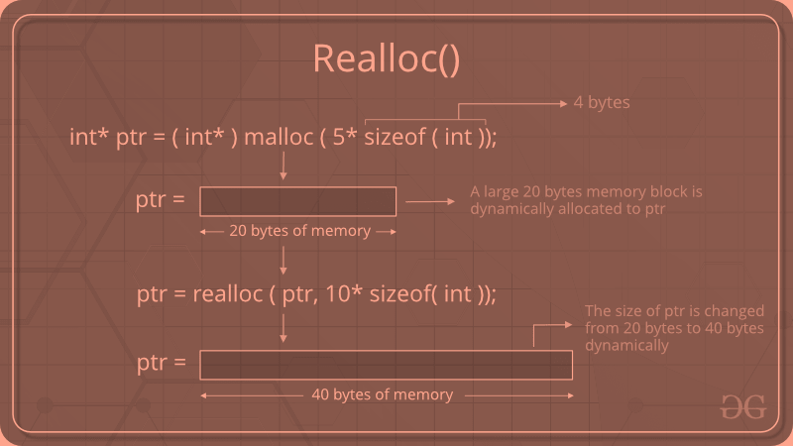
C realloc() method
“realloc” or “re-allocation” method in C is used to dynamically change the memory allocation of a previously allocated memory. In other words, if the memory previously allocated with the help of malloc or calloc is insufficient, realloc can be used to dynamically re-allocate memory. re-allocation of memory maintains the already present value and new blocks will be initialized with the default garbage value.
Syntax:
ptr = realloc(ptr, newSize); where ptr is reallocated with new size 'newSize'.

Slide 56
New Operator in C++
The new operator
The new operator requests for the memory allocation in heap. If the sufficient memory is available, it initializes the memory to the pointer variable and returns its address.
Syntax:
Here is the syntax of new operator in C++ language,
pointer_variable = new datatype;
Here is the syntax to initialize the memory,
pointer_variable = new datatype(value);
Here is the syntax to allocate a block of memory,
pointer_variable = new datatype[size];

Slide 57
New Operator in C++
In other programming languages such as Java and Python, the compiler automatically manages the memories allocated to variables. But this is not the case in C++.
In C++, we need to deallocate the dynamically allocated memory manually after we have no use for the variable.
We can allocate and then deallocate memory dynamically using the new and delete operators respectively.
Syntax:
Here is the syntax of delete operator in C++ language,
delete pointer_variable;
Here is the syntax to delete the block of allocated memory,
delete[ ] pointer_variable;

Slide 58
Cost estimation of Operations on Data Structures
A solution is said to be efficient if it solves the problem within the required resource constraints. Examples of resource constraints include the total space available to store the data—possibly divided into separate main memory and disk space constraints—and the time allowed to perform each subtask.
A solution is sometimes said to be efficient if it requires fewer resources than known alternatives, regardless of whether it meets any particular requirements. The cost of a solution is the amount of resources that the solution consumes. Most often, cost is measured in terms of one key resource such as time, with the implied assumption that the solution meets the other resource constraints.
There are costs and benefits associated with every data structure or algorithm. This is done by describing, for each data structure, the amount of space and time required for typical operations. For each algorithm, we will examine the time required for key input types.

Slide 59
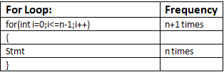
Cost estimation of Operations on Data Structures Step Count Method:
The step count method is one of the method to analyze the algorithm. In this method, we count number of times one instruction is executing
.
T(n)=O(n) (Considering degree)

Slide 60
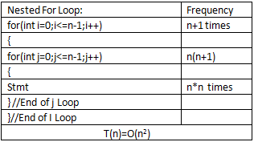
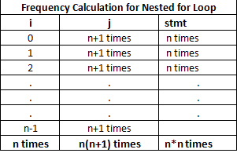
Cost estimation of Operations on Data Structures Step Count Method:

Slide 61
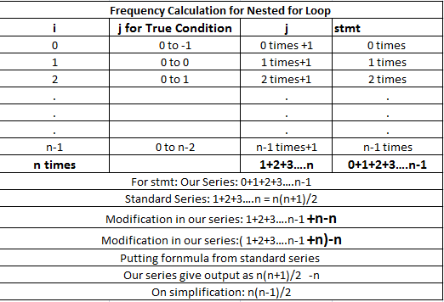
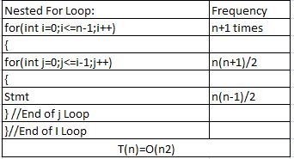
Cost estimation of Operations on Data Structures Step Count Method:

Slide 62
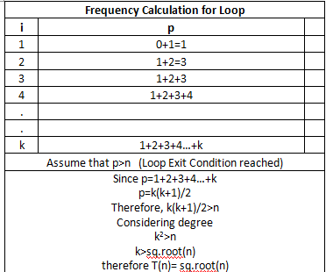
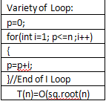
Cost estimation of Operations on Data Structures Step Count Method:

Slide 63
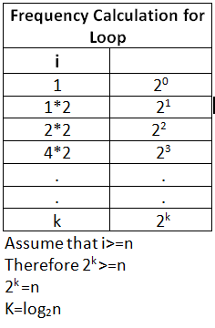
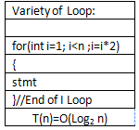
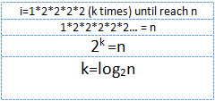
Cost estimation of Operations on Data Structures Step Count Method:

Slide 64
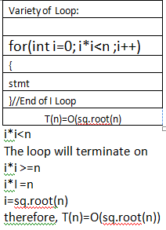
Cost estimation of Operations on Data Structures Step Count Method:

Slide 65
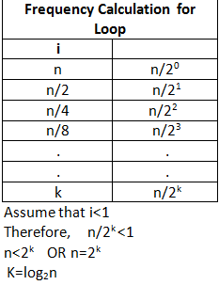
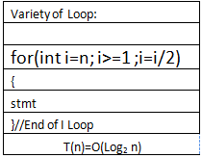
Cost estimation of Operations on Data Structures Step Count Method:

Slide 66
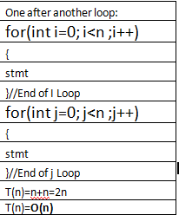
Cost estimation of Operations on Data Structures Step Count Method:

Slide 67
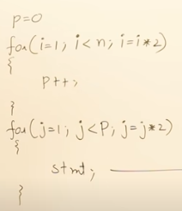
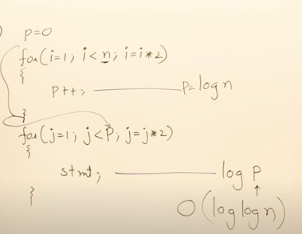
Cost estimation of Operations on Data Structures Step Count Method:

Slide 68
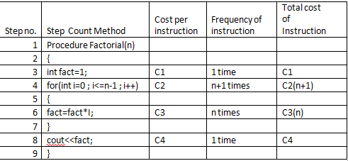
Cost estimation of Operations on Data Structures Step Count Method:
The step count method is one of the method to analyze the algorithm. In this method, we count number of times one instruction is executing.
T(n)= C1+C2(n+1)+C3(n)+C4
T(n)= C1+C2n+C2+C3n+C4
T(n)= C2n+C3n+C2+C1+C4
T(n)= n(C2+C3)+(C2+C1+C4)
T(n)= an+b
Linear equation
Therefore T(n)=O(n)

Slide 69
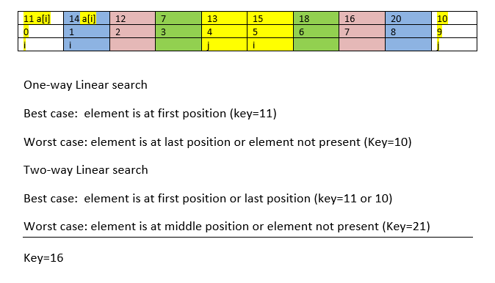
One way and two-way linear search

