Slide 1
Logic of Inference Project
Prof. Naresh Jotwani
Ujjaval Patel (201601234)
Divyesh Rajkotiya (201601111)
Vatsal Chandan (201601094)

Slide 2
N Queen Problem
The N Queen is the problem of placing N chess queens on an N×N chessboard so that no two queens attack each other. Thus, A solution requires that no two queens share same raw, column or diagonal.

Slide 3
Generalization
The N-Queen problem is basically generalization of 8x8 queen problem.
Where are 92 different arrangement for 8 queens is possible such that no queen can attack any other queen.
Using this concept the size of the board is varied to find different permutation for given size of chess board.

Slide 4
The Basic Approach is Backtracking
1) We can start from the leftmost column
2) Try all rows in the current column. Do following for every tried row.
a) If the queen can be placed safely in this row then mark this as part of the solution and recursively check if placing queen here leads to a solution.
b) If placing the queen in [row, column] leads to a solution then return True.
c) If placing queen doesn't lead to a solution then umark this [row, column] (Backtrack) and go to step (a) to try other rows.
3) If all rows have been tried and nothing worked, return false to trigger backtracking.

Slide 5
Branch And Bound Approach
1) In Backtracking we mark all rows , columns and diagonal we can’t be visited but in branch and bound approach we use a map which stores that on which rows and columns and diagonal we have placed Queen.
2) Now to check if this row or column is valid we check our map if that particular row or column or diagonal is there already so it is invalid.
3) Apart from this , It is most like backtracking.

Slide 6
Heuristic search Approach
In a general sense, the term heuristic is used for any advice that is often effective, but is not guaranteed to work in every case. Within the heuristic search architecture, however, the term heuristic usually refers to the special case of a heuristic cost function.
For this problem we take this cost function as number of conflicts happen due to position of queens.
cost=0;
For every column,row and diagonal
cost=cost + n*(n-½);
Where n= number of queens on particular row,column or diagonal.
For this problem first we initialize board using cost function which makes minimum conflicts. Now if the cost of the board is zero then we got solution otherwise
we find the queen with maximum conflicts and remove it and find the place in that raw where conflicts is minimum and we put it there.
Now if cost is zero then we got solution otherwise we repeat step 1.

Slide 7
Analysis
In Backtracking we are exploring each and every possibility of the solution. In backtracking solution we backtrack when we hit a dead end. Now here after we place a queen we update 2D matrix to see which rows and columns are under attack. In backtracking we make a branch our row or say column reduced by one.
T(n) = n * T (n-1)
T(n-1) = n * (n-1) * T(n-2)
From this we can see
T(n) = n * (n-1) * (n-2) * ……* 1
T(n) = n!
Here we can see that it is n! Which is exponential, for big inputs like 50 it can be beyond our computer’s limitation.

Slide 8
Now because of the limitations of Backtracking we can use branch and bound approach which is most like optimized version of backtracking.
In branch and bound we optimized time to mark all attacked columns and rows and diagonals. There we used 2D matrix to mark but in this approach we use map for rows, columns and diagonals. If we want to check if any cell is valid or not we simply see to map to check it is valid or not.
In Branch and Bound we optimized solution from N^2 to N for marking invalid row, column and diagonal. So our this solution is still near to N! But it is more optimized than of simple backtracking.
And to find all valid solutions we use this approach.
Now we will talk about heuristic approach.This approach can not solve all solutions like backtracking algorithm does.
In this first we initializing the board with cost function which runs in N^2 time. After that we found the queen with maximum conflicts and try to replace that queen with place which have the minimum conflicts. We do this procedure untill conflicts become 0 so here our time complexity is not fixed because we are using random function for position. But we can generalize our complexity with
O(n*n + C*(3*n)) = C*n , where C is number of steps to find 0 conflicts and n is number of queens.

Slide 9
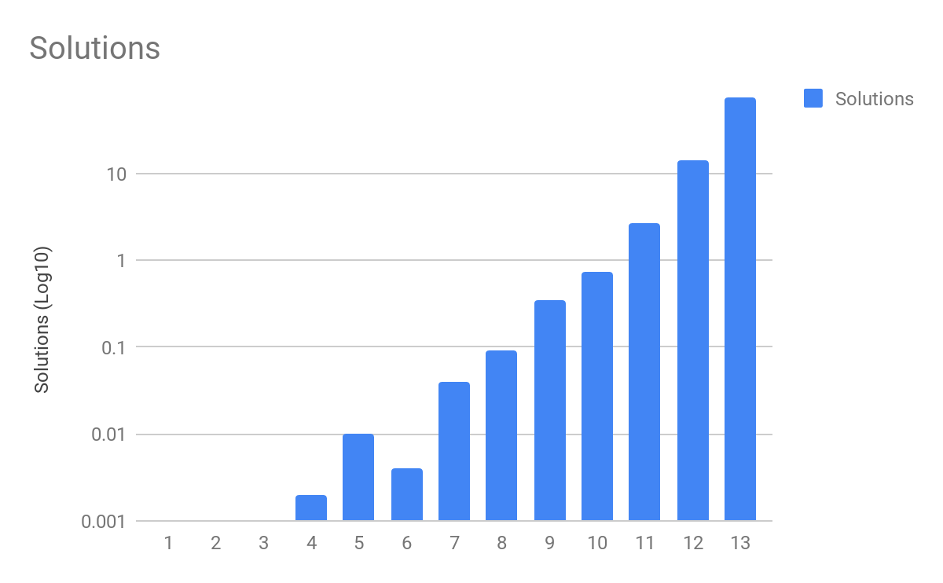
Analysis of number of solution for N-queen problem

Slide 10
References
https://ieeexplore.ieee.org/document/5383157/
https://github.com/lemmingapex
https://codepen.io/s3408985/pen/EWKwJr
http://crystal.uta.edu/~kumar/CSE5311_10FLDAA/CSE5311M_BT_BB.pdf

Slide 11
Thank You.

