Slide 1

SMART INDIA HACKATHON 2026
Pawlytics
Human–street dog conflict intelligence
Problem Statement ID
26206
Problem Statement Title
Student/Open Innovation
Theme
Disaster Management
PS Category
Software
Team ID
____________________________
Team Name (Registered on portal)
Team Pawlytics
Notes:
Official title: Student/Open Innovation. Theme: disaster management. Registered team name: Team Pawlytics. These fields supplied by the user. Team ID deliberately blank per user request. PS ID 26206 retained from original project deck. Software category reflects the web application. Original SIH template artwork and title retained.

Slide 2
IDEA TITLE
Team
Pawlytics
A sighting should change the next walk
Proposed solution
Report
Check
Map
Navigate
Photo, place, time
and voice input
Metadata + Gemini
with human review
Active sightings
and 250 m zones
Route comparison
Google Maps handoff
How it addresses the problem
Innovation and uniqueness
Makes recent sightings usable before a walk.
Connects local awareness with nearby animal
and rabies-care searches.
Checks the evidence behind each report.
Ranks routes by exposure to active sightings.
Keeps report status and reasons traceable.
Designed for precaution and informed choices. No route carries a safety guarantee.
Notes:
Verified project: https://github.com/UjjvxL/new_pawlytics. Sources: README.md; src/App.tsx groupHotspots and routeRisk; functions/src/index.ts verification pipeline; functions/src/report-policy.ts. Voice uses browser Web Speech. Location/capture metadata is checked with Gemini image/report analysis. Eligible AI cases can publish provisionally; uncertain cases require human review. 250 m zones are design heuristics, not validated attack-probability estimates. Innovation is a design contribution, not a patent novelty claim.

Slide 3
TECHNICAL APPROACH
Team
Pawlytics
Evidence in. A moderated safety signal out.
01 Capture
02 Private evidence
03 Server checks
React + TypeScript + Vite
Google login, photo and voice
Cloud Storage: original images
Firestore: reports and metadata
Cloud Functions
Metadata and duplicate checks
06 Map + routing
05 Moderation
04 Gemini analysis
Live Firestore public sightings
Google Maps route comparison
Provisional publish, human
review or reject / expiry
Dog count and scene evidence
Model fallbacks, server-held key
Technologies
Firebase Hosting + Auth + Firestore + Storage + Functions / Google Maps / Gemini
Notes:
Architecture grounded in https://github.com/UjjvxL/new_pawlytics README, src/firebase.ts, src/App.tsx, functions/src/index.ts and report-policy.ts. Figure is a logical processing sequence, not a claim of a single synchronous request. Firebase callable functions enforce upload/report stages, queue/trigger processing, Gemini response triage, provisional publicSightings and human review. Routing reads active public sightings. Source evidence remains private under Firestore/Storage rules. The Gemini key is server-side. All six boxes and connecting arrows remain editable in PowerPoint.

Slide 4
FEASIBILITY AND VIABILITY
Team
Pawlytics
A working prototype with clear pilot gates
Feasibility of the idea
Built: Google login, photo uploads, server verification, live sightings and route ranking.
Pilot: validate the evidence checks and route choices with local field partners.
Potential challenges and risks
Strategies for overcoming them
Weak, missing or misleading photo evidence
Metadata checks and uncertain-case human review.
Stale sightings and incomplete coverage
Expiry, reporter trust and visible report status.
API cost, quotas and service interruptions
Rate limits, model fallback and stalled-job recovery.
Before public rollout: field validation, response ownership and production-hardening gates.
Notes:
Implemented capabilities from https://github.com/UjjvxL/new_pawlytics README and functions/src/index.ts. Risk controls include triageReport, review cases, report expiry, rate limiting, duplicate detection, model fallback and recoverStalledReports. External controls and release requirements remain in docs/PRODUCTION_HARDENING.md. No deployment cost, outcome improvement, field accuracy or production-readiness certification is asserted. Pilot gates are proposed.

Slide 5
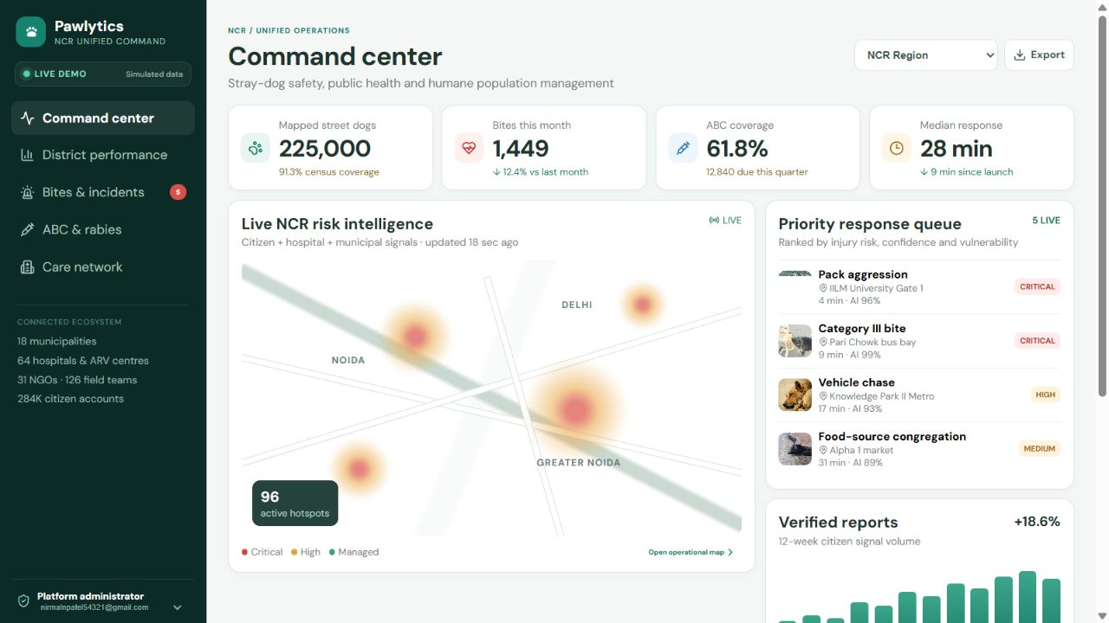
IMPACT AND BENEFITS
Team
Pawlytics
One view for coordinated local response
Citizens
Earlier awareness.
A clearer path to care.
Municipal teams
Shared priorities and
traceable follow-up.
Animal welfare
Evidence to guide humane
care and field response.
NCR command-centre concept uses simulated data. Social and operational benefits require pilot evaluation.
Notes:
Screenshot from https://pawlytics-506516.web.app/demo/authority, captured during this session. Source: src/DemoAuthorityPortal.tsx and src/demoAuthorityData.ts. All displayed scale figures, percentages, AI confidence labels, activity, coverage and response times are simulated, not government data or measured product performance. Target benefits: awareness/access to care for citizens, better coordination for authorities and humane response for animal welfare. Suggested pilot measures: verification turnaround, route-ranking error, data coverage and response closure.

Slide 6
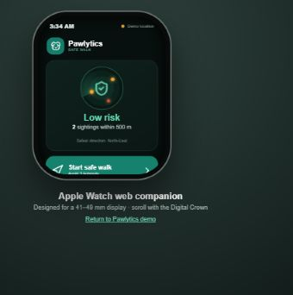
RESEARCH AND REFERENCES
Team
Pawlytics
Product and source code
pawlytics-506516.web.app
github.com/UjjvxL/new_pawlytics
Research and references
1 PIB / NCDC: reported dog-bite burden, 2024
37,17,336 dog-bite cases and 54 reported suspected rabies deaths.
PIB, 22 July 2025. Reported totals do not measure the full burden.
2 Geospatial dog-bite analysis in India, 2018–2023
Janekunte et al., 2025. Spatial-analysis precedent.
This research does not validate Pawlytics route scores.
Watch companion
Browser concept demo
Simulated safety indicators
3 Implementation: app, functions and report policy
Notes:
Correct project and user-specified links: https://github.com/UjjvxL/new_pawlytics ; https://pawlytics-506516.web.app/. Research sources: https://www.pib.gov.in/PressReleasePage.aspx?PRID=2146821 ; https://pmc.ncbi.nlm.nih.gov/articles/PMC12533994/. Watch screenshot: https://pawlytics-506516.web.app/demo/watch ; source src/WatchDemo.tsx. This is a web UI concept with simulated risk values and interactions, not an independently shipped native watch application or live verified warning system. Original SIH template preserved. All six required sections fit six slides. Team ID intentionally blank.

