Slide 1


SMART INDIA HACKATHON 2026
Pawlytics
Human–street dog conflict intelligence
Ward-level risk awareness for citizens.
Evidence for municipal action.
Problem Statement 26206
Notes:
Project identity and problem statement number retained from the supplied pitch deck. Product context: https://github.com/UjjvxL/Pawlytics.

Slide 2
PAWLYTICS
The public safety problem
National reports show the scale. Local teams need a usable picture of risk.
37.17 lakh
54
Reported dog-bite cases in India, 2024
Reported suspected human
rabies deaths, 2024
The operational gap
Complaints and incident records need verification, location context and follow-up before they can guide ward-level action.
PIB, 22 July 2025. Exact dog-bite count: 37,17,336. Reported figures are not estimates of the full burden.
02
Notes:
Source: https://www.pib.gov.in/PressReleasePage.aspx?PRID=2146821. NCDC/NRCP figures for 2024: 3,717,336 dog-bite cases and 54 reported suspected human rabies deaths. This replaces the original 37.15 lakh with the figure in the cited PIB release. The operational gap is the project problem framing, not a measured finding.

Slide 3
PAWLYTICS
Where Pawlytics fits
An intelligence layer that supports existing animal welfare and civic response work.
Existing response
Information needed for action
Sterilization and vaccination
Where should teams prioritize coverage?
Shelter and veterinary capacity
Which incidents need a field response?
Municipal complaints and drives
Who verified the report and what happened next?
Pawlytics connects verified reports to local priorities and an action history.
03
Notes:
Framing adapted from slides 3–4 of the supplied deck. Pawlytics is presented as complementary decision support. Existing intervention context: https://www.pib.gov.in/PressReleasePage.aspx?PRID=2146821. No claim of proven reductions in conflict, legal compliance certification, or replacement of professional response.

Slide 4
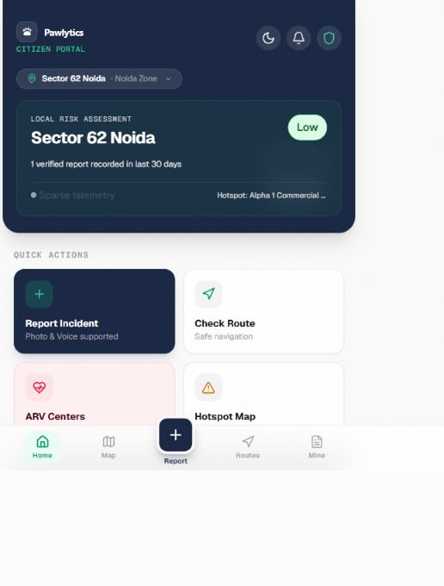
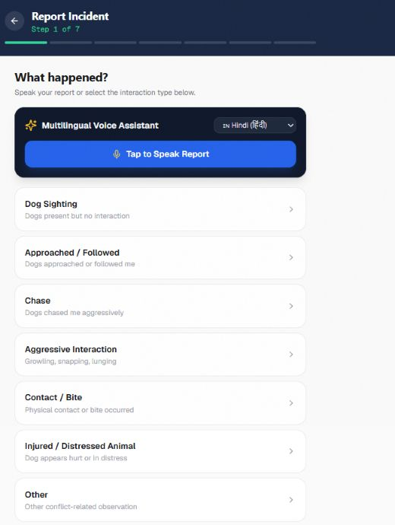
PAWLYTICS
Citizen experience
Local risk context and structured reporting in a mobile web app.
Know before you go
See the current risk label and the amount of verified evidence behind it.
Report what happened
Choose an incident category or start with the voice reporting interface.
Live app screenshots. Synthetic demo data, not government records.
04
Notes:
Screenshots captured from https://pawlytics-one.vercel.app/ and https://pawlytics-one.vercel.app/report on 6 September 2026. Cropped to the application content. The citizen page explicitly labels its records synthetic demo/pilot data. Screens illustrate the UI only and do not establish real deployment, validated safety, or measured accuracy.

Slide 5
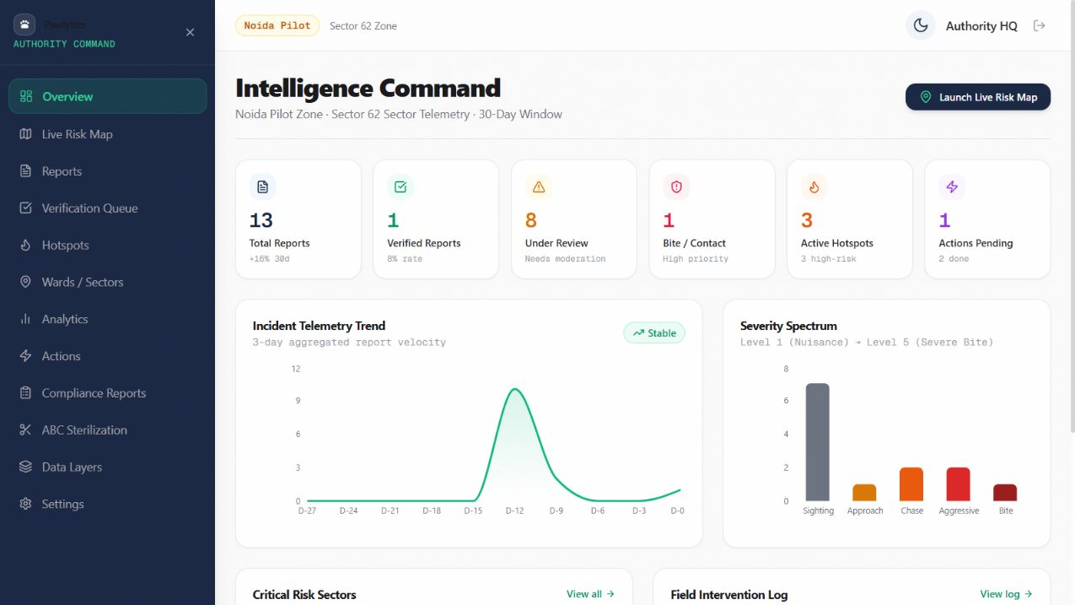
PAWLYTICS
Municipal authority workspace
A shared view of reports, review workload and intervention activity.
Review
Triage reports in the verification queue.
Prioritize
Compare sectors and track hotspots.
Follow up
Record actions and export summaries.
05
Live demo UI. Counts and trends shown are synthetic.
Notes:
Screenshot captured from https://pawlytics-one.vercel.app/authority on 6 September 2026. Synthetic pilot demonstration, not real government records or traction metrics. Feature scope: https://github.com/UjjvxL/Pawlytics README.

Slide 6
PAWLYTICS
System architecture
Current repository stack and the flow between the application layers.
Citizen PWA
React application
Supabase
Reports and risk views
React Router, TanStack Query
Vite and Tailwind CSS
PostgreSQL, Auth and RLS
Authority portal
Risk + spatial layer
Operational records
Verification and actions
JavaScript risk engine
Leaflet and OpenStreetMap
Reports, verifications, wards,
hotspots, alerts and actions
Role-based access and row-level security protect the data layer. Scores support human decisions.
06
Notes:
Architecture summarized from local README.md, src/api/services and src/lib/riskEngine.js. Public repository: https://github.com/UjjvxL/Pawlytics. React 18, Vite 6, Tailwind 3.4, React Router, TanStack Query, Supabase PostgreSQL/Auth/RLS, Leaflet/OpenStreetMap. This describes the repository architecture, not a production security audit. FastAPI, PostGIS and YOLO are not represented as the current core stack because the supplied source did not establish them as current dependencies. All diagram nodes and connectors are native editable PowerPoint objects.

Slide 7
PAWLYTICS
Report-to-action flow
Verification and confidence make the risk score explainable.
Report
Verify
Score
Inform
Act
Location, time
and incident type
Authority reviews
the evidence
Weight verified
recent reports
Risk views
and alerts
Field response
and follow-up
Risk calculation
Confidence stays visible
Severity, age, trust and local context contribute to the score. Older incidents lose weight over time.
The verified report count indicates evidence strength. No reports means unknown risk.
Decision support only. The score does not predict an individual dog’s behaviour or guarantee route safety.
07
Notes:
Source: local src/lib/riskEngine.js. Recent non-expired 30-day reports, verified/assigned/resolved statuses or verified flag, excluding CV-rejected reports. Severity is multiplied by age, state, trust, confirmations, dog count and context weights. Age half-life is 14 days. A saturating curve maps exposure to 0–100. Confidence uses verified count. Product flow includes human verification and follow-up. https://github.com/UjjvxL/Pawlytics

Slide 8
PAWLYTICS
Pilot plan and scale-up
Proposed milestones. Progress depends on field evidence and municipal participation.
One ward
3–6 months
12+ months
Proposed seed target:
150–250 ground-truth reports
Trust calibration and
multi-ward validation
Authorized data feeds and
forecasting research
Pilot success measures
Conditions for expansion
Verification turnaround
Report location quality
Action closure time
Named field verification partners
Reliable ward coverage
Data-sharing agreements
The first pilot should establish a baseline before claiming a reduction in incidents.
08
Notes:
Proposed 150–250 ground-truth report seed target and 3–6/12+ month horizons adapted from the supplied deck. These are plans, not achievements or committed launch dates. Metrics and expansion gates are proposed evaluation criteria. Forecasting requires sufficient longitudinal data and validation.

Slide 9
PAWLYTICS
Explore Pawlytics
Live product, source code and the evidence behind this pitch.
LIVE WEB APP
pawlytics-one.vercel.app
GITHUB REPOSITORY
github.com/UjjvxL/Pawlytics
Authority dashboard
Evidence and implementation
PIB: 2024 reported dog-bite and suspected rabies figures
Architecture: repository README and riskEngine.js. UI images: live app, 6 September 2026.
09
Notes:
Verified public repository: https://github.com/UjjvxL/Pawlytics. Its About section links to https://pawlytics-one.vercel.app/. Live citizen, report and authority pages opened successfully on 6 September 2026. All displayed links are clickable PowerPoint hyperlinks. Evidence: https://www.pib.gov.in/PressReleasePage.aspx?PRID=2146821. Original reference deck supplied by the user: Pawlytics_SIH2026_Judge_Pitch_Deck.pptx.

