Slide 1

SMART INDIA HACKATHON 2026
Pawlytics
Human–street dog conflict intelligence
Problem Statement ID
26206
Problem Statement Title
Student/Open Innovation
Theme
Disaster Management
PS Category
Software
Team ID
____________________________
Team Name (Registered on portal)
Team Pawlytics
Notes:
Official title: Student/Open Innovation. Theme: disaster management. Registered team name: Team Pawlytics. These fields supplied by the user. Team ID deliberately blank per user request. PS ID 26206 retained from original project deck. Software category reflects the web application. Original SIH template artwork and title retained.

Slide 2
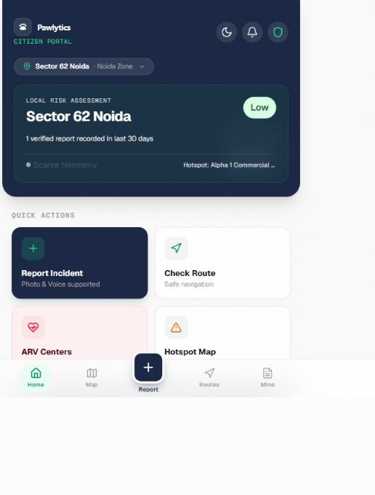
IDEA TITLE
Team
Pawlytics
Pawlytics: ward-level conflict intelligence
Proposed solution
Citizen reports capture incident type, location and time.
Authorities verify evidence and track field actions.
How it addresses the problem
Recent, verified reports inform local risk views and route
caution. Ward dashboards support response priorities.
Innovation and uniqueness
An explainable score combines severity, age and trust.
Evidence confidence stays visible. Actions close the loop.
Citizen portal: synthetic demo data
Notes:
Solution and implementation evidence: https://github.com/UjjvxL/Pawlytics and local src/lib/riskEngine.js. Screenshot from https://pawlytics-one.vercel.app/ captured 6 September 2026 and cropped to application content. Synthetic demo data. Innovation describes the product design contribution, not a claim of patent novelty or validated predictive accuracy. Risk views are decision support and do not guarantee route safety.

Slide 3
TECHNICAL APPROACH
Team
Pawlytics
Technologies and system architecture
Citizen PWA
React application
Supabase
Incident reports and risk views
Vite, Tailwind, React Router
and TanStack Query
PostgreSQL, Auth and
row-level security
Authority portal
Risk + spatial layer
Operational data
Verification, actions and exports
JavaScript scoring engine
Leaflet and OpenStreetMap
Reports, wards, verifications,
hotspots, alerts and actions
Methodology and implementation process
Report
Verify
Score
Inform
Act
Recent verified evidence drives the score. Human teams decide the response.
Notes:
Architecture: https://github.com/UjjvxL/Pawlytics README and local src/api/services and src/lib/riskEngine.js. All diagram nodes and connectors are native editable PowerPoint objects. No FastAPI, YOLO or PostGIS implementation is asserted. Arrows show exchange/data processing, with arrowheads at target ends. Severity, age, state, trust and context weight risk. Scores are decision-support indicators, not individual-animal behaviour predictions.

Slide 4
FEASIBILITY AND VIABILITY
Team
Pawlytics
Feasibility of the idea
Existing web prototype and managed database support a focused one-ward pilot.
Proposed seed target: 150–250 ground-truth reports with a field verification partner.
Potential challenges and risks
Strategies to overcome them
Sparse or uneven reporting
Seed one ward and show evidence confidence.
False, duplicate or low-quality reports
Human review, trust weighting and audit history.
Privacy and limited field capacity
Role-based access, RLS and a named response team.
One ward
3–6 months
12+ months
Validate data and response
Calibrate across wards
Study feeds and forecasting
Notes:
Feasibility based on the repository and observed live prototype. 150–250 reports and roadmap horizons adapted from the supplied deck and remain proposed targets. Mitigations include both existing mechanisms and planned pilot operations, not guarantees. Forecasting depends on longitudinal data, consent/authorization and validation. https://github.com/UjjvxL/Pawlytics

Slide 5
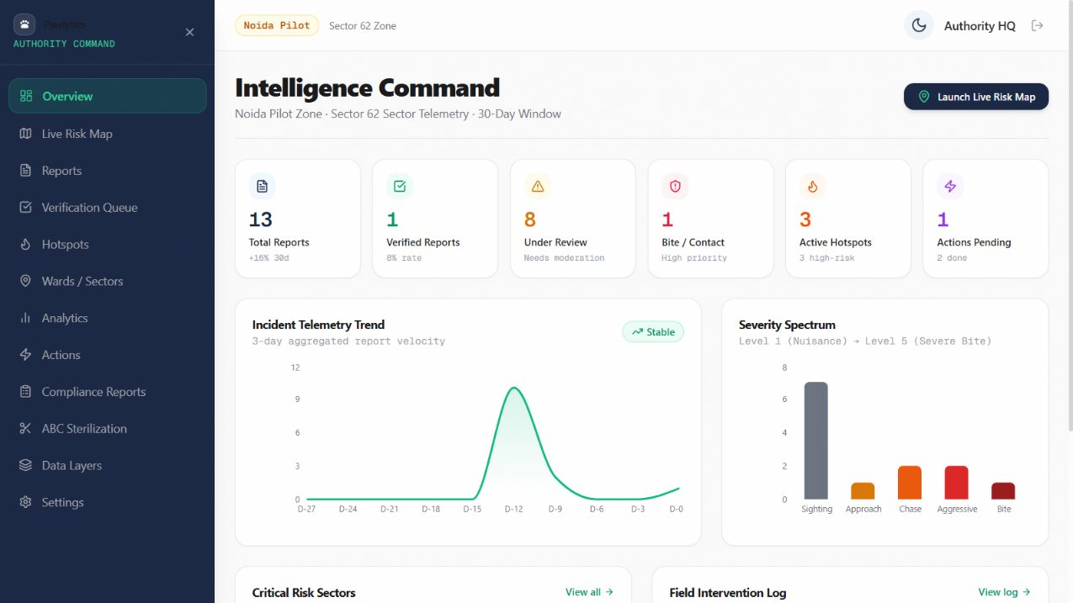
IMPACT AND BENEFITS
Team
Pawlytics
Potential impact on the target audience
Social: citizens
Local risk awareness and a
clear reporting channel.
Economic: municipal teams
Prioritized review and fewer
disconnected work records.
Welfare and environment
Evidence for ABC campaigns
and waste-site follow-up.
Pilot measures: verification turnaround, action closure time and report location quality.
Screenshot uses synthetic demo data. Benefits are expected outcomes to test in the pilot.
Notes:
Screenshot: https://pawlytics-one.vercel.app/authority, captured 6 September 2026. Synthetic data and demonstration counts, not proven outcomes. Potential benefits respond to SIH target-audience/social/economic/environmental pointers. Pilot metrics are proposed, with no numeric reduction or cost-saving claim.

Slide 6
RESEARCH AND REFERENCES
Team
Pawlytics
Working prototype and source code
Live app: pawlytics-one.vercel.app
GitHub: github.com/UjjvxL/Pawlytics
Research and references
1. PIB / NCDC: dog-bite and suspected rabies reports, 2024
37,17,336 reported dog-bite cases and 54 reported suspected human rabies deaths.
PIB, 22 July 2025. Reported figures do not estimate the full burden.
2. State-wise geospatial analysis of dog bite burden in India, 2018–2023
Janekunte et al., 2025. QGIS study supports a spatial analysis approach.
It does not validate Pawlytics or its ward-level risk score.
3. Implementation reference: README and explainable risk engine
Live UI captures: 6 September 2026. Technical details and source code are available through GitHub.
Notes:
Sources: https://www.pib.gov.in/PressReleasePage.aspx?PRID=2146821 ; https://pmc.ncbi.nlm.nih.gov/articles/PMC12533994/ ; https://github.com/UjjvxL/Pawlytics ; https://pawlytics-one.vercel.app/. All visible links are clickable. Statistics use the cited July 2025 PIB release. Research is cited as methodological precedent only. Template retained from the user-provided SIH2026-IDEA-Presentation-Format (1).pptx. Six slides, including cover; instructional seventh slide omitted for submission format.

