Slide 1
INTERNSHIP PROJECT DEFENSE // 2026
Smart Ship Engine Room
Safety & Vitals Monitoring System
An automated hardware sentinel that constantly checks temperature, fuel gas leaks, and machinery distance to stop ship engine fires before they happen.
THE BRAIN
STM32 Black Pill
A fast 32-bit chip running custom C code that never freezes
THE SENSES
3 Critical Sensors
Watches heat levels, sniffs gas leaks, and measures distance
THE REFLEXES
Instant Alarms
Reacts in milliseconds with lights, buzzer, and OLED alerts
THE WINDOW
Live PC Dashboard
Streams live rolling graphs to a laptop screen and logs to Excel
DEVELOPER: Ujjval | REPO: github.com/UjjvxL/Ship-Engine-Room-Safety-Monitor- | INTERNSHIP PROJECT DEFENSE

Slide 2
PROJECT WALKTHROUGH // THE REAL PROBLEM
SLIDE 02 / 14
Why Do Ships Urgently Need This?
01 / A HARSH ENVIRONMENT
02 / DISASTER HAPPENS FAST
03 / OUR SIMPLE GOAL
Too Dangerous for People
▹ Ship engine rooms are boiling hot, deafeningly loud, and cramped.
▹ Humans cannot stand inside 24 hours a day watching every pipe.
▹ Crew members only inspect once every few hours—leaving long blind spots.
▹ International maritime safety rules (SOLAS) require automated warnings.
30 Seconds Can Sink A Ship
▹ A tiny diesel spray hitting a hot pipe can cause a fire in seconds.
▹ Overheating bearings can seize and leave a ship stranded in rough storms.
▹ Toxic fuel fumes can knock out crew members without warning.
▹ Waiting for smoke to drift up to the bridge is already too late.
A Tireless Digital Guard
▹ Build a small, affordable device that sits right on the engine block.
▹ Continuously watches heat, gas fumes, and distance 24/7.
▹ Sounds immediate loud sirens on the spot without relying on computers.
▹ Streams live numbers to the bridge laptop so officers stay informed.

Slide 3
PROJECT WALKTHROUGH // WHAT IT MONITORS
SLIDE 03 / 14
The 3 Critical Dangers We Watch For
DANGER 1: FUEL GAS & SMOKE LEAKS
OUR STRICT SAFETY RULES
SENSOR: MQ GAS DETECTOR
Sniffs out volatile diesel fumes, exhaust leaks, or burning wire insulation before open flames erupt. Triggers an alert instantly to stop bilge explosions.
01. Works Standalone
The box works completely on its own—even if the laptop disconnects or crashes.
02. Never Freezes
Sensor reads never make the code pause or sleep; safety checks happen every microsecond.
03. Impossible to Miss
Bright colored lights + loud beeping horn + glowing OLED screen cut through loud engine noise.
04. Simple PC Link
Sends easy-to-read text messages to laptops and ship bridge systems.
DANGER 2: ENGINE OVERHEATING
SENSOR: DS18B20 DIGITAL PROBE
Touches engine metal and coolant loops to read temperatures down to 0.1°C precision. Triggers an alert the moment heat crosses 45.0°C.
DANGER 3: MACHINERY CLEARANCE
SENSOR: HC-SR04 SONAR
Shoots sound waves like a bat to verify machinery isn't vibrating loose, and warns if someone gets dangerously close to spinning shafts.

Slide 4
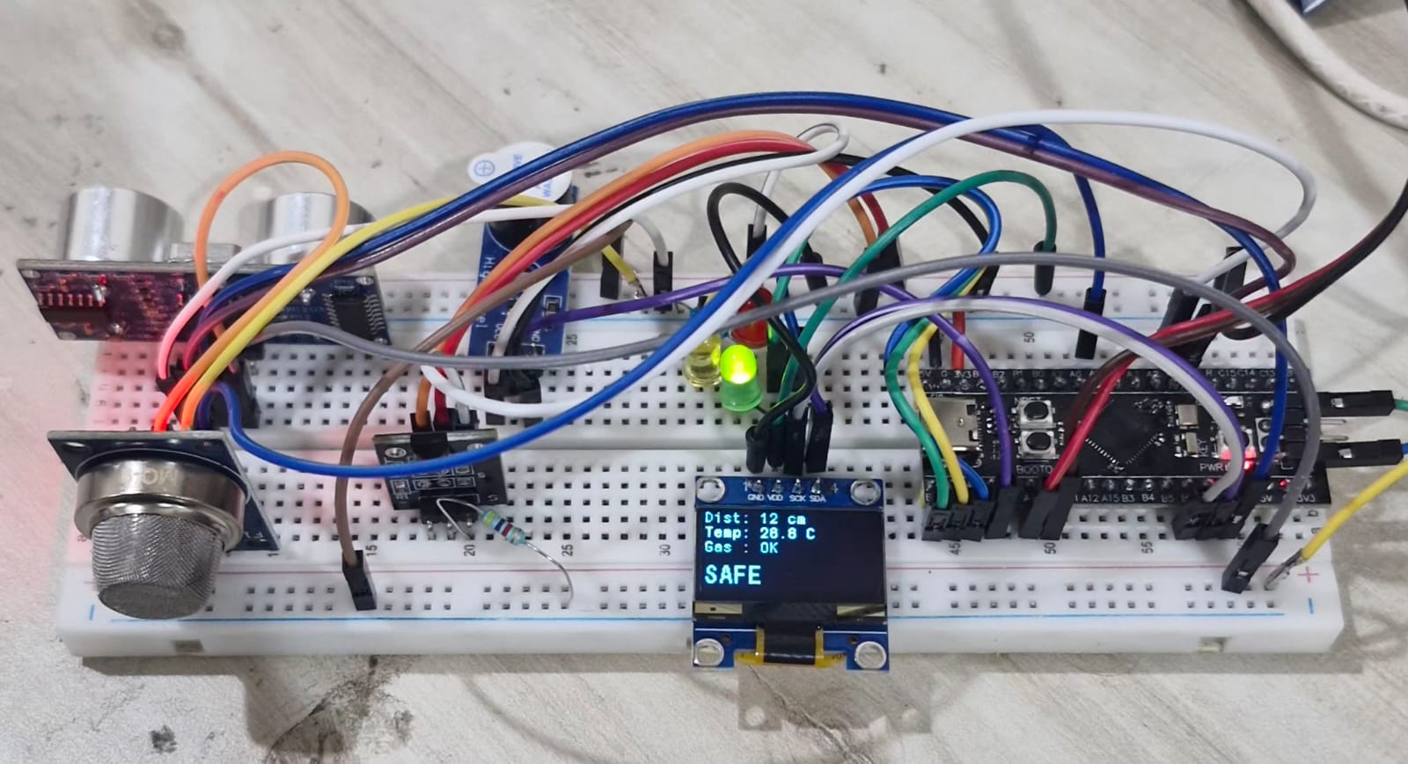
PROJECT WALKTHROUGH // HARDWARE SETUP
SLIDE 04 / 14
The Hardware Pieces (How It Looks)
OUR ASSEMBLED BENCH PROTOTYPE
SIMPLE PARTS BREAKDOWN
THE BRAIN CHIP • STM32 Black Pill
A fast 32-bit ARM mini-computer that reads all sensors and runs our C code.
DISTANCE SENSOR • Ultrasonic HC-SR04
Shoots sound pulses to measure distance from 2cm up to 4 meters away.
TEMPERATURE SENSOR • DS18B20 Digital Probe
Stainless steel probe placed on hot engine metal. Accurate to 0.1°C.
GAS SENSOR • MQ Gas Comparator
Sniffs out volatile diesel fumes or wire smoke in the surrounding air.
MINI SCREEN • SSD1306 OLED Display
A bright mini-screen showing distance, temp, and mode right on the box.
LIGHTS & SIREN • 3 LEDs + Piezo Buzzer
Green (Safe), Yellow (Hazard), Red (Emergency), plus loud beeping horn.

Slide 5
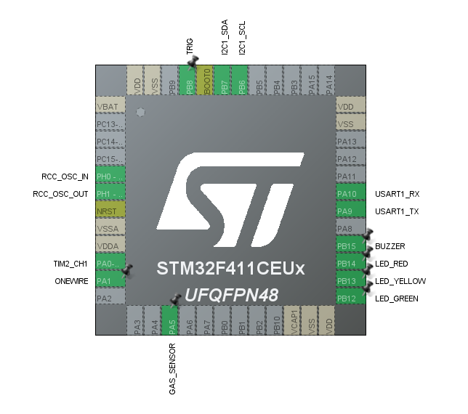
PROJECT WALKTHROUGH // HARDWARE WIRING
SLIDE 05 / 14
Clean Wiring & Connections (The Blueprint)
STM32 CHIP WIRING MAP
DEDICATED SIGNAL HIGHWAYS
HOW SIGNALS TRAVEL WITHOUT TRAFFIC JAMS
▹ Main Clock Speed: Tuned to 96 MHz (96 million ticks every second).
▹ No Traffic Jams: Every sensor gets its own dedicated pin.
▹ Automatic Counting: Hardware timer counts sound echoes in the background.
▹ Protected Power: Clean 3.3V / 5V rails for reliable sensor readings.
PIN CONNECTIONS EXPLAINED SIMPLY
PA1 -> Temp Wire (Talks to DS18B20 temperature sensor)
PA5 -> Gas Wire (Reads gas detector (goes LOW on fume leak))
PA9/10 -> Serial Cable (Sends live numbers to the PC laptop)
PB6/7 -> Screen Wires (Sends drawings to the OLED screen)
PB8 -> Trigger Wire (Tells ultrasonic sensor to shoot sound pulse)
TIM2 -> Echo Timer (Automatically counts how long sound takes to return)
PB12–15 -> Alert Wires (Switches on Green/Yellow/Red lights and Buzzer)

Slide 6
PROJECT WALKTHROUGH // FIRMWARE LOGIC
SLIDE 06 / 14
The Secret Sauce: Code That Never Freezes!
TASK 1: MEASURE DISTANCE
TASK 2: READ TEMPERATURE
RUNS 10 TIMES A SECOND (EVERY 100MS)
▹ Fires a 10-microsecond sound pulse every 100ms.
▹ The chip's internal timer catches the echo return on its own.
▹ The main processor never wastes time waiting for sound to bounce back.
NON-BLOCKING 750MS CYCLE
▹ The temperature sensor takes 0.75 seconds to convert heat into a number.
▹ Our code tells it to start converting, then immediately walks away to do other work!
▹ It checks the clock and picks up the answer 750ms later—zero time wasted.
TASK 3: CHECK FOR DANGER
TASK 4: UPDATE SCREEN & PC
RUNS EVERY 10 MICROSECONDS
▹ Instantly checks if gas is leaking or temperature crossed 45°C.
▹ Switches the Green, Yellow, or Red LED lights right away.
▹ Controls the buzzer: silent in Safe, slow beeps in Hazard, rapid siren in Emergency.
BATCHED 4 TIMES A SECOND (EVERY 250MS)
▹ Draws clean numbers onto the OLED mini-screen.
▹ Sends formatted text line to laptop: [DIST:x|TEMP:x|GAS:x|MODE:x].
▹ Batching keeps the screen smooth without hogging the processor.
THE CHEF ANALOGY: Like a chef cooking 4 dishes at once, the code checks timers and never stands still.

Slide 7
PROJECT WALKTHROUGH // CLEVER SOLUTIONS
SLIDE 07 / 14
3 Smart Coding Tricks We Implemented
TRICK 1: HARDWARE TIMER ECHO
TRICK 2: MICROSECOND TIMING
TRICK 3: BATCHED 4 Hz UPDATES
ZERO CPU WAIT TIME
▹ The Problem: Standard code uses busy-wait loops while waiting for sound echoes, freezing the chip for up to 30ms.
▹ Our Solution: Configured the STM32 timer hardware to catch the echo rising and falling edges automatically.
▹ Result: 0% CPU load during sound transit. The chip is free to do other safety checks.
USING THE INTERNAL CYCLE COUNTER
▹ The Problem: The temperature sensor needs exact microsecond pulses, but normal code only counts milliseconds.
▹ Our Solution: We turned on the ARM chip's internal DWT counter, which ticks every 10 nanoseconds.
▹ Result: Nanosecond-precise communication without needing extra timer chips.
KEEPING DISPLAYS SMOOTH
▹ The Problem: Sending screen pixels too frequently slows down communication and causes visible flickering.
▹ Our Solution: Grouped screen drawing and laptop messages together at steady 250ms intervals.
▹ Result: Silky-smooth display updates with plenty of room left on the data bus.

Slide 8
PROJECT WALKTHROUGH // THE DECISION BRAIN
SLIDE 08 / 14
How the System Thinks (3 Simple Rules)
THE DECISION CODE EXPLAINED
MODE: SAFE
// 1. Check Sensor Triggers
gas_alert = (Gas Sensor detects fumes);
temp_alert = (Temperature >= 45.0 °C);
// 2. Apply the 3 Simple Rules
if (gas_alert AND temp_alert) {
CurrentMode = EMERGENCY; // Red Light + Fast Siren
}
else if (gas_alert OR temp_alert) {
CurrentMode = HAZARD; // Yellow Light + Beep
}
else {
CurrentMode = SAFE; // Green Light + Silent
}
• Runs every 10 microseconds (instant reaction).
• One clear truth controls the lights, buzzer, and screen.
• No guessing or confusing middle states.
GREEN LIGHT ON | BUZZER SILENT
Normal cruising. Temperature is below 45°C and air is clean. All clear!
MODE: HAZARD
YELLOW LIGHT ON | SLOW WARNING BEEP
Warning! Either temperature is high OR gas is detected. Crew must investigate.
MODE: EMERGENCY
RED LIGHT ON | RAPID SIREN ALARM
Urgent! BOTH high heat AND gas detected together. Immediate fire hazard!

Slide 9
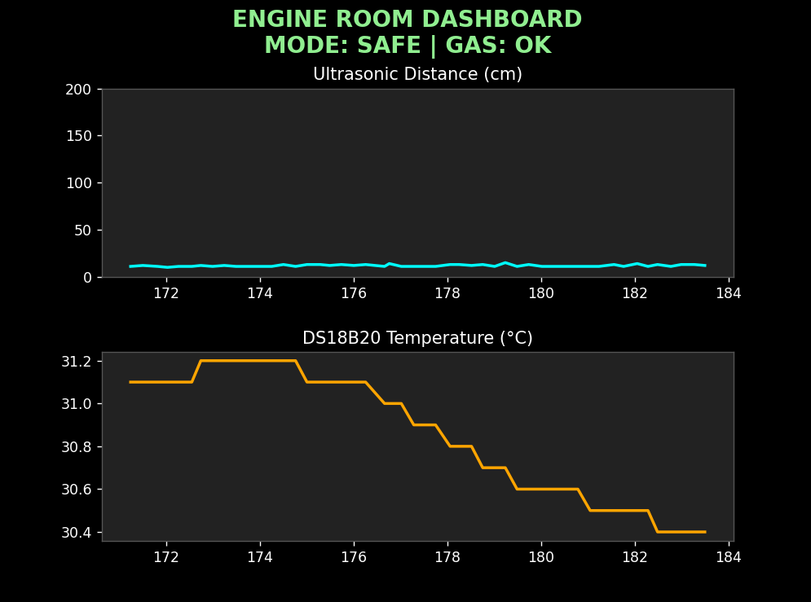
PROJECT WALKTHROUGH // PC SOFTWARE
SLIDE 09 / 14
The Live PC Dashboard & Excel Recorder
REAL-TIME ROLLING GRAPHS
HOW IT TALKS TO THE LAPTOP
SIMPLE READABLE MESSAGE FORMAT
[DIST:23 | TEMP:31.4 | GAS:OK | MODE:SAFE]
• Sent 4 times a second over a standard USB serial cable.
• Clean and readable by humans and software alike.
OUR PYTHON APPLICATION FEATURES
▹ Background Listener: Constantly grabs data from the cable so no numbers get lost.
▹ One-Key Excel Logging: Type 'LOG' in the console to save every reading into a timestamped CSV file.
▹ Color-Shifting Graphs: The title bar turns Green, Yellow, or Red to match the engine room status.

Slide 10
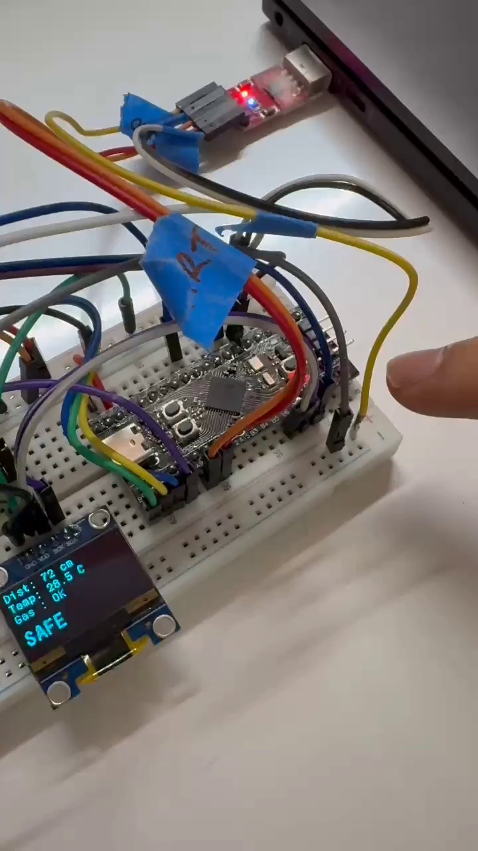
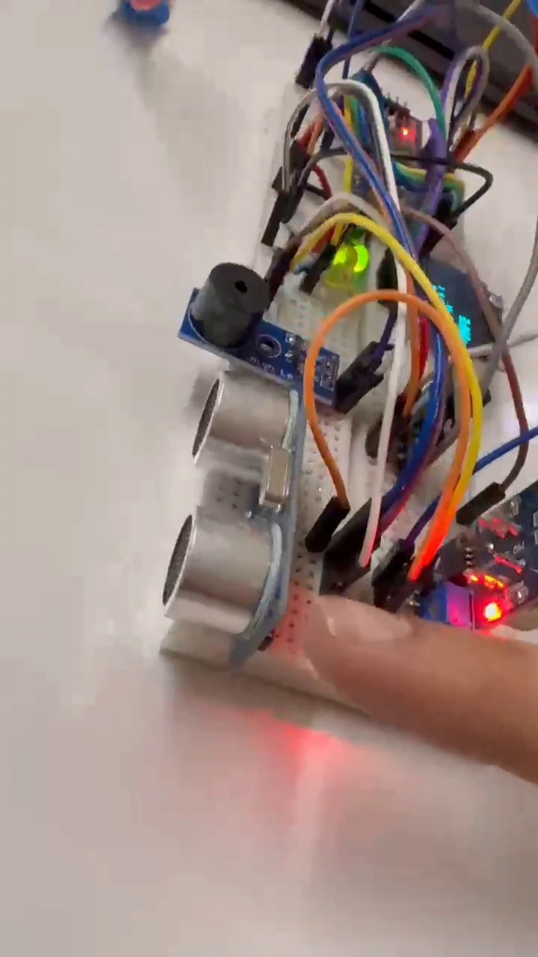
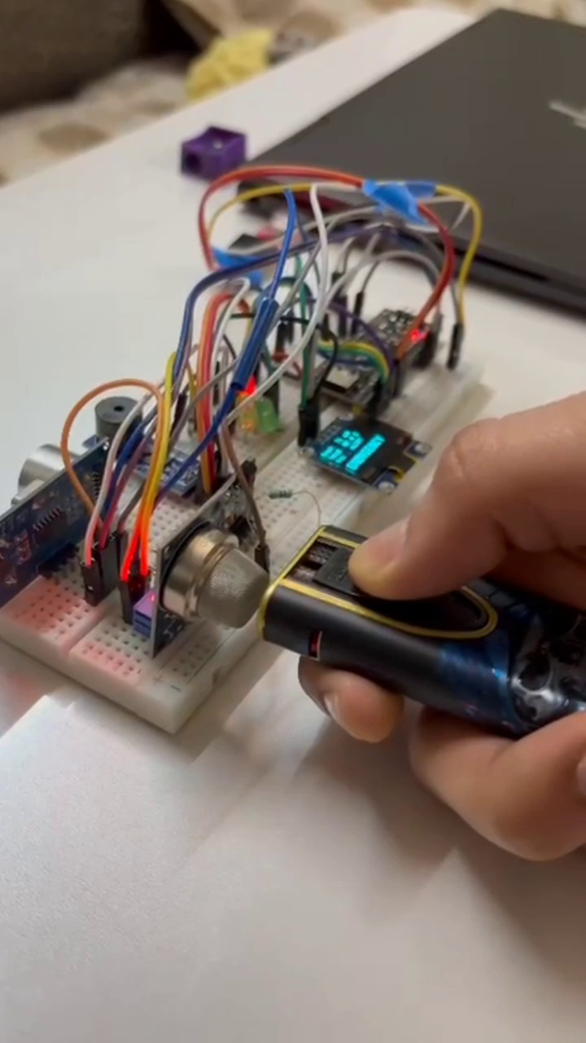
PROJECT WALKTHROUGH // LIVE TESTING
SLIDE 10 / 14
Testing With Real Heat & Gas (The Proof)
PHASE 1: SAFE STATE
PHASE 2: GAS ALERT
PHASE 3: EMERGENCY!
Clean air, normal 29.2°C temperature. Green light on, OLED showing numbers.
Gas fumes sprayed. Instantly flips to Yellow; buzzer begins 500ms warning beeps.
Heat crosses 45°C while gas is present. Flips to Red with rapid 100ms siren alarm!
MEASURED TEST PERFORMANCE
Reaction Speed: < 15 milliseconds (faster than a blink) | Dropped Packets: 0.00% across hours of continuous logging | Memory Used: Under 5% of chip capacity

Slide 11
PROJECT WALKTHROUGH // PROBLEM SOLVING
SLIDE 11 / 14
The Toughest Roadblocks We Solved
ROADBLOCK 1: 0.75s SENSOR LAG
ROADBLOCK 2: JUMPY DISTANCE READINGS
THE FREEZING PROBLEM
▹ The Problem: The temperature sensor takes 750ms to read. Traditional delay commands froze the chip and missed gas alarms.
▹ How We Fixed It: Split the read into two states: ask for data now, and pick it up 750ms later while keeping all other sensors running.
ELIMINATING SOFTWARE JITTER
▹ The Problem: Using software loops to time distance sound waves caused wild jumps because other tasks interrupted the timing.
▹ How We Fixed It: Let the chip's internal silicon timer (TIM2) capture sound edges automatically in hardware. Rock-solid accuracy.
ROADBLOCK 3: COUNTING MICROSECONDS
ROADBLOCK 4: PC GRAPH STUTTERING
HARDWARE TIMING PRECISION
▹ The Problem: Standard microcontroller libraries only count in whole milliseconds, but 1-Wire sensors need 5-microsecond pulses.
▹ How We Fixed It: Enabled the ARM chip's internal DWT cycle counter, which ticks every 10 nanoseconds for pinpoint accuracy.
SMOOTH PYTHON MULTITHREADING
▹ The Problem: Waiting for serial messages made the Matplotlib graph lag and freeze up on the laptop.
▹ How We Fixed It: Decoupled reading and plotting into separate background threads, creating a buttery-smooth display.

Slide 12
PROJECT WALKTHROUGH // PERSONAL GROWTH
SLIDE 12 / 14
What I Personally Learnt From This Project
01 / REAL EMBEDDED C
02 / MULTITASKING
03 / HARDWARE PROTOCOLS
Bare-Metal Programming
Configuring internal registers, clock frequencies (96 MHz), and hardware peripherals directly in C.
Non-Blocking Logic
How to architect systems where 4 different jobs run smoothly without any task starving or freezing the chip.
Sensors & Wiring
Mastered 1-Wire digital communication, fast 400 kHz I2C buses, and reliable UART serial links.
04 / HARDWARE TIMERS
05 / PC DATA TOOLS
06 / PRACTICAL DEBUGGING
Input Capture ISRs
Using hardware timer interrupts to count microsecond sound waves without wasting CPU cycles.
Python Multithreading
Writing multi-threaded Python applications to visualize sensor data live and export clean Excel/CSV logs.
Real Hardware Wisdom
Tracking down loose ground wires, voltage drops, and timing bugs on real physical breadboards.

Slide 13
PROJECT WALKTHROUGH // FUTURE ROADMAP
SLIDE 13 / 14
How We Can Make This a Commercial Product
PHASE 1
PHASE 2
PHASE 3
PHASE 4
Industrial CAN Bus
▹ Replace USB serial cables with heavy-duty marine CAN bus so multiple sensor pods connect across the whole ship.
▹ Noise-immune differential signals designed for high-voltage marine engine bays.
Satellite Cloud Links
▹ Beam live telemetry over satellite so shore-side fleet headquarters can check engine health anywhere on earth.
▹ Fleet-wide monitoring dashboards with automatic maintenance reminders.
Predictive AI (TinyML)
▹ Train miniature neural networks on vibration sensors to catch failing bearings weeks before they overheat.
▹ Move from reactive alarms to proactive predictive maintenance.
Marine Metal Casing
▹ Design a custom PCB inside an IP67 waterproof, flame-retardant aluminum housing built for diesel environments.
▹ Certified for explosive marine atmospheres (ATEX / IECEx).

Slide 14
PROJECT WALKTHROUGH // WRAP-UP & QUESTIONS
SLIDE 14 / 14
Project Summary & Evaluation Q&A
FINAL RECAP
PROJECT REPOSITORY & DEMO
✓ Solved a Real Problem
Continuous, automated 24/7 vitals monitoring for harsh ship engine rooms.
✓ Zero Freezing or Lag
Engineered a non-blocking cooperative superloop running all sensors seamlessly.
✓ Bench-Tested & Proven
Validated with live gas fumes and heat triggers with <15ms instant response.
✓ Complete System Suite
Built low-level C firmware, hardware wiring, and multithreaded Python telemetry.
GITHUB REPOSITORY
https://github.com/UjjvxL/
Ship-Engine-Room-Safety-Monitor-
RECORDED DEMO VIDEOS
1. Final Vid 1.mp4 (Bench Test & Sensor Verification)
2. Final vid 2.mp4 (Full System & Alert Run)
THANK YOU!
Open for Questions & Evaluation Discussion

