Slide 1

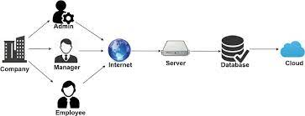

Team Software Chasers
Final Project

Slide 2
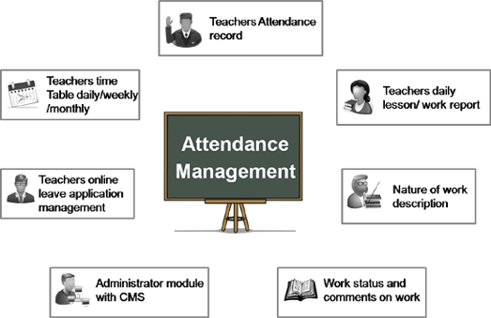
PROJECT TITLE
Attendance
Management
System

Slide 3

AGENDA
Problem Statement
Project Overview
Who are the end users?
YOUR SOLUTION AND ITS VALUE PROPOSITION
THE WOW IN YOUR SOLUTION
Modelling
Results
Meet our Team

Slide 4

PROBLEM STATEMENT
School and College scenarios
Traditional way is time consuming in schools and colleges.
Requires the registers or records to maintain the attendance. So it’s not reliable.
It is difficult to maintain or store the registers/records safe for years.
Now a days many of the student benefits are linked to the attendance percentage of the students.
It’s not possible to track or know the current percentage time to time.
It can be only known whenever the teacher publishes the reports.

Slide 5

PROJECT OVERVIEW
Attendance management system is an innovative application designed to maintain and manage the attendance of students or employees. This project keeps the attendance details of all the students or employees and it also allows us to create flexible and configurable attendance. The basic idea behind this project is to monitor the activity of student or employer attendance.

Slide 6
WHO ARE THE END USERS?
SCHOOLS
COLLEGES
ORGANIZATIONS
This proposed project will be very much suitable in schools.
As the number of students will be more, traditional attendance system takes more time.
But, by using this website the time will be saved.
Here also the project can be very helpful.
Most of the colleges are still following the traditional attendance system.
They will get benefited by using this methodology. As it is time saving, efficient, reliable and easy to use.
Not only the students some organizations can also implement this kind of procedure for taking the attendance of their employees.
They can actually update this process of taking attendance by adding some additional features like face detection, NFCs, etc.

Slide 7

YOUR SOLUTION AND ITS VALUE PROPOSITION
Our solution to the given problem is building a Static website along with a database (to store the details like attendance percentages and the personal details of the individuals) can help us to maintain and manage the attendance of the students.
The interface of our website is very simple and easy to understand and navigate. Students can view their attendance percentages whenever they want. Also, due to authentication it’s secure i.e. the students can not log into the faculty’s account unless the credentials are known. So, there will not be a chance of manipulating the attendance.

Slide 8
With the help of database :
accessing the files/details are faster.
number of students can be very large compared to the traditional type of attendance management system.
easy to maintain even for years.
In this Website, the attendance will be updated/posted whenever the faculty submits the form. Due to direct posting of the records, errors can be minimized and the attendance status will be updated time to time.
So, It will be very much helpful in maintaining the attendance of any school, college faithfully.

Slide 9

THE WOW IN YOUR SOLUTION
Time saving as manual paper work is less.
There is less chance of error.
It eliminates duplicate data entry in time and attendance entries.
It is trouble free to use.
It has relatively faster to approach enter attendance.
It is highly reliable.
Very simple user interface.
Efficient reports.

Slide 10
MODELLING
Teams cam add wireframes
Teacher
Take attendance
Save attendance
Student
Login
Login
Home
Students list
Dash board
Teacher
Report
Student

Slide 11
RESULTS
Secured and Accessible Data Management
In Student Attendance Management systems, the students’ attendance is stored in the form of digital data.
This data is highly secured as this software is protected with multiple layers of security.
To login into the software, users need to enter their assigned user ID followed by their passwords.
Unauthorized users can’t have access to this software.
Only school/college management has the access, which they can do anytime and from anywhere. All they need is a mobile, laptop or a computer with internet connectivity.
Students can now easily track their attendance. So, Student attendance management system lessens the teacher workload, saving critical time that can be utilized for the student’s developmental activities.
Demo Link

Slide 12
Paperless, Eco-Friendly, and User-Friendly Process
With the incorporation of student attendance management systems, institutions can now get rid of the paper cost which was earlier incurred by them.
As attendance will now be entirely recorded digitally, the whole attendance procedure becomes cost-effective and eco-friendly at the same time.
The funds saved from eliminating the paper cost can be utilized further for various infrastructural or other administrative activities.
Due to the simple user interface of these systems, it is easy to navigate and explore their features. This makes data retrieval easy.
Hence we can conclude that student attendance management systems are pretty useful as they are eco-friendly and cost-effective.
It makes the attendance procedure hassle-free and less time-consuming.
Due to its accessibility feature, students and parents get regular updates about their daily attendance.
Therefore, educational institutions should incorporate student attendance management systems.

Slide 13






MEET OUR TEAM
Ujjwal Pramanick
Ruchitha
Goli
Sambhav Jha
MD Imran
Priyadharshini R
Allumolu Thulasikrishna

