Slide 1
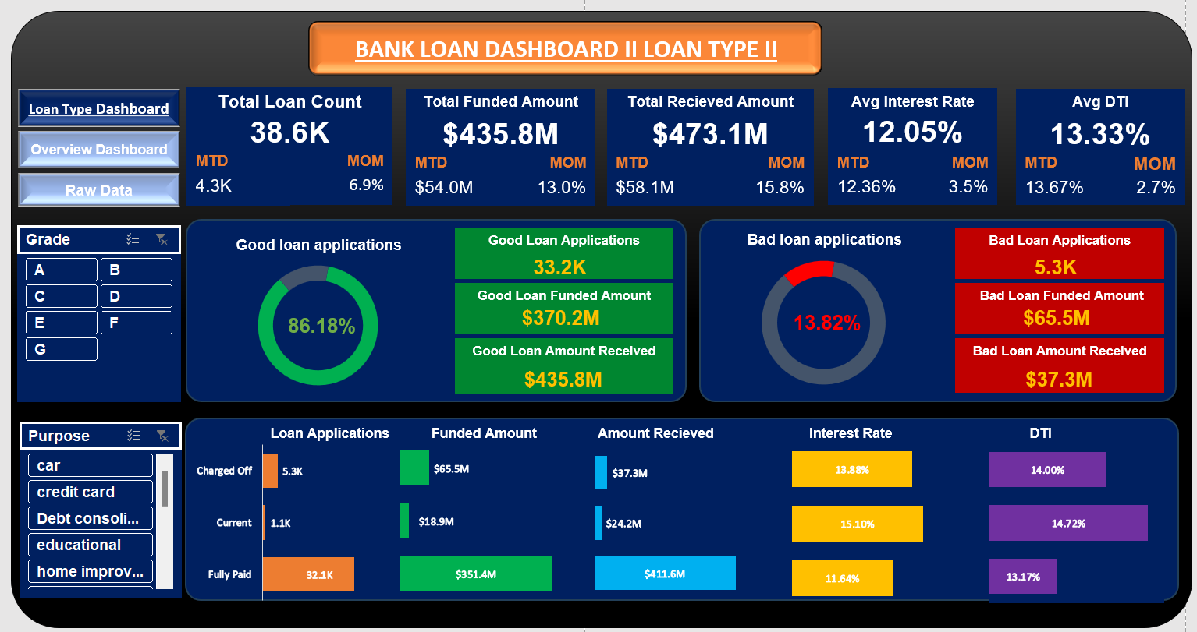

Slide 2
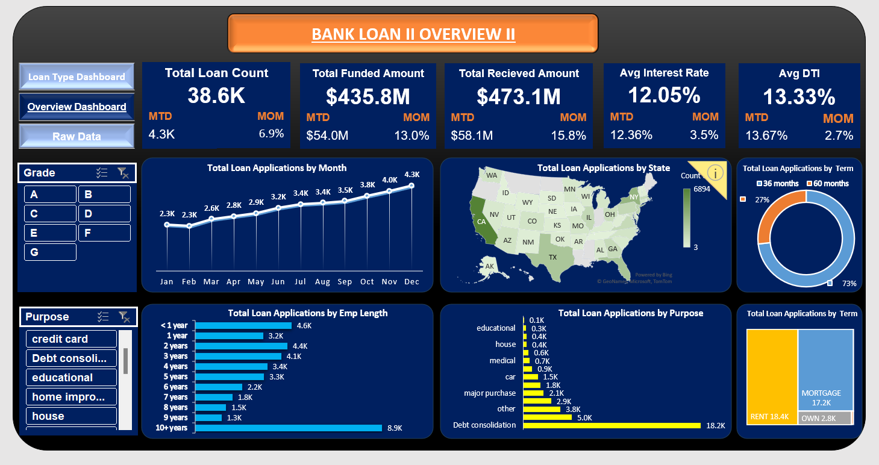

Slide 3
KPIs
Total Loan count has increased month-on-month by 6.9% for the month of December and growth rate for this year is almost 100% which are both phenomenal figures for a bank of this size.
Similar is the case with total funded and received amount.
But the average interest rate is at 12.05% and this interest rate combined with a phenomenal growth is initially indicating that we are offering our loans to very high risk customers.
Average DTI is under control as 30% is considered to be a good limit but it is slightly higher than current the industry average of 9%

Slide 4
Percentage of Bad loans applications is very high 13.82% as average banks of US have NPL of around 2-3% which reinstates the previous analysis that we are offering our loans to very high risk customers.
Total Good Loan Funded Amount is $370.2M and Total Bad loan amount received is $435.8M which may seem good but it is not adjusted with the depreciation with the loss in value of money with time and inflation and same is the case with bad loan stats.
So Analysing what are the reasons and categories because of which we are into bad loans so heavily is a must at this stage of business.

Slide 5
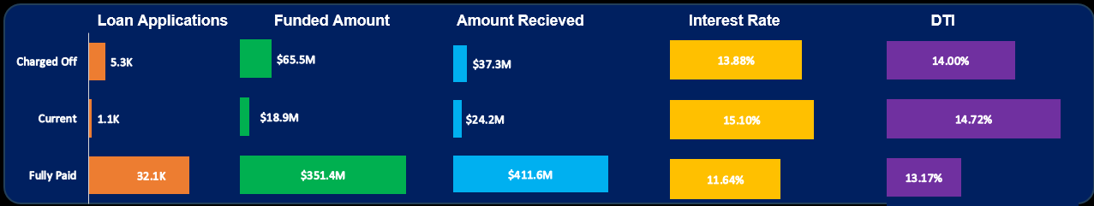
Average interest rate and DTI both are high for charged off loans than fully paid loans at 13.88% and 14% than 11.64% and 13.17% which can be the reasons for such number of band loans this year as higher interest rate means higher monthly Emi for borrowers and higher percentage of their incomes going for loan payoffs only.
More concerning part about this data is that interest rate and DTI for current loans are highest at 15.10% and 14.72% which means many of these borrowers may not be able to pay off their loans in future.
The increase in interest rate maybe due to increase in FED rates in covid or may also be our strategic fault in choosing the category of loans and customers which should be immediately checked.

Slide 6
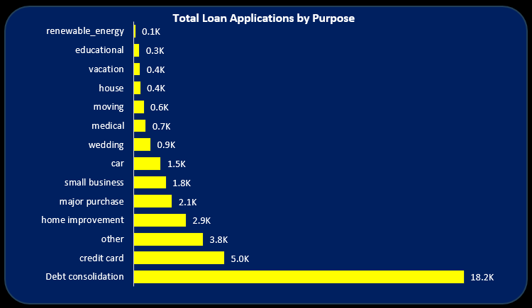
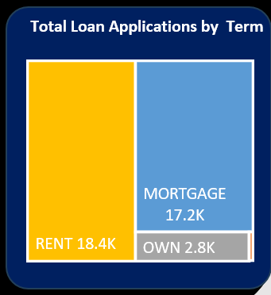
Loans of category House, Education and Renewable energy is very less as compared to others loans which is a big red flag as these are almost safe loans as they have a collateral and easy cashflows alongside them and if anything bad happens and therefore called secured loans
A very high number of our loan count is of Debt Consolidation and Credit Card category which as mostly taken by borrowers who are not able to manage their finances very well and lending them loans in such big quantity in a high interest rate environment is very dangerous
Therefore it is advised to lower our exposure with these loans unsecured loans and focus more on the safer loans segment
Only 2.8k customers own their own house rest all are living in a rented (18.4k) or mortgage(17.2k) apartments which means they already have a financial commitment in the form of rent or mortgage loan other than our loan repayment which makes them further financially unstable

Slide 7
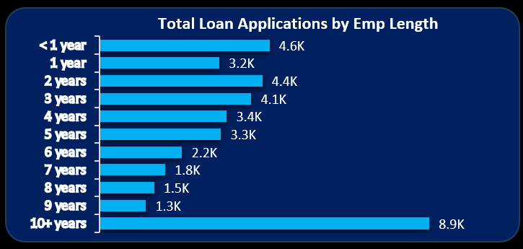
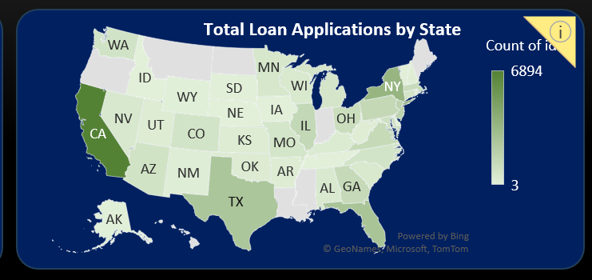
As data for 10+ years might be little deceptive as it includes many employee lengths so by seeing the other trend we can conclude that the bank is heavily preferred by customers with less employment length and as it increases the number of loans are decreasing drastically so here again we have a high risk customer segment involvement
Reasons for this might be that we are preferred more by the younger populations or the loan approval process is less strict that makes it preferable amongst the financial unstable borrowers
We have a highly concentrated customer base from California, New York and Texas which are amongst the highest per capita income states of USA which explains the high growth by a little but diversification is highly important in financial sectors
We can start diversification from other high income states like Washington D.C., Massachusetts, Maryland, New Jersey, etc

Slide 8
Final Verdict
There is very high percentage o bad loans so Analysing what are the reasons and categories because of which we are into bad loans so heavily is a must at this stage of business.
The ongoing loans are facing a problem of higher interest rates which further increase their chances of becoming a bad loan.
We are highly focused with unsecured and non collateral loans like debt reconsolidation and credit card category and at the same time very less focused into safer loans like housing, education and renewable loans. Therefore it is advised to lower our exposure with these loans unsecured loans and focus more on the secure loans segment.
Our customer base already have a major other financial commitment in the form of rent or home loan which means our criteria for giving loans needs to be strictened atleast in this high interest rate environment and we need to focus on more stable employment customer segment
Lastly starting to diversify our customer base to other high income states like Washington D.C., Massachusetts, Maryland, New Jersey, etc also seems to be a good idea both for risk diversification and to continue the same growth rate for the business

