Slide 1
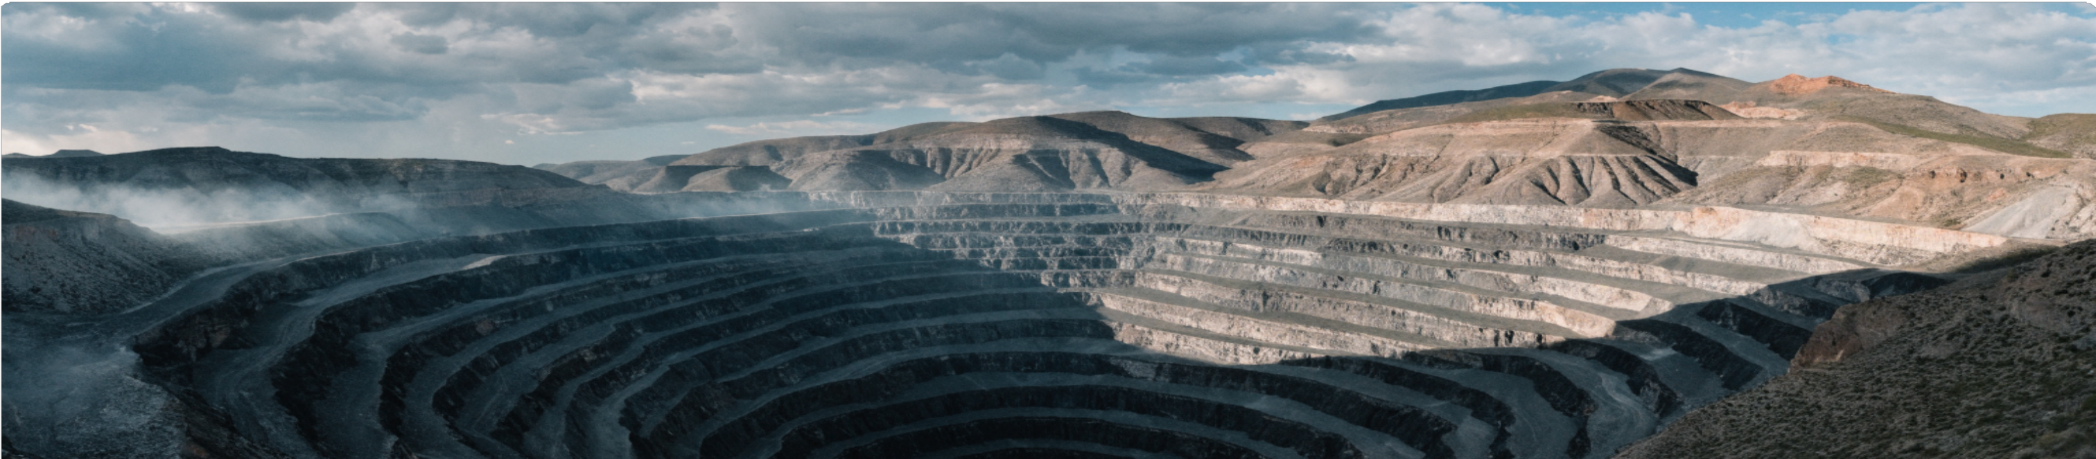
Mine Guard
Satellite-powered ground East-West movement monitoring — designed for every mine site engineer.
React + TypeScript
Python FastAPI
SNAP InSAR Engine
Sentinel-1 ASC+DSC
Final Project • ECE Department • NIT Rourkela • Ujjwal Rawat (225EC6010)
1 / 13

Slide 2
PRODUCT SPECIFICATION › INTRODUCTION
What is MineGuard?
MineGuard is a full-stack web application that uses free Sentinel-1 satellite radar data to automatically detect and track ground horizontal deformation at active mine sites — with no programming or satellite expertise required.
Why It Matters
What It Uses
What It Delivers
▸ Problem Mining excavations cause ground to sink and slide — often undetected until too late.
▸ Cost Traditional ground sensors are expensive, local, and require specialist teams.
▸ Gap No affordable, automated tool existed for non-technical mine site engineers.
▸ Satellite Free Sentinel-1 SAR images from the European Space Agency (ESA) Copernicus programme.
▸ Engine SNAP (Sentinel Application Platform) for professional InSAR interferogram processing.
▸ Stack React TypeScript frontend + Python FastAPI backend — runs entirely in a web browser.
▸ Output Millimetre-precision ground displacement measurements at user-selected hotspot locations.
▸ Report Automated geotechnical risk assessment: Low / Medium / High / Critical per hotspot.
▸ Access Any mine on Earth, any timeframe from 2014–present, zero cost satellite data.
2 / 13

Slide 3
PRODUCT SPECIFICATION › USER EXPERIENCE
Built for the Field Engineer
Every design decision was made for mine site engineers who have no computer science background. The application guides users through every step without jargon.
Step-by-Step
Instructions
Purpose-Built
Dark Theme
Plain-English
Graph Captions
Boundary-Safe
Inputs
Live Status
Feedback
Every page opens with a clearly numbered instruction panel explaining exactly what to do next. The user never wonders what a button does.
A high-contrast dark colour scheme reduces eye fatigue during long monitoring sessions. Key actions are highlighted in vivid blue.
Each displacement chart is accompanied by an auto-generated sentence explaining what the graph shows — no data science knowledge needed.
Click-safety guards prevent users from placing hotspot markers outside the crop boundary, and warn before any destructive action is taken.
The processing dashboard updates every 3 seconds so engineers always know which satellite pairs are running, complete, or waiting.
3 / 13

Slide 4
PRODUCT SPECIFICATION › USE CASES
Who Uses MineGuard?
MineGuard is designed as a universal tool — from daily operational safety checks to long-term academic subsidence research.
Mine Site Engineer
Geotechnical Consultant
Research / Academia
▸ Daily Task Open the app, select the mine, and check if any hotspot crossed a risk threshold overnight.
▸ Value Replaces expensive GPS survey teams. Results available within hours of satellite pass.
▸ Ease No training needed beyond basic web browsing. The app instructs the user at every step.
▸ Task Import a client's mine, define the crop area, and run a multi-year displacement analysis.
▸ Value Generates a professional, printable risk report automatically — ready to hand to the client.
▸ Ease All complex InSAR maths is automated; the consultant only interprets the final charts.
▸ Task Study long-term subsidence trends across multiple mine sites using Sentinel-1 archives.
▸ Value Free satellite data from 2014 onwards provides a decade-long deformation record.
▸ Ease Export-ready CSV displacement values and publication-quality matplotlib charts.
4 / 13

Slide 5
PRODUCT DETAIL › THE CORE PROBLEM
Ground Doesn't Just Sink — It Slides.
East–West horizontal displacement is the earliest warning signal of mine-slope failure — yet it is invisible to conventional vertical sensors.
Without East–West Detection
MineGuard — Horizontal First
▸ Hidden Hazard Horizontal sliding begins weeks before the ground visibly sinks — giving a false sense of stability on vertical-only monitors.
▸ Wrong Metric A sensor measuring only depth cannot distinguish whether a mine wall is sliding laterally outward or simply compressing downward.
▸ Late Warning By the time vertical settlement becomes measurable, the lateral failure has already progressed to a point where intervention is difficult.
▸ Industry Gap Most traditional InSAR tools report only vertical or line-of-sight displacement, omitting the critical East–West component entirely.
▸ True E–W Measurement Combines Ascending and Descending satellite passes to mathematically isolate the pure East–West component of ground movement.
▸ mm-Level Precision Sentinel-1 C-band radar resolves displacements as small as 1–3 mm, detecting lateral shifts months before they become dangerous.
▸ Early Intervention Knowing the direction of movement allows geotechnical teams to install targeted support structures before a critical failure event.
▸ Proven Science 2D ASC+DSC InSAR decomposition is the standard method used in professional mine subsidence monitoring worldwide (e.g., Anglo American, BHP site surveys).
5 / 13

Slide 6
PRODUCT DETAIL › 3D VISUALISATION
Displacement Mapped into 3D Space
MineGuard plots every hotspot's complete deformation history on three orthogonal axes — so engineers can see exactly how, where, and when each point is moving.
X — HORIZONTAL (East ↔ West)
Measures true East–West ground displacement in millimetres per epoch. | Positive (+) means the ground moved Eastward. Negative (−) means Westward sliding.
↳ Example: P2 drifted −283 mm westward by 2021 — the strongest lateral movement on site.
Y — VERTICAL (Subsidence)
Measures true vertical ground settlement in millimetres (downward is negative). | Derived from the same ASC+DSC decomposition as horizontal — both axes share one calculation.
↳ Example: P1 settled −159 mm vertically over 4 years — moderate but steady subsidence.
Z — TIME (Year Axis)
The temporal axis converts calendar dates to decimal years (e.g., June 2018 = 2018.42). | Time is shown continuously so acceleration or deceleration of movement is immediately visible.
↳ Example: P5 was stable until 2018 then showed a sudden −210 mm lateral event in one epoch.
6 / 13

Slide 7
PRODUCT DETAIL › HOW WE MEASURE HORIZONTAL DISPLACEMENT
Two Satellite Passes. One Precise Answer.
A single satellite pass measures ground movement only along its line-of-sight — a mixture of horizontal and vertical. Two opposite-direction passes let us mathematically separate both components.
Ascending Pass (ASC)
Descending Pass (DSC)
Result
▸ Direction Satellite flies Northward along an inclined orbit track.
▸ Look angle Radar beam points East toward ground, ~40° from vertical.
▸ Measures LOS displacement = blend of eastward shift + vertical settlement.
▸ Coverage Four ASC interferometric pairs acquired over 2017–2021.
▸ Direction Satellite flies Southward — the opposite track to ASC.
▸ Look angle Radar beam points West toward ground, ~35° from vertical.
▸ Measures LOS displacement from the opposite side — the other equation.
▸ Coverage Four DSC interferometric pairs matched within ≤12 days of ASC.
ASC
+
DSC
↓
True E/W
&
Vertical
7 / 13
Formula: d_LOS = −sin(θ)·cos(α)·d_E + cos(θ)·d_U — solved simultaneously for ASC & DSC using Cramer's Rule.

Slide 8
WORK DONE › METHODOLOGY
How MineGuard Processes Satellite Data
Five sequential processing stages transform raw radar images into millimetre-precision ground displacement measurements and an automated risk report.
Stage 01
Stage 02
Stage 03
Stage 04
Data Acquisition
InSAR Pre-Processing (SNAP)
2D ASC+DSC Decomposition
Risk Classification & Reporting
▸ Source Free Sentinel-1 C-band SAR images retrieved from the ESA Copernicus Data Space Ecosystem (CDSE) via the OData REST API.
▸ Selection Both Ascending (ASC) and Descending (DSC) orbit passes are queried for the user-defined ROI, timeframe, and IW-SLC product type.
▸ Pairs Images are automatically matched into interferometric pairs within a ≤12-day temporal baseline to maintain coherence.
▸ Co-registration Master and slave SLC images are precisely aligned at sub-pixel accuracy using a cross-correlation-based co-registration graph in ESA SNAP.
▸ Interferogram Phase difference between the two acquisitions is computed; flat-earth and topographic phase are removed using a DEM.
▸ Filtering + Unwrapping Goldstein adaptive phase filter reduces noise; Snaphu phase unwrapping converts wrapped phase (−π to π) to absolute phase.
▸ System One ASC LOS and one matched DSC LOS measurement form a 2×2 linear system: d_LOS = −sin(θ)cos(α)·d_E + cos(θ)·d_U.
▸ Solution The system is solved analytically using Cramer's Rule to yield true East–West (d_E) and true Vertical (d_U) displacement per epoch.
▸ Output Cumulative E/W and Vertical time-series are computed by summing incremental epoch values from the start of the monitoring period.
▸ Thresholds Cumulative displacement is compared against geotechnical severity bands: LOW < 30 mm | MEDIUM < 80 mm | HIGH < 150 mm | CRITICAL ≥ 150 mm.
▸ Report An automated natural-language executive summary and colour-coded risk table are generated per hotspot without manual intervention.
▸ Actions Engineering recommendations (e.g., install inclinometers, evacuate zone) are ranked and output in order of severity.
▶
▶
▶
▶
8 / 14

Slide 9
WORK DONE › COMPLETE APPLICATION WORKFLOW
8 Pages. One Seamless Pipeline.
The app guides the engineer through eight sequential pages — from mine selection to automated risk report — each page building on the output of the one before it.
1
2
3
4
Search Mine
Crop Area
Timeline
Data Download
Type mine name → global geocoding → satellite map centres automatically.
▶
Draw a bounding box on the map to define the exact monitoring zone.
▶
Select start/end year + frequency. App estimates data size & compute time.
▶
App queries ESA Copernicus and downloads Sentinel-1 SLC files automatically.
↙ continues
5
6
7
8
Processing
Pick Hotspots
Results
Risk Report
SNAP engine generates interferograms. Live progress dashboard updates every 3s.
▶
Click up to 10 danger zones on the satellite map. Coordinates sent to engine.
▶
Three scientific plots: E/W drift, LOS displacement, and 3D trajectory.
▶
Automated geotechnical summary with risk ratings and engineering actions.
8 / 13

Slide 10
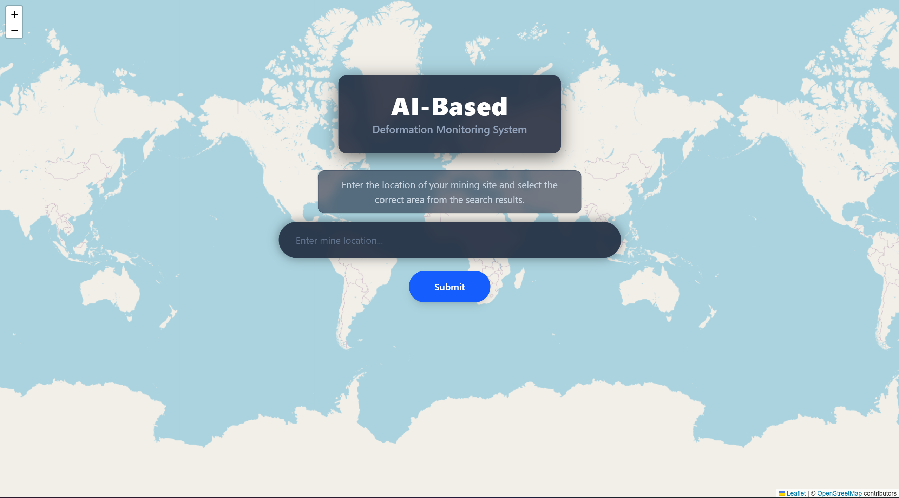
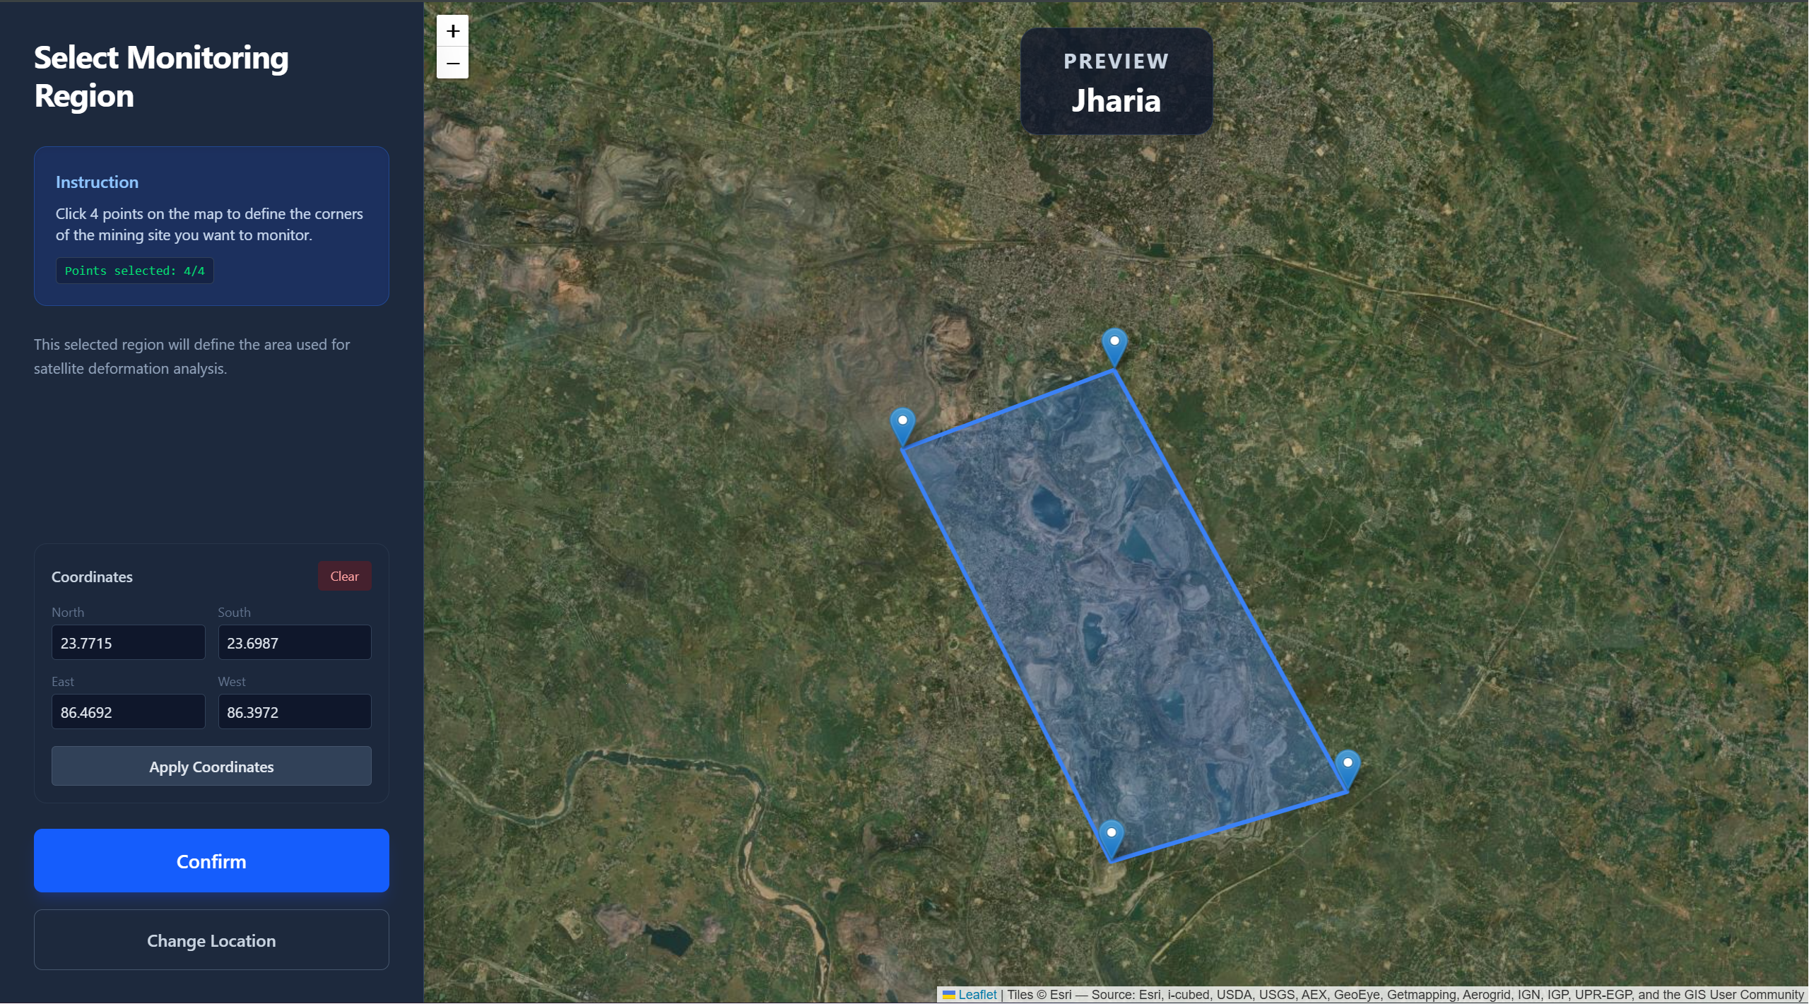
WORK DONE › PAGE 1 & PAGE 2
Step 1: Find Your Mine | Step 2: Define the Zone
The first two pages establish where and what to monitor — transforming a mine name into precise geographical coordinates.
PAGE 1 — Search Mine (Entry Point)
PAGE 2 — Crop / Region of Interest
▸ What the user does Types the name of the mine (e.g., 'Jharia Coal Field') into a search bar.
▸ What happens The Nominatim OpenStreetMap API geocodes the name in real-time and returns GPS coordinates as the user types — no manual lat/lon entry needed.
▸ Map response An interactive Leaflet satellite map (Esri World Imagery) instantly recentres and zooms to the mine location for visual confirmation.
▸ Design note A live dropdown shows ranked results so users can distinguish between similarly named mines in different countries.
▸ What the user does Clicks four corner points directly on the satellite map to draw a tight bounding box around the specific mine area to monitor.
▸ Alternative input Manual coordinate fields (North/South/East/West) allow precise numerical entry for users who already know their ROI boundaries.
▸ Why it matters The ROI boundary is sent to the backend for all satellite queries — a tight crop reduces download size by 60–80 % vs. a default wide area.
▸ Safety Coordinates are immediately validated and stored in React Context, persisting across all downstream pages without any re-entry.
9 / 13

Slide 11
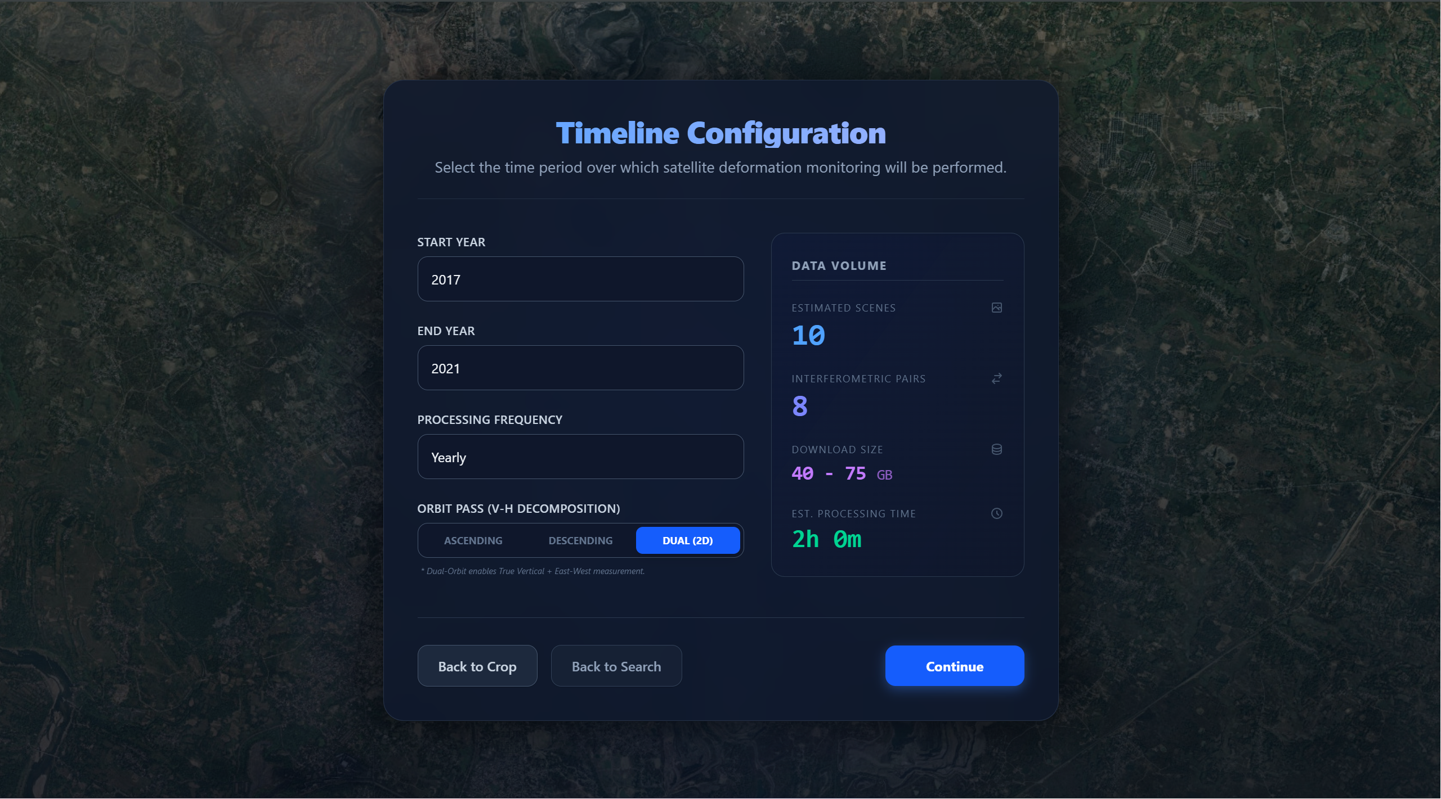
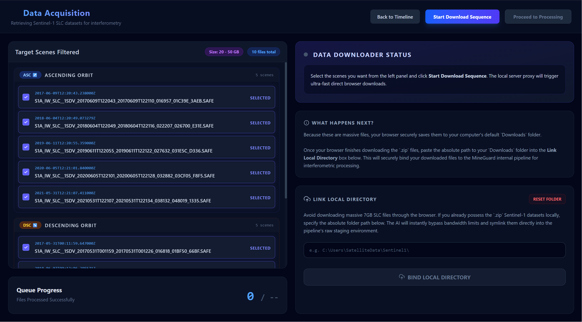
WORK DONE › PAGE 3 & PAGE 4
Step 3: Set the Timeframe | Step 4: Retrieve Satellite Data
These two pages configure the temporal scope of the analysis and automatically retrieve multi-gigabyte satellite datasets from ESA.
📷
📷
Page 3 — Timeline Selection
Page 4 — Data Download
Insert screenshot here
Insert screenshot here
PAGE 3 — Timeline Configuration
PAGE 4 — Sentinel-1 Data Download
▸ What the user does Selects a Start Year, End Year, and analysis frequency (e.g., Monthly, Quarterly) using simple dropdown menus.
▸ Smart estimator The app dynamically calculates the total Sentinel-1 data volume (in GB) and estimated SNAP processing time for the chosen period.
▸ Value Engineers can budget bandwidth and compute time before committing — avoiding accidental 200 GB downloads on a slow connection.
▸ Output The selected timeframe is passed to the CDSE OData API query for building the interferometric pair schedule.
▸ What the user does Clicks 'Start Download'. The app queries the ESA Copernicus Data Space Ecosystem API and fetches matching Sentinel-1 SLC scenes.
▸ Background processing Downloads run asynchronously — the web UI remains fully responsive while 7 GB files transfer in the background.
▸ Local Directory Link Users who already have the SLC files saved locally can click 'Link Local Directory' to bypass downloading entirely — saving hours.
▸ Integrity check Each file is verified before the pipeline advances: if any file is corrupt or missing, the user is warned before processing begins.
10 / 13

Slide 12
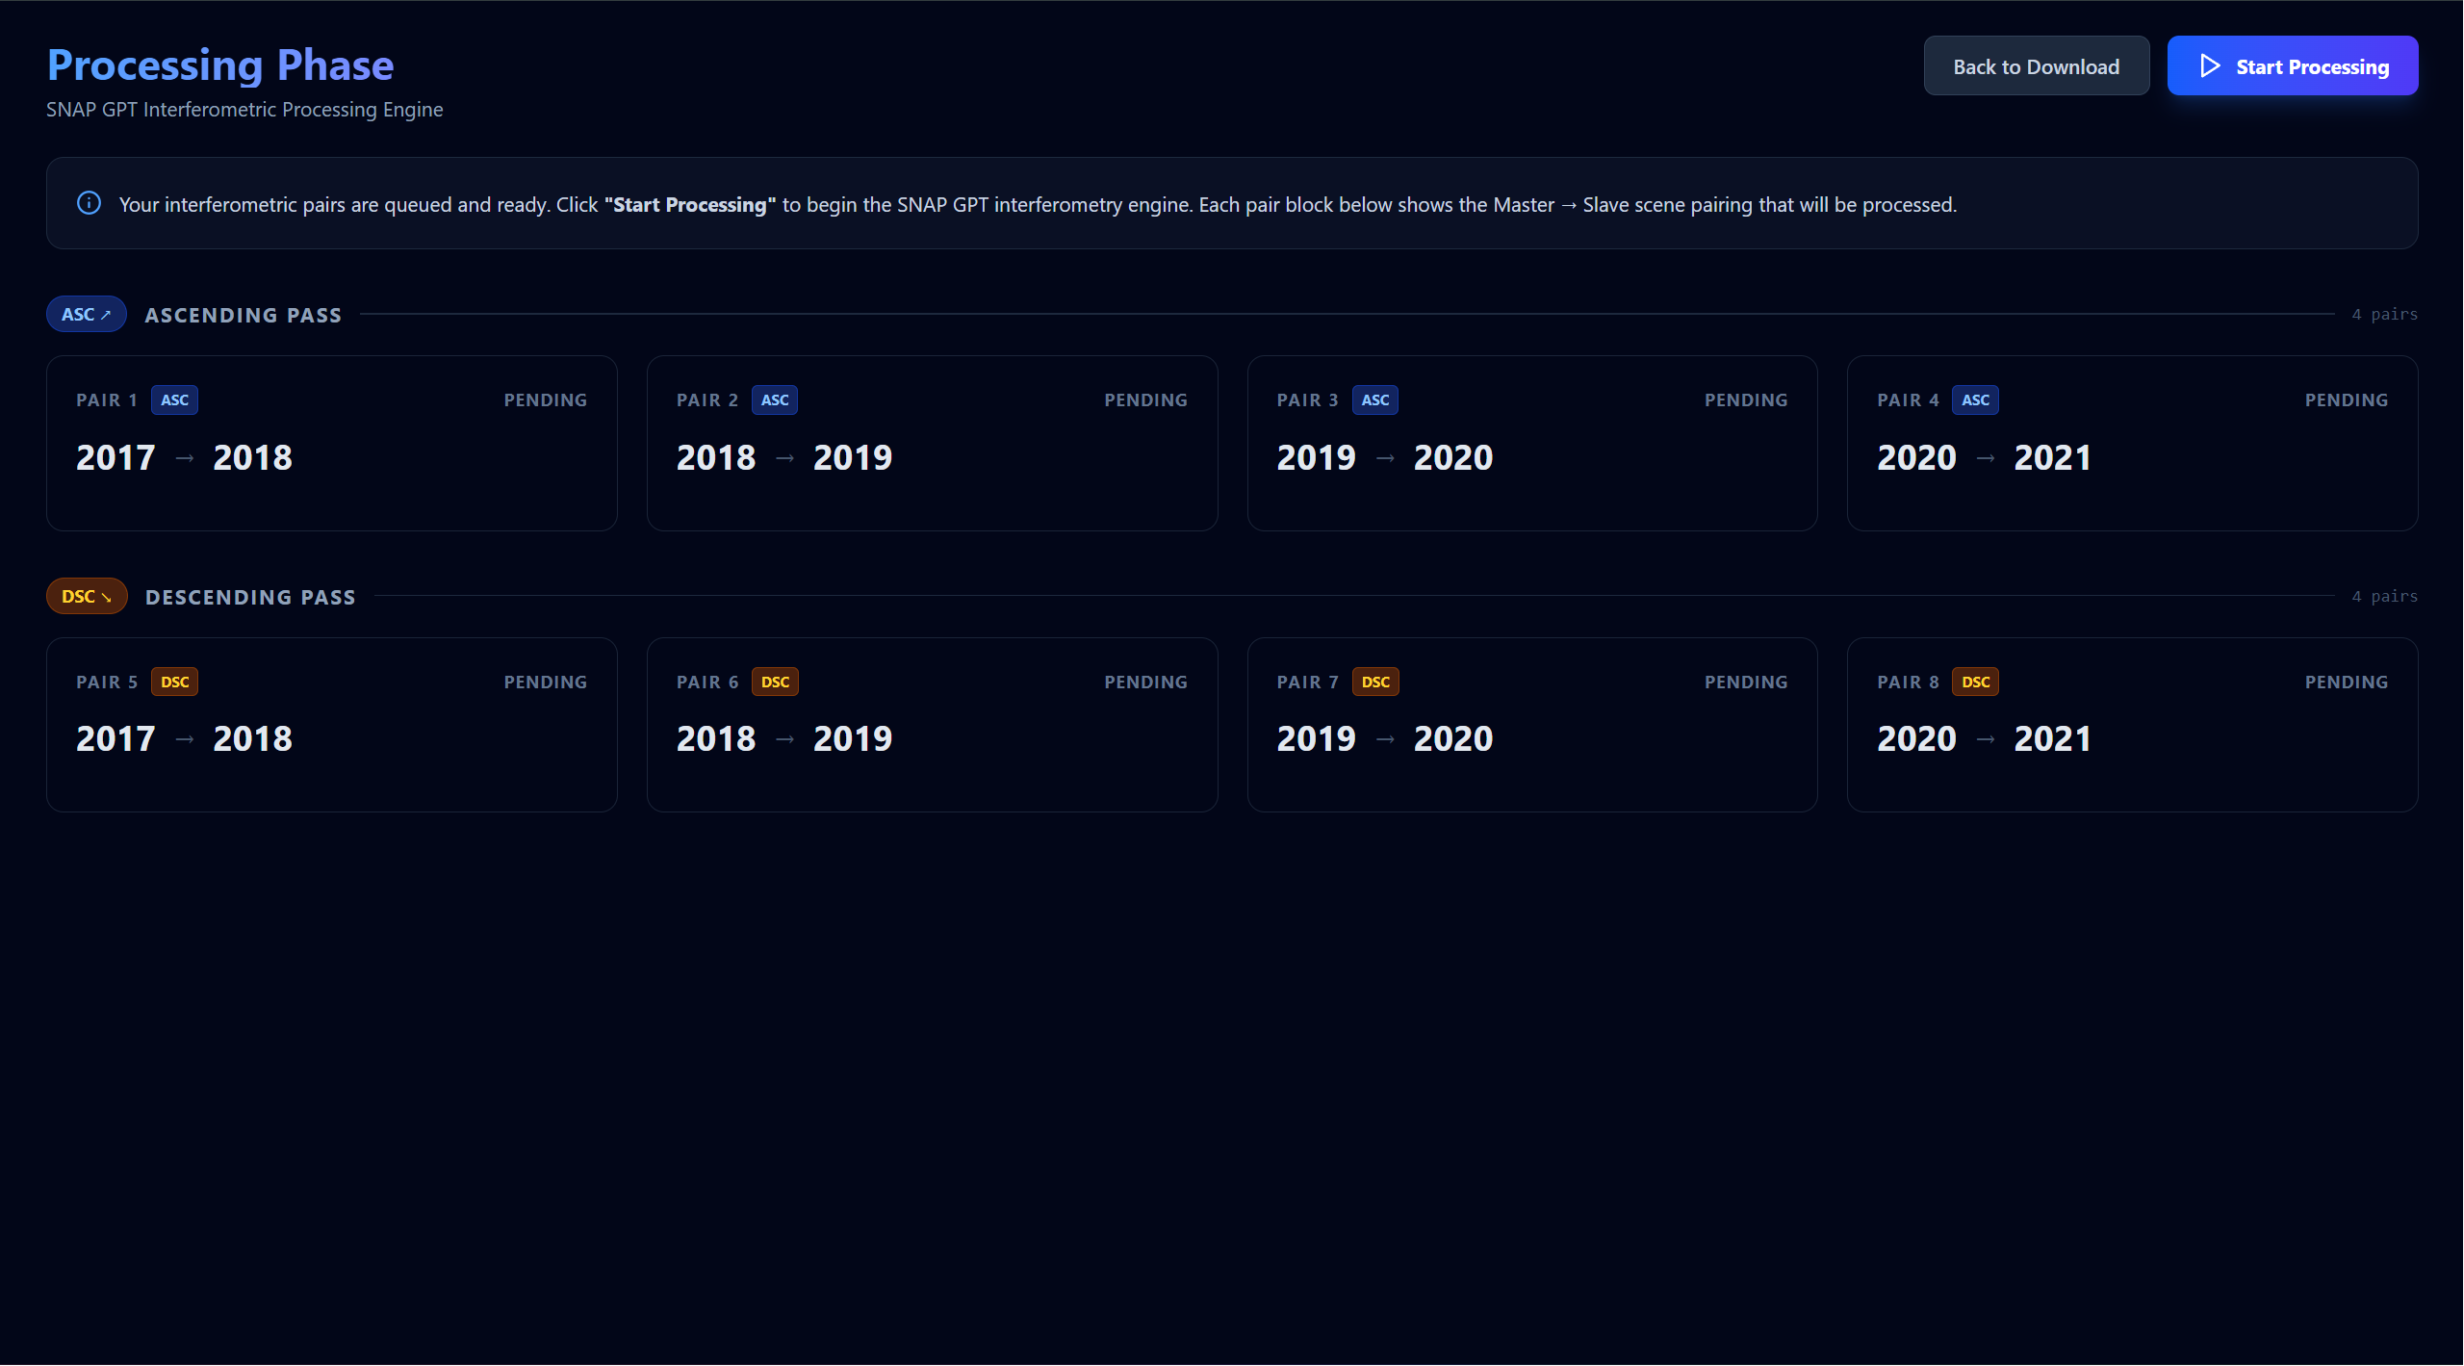
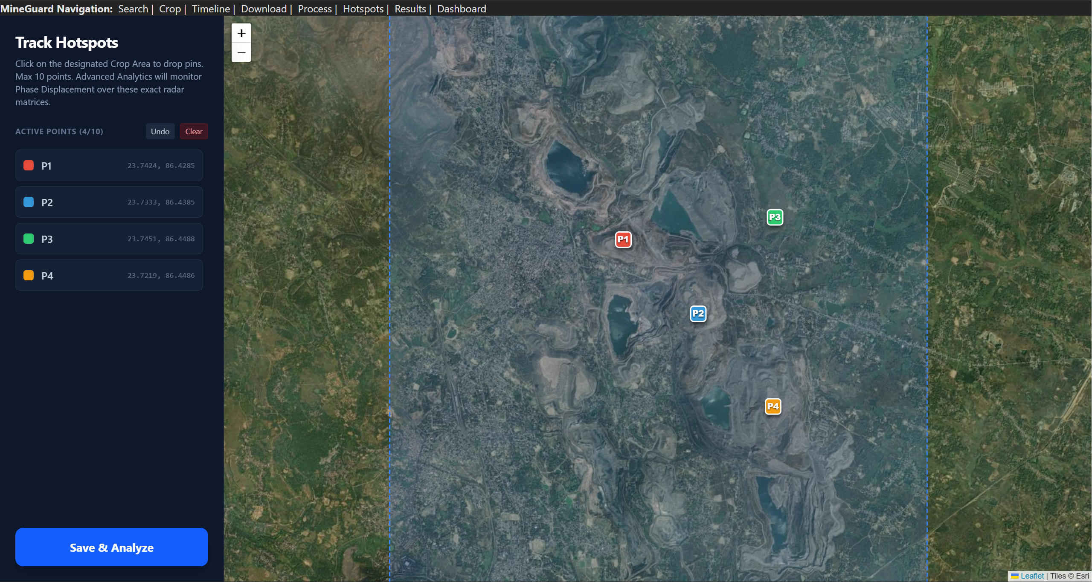
WORK DONE › PAGE 5 & PAGE 6
Step 5: Process InSAR | Step 6: Select Hotspots
The most technically intensive stage — generating interferograms with SNAP — and then targeting the specific danger zones to monitor.
PAGE 5 — SNAP InSAR Processing Dashboard
PAGE 6 — Interactive Hotspot Targeting
▸ What happens The app launches Python workers that run the ESA SNAP graph for each ASC and DSC interferometric pair (8 pairs total).
▸ Live queue A colour-coded dashboard updates every 3 seconds: Pending (grey), Processing (amber spinner), Complete (green badge with elapsed time).
▸ Smart pre-scan On restart, the app scans output folders and automatically skips any pair whose .dim file and .data directory already exist — no redundant compute.
▸ Worker control A 'Start Processing' button begins the queue; a 'Stop Worker' button cancels at any time without corrupting completed outputs.
▸ What the user does Clicks directly on the satellite map to place numbered monitoring markers (P1–P10) over specific high-risk zones such as pit walls.
▸ Boundary guard The app prevents markers from being placed outside the ROI defined in Page 2 — a yellow warning appears if the user clicks outside.
▸ Precision Each marker's exact GPS latitude and longitude is captured and displayed next to its label for field-team cross-reference.
▸ Handoff Saved hotspot coordinates are passed directly to the Python analysis engine for pixel-level time-series extraction from the interferograms.
11 / 13

Slide 13
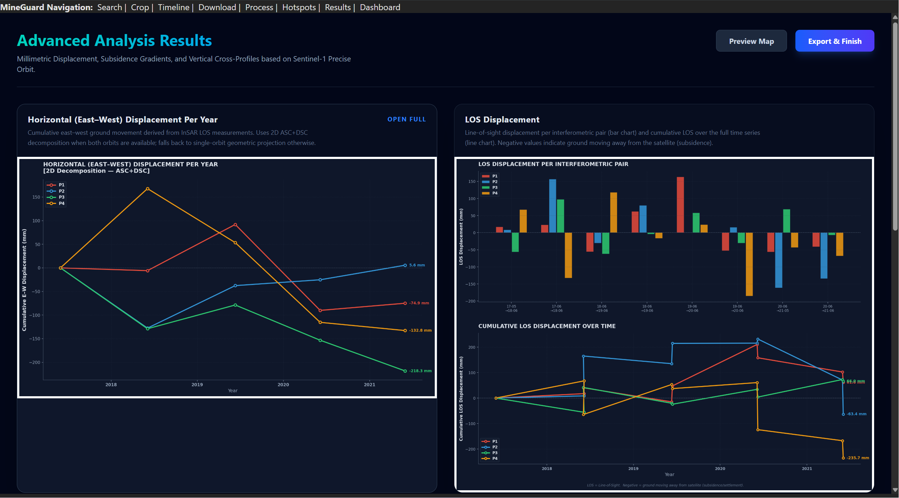
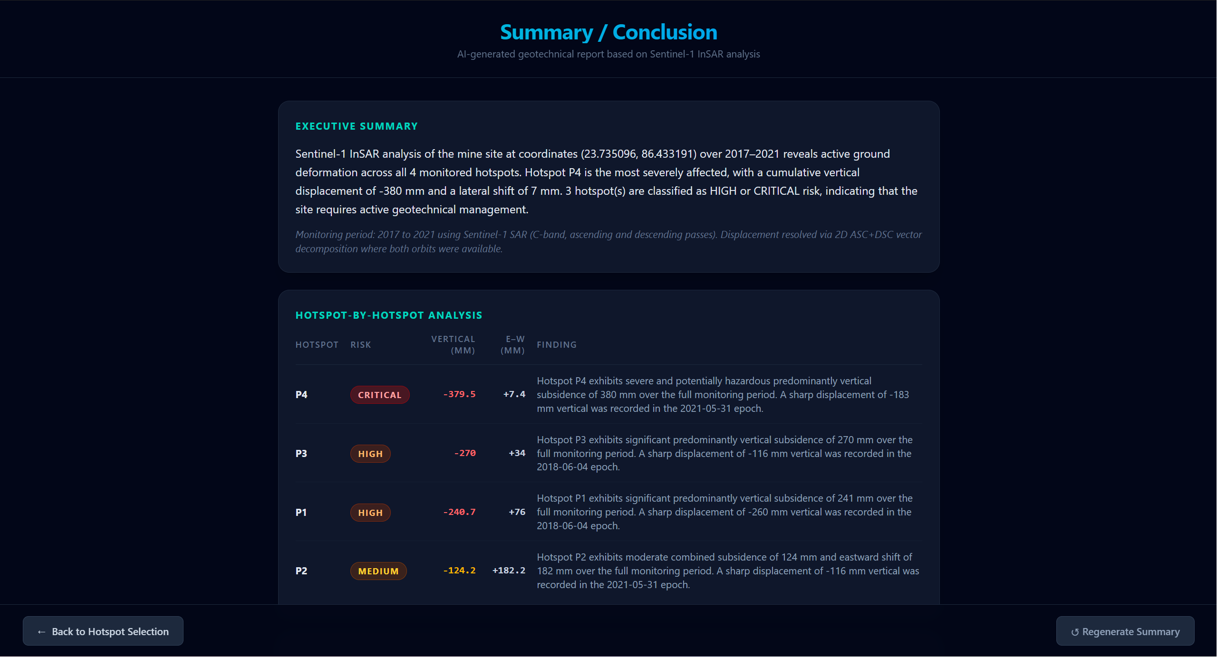
WORK DONE › PAGE 7 & PAGE 8 (RESULTS)
Step 7: Analyse Results | Step 8: Automated Risk Report
The final two pages transform raw InSAR numbers into three scientific charts and a complete geotechnical safety verdict.
PAGE 7 — Advanced Displacement Analysis
PAGE 8 — Automated Geotechnical Risk Assessment
▸ Chart 1 — E/W Displacement Cumulative East–West displacement time-series for all hotspots. Positive = Eastward; Negative = Westward sliding.
▸ Chart 2 — 3D Trajectory Dark-background 3D scatter plot: X = E/W, Y = Vertical, Z = Time. Each hotspot traces its full unique deformation path in space.
▸ Plain-English Captions Below every chart, an auto-generated sentence explains the key finding in non-technical language for site managers.
▸ Risk Classification Calculates cumulative displacement per hotspot and assigns: LOW (<30 mm) / MEDIUM (<80 mm) / HIGH (<150 mm) / CRITICAL (>150 mm).
▸ Executive Summary Auto-generates a site-wide natural-language paragraph describing the overall deformation pattern and dominant failure direction.
▸ Hotspot Risk Table Colour-coded table (green → red) listing each hotspot's peak displacement, trend direction, and individual risk verdict.
▸ Engineering Actions Produces a ranked list of recommended actions (e.g., 'Install inclinometers at P2') scaled automatically to the detected severity level.
12 / 13

Slide 14
MineGuard
Affordable
Automated
Accurate
Any mine. Any continent. No satellite expertise required.
InSAR Pipeline
Fully automated SNAP interferometric processing for ASC & DSC Sentinel-1 pairs.
2D Decomposition
True East–West and Vertical displacement separated by solving a 2×2 linear system.
8-Page Web App
React TypeScript frontend + Python FastAPI backend; runs entirely in a browser.
Auto Risk Report
Threshold-based geotechnical risk classification with engineering action recommendations.
Thank You — Questions & Discussion
Ujjwal Rawat • 225EC6010 • ECE Department • NIT Rourkela
13 / 13

