Slide 1
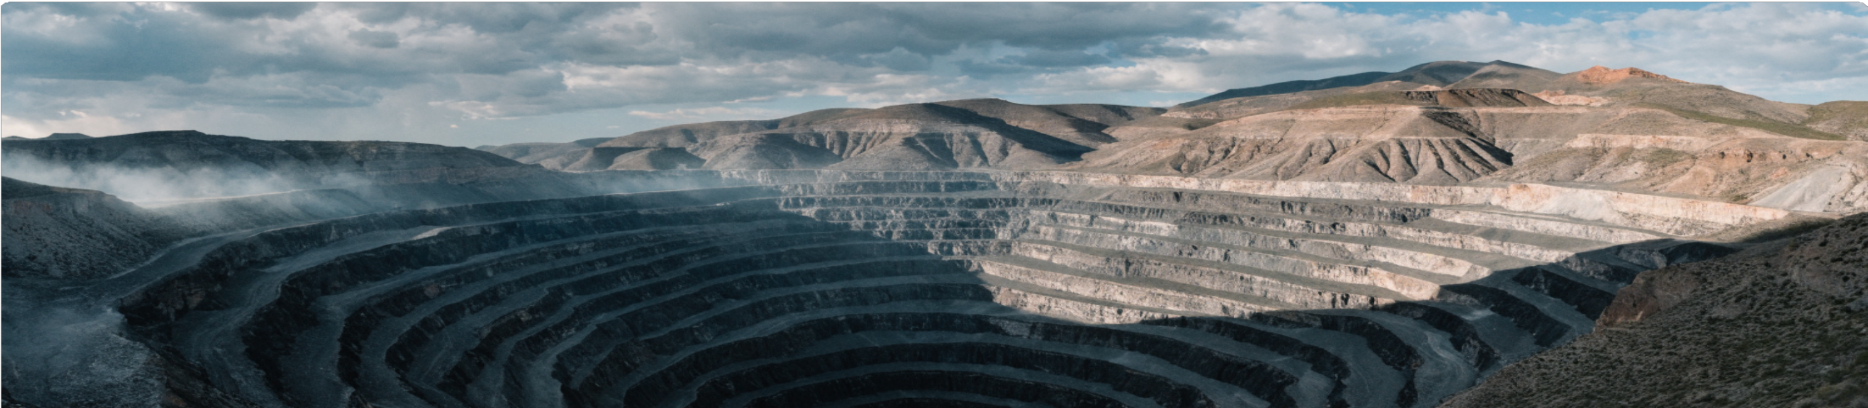
Mine Guard
Satellite-powered ground East-West movement monitoring — designed for every mine site engineer.
React + TypeScript
Python FastAPI
SNAP InSAR Engine
Sentinel-1 ASC+DSC
Final Project • ECE Department • NIT Rourkela • Ujjwal Rawat (225EC6010)
1 / 11

Slide 2
PRODUCT SPECIFICATION › INTRODUCTION
What is MineGuard?
MineGuard is a full-stack web application that uses free Sentinel-1 satellite radar data to automatically detect and track ground horizontal deformation at active mine sites — with no programming or satellite expertise required.
Why It Matters
What It Uses
What It Delivers
▸ Problem Mining excavations cause ground to sink and slide — often undetected until too late.
▸ Cost Traditional ground sensors are expensive, local, and require specialist teams.
▸ Gap No affordable, automated tool existed for non-technical mine site engineers.
▸ Satellite Free Sentinel-1 SAR images from the European Space Agency (ESA) Copernicus programme.
▸ Engine SNAP (Sentinel Application Platform) for professional InSAR interferogram processing.
▸ Stack React TypeScript frontend + Python FastAPI backend — runs entirely in a web browser.
▸ Output Millimetre-precision ground displacement measurements at user-selected hotspot locations.
▸ Report Automated geotechnical risk assessment: Low / Medium / High / Critical per hotspot.
▸ Access Any mine on Earth, any timeframe from 2014–present, zero cost satellite data.
2 / 11

Slide 3
PRODUCT DETAIL › THE CORE PROBLEM
Ground Doesn't Just Sink — It Slides.
East–West horizontal displacement is the earliest warning signal of mine-slope failure — yet it is invisible to conventional vertical sensors.
▸ Hidden Hazard Horizontal sliding precedes vertical collapse.
▸ Late Warning Depth-only sensors miss early failure signs.
▸ True E–W Measurement Isolates pure lateral drift.
▸ Early Intervention Provides months of advance warning.
▸ Hidden Hazard Horizontal sliding begins weeks before the ground visibly sinks — giving a false sense of stability on vertical-only monitors.
▸ Wrong Metric A sensor measuring only depth cannot distinguish whether a mine wall is sliding laterally outward or simply compressing downward.
▸ Late Warning By the time vertical settlement becomes measurable, the lateral failure has already progressed to a point where intervention is difficult.
▸ Industry Gap Most traditional InSAR tools report only vertical or line-of-sight displacement, omitting the critical East–West component entirely.
▸ True E–W Measurement Combines Ascending and Descending satellite passes to mathematically isolate the pure East–West component of ground movement.
▸ mm-Level Precision Sentinel-1 C-band radar resolves displacements as small as 1–3 mm, detecting lateral shifts months before they become dangerous.
▸ Early Intervention Knowing the direction of movement allows geotechnical teams to install targeted support structures before a critical failure event.
▸ Proven Science 2D ASC+DSC InSAR decomposition is the standard method used in professional mine subsidence monitoring worldwide (e.g., Anglo American, BHP site surveys).
3 / 11

Slide 4
PRODUCT DETAIL › 3D VISUALISATION
Displacement Mapped into 3D Space
MineGuard plots every hotspot's complete deformation history on three orthogonal axes — so engineers can see exactly how, where, and when each point is moving.
X — HORIZONTAL (East ↔ West)
Measures true East–West ground displacement in millimetres per epoch. | Positive (+) means the ground moved Eastward. Negative (−) means Westward sliding.
↳ Example: P2 drifted −283 mm westward by 2021 — the strongest lateral movement on site.
Y — VERTICAL (Subsidence)
Measures true vertical ground settlement in millimetres (downward is negative). | Derived from the same ASC+DSC decomposition as horizontal — both axes share one calculation.
↳ Example: P1 settled −159 mm vertically over 4 years — moderate but steady subsidence.
Z — TIME (Year Axis)
The temporal axis converts calendar dates to decimal years (e.g., June 2018 = 2018.42). | Time is shown continuously so acceleration or deceleration of movement is immediately visible.
↳ Example: P5 was stable until 2018 then showed a sudden −210 mm lateral event in one epoch.
4 / 11

Slide 5
PRODUCT DETAIL › HOW WE MEASURE HORIZONTAL DISPLACEMENT
Two Satellite Passes. One Precise Answer.
A single satellite pass measures ground movement only along its line-of-sight — a mixture of horizontal and vertical. Two opposite-direction passes let us mathematically separate both components.
Ascending Pass (ASC)
Descending Pass (DSC)
Result
▸ Direction Satellite flies Northward along an inclined orbit track.
▸ Look angle Radar beam points East toward ground, ~40° from vertical.
▸ Measures LOS displacement = blend of eastward shift + vertical settlement.
▸ Coverage Four ASC interferometric pairs acquired over 2017–2021.
▸ Direction Satellite flies Southward — the opposite track to ASC.
▸ Look angle Radar beam points West toward ground, ~35° from vertical.
▸ Measures LOS displacement from the opposite side — the other equation.
▸ Coverage Four DSC interferometric pairs matched within ≤12 days of ASC.
ASC
+
DSC
↓
True E/W
&
Vertical
5 / 11
Formula: d_LOS = −sin(θ)·cos(α)·d_E + cos(θ)·d_U — solved simultaneously for ASC & DSC using Cramer's Rule.

Slide 6
WORK DONE › METHODOLOGY
How MineGuard Processes Satellite Data
Five sequential processing stages transform raw radar images into millimetre-precision ground displacement measurements and an automated risk report.
Stage 01
Stage 02
Stage 03
Stage 04
Data Acquisition
InSAR Pre-Processing (SNAP)
2D ASC+DSC Decomposition
Risk Classification & Reporting
▸ Source Free Sentinel-1 C-band SAR images retrieved from the ESA Copernicus Data Space Ecosystem (CDSE) via the OData REST API.
▸ Selection Both Ascending (ASC) and Descending (DSC) orbit passes are queried for the user-defined ROI, timeframe, and IW-SLC product type.
▸ Pairs Images are automatically matched into interferometric pairs within a ≤12-day temporal baseline to maintain coherence.
▸ Co-registration Master and slave SLC images are precisely aligned at sub-pixel accuracy using a cross-correlation-based co-registration graph in ESA SNAP.
▸ Interferogram Phase difference between the two acquisitions is computed; flat-earth and topographic phase are removed using a DEM.
▸ Filtering + Unwrapping Goldstein adaptive phase filter reduces noise; Snaphu phase unwrapping converts wrapped phase (−π to π) to absolute phase.
▸ System One ASC LOS and one matched DSC LOS measurement form a 2×2 linear system: d_LOS = −sin(θ)cos(α)·d_E + cos(θ)·d_U.
▸ Solution The system is solved analytically using Cramer's Rule to yield true East–West (d_E) and true Vertical (d_U) displacement per epoch.
▸ Output Cumulative E/W and Vertical time-series are computed by summing incremental epoch values from the start of the monitoring period.
▸ Thresholds Cumulative displacement is compared against geotechnical severity bands: LOW < 30 mm | MEDIUM < 80 mm | HIGH < 150 mm | CRITICAL ≥ 150 mm.
▸ Report An automated natural-language executive summary and colour-coded risk table are generated per hotspot without manual intervention.
▸ Actions Engineering recommendations (e.g., install inclinometers, evacuate zone) are ranked and output in order of severity.
▶
▶
▶
▶
8 / 14

Slide 7
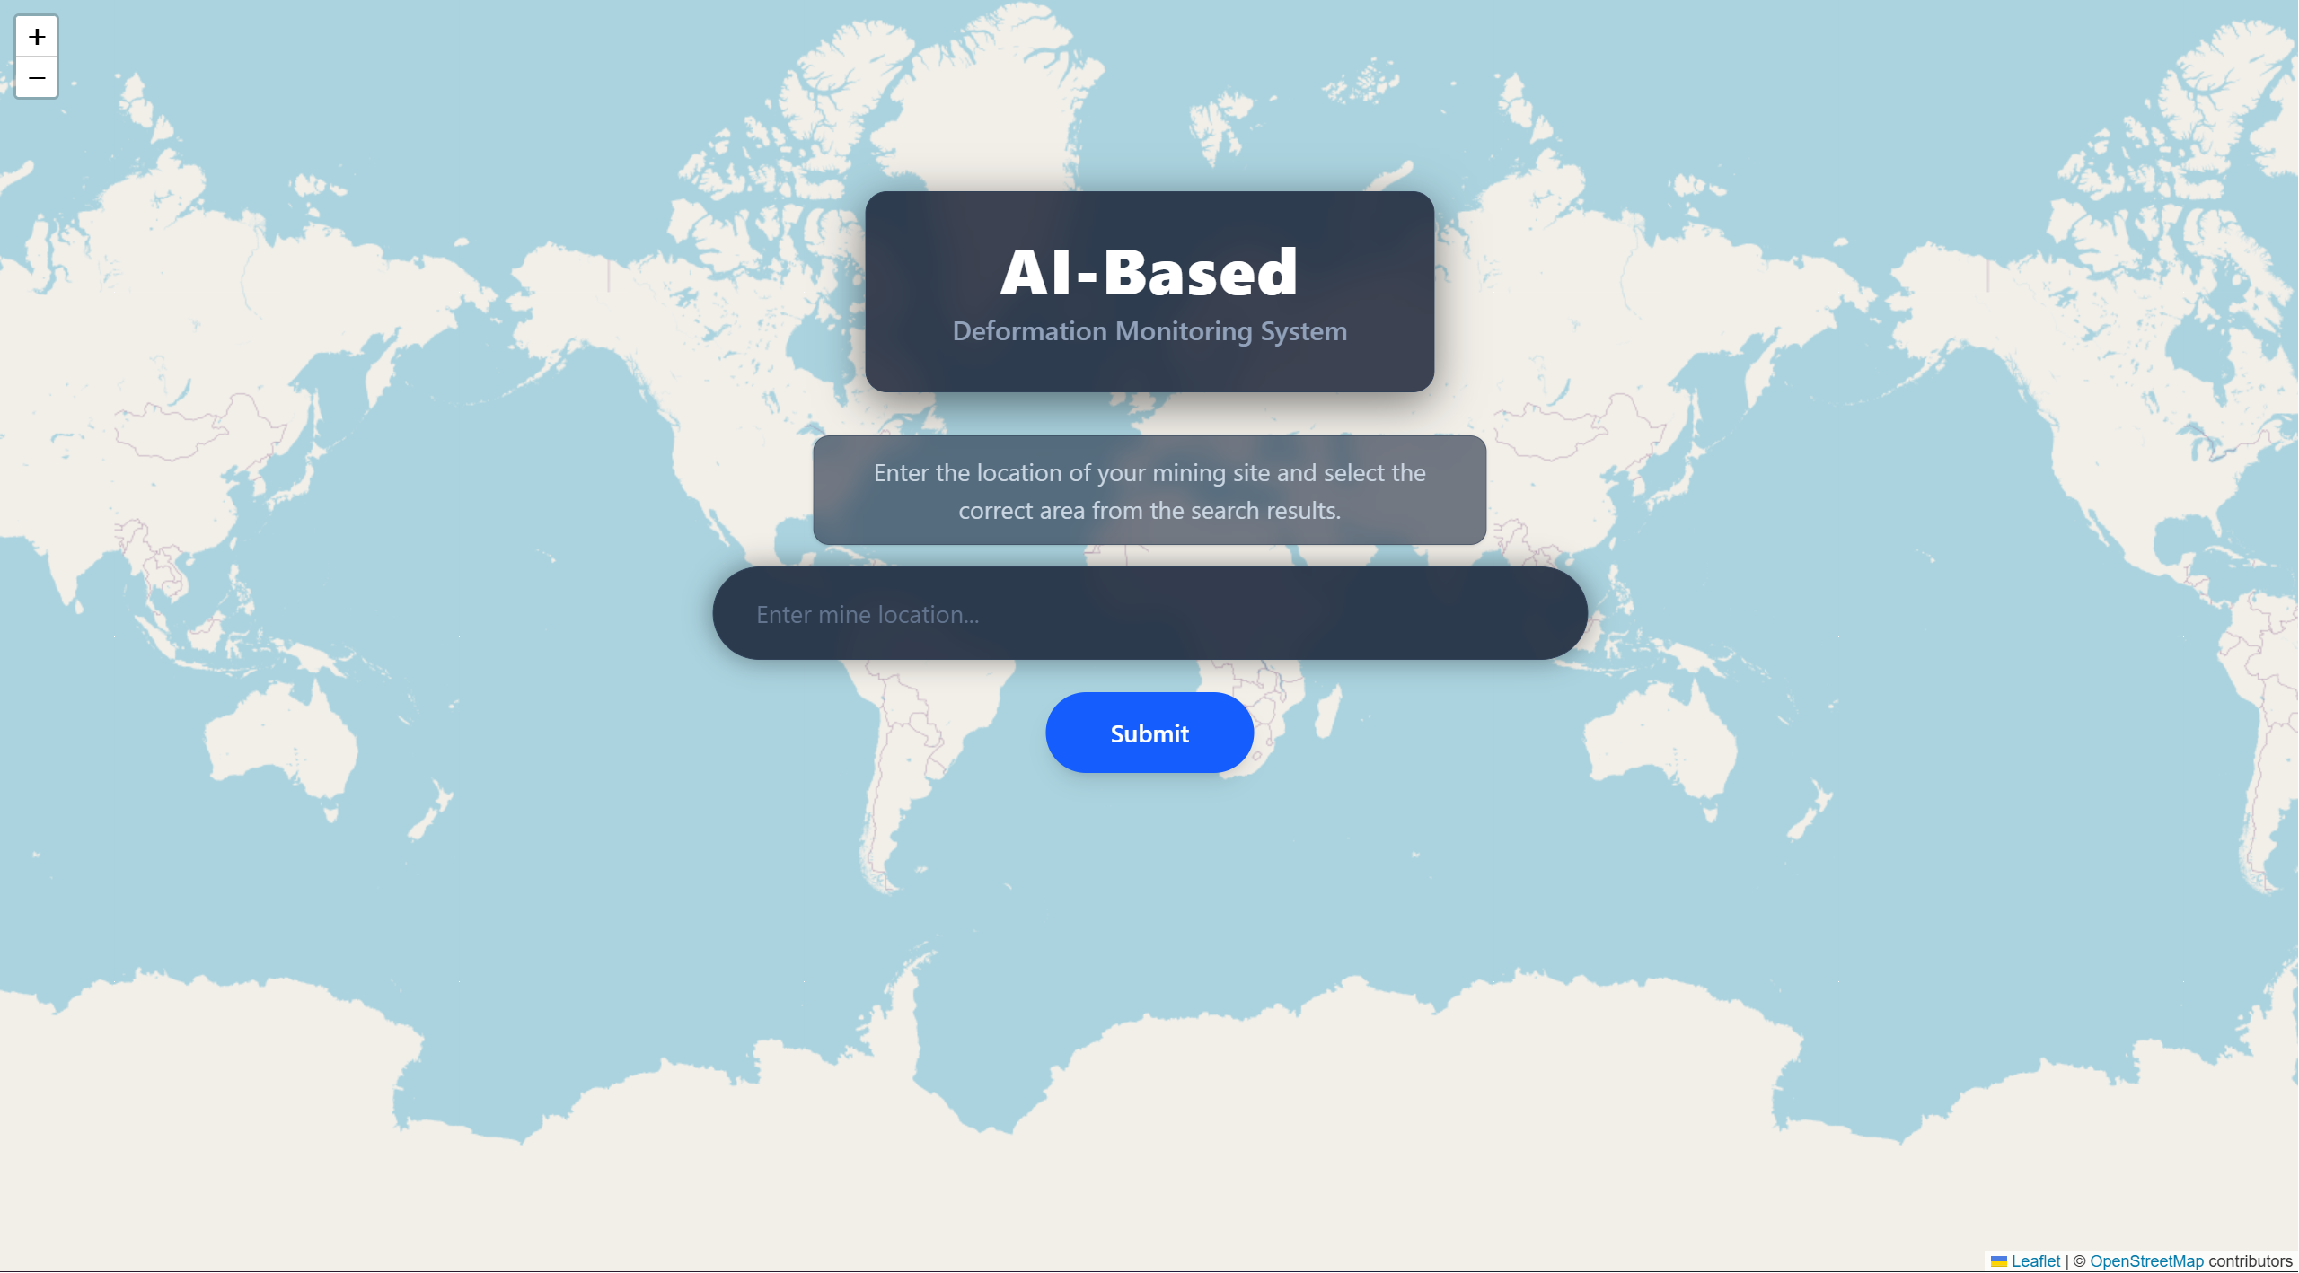
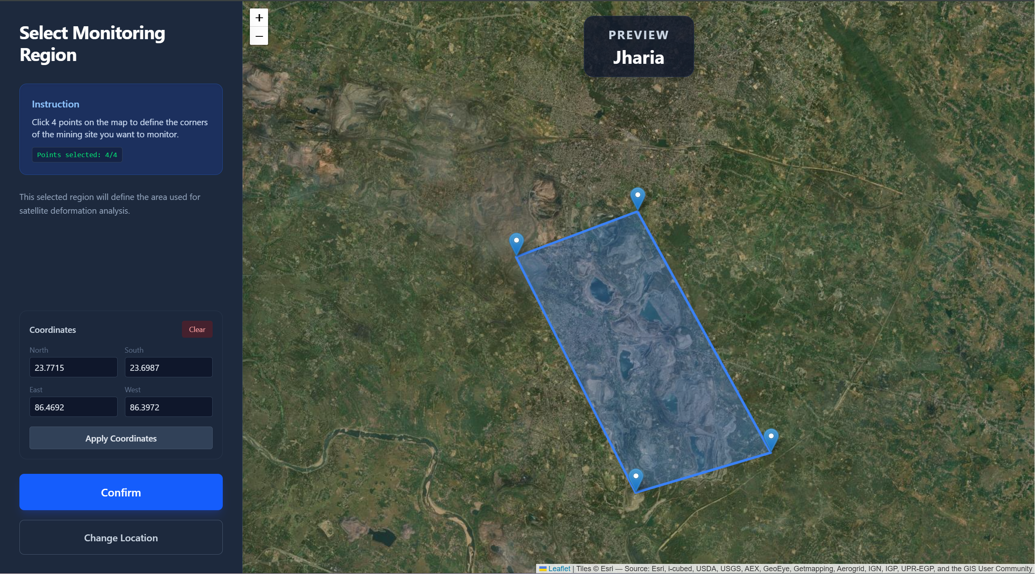
WORK DONE › PAGE 1 & PAGE 2
Step 1: Find Your Mine | Step 2: Define the Zone
The first two pages establish where and what to monitor — transforming a mine name into precise geographical coordinates.
PAGE 1 — Search Mine (Entry Point)
PAGE 2 — Crop / Region of Interest
▸ Real-time OpenStreetMap geocoding converts mine name to GPS coordinates in seconds.
▸ Interactive map bound-box defines precise ROI, drastically reducing unnecessary data downloads.
7 / 11

Slide 8
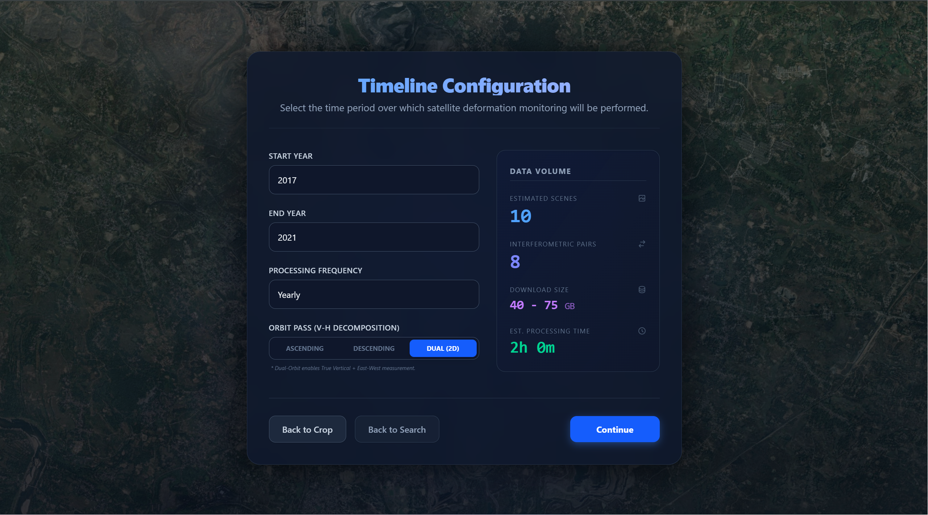
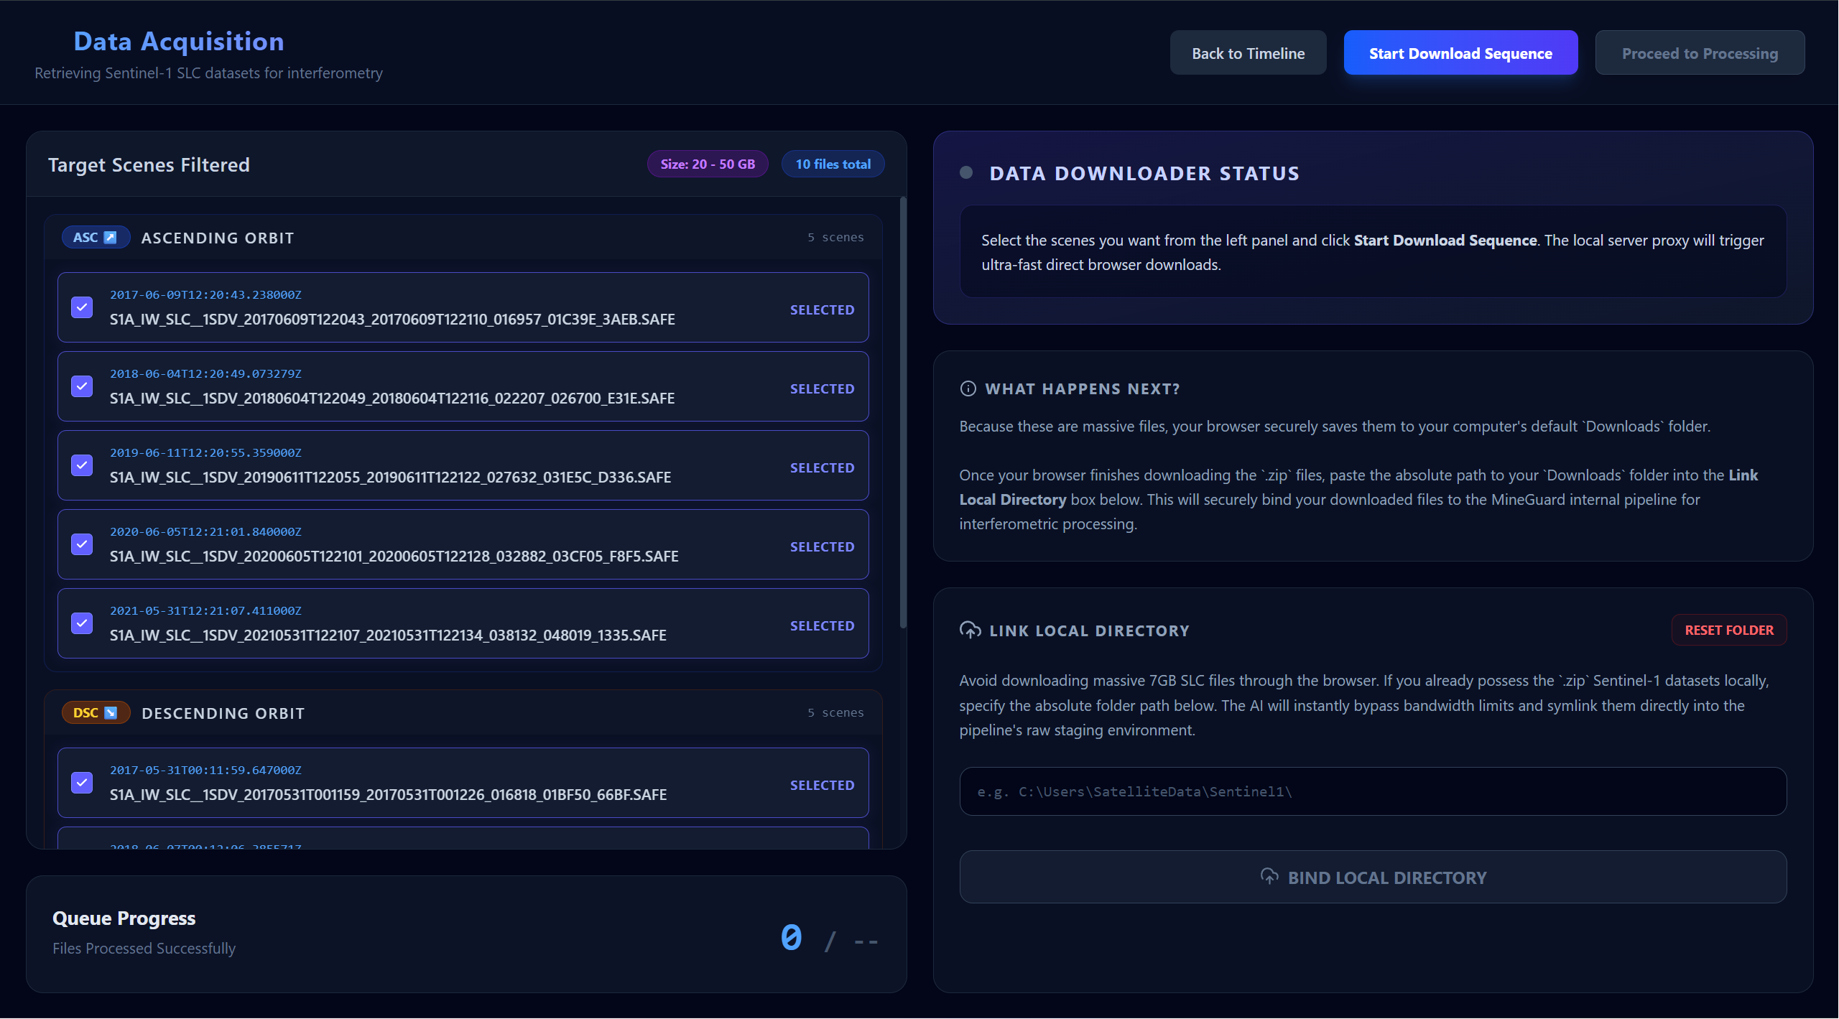
WORK DONE › PAGE 3 & PAGE 4
Step 3: Set the Timeframe | Step 4: Retrieve Satellite Data
These two pages configure the temporal scope of the analysis and automatically retrieve multi-gigabyte satellite datasets from ESA.
📷
📷
Page 3 — Timeline Selection
Page 4 — Data Download
Insert screenshot here
Insert screenshot here
PAGE 3 — Timeline Configuration
PAGE 4 — Sentinel-1 Data Download
▸ Users define start/end years and frequency. App provides instant data size estimator.
▸ Automated background downloading from ESA Copernicus API with full file integrity checks.
8 / 11

Slide 9
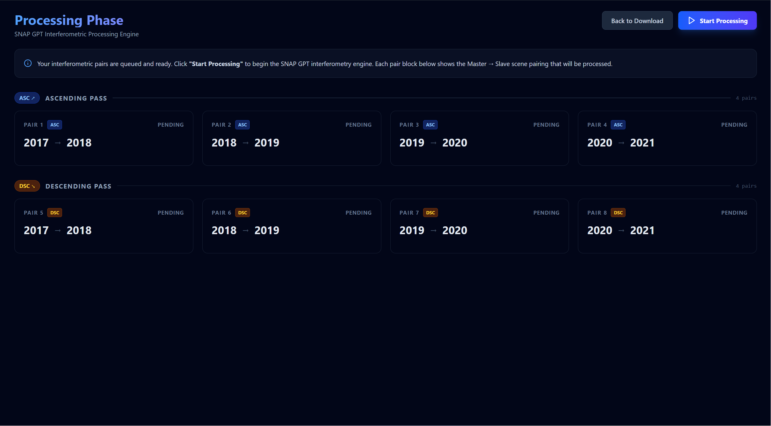
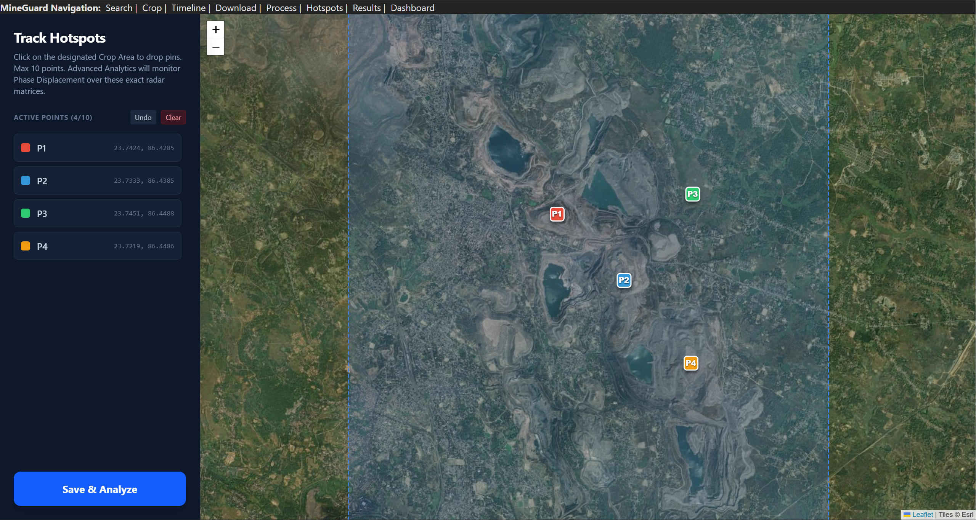
WORK DONE › PAGE 5 & PAGE 6
Step 5: Process InSAR | Step 6: Select Hotspots
The most technically intensive stage — generating interferograms with SNAP — and then targeting the specific danger zones to monitor.
PAGE 5 — SNAP InSAR Processing Dashboard
PAGE 6 — Interactive Hotspot Targeting
▸ Live dashboard orchestrates SNAP InSAR processing with smart queueing and skip-logic.
▸ Boundary-safe interactive markers target exact danger zones without leaving the browser.
9 / 11

Slide 10
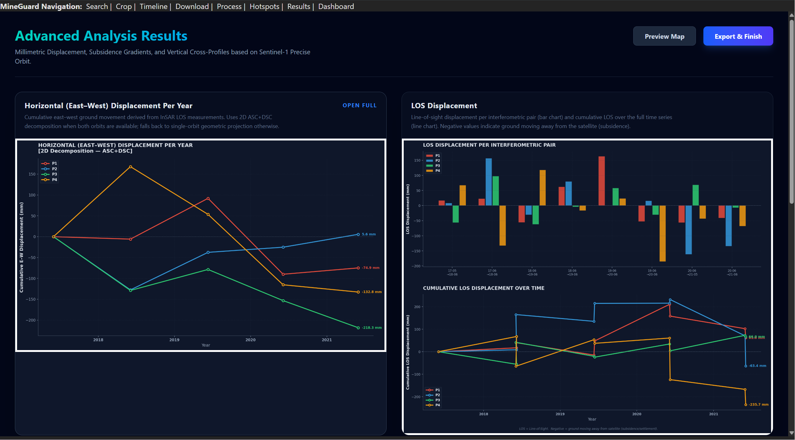
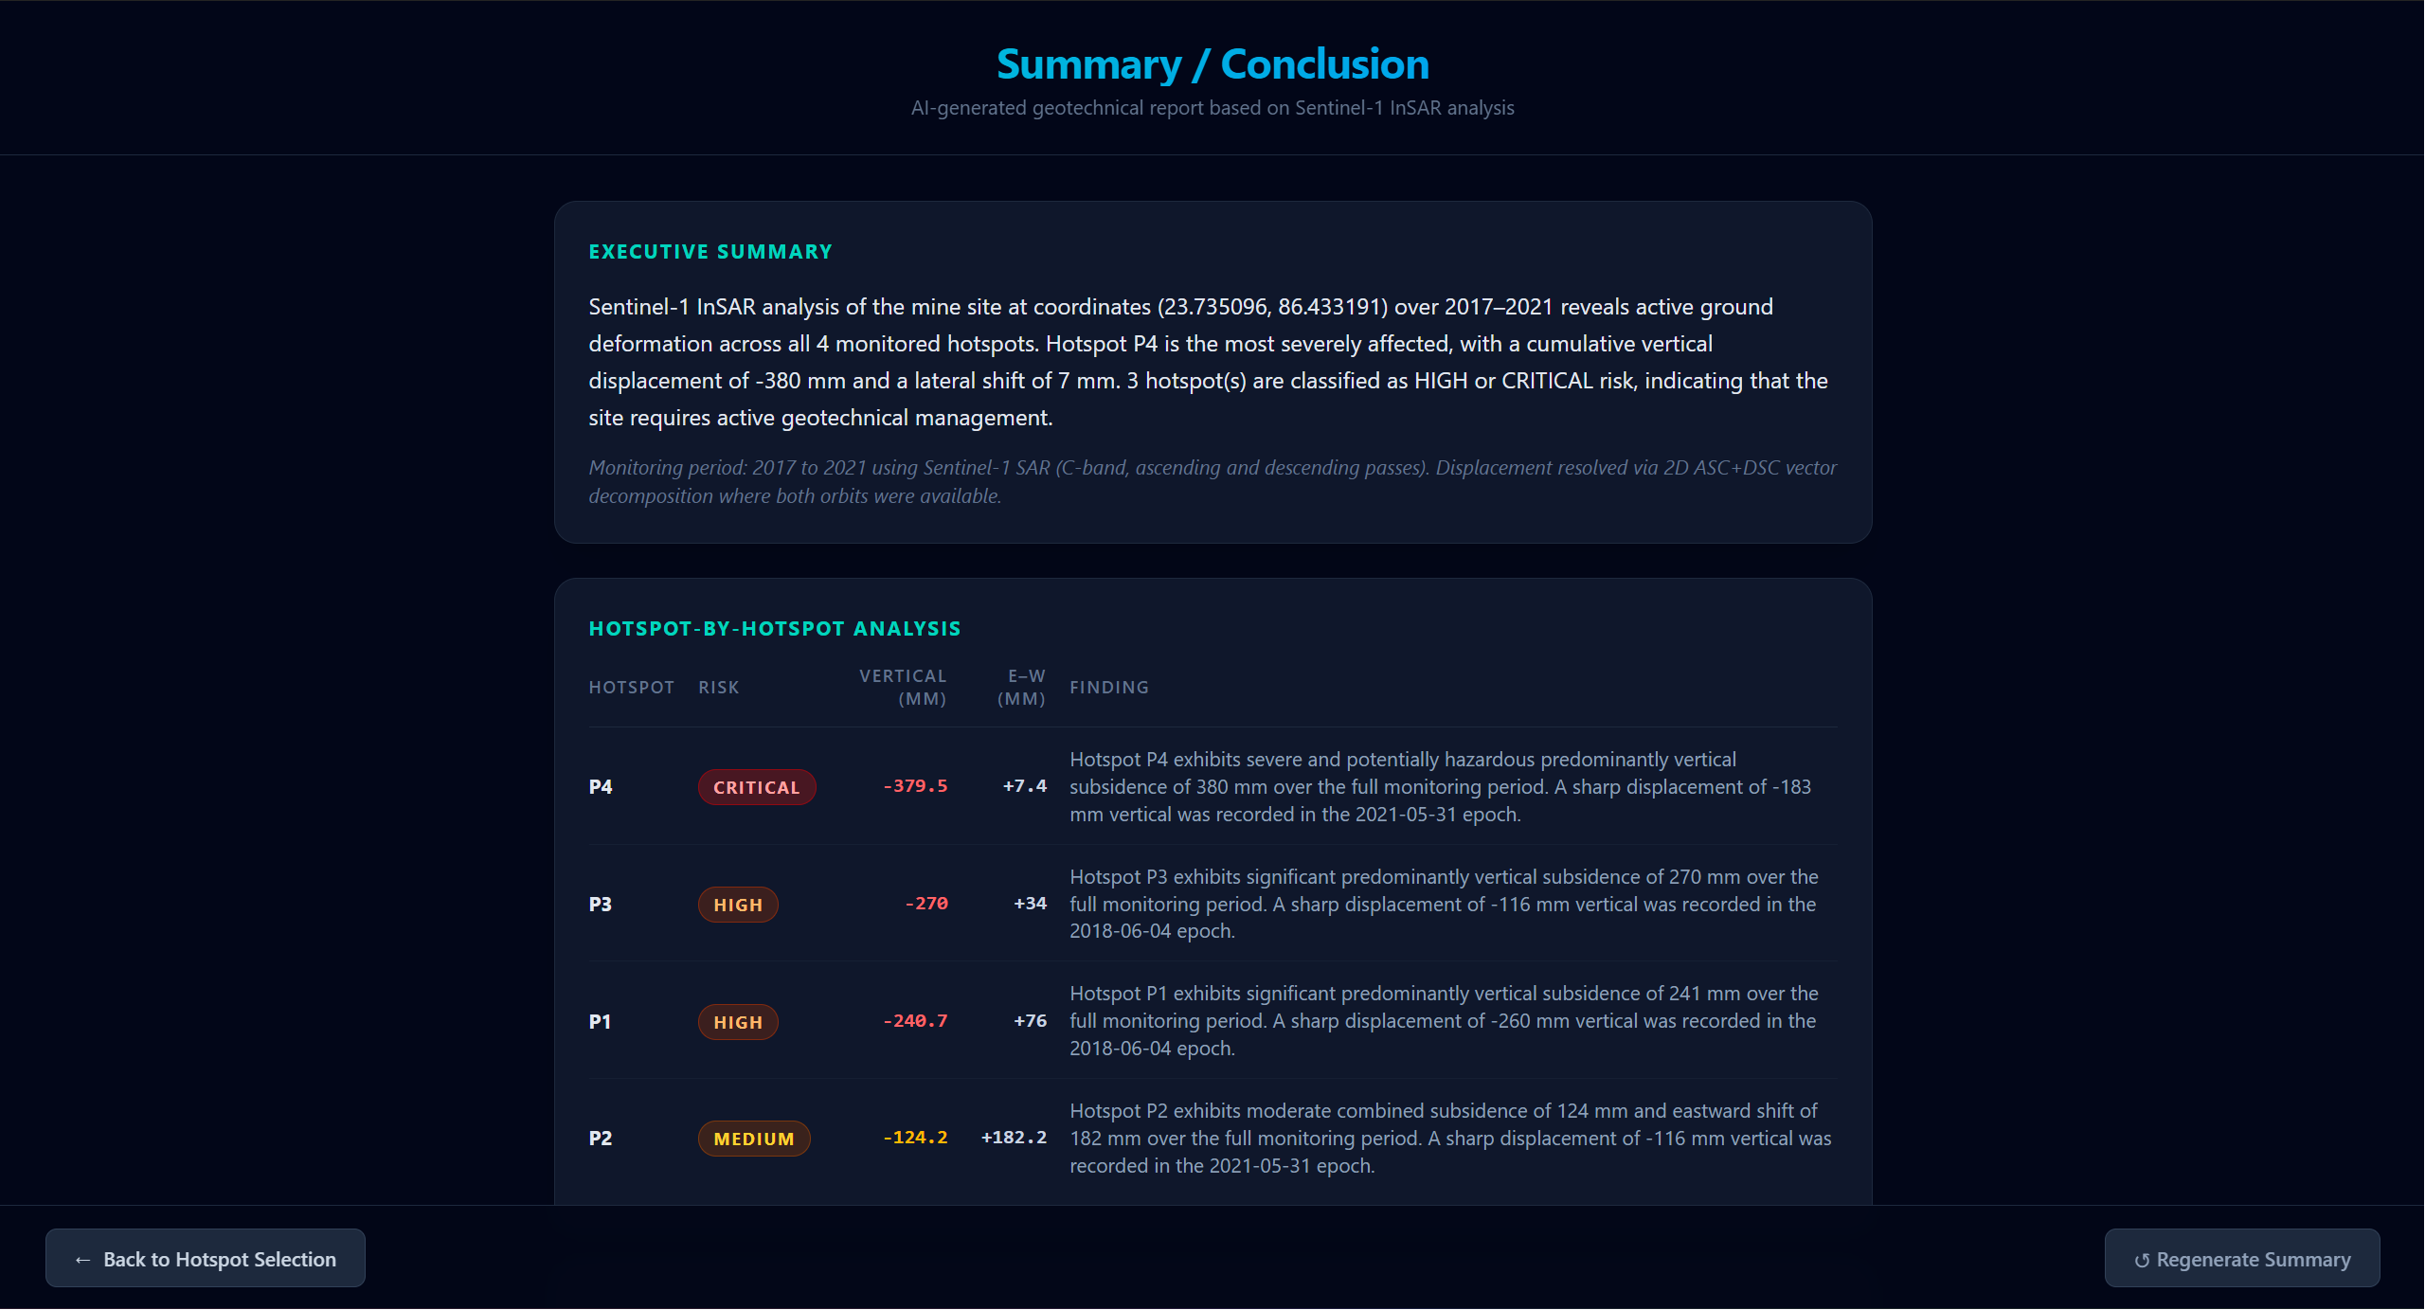
WORK DONE › PAGE 7 & PAGE 8 (RESULTS)
Step 7: Analyse Results | Step 8: Automated Risk Report
The final two pages transform raw InSAR numbers into three scientific charts and a complete geotechnical safety verdict.
PAGE 7 — Advanced Displacement Analysis
PAGE 8 — Automated Geotechnical Risk Assessment
▸ Automatically plots E/W drift, LOS, and 3D trajectories with auto-generated plain-English findings.
▸ Calculates threshold-based geotechnical severity and recommends concrete engineering actions.
10 / 11

Slide 11
MineGuard
Affordable
Automated
Accurate
Any mine. Any continent. No satellite expertise required.
InSAR Pipeline
Fully automated SNAP interferometric processing for ASC & DSC Sentinel-1 pairs.
2D Decomposition
True East–West and Vertical displacement separated by solving a 2×2 linear system.
8-Page Web App
React TypeScript frontend + Python FastAPI backend; runs entirely in a browser.
Auto Risk Report
Threshold-based geotechnical risk classification with engineering action recommendations.
Thank You — Questions & Discussion
Ujjwal Rawat • 225EC6010 • ECE Department • NIT Rourkela
11 / 11

